Slide 1
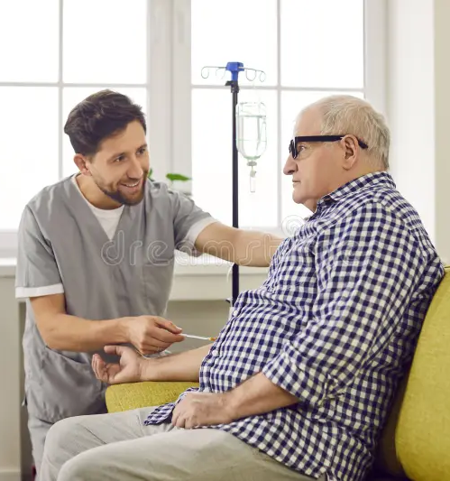
Sunray HHA TN LLC
TN Health Facilities Commission
September 23, 2026
CN2607-015

Slide 2
Michael D. Brent
Attorney, Bradley Arant Boult Cummings, LLP

Slide 3
Basic Need
Initiate home health services limited to infusion therapy for patients receiving specialty medications dispensed by Vital Care of Franklin, TN – a specialty pharmacy
Service area of all 95 counties
Similar in operations to other franchisees of Vital Care in other areas of Tennessee which have obtained Certificates of Need (limited to providing services to patients of their affiliated pharmacies)
Traditional population-based formula not met, but as previously stated by HFC, that “1.5% formula” does not accurately reflect the need for unique home-based infusion therapy services

Slide 4
Consumer Advantage
Less travel and family burden for many patients statewide
More home infusion services are being allowed by private insurers and Medicare, both of which will be accepted by Sunray HHA TN
Faster hospital discharges due to prompt and timely acceptance of referrals
Reduced turnaround time establishing home health infusion services.
Less risk of exposure to communicable diseases, often found in acute care and outpatient facilities, especially at a time of increased vulnerability
Patients heal quicker in their home and are not kept at the hospital unnecessarily

Slide 5
Kelly Painter
Pharmacist in Charge, Sunray RX NSHTN, LLC d/b/a Vital Care of Franklin, TN

Slide 6
Description of Therapies
Anti-Infectives
Anti-Inflammatory Therapies
Immunoglobulin Therapy
Specialty Medications

Slide 7
Description of Patients
Immunodeficient patients receive infusions via IVIG or SCIG
Neurological patients receiving IVIG therapy are typically infused monthly, over several days for 4-5 hours each day
Patients receiving anti-inflammatory or specialty therapies are typically infused monthly or bi-monthly
Pediatric patients receiving IVIG therapy require infusions monthly

Slide 8
Chronic Conditions Treated
Neurological conditions such as Chronic Inflammatory Demyelinating Polyneuropathy, Myasthenia Gravis, Multifocal Motor Neuropathy, Myositis, Multiple Sclerosis, and Migraine
Primary immunodeficiency disorders, encompassing more than 500 unique diagnoses
Autoimmune inflammatory conditions such as Rheumatoid Arthritis, Crohn’s Disease, Ulcerative Colitis, Psoriasis, and Lupus
Pulmonary conditions such as Alpha-1 Antitrypsin Deficiency, Asthma, Chronic Obstructive Pulmonary Disease

Slide 9
Supported Therapies
Intravenous immune globulin (IVIG)
Subcutaneous immune globulin (SCIG)
Anti-Infectives
Specialty Therapies for Chronic Conditions
  Tysabri
  Soliris
Anti-Inflammatory Therapies for Chronic Conditions
  Skyrizi
  Tremfya

Slide 10

Patient Examples
32 y/o female
Dermatomyositis
IVIG Therapy
5 hours, 2x monthly
Established Routine, Reduced Childcare Need, Cost
48 y/o female
Primary Immunodeficiency
IVIG Therapy
4 hours, 1x monthly
Increased adherence, eliminated transportation burden
66 y/o male
Crohn’s Disease
Anti-Inflammatory Therapy
Non-ambulatory, comorbidities
Lab monitoring, adherence, disease management

Slide 11
Tori Harrigill
Director of Operations and Member, Sunray HHA TN, LLC
Director of Operations and Member, Sunray RX NSHTN, LLC d/b/a Vital Care of Franklin, TN

Slide 12
Vital Care of Franklin, TN Overview
Locally operated with national support
State of the art compounding pharmacy
Private infusion suites. One currently attached to the pharmacy (Franklin) and two more opening next year (Shelbyville and Lebanon)
ACHC Accredited with additional accreditation by ACHC pending
Ability to accept all major commercial insurance carriers (both local and national)
Excellent product accessibility through trade partnerships
Patient and Caregiver education provided to patients at time of service

Slide 13
Sunray HHA TN Home Health Benefits
Patient Benefits
Improves patient outcomes and quality of life
Reduces patient care burden
Enhanced flexibility and choice
Provider / System Benefits
Cost-effective care in lower-acuity settings
Care coordination across the service area

Slide 14
Barriers to Home Care
Unlike traditional home health agencies, we are designed to:
  Deliver first-dose and specialty infusion therapy safely and efficiently
  Provide flexible, patient-centered scheduling without visit constraints
  Serve patients in rural or underserved areas with highly trained nurses
  Focus on providing dedicated infusion nursing support only
  Bring infusion care to patients at home, regardless of traditional eligibility restrictions

Slide 15
Commitment to Quality
Performance Improvement Program
Quality Management Program
Corporate-supported Compliance Program including a “Regulatory and Compliance Playbook” developed by our PIC and Operations Team, in conjunction with Vital Care Corporate
Highly trained infusion nurses will be employed, in addition to established subcontracted nursing relationships for immediate back up support
Standardized policies and procedures
Established relationships with suppliers, providers, payors, etc.
Proven history of quality service across Vital Care locations nation wide

Slide 16
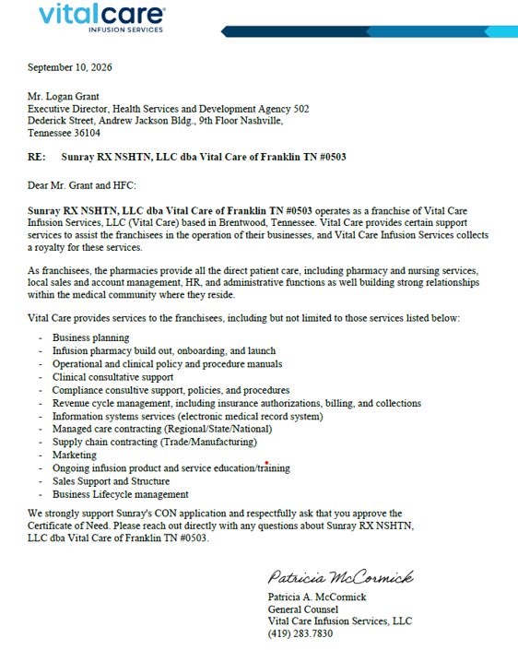
Additional Letter of Support from Vital Care Infusion Services, LLC

Slide 17
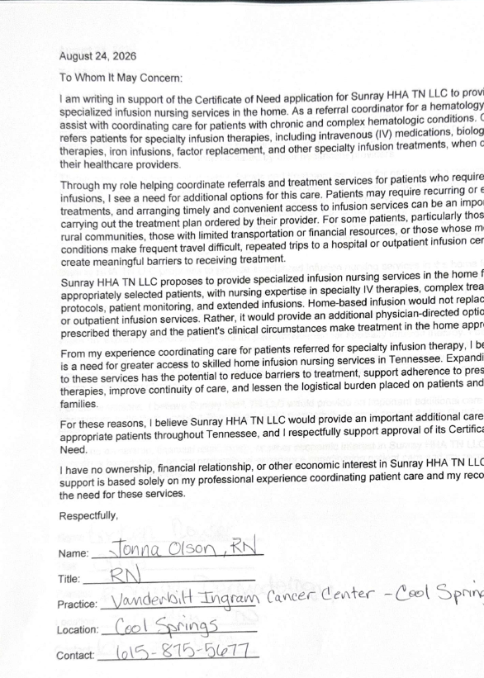
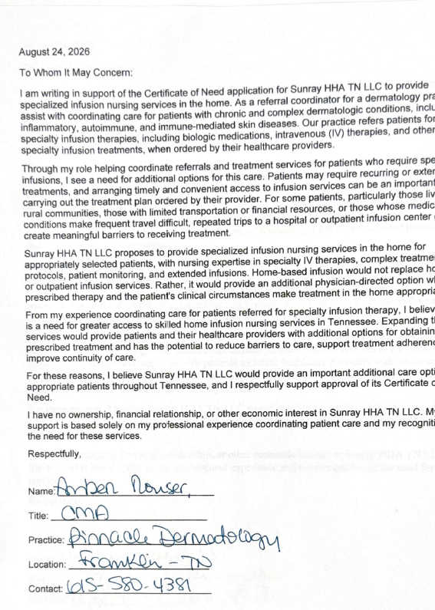
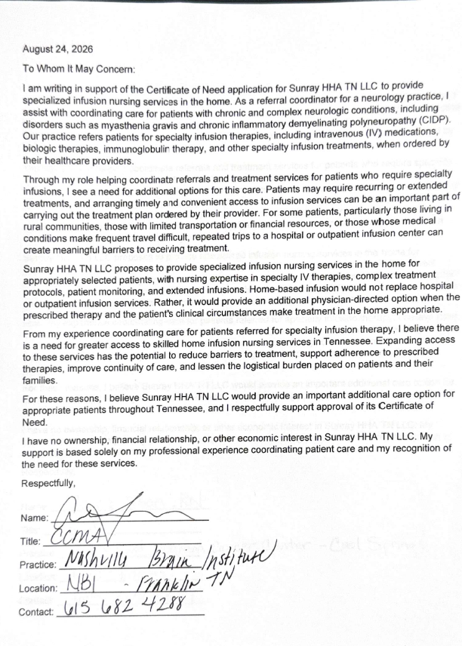
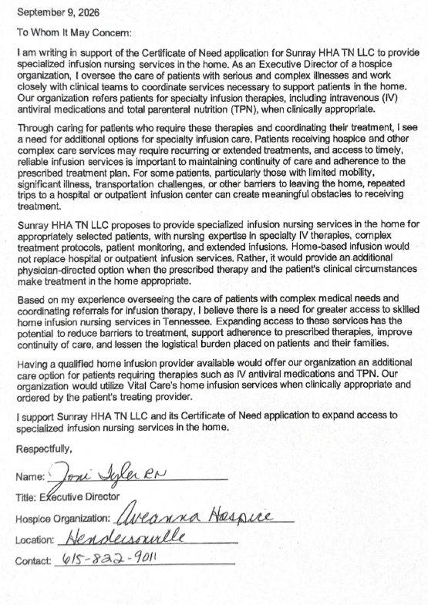
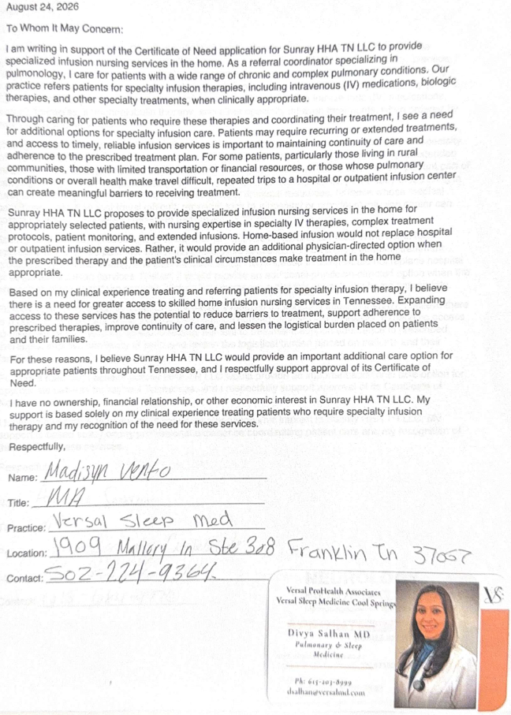
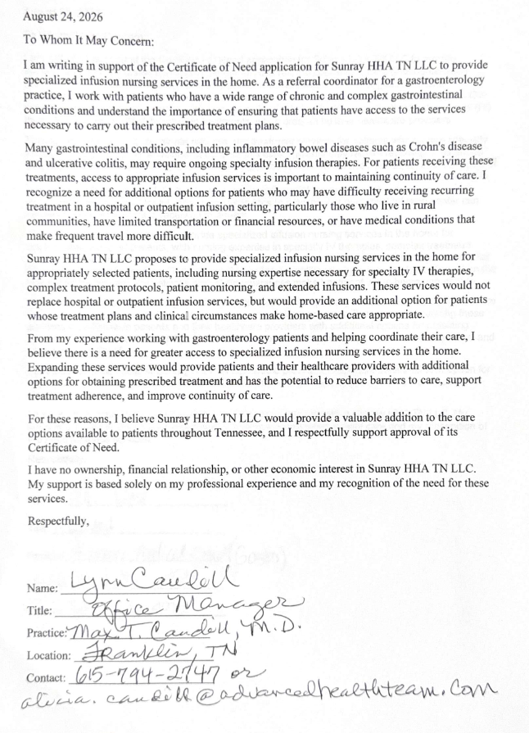
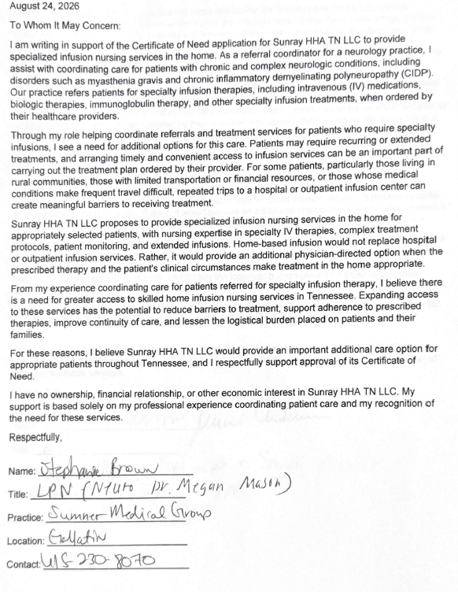
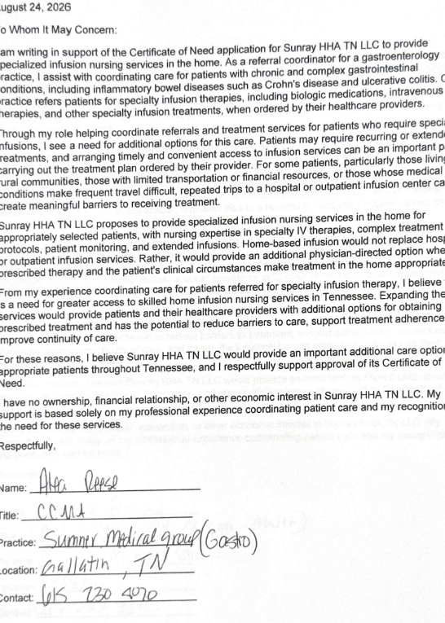
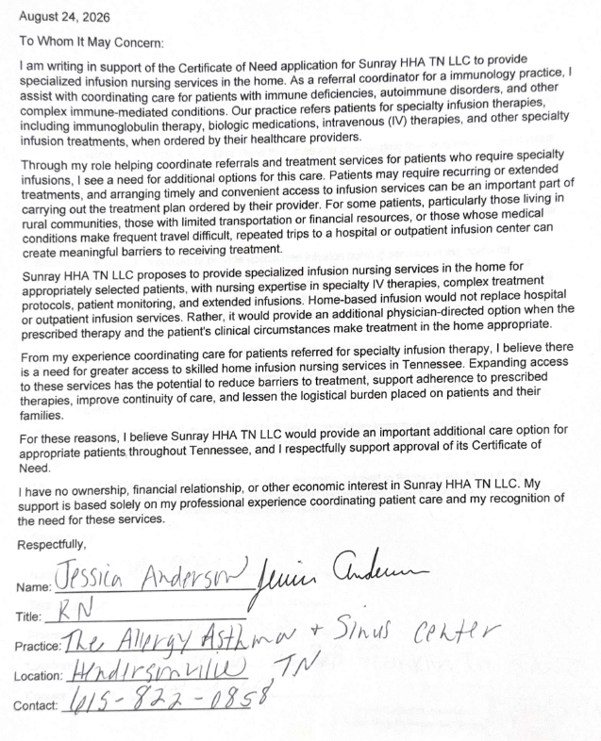
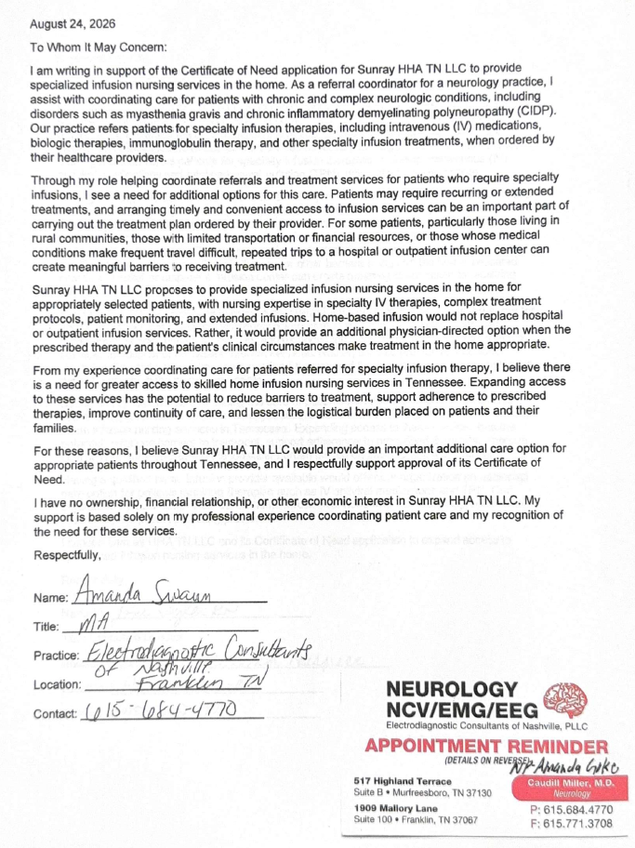
Additional Letters of Support (10 additional, 14 total)

