Slide 1
Heart ‘N Soul Hospice Memphis
CN2511-043
February 25, 2026

Slide 2
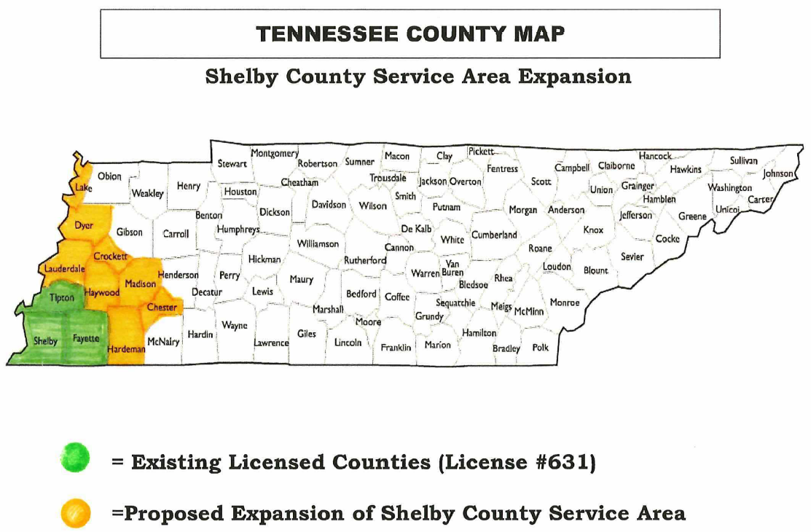

Slide 3
Need

Slide 4
Hospice Rates and Projected Need
County | Hospice Penetration Rate | Hospice Penetration Rate and Need (Surplus) (80%) | Hospice Penetration Rate and Need (Surplus) (85%)
Chester | 0.495 | 3 | 10
Crockett | 0.489 | 4 | 11
Dyer | 0.664 | (73) | (58)
Hardeman | 0.478 | 11 | 22
Haywood | 0.474 | 8 | 15
Lake | 0.433 | 7 | 10
Lauderdale | 0.484 | 8 | 18
Madison | 0.223 | (177) | (142)
Source: 2022-2023 Hospice Rates and Projected Need

Slide 5
NEED
“Decision to approve a CON application should be determined by the cumulative weight of all standards and criteria” (NOT JUST NUMERICAL NEED FORMULA)
“The Division believes that hospice services in Tennessee are underutilized, most likely as a result of community and societal norms and a need for more education to the general public on the benefits of hospice. Consequently, the Division believes that hospice services should be encouraged, within reason, in Tennessee and that providing broader opportunities for these services will help educate the public as to their value.”

Slide 6
Demographic Data
County | % of Persons Below Poverty Level | TennCare Enrollees as %
Chester | 15.6% | 20.34%
Crockett | 14.8% | 24.46%
Dyer | 17.9% | 27.07%
Hardeman | 17.3% | 26.97%
Haywood | 22.8% | 29.03%
Lake | 32.3% | 26.79%
Lauderdale | 18.7% | 27.49%
Madison | 20.3% | 24.84%
Service Area Total | 17.9% | 23.77%
State Average | 14% | 19.65%

Slide 7
Projected Utilization
County | Projected Utilization Year 1 (2026) | % of Total
Chester | 5 | 7.69%
Crockett | 6 | 9.23%
Dyer | 2 | 3.08%
Hardeman | 15 | 23.08%
Haywood | 11 | 16.92%
Lake | 10 | 15.38%
Lauderdale | 11 | 16.92%
Madison | 5 | 7.69%
Total | 65 | 100%

Slide 9
Positive Effects of
Duplication or Competition

Slide 10
Positive Effects of Duplication or Competition
Equitable access: Advantage in additional choice of a hospice provider, particularly one who addresses needs of rural areas and other underserved populations such as minority patients
Additional choice improves access and availability of a necessary health care service to a vulnerable patient population
Strong community support for an additional hospice provider in the proposed service area

Slide 11
Brook James,
Director of Operations
Heart ‘N Soul Hospice

Slide 12
Quality

Slide 13
Quality
Applicant: Accredited by Community Health Accreditation Program (“CHAP”) -
  Patient centered care, safe care delivery, and sustainable organizational structure
Family satisfaction surveys
  “higher caliber of care team than most”
  “quick passion response time and attention to detail”
QAPI (Quality Assurance and Performance Improvement)
Healthcare First: monitor and analyze quality assurance and performance improvement programs

Slide 14
Meredith Portwood,
Community Education Representative
Heart ‘N Soul Hospice

Slide 15
Community Support

Slide 16
Community Outreach
Dedicated community educators solely focused on this region and will use guided tools to engage with diverse populations in the area.
Conduct in-service presentations and workshops at referral care settings, establish relationships with discharge planners, collaborate with public hearth nursing agencies and partner with faith-based organizations, community centers, and advocacy groups serving the target population to address specific cultural, linguistic, and informational needs about hospice.

Slide 17
Letters of Support
University of Tennessee Extension Institute of Agriculture
  “Heart ‘N Soul Hospice understands what is needed in our diverse community to provide quality end of life care to people of all ages, all races, and all diagnoses.”
Bailey Manor Assisted Living
  “Heart ‘N Soul Hospice offers unique programs that can fill gaps in the current healthcare system, giving families peace of mind during a challenging time.”
Dyer County Office on Aging
  “When other hospices have reduced their special programs, it is a pleasure to see that Heart ‘N Soul Hospice is fully committed to their programs.”

