Slide 1

River City Infusion Health Facilities Commission January 28, 2026 CN2511-042

Slide 2
Michael D. Brent
Attorney, Bradley Arant Boult Cummings, LLP

Slide 3
Basic Need
Initiate home health services limited to infusion therapy for patients receiving specialty medications dispensed by Vital Care of Chattanooga – a specialty pharmacy
Service area of all 95 counties, plus areas of North Georgia
Similar in operations to other franchisees of Vital Care in other areas of Tennessee which have obtained Certificates of Need (limited to providing services to patients of their affiliated pharmacies)
Traditional population-based formula not met, but that “1.5% formula” does not accurately reflect the need for unique home-based infusion therapy services

Slide 4
Consumer Advantage
Less travel and family burden for many patients
More and more home infusion services are being allowed by private insurers and Medicare
Reduced turnaround time establishing home health infusion services
Less risk of exposure to communicable diseases, often found in acute care and outpatient facilities, especially at a time of increased vulnerability
Patients are more comfortable in their home

Slide 5
Kayla Stone
Director of Operations and Member, River City Infusion, LLC
Director of Operations and Member, RCIV, LLC d/b/a Vital Care of Chattanooga

Slide 6
Vital Care of Chattanooga Overview
Locally operated with national support
State of the art sterile compounding pharmacy
Private infusion suite
ACHC Accredited
Nationally contracted with all major insurance carriers
Excellent product accessibility through trade partnerships
Comprehensive Patient and Caregiver education

Slide 7
Description of Therapies
Anti-Infectives
Anti-Inflammatory Therapies
Immunoglobulin Therapy
Specialty Medications

Slide 8
Chronic Conditions Managed
Neurological conditions such as Chronic Inflammatory Demyelinating Polyneuropathy, Myasthenia Gravis, Multifocal Motor Neuropathy, Myositis, Multiple Sclerosis, and Migraine
Primary immunodeficiency disorders, encompassing more than 500 unique diagnoses
Autoimmune inflammatory conditions such as Rheumatoid Arthritis, Crohn’s Disease, Ulcerative Colitis, Psoriasis, and Lupus
Pulmonary conditions such as Alpha-1 Antitrypsin Deficiency, Asthma, and Chronic Obstructive Pulmonary Disease

Slide 9
Description of Patients
Immunodeficient patients receive monthly IVIG infusions or weekly SCIG infusions
Neurological patients receive IVIG infused monthly, over several days for 4-5 hours each day
Patients receive anti-inflammatory or specialty therapy infusions monthly or bi-monthly
Pediatric patients receive IVIG therapy monthly

Slide 10
River City Infusion Home Health Benefits
Patient Benefits
Improves patient outcomes and quality of life
Reduces patient care burden
Enhanced flexibility and choice
Provider / System Benefits
Cost-effective care in lower-acuity settings
Care coordination across the service area
Experience reimbursement team

Slide 11
Barriers to Home Care
Unlike traditional home health agencies, we are designed to:
Deliver first-dose and specialty infusion therapy safely and efficiently
Provide flexible, patient-centered scheduling without visit constraints
Serve patients in rural or underserved areas with highly trained nurses
Deliver dedicated infusion nursing support only
Bring infusion care to patients at home, regardless of traditional eligibility restrictions

Slide 12

Patient Examples
32 y/o female
Dermatomyositis
IVIG Therapy
5 hours, 2x monthly
Established Routine, Reduced Childcare Need, Cost
48 y/o female
Primary Immunodeficiency
IVIG Therapy
4 hours, 1x monthly
Increased adherence, eliminated transportation burden
66 y/o male
Crohn’s Disease
Anti-Inflammatory Therapy
Non-ambulatory, comorbidities
Lab monitoring, adherence, disease management

Slide 13
Commitment to Quality
Performance Improvement Program
Quality Management Program
Corporate-supported Compliance Program
Highly trained infusion nurses
Standardized policies and procedures
Established relationships
Proven history of quality service

Slide 14
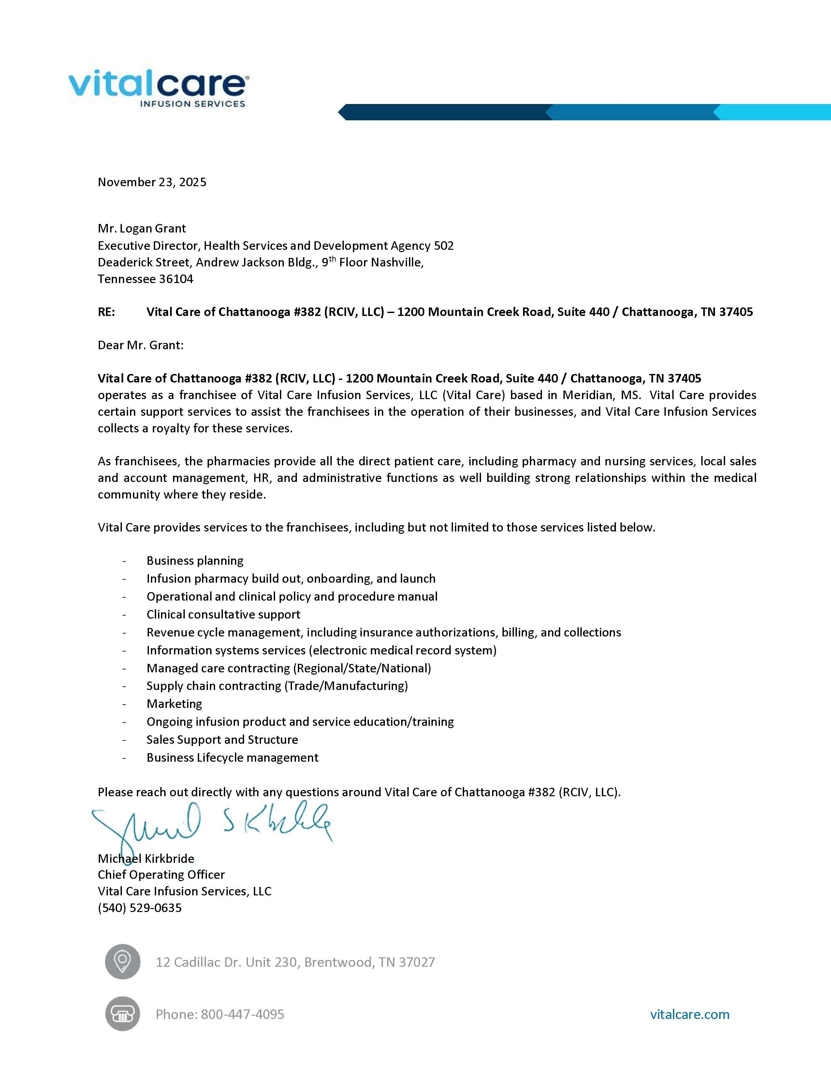
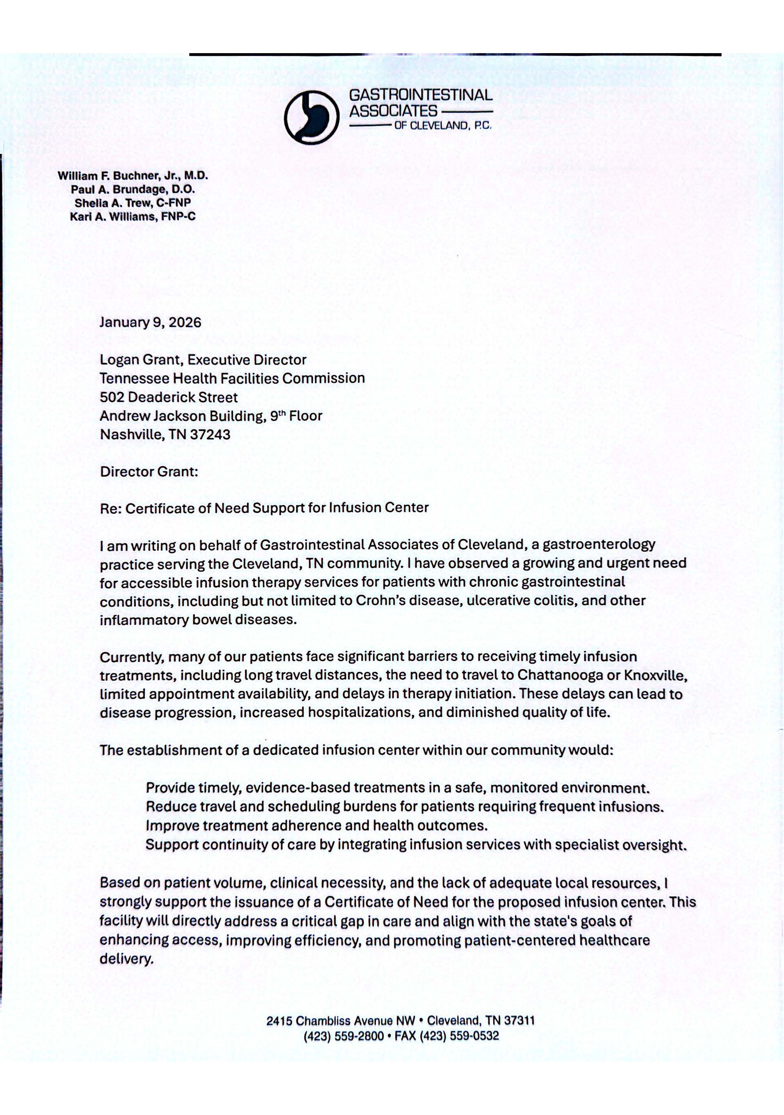
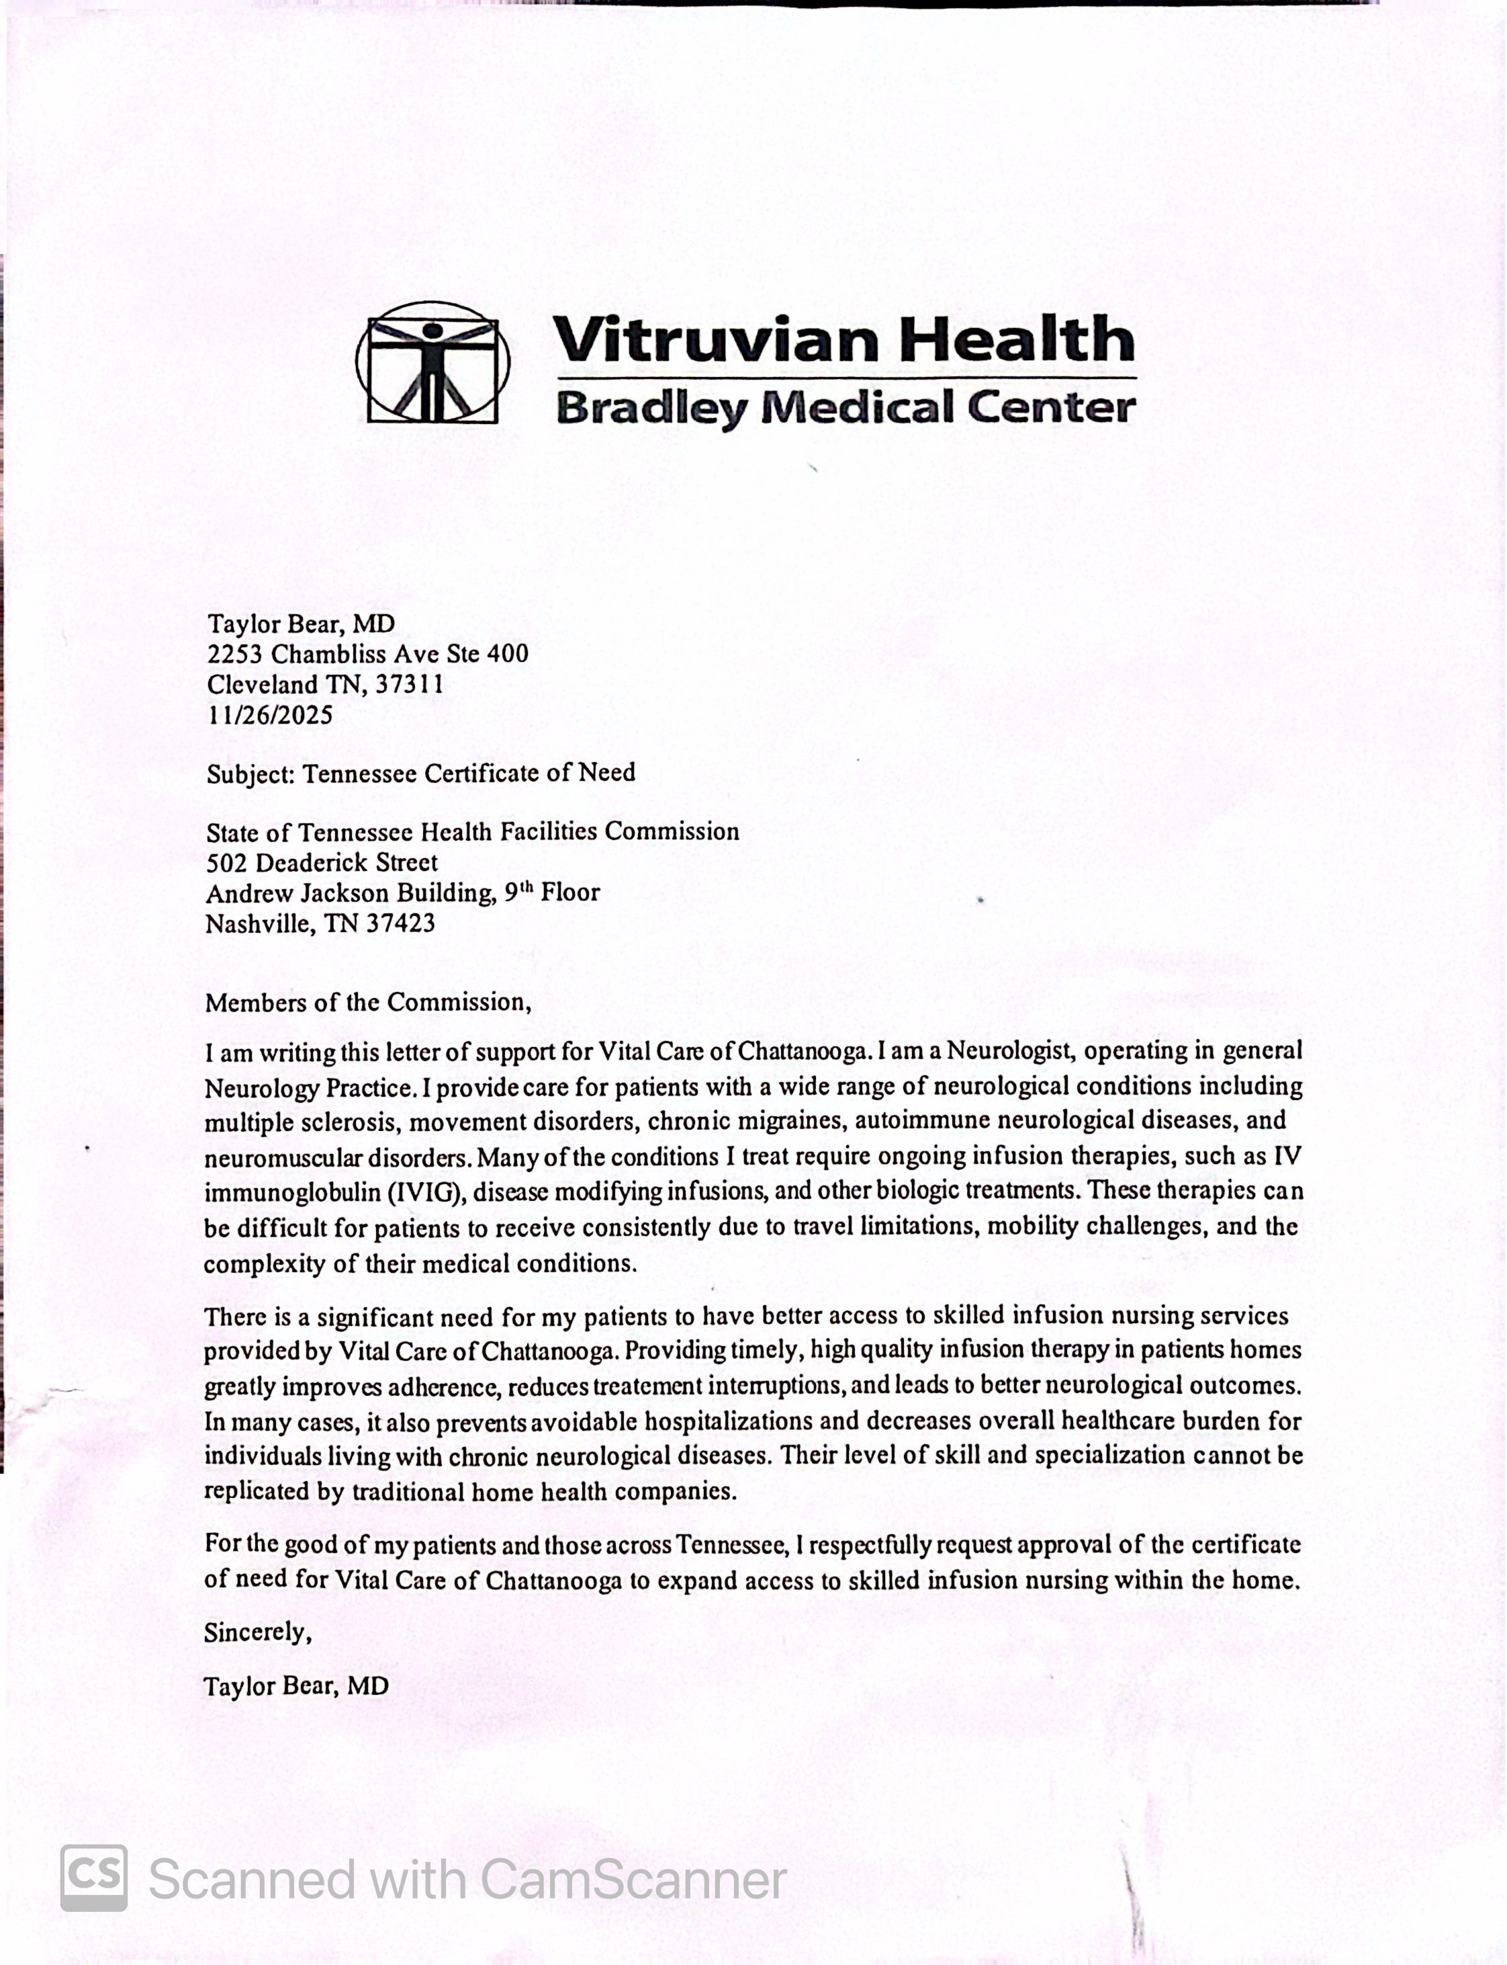
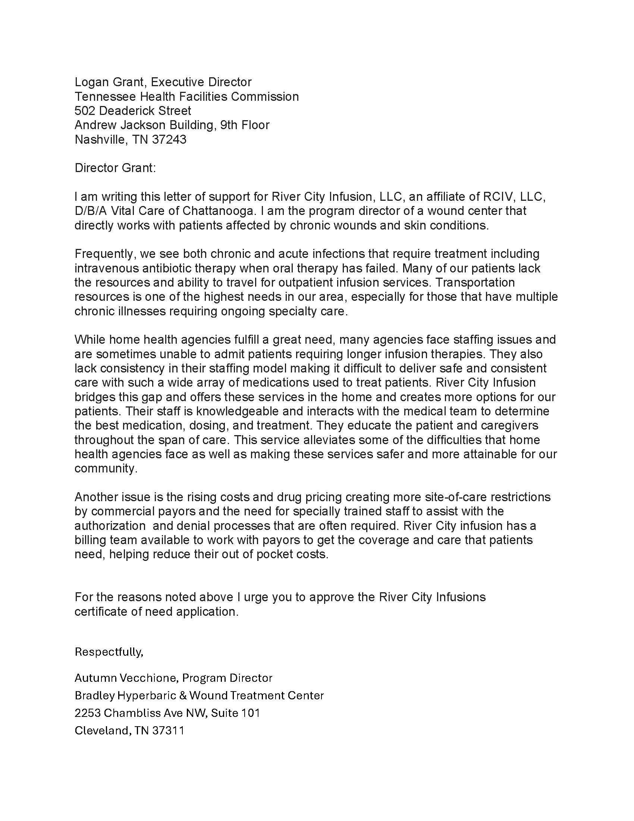
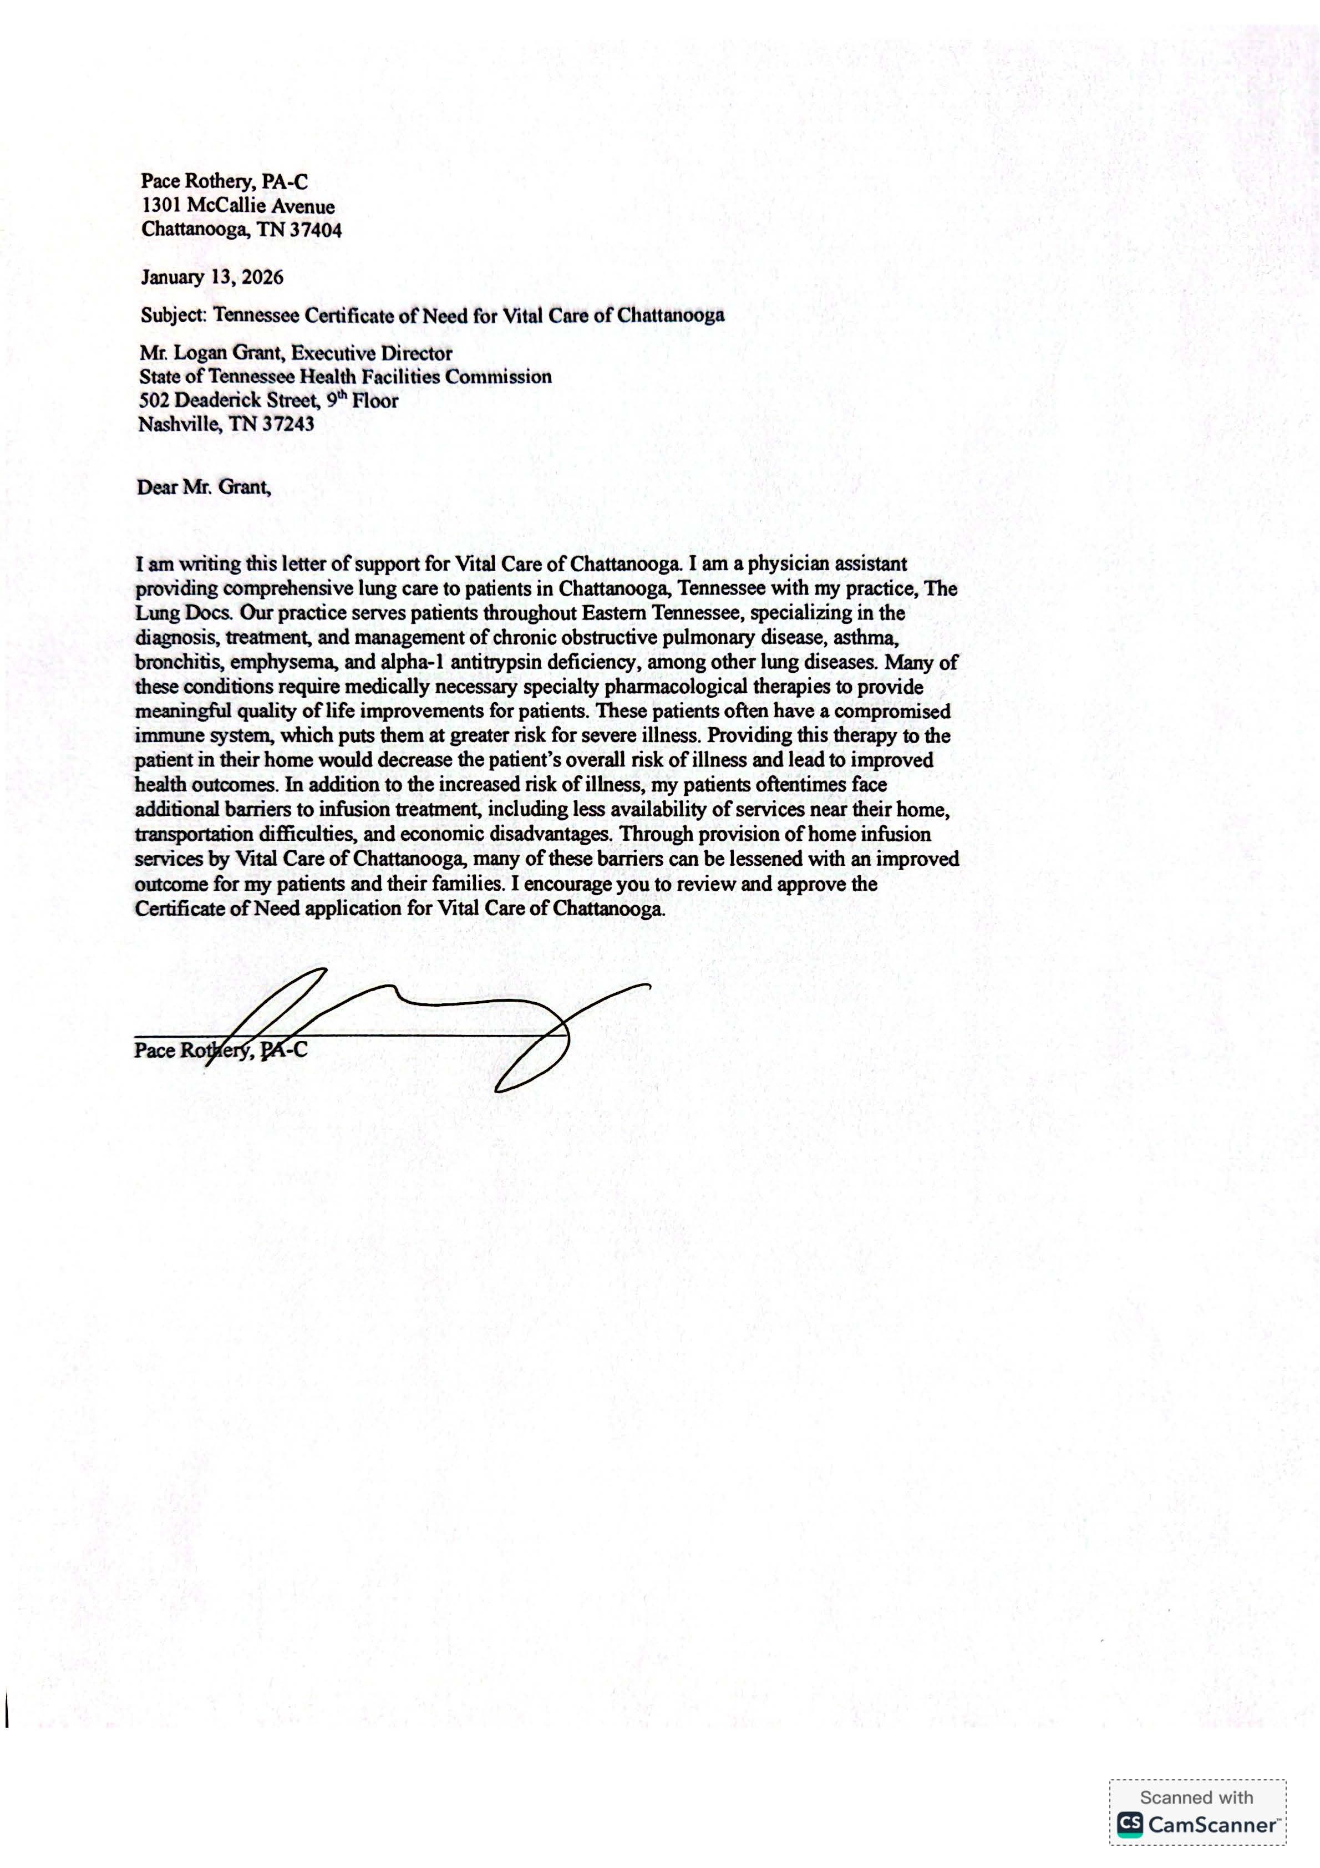
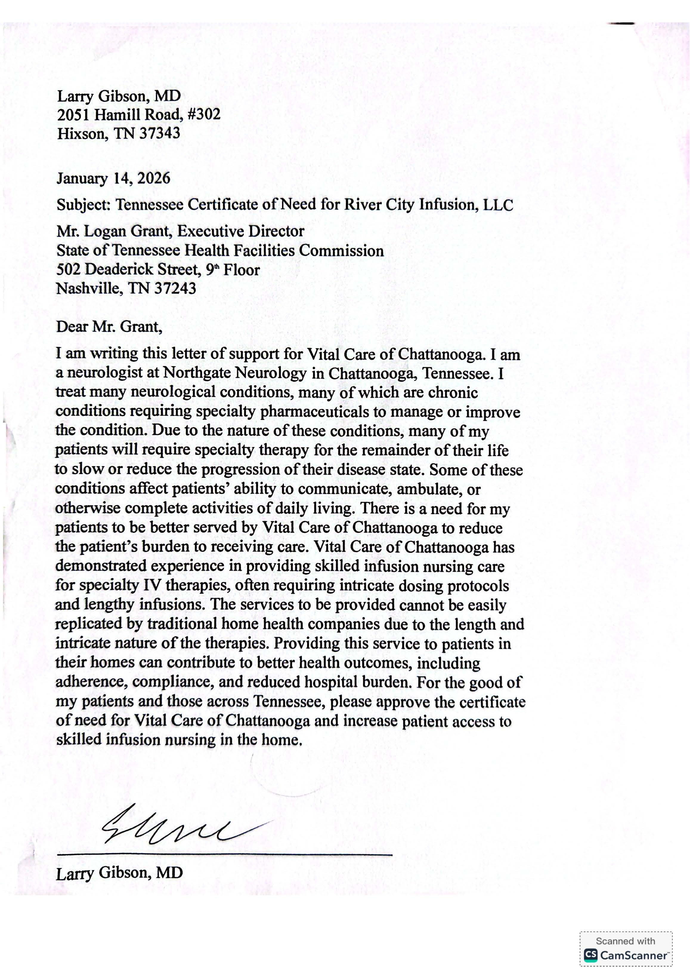
Letters of Support

