Slide 1
Vanderbilt University Medical Center
CN2510-038, Initiation of a 12-bed Inpatient Pediatric Rehabilitation Unit
January 28, 2026

Slide 2
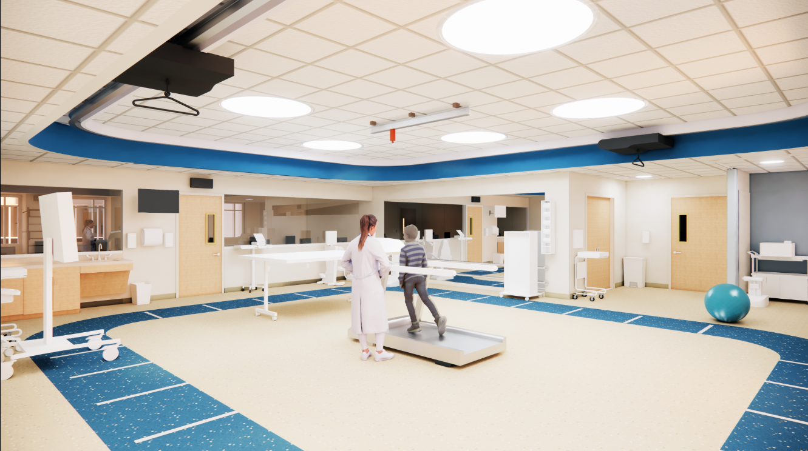
Pediatric-Focused Rehabilitation

Slide 3
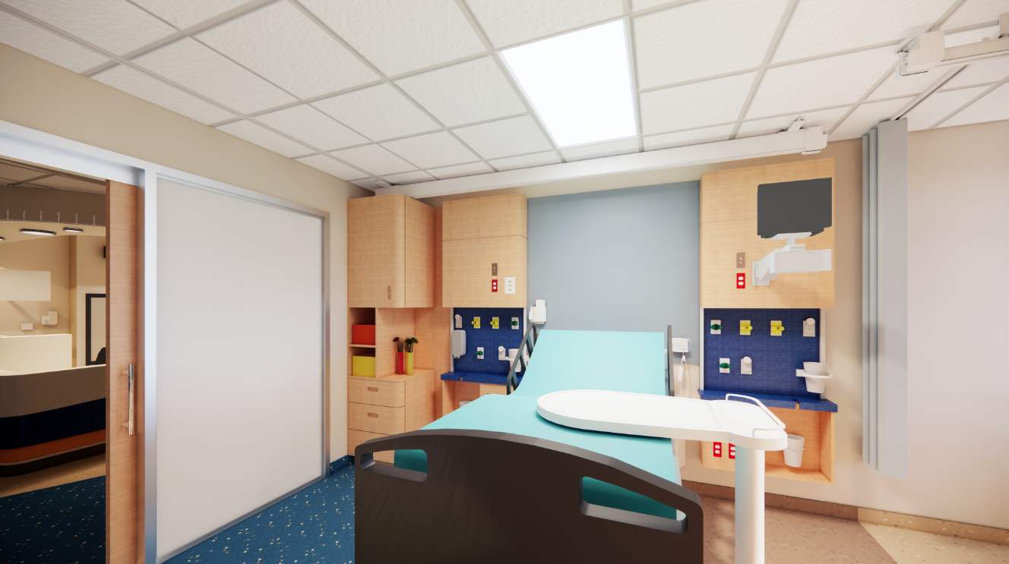
Pediatric-Focused Rehabilitation

Slide 4
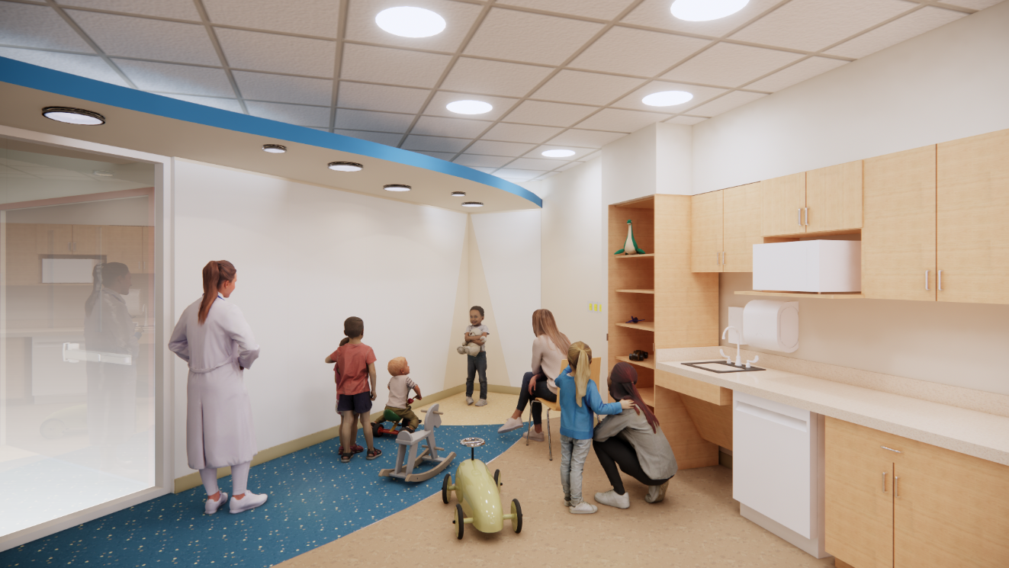
Pediatric-Focused Rehabilitation

Slide 5
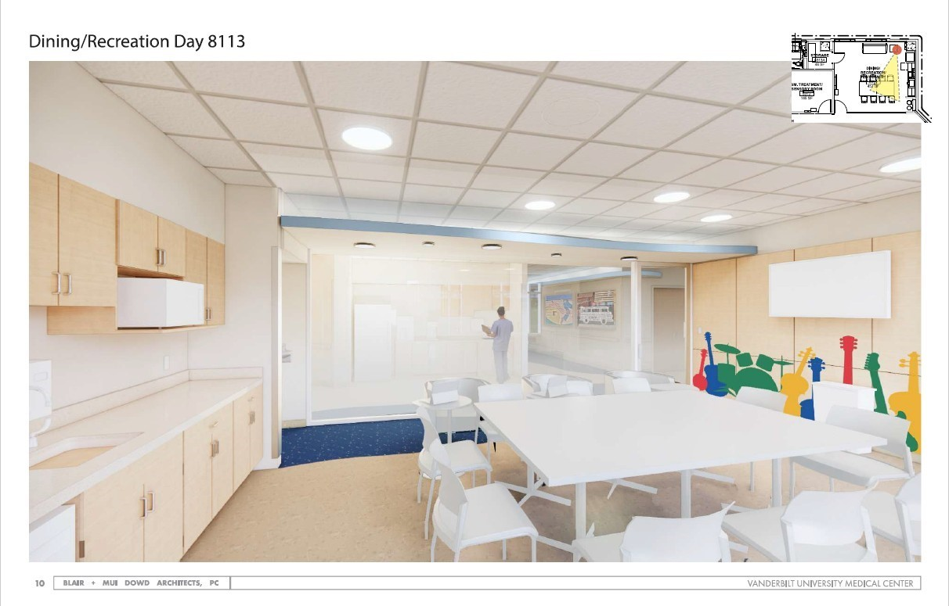
Pediatric-Focused Rehabilitation

Slide 6

Need Established: First Tennessee Inpatient Pediatric Rehab Unit

Slide 7
Quality: Leading Provider of Pediatric Care in Southeast

Slide 8




Recognition for High Quality Care
#1 in Tennessee and
the entire Southeast*
100 GREAT HOSPITALS IN AMERICA
Notes:
Monroe Carell Jr. Children’s Hospital at Vanderbilt has earned the distinction of being a Leapfrog Top Hospital for 2025, reaffirming the hospital’s leadership in safety and quality nationwide for the fourth year in a row.
This year, Monroe Carell is one of only 15 children’s hospitals nationwide to receive the Top Hospitals designation.

Slide 9
Consumer Advantage: Community Support and Reduced Travel

Slide 10


Support from Other TN Pediatric Hospitals

