Slide 1


Certificate Of Need Proposal
A Research-Based Non-Medicare Home Health Provider

Slide 2



Abe’s Story
Our Mission
The long-term vision of Abe’s Garden
Memory Support has always been to
enhance the lives and cognitive health of all seniors – not just those living with cognitive challenges.
To better reflect our vision – and our future
– our mission has evolved:
To establish a replicable model for senior life that is focused on brain health, wellness and purposeful living.
The seeds of Abe’s Garden Community were planted when founder Michael Shmerling’s
father, Abram C. “Abe” Shmerling, MD, was diagnosed with Alzheimer’s disease. Dealing
with the disease firsthand, Michael and his family experienced the limited availability of
quality services and care dedicated to a rapidly growing population of older adults
with Alzheimer’s disease and other forms of
dementia.

Slide 3


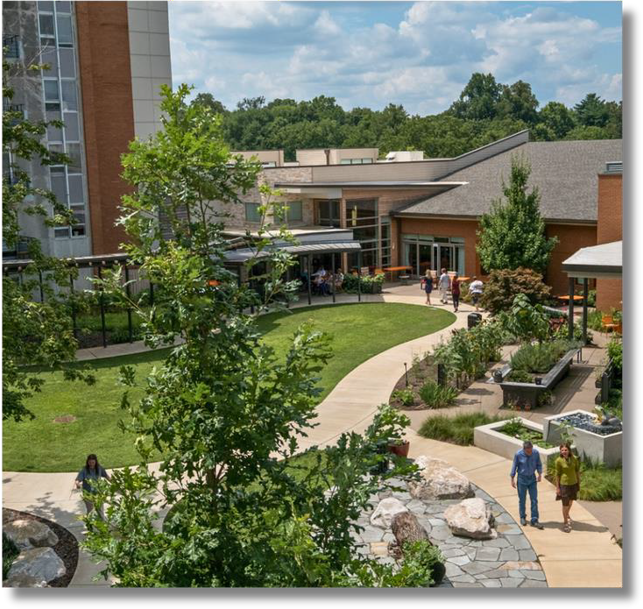

The Hearthstone History
Founded in 1992 to provide innovative care for people with Alzheimer's and other dementias in senior living communities.
Backed by 30+ years of research and field testing
A recognized leader in its field for over three decades
Hearthstone's partner organizations receive cutting-edge training that allows them to provide excellent care, well-being, and quality of life to people with cognitive challenges.
Abe’s Garden acquired the Hearthstone Institute in 2022 and implements all aspects throughout the community as well as all ancillary services.

Slide 4
The I’m Still Here
approach decreases:
Engagement is the “Antidote” to Reactive Behaviors
32%
41%
42%
Neuropsychiatric Symptoms
Anxiety
Depression

Slide 5
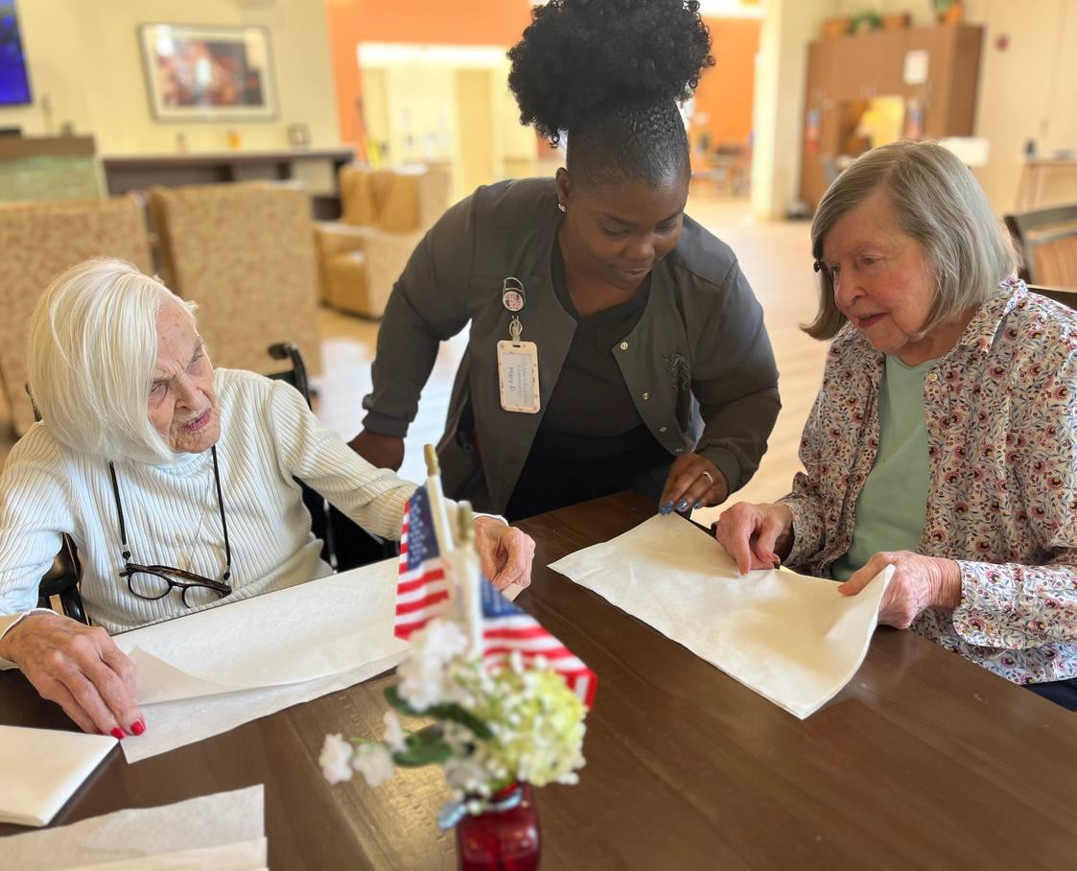
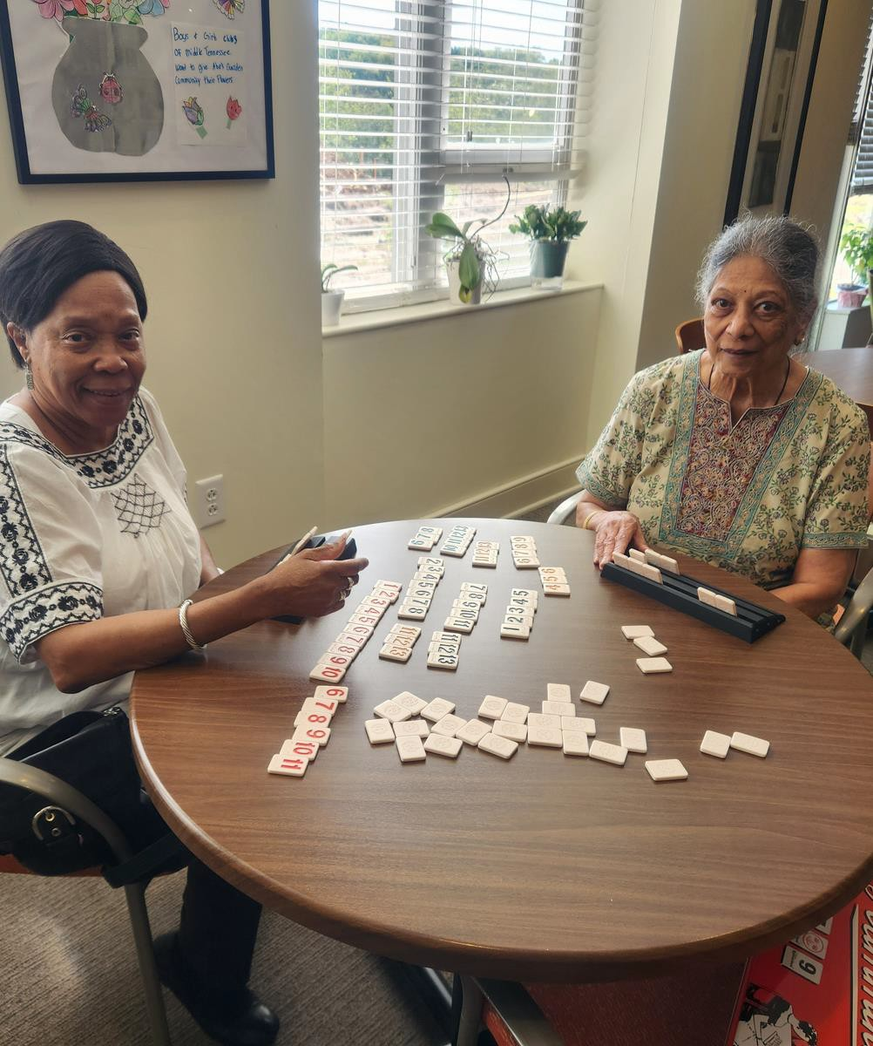
Section 1: Why the project is necessary to provide needed health care in the service area
More than 120,000 Tennesseans are living with Alzheimer’s and 5.4 Million Americans
Alzheimer’s disease is the 6th leading cause of death in the United States
The country experienced a 54.5% increase in deaths attributed to Alzheimer’s between 1999 and 2014.
Those we serve:
Residents of Abe’s Garden Community
Independent Living
Assisted Living and Memory Care
Seniors in Middle Tennessee
Davidson, Williamson, Wilson, Maury and Coffee Counties
Specialized for those living with Dementia
Allows more seniors to age in place
Current gaps in service provision

Slide 6

PSSA Licensure Support
Supportive Services
Bathing
Dressing
Grooming
Mobility/Transfer Support
Med. Assistance
Ensuring medications are not expired
Medication reminders
Prescription ordering
Understanding your medication
Concierge Services
Medical appointment assistance
Home and safety assessments
Housekeeping
Laundry
Meal prep
Packing/unpacking
Shopping & errands
Home Health Services
Medication Administration
Medication Setup, Reconciliation
Simple Wound Care
Diabetic Care
Pain Management
Injectables
Catheter care
Oxygen Therapy Monitoring

Slide 7
Home Health Licensure Support
PSSA Level of Service
Supportive Services
Medication Assistance
Concierge Services
Home Health Services
Medication Administration
Medication Setup, Reconciliation
Simple Wound Care
Diabetic Care
Pain Management
Injectables
Catheter care
Oxygen Therapy Monitoring
Assessment & Monitoring
Initial and Ongoing Nursing Assessments
Vital Sign Monitoring
Chronic Disease Monitoring
Fall Risk Assessments
Infection Monitoring and Prevention
Care Coordination & Case Management
Care Plan Development
Coordination with Physicians and Other Providers
Communication with Family/Caregivers
Discharge Planning

Slide 8
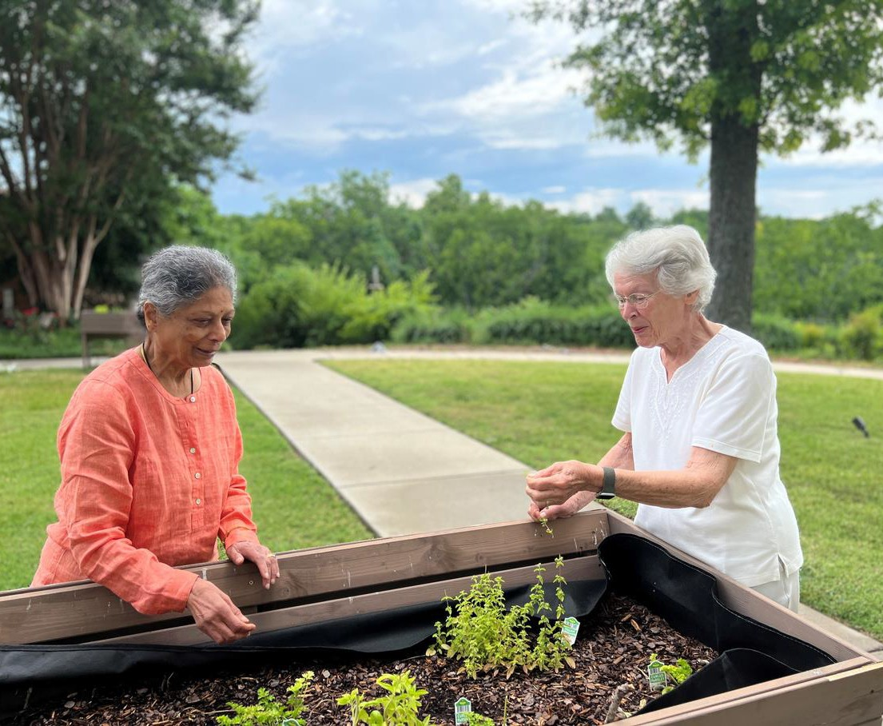
Section 2: How it will provide health care that meets appropriate quality standards
Certified by the Hearthstone Institute
CHAP Accreditation – Most recognized for quality standards
Continued involvement in research studies/programs
Client surveys for continuous feedback and improvement
Shed meds program with a major research hospital

Slide 9

Research and Quality Improvement
Research Funded Through NIH and Foundational Grant Support
Research and Quality Improvement Studies Published in: Journal of the American Gerontological Society
The Gerontologist
Journal of the American Medical Directors Association
Featured in the World Alzheimer’s Report 2020
2024 and 2026 Alzheimer's Disease International Global Conference Presenters

Slide 10
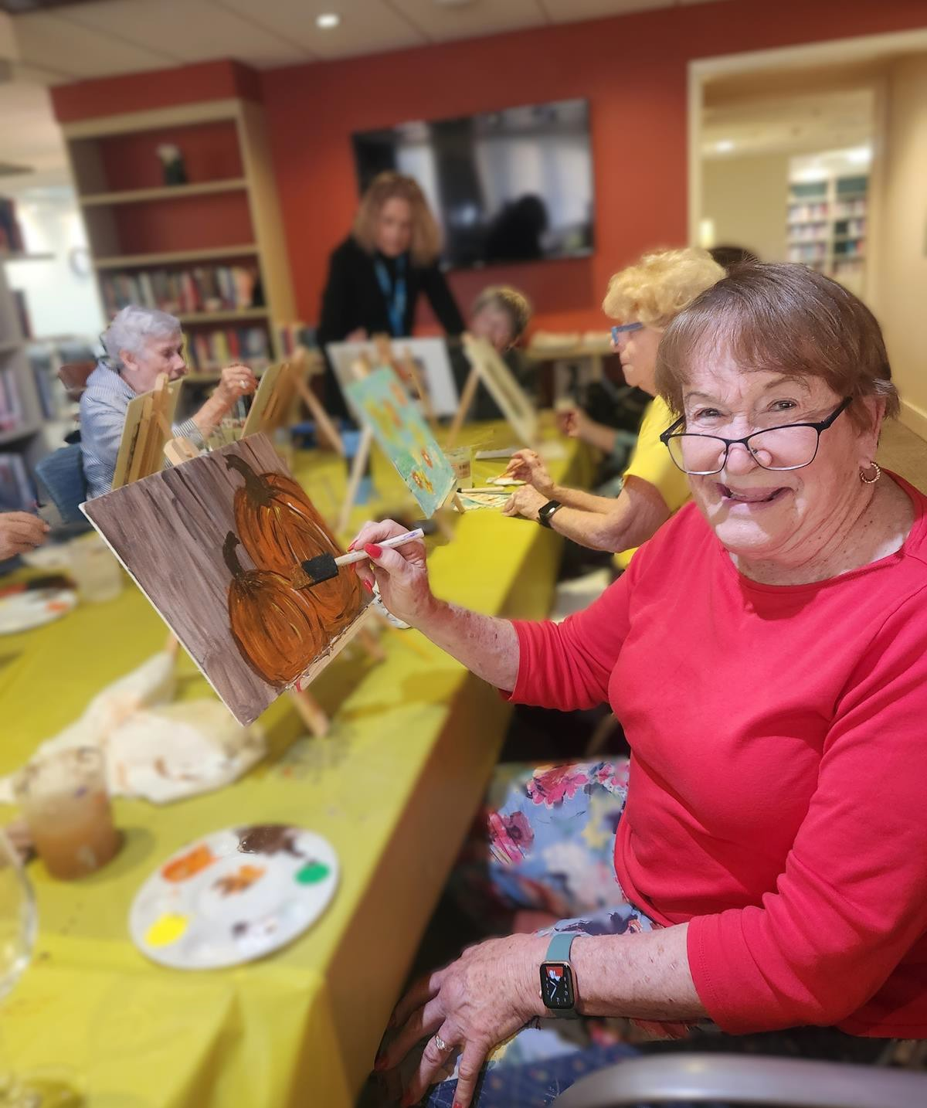
Section 3: How the effects attributed to competition or duplication would be positive for consumers
Continuity of Care
Specialized approaches to cognitive decline
Choice allows better care
Current Client and Resident Support

Slide 11
RECOGNITION, AWARDS & ACCOMPLISHMENTS
2025: Sage Award Honoree – Recognized by AgeWell Middle Tennessee for extraordinary contributions and positive impact on the lives of older adults in Middle Tennessee.
2025: nFocus Magazine Fresh Faces of Philanthropy Impact Awarded to Abe's Garden Community volunteer, Morgan Huelsman
2025-2020: Named “Best Memory Care Community Nashville” by Memorycare.com
2024: Abe’s Garden Community wins LeadingAge TN Songwriter Project Competition for the original song “I Am Who I Am.
2023: Recognized nationally with a LeadingAge Tennessee Care Partner Recognition Award
2021: Received six LeadingAge TN awards across four categories, including On The Front Lines, Innovator in Action, Distinguished Senior, and Grand Positive Influence
2018: Journal of the American Geriatrics Society published “A System for Managing Staff and Quality of Dementia Care in Assisted Living Facilities,” co-authored in conjunction with VUMC, Center for Quality Aging
2018: Received a Therapeutic Garden Design Award by Therapy Association
2017: The Gerontologist published “Managing Person-Centered Dementia Care in an Assisted Living Facility: Staffing and Time Considerations,” co-authored in conjunction with VUMC, Center for Quality Aging
2016: Received an “Excellence in Development” Award by Urban Land Institute Nashville
2015: Named “Architecture & Design, Best Stand-Alone Memory Care” by Senior Housing News

Slide 12


abesgarden.org
abesgarden.org/education-advisory-services/

