Slide 1
Tennessee Department of Health Farmers Market Nutrition Webinar
Narrated by
Sierra Mullen
Epidemiologist
Family Health & Wellness
Notes:
Welcome to the Tennessee Farmers Market Nutrition Program Webinar for Farmers. We are excited to provide this option for farmers who have previously participated in the program and plan to return for the 2018 season. This training will also provide an overview for those who are interested in becoming authorized to take the Program’s vouchers for the first time.
Federal regulations require that first time farmers attend an in-person training session. These sessions have been scheduled throughout the state. Farmers who did not register for this webinar will also need to attend an in-person training session.*

Slide 2
Today’s Learning Objectives
When you have completed this training, you will be able to:
Describe the process of becoming an authorized farmer in the Farmers Market Nutrition Program.
Notes:
When you have completed this training, you will be able to describe the process of becoming an authorized farmer in the Farmers Market Nutrition Program.
You may ask questions by typing in the Chat Room. We will answer questions later in the presentation.
You may listen to the webinar through your computer or by calling the toll free number on the screen and, in that case, please mute your phone.*

Slide 3
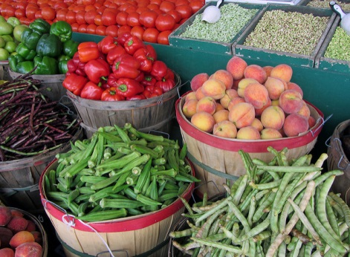
We will cover:
Farmers Application
The Farmers Handbook
Farmers Agreement
Notes:
In this presentation, we will cover:*
The Farmers Application *
The Farmers Handbook, and*
The Farmers Agreement*

Slide 4
What is the FMNP?
The Farmers Market Nutrition Program (FMNP) provides:
Fresh, unprocessed, Tennessee-grown produce (fruits, vegetables, and herbs) to WIC and Senior participants.
Notes:
First, let’s talk about what the Farmers Market Nutrition Program is. The program provides fresh, unprocessed, Tennessee-grown produce to WIC participants and low income seniors at local farmers markets in selected Tennessee counties.
The Department of Health administers the program in Tennessee. Tennessee has provided both programs, the WIC Farmers Market Nutrition Program and the Senior Farmers Market Nutrition Program, since 2001.*

Slide 5
The goals of the FMNP are:
To provide nutritious, Tennessee-grown produce to WIC participants and low income seniors.
To increase awareness and sales at farmers markets.
To expand awareness and the use of produce grown by Tennessee farmers.
Notes:
The goals of the Program are*
To provide nutritious, Tennessee-grown produce to WIC participants and low income seniors.*
To increase the awareness of and sales at local farmers markets, and*
to expand the awareness of and use of produce grown by Tennessee farmers. *
So what is WIC and who are WIC participants?*

Slide 6
Women, Infants and Children (WIC)
WIC serves low income
Pregnant, postpartum and breastfeeding women
Infants
Children to the age of five
And provides
Nutrition education
Supplemental foods
Breastfeeding promotion and support, and
Referrals for health care
Notes:
The Women, Infants and Children Special Supplemental Nutrition Program is a federal program* designed to serve low-income pregnant, postpartum and breastfeeding women, infants and children until the age of five.
The program provides a combination of nutrition education, supplemental foods, breastfeeding promotion and support, and referrals for health care.*

Slide 7
Eligibility for WIC FMNP
Must be WIC participant (pregnant, postpartum or breastfeeding women or child 1 to 5 years of age)
Income at or below 185% of poverty level (verification required)
Resident of Tennessee (verification required)
Notes:
*Only participants in the WIC program (pregnant, postpartum or breastfeeding women or children 1 to 5 years of age) are eligible for the WIC Farmers Market Nutrition program. Infants are not included in this program.
To be eligible for WIC, a participant’s household Income must be at or below 185% of the poverty level. Proof of income is required. The participant must also show proof that she is a resident of Tennessee.
To be eligible for the Farmers Market Nutrition Program, the WIC participant must receive WIC benefits in a participating county. *

Slide 8
Tennessee FMNP
Notes:
Only eight Tennessee Counties participate in the WIC FMNP:
They are Coffee, Hickman, Lincoln, Madison, Maury, Moore, Rutherford and Sullivan Counties.*

Slide 9
Operation of WIC FMNP
Vouchers for Tennessee-grown fruits, vegetables and herbs are printed on site in the local participating health departments.
Vouchers are month-specific. Each participant receives:
2 $5 vouchers for July
2 $5 vouchers for August
$20 total for summer
Notes:
Vouchers are printed on site in the local participating health department and exchanged for fruits, vegetables and herbs grown by Tennessee farmers.
Vouchers are month specific. (which means they can only be cashed in the month designated on the voucher). Each participant receives:
2 $5 vouchers for July and
2 $5 vouchers for August for a total of
$20 for the summer*

Slide 10
Eligibility for Senior FMNP
Age 60 or over
Income at or below 130% of poverty level (verification required)
Resident of participating county (verification required)
Notes:
To be eligible for the Senior program:*
A participant must be age 60 or over*
Have a household income at or below 130% of the poverty level, and*
Live in the participating county.*

Slide 11
Tennessee Senior FMNP
Notes:
The Senior Program is in 5 Tennessee Counties:
Davidson, Dyer, Hamblen, Shelby and Warren*

Slide 12
Operation of Senior FMNP
Vouchers are printed on site in local health departments or Commodity Supplemental Food Program (CSFP) warehouses.
Vouchers are month specific:
3 – 4 $5 vouchers for July
3 – 4 $5 vouchers for August
$35 - $40 total for summer
Notes:
Vouchers are exchanged for Tennessee-grown fruits, vegetables and herbs and are printed on site in local health depts. or at Commodity Supplemental Food Program warehouses.
Vouchers are month specific. Depending on the amount received from USDA each participant usually receives:
4 $5 vouchers for July and
3 – 4 $5 vouchers for August for a total of
$35 - $40 for the summer
For example, a 60 year old woman, living alone in Morristown, with an income of less than $1,287 a month, would be eligible for the program. In July, she could go to the Hamblen County Health Department with verification of her age, income and residency and receive three to four $5 vouchers for July and four $5 vouchers for August.*

Slide 13
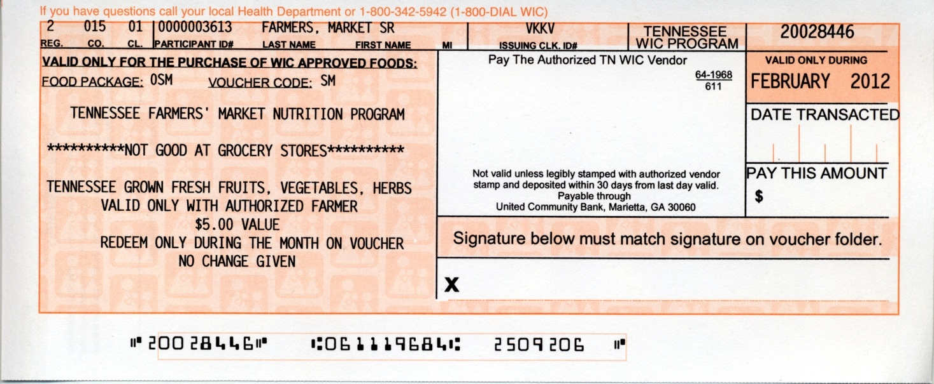
FMNP Vouchers
Notes:
Participants use five dollar vouchers to purchase Tennessee-grown produce from farmers who have completed training and have been authorized by the state to accept vouchers.
How does this work? The authorized farmer enters the amount of the purchase, the date on the voucher and asks the participant to sign the voucher on the signature line. The signature must match the signature on the front of the voucher folder. The farmer then validates the vouchers with a stamp provided by the Department of Health. The back of the voucher is stamped with the farmer’s bank account number, and deposited into his or her bank account for payment.
We will discuss this in more detail later in the webinar.*

Slide 14
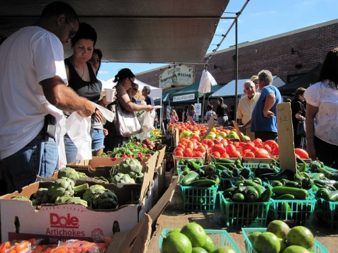
Authorized Farmers
An Authorized Farmer is an individual who farms in Tennessee who has a signed agreement with the FMNP/SFMNP to sell eligible foods at farmers markets.
Notes:
An Authorized Farmer is an individual who farms in Tennessee and who has a signed agreement with the program to sell eligible foods at farmers’ markets and/or roadside stands.
A roadside stand is a definite location at which an individual farmer sells his or her produce directly to customers. The stand must have an address so that participants can be directed to it.
Individuals, who exclusively sell produce grown by someone else such as wholesale distributors, cannot be authorized to participate in the program.
Individuals must annually apply for and receive farmer authorization in order to participate. How can farmers benefit? The program can provide new customers and increased sales. Many WIC and senior participants have never shopped at a farmer’s market before receiving these vouchers. Many of the participants said they would return, even without vouchers to spend.*

Slide 15
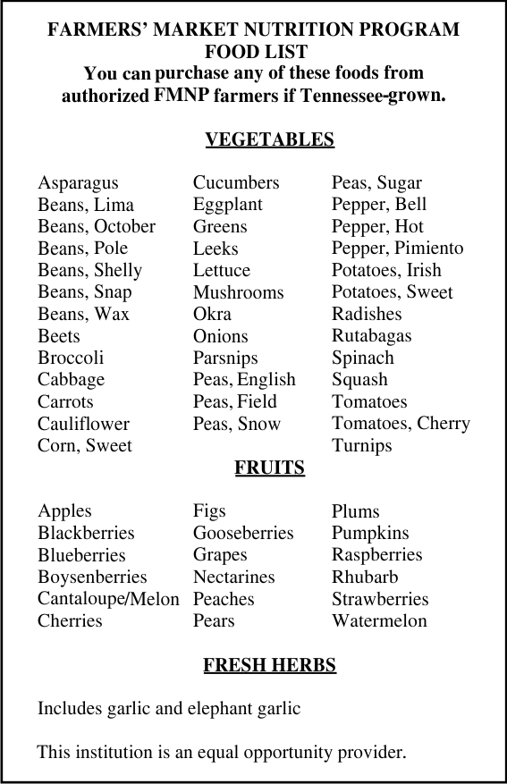
What foods are included?
Notes:
Eligible foods are those fruits, vegetables and herbs listed on the approved food list and must be grown in Tennessee.
The authorized farmer must have personally grown over half of the eligible foods he or she has for sale.
A voucher can be redeemed for only fresh, unprocessed, Tennessee-grown produce listed on the Food List. Produce may be cleaned, trimmed and packaged but not otherwise processed, heated, or cooked. Vouchers cannot be redeemed for nuts, honey, jelly, jam, eggs, baked goods, plants, flowers or other non food items or items not produced on Tennessee farms.*

Slide 16
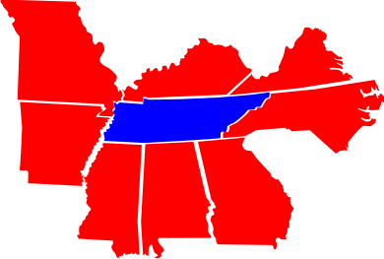
Only Tennessee Farmers?
Notes:
Why do we authorize only Tennessee Farmers?
Federal regulations state that, “locally grown means grown within state borders. If the state agency chooses, locally grown may also mean grown in areas of states adjacent to that state. “
Of all the states, Tennessee and Missouri have the most adjacent states . They each have 8 states which share their borders. If Tennessee approved farmers in adjacent states, the federal dollars given to Tennessee for Tennessee farmers would have to be shared with Kentucky, Virginia, North Carolina, Georgia, Alabama, Mississippi, Arkansas and Missouri farmers. Therefore, Tennessee has made the decision to only approve farmers who are Tennessee producers.
We are going to describe the procedures to become an authorized farmer in the Tennessee Farmers Market Nutrition Program. Once you are authorized you will be able to exchange vouchers for Tennessee grown produce in either program (WIC or Seniors).*

Slide 17
After this presentation, you will be able to:
Download a farmers handbook.
Download an application to become an authorized farmer,
Download an agreement for review, and
Ask questions at the end of this webinar.
Notes:
If you have not already done so, after this presentation, you will be able to
download a farmers handbook and an application. You will also be able to download an agreement to review. You will be given an opportunity to ask questions later in the webinar.*

Slide 18
Tennessee FMNP Farmer Authorization:
The farmer must
Complete an authorized application
Receive training and a copy of the farmer handbook
Receive a copy of the agreement signed by both the farmer and a representative of the Tennessee Department of Health, and
Receive a vendor stamp and vendor identification signs.
Notes:
How often are farmers authorized? A Farmer’s authorization expires on December 31st each year. Individuals must apply each spring to receive authorization for the summer season.
In order to become authorized to receive vouchers, a farmer must take the following steps :**
Complete an authorized application,*
receive training and a copy of the farmer handbook,*
receive a copy of the agreement signed by both the farmer and a representative of the Tennessee Dept of Health, and*
receive a vendor stamp and vendor identification signs.
Let’s look at each of these steps.*

Slide 19
Tennessee FMNP Farmer Application
Notes:
Let’s first look at the application.*

Slide 20
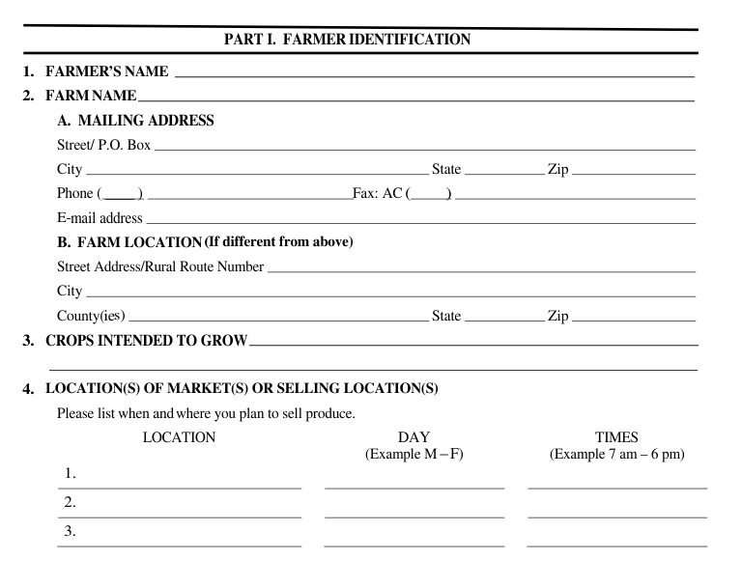
Tennessee FMNP Farmer Application
Notes:
In order to complete the application, the following must be filled out:
The farmer’s name and mailing address.
The farm location. The farmer’s growing site will be verified by a site visit by the County Agriculture Extension Agent or by a representative of the Health Dept.
A list of crops that the farmer intends to grow.
And the location of the market(s) or selling location(s). The Farmer should list when and where he or she plans to sell produce. These dates, times and locations will be given in writing to participants. If these change during the market season, the regional vendor representative should be notified. We encourage everyone to sell at a farmers market.*

Slide 21
Tennessee FMNP Farmer Application
Notes:
When the farmer is not present, he or she should designate an alternate person in authority. This person’s contact information should be entered. The farmer may send an employee or helper to the market to sell his produce. The employee or helper can only assist one farmer at a time.*

Slide 22
Tennessee FMNP Farmer Application
Notes:
On the 2nd page of the application at the top of the sheet, the applicant names the bank where the vouchers will be deposited. Vouchers cannot be cashed but must be deposited, therefore a bank account is necessary.

Slide 23
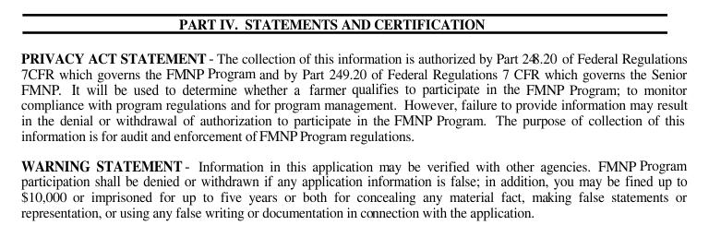
Tennessee FMNP Farmer Application
Notes:
As stated in the Privacy Act Statement, the collection of this information is authorized by federal regulations. It will be used to determine whether a farmer qualifies to participate in the FMNP, to monitor compliance with regulations and for program management. Failure to provide information on the application may result in the denial or withdrawal of authorization to participate in the FMNP Program. The purpose of the collection of this information is for audit and enforcement of Program regulations.
The Warning Statement states, that “Information in this application may be verified with other agencies. Program participation shall be denied or withdrawn if any application information is false; in addition, you may be fined up to $10,000 or imprisoned for up to five years or both for concealing any material fact, making false statements or representation, or using any false writing or documentation in connection with the application.*

Slide 24
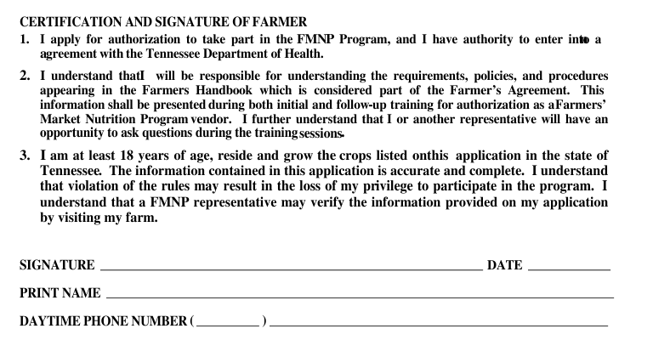
Tennessee FMNP Farmer Application
Notes:
Let’s discuss the Certification section of the Application. First, it is understood that the farmer is the one applying for authorization and has the authority to enter into an agreement.
Second, it is understood that the farmer is responsible for understanding the requirements, policies, and procedures appearing in the Farmers Handbook. The handbook is considered part of the Farmer’s Agreement. Information in the handbook will be presented during this training and during any follow-up training for authorization. The farmer understands that he or she will have an opportunity to ask questions during the training sessions. We will take questions at the end of this webinar.
And Third, the farmer is at least 18 years old, lives and grows the crops listed on this application in the state of Tennessee. The farmer agrees that the information contained in this application is accurate and complete, and understands that violation of the rules may result in the loss of his or her privilege to participate in the program. The farmer understands that a program representative may verify the information provided on this application by visiting the farmers growing location or farm.
If this is agreeable, the farmer requesting authorization should sign and date the application.*

Slide 25
Tennessee FMNP Farmer Application
Notes:
At the bottom of the page, notice the non-discrimination statement. This institution is prohibited from discriminating on the basis of race, color, national origin, sex, age, or disability. To file a complaint of discrimination, a farmer should submit his complaint to the address on the application.*

Slide 26
Tennessee FMNP Farmer Application
Download the application from this website:
http://tn.gov/health/topic/MCH-farmers
Click “For Farmers” on the left.
Notes:
You may download the application from the link shown here.
Just click “For Farmers” on the left.*

Slide 27
Tennessee FMNP Farmer Authorization
The farmer must
Complete an authorized application
Receive training and a copy of the Farmer Handbook
Receive a copy of the agreement signed by both the farmer and a representative of the Tennessee Department of Health, and
Receive a vendor stamp and vendor identification signs.
Notes:
Now let’s discuss training and then the farmer’s handbook.*

Slide 28
Tennessee FMNP Training
To be eligible to participate in the FMNP:
All farmers must be authorized by the Department of Health either through in-person training, or through web-based interactive training.
Notes:
To be eligible to participate in the Program,
All farmers must be authorized by the Dept of Health either through in-person training or through web-based interactive training.
Training is conducted annually in each region where a Farmers Market Nutrition Program is provided.
Again, this year, each region will be conducting additional training sessions for new farmers and reviews for farmers who would like to attend. Check with the vendor representative in your regional office for the time and locations of these trainings. The vendor representative contact information can be found on the Farmers Market Nutrition Program website.*

Slide 29
Tennessee FMNP Training
What is different about the In-Person Farmer Training?
Local presentations may also include:
Local Farmers Market Management
Agriculture Extension Agency
County Codes Department
County Environmental Health Department
Weights and Measures Representative
Notes:
What is different about the in-person farmers training?
These training sessions may also include presentations from:
Local Farmers Market Management, the local Agriculture Extension Agency, the County Codes Department, the County Environmental Health Department and/ or a representative from Weights and Measures.*

Slide 30
Tennessee Farmer’s Handbook
Download the Handbook from this website:
http://tn.gov/assets/entities/health/attachments/FMNP_Handbook.pdf
Click “For Farmers” on the left.
Notes:
Most of the Handbook is covered during this webinar. We will point out some of the key points now.
The Handbook may be downloaded from the web site shown here.
Just click the “For Farmers” tab on the left. *

Slide 31
Farmer’s Handbook
Criteria to be an authorized farmer:
Live and grow eligible foods within Tennessee borders;
Meet the eligibility requirements based on the information submitted in a completed application;
Submit a completed and signed agreement;
Intend to participate in the program for a majority of the season (July and August).
Notes:
*In the Handbook, the Criteria to be an authorized farmer can be found on page 3. * Let’s discuss some of these. To become authorized, the farmer must:*
live and grow eligible foods within Tennessee’s borders; *
Meet the eligibility requirements based on the information submitted in a completed application; *
Submit a completed and signed agreement.*
Intend to participate in the program for a majority of the season which is July and August.
Also, the farmer must agree to notify the regional vendor representative if selling should stop at which time the farmer must return the State of Tennessee farmer identification stamp. If the selling location changes during the season, the farmer must notify the vendor representative. At the discretion of the Vendor Representative, a new application may need to be submitted, noting the new location, and a new agreement may need to be signed.*

Slide 32
Farmer’s Handbook
Provide information requested for reporting to the USDA;
Provide suitable selling hours and environment for participant access;
Offer participants any courtesies offered to other customers; and
Agree to prominently display FMNP identification sign.
Notes:
**The farmer must
Provide information requested for reporting to the USDA; for example, responding to a survey;*
Provide suitable selling hours and environment for participant access.*
Offer participants any courtesies offered to other customers. Acknowledge and comply with USDA nondiscrimination provisions: that standards for participation in the program are the same for everyone regardless of race, color, national origin, sex, age, or disability;*
Agree to prominently display an authorized farmer identification sign stating participation in the Farmer’s Market Nutrition Program. The sign should be removed when eligible foods are sold out. In the event of loss, destruction, or theft of the authorized vendor identification sign or the authorized vendor stamp , the vendor representative should be Immediately informed so that a replacement can be issued;

Slide 33
Farmer’s Handbook
Accept vouchers only in exchange for Tennessee-grown produce;
Agree that prices charged to participants for eligible foods shall be the same or lower than prices charged to others;
Agree that sales tax will not be charged;
Agree not to issue cash change
Notes:
The farmer must
First, accept vouchers only in exchange for Tennessee-grown produce as listed on the approved food list at the farmer’s authorized location. The voucher should be properly completed and signed by the participant or his or her proxy at the time of sale. The signature on the voucher that is presented must be compared to the signatures on the voucher folder;
Next, the farmer must agree that prices charged to participants for eligible foods shall be the same or lower than prices charged to other customers.
The farmer must also agree that sales tax will not be charged for foods purchased with vouchers;
Finally, they must agree not to issue cash change for purchases that are in an amount less than the value of the voucher;

Slide 34
Farmer’s Handbook
Agree to accept vouchers only in the month and year printed on the face of the voucher;
Agree to stamp each transacted voucher with vendor number before depositing;
Agree to submit vouchers for payment within 30 days from the last day valid on the face of the voucher. For example, a July voucher must be deposited before August 30th.
Notes:
He or she must:
Agree to accept vouchers as payment for eligible foods only if the voucher is presented in the month and year printed on the face of the voucher.
Agree to stamp each voucher with the farmer’s vendor number before depositing.
And agree to submit vouchers for payment within 30 days from the last day valid that is printed on the face of the voucher;
(For example, a July voucher must be deposited before August 30th.)

Slide 35
Farmer’s Handbook
Agree not to seek reimbursement from participants
Grant the program the right to collect claims of reimbursement due to error, negligence or fraud;
Participate in training through attendance in an entire session of a training meeting;
Take responsibility for properly training and informing employees/helpers of obligations to the program.
Notes:
If a voucher is not paid by the FMNP, the farmer must agree not to attempt to seek reimbursement from participants.
He or she must
Grant the program the right to collect any claims of reimbursement due to error, negligence, or fraud; and
Participate in the training on the program rules and procedures through attendance in an entire session of one of the training meetings conducted by the program staff.
Finally, he or she must
Take responsibility for properly training and informing employees or helpers of obligations to the program, and is accountable for the actions of his or her employees or helpers.

Slide 36
Farmer’s Handbook
Agree to be monitored at selling and growing sites for compliance with requirements;
Acknowledge that non-compliance may result in sanctions;
Acknowledge that a farmer who commits fraud or abuse of the program is liable to prosecution
Notes:
He or she must
Agree to be monitored at selling and growing sites for compliance with program requirements, including both overt and covert monitoring, and to provide directions to growing sites upon the request of program staff.
Acknowledge that non-compliance with clauses contained in this section may result in sanctions being issued by the program according to the Farmer Sanction Procedures section of the Tennessee Farmer’s Handbook;
Acknowledge that a farmer who commits fraud or abuse of the program is liable to prosecution under applicable Federal, State or local laws.

Slide 37
The FMNP Voucher
Notes:
We have talked about vouchers. Now, let’s talk about the details.
As previously mentioned, the local health department or the Commodity Supplemental Food Program warehouse issues vouchers to participants. If you have a handbook, a sample voucher is on page 11. The valid month is printed on each voucher. Therefore, it is important to make sure that the participant is redeeming the current month’s voucher. The farmer should Accept only vouchers for the current month and year! Any voucher redeemed out of the valid month will not be paid. The date should be filled in immediately upon receipt.

Slide 38
The FMNP Voucher
Notes:
The redemption amount is the price of the total items purchased at the time of the transaction. Remember Sales tax should not be charged! Enter this amount in exact dollars and cents. This is the amount of money the bank will pay on the voucher. No change will be returned and no credit due given. No voucher can be redeemed for more than $5.00. If a participant selects produce and the total amount is less than $5.00, farmers are encouraged to offer additional fruits and or vegetables so that the participant receives $5.00 worth of produce. The participant benefits from receiving more fruits and vegetables and the farmer benefits by receiving the full value of the voucher. It’s a win-win!
*The signature on the voucher must match one of the signatures on the folder. Do not accept the voucher if it has been pre-signed.

Slide 39
The FMNP Voucher
Altering a voucher may result in non-payment.
Hold voucher and submit it to FMNP regional contact before depositing it in the bank.
Notes:
The voucher should never be altered (for example changed, rewritten or erased) for any reason. Altering a voucher may result in non-payment of that voucher. If a mistake is made on a voucher, hold the voucher and submit it to the FMNP regional vendor representative (the contact list is on page 16 of the handbook) prior to depositing that voucher in the bank.
A voucher must be deposited in the bank within thirty (30) days from the last day of the voucher’s valid month and year.
The voucher is void and the bank will return it to the farmer if the dollar amount is over the $5.00 dollar amount.
A claim for reimbursement will be made if the amount the bank paid on the voucher is incorrect due to error, negligence, or fraud.

Slide 40
The FMNP Voucher
What is a WIC cash value voucher?
Used at grocery stores
Issued year round
Fresh and/or frozen fruits and vegetables
Farmers Market Nutrition Program voucher
Used at Farmers Markets
Issued for July and August
Fresh Tennessee-grown fruits, vegetables & herbs
Notes:
What is a cash value voucher for fruits and vegetables and how is it different from the farmers market voucher?
Cash Value Vouchers are issued statewide to women and children on the WIC program. They are to be used at authorized grocery stores only. These vouchers are issued monthly on a year round basis for values of $4, $8, $10, and $15. They are to be spent on any produce.
Farmers Market Vouchers are issued to women and children on the WIC program and to seniors in selected counties. They are to be used with authorized farmers only. These vouchers are issued only in July and August each year for a value of $5. They are to be spent on Tennessee-grown produce only.

Slide 41
The FMNP Voucher
Notes:
The bank will deny Cash Value Vouchers (CVVs) taken by farmers. The banking system will only allow the CVVs to be taken by grocery stores.
Please be certain that any voucher you take states, “VALID ONLY WITH AUTHORIZED FARMER” and “$5.00 VALUE”

Slide 42
The FMNP Voucher
Separate the FMNP foods from other purchases.
Check the foods to be sure that the participant has selected Tennessee grown foods.
Total the FMNP foods before the participant signs the voucher.
Fill in the dollar amount of the FMNP purchase (without sales tax).
Fill in the date redeemed (month, day and year).
Notes:
All employees and/or helpers should be trained before accepting any vouchers. The farmer is accountable for all actions of employees and or helpers.
When a FMNP voucher is presented, follow these steps:
Separate the FMNP foods from other purchases.
Check the foods with the FMNP Food List to make sure that the participant has selected Tennessee grown foods.
Total the FMNP foods before the participant signs the voucher. The redeemed amount and date must be filled out at the time of purchase.

Slide 43
The FMNP Voucher
Notes:
*Fill in the dollar amount of the FMNP purchase (without sales tax).
*Fill in the date redeemed (month, day and year). This must be within the valid month/year printed at the top of the voucher.

Slide 44
The FMNP Voucher
Notes:
The “PAY THIS AMOUNT” must be equal or less than $5.00.
Have the customer sign his or her name on the signature line only after the “Pay this amount” block has been completed. The signature must match one of the signatures on the voucher folder.
Stamp the voucher with your authorized FMNP Farmer stamp assigned to you by the State.

Slide 45
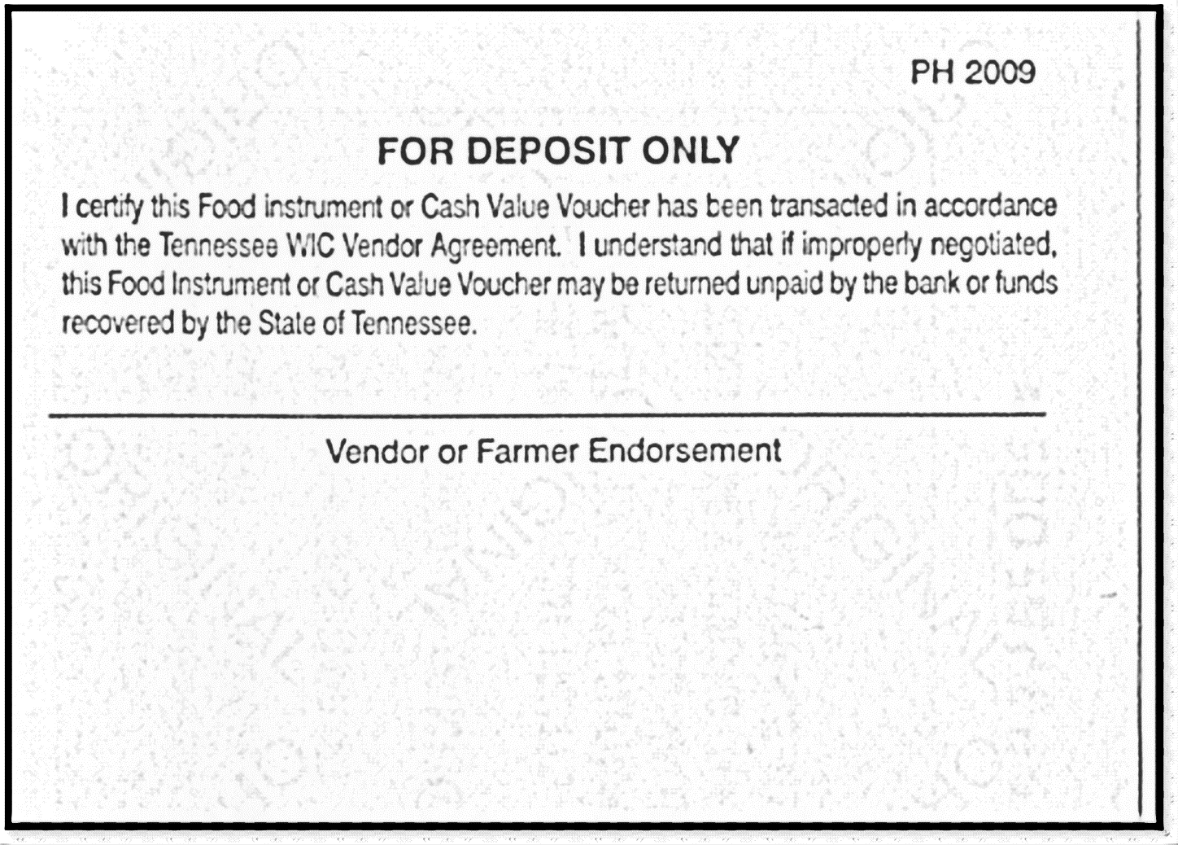
The FMNP Voucher
Notes:
*Endorse each voucher on the reverse side.

Slide 46
The FMNP Voucher
Bank will return vouchers for following mistakes:
Date blank or altered.
Monetary amount not legible, left blank or altered.
Vouchers filled out for more than the $5.00 amount.
Not signed on the “redeemed” line by the participant.
Notes:
The bank will return vouchers to the farmer for any of these mistakes:
The Date is blank or altered.
The Monetary amount is not legible, left blank or altered.
The Vouchers are filled out for more than the $5.00 amount or
Not signed on the “redeemed” line by the participant.

Slide 47
The FMNP Voucher
Bank will return vouchers for following mistakes:
Assigned FMNP farmer stamp left off or illegible.
Valid month or year altered.
Vouchers redeemed outside the valid month or year.
Vouchers deposited more than thirty (30) days from the last day of the voucher’s valid month.
Notes:
The bank will return vouchers for these mistakes as well:
The assigned farmer stamp is left off or illegible.
The valid month or year has been altered.
The vouchers were redeemed outside the valid month or year or
The vouchers were deposited more than thirty (30) days from the last day of the voucher’s valid month.

Slide 48
The FMNP Voucher
Validation/replacement of vouchers shall be kept to an absolute minimum. It will be done only with valid justification as determined by your regional contact.
No validations or replacements will be made for the following errors:
Valid month or year altered.
Vouchers redeemed outside the valid month and year.
Vouchers deposited more than thirty (30) days from the last day of the voucher’s valid month and year.
Notes:
If mistakes are made, the regional vendor representative can validate the voucher so that it will not be returned by the bank. However, Validation of vouchers shall be kept to an absolute minimum. It will be done only with valid justification as determined by your FMNP regional vendor representative (listed on page 16 of the handbook).
There will be no validations or replacements made for the following errors:
Valid month or year altered.
Vouchers redeemed outside the valid month and year or
Vouchers deposited more than thirty (30) days from the last day of the voucher’s valid month and year.

Slide 49
The FMNP Voucher
Cases of possible fraud and abuse will be investigated and the appropriate action shall be taken.
Money will be collected for fraud.
Reimbursements will be made payable to the Tennessee FMNP Program.
Notes:
Cases of possible fraud and abuse will be investigated and the appropriate action shall be taken. Evidence will be forwarded to proper authorities and prosecution may follow.
Money will be collected for fraud or
Reimbursements will be made payable to the Tennessee FMNP Program.

Slide 50
What is fraud?
Farmer fraud is considered to be:
Untruthful entries on application form.
Use of higher prices for participants than other customers.
Giving of cash for vouchers.
Furnishing non-authorized items.
A Farmer who commits fraud may be disqualified from the program, and will be subject to applicable federal, state, or local laws.
Notes:
Farmer fraud is considered to be, but not limited to, the following:
Untruthful entries on the application form.
The use of higher prices for participants than for other customers.
The giving of cash for vouchers or
Furnishing non-authorized items.
A farmer who commits fraud or abuse of the program is liable to prosecution under applicable federal, state or local laws. Farmers who commit fraud may be disqualified from the program.

Slide 51
What is fraud?
Participant fraud is considered to be:
Receiving cash for vouchers.
Purchase of non-authorized items.
Selling vouchers.
Participants who commit fraud may be suspended from the program, and are subject to applicable federal, state, or local laws.
Notes:
Participant fraud is considered to be, but not limited to, the following:
Receiving cash for vouchers.
Purchase of non-authorized items or
Selling vouchers.
Participants who commit fraud may be suspended from the program, and are subject to applicable federal, state, or local laws.

Slide 52
Tennessee FMNP Farmer Agreement
Notes:
Sanctions are listed in the Farmer’s Handbook but will be discussed later in the presentation.
Now we will talk about the agreement.

Slide 53
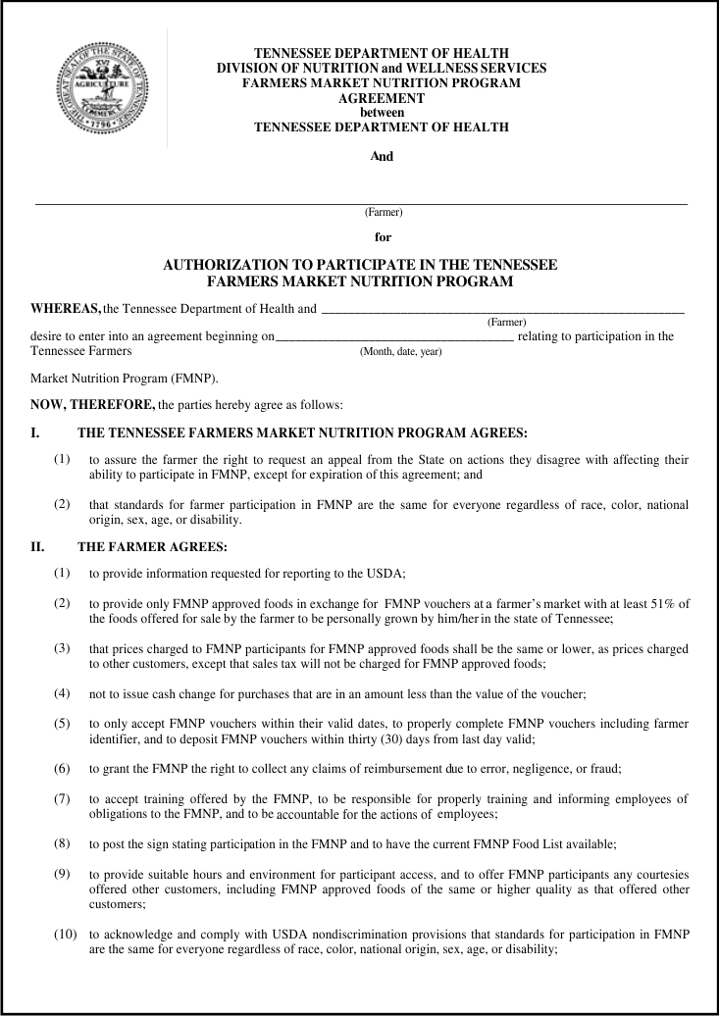
Tennessee FMNP Agreement
Notes:
Farmers must annually apply for and receive authorization in order to participate in the program. Authorization of all Farmers ends on Dec 31st of each year. A farmer authorized to accept program vouchers may accept vouchers at any location in the state, depending upon his or her acceptance by the local market.

Slide 54
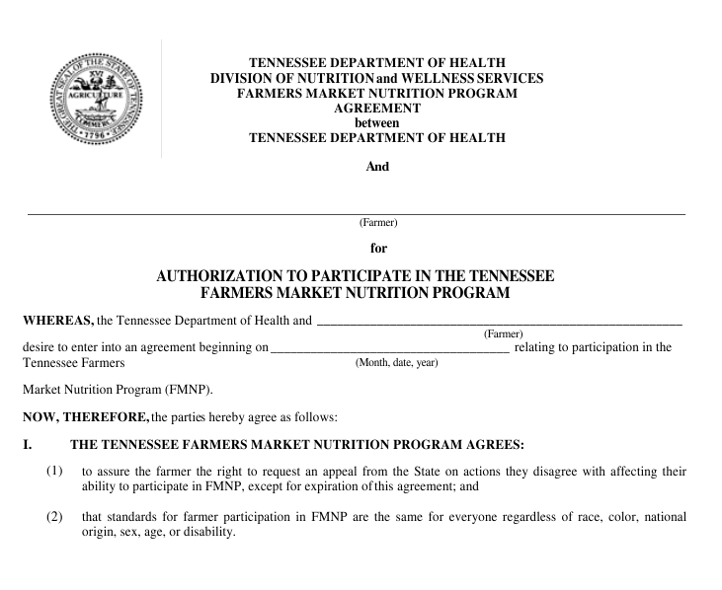
The Tennessee FMNP Agrees:
Notes:
The Tennessee Farmers Market Nutrition Program agrees to assure the farmer the right to request an appeal from the State on actions they disagree with affecting their ability to participate in FMNP, except for expiration of this agreement;

Slide 55
The Tennessee FMNP Agrees:
that standards for farmer participation in FMNP are the same for everyone regardless of race, color, national origin, sex, age, or disability.
Notes:
And AGREES that standards for farmer participation in the Farmers Market Nutrition Program are the same for everyone regardless of race, color, national origin, sex, age, or disability.

Slide 56
The Farmer Agrees to:
Provide information requested for reporting to the USDA,
Accept vouchers only in exchange for Tennessee-grown produce at the farmers market location, and
Have personally grown at least 51% of the eligible foods for sale.
Notes:
The farmer agrees to:
Provide information requested for reporting to the USDA,
Accept vouchers only in exchange for approved foods and
have personally grown at least 51% of the eligible foods for sale. In other words, over half of the foods available for sale must have been personally grown by the farmer.

Slide 57
The Farmer Agrees:
That prices charged to FMNP participants for FMNP approved foods shall be the same or lower as prices charged to other customers.
That sales tax will not be charged for FMNP approved foods.
Not to issue cash change for purchases that are in an amount less than the value of the voucher.
Notes:
The Farmer agrees
That prices charged to FMNP participants for FMNP approved foods shall be the same or lower than prices charged to other customers.
That sales tax will not be charged for FMNP approved foods and
Not to issue cash change for purchases that are in an amount less than the value of the voucher.

Slide 58
The Farmer Agrees:
To only accept vouchers within their valid dates,
to properly complete the vouchers including the farmer identifier, and
to deposit the vouchers within 30 days from the last day valid.
Notes:
The Farmer agrees:
To only accept vouchers within their valid dates,
To properly complete the vouchers including the farmer identifier, and
To deposit the vouchers within 30 days from the last day valid.

Slide 59
The Farmer agrees to:
Grant the FMNP the right to collect any claims of reimbursement due to error, negligence or fraud.
Notes:
The farmer agrees to
Grant the FMNP the right to collect any claims of reimbursement due to error, negligence or fraud.

Slide 60
The Farmer Agrees to:
Accept training offered by the FMNP;
Take responsibility for properly training helpers/employees and be accountable for their actions.
Notes:
The farmer agrees to
Accept training offered by the FMNP and
Take responsibility for properly training helpers/employees and be accountable for their actions.

Slide 61
The Farmer Agrees to:
Prominently display an authorized farmer identification sign, and have the current Food List available.
Provide suitable hours and a safe and clean environment and again, offer participants any courtesies offered to others.
Notes:
The farmer agrees to
Prominently display an authorized farmer identification sign, and have the current food list available and
Provide suitable hours and a safe and clean environment and again, offer participants any courtesies offered to others.

Slide 62
The Farmer Agrees to:
Acknowledge and comply with USDA nondiscrimination provisions that standards for participation in FMNP are the same for everyone regardless of race, color, national origin, age, sex or disability
Notes:
The farmer agrees to Acknowledge and comply with USDA nondiscrimination provisions that standards for participation in FMNP are the same for everyone regardless of race, color, national origin, age, sex or disability.

Slide 63
The Farmer agrees to:
Be monitored for compliance at selling and/or growing locations.
Not to attempt to seek reimbursement from participants for a voucher not paid by FMNP.
To notify the regional representative of a change of market location.
If operations stop, return stamp to the regional vendor representative.
Notes:
The farmer agrees to
Be monitored for compliance at selling and/or growing locations.
Not to attempt to seek reimbursement from a participant for a voucher not paid by the program.
To notify the regional representative of a change of market location and
If operations stop, return the identification stamp to the regional vendor representative.

Slide 64
The Farmer agrees to:
Acknowledge that non-compliance may result in sanctions.
Acknowledge that a farmer who commits fraud or abuse is liable under Federal, state, or local laws.
Notes:
Finally, the farmer agrees to
Acknowledge that non-compliance may result in sanctions and
Acknowledge that a farmer who commits fraud or abuse is liable under Federal, state, or local laws.

Slide 65
Both parties agree:
That the agreement is void if the farmer ceases operations.
That the agreement may be terminated by either party for negligence, fraud, abuse or violation of the agreement or for any other reason providing not less than 15 days notice.
Notes:
Both parties agree
That the agreement is void if the farmer ceases operations or
That the agreement may be terminated by either party for negligence, fraud, abuse or violation of the agreement or for any other reason providing not less than 15 days notice.

Slide 66
Both parties agree:
That neither the FMNP or the farmer has an obligation to renew this agreement.
That the Farmer’s Handbook is part of this agreement.
Notes:
Both parties agree
That neither the FMNP or the farmer has an obligation to renew this agreement and
That the Farmer’s Handbook is part of this agreement.

Slide 67
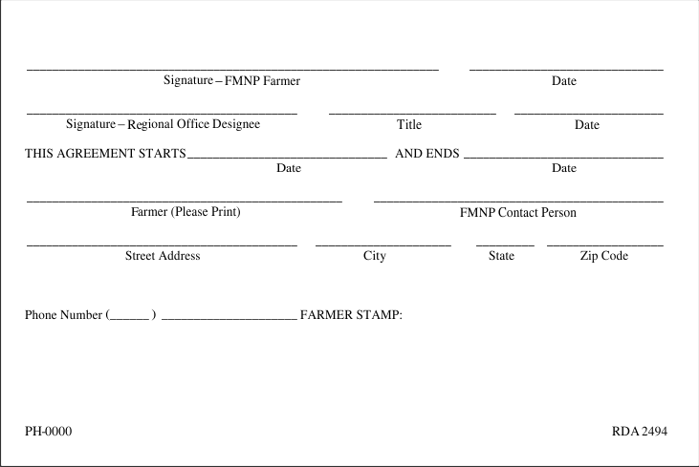
Agreement Signatures
Notes:
The agreement is valid only if signed and dated by both the farmer and the Tennessee Department of Health Regional Office Designee.
After the validation of the agreement, the Regional Office Designee will stamp the farmer’s identification number on the agreement.

Slide 68
Sanctions:
Sanction Procedures for violations of the FMNP Agreement are required by federal regulations.
Actions of a farmer which are violations of the procedures of the FMNP are divided into Class I and Class II violations.
Notes:
Sanction Procedures for violations of the Agreement are required by federal regulations. Actions of a farmer which are violations of the procedures of the FMNP are divided into Class I and Class II violations. The Tennessee FMNP may issue sanctions for the following:

Slide 69
Class I Violations:
Will result in a documented warning from the Tennessee FMNP to the farmer and will be included in the FMNP file for that farmer.
A second occurrence of a Class I violation during a season will be considered a Class II violation.
Notes:
Class I violations will result in a documented warning from the Tennessee FMNP to the farmer and will be included in the FMNP ‘s file for that farmer. A second occurrence of a Class I violation during a season will be considered a Class II violation.

Slide 70
Class I Violations:
Accepting FMNP vouchers outside of the valid dates;
Failing to complete FMNP vouchers at the time of the transaction;
Failing to display the Tennessee FMNP poster or have the current FMNP Food List available;
Failing to train and inform employees/ helpers of obligations to the FMNP Program;
Notes:
Class I Violations include:
Accepting FMNP vouchers outside of the valid dates;
failing to complete FMNP vouchers at the time of the transaction;
failing to display the Tennessee FMNP poster or have the current FMNP Food List available or
failing to train and inform employees and or helpers of obligations to the FMNP Program;

Slide 71
Class I Violations:
Failing to be accountable for the actions of employees/helpers;
Failing to offer FMNP participants the same courtesies offered other customers including FMNP approved foods of the same or higher quality as that offered other customers;
Notes:
Class I Violations also include:
failing to be accountable for the actions of employees or helpers or
failing to offer FMNP participants the same courtesies offered other customers including FMNP approved foods of the same or higher quality as that offered other customers;

Slide 72
Class I Violations:
Failing to acknowledge and comply with USDA nondiscrimination provisions that standards for participation in FMNP are the same for everyone regardless of race, color, national origin, sex, age, or disability; or
Failing to allow a FMNP representative to conduct an unannounced on-site monitoring visit.
Notes:
Class I Violations include:
Failing to acknowledge and comply with USDA nondiscrimination provisions that standards for participation in the Farmers Market Nutrition Program are the same for everyone or
failing to allow a FMNP representative to conduct an unannounced on-site monitoring visit.

Slide 73
Class II Violations:
Class II violations by a farmer shall result in disqualification from the Tennessee FMNP for the remainder of the market season.
Notes:
Class II violations by a farmer shall result in disqualification from the Tennessee FMNP for the remainder of the market season.

Slide 74
Class II Violations include:
Failing to provide information requested for reporting to the USDA;
Providing false information on farmers application.
Failing to provide only FMNP approved foods in exchange for FMNP vouchers at the farmer’s market location;
Notes:
Class II Violations include:
failing to provide information requested for reporting to the USDA;
providing false information on farmers application.
failing to provide only FMNP approved foods in exchange for FMNP vouchers at the farmer’s market location;

Slide 75
Class II Violations include:
Failing to charge FMNP participants the same or lower prices for FMNP approved foods as that charged to other customers;
Issuing cash change for purchases that are in an amount less than the value of the FMNP voucher;
Charging sales tax for FMNP approved foods;
Notes:
failing to charge FMNP participants the same or lower prices for FMNP approved foods as that charged to other customers;
issuing cash change for purchases that are in an amount less than the value of the FMNP voucher;
charging sales tax for FMNP approved foods;

Slide 76
Class II violations include:
Attempting to seek reimbursement from FMNP participants for FMNP vouchers not paid by FMNP.
Failing to return a State of Tennessee FMNP Stamp to the FMNP agency.
Notes:
attempting to seek reimbursement from FMNP participants for FMNP vouchers not paid by FMNP or
failing to return a State of Tennessee FMNP Stamp to the FMNP agency

Slide 77
Disqualifications:
A disqualification may be invoked under the following circumstances:
The second occurrence of any Class I violation during the current market season.
The first occurrence of any Class II violation during the current market season.
Notes:
Disqualifications:
A disqualification may be invoked under the following circumstances:
The second occurrence of any Class I violation during the current market season or
The first occurrence of any Class II violation during the current market season.

Slide 78
Disqualifications:
A second Class II violation within the same market season and/or the following market season will result in disqualification from the Tennessee FMNP for up to 3 years.
In the event that a farmer who is disqualified redeems FMNP vouchers, the farmer must pay the state agency for the total amount of the transactions in violation.
Notes:
A second Class II violation within the same market season and/or the following market season will result in disqualification from the Tennessee FMNP for up to 3 years. The FMNP Stamp and poster(s) shall be surrendered to an FMNP representative during the period of disqualification. In the event that a farmer who is disqualified redeems FMNP vouchers, the farmer must pay the state agency for the total amount of the transactions in violation.

Slide 79
Prosecution
FMNP farmers may be subject to penalties in the case of deliberate fraud. According to federal regulations, whoever receives, conceals or retains such funds, assets or property for his or her own interest, knowing such funds, assets or property have been embezzled, willfully misapplied, stolen, or obtained by fraud shall, if such funds, assets or property are of the value of $100 or more, be fined not more than $10,000 or imprisoned not more than five years, or both, or if such funds, assets or property are of a value of less than $100, shall be fined not more than $1,000.
Notes:
Prosecution
FMNP farmers may be subject to penalties in the case of deliberate fraud. According to federal regulations, whoever receives, conceals or retains such funds, assets or property for his or her own interest, knowing such funds, assets or property have been embezzled, willfully misapplied, stolen, or obtained by fraud shall, if such funds, assets or property are of the value of $100 or more, be fined not more than $10,000 or imprisoned not more than five years, or both, or if such funds, assets or property are of a value of less than $100, shall be fined not more than $1,000.

Slide 80
Termination
In addition to the above sanction actions, the FMNP may terminate the farmer’s FMNP Agreement due to negligence, fraud, abuse, violation of the agreement, or for any other reason.
The notification will describe the farmer’s opportunity to appeal.
Notes:
Termination
In addition to the above sanction actions, the FMNP may terminate the farmer’s FMNP Agreement due to negligence, fraud, abuse, violation of the agreement, or for any other reason. The FMNP shall provide the farmer with fifteen (15) calendar days prior notice of such action. This notification will be made by certified mail, return receipt requested, or by hand delivery. The notification will also outline the farmer’s opportunity to appeal the action and to request a hearing within 30 days of the date of the notification letter.

Slide 81
Appeals
Farmers may request a hearing to appeal any adverse action taken against them except for the FMNP’s decision not to renew the farmer’s FMNP Agreement.
Notes:
Appeals
Farmers may request a hearing to appeal any adverse action taken against them except for the Program’s decision not to renew the farmer’s FMNP Agreement.

Slide 82
Sanction Action
The FMNP shall provide fifteen (15) calendar days prior notice of a sanction action being taken against a farmer. The sanction notice shall contain:
the violation(s) used for the decision,
the procedure to file for an administrative review,
the effective date of the sanction(s),
the time period allowed to appeal, and
any other pertinent information.
Notes:
The FMNP shall provide fifteen (15) calendar days prior notice of a sanction action being taken against a farmer. The sanction notice shall contain:
the violation(s) used for the decision,
the procedure to file for an administrative review,
the effective date of the sanction(s),
the time period allowed to appeal, and
any other pertinent information.

Slide 83
Request for Hearing
Shall be received within thirty (30) calendar days from the date of the sanction notice.
The appeal letter shall be sent to:
FMNP/SFMNP Coordinator,
Family Health & Wellness,
Tennessee Department of Health,
Andrew Johnson Tower
710 James Robertson Parkway
Nashville, TN 37243
Notes:
The farmer’s request for an administrative hearing in order to appeal the actions of the FMNP shall be received within thirty (30) calendar days from the date of the sanction notice. The appeal letter shall be sent to the address show.

Slide 84
What to do next:
Download application.
Send to nearest vendor representative
Notes:
Thank you for joining us this morning. If you would like to apply to be a 2018 authorized farmer, download an application. Complete it and send it to by fax or mail to the nearest vendor representative.

Slide 85
FMNP Partners:
Commodity Supplemental Food Program
Fruits & Veggies – More Matters®
Local Departments of Aging
TN Department of Agriculture
University of TN Agricultural Extension Service
Welch’s Cost Relief Grant
St. Thomas Community Health & Benefit
Notes:
We appreciate the support of our many partners in this program.
Commodity Supplemental Food Program
Fruits & Veggies – More Matters®
Local Departments of Aging
TN Dept of Agriculture
University of TN Agricultural Extension Service
Welch’s Cost Relief Grant
St. Thomas Community Health & Benefit

Slide 86
For additional information:
Kelly Soliman Family Health and Wellness Tennessee Dept. of Health
Andrew Johnson Tower 710 James Robertson Parkway Nashville, TN 37243 Tele:(615) 532-8173 FAX: (615) 532-7189 kelly.soliman@TN.gov

Slide 87
Notes:
Now is the time for any questions or concerns you may have.

