Slide 2
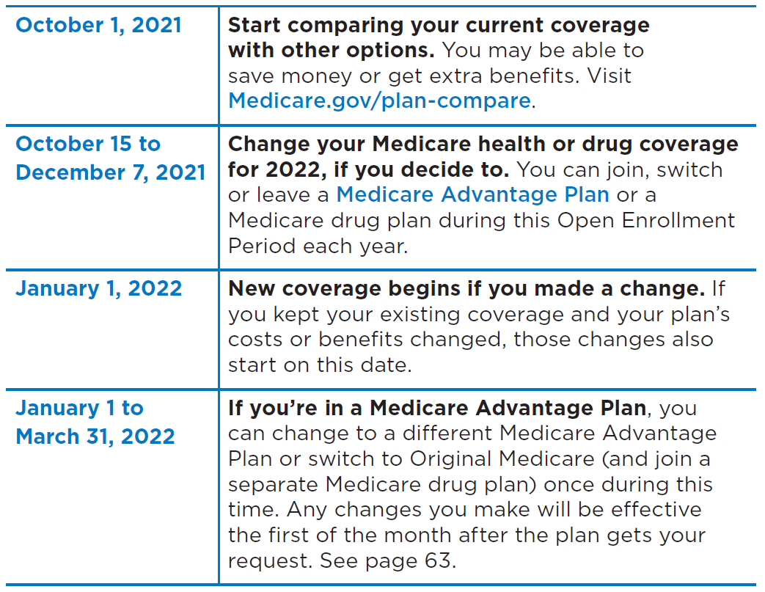
Yearly Open Enrollment (OEP) for People with Medicare

Slide 3
Comparing Plans
Each year
Medicare plans can change costs and coverage
Plans mail or provide electronically
Annual Notice of Change (ANOC) explains changes from last years’ coverage, (electronically—if enrollee has opted into receiving electronic version)
Explanation of Coverage (EOC) explains coverage and costs for following year’s coverage
Some plans may choose to leave Medicare

Slide 4
Things to Consider
Cost
Coverage
Supplemental coverage
Prescription drugs
Doctor and hospital choice
Quality of care
Travel

Slide 5
With Other Coverage
IMPORTANT
If the Medicare beneficiaries have other coverage, like from an employer or union
They need to check with their plan’s benefits administrator before making any changes to their coverage
Otherwise, they could lose coverage for them and their dependents

Slide 6
Open Enrollment Goals
Encourage people with Medicare to review and compare Medicare health and drug plans
Emphasize the October 15 – December 7 dates
Promote the Medicare Plan Finder tool that makes it easy to compare coverage options and shop for Medicare health and drug plans
Highlight that Medicare Savings Programs are available for people who may be having trouble paying for their Medicare costs
Target audiences with traditionally lower access to health care

Slide 7
Key Media Messages
Open Enrollment is the time to review your current health and drug plans and make changes if you want
Even if you’re happy with your current coverage, you might find a better fit for your budget or health needs – you might be able to save money
Plans can change their offerings every year, and so can your health or finances so review to make sure your plan still works for you
If you are having trouble paying for healthcare costs, Medicare Savings Programs may help you pay Medicare premiums and other costs

Slide 8
Research, Compare, and Choose
2022 “Medicare & You” Handbook
Plan’s Annual Notice of Change (ANOC) and/or Evidence of Coverage (EOC)
1-800-MEDICARE (1-800-633-4227); TTY: 1-877-486-2048
State Health Insurance Assistance Program (SHIP)-TN
1-877-801-0044 TTY 1-800-848-0299
Medicare.gov/plan-compare
Plans’ websites

Slide 9
Beware of Marketing Fraud
Watch out for people who:
Pressure you to join their plan
Say they represent Medicare or give you a service for free
Call your home without permission
Say that you’ll lose your Medicare benefits if you don’t sign up for their plan
Require you to provide contact information at a plan event

Slide 10
Marketplace Open Enrollment

Slide 11
American Rescue Plan (ARP)—Marketplace Provisions
Improve affordability by expanding premium assistance for consumers
Reduce the % of household income you’re expected to contribute to your monthly premium for a benchmark plan
Removed 400% premium tax credit (PTC) cap for consumers with household income above 400% of the federal poverty level (FPL)
Suspends the requirement that taxpayers repay the excess PTC for 2020
Application of PTC in case of individuals receiving unemployment compensation during 2021

Slide 12
2021 Expanded Premium Tax Credit
Over 90% of consumers who enrolled during the SEP saw their premiums reduced due to these tax credits.
Existing consumers saved an average of $67 per consumer, per month, in premium savings.
48% of new HealthCare.gov consumers received a monthly premium of $10 or less after tax credits.
The median deductible for new HealthCare.gov consumers fell by over 90%.

Slide 13
Marketplace Open Enrollment Period
Nov. 1, 2021 – Jan. 15, 2022
Extends enrollment by 30 days
Monthly SEP for lower-income consumers
www.healthcare.gov
Marketplace: 1-800-318-2596
Find local help from assisters: https://localhelp.healthcare.gov

Slide 14
Marketplace Assisters and Partners
Assisters
Navigators
Family and Children’s Service
Aida Whitfield-Healthcare Access Manager – Affordable Care Act
Office: (615) 320-0591 Ext. 242 Cell: (615) 300-7378 Email: aida.whitfield@fcsnashville.org
Structured Employment Economic Development Corp (SEEDCO)
Marla Smith-Brown ■ Senior Director
Office: 901-405-7906 Email: mbrown@seedco.org
Certified Application Counselor Designated Organization (CDO)
https://marketplace.cms.gov/certified-application-counselor-designated-organization-cdo-program-information
Agents/ Brokers
Partners
Champions for Coverage
To apply: https://marketplace.cms.gov/technical-assistance-resources/assister-programs/champion-apply
For questions: Please email us at champion@cms.hhs.gov

Slide 15
Immunization Campaign

Slide 16
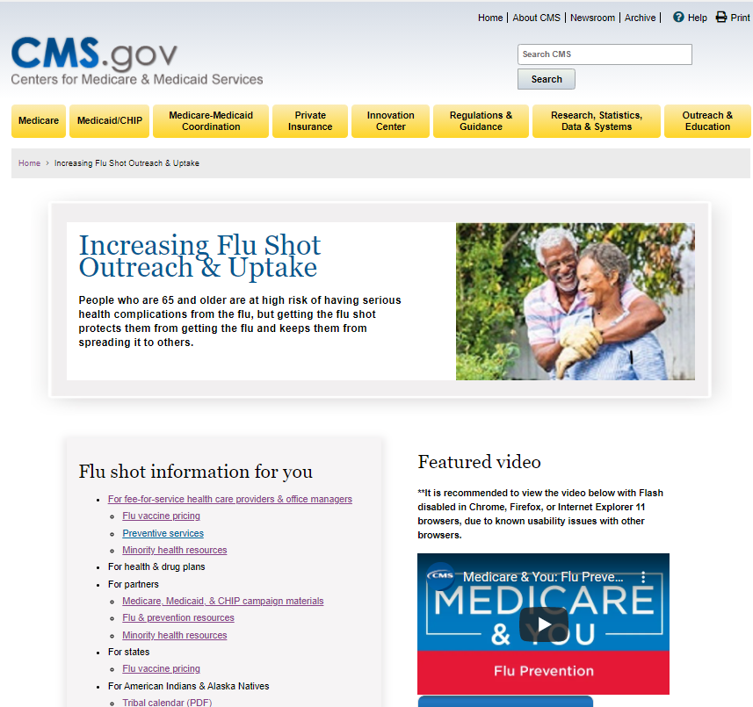
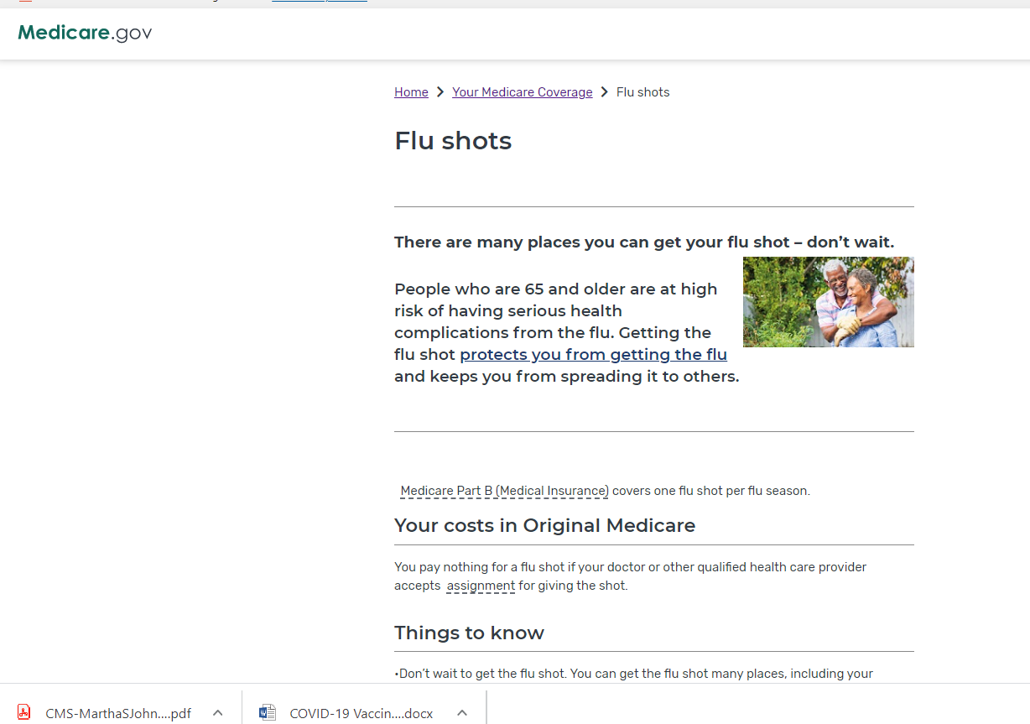
CMS Resources
medicare.gov/medicare-coronavirus
cms.gov/flu

Slide 17
Can I get COVID and flu vaccinations at the same time?
From CDC.gov: You can get a COVID-19 vaccine and other vaccines, including a flu vaccine, at the same visit. You no longer need to wait 14 days between vaccinations. Experience with other vaccines has shown that the way our bodies develop protection, known as an immune response, and possible side effects after getting vaccinated are generally the same when given alone or with other vaccines.

Slide 19
Questions and Discussion
Questions or Comments?

Slide 20
CMS Contacts
Kim Bucklen Teresa Zayas
404-562-7158 404-562-7220
kim.bucklen@cms.hhs.gov teresa.zayas@cms.hhs.gov

