Slide 1
Infection Prevention, Antibiotic Stewardship & Virtual Rapid Response Teleconsultation
Maury Regional Healthcare CMP Grant Project

Slide 2
Goals of the IPASRR Initiative
Infection Prevention
Antibiotic Stewardship
Virtual Rapid Response Teleconsultation
(VRRT)
Early Care & Treatment for Resident/Patient
Treat In Place
Improved outcomes
Reduce Hospital Readmissions

Slide 3
Building a Healthcare Team
Skilled Nursing Facilities
Hospital
Review current practices revising if needed
Education on best practice guidelines for Infection Prevention, Antibiotic Stewardship and Sepsis
Training on VRRT process and telehealth equipment
Regional Antibiogram developed by the Infectious Disease PharmD provided to SNF PCP’s.
Best practice standard operating procedures (SOP) developed using Antibiograms, and current best practice standards of hospital rapid response team protocols.
Development and training of Virtual Rapid Responders

Slide 4
Phase 1 Education
Aug ‘19- Feb. ‘20

Slide 5
VRRT Education

Slide 6
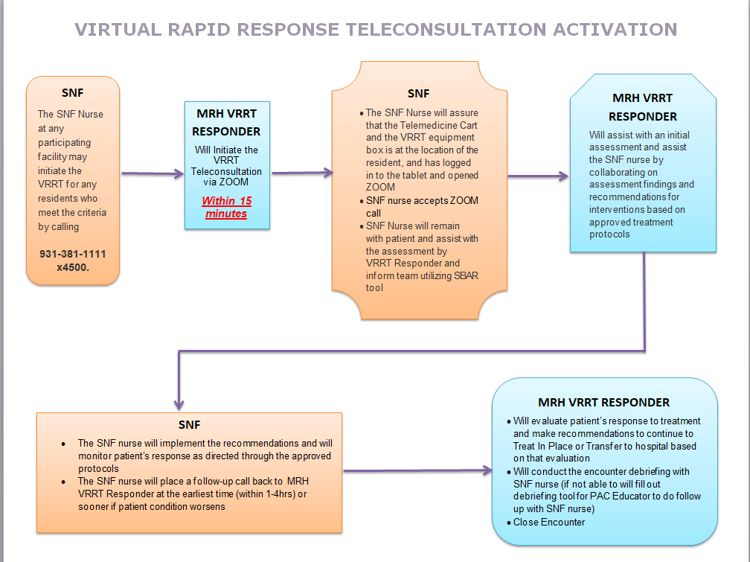
Virtual Rapid Response Teleconsultation Activation Protocol
Notes:
This is the Protocol for VRRT initiation

Slide 7
VRRT Follow-Up
SNF nurse and VRRT responder follow-up within 1-4 hours to evaluate patients response to interventions
PAC Education Coordinator reviews all diagnostics and follow up with SNF nurse within 24 hours and as needed
Consult to Infectious Disease PharmD on all encounters involving infectious processes within 24 hours and as needed
SNF provider notified of encounter per center’s protocol

Slide 8
VRRT Encounter Types
Sep’20 – Sep 21

Slide 9
VRRT Dispositions
Sep’20 – Sep 21

Slide 10
Antibiotic Treatment Received
Sep’20 – Sep 21

Slide 11
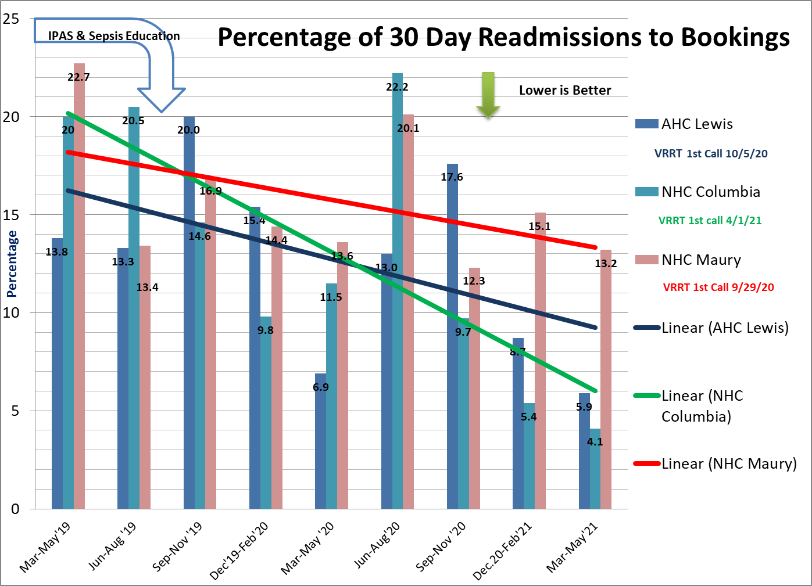
IPASRR Outcomes (SNF’s with VRRT Capabilities)
Mar ‘19-May ‘21

Slide 12
VRRT Encounters to Missed Opportunities Sep. 2020 through Sep. 2021

Slide 13
Goals
Next site training now (October 2021)
Plans to train 3 sites in November & December
Continue offering MOCK VRRT training to all SNF’s
All 11 SNF’s actively using the VRRT program by March 1st, 2022

Slide 14
Questions?
Theresa Harris, RN, MSN, CCRN-K, ACCNS-AG
Post Acute Care Education Coordinator
Maury Regional Healthcare
tharris@mauryregional.com

