Slide 1

Competitive Schedule | May 15, 2026

Slide 2
Today's Agenda
1 |
Intro & Purpose
2 |
Announcement of Release
3 |
Competitives Overview
4 |
Application Preparation and Tips

Slide 3
Stevens Amendment Disclaimer
This project is supported by the Centers for Medicare & Medicaid Services (CMS) of the U.S. Department of Health and Human Services (HHS) as part of a financial assistance award totaling $206,888,882.11 with 100 percent funded by CMS/HHS. The contents are those of the author(s) and do not necessarily represent the official views of, nor an endorsement, by CMS/HHS, or the U.S. Government.

Slide 4
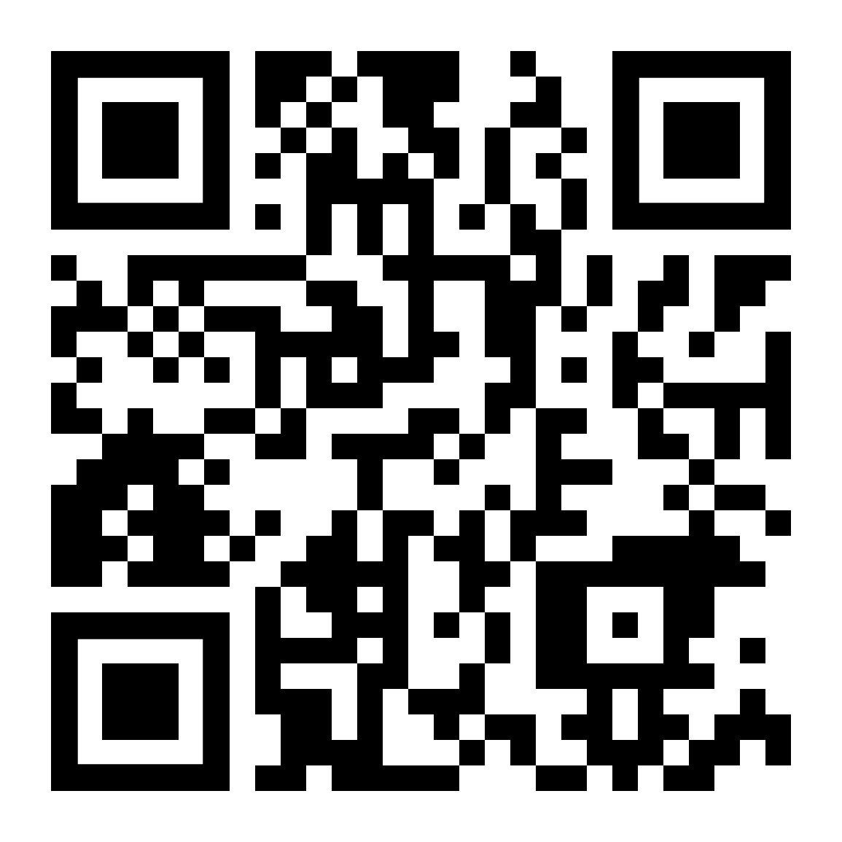
Housekeeping
This Webinar is being recorded
Slides and Recording will be shared following the webinar
  FAQs, application materials, and additional information can be found here: www.tn.gov/health/rural

Slide 5
Webinar Purpose
This webinar will provide an overview of upcoming competitive opportunities for Tennessee’s Rural Health Transformation Program (RHTP), and offer guidance and resources to help organizations and communities engage with these opportunities.

Slide 6
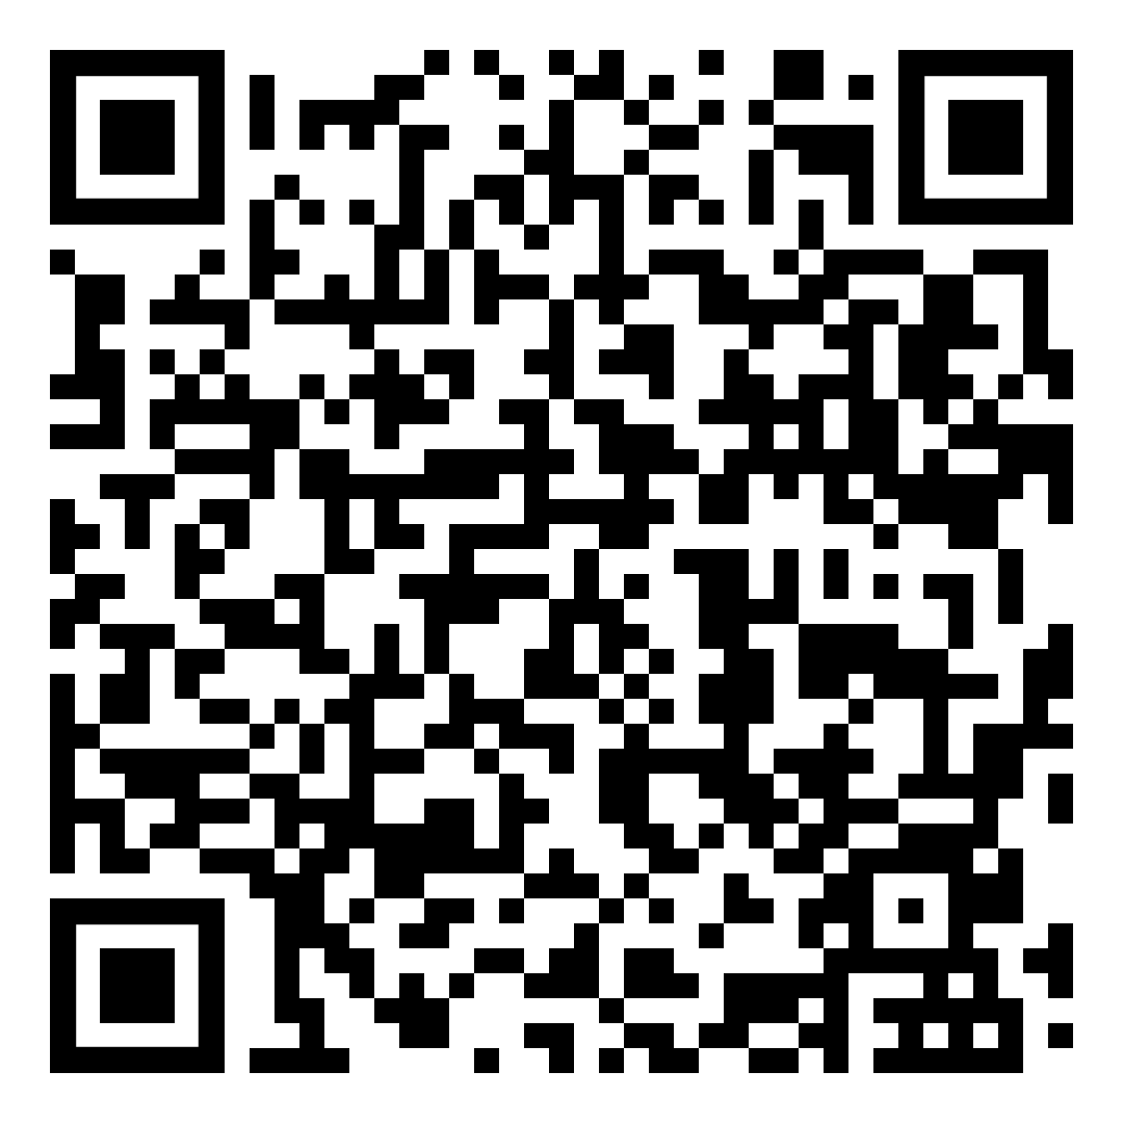
Prior RHTP Webinars
Webinar #1: Community Kickoff – March 31, 2026
  RHTP Overview
  Review of Large Grants (HRP)
  Review of eligible expenses, application process, etc
Webinar #2: FAQs and Additional Opportunities– April 15, 2026
  Review of Additional Opportunities
  FAQs

Slide 7
Tennessee Is Announcing a Schedule of Competitive Opportunities for RHTP
This includes the schedule for 8 RFAs and 6 RFP opportunities which will take place between now and October 30, 2026
Additional info available at www.tn.gov/health/rural
Additional opportunities may be made available
Dates are subject to change

Slide 8
Schedule Notes
CMS Requires that all RHTP funds for BP1 must be obligated by October 30, 2026
Our timeline is condensed
Your timeline is condensed
We want to give as much advance notice as possible

Slide 9
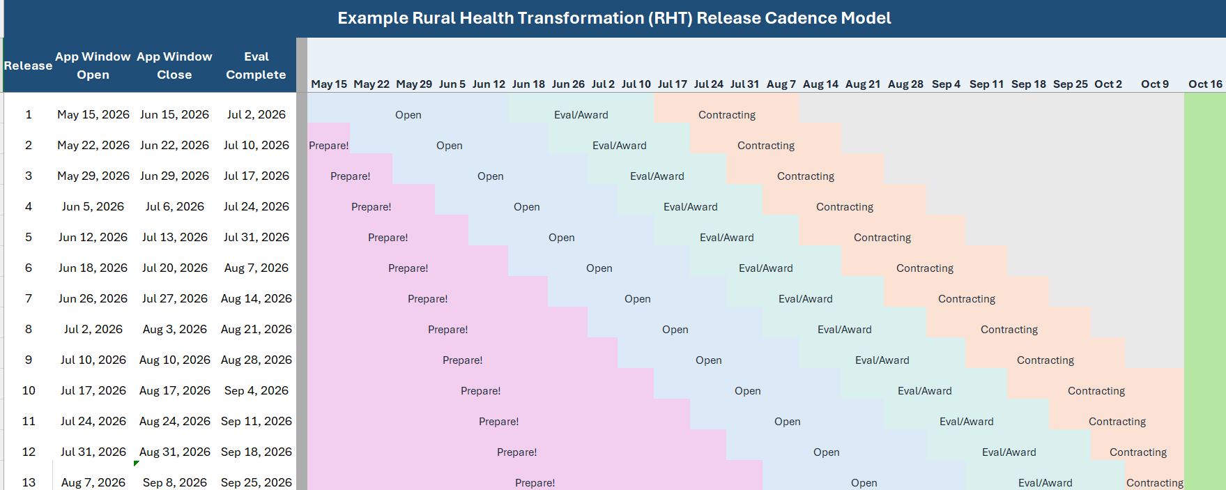
RHTP Draft RFA Schedule (Example)
DRAFT
*Schedule is draft, and subject to change

Slide 10
Schedule for Specific RFA’s
Perinatal and Pediatric Behavioral Health Teleconsultation and Education Project
May 15, 2026 – June 15, 2026
Healthy Active Rural TN (HART) (Active Living)
May 22, 2026 – June 22, 2026
HRP: Maternal Child Health
May 29, 2026 – June 29, 2026
End Zone for Chronic Disease Prevention (Nutrition Security)
June 5, 2026 – July 6, 2026
HRP: Service Line Expansion and Co-Location
June 12, 2026 – July 13, 2026
Memory Care Assessment Network (MCAN)
June 18, 2026 – July 20, 2026
HRP: Health Tech Innovation
June 26, 2026 – July 27, 2026
HRP: Make Rural Tennessee Healthy Again (MaRTHA)
July 3, 2026 – August 3, 2026
*Schedule is draft, and subject to change

Slide 11
RFP Proposed Schedule
RHTP RFP Opportunity
Statewide eConsult Platform
CHANT Call Center
HRP: Rural Non-Emergency Transportation
Mobile App for Pregnancy and Post-Partum
Rural Health Innovation Catalyst
Expanded CHANT
Release:
Early July
Response Deadline:
Late August
Notice of Intent to Award:
October
*Schedule is draft, and subject to change

Slide 12
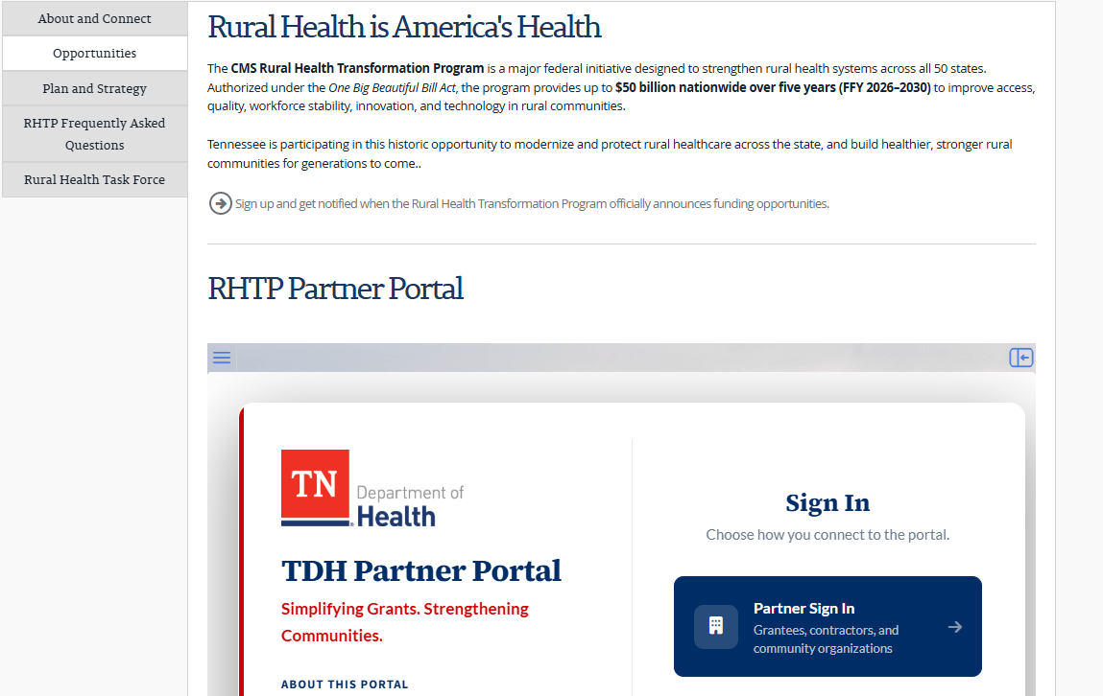
Where Will Opportunities Be Posted?
tn.gov/health/rural
Sign Up for Alerts!

Slide 13
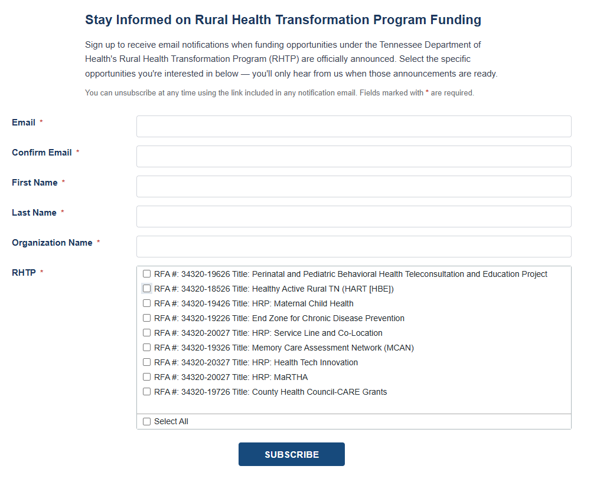
RHTP Notifications

Slide 14
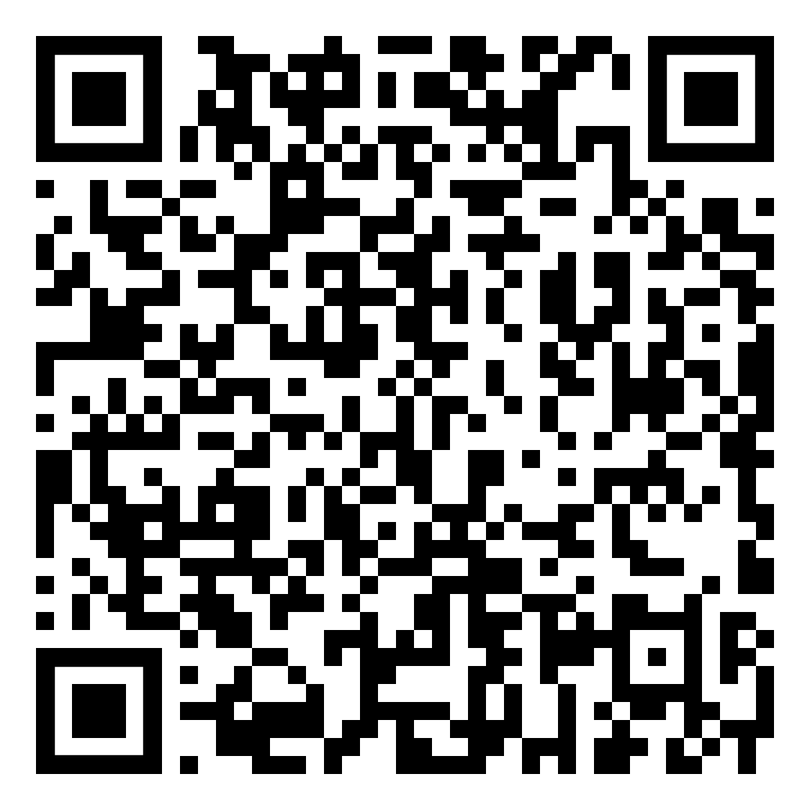
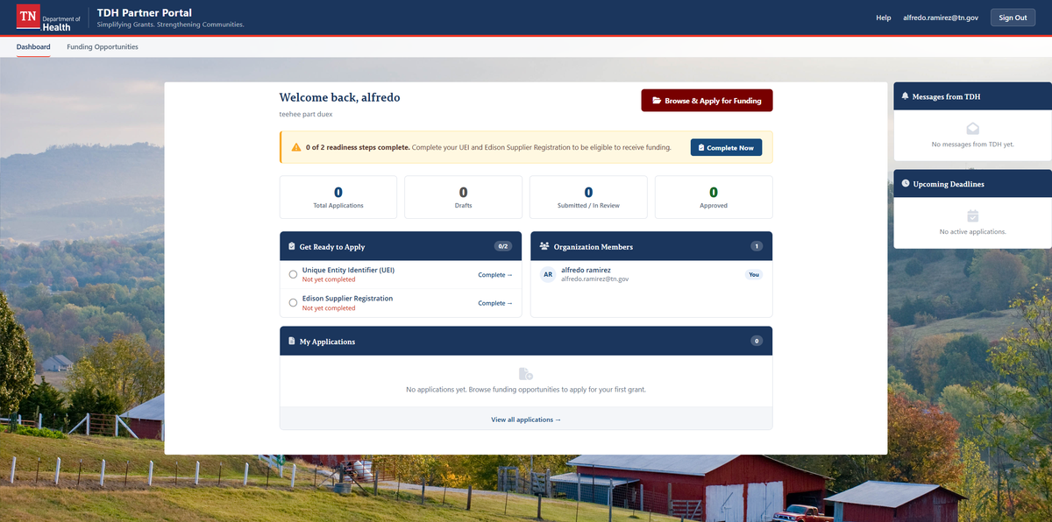




Simplifying Grants.
Strengthening Communities.
The TDH Partner Portal is the department’s centralized, secure platform for managing the full grant lifecycle — from discovering funding to submitting applications and tracking awards.
Browse Open Funding
Apply Online
Discover RFAs posted by TDH programs
Submit complete applications digitally
Direct Messaging
Track Your Awards
Communicate with TDH staff in one place
Monitor status, deadlines, and reports

Slide 15
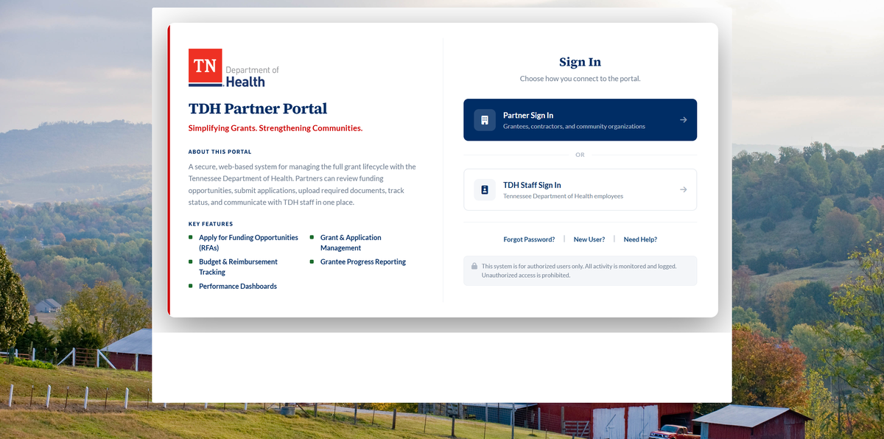
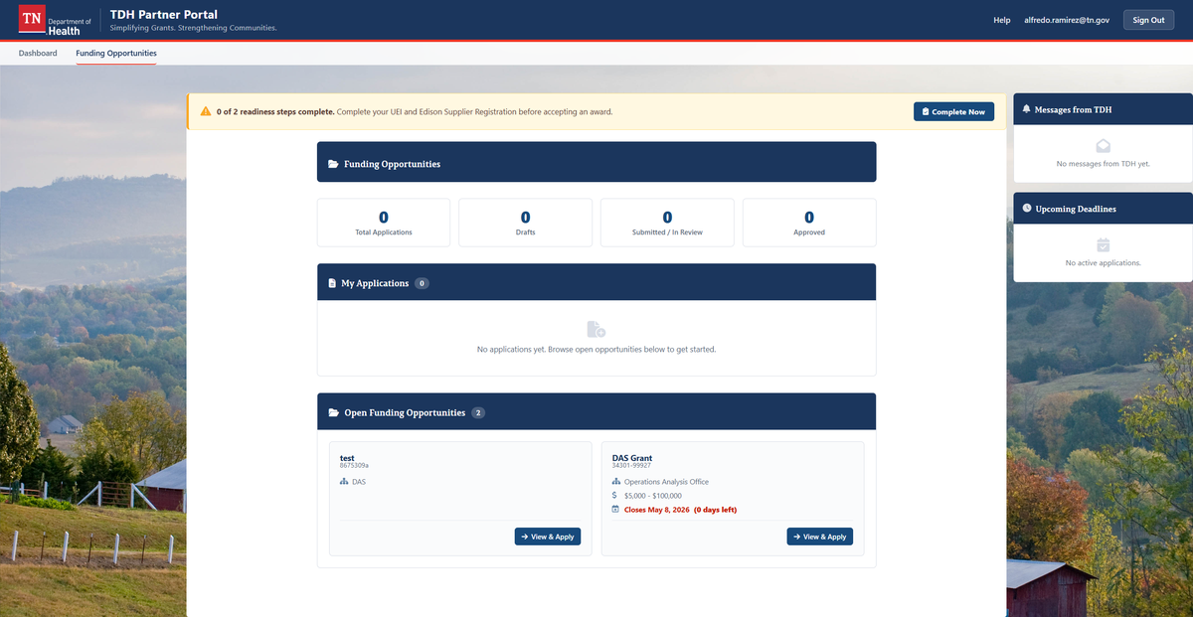
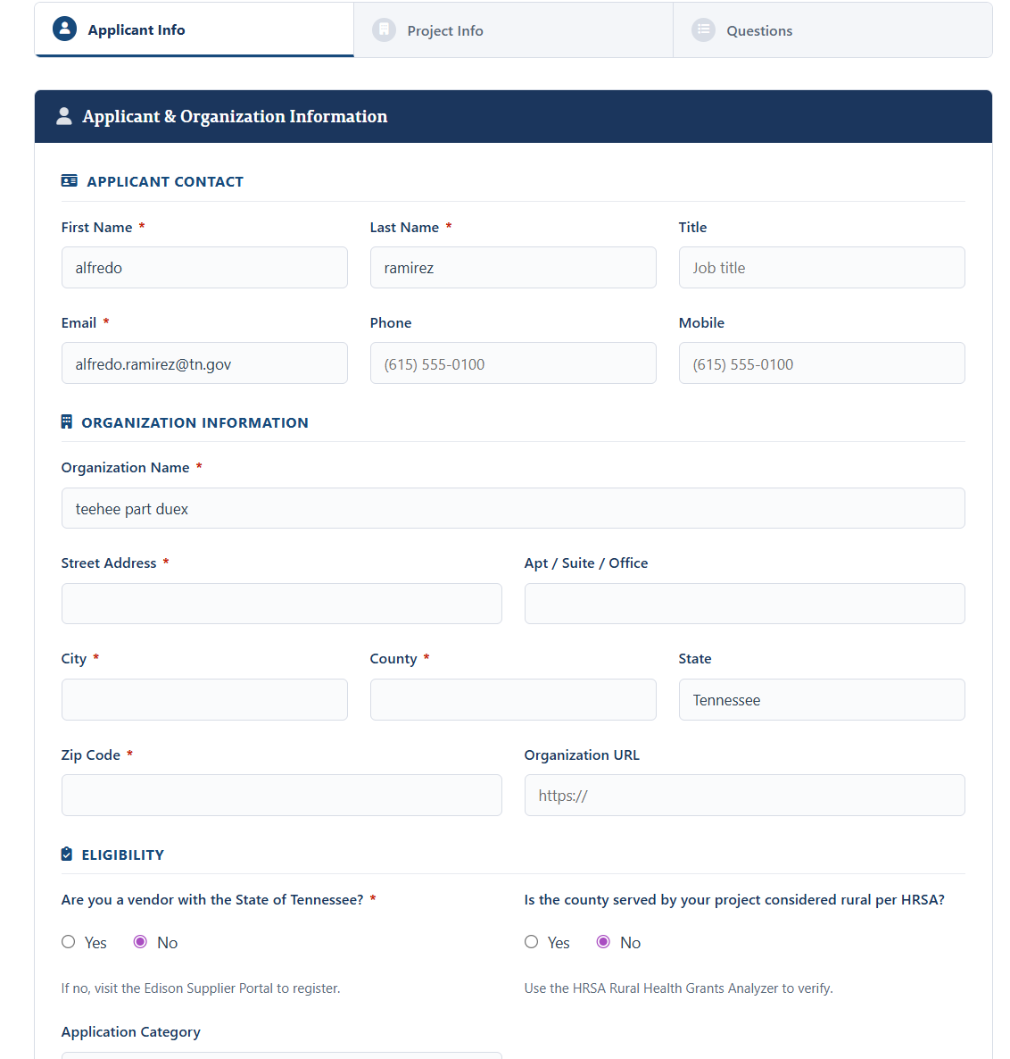
How It Works
Getting grant funding through TDH takes just four steps
1
2
3
4
Register
Explore Funding
Apply
Track & Manage
Create your account and set up your organization profile
Browse open RFAs and funding opportunities from TDH
Complete and submit your application with all required documents
Monitor award status, messages, and post-award reporting

Slide 16

Dashboard (home)

Slide 17
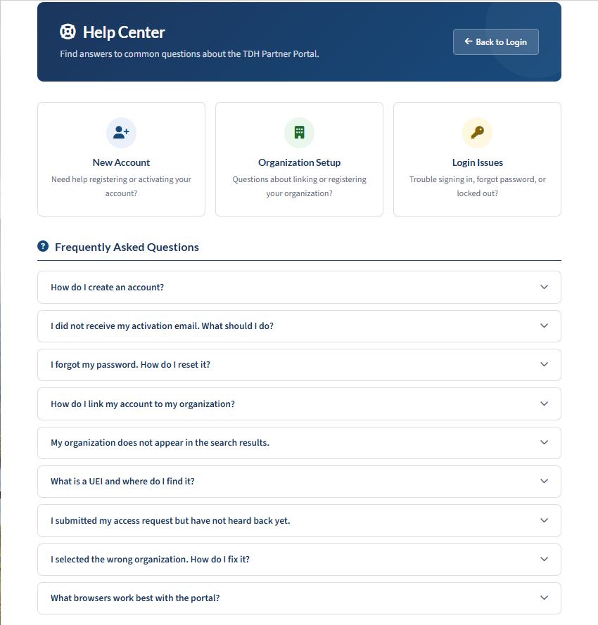
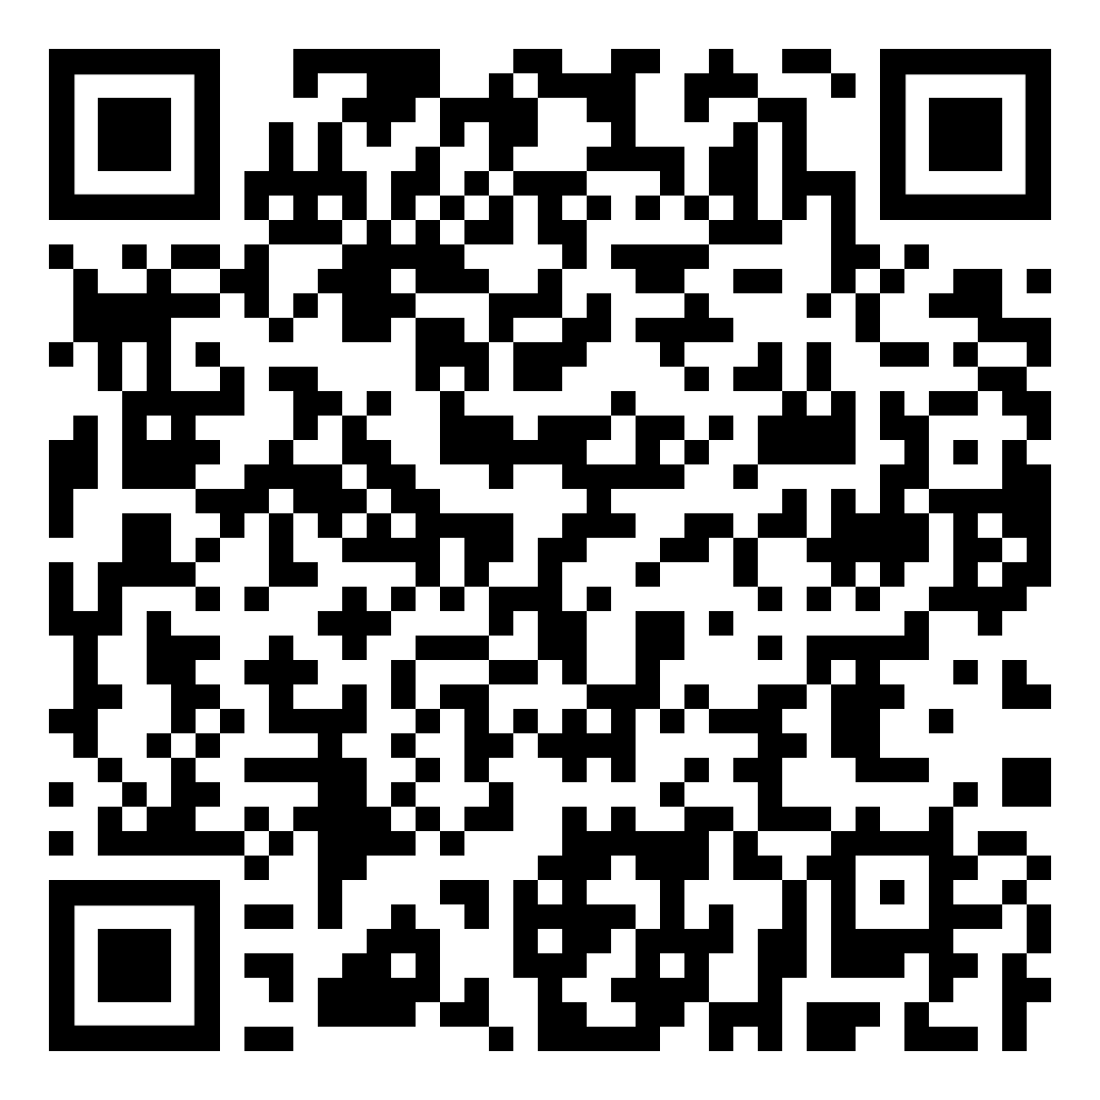
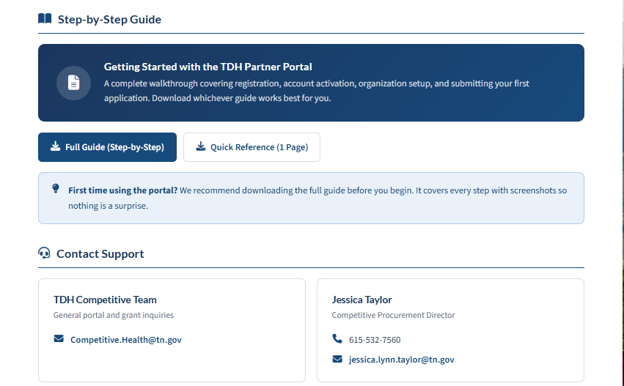
Help Center

Slide 18
Grant Basics
Most grants will be five year agreements
Awards and Contracting Process: Must be obligated by Fri. October 30, 2026
Reimbursement-based grants
HPR applications will be scored out of 100 points;
  35 points: Community Need
  35 points: Project Quality
  10 points: Sustainability
  10 points: Evaluation plan
  10 points: Budget

Slide 19
Application Required Items
Project Summary
Project Narrative
  Community need and target rural population
  Proposed project goals and strategies, workplan, and description of how project is aligned with TN priorities
  Proposed plan for engaging communities, cross-sector partners, and local health departments and health councils
Evaluation Plan
Sustainability Plan
Budget Narrative
Application Checklist

Slide 20
Notes on Compliance
Administrative costs are capped at 10%
Document everything
Do not begin spending until contract is completed and signed
State reports to CMS and provide monitoring of budgets and program activities on a quarterly and annual basis
    Includes narrative progress reports, workplan updates, use of funds, success stories, sustainability plan progress, and supporting evidence
    Annual detail is expected within project budgets
Funding for budget periods 2-5 is contingent on program progress

Slide 21
A Strong Application Will Demonstrate...
Fidelity to the goals and outcomes stated in Tennessee’s RHT Program
How rural populations are served, including those who are low-income or under-served
High levels of engagement with community stakeholders (Health Councils,
patients, cross-sector partnerships)
An ability to meaningfully address community-identified needs
Transformative impact, and sustainability beyond the performance period

Slide 22
Awardees should expect to:
Participate in Tennessee’s Health Information Exchange (if eligible)
Engage with TN Community Compass (if eligible)
Provide annual updates to their local County Health Council
Seek opportunities to connect with existing TN RHT projects
Be provided with support and technical assistance from the TDH team
throughout the process

Slide 23
Steps For You to Take
Go to Partner Portal and Register https://tndeptofhealth.caspio.app/tdh-partner-portal/home
Bookmark www.tn.gov/health/rural and check site regularly for updates
Sign-up for list-serves for the opportunities you are interested in
  You will be notified of future funding opportunities & FAQs
Begin preparing your applications
Consider pre-approvals with Commissions / Boards
For questions specific to competitive opportunities, please direct them to the email address competitive.health@tn.gov

Slide 24
What if I have questions?
Website: www.tn.gov/health/rural
Email: Competitive.Health@tn.gov
LANGAUAGE AOUT HOW THIS IS DRAFT SUBJECT TO CHANGE

Slide 25

Thank you for attending this webinar.
We look forward to working with you to transform rural health in Tennessee!

