Slide 1
Tennessee COVID-19 Vaccination Plan Overview

Slide 2
VPD and Immunizations Program
Vaccines For Children Program
Entitlement program providing vaccines to under/uninsured children <19yo
625 partners vaccinate ~800K TN children
Annual budget $119M
Manages 2M vaccine doses/year
Tennessee Immunization Information System (TennIIS)
Statewide immunization registry
>8.2M patients, >78M vaccinations
Vaccine-Preventable Diseases Program
Investigates and mitigates vaccine-preventable disease outbreaks
Pandemic preparedness
Pandemic Vaccine Allocation and Distribution
COVID-19 vaccine for ~6.8M Tennesseans

Slide 3
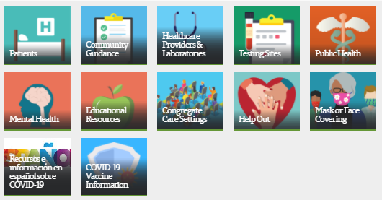
Tennessee COVID-19 Vaccination Plan
www.tn.gov/health
Click here

Slide 4
Pandemic Vaccine Stakeholder Group
TDH Vaccine-Preventable Diseases and Immunization Program
TDH Emergency Preparedness Program
TDH Community Health Services
TDH COVID-19 EP Response
TDH Office of Disparities Elimination
TDH Office of Communications and Media Relations
Metro Health Departments (4 of 6)
TN Pharmacist Association
TN Chapter of the American Academy of Pediatrics
TN Hospital Association
TN Primary Care Association
TN Department of Corrections
TN Sheriffs’ Association
Vanderbilt Center for Biomedical Ethics and Society
TN Higher Education Commission
TN Commission on Aging and Disabilities
TN Home Care Association
TennCare
TEMA
TN Department of Education, Office of Coordinated School Health
TN Medical Association
Tennessee Legislators
Tennessee Office of Refugees
Tennessee Health Care Coalitions
TN Department of Intellectual and Developmental Disabilities
Tennessee Academy of Family Physicians
ImmunizeTN
TN AARP
TN Department of Mental Health and Substance Abuse Services

Slide 5
Vaccine Allocation Phases
Equity is a crosscutting consideration:
In each population group, vaccine access should be prioritized for geographic areas identified through CDC’s Social Vulnerability Index or another more specific index.
2
3
4
1a1
1a2
1b
Inpatient and other high-exposure HCW
Residents and staff of LTCF
First Responders
All other HCW
High-risk comorbidities
Critical infrastructure
School and childcare staff
Mod-risk comorbidities
Congregate care
Corrections
Young adults
Children
Industry
All others
>65 years old
Est. 450K
Est. 100K
Est. 1.2M
Est. 2.55M
Est. 2.0M
Est. 500K
Adapted from https://www.nap.edu/catalog/25917/framework-for-equitable-allocation-of-covid-19-vaccine
Notes:
Put 1a1, 1a2, 1b in red to trigger comment that the nomenclature has changed. We split the federal 1a phase into 1a1 and 1a2 (formerly 1a and 1b) to make 1a more manageable.

Slide 6
Vaccine Safety

Slide 7
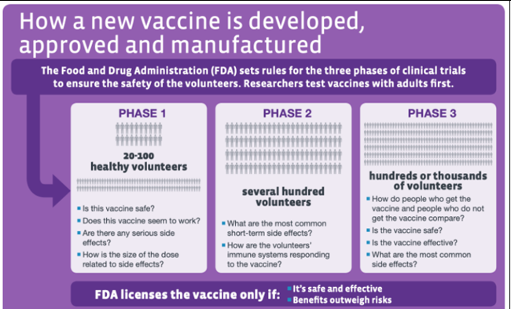
Vaccine Safety
Phase 1-3 Clinical Trials & Manufacturing
FDA Emergency Use Authorization (EUA)
ACIP Recommendations
Continuous Monitoring
Surveillance

Slide 8
Vaccine Safety
V-SAFE Application
Text messaging and web surveys to those receiving vaccine to monitor health after vaccination
Vaccine Adverse Event Reporting System (VAERS)
Passive reporting from people who believe they had an adverse event
Vaccine Safety Datalink (VSD)
Ongoing monitoring and proactive searches of electronic health records from partnering hospitals
Clinical Immunization Safety Assessment (CISA) Project
Conducts research to identify risk factors for adverse events following vaccines, provides clinical consultation, serves as safety resource
National Healthcare Safety Network (NHSN)
Acute and long-term care facility monitoring system with reporting to VAERS

Slide 9
Vaccines in Progress
Pfizer/BioNTech (mRNA)
21 days between doses
Ultra-cold storage, -70ºC
Moderna (mRNA)
28 days between doses
Frozen storage, -20ºC
Astra Zeneca/University of Oxford (replication defective vector)
28 days between doses
Chimpanzee adenovirus vector causes production of spike protein
Refrigerated
Jansen/Johnson & Johnson (replication defective vector)
Single dose (but now has a 2-dose, 57-day study, as well)
Adenovirus vector
Frozen storage, -20ºC
Novavax (adjuvanted protein subunit vaccine)
21 days between doses
Insect baculovirus infects moth cells
Refrigerated
Sanofi and GlaxoSmithKline (adjuvanted protein subunit vaccine)
Insect baculovirus
Similar to FluBlok vaccine

Slide 10
2020 Vaccines
Pfizer/BioNTech (mRNA vaccine)
95% effective in preventing COVID-19 7d after dose 2
Tested in >40,000
No sig adverse events
Anticipating 56,550 doses ~December 18
58 boxes of 975 doses
Shipped directly from Pfizer to vaccinating facilities
Ultra-cold storage, -70ºC
Maintained in shipper up to 14d with dry ice recharge x 3
Ancillary kits include needles, syringes, PPE, saline diluent, alcohol swabs, patient cards (no gloves)
21 days between doses
Allocated to 27 hospitals with >1,400 Phase 1a population
Manually allocated to minimize wastage
Use: vaccinate hospital workers

Slide 11
2020 Vaccines
Moderna (mRNA vaccine)
94.5% effective in preventing COVID-19 7d after dose 2
Tested in >30,000
Anticipating ~100,000 doses ~December 22
~1,000 boxes of 100 doses
Shipped from McKesson warehouse
Frozen storage, -20ºC
Ancillary kits include needles, syringes, PPE, alcohol swabs, patient cards (no gloves)
28 days between doses
Allocated to approved facilities based on formula:
5% retained by the State
100 doses allocated to each county health department location (~10%)
85% allocated across 95 counties based upon county population and distributed across approved facilities
Use: Vaccinate first responders, LTCF staff and others through health depts, PODs, strike teams, and pharmacies

Slide 12
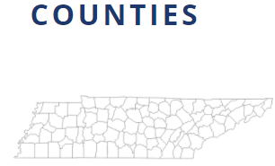
Vaccine Allocation and Distribution
2
CDC places order with Pfizer and Pfizer ships directly to facilities
3
4
CDC places Moderna order with McKesson
McKesson distributes directly to facilities
Allocates based on population
Distributes vaccine and supplies
Allocates to counties based on predetermined criteria
Allocates to facilities
Administers to population based on state recommendations
States order allocated number
of doses for each facility
1

Slide 13
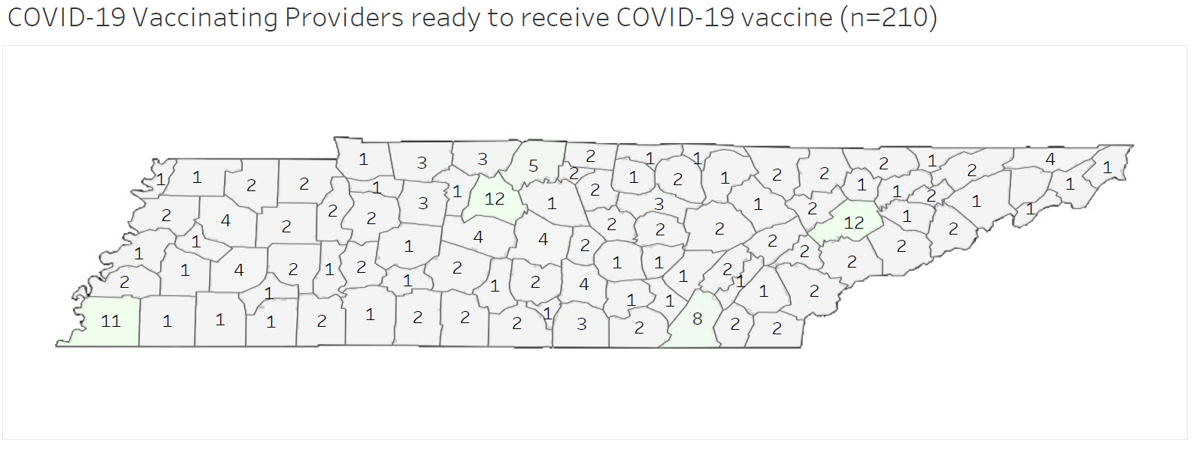
COVID-19 Vaccine Providers
1

Slide 14
Pfizer Allocation ~Dec 18
December 2020
 |  | 1 | 2 | 3 | 4 | 5
6 | 7 | 8 | 9 | 10 | 11 | 12
13 | 14 | 15 | 16 | 17 | 18 | 19
20 | 21 | 22 | 23 | 24 | 25 | 26
27 | 28 | 29 | 30 | 31 | Jan 1 | 2
58 boxes of 975 doses each
11 counties
27 hospitals
FDA
-1
0

Slide 15
Pfizer Vaccine
Day -1
State orders vaccine
Day 0
Vaccine received
Dry ice
Days 1-14
Order accepted
Vaccinate 1a
Day 15-20
Refrigerate
Dry ice days 5 & 10
Vaccinate 1a and others to use supply
Daily reporting
Daily reporting
Vaccine ships from Pfizer to hospital
Ancillary kits
Day 18
State orders second dose
Day 19
Vaccine received
Dry Ice
Days 20-33
Order accepted
Second dose to 1a
Day 34-38
Refrigerate
Dry ice days 24 & 29
Second dose to 1a and others
Daily reporting
Daily reporting
Vaccine Ships from Pfizer to hospital
Ancillary kits

Slide 16
Moderna Vaccine
Day -1
State orders vaccine
Day 0
Vaccine received
Days 1-28
Order accepted
Vaccinate 1a
Daily reporting
Vaccine ships from McKesson to sites
Ancillary kits
Day 26
State orders second dose
Day 27
Vaccine received
Days 28-56
Order accepted
Second dose to 1a
Daily reporting
Vaccine from McKesson to sites
Ancillary kits

Slide 17
Resources
www.tn.gov/health
COVID-19 Vaccine Partners
Register to Become a COVID-19 Pandemic Vaccinating Provider
CDC COVID-19 Vaccination Program Provider Agreement (10/30)
Vaccine Program Provider Agreement FAQs (10/30)
Vaccine Storage and Handling Guidance
Reporting COVID-19 Vaccine Administration data to TennIIS
Provider Resources for COVID-19 Vaccine Conversations with Patients
Mass Vaccination Clinics: Challenges and Best Practices
COVID-19 Vaccination Record Cards
Click here
Vaccine Information
Frequently Asked Questions (12/2)
CDC COVID-19 Vaccine Information
Tennessee COVID-19 Vaccine Allocation and Distribution Plan
Tennessee COVID-19 Vaccination Plan (12/2)
Framework for Equitable Allocation of COVID-19 Vaccine
Click here

Slide 18
Questions? www.tn.gov/health

