Slide 1
COVID-19 Vaccines January 14, 2021
Michelle Fiscus, MD FAAP | Medical Director, Vaccine-Preventable Diseases and Immunization Program

Slide 2
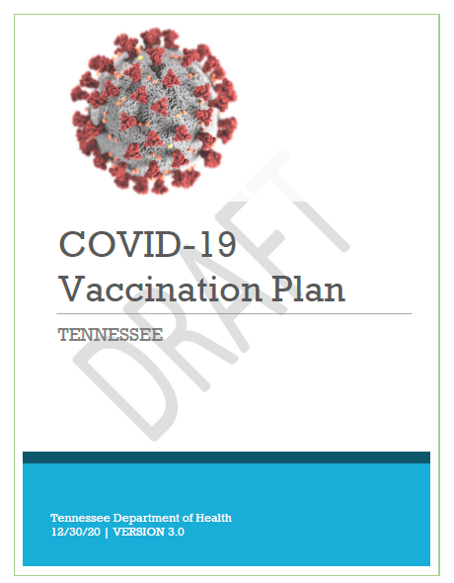
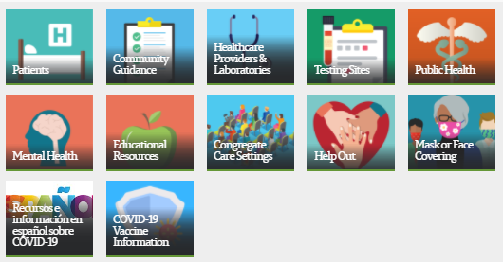
Tennessee COVID-19 Vaccination Plan
www.tn.gov/health
Click here
Notes:
Look for an updated plan to post next Wednesday that will have more details about phased roll-out of vaccines and some additions to risk group phases.

Slide 3
Vaccine Allocation Phases*
Equity is a crosscutting consideration:
In each population group, vaccine access should be prioritized for geographic areas identified through CDC’s Social Vulnerability Index or another more specific index.
*Updated 12.28.2020
Estimated timeline and phases are preliminary and subject to change.
Adapted from https://www.nap.edu/catalog/25917/framework-for-equitable-allocation-of-covid-19-vaccine
Notes:
Still in 1a1, 1a2 and 75+ in all counties. A few counties are in 1b and that was before GBL asked that we vaccinate 75+ and then 70+ before moving to that phase. Those counties will complete 1b while vaccinating 75+ and then 70+ before moving to a new phase. Updated graphic coming next week that will explain the phases more clearly. Corrections officers and jailers have been added to 1a1. We are in the process of defining criteria so that parents of medically fragile children who are not old enough to be vaccinated in 1c can receive vaccine.

Slide 4
Vaccine Allocations and Roll-Out
 | December | January | February | March…
Total Doses Received | 382,650 | 184,850+ | ??? | ???????
Positioning | Hospitals (65%) Health Depts (35%) *Federal LTCF Partnership | Health Depts (67%) Hospitals (32%) Indy LTCF Pharmacies (1%) *Federal LTCF Partnership Indy Pharmacies (0%) | Wal-Mart Pharmacies (High SVI first) Health Depts Safety Net (Low SES first) Hospitals Indy Pharmacies | Federal Pharmacy Program? TBR Partnership? Wal-Mart Pharmacies Safety Net Indy Pharmacies Medical Clinics Health Departments Hospitals
*Federal LTCF partnership allocations are taken off the top of the state allocation
Notes:
Just to give an overview of where we’ve been and where we’re going– early on the focus was on getting vaccines to hospitals so they could protect their HCW. This is largely completed now. Some vaccines went to health depts in Dec and the federal government takes a portion of our state allocation to provide vaccines to Walgreens and CVS for the LTCF partnership. In January we have received about 185K vaccines so far and the shift is to provide more vaccines to health departments. The supply is still extremely limited. A small amount of vaccines are going to small pharmacies that are vaccinating in LTCFs and later this month we will start placing vaccines in some independent pharmacies in select counties where the only place to receive a vaccine is a health department. Going forward we’re not sure what allocations will look like with the change in federal administration. The Biden administration has signaled they will release all vaccines in stockpile to the states, which will allow us to place vaccines in Wal-Mart stores– first in counties with high social vulnerability index values, and then across the state. We will also be placing vaccines in select safety net clinics, with some vaccines still going to some partnering hospitals and independent pharmacies. In March we have no idea what the supply will look like. We know there is a federal plan to allocate vaccines to 19 pharmacy chains across the country, but we’ve not been given a date. Additionally, the Jansen/Johnson and Johnson vaccine and the AstraZeneca vaccine may get FDA EUA some time in March. We are planning to open semi-permanent vaccination sites at community college campuses and campuses of Colleges of Applied Technology and are in the early stages of planning for that. We also plan to expand to more safety net clinics, independent pharmacies, perhaps some large medical clinics, and will continue to supply health departments and hospitals, but likely to a lesser extent.

Slide 5
CDC Pandemic Vaccine Timeline
Slide from CDC- DO NOT DISTRIBUTE.

Slide 6
Vaccines in Progress
Pfizer/BioNTech (mRNA)
21days between doses
Ultra-cold storage, -70ºC
Moderna (mRNA)
28 days between doses
Frozen storage, -20ºC
Astra Zeneca/University of Oxford (replication defective vector)
28 days between doses
Chimpanzee adenovirus vector causes production of spike protein
Refrigerated
Jansen/Johnson & Johnson (replication defective vector)
Single dose (but now has a 2-dose, 57-day study, as well)
Adenovirus vector
Frozen storage, -20ºC
Novavax (adjuvanted protein subunit vaccine)
21 weeks between doses
Insect baculovirus infects moth cells
Refrigerated
Sanofi and GlaxoSmithKline (adjuvanted protein subunit vaccine)
Insect baculovirus
Similar to FluBlok vaccine

Slide 7
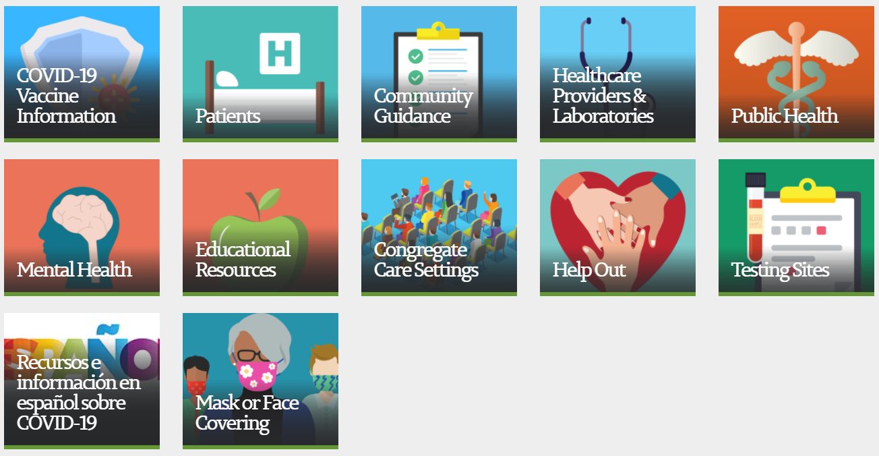
Where Can I Get More Information?
www.tn.gov/health
Click here

Slide 8
Finding Your Phase: https://covid19.tn.gov

Slide 9
Getting Vaccinated: https://covid19.tn.gov

Slide 10
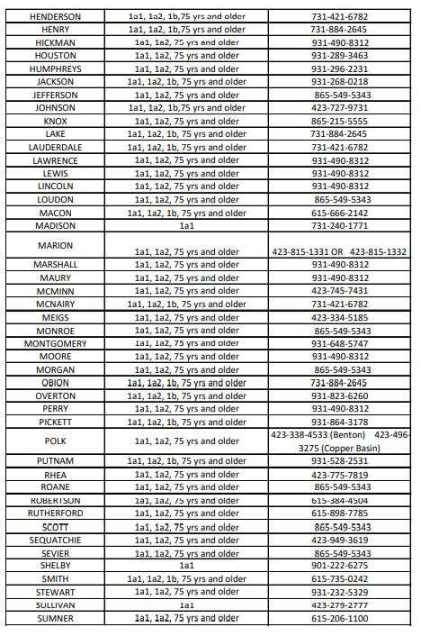
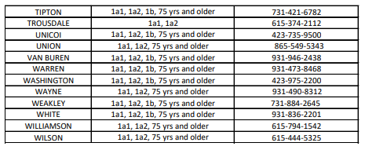
County Vaccine Availability: https://covid19.tn.gov

Slide 11
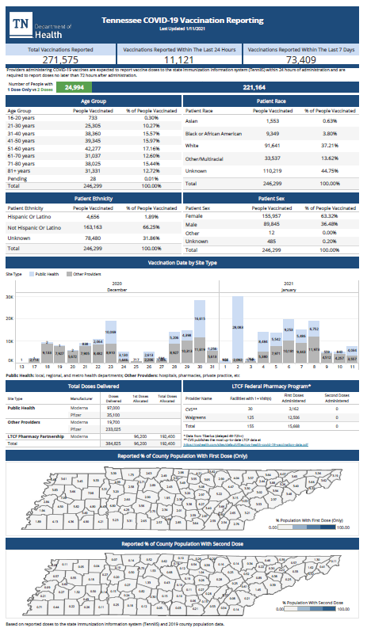
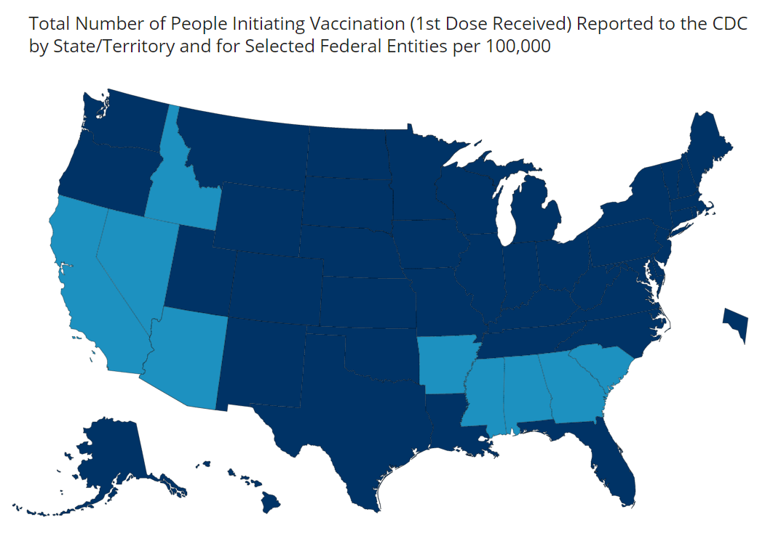
Following Progress: https://covid19.tn.gov
https://covid.cdc.gov/covid-data-tracker/#vaccinations

Slide 12
Reporting to TennIIS
Use the Vaccine Ordering Module (VOMS) to reconcile inventory in TennIIS
Input into decisions related to Allocation
TennIIS inventory numbers feed CDC’s Vaccine Finder application
Report Administration of COVID-19 doses preferably within 24 hours – required within 72 hours
Drives TN dashboard numbers
Input into decisions related to Allocation
Used to send out Centralized 2nd dose Reminders
How?
Mass Immunization Module
Electronic connection between your eHR system and TennIIS

Slide 13
FAQs
Where is it?
Some hospitals
All 95 health departments
Where is it going?
Select Wal-Mart stores Feb 1, 2021
Local pharmacies in high SVI counties in the next two weeks
FQHCs and Community Health Centers in certain neighborhoods based on SES as supply allows
When can I get it?
https://covid19.tn.gov for the phase tool
How can I get it?
Call your local HD or visit https://covid19.tn.gov

Slide 14
Thank you! 877-857-2945

