Slide 1
Applying
Primary Prevention Principles to Tobacco Use Prevention & Control Module
Primary Prevention Initiative: Tobacco Use Prevention & Control Module

Slide 2

Tennessee Data: Tobacco Use in Adults
24.9% of adults in Tennessee were current cigarette smokers in 2012
Nationwide, 19.6% of adults smoked
Tennessee had the fourth highest adult smoking prevalence in the nation
Data Source: Centers for Disease Control and Prevention (CDC). Behavioral Risk Factor Surveillance System Survey Data. Atlanta, Georgia: U.S. Department of Health and Human Services, Centers for Disease Control and Prevention, 2012.

Slide 3
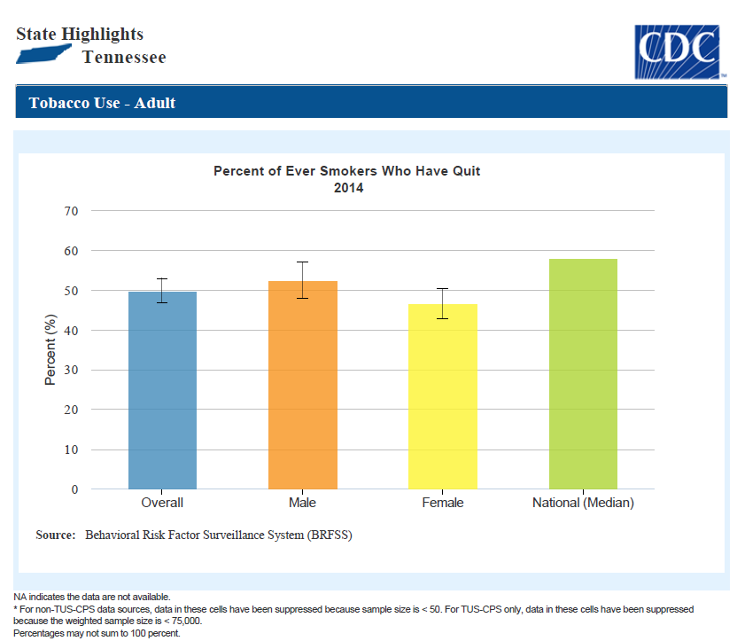

Slide 4
Tennessee Data: Tobacco Use in Youth
Data Source: Centers for Disease Control and Prevention (CDC). 1991-2013 High School Youth Risk Behavior Survey Data.
Available at http://nccd.cdc.gov/youthonline/. Accessed on 8/11/2014.

Slide 5
Tennessee Data: Tobacco Use in Youth
Data Source: Centers for Disease Control and Prevention (CDC). 1991-2013 High School Youth Risk Behavior Survey Data.
Available at http://nccd.cdc.gov/youthonline/. Accessed on 8/11/2014.

Slide 6
The Toll Of Tobacco In Tennessee
High school students who smoke | 15.4% (51,600)
Male high school students who use smokeless or spit tobacco | 20.9% (females use much lower)
Kids (under 18) who become new daily smokers each year | 4,700
Packs of cigarettes bought or smoked by kids each year | 10.5 million
Adults in Tennessee who smoke | 24.2% (1,223,200)
Smoking and smokeless rates, deaths, and other state tobacco-related information
Adult smoking from CDC 2014 BRFSS online data; 2014 BRFSS rate is not comparable to years prior to 2011; youth tobacco use from state YRBS, YTS, or other state-specific surveys.
New underage daily smoker estimate based on data from U.S. Dept of Health and Human Services (HHS), “Results from the 2014 National Survey on Drug Use and Health,” with the state share of national initiation number based on CDC data on future youth smokers in each state compared to national total.
National adult smoking rate from the 2014 National Health Interview Survey. National High school smoking and smokeless rates from the 2013 Youth Risk Behavior Survey.

Slide 7
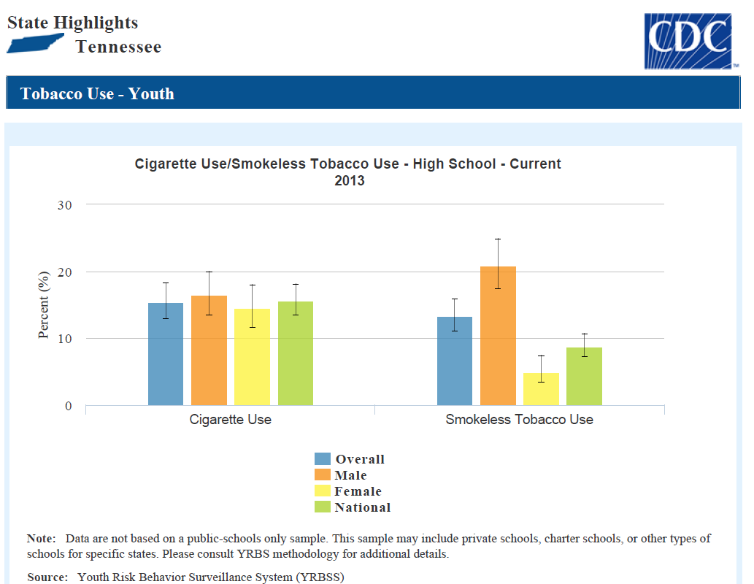

Slide 8
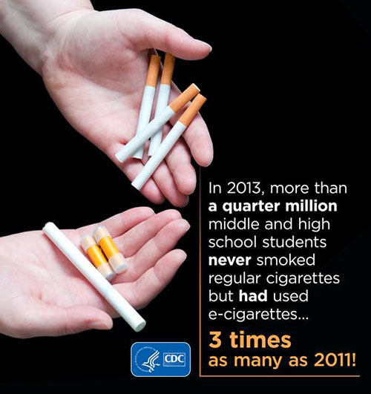

Slide 9
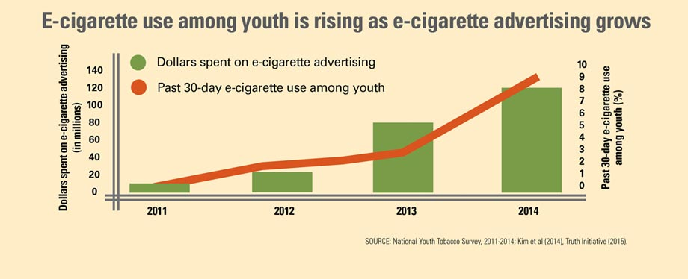

Slide 10
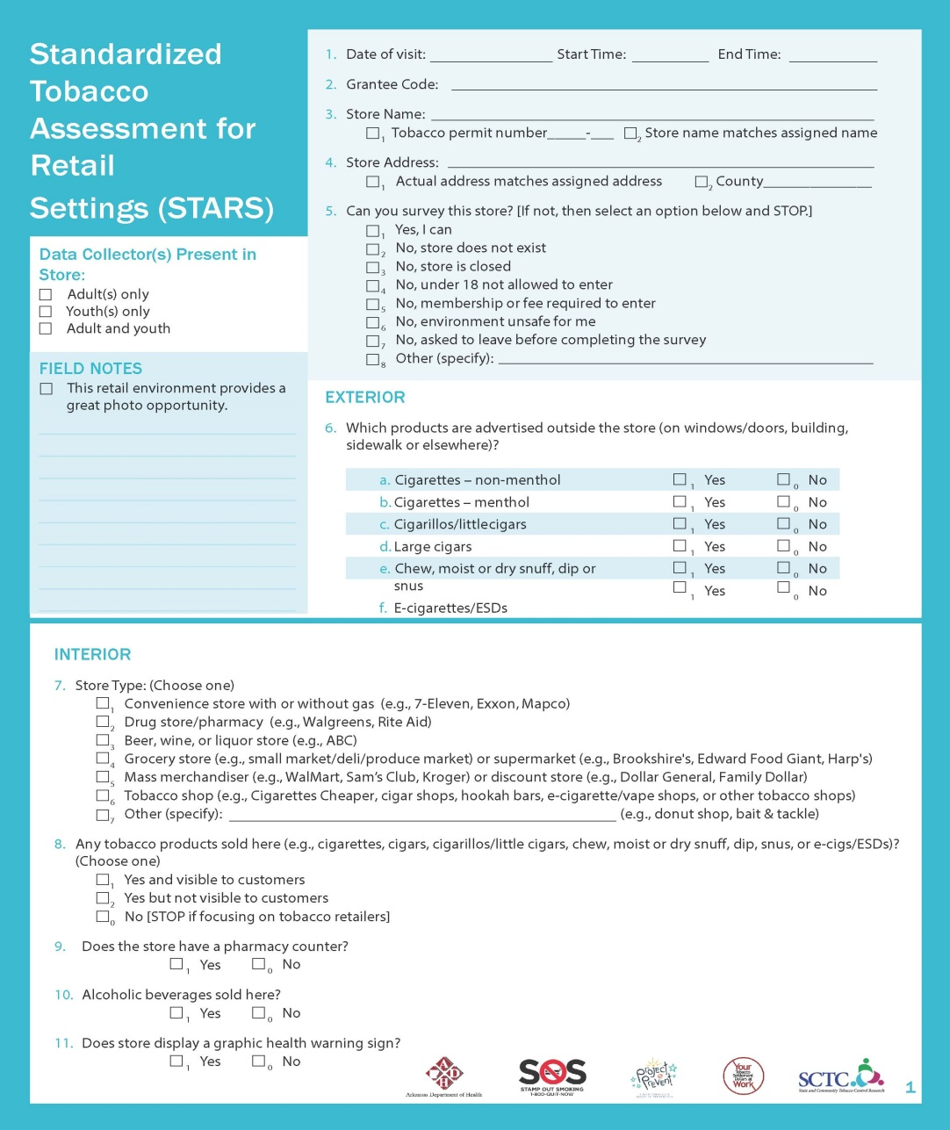
Proven Primary Prevention Strategies
Example 1: Standardized Tobacco Assessment for Retail Setting (STARS)
Data collection tool for tobacco products at the point of sale
Gain a better understanding of tobacco marketing
Inform policy makers and educate community about point of sale

Slide 11
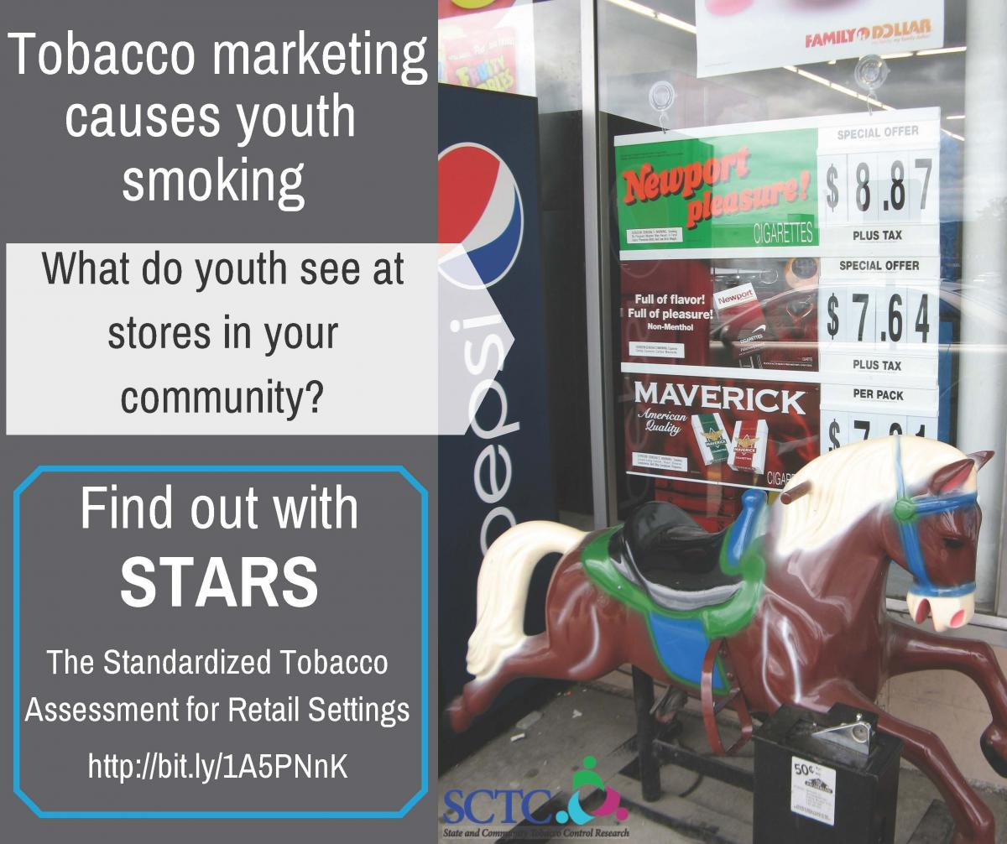
Standardized Tobacco Assessment for Retail Setting (STARS)
Ability to compare tobacco retail across communities and even states
Resources
  http://www.cdc.gov/pcd/issues/2016/15_0504.htm
  http://cphss.wustl.edu/Products/ProductsDocuments/ASPiRE_2015_STARS_Report.pdf
  http://www.sctcresearch.org/blog/standardized-tobacco-assessment-for-retail-setting/

Slide 13
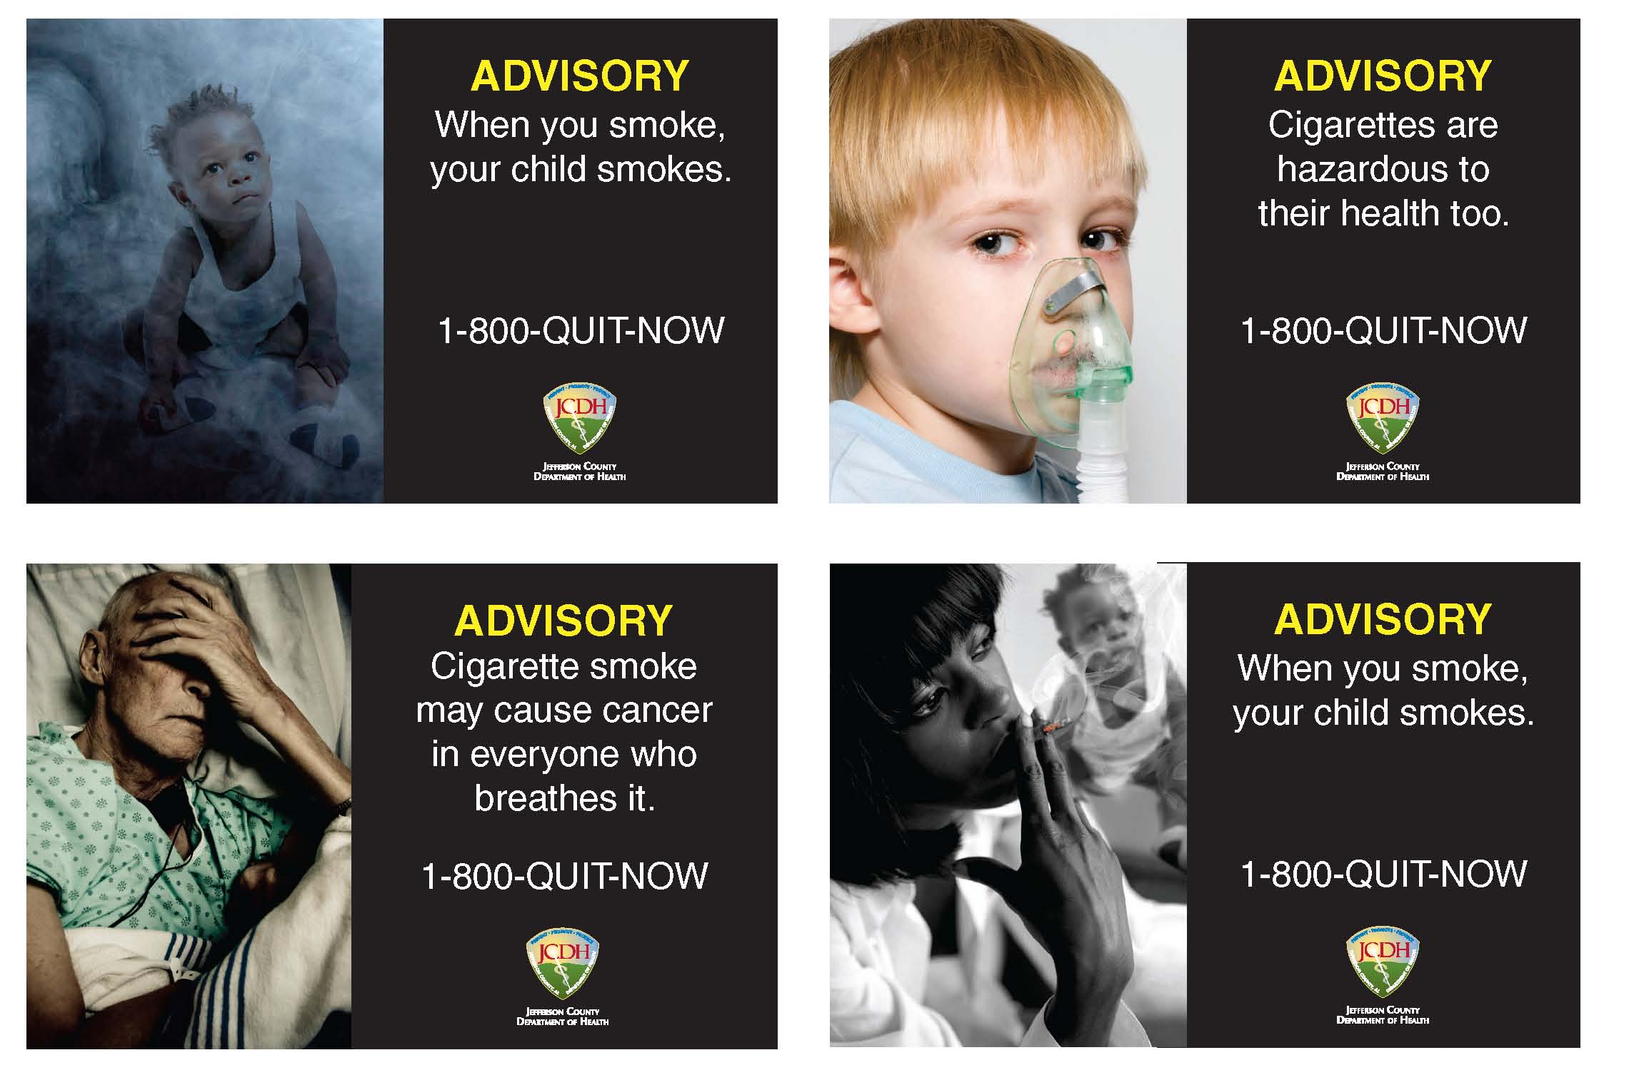
Point of Sale Warnings
Jefferson County, AL
  Voluntary agreement with tobacco retailers to post health warning signs and signs promoting Quit-Line in store
  51 store owners agree to post signs

Slide 14
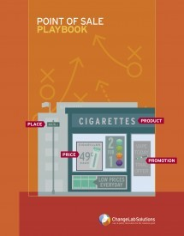
Point of Sale Warnings
Further information
  http://www.countertobacco.org/resources-tools
  http://www.countertobacco.org/sites/default/files/Alabama%20POS%20Warning%20signs-Jefferson%20County.pdf

Slide 15
Proven Primary Prevention Strategies
Example 2—Preventing Youth Access
Objective: Increase # of tobacco/nicotine-free schools and child care campuses
Activity: Youth Tobacco Prevention Committee
Schools implement tobacco/nicotine-free schools/campuses
      Engage schools, youth, parents – tobacco education
  Schools promote education preventing tobacco/nicotine use among youth
  Promote Gold Sneaker policies (includes tobacco free day care campuses)

Slide 16

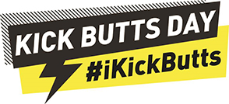
Preventing Youth Access
Kick Butts Day (www.kickbuttsday.org)
-A national day of activism that empowers youth to stand out, speak up, and seize control against Big Tobacco.
-The Kick Butts Day website offers a wealth of resources to see best practices and learn what other communities have and are doing to help promote anti-tobacco initiatives in their local communities.

Slide 17
Proven Primary Prevention Strategies
Example 3—Eliminate exposure to secondhand smoke in public places
Objective: Increase # of workplaces, restaurants, parks that are 100% smoke free – including patios and outdoor areas
Activity: Educate public about dangers of secondhand smoke
  Target key areas using community supporters
  Encourage restaurants/ bars to be 100% smoke free including outdoor areas (voluntarily)
  Distribute print materials and display posters on tobacco use
  Spotlight and advertise workplaces that agree to a voluntary 100% smoke-free policy

Slide 18

Smoke-Free Multi-Housing
Landlords are discovering the benefits of adopting a smoke-free policy
Under the law in Nashville, smokers are not a protected class, and property managers may place restrictions on smoking.
http://www.nashville.gov/Health-Department/Smoke-Free-Housing/Property-Managers.aspx

Slide 19
Tobacco Free Campus Initiative
Created by Dept. of Health & Human Services partnered with American College Health Association and the University of Michigan
Website
  http://tobaccofreecampus.org/
Toolkit
  http://tobaccofreecampus.org/keyresources-tftoolkits

Slide 20



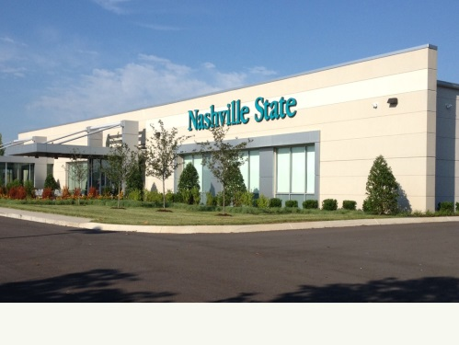


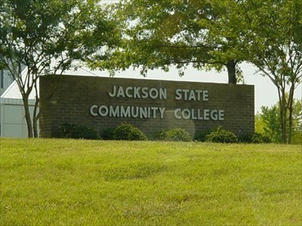
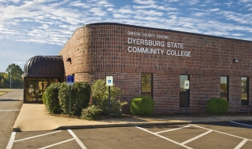
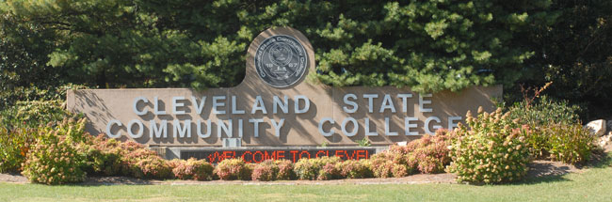
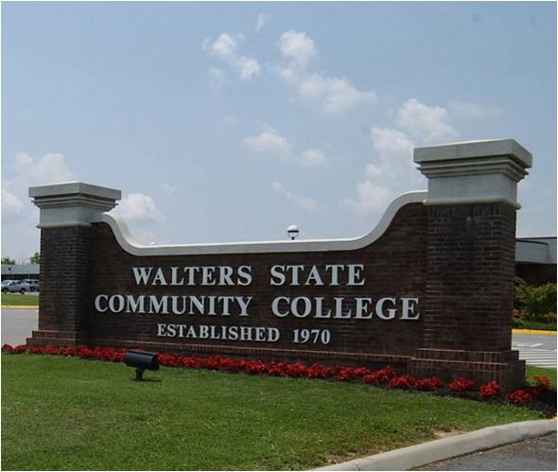

Tobacco Free Campus Initiative
List of tobacco/smoke free colleges/universities by state http://tobaccofreecampus.org/campus-list-progress

Slide 21

Smoke-Free County Government Property
On April 11, 2016, Montgomery County (Clarksville) passed a resolution to implement a “No Smoking Policy” for all Montgomery County Government property.
https://mcgtn.org/sites/default/files/commission/agenda/resolution/2016/april-4-2016.pdf

Slide 22
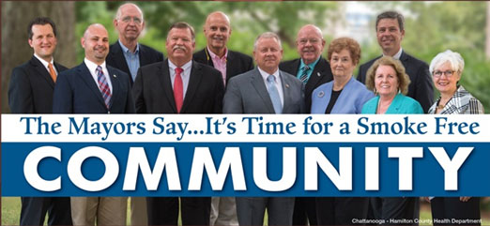
Voluntary Smoke-free Campaigns
In October 2015, the 11 mayors of Hamilton County, TN (Chattanooga) launched an initiative to ask citizens and visitors to not smoke in parks and public places.

Slide 23
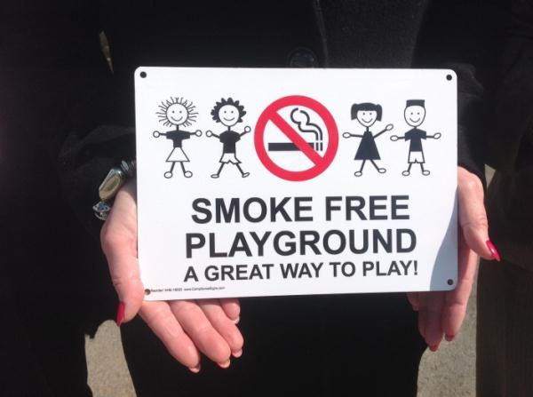
Voluntary Smoke-free Campaigns
Williamson County Voluntary Smoke-Free Parks Campaign:
http://franklinhomepage.com/smoke-free-playground-initiative-launched-in-city-cms-11228#.V2sImvkrJhF

Slide 24
Voluntary Smoke-free Campaigns
Natl Rec and Parks Association
  p46,p47 examples of local parks process to be smoke free
  https://www.nrpa.org/uploadedFiles/nrpaorg/Grants_and_Partners/Recreation_and_Health/Resources/Case_Studies/Healthy-Communities-Success-Stories.pdf
Toolkit from Connecticut Health Dept
  http://www.norwichct.org/ArchiveCenter/ViewFile/Item/319

Slide 25
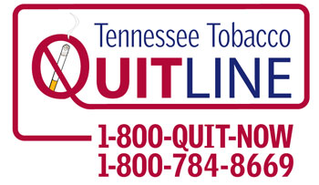

Tobacco Cessation – 1-800-QUIT NOW*
The Tennessee Tobacco QuitLine is a
toll-free telephone service that provides personalized support for Tennesseans who want to quit smoking or chewing tobacco.
When you call the QuitLine, you will be assigned a quit coach that can help develop a plan that is right for you!
All services are free through the quitline!
The Quitline is available Mon-Fri, 8am-11pm; Saturday, 8am-5pm, Sunday, 10am-4pm (Eastern Time).
The Quitline boasts a quit rate of 41.6% as of 2015.
* The Tobacco Quitline by definition is not considered primary prevention, it is considered secondary prevention.

Slide 26
Preemption Resources
Americans for NonSmokers’ Rights
  http://www.no-smoke.org/document.php?id=397
Rockefeller Family Fund
  http://grassrootschange.net/wp-content/uploads/2016/01/RFF-2015-Toolkit.pdf
NC Preemption Toolkit
  http://www.ncallianceforhealth.org/wp-content/multiverso-files/3_55a8098493e21/NCAH-Preemption-Toolkit-and-Case-Study.pdf

Slide 27
Bright Spot-Henderson County
PPI members identified all factories and industries in the county.
Pairs of PPI members approached businesses
  promote the Great American Smokeout
  survey wellness programs
  provide tobacco related education if interested
Visited 28 businesses

Slide 28
Bright Spot-Henderson County
Able to partner with Falcon plastics
  Educational display of pig lung model to 60 employees
  Smoking cessation classes to employees
    10 members with 3 quitting smoking and others decreasing the number of cigarettes smoked
Project Contact:
Emily Rushing, Health Educator
Henderson County Health Emily.rushing@tn.gov

Slide 29
Additional Resources
Behavioral Risk Factor Surveillance System
  http://www.cdc.gov/brfss/
CDC Best Practices User Guide
  http://www.cdc.gov/tobacco/stateandcommunity/bp_user_guide/index.htm
CDC Evaluation Toolkit for Smoke Free Policies
  http://www.cdc.gov/tobacco/basic_information/secondhand_smoke/evaluation_toolkit/index.htm
CDC Tobacco Free Sports
  http://www.cdc.gov/tobacco/youth/sports/index.htm
County Health Rankings
  http://www.countyhealthrankings.org/#app/

Slide 30
Technical Assistance Resources for Tobacco
Marcella Bianco
  Tobacco Use Prevention and Control Program Director
  615-253-2551
Horace C. Pulse Jr.
  Tobacco Use Prevention and Control Health Educator
  615-741-7577

