Slide 1
Primary Prevention Initiative: Substance Use Module

Slide 2
Tennessee Data: Alcohol Use in Youth
28.4% of TN high school students were current drinkers in 2013*
16.1% reported binge drinking†
Data Source: Centers for Disease Control and Prevention (CDC). 1991-2013 High School Youth Risk Behavior Survey Data. Available at http://nccd.cdc.gov/youthonline/. Accessed on 8/11/2014.
*Current drinking defined as at least one drink of alcohol on at least 1 day during the 30 days before the survey.
†Binge drinking defined as five or more drinks of alcohol in a row within a couple of hours on at least 1 day during the 30 days before the survey.

Slide 3
Tennessee Data: Alcohol Use in Youth
Data Source: Centers for Disease Control and Prevention (CDC). 1991-2013 High School Youth Risk Behavior Survey Data. Available at http://nccd.cdc.gov/youthonline/. Accessed on 8/11/2014.
*Current drinking defined as at least one drink of alcohol on at least 1 day during the 30 days before the survey.
†Binge drinking defined as five or more drinks of alcohol in a row within a couple of hours on at least 1 day during the 30 days before the survey.

Slide 4
Drug Overdose Deaths Are Increasing
The number of drug overdose deaths in Tennessee increased from 753 in 2001 to 1,166 in 2013.
The number of drug overdose deaths in 2013 represents an increase of 150% over the 10 year time period
Data source: Tennessee Department of Health; Division of Policy, Planning and Assessment; Death Statistical System. Overdose deaths were defined as having underlying cause of death ICD-10 codes X40-X44, X60-X64, X85, and Y10-Y14.

Slide 5
Drug Overdose Deaths Are Increasing
Data source: Tennessee Department of Health; Division of Policy, Planning and Assessment; Death Statistical System. Overdose deaths were defined as having underlying cause of death ICD-10 codes X40-X44, X60-X64, X85, and Y10-Y14.

Slide 6
Data sources: 1) Tennessee Department of Health; Division of Policy, Planning and Assessment; Death Statistical System. Deaths defined as having underlying cause of death ICD-10 codes X40-X44, X60-X64, X85, and Y10-Y14 (overdose) or V02-V04,V09.0,V09.2,V12-V14,V19.0-V19.2,V19.4-V19.6,V20-V79,V80.3-V80.5,V81.0-V81.1,V82.0-V82.1,V83-V86,V87.0-V87.8,V88.0-V88.8,V89.0,V89.2 (motor vehicle accident). 2) Centers for Disease Control and Prevention, National Center for Health Statistics. Underlying Cause of Death 1999-2011 on CDC WONDER Online Database, released 2014. Accessed at http://wonder.cdc.gov/ucd-icd10.html on Aug 12, 2014. 3) Warner M, Chen LH, Makuc DM, Anderson RN, Miniño AM. Drug poisoning deaths in the United States, 1980–2008. NCHS data brief, no 81. Hyattsville, MD: National Center for Health Statistics. 2011.

Slide 7
Proven Primary Prevention Strategy
Example-Preventing Access to Prescription Drugs
Objective: Decrease the prescription drugs available on the street.
Proposal: Within a local county, work in conjunction with the local county Sheriff’s Office.
- Event will be held at the local county Sheriff’s Office.
- Assist the local county Sheriff’s Office with obtaining collection barrels for the event from the Tennessee Department of Environment and Conservation (TDEC).
- Work with local media for promotion of the event.
- Create flyers/posters for local county businesses to display. - At event, allow the Sheriff’s Office to work the take back, while local health department staff and volunteers distribute information about substance abuse and rehabilitation resources.

Slide 8
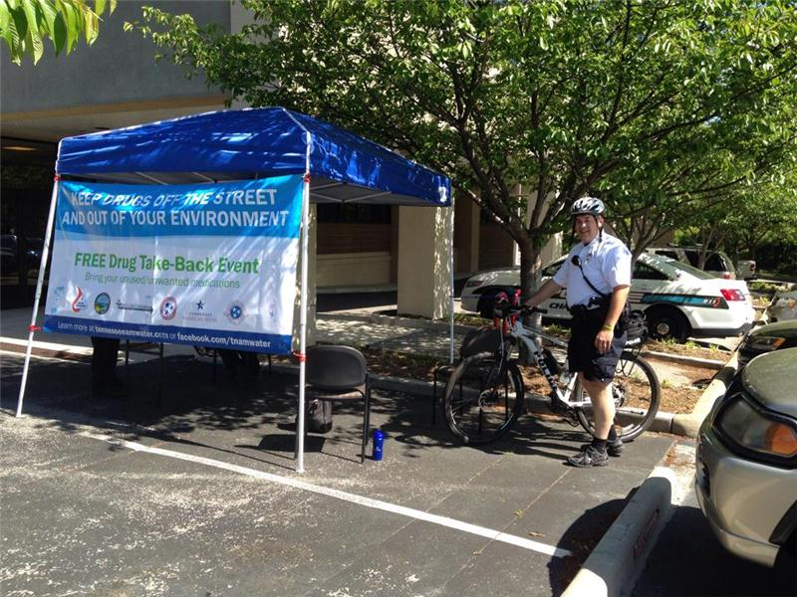
Proven Primary Prevention Strategy
Example-Preventing Access to Prescription Drugs
Evaluation: Indicators to evaluate include:
The amount in weight (lbs) of drugs taken back.
The number of informative pamphlets handed out at the event.
Measure the effectiveness of the advertising strategy.
Compare prior event weigh-ins or other county event take-back weigh in’s.

Slide 9
Proven Primary Prevention Strategy
Example-Preventing Access to Prescription Drugs
Helpful Contacts:
Tennessee Dept. of Environment & Conservation
Harmon D. Thomasson, 931-409-7460, DELT@rid-meth.org
Drug Enforcement Agency (DEA)
DI Kendra Toussaint, 615-736-7188
To determine if there is an authorized site in your community already, please visit the following website: https://www.deadiversion.usdoj.gov/pubdispearch/spring/main?execution=e1s1
If you would like to coordinate the local county take-back event with the coalition assigned to the area, please visit the Prevention of Alliance, http://www.tncoalitions.org/coalitions/

Slide 10
Additional Resources
Youth Risk Behavior Survey
http://www.cdc.gov/HealthyYouth/yrbs/index.htm
Tennessee Data Mart
http://eou.emt.org/_TN_Repository/
SAMHSA Center for Substance Abuse Prevention
http://www.samhsa.gov/prevention/

Slide 11
Technical Assistance Resources
Sarah Cooper
Department of Mental Health & Substance Abuse Services
Director of Prevention and Early Intervention Services
615-532-7786
Sarah.Cooper@tn.gov
Melissa L. McPheeters
Department of Health
Director of Public Health Informatics and Analytics
615-741-9407
Melissa.L.McPheeters@tn.gov

