Slide 1
Primary Prevention Initiative: Infant Mortality Module

Slide 2
Tennessee Data: Infant Mortality
6.9 out of every 1,000 babies born in Tennessee die before reaching their first birthday (2014)
Many infant deaths in Tennessee can be attributed to prematurity and low birth weight, which are largely related to the mother’s health before she ever becomes pregnant
Other causes of infant death include:
Congenital malformations
Suffocation/strangulation (ex. Sleep-related deaths)
Infection
Data Source: Tennessee Department of Health; Division of Policy, Planning and Assessment; Office of Health Statistics.

Slide 3
National and State Data: Infant Mortality Trends
Data Sources: 1)Tennessee Department of Health; Division of Policy, Planning and Assessment; Office of Health Statistics;
2) Centers for Disease Control and Prevention, National Center for Health Statistics.

Slide 4
Tennessee Regional Data:Infant Mortality
Data Source: Tennessee Department of Health; Division of Policy, Planning and Assessment; Office of Health Statistics.

Slide 5
Proven Primary Prevention Strategies
Example 1—Promote Breastfeeding
Objective: Increase the percentage of mothers who breastfeed their infants
Activity: Support mothers’ efforts in initiating and continuing breastfeeding.
Encourage businesses to take the “Breastfeeding Welcome Here” pledge
http://www.eatwellplaymoretn.org/resources-and-tools/breastfeeding-welcome-here.html
Promote existing laws that support breastfeeding
Build breastfeeding support groups for prenatal and breastfeeding mothers and their families
Implement the “Give Me 5” campaign in local hospitals
http://www.nashvitality.org/healthy/breastfeeding.aspx

Slide 6
Proven Primary Prevention Strategies
Examples of the “Breastfeeding Welcomed Here” door sticker/sign on businesses’ doors in Nashville and Knox County.

Slide 7
Proven Primary Prevention Strategies
Example 2—Promote Safe Sleep
Objective: Increase safe sleep practices among Tennessee caregivers
Activity: Promote “ABC’s of Safe Sleep”
Work with local child care centers to develop safe sleep policies that align with the latest recommendations from the American Academy of Pediatrics
Contact local businesses and ask them to display a safe sleep floor talker
Share safe sleep information with new parents and other caregivers (grandparents and other relatives)
Create a safe crib display for use in public venues

Slide 8
Proven Primary Prevention Strategies
Safe Sleep Floor Talker sticker for businesses and physician’s office to display on their floors.

Slide 9
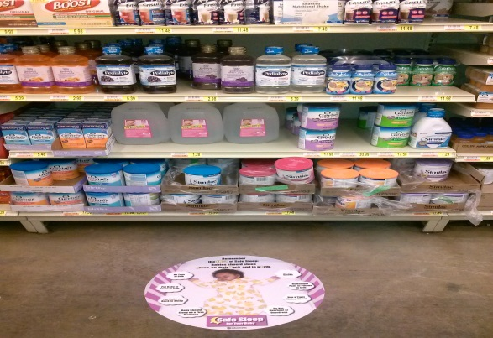
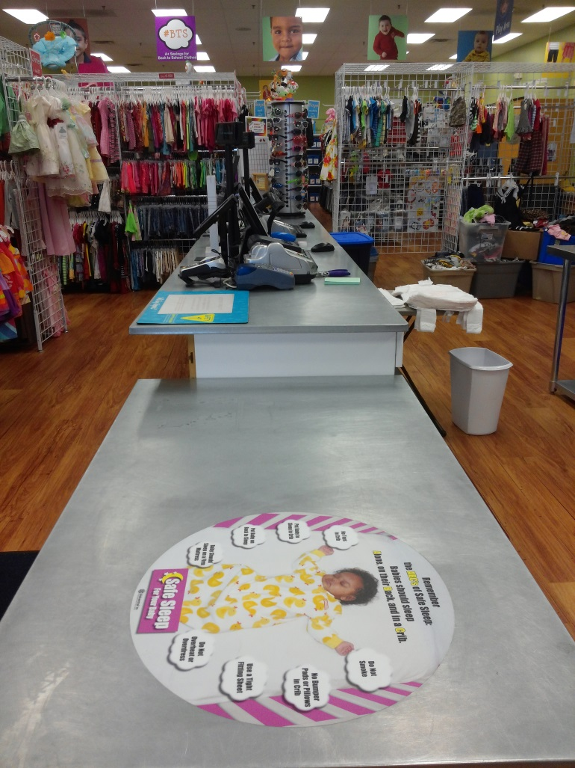
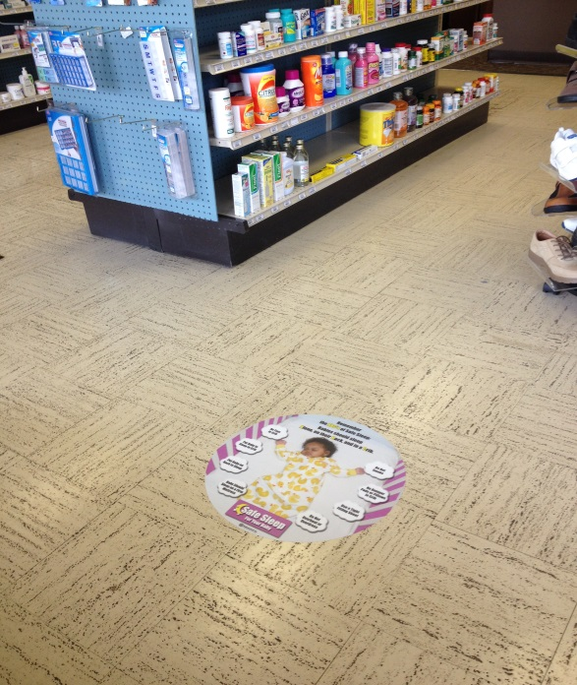
Proven Primary Prevention Strategies
Examples of the Safe Sleep Floor Talker in various businesses and physician’s office.

Slide 10
Proven Primary Prevention Strategies
Example 3—Prevent smoking among women of childbearing age
Objective: Decrease the percentage of women of childbearing age who smoke
Activity: Educate public about dangers of smoking for mother and baby and connect smoking women with cessation resources
Distribute print materials and display posters on tobacco use
Discuss the dangers of smoking at adolescent well visits and well-woman visits
Screen pregnant women for substance use (including tobacco)*
Promote use of the Tobacco QuitLine for everyone who smokes*
*Note: Smoking cessation would normally not be considered primary prevention. However, in the case of infant mortality, smoking cessation among women of childbearing age can reduce the likelihood of premature birth or low birth weight, both of which contribute to infant mortality. While smoking cessation is tertiary prevention for the mother, it can be viewed as primary prevention of infant mortality when viewed from the infant’s perspective.

Slide 11
Proven Primary Prevention Strategies

Slide 12
Additional Resources
AMCHP Compendium: Forging a Comprehensive Initiative to Improve Birth Outcomes and Reduce Infant Mortality
http://www.amchp.org/programsandtopics/womens-health/infant-mortality/Pages/default.aspx
Georgetown MCH Library: Infant Mortality and Pregnancy Loss Knowledge Path
http://mchlibrary.info/KnowledgePaths/kp_infmort.html
National SUID/SIDS Resource Center
http://www.sidscenter.org/
TN Department of Health Safe Sleep Campaign
http://safesleep.tn.gov

Slide 13
Technical Assistance Resources
Rachel Heitmann
Director, Injury Prevention and Detection
615-741-0368
Kelly Luskin
Women’s Health Nurse Consultant
615-741-0370

