Slide 1
Primary Prevention Initiative: Healthcare Associated Infections Module

Slide 2
Objectives
Upon completion of this module, learner will be able to:
Define levels of prevention
Describe how to select relevant topic, locate data, and identify an appropriate intervention

Slide 3
The Levels of Prevention
 | PRIMARY Prevention | SECONDARY Prevention | TERTIARY Prevention
Definition | An intervention implemented before there is evidence of a disease or injury | An intervention implemented after a disease has begun, but before it is symptomatic. | An intervention implemented after a disease or injury is established
Intent | Reduce or eliminate causative risk factors (risk reduction) | Early identification (through screening) and treatment | Prevent sequelae (stop bad things from getting worse)
Example | Encourage exercise and healthy eating to prevent individuals from becoming overweight. | Check body mass index (BMI) at every well checkup to identify individuals who are overweight or obese. | Help obese individuals lose weight to prevent progression to more severe consequences.
Adapted from: Centers for Disease Control and Prevention. A Framework for Assessing the Effectiveness of Disease and Injury Prevention. MMWR. 1992; 41(RR-3); 001. Available at: http://www.cdc.gov/mmwr/preview/mmwrhtml/00016403.htm

Slide 4
Primary Prevention Initiative (PPI)
Established by Dr. Dreyzehner in 2012
Goal is to focus the Department’s energy on primary prevention—eliminating risk factors for later problems
Intent is for all TDH employees to engage in primary prevention efforts in their community
Statewide Roll- out January, 2013

Slide 5
PPI Process
All counties participating in Primary Prevention Initiatives
County forms PPI Team
PPI Team meets to determine focus areas
Counties may utilize Community Health Assessments to determine priority topics
PPI Team submits PPI Proposal
PPI Team submits reports on each Activity
Process continues

Slide 6
Team Work
Your county may have multiple teams working on different community activities
Teams will spend 5% of their time working on PPI
Approximately ½ day every other week

Slide 7
PPI Teams
Team members will be:
Catalysts
Encouragers
Resource providers
Data keepers/providers
Team members are not sole workers
Teams will engage community partners to accomplish activities

Slide 8
PPI Teams
Team size will vary
Teams of 3, 5, or 7 depending on health department size
Team composition:
Include community members
Teams should be multidisciplinary (clerical, nursing, clinical, administrative)
Include Regional office staff
i.e. Health Promotion Coordinator and/or Community Health Council Coordinator, county staff such as Health Educator, Health Care Provider, and administrative staff

Slide 9
Topics for PPI Activities
Tobacco
Obesity
Teen Pregnancy
Infant Mortality
Substance Use and Abuse
Immunizations
Suicide Prevention
Occupational Safety
Healthcare Associated Infections

Slide 10
Selecting a Topic
There are so many things you could choose to work on—but time and resources are limited!
You will need to prioritize your efforts based on the specific need(s) in your community
Needs (and therefore, projects) will likely vary across the State

Slide 11
Selecting a Topic
What can you use to help you prioritize?
Community Health Assessment Tools
County Health Council Priorities
Needs Assessments
Strategic Plans
Ranking/Report Card findings

Slide 12
Locating Data
Once you’ve selected the topic on which you plan to focus, you will need to locate data that is relevant to the topic
Data can help you:
Confirm “suspicions” or “hunches”
Sharpen your focus on a particular aspect of the topic
Identify baseline for measuring improvement

Slide 13
Locating Data
Some Potential Data Sources:
Birth/death certificates
Hospital Discharge data
Health Information Tennessee (HIT) website
Behavioral Risk Factor Surveillance System (BRFSS)
Youth Risk Behavior Survey (YRBS)
Pregnancy Risk Assessment Monitoring Survey (PRAMS)
Data from community health assessments

Slide 14
Identifying An Intervention
Once you’ve selected your topic and gathered appropriate data, it’s time to decide what you’re actually going to do
There is no need to “re-invent the wheel”
Explore what others have done, what has been tested, and what has been shown to work

Slide 15
Identifying An Intervention
Some Sources for Identifying an Intervention:
Guide to Community Preventive Service
http://www.thecommunityguide.org/index.html
Healthy People 2020, Community Interventions
http://www.healthypeople.gov/2020/topicsobjectives2020/ebr.aspx?topicid=33#inter
Institute of Medicine
http://www.iom.edu/~/media/Files/Report%20Files/2012/APOP/APOP_insert.pdf
Tennessee State Plan on Nutrition, Physical Activity and Obesity
http://www.eatwellplaymoretn.org/assets/files/plan.pdf

Slide 16
PPI Proposal
Once determined, submit PPI Proposal in PPI Proposal Survey Gizmo link:
http://www.surveygizmo.com/s3/1537642/PPI-Proposal

Slide 17
PPI Proposal contains
County
Topic
Objective
Activities
Team members
Primary contact
Community partners
Estimated Start Date
Estimated Completion Date

Slide 18
PPI Activity Reporting
As the PPI Team completes each activity, report in PPI Activity Reporting Survey Gizmo link:
http://www.surveygizmo.com/s3/1458250/PPI-V3-0

Slide 19
PPI Activity Reporting Contains
County name
Division/Office
Topic
Objective
Activity description
Key Partners/Contributions
Start date of activity
Facilitating factors of success
Barriers encountered
Plans to overcome barriers
Unanticipated outcomes
Impact measures- numbers served
Stage of Change
Success Stories

Slide 20
Applying Primary Prevention Principles to Patient Safety in Healthcare

Slide 21
Patient Safety in Healthcare
Emphasis on proactive patients who are advocates for their own safe healthcare
Areas of focus:
1. Antibiotic resistance due to overuse
when antibiotics are not needed
2. Unsafe injection practices
3. Hand hygiene to prevent infections

Slide 22
Antibiotic Resistance Data
Each year in the United States, at least 2 million people become infected with bacteria that are resistant to antibiotics and at least 23,000 people die as a direct result of these infections. (CDC)
The use of antibiotics is the one of the most important factor leading to antibiotic resistance around the world. (CDC)
Up to 50% of all the antibiotics prescribed for people are not needed (CDC)
Tennessee has the 3rd highest outpatient prescribing rate of antibiotics per person in the state (and double the rate of California) (CDC).

Slide 23
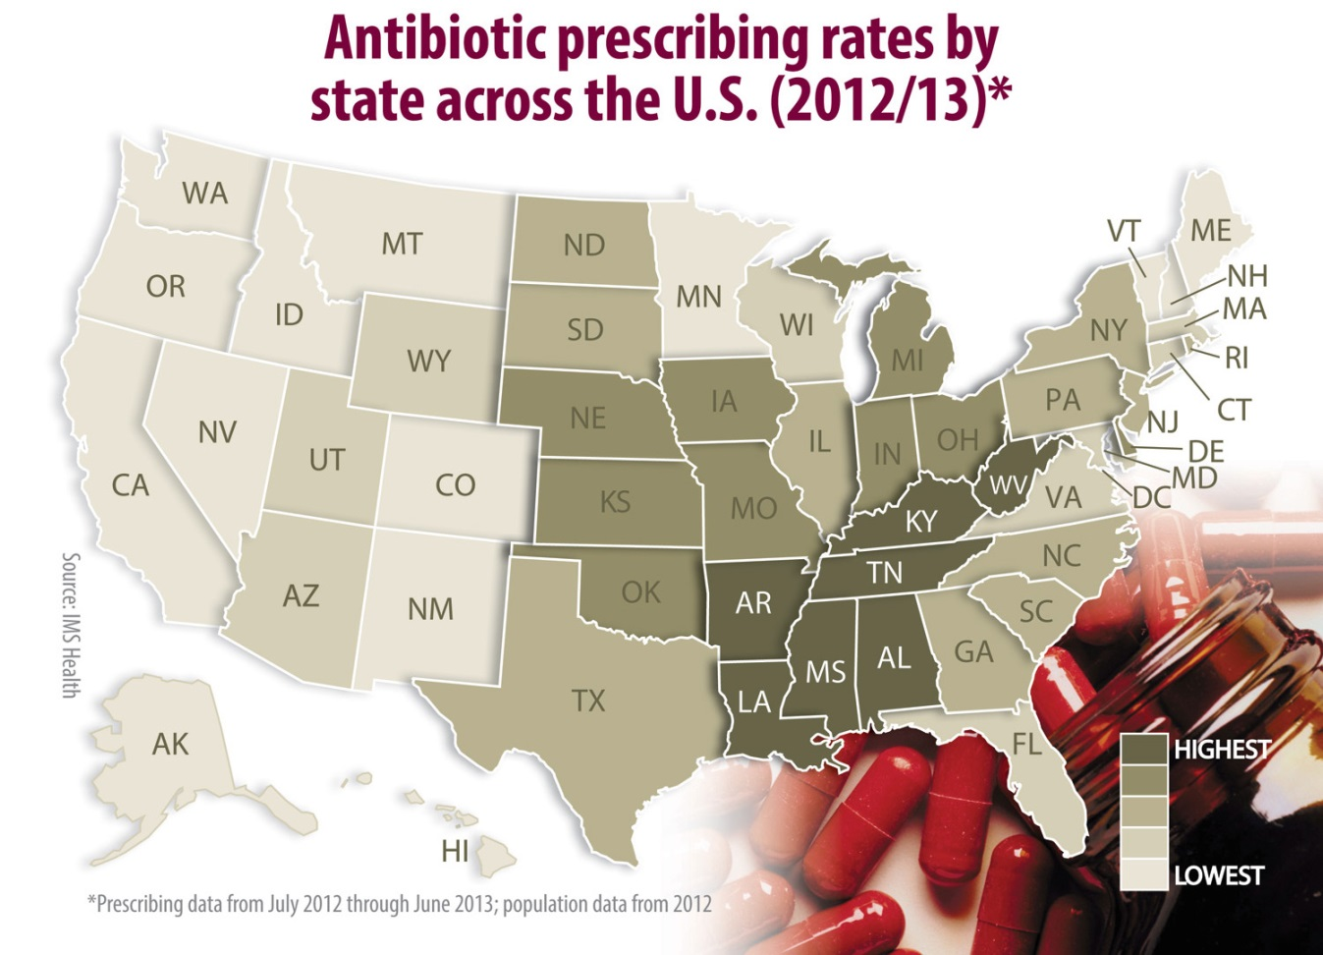
Antibiotic Use in Tennessee
Source: http://www.cdc.gov/media/releases/2012/images/dpk-antibiotics-week-prescribing-rate.html

Slide 24
Injection Safety Data
CDC reported >50 outbreaks of infection (bacterial and viral) due to unsafe injection practices since 2001. (CDC)
More than 150,000 patients have been impacted. (CDC)
Outbreaks have occurred in primary care clinics, pediatric offices, ambulatory surgical centers, pain clinics, imaging facilities, oncology clinics, and health fairs. (CDC)
Unsafe practices include: (CDC)
Reusing a syringe or needle for more than one patient
Using a single-dose or single-use medication for more than one patient

Slide 25
Injection Safety Data
Source: https://www.dhs.wisconsin.gov/communicable/HAI/PDFs/InjectionSafetyPresentation.pdf

Slide 26
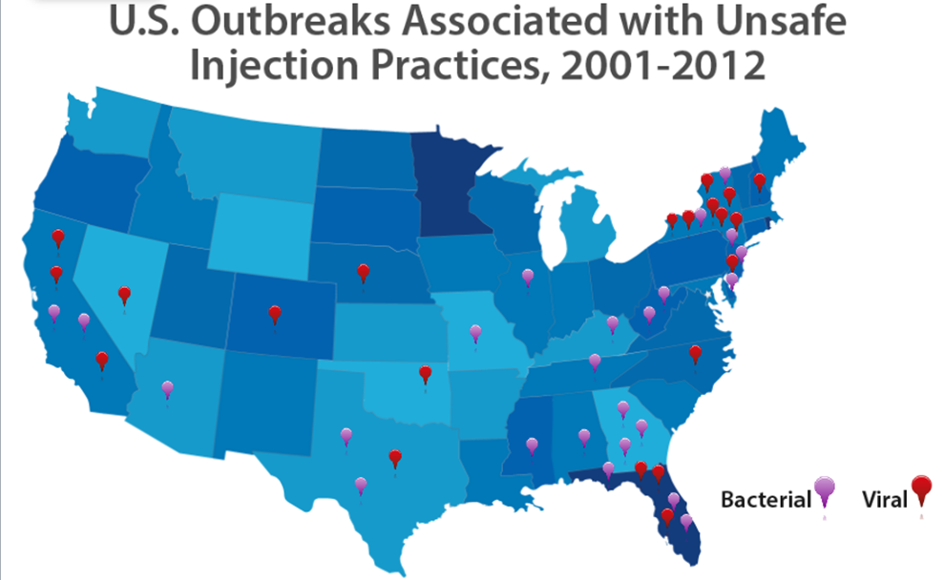
Injection Safety in Tennessee
Source: “They Did What?” : Infections, Injections, and Drug Theft. Presented by Joe Perz (Centers for Disease Control and Prevention at the FSHRMPS 2014 Annual Meeting and Education Conference on August 7, 2014.

Slide 27
Hand Hygiene and Infection Data
Survey indicated 1/25 hospital patients acquired at least one healthcare-associated infection. (CDC)
Of the almost 722,000 HAIs in acute care hospitals in 2011, about 75,000 hospital patients died. (CDC)
Studies in hospitals completed between 1994 and 2000 found hand hygiene adherence around 40% overall. (CDC)
Hands are the most common mode of transmission of germs (CDC). (slide 3)

Slide 28
Proven Primary Prevention Strategies
Example 1—Promote Appropriate Antibiotic Use
Objective: Reduce inappropriate use of antibiotics among Tennessee patients and parents of patients
Activity: Educate the public about the appropriate indications for antibiotics and consequences of inappropriate use
Distribute materials and display posters on antibiotic indications to be shared in patient waiting areas
Distribute materials to pharmacies to improve patient adherence to antibiotic prescriptions
Distribute materials to public health clinics to be used in counseling patients about the appropriate use of antibiotics

Slide 29
Resources for Antibiotic Use
Resources for the public:
Overview of antibiotic resistance for patients
Get Smart About Antibiotics Week
Why antibiotics are not for the cold and flu: posters and brochures
Antibiotic Resistance Fast Facts
Frequently Asked Questions and Answers
Letter to parents (follow the link and then click on):Matte Article: Calling All Moms and Dads- Antibiotics Aren’t Always the Answer

Slide 30
Proven Primary Prevention Strategies
Example 2—Promote patient advocacy skills for safe injection practices
Objective: Eliminate unsafe injection practices in Tennessee
Activity: Educate the public and providers about unsafe injection practices
Inform the public about unsafe injection practices in outpatient and inpatient are resulting in serious infections
Educate the public on questions to ask healthcare providers before receiving an injection
Share injection safety reminders and resources with providers to train and monitor team members

Slide 31
Resources for Injection Safety
Resources of public health:
Overview of injection safety
Resources for the public:
1 Needle+1 Syrine+1 Time=0 Infections Posters and Brochure
The Impacts of Unsafe Medical Injections in the U.S.
Video explaining the risks to the public (Joe)
Resources for providers:
Video materials to train staff
Dangerous misperceptions

Slide 32
Proven Primary Prevention Strategies
Example 3—Promote patient advocacy skills for hand hygiene in healthcare settings
Objective: Increase hand hygiene of healthcare providers to reduce healthcare-associated infections
Activity: Encourage patients to remind healthcare providers about hand hygiene
Post guidance on the appropriate steps for hand hygiene
Post visual alerts in public areas reminding the public and visitors to practice hand hygiene
Inform patients about the 5 Moments for Hand Hygiene
Educate patients on why hand hygiene in healthcare matters
Encourage patients to question and remind providers about hand hygiene

Slide 33
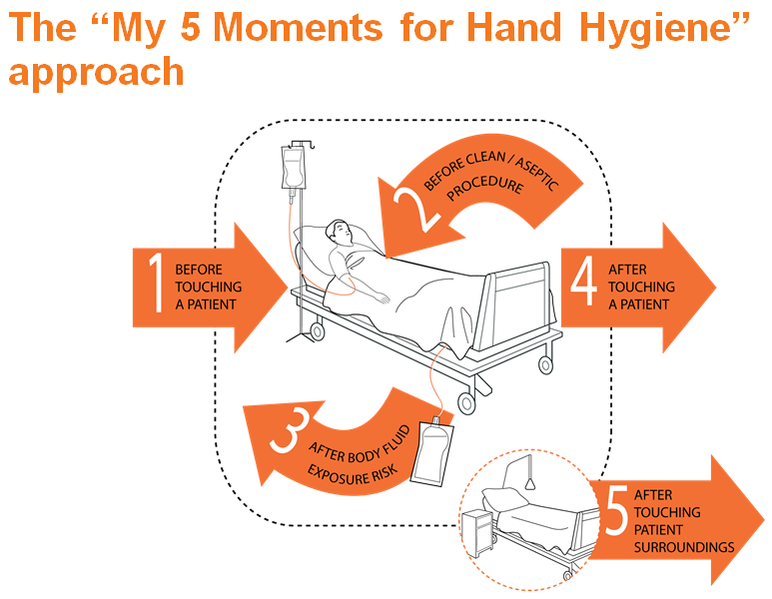
5 Moments for Hand Hygiene
Source: http://www.who.int/entity/gpsc/5may/slides_for_hand_hygiene_coordinator.ppt?ua=1
Notes:
These are the five steps at which healthcare providers should be cleaning their hands. Patients should remind providers prior to each step to be sure their hands are free of germs.

Slide 34
Resources for Hand Hygiene
Resources for public health:
Overview of the importance of hand hygiene
Resources for the public:
Safe Care Campaign video on handwashing
Video explaining the importance of hand hygiene to patients (short version, Spanish)
Posters for the public for hand hygiene
Overview of hand hygiene for patients
Five Moments of Hand Hygiene Campaign
Each patient should be an island (slides 10-11)

Slide 35
Patient Advocacy Resources
Safe Care Campaign
Centralized source of information for patients about accessing safe care
Provides information on how to prevent several healthcare-associated infections, as well as on hand hygiene and antibiotic use/misuse
http://www.safecarecampaign.org/
How to Be a Safe Patient (overview for safe healthcare)
Detailed brochure for medical procedures
Speak Up Initiative (Joint Commission)
Brochures to help patients prevent infections and medical errors
Speak Up Video
Patient Safety Partnership
Safe Patient Guides (by scenario and topic)

Slide 36
Technical Assistance Resources
Healthcare Associated Infections Team
HAI.Health@tn.gov
Meredith Kanago
Healthcare Associated Infections Program Coordinator
615-532-6833
Dr. Marion Kainer
Director, Healthcare Associated Infections and Antimicrobial Resistance Program
615-741-7247

