Slide 1
Applying Primary Prevention Principles to Obesity Prevention
Primary Prevention Initiative: Nutrition Module

Slide 2
2012 Adult Obesity Rates
US = 27.6% obese
Tennessee = 31.1% obese*
10th worst in the US (tied with Michigan)
Best = Colorado 20.5% obese
Worst = Louisiana 34.7% obese
* In 2013, the TN obesity rate was 33.7%
Data Source: Centers for Disease Control and Prevention (CDC). Behavioral Risk Factor Surveillance System Survey Data. Atlanta, Georgia: U.S. Department of Health and Human Services, Centers for Disease Control and Prevention, 2012.

Slide 3
2013 Youth Obesity Rates
US = 13.7 % obese
Tennessee = 16.9 % obese
4th worst in the US (out of 42 states)
Best = Utah 6.4% obese
Worst = Kentucky 18.0% obese
Data Source: Centers for Disease Control and Prevention (CDC). 1991-2013 High School Youth Risk Behavior Survey Data. Available at http://nccd.cdc.gov/youthonline/. Accessed on 8/11/2014.

Slide 4
Major changes in survey methodology*
Data Sources: 1) Centers for Disease Control and Prevention (CDC). Behavioral Risk Factor Surveillance System Survey Data. Atlanta, Georgia: U.S. Department of Health and Human Services, Centers for Disease Control and Prevention, 2012. 2) Tennessee Department of Health; Division of Policy, Planning and Assessment; Behavioral Risk Factor Surveillance System. *BRFSS had substantial methodological changes starting in 2011; 2011-2013 data are not comparable to earlier years.

Slide 5
Proven Primary Prevention Strategies
Example 1 — Obesity Prevention
Objective: Early Childhood Obesity Prevention
Activity: Increase the number of licensed child care facilities that have healthy environments for nutrition, physical activity and tobacco.
Promote Gold Sneaker to local child are facilities, providing technical assistance
Promote the involvement of children in meal planning and meal preparation (at childcare facilities?)
Establish “screen free week” at local facilities
Provide expertise for parent education nights
Educate providers on how to support breastfeeding moms and babies
Establish family gardens at child care facilities

Slide 6
Become a Gold Sneaker Facility
TDOH free and voluntary initiative for childcare facilities
9 policies promoting physical activity, nutrition and a tobacco-free campus
Website
https://tn.gov/health/topic/goldsneaker

Slide 7
Gold Sneaker
Technical Assistance
Yvette Mack, Phd, MSPH, MCHES yvette.mack@tn.gov

Slide 8
Screen Free Week
Screen time is
watching TV, playing video games, using apps or surfing the web
greatest among low income, African American and Hispanic children
a risk factor for childhood obesity

Slide 9
Screen Free Week
Website (flyers, pledge cards, activity logs…)
http://www.screenfree.org/
Toolkit
http://www.screenfree.org/wp-content/uploads/2016/02/Organizers-Kit.pdf

Slide 10
Proven Primary Prevention Strategies
Example 2 — Obesity Prevention
Objective: Promote Breastfeeding
Activities: Create a community supportive of breastfeeding
Encourage businesses to take the “Breastfeeding Welcomed Here” pledge
Promote existing laws that support breastfeeding
Publicize and enforce employer compliance with existing law to accommodate breastfeeding mothers at work
Build breastfeeding support groups for prenatal and breastfeeding mothers and their families
Encourage hospitals to have a breastfeeding policy that supports the 10 Steps to Successful Breastfeeding
Notes:
Is this a realistic PPI when only 3 hospitals have done the 10 steps. Should it be to adopt 1 of the policies or assess where local hospital stand.

Slide 11
Breastfeeding Welcomed Here
Tennessee law allows breastfeeding in any public or private space
Businesses show support by taking a pledge and displaying a decal
Supports women breastfeeding their babies with community support

Slide 12
Breastfeeding Welcomed Here
Website
https://www.tn.gov/health/article/breastfeeding-welcomedHere

Slide 13
Breastfeeding Welcomed Here
Notes:
Here is an example of a public nursing area at the Cincinnati Red’s Great American Ballpark….This provides a comfortable area for nursing mothers to come and nurse their child.

Slide 14
Adolescent Breastfeeding
Only 19% of mothers ≤ 20 years of age breastfeed infants at 3 months compared to 36% of women aged 20-29 and 45% of women aged > 30 years old.
71% of adolescent moms receive a gift pack containing infant formula from the hospital
In 2011 Tennessee ranked 10th for teen pregnancy (aged 15-19) (rank of 1 as highest pregnancy rate)
http://www.hhs.gov/ash/oah/adolescent-health-topics/reproductive-health/states/tn.html
http://www.cdc.gov/mmwr/volumes/65/wr/mm6502a1.htm
Notes:
Tenn pregnancy reference- http://www.hhs.gov/ash/oah/adolescent-health-topics/reproductive-health/states/tn.html
Adolescent breastfeeding reference- http://www.cdc.gov/mmwr/volumes/65/wr/mm6502a1.htm

Slide 15
Resources for Adolescent Breastfeeding Promotion
LaLeche League
http://www.llli.org/llleaderweb/lv/lvjunjul03p58.html
http://www.llli.org/llleaderweb/lv/lvmarapr90p19.html
Articles
http://internationalbreastfeedingjournal.biomedcentral.com/articles/10.1186/1746-4358-7-13
http://www.unicef.org.uk/BabyFriendly/News-and-Research/Research/Interventions-that-promote-breastfeeding/Telephone-peer-support-for-improves-breastfeeding-outcomes/

Slide 16
Resources for Adolescent Breastfeeding Promotion

Slide 17
Employee Breastfeeding Support
Employers can help support their employees to continue breastfeeding their infants
Benefits to employer
Reduced healthcare cost
Retain employees
Employees take less time off for sick child

Slide 18
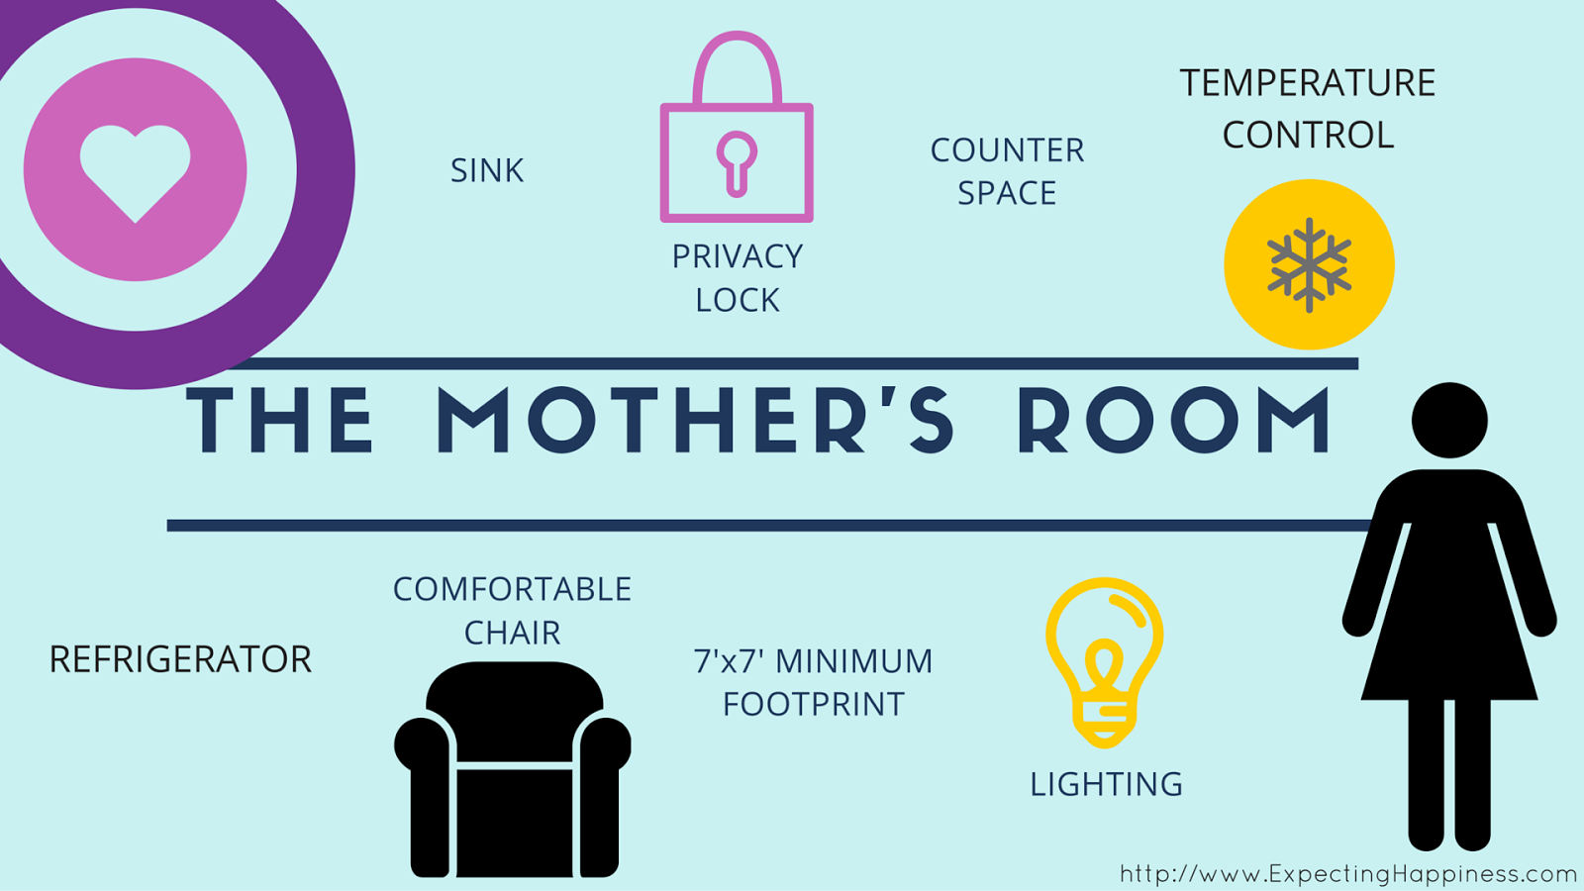
Employee Breastfeeding Support
There are low-cost but effective steps employers can take to support breastfeeding
Inform employees during prenatal period about breastfeeding policies
Private space to express milk
Flexible break times to express milk

Slide 19
Employee Breastfeeding Support
Toolkit
https://www.colorado.gov/pacific/sites/default/files/Tool%20Kit%20Resources%20for%20Building%20a%20Lactation%20Support%20Program.pdf
Resources
http://mchb.hrsa.gov/pregnancyandbeyond/breastfeeding/
https://www.tn.gov/health/article/breastfeeding-business

Slide 20
10 Steps to Successful Breastfeeding
Have a written breastfeeding policy that is routinely communicated to all health care staff.
Train all health care staff in skills necessary to implement this policy.
Inform all pregnant women about the benefits and management of breastfeeding.
Help mothers initiate breastfeeding within half an hour of birth
Show mothers how to breastfeed, and how to maintain lactation even if they should be separated from their infants.

Slide 21
10 Steps to Successful Breastfeeding
6. Give newborn infants no food or drink other than breast milk, unless medically indicated.
7. Practice rooming-in - that is, allow mothers and infants to remain together - 24 hours a day.
8. Encourage breastfeeding on demand.
9. Give no artificial nipples or pacifiers to breastfeeding infants.
10. Foster the establishment of breastfeeding support groups and refer mothers to them on discharge from the hospital or clinic.
http://www.unicef.org/newsline/tenstps.htm
Notes:
Removal of gift pack with infant formula on discharge (has this already been done in TN hospitals?) Baby Friendly designation only 1 hospital in TN?? Could removal of gift pack be a PPI?

Slide 22
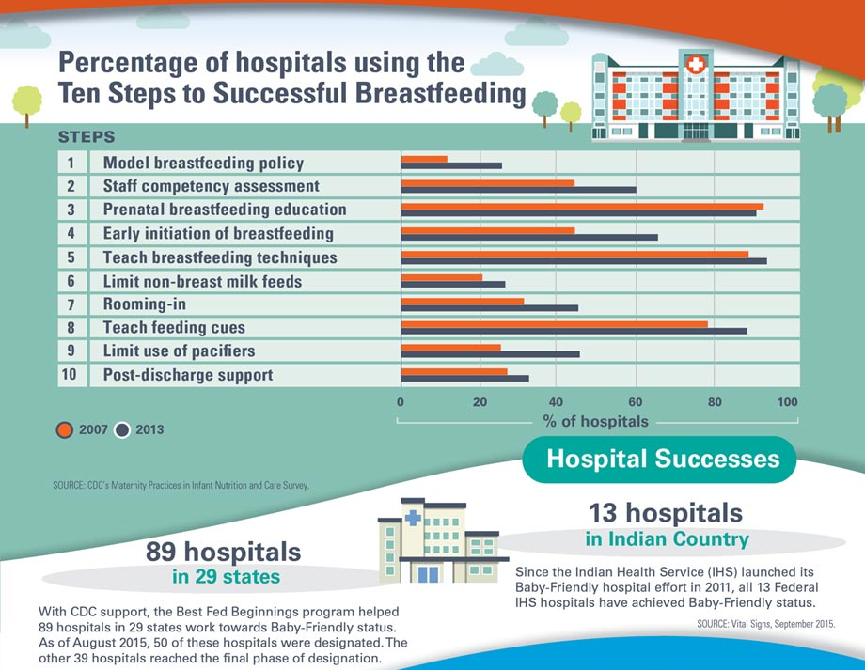

Slide 23
10 Steps Resources
Baby Friendly USA
http://www.babyfriendlyusa.org/about-us/baby-friendly-hospital-initiative/the-ten-steps/
10 steps frequently asked ?’s
file:///C:/Users/dc60ku9/Downloads/Ten_Steps_Q_and_A_4_12_13.pdf
CDC
http://www.cdc.gov/vitalsigns/breastfeeding2015/

Slide 24
Alternative Baby Gift Bags
One step to encourage the 10 steps to successful breastfeeding
Traditionally upon leaving the hospital mothers receive a gift bag that contains formula and coupons for formula which discourages breastfeeding

Slide 25
Alternative Baby Gift Bags
Alternative gift bags contain items that encourage breastfeeding (breast pads, milk storage bags, nipple cream,…)

Slide 26
Alternative Baby Gift Bags
Partner with local breastfeeding coalitions and lactation consultants
Ban the Bags Toolkit
http://banthebags.org/wp-content/uploads/2012/09/ToolKit-revision-10-11-12.pdf
Case studies of communities that were able to ban formula gift bags
http://www.citizen.org/documents/report-successful-initiatives-formula-marketing.pdf
Notes:
Link to TN hospitals that allow gift bags. Cottonwood-kids.com (alternative gift bags$2.19/bag)

Slide 27
Other Resources
Link to TN hospitals that ban gift bags or baby friendly hospitals
http://www.citizen.org/documents/Best-Hospitals-End-Infant-Formula-Marketing-to-Support-Breastfeeding-Report.pdf

Slide 28
Proven Primary Prevention Strategies
Example 3 — Promoting Nutritious Choices
Objective: Increase availability of nutritious food in the community
Activity: Ensure nutritious choices are available for people away from home
Adopt healthy meeting policies for worksites
Enable local park and recreation facilities adopt healthier menus for concessions
Revamp vending choices to make healthier options available at local worksites
Ban the sale of sugar sweetened sodas in public places
Work to establish local farmers markets and improved distribution of local produce
Establish community gardens
Promote Food Service Guidelines in school cafeterias

Slide 29
Healthy Meeting Policy
Encourages healthy choices (food, tobacco, sustainability and physical activity) at meeting/conferences
Website
http://www.cspinet.org/nutritionpolicy/healthy-meeting.html
Toolkit
http://cspinet.org/nutritionpolicy/Healthy-Meeting-Toolkit.pdf

Slide 30
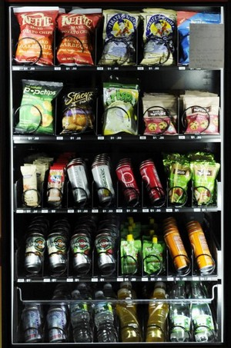
Healthy Vending
Providing healthy options in vending machines at work sites, public spaces, businesses
Benefits
Support peoples health related goals
Increase demand for healthier options
Reduce healthcare costs

Slide 31
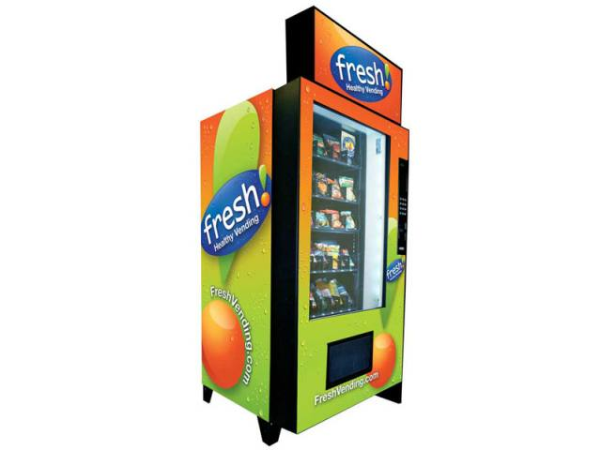
Vending worksites
Healthy Vending Toolkit
http://www.kingcounty.gov/healthservices/health/nutrition/~/media/health/publichealth/documents/nutrition/HealthyVendingToolkit.ashx
Multiple Resources on Healthy Vending
http://www.cspinet.org/nutritionpolicy/foodstandards.html

Slide 32
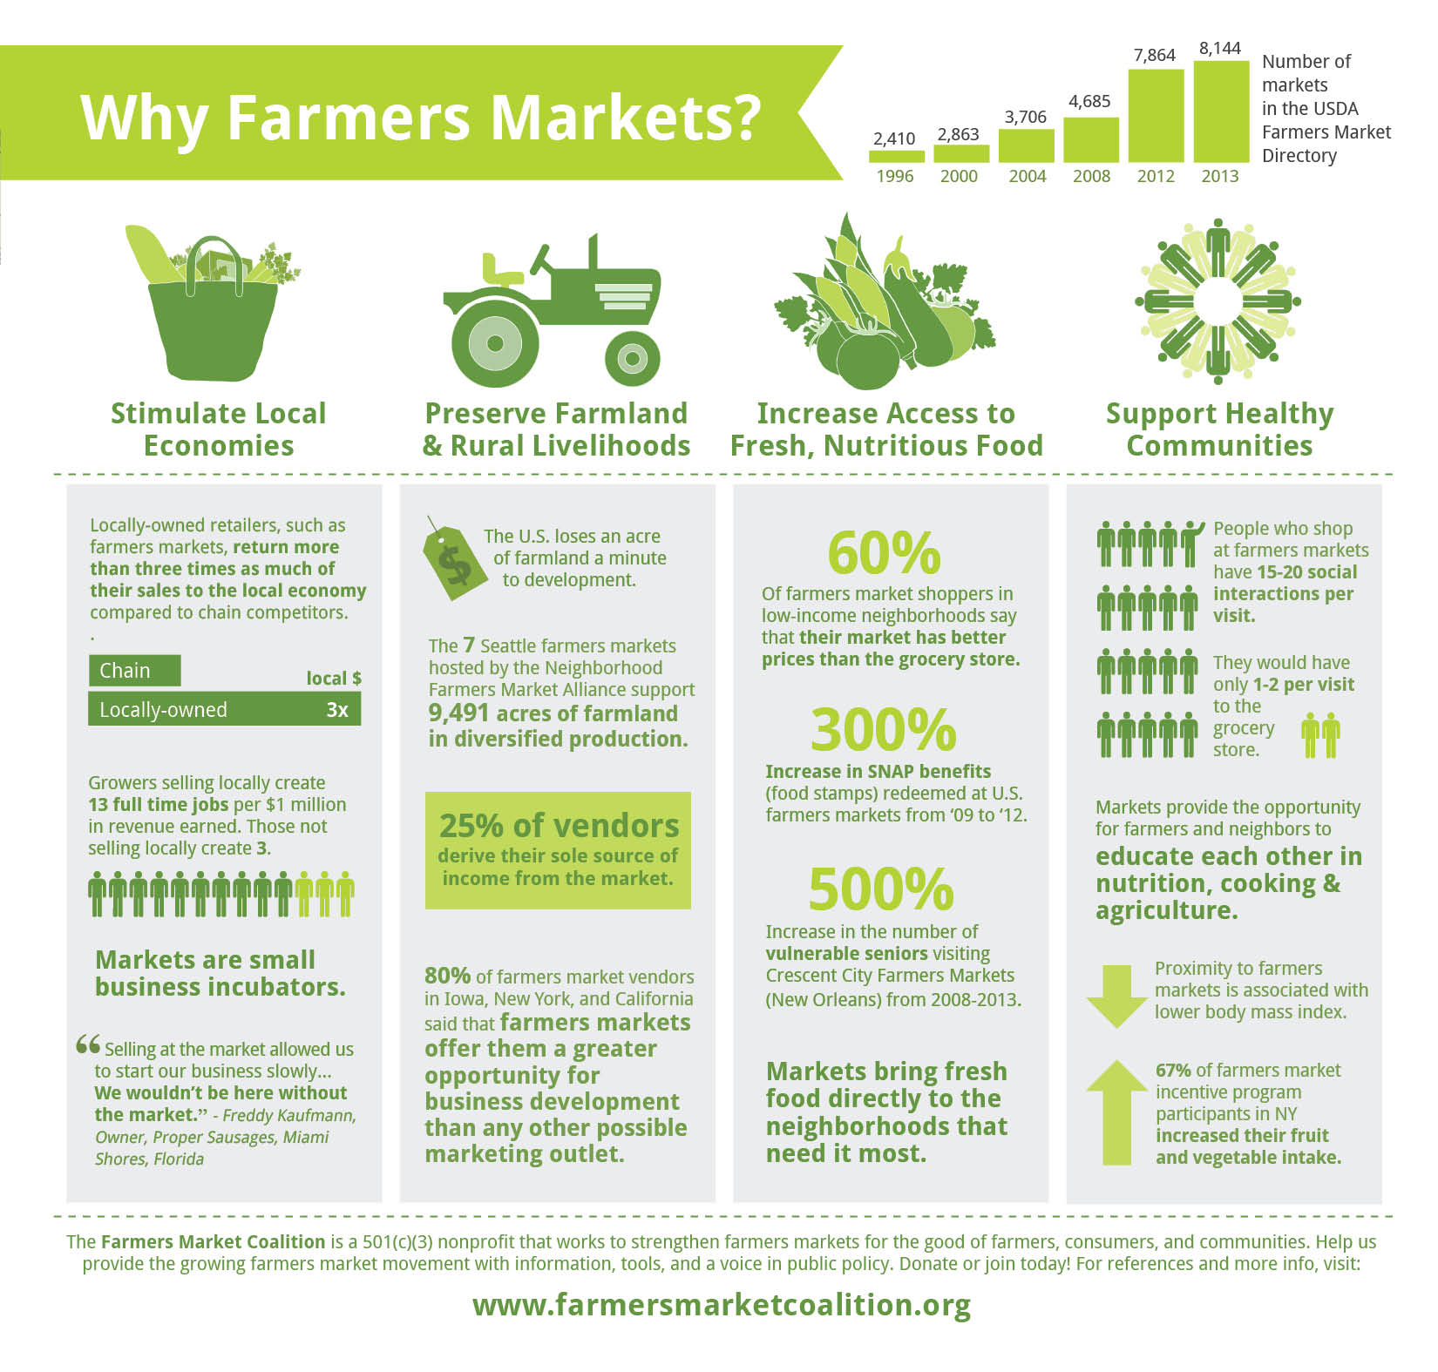
Why Farmers’ Markets?

Slide 33
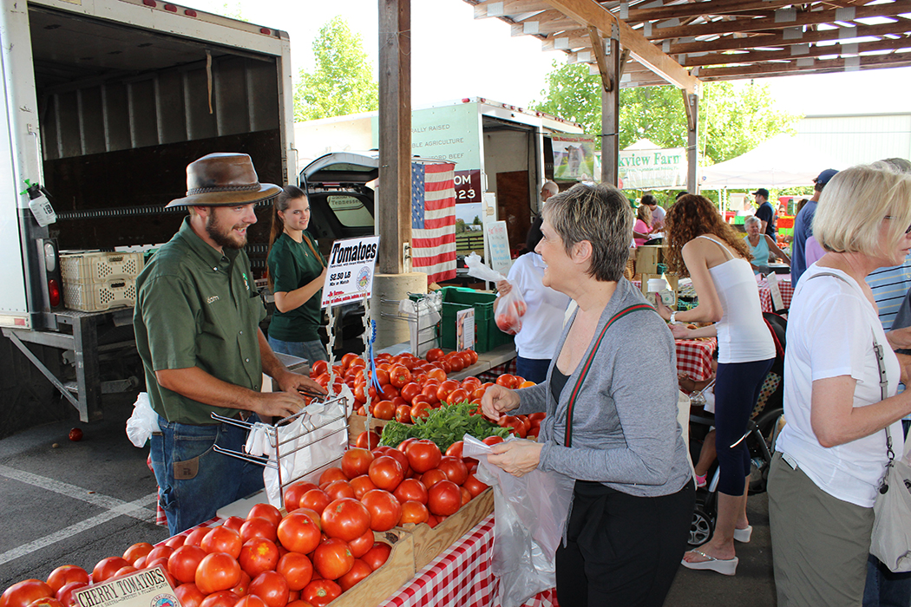
Farmers’ Market
Univ. of KY: Operating a Community Farmers’ Market
http://www2.ca.uky.edu/agc/pubs/aec/aec77/aec77.pdf
Mass.gov: Organize & Run a Farmers’ Market
http://www.mass.gov/eea/agencies/agr/markets/farmers-markets/farmers-market-howtorun-generic.html#gettingstarted

Slide 34
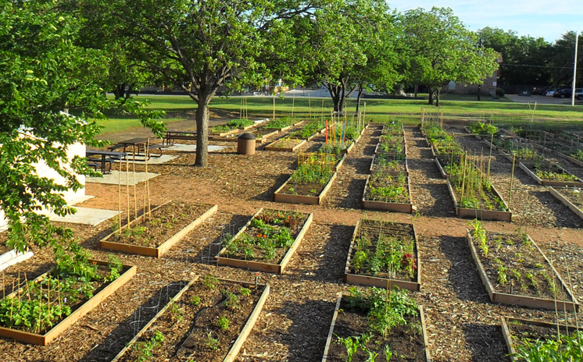
Community Garden
Benefits
Types
Resources on gardens

Slide 35
Community Garden Benefits
Increase consumption of fruits and vegetables
Among children increased nutrition knowledge
Increase physical activity
Improve community relationships
https://nccommunitygardens.ces.ncsu.edu/nccommunitygardens-research/

Slide 36
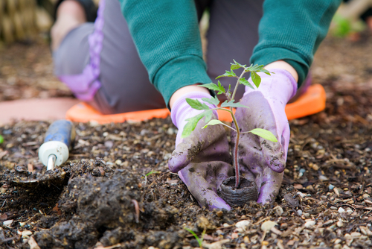
Types of Community Gardens
Community
School/Childcare
Church
Food pantry

Slide 37
Garden Checklist
Community Garden
http://www.letsmove.gov/sites/letsmove.gov/files/pdfs/LM%20Community%20Garden%20Checklist.pdf
School Garden
http://www.letsmove.gov/sites/letsmove.gov/files/pdfs/LM%20School%20Garden%20Checklist_0.pdf

Slide 38
Garden Resources
CDC website (white papers, case studies…)
http://www.cdc.gov/healthyplaces/healthtopics/healthyfood/community.htm
Wisconsin DOH youth gardening toolkit (some info. is specific to WI)
https://www.dhs.wisconsin.gov/publications/p4/p40112.pdf
USDA
http://www.usda.gov/wps/portal/usda/usdahome?navid=GARDEN_RT3&parentnav=PEOPLES_GARDEN&navtype=RT
http://www.usda.gov/wps/portal/usda/usdahome?navid=GARDEN_RT5&parentnav=PEOPLES_GARDEN&navtype=RT
http://healthymeals.nal.usda.gov/resource-library/school-and-preschool-gardens/school-garden-resources (multiple resources)

Slide 39
Proven Primary Prevention Strategies
Example 4 — Promoting Physical Activity
Objective: Increase opportunities for residents to be more active
Activity: Ensure physical activity opportunities are available
Establish Joint Use Agreements with local schools
Establish natural surface walking trails on public land
Establish walking groups and walking clubs for community participation
Promote before and after school exercise, run and/or walk clubs
Create walking school bus routes to enable children to walk to school
Promote daily physical activity within schools
Notes:
Link to Physical Activity PPI

Slide 40
CDC Strategies & Guidelines Links
Strategies to Increase the Consumption of Fruits and Vegetables
http://www.cdc.gov/obesity/downloads/fandv_2011_web_tag508.pdf
Breastfeeding
http://www.cdc.gov/breastfeeding/resources/guide.htm

Slide 41
Bright Spot: Gibson County
Objective:
increase the proportion of exclusively breastfed infants
Activity:
PPI team educated local businesses on the Breastfeeding Welcomed Here initiative

Slide 42
Bright Spot: Gibson County
Outcome of Breastfeeding Welcomed Here PPI
Oct.2014: pledges increased from 21 to 58
Nov.2014: total of 93 businesses learned about initiative

Slide 43
Bright Spot: Hickman County
Objective
Increase the intake of healthy foods
PPI team partnered with local farmers’ market director, UT extension and local health council
Activity: Community focus group assessment and in-house health department survey:
Few home gardens, lack of transportation
Lack of awareness of farmers’ market, inconvenient hours

Slide 44
Bright Spot: Hickman County
Promotion through banners, water bottles, T-shirts…
Offered on-site nutrition education, cooking tips at twice weekly market
Weekly walking program adjacent to farmers’ market
Produced a monthly newsletter
Link to word.doc

Slide 45
Additional Resources
Behavioral Risk Factor Surveillance System
http://www.cdc.gov/brfss/
County Health Rankings
http://www.countyhealthrankings.org/#app/
American Public Health Association
http://www.apha.org/programs/resources/obesity/
Center for Disease Control and Prevention
http://www.cdc.gov/obesity/resource/
Notes:
Keep or remove?

Slide 46
Technical Assistance Resources
Beth Allen: elizabeth.allen@tn.gov
CDC 1305 Chronic Disease & School Health Grant
Nutritionist
615-253-8729
Joan Cook: joan.cook@tn.gov
Project Diabetes & Gold Sneaker Initiative
Nutritionist
615-253-8745
Dare Bible: dare.bible@tn.gov
Project Diabetes
Public Health Educator
615-253-0005
Notes:
Keep or remove?

