Slide 1
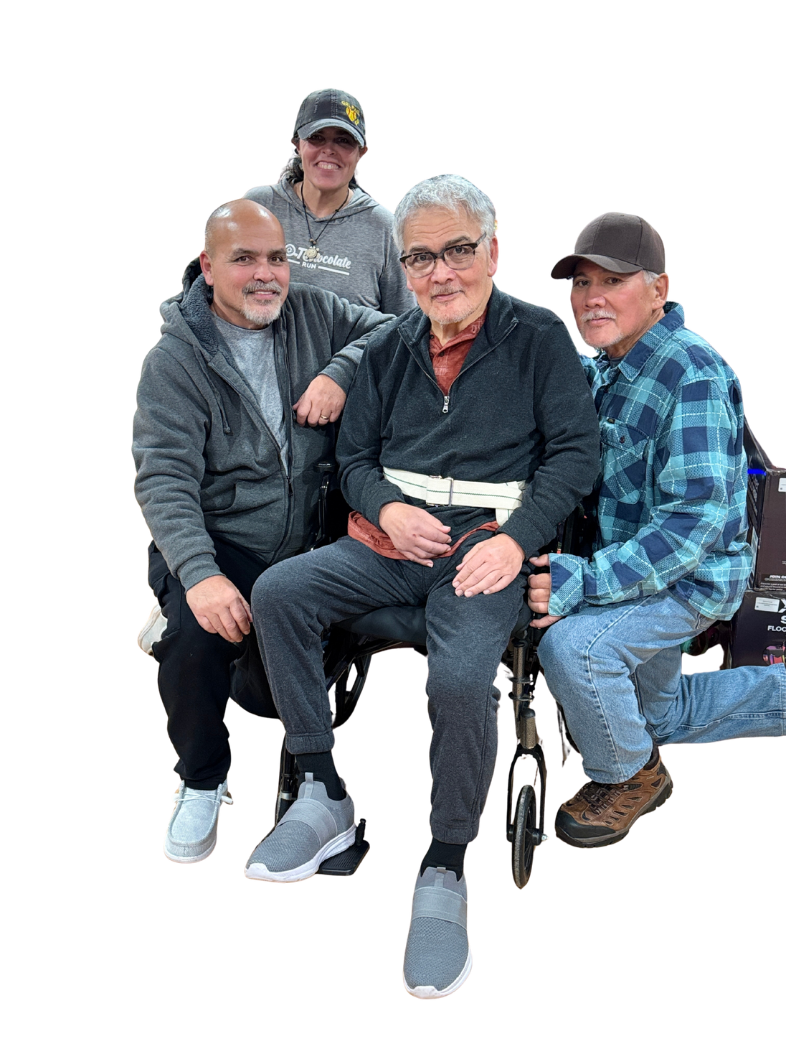
TN ADRD ADVISORY COUNCIL
November 13, 2025
NOVEMBER: NATIONAL FAMILY CAREGIVER MONTH
Notes:
Image: Personal photo by Shelly Kitts. Used with permission.
Description: Blue and white background with text that reads “TN ADRD Advisory Council | November 13, 2025 | November: National Family Caregiver Month.” In the lower left corner is an image of 3 older adult males (1 in a wheelchair) and 1 female.
Alt Text: Front row: 3 older adult males; 1 male sitting, 1 male in a wheelchair, and 1 male kneeling. Back row: 1 older adult female standing.

Slide 2

Call to Order (1:00)
Roll Call (1:00 - 1:10)
State Dementia Director Updates (1:10 - 1:20)
ADA Requirements & Protocol
2026 Office of Healthy Aging Intern
Old Business (1:20 - 1:30)
Approval of Aug Meeting Minutes
2026 Meeting Schedule
New Business (1:30 - 2:15)
Dementia: A Year in Review Executive Summary Draft
Planning the Agenda for the Next Council Meeting (2:15 - 2:45)
Council Member Comments/Announcements (2:45 - 2:50)
Public Comment (2:50 - 3:00)
Next Council Meeting: TBD
Adjournment (3:00)
AGENDA
Notes:
Description: Meeting agenda listing discussion items and times on a white background.

Slide 3
ROLL CALL
Notes:
Description: Blue background with white, centered text indicating this portion of the meeting will confirm attendance.

Slide 4
STATE DEMENTIA
DIRECTOR UPDATES
Notes:
Description: Blue background with white, centered text marking transition to presentation by the State Dementia Director.

Slide 5

ADA Compliance: Recorded Meetings
Before the Meeting:
Facilitator:
Turn on live captioning or CART services.
Slides will be available in PDF format.
If virtual:
Sign on with your full name.
Test audio and camera quality.
Keep the camera on.
Mute and unmute as appropriate.
Reduce background noise.
If in-person:
Place the name tent in a visible, unobstructed location.
Silence phones and minimize distractions.
Notes:
ADA Purpose: Ensure all recorded meetings comply with the Americans with Disabilities Act (ADA) and Section 508 by providing effective communication and equal access for individuals with disabilities.
Description: Lists steps for ensuring ADA compliance.
Alt Text: Circular ADA logo with white letters “ADA” in the center of a blue circle surrounded by a white outer ring.

Slide 6
ADA Compliance: Recorded Meetings
﻿Communication Standards:
Identify yourself before speaking.
First mention: [First & Last Name | Organization, Title]
Subsequent mentions: [Last Name]
Speak clearly and at a steady pace.
Define acronyms before using them.
Avoid overlapping dialogue or interruptions.
Describe visuals aloud (slides, charts, or images).
Refrain from side conversations while the recording is active.
Keep remarks relevant to the agenda.
Notes:
Description: Emphasizes clear speech, self-identification, and accessibility.

Slide 7



OHA Intern
Timeline: Jan 6th - Apr 30th
Engage Partners
Analyze Alignment
Recommend
Notes:
Concept Overview
• Engage Partners: Collect input from ADRD Council, TDAC, and key organizations/partners to document activities supporting State Plan goals.
• Analyze Alignment: Map activities to the 5 goals, identify overlaps and gaps, and assess alignment with federal priorities (CDC BOLD, CMS GUIDE, etc.).
• Modernize the Plan: Develop forward-looking recommendations integrating best practices, workforce and technology innovations, and caregiver equity.
Deliverables
• Activities Inventory: Summary of statewide efforts by goal and action step.
• Recommendations Document: Updated goals, action steps, and metrics with supporting evidence.
• Council Presentation: 20–30-minute visual briefing summarizing key findings and recommending next steps.
Description: Text lists internship period January 6 – April 30 and three key functions: engage partners, analyze alignment, and recommend actions.
Alt Text: Three icons illustrating an internship workflow and timeline. Three (3) speech bubbles with lines, a heart, and multiple periods labeled "Engage Partners". Map with a pin icon on a white background labeled "Analyze Alignment". A red badge with a thumbs up sign on it and three (3) stars labeled "Recommendations".

Slide 8


State Dementia Services Coordinator (DSC) Summit
October 2025 - Washington, D.C.
National Direction: From Crisis to Coordination
Biomarker Readiness & Equity
Workforce & Primary Care Integration
Risk Reduction & Public Health Practice
Behavioral Health & Long-Term Care
Data & Systems Integration
Notes:
Description: Text lists information about the State Dementia Services Coordinator (DSC) Summit.
1. National Direction: From Crisis to Coordination
The federal and state landscape is shifting from reactive crisis care toward early detection, prevention, and systems-level integration.
States are expected to operationalize dementia within public health, not as a siloed aging or clinical issue.
2. Biomarker Readiness and Equity
Blood-based biomarkers are transforming diagnosis, offering earlier, scalable, and less invasive detection. States must plan for coverage parity, workforce training, privacy protections, and ethical standards before widespread rollout.
3. Workforce and Primary Care Integration
The national workforce crisis remains acute—by 2050 the U.S. will need 18,000 geriatricians to care for 13 million people with Alzheimer’s.
The only scalable solution: integrate dementia into primary care.
States are institutionalizing dementia training through licensure, academic curricula, and ECHO networks.
4. Risk Reduction and Public Health Practice
*Chelsea Ridley, Panelist
The U.S. POINTER study confirmed that lifestyle interventions can delay cognitive decline by 1–2 years.
Tennessee’s Knox County project, funded through state and BOLD, will develop a Local Health Department toolkit translating POINTER principles into practice.
5. Behavioral Health and Long-Term Care
States are tackling dementia-related behavioral crises by embedding behavioral health liaisons in facilities and adopting the HEAR model (Health, Environment, Approach, Resident) to prevent hospitalizations.
6. Data and Systems Integration
*Rochelle Roberts, spoke to leadership buy-in and success translation.
Tennessee was prominently featured for leadership alignment and system integration (SHIP).
Dr. Joseph Gaugler (University of Minnesota; PI, BOLD Center of Excellence on Dementia Caregiving) highlighted Tennessee’s MPA Data Dashboard V2 as a national model for merging qualitative and quantitative data to show ROI and drive policy.
Alt Text: Top of the Capitol building dome with AIM, Alzheimer's Impact Movement and the Alzheimer's Association logo below in purple.
Group photo of approximately 25 participants from the State Dementia Director Meeting standing and seated in three rows inside a conference room.

Slide 9
OLD BUSINESS
Notes:
Description: Blue background with white, centered text marking transition to agenda segment addressing prior meeting items.

Slide 10
Approval of August Meeting Minutes
2026 Meeting Schedule
February 19th
March 19th
April 16th
July 16th
September 17th
November 12th
Intern
Jan 6th - Apr 30th
Notes:
Description: Text requesting approval of August Meeting Minutes and suggested 2026 meeting schedule.

Slide 11
NEW BUSINESS
Advancing the TN ADRD State Plan Together: A Year in Review
Notes:
Description: Blue background with white, centered text marking transition to New Business, emphasizing Advancing the TN ADRD State Plan Together: A Year in Review.

Slide 12
PLANNING THE AGENDA
Notes:
Description: Blue background with white, centered text marking a transition to agenda planning.

Slide 13

Council Member Comments/Announcements
Public Comment
Next Council Meeting
Adjournment
Notes:
Description: Text stating agenda items - Council Member Comments/Announcements, Public Comment, Next Council Meeting, Adjournment.
Alt Text: A judge's gavel clipart.

Slide 14

For additional questions/comments contact:
Rochelle Roberts | State Dementia Director (rochelle.l.roberts@tn.gov).
TN ADRD Advisory Council • TN ADRD State Plan • What To Do Next Trifold
Notes:
Description: TN Department of Health logo with contact information for Rochelle Roberts, State Dementia Director and Facilitator.
Alt Text: The TN Department of Health logo.

