Slide 1
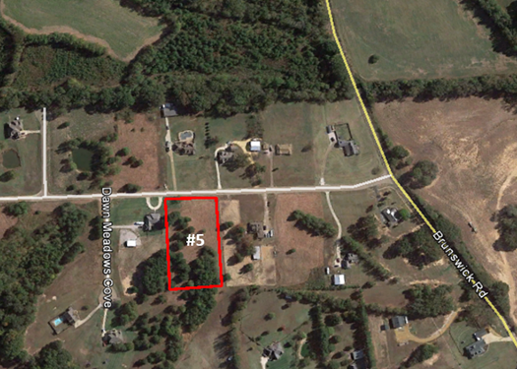
Shelby Meadows Subdivision
Shelby Meadows Lane at Brunswick Road
Atoka (Shelby County), Tennessee +/- 2 Acre Residential Lot
FOR SALE
The State of Tennessee is pleased to offer this property for sale. Please see Terms of Offering for State TR# 12-10-018. Properties will be offered by Sealed Bid at a date and time to be determined. No offers will be accepted until such time as STREAM has advertised when Sealed Bids are due. Please contact us (or visit our website) for bid package and additional information |  | State of Tennessee Real Estate Asset Management Toll Free (844) 660-8100 Brannon Butler (615) 354-3448 Bruce Nelson (615) 651-4677 Visit our website at tn.gov/generalservices/topic/surplus-real-estate

