Slide 1
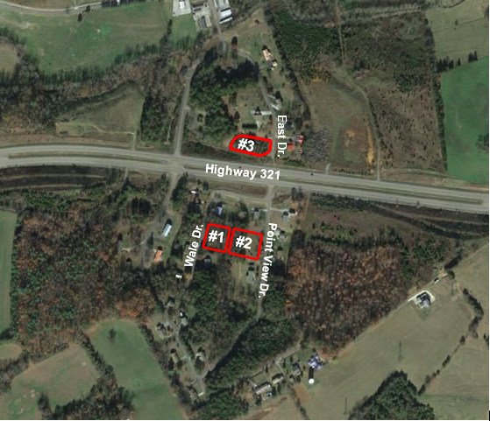
LAND: 3 Single Family Lots
124 Wale Dr., 145 Point View Dr. and East Dr.
Parrottsville (Cocke Co.) Tennessee
Acres: +/- 0.488 (Lot #1), +/- 0.549 (Lot #2) and +/- 0.603 Acres
FOR SALE
The State of Tennessee is pleased to offer the properties for sale. Please see Terms of Offering for details of TR# 21-02-001 and 002 and 21-05-006. Properties will be offered by Sealed Bid at a date and time to be determined. No offers will be accepted until such time as STREAM has advertised when Sealed Bids are due. The State reserves the right to reject any and all bids. Please contact us (or visit our website) for bid package and additional information. |  | State of Tennessee Real Estate Asset Management Toll Free (844) 660-8100 Brannon Butler (615) 354-3448 Jessica Wilson (615) 739-0162 Visit our website at tn.gov/generalservices/topic/surplus-real-estate

