Slide 1
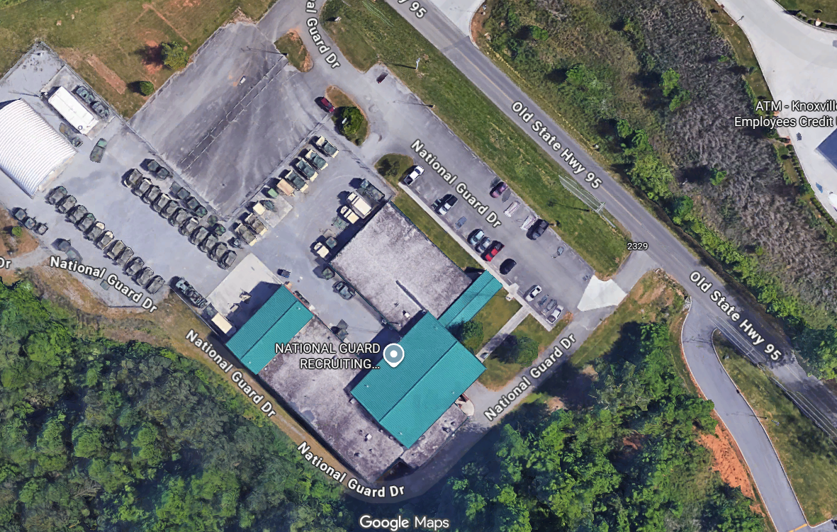
Gate #1- note opening
direction
> Two Dual Keypad Entrance, one per gate
Dark Blue - ~341’ Black Security Fence
Light Blue - ~ 48’, two 24’ Security V Track Gates
Yellow - ~ 150’ Chain Link Fence
Orange – 24’ Center Swing
Red/Electrical Power –
  Gate One ~ 260’
  Gate Two ~ 150’
Purple/Communications –
  Gate One ~ 260,’
  Gate Two ~ 150’
>
Gate #2, note
Opening direction

