Slide 1
STATE OF TENNESSEE
VCIF Open Office Hours #3
January 24, 2023
2023
Notes:
Good afternoon! Welcome to VCIF Office Hours #2. We will get started in a few minutes. Please keep yourself on mute during the meeting. You are welcome to type questions in the chat during the presentation at any time. You may also use the “raised hand” function in Teams, and we will invite you to come off mute to ask a question once you are called on.

Slide 2
Agenda
Reminders
Purchasing Equipment (e.g., vehicles)
Invoicing
UT Trainings

Slide 3
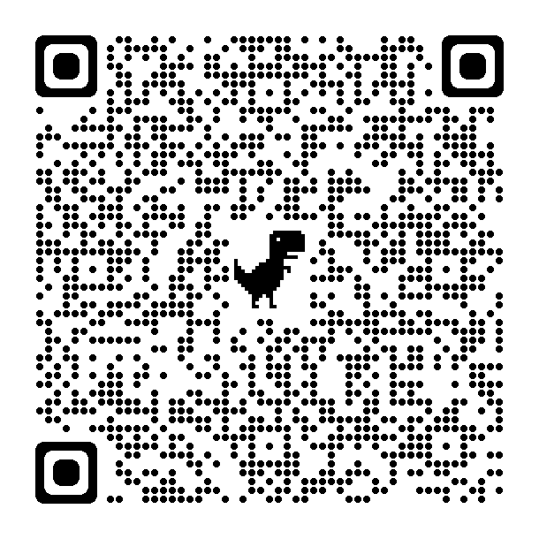
Remember!
Agency must provide written notification to their OCJP PM Specialist within ten (10) days from the date of occurrence of any change in designation or contact information of:
Authorized Official
Project Director
Financial Director
Notes:
OCJP Grant Personnel (in the manual): https://www.tn.gov/finance/office-of-criminal-justice-programs/ocjp/ocjp-grants-manual/achievement-of-operational-status.html

Slide 4
Reminder: VCIF New Project Orientation
All new Project Directors & Financial Directors must view this required training video – Deadline was December 29, 2023
Video can be found on VCIF Fund Source Chapter page: https://www.tn.gov/finance/office-of-criminal-justice-programs/ocjp/ocjp-grants-manual/redirect-fund-source-chapters/fund-source-chapters/vcif.html
Agency personnel must email their project management specialist or info.ocjp@tn.gov when they have completed this training video.
Notes:
VCIF Fund Source Chapter: https://www.tn.gov/finance/office-of-criminal-justice-programs/ocjp/ocjp-grants-manual/redirect-fund-source-chapters/fund-source-chapters/vcif.html

Slide 5
Civil Rights Compliance and Training
All new Project Directors are responsible for completing Civil Rights Compliance Training within 90 days of start date as well as providing periodic training for staff.
At the end of the online quiz, Project Directors should retain verification of completion in the grant file. The Project Director and the Civil Rights Compliance Officer should complete this training annually. Verification of the training must be retained in the personnel files.
It is the responsibility of the Project Director to maintain documentation demonstrating the required Civil Rights Training has been completed annually.
Notes:
Civil Rights Compliance training and quiz: https://stateoftennessee.formstack.com/forms/title_vi_training
Civile Rights Compliance Grants Manual Chapter: https://www.tn.gov/finance/office-of-criminal-justice-programs/ocjp/ocjp-grants-manual/civil-rights.html

Slide 6
Reminder: Amendment Requests
Deadline to submit a request to amend executed contract is February 29th
Requests must be submitted in writing
Requests may not be approved
Please explain the following in your request:
  New/changed expense and justification
  Reason for eliminating old expense
  How much $ needs to be moved and to which budget line (e.g., Professional Fees)
  Where that $ is coming from, including which budget line (e.g., Supplies)
Next Office Hours - Amendments: 2/21 at 9:30 AM

Slide 7
Questions?

Slide 8
Review: Purchasing Equipment w VCIF
Follow your agency’s procurement policies (sole source, bid process)
Follow TN & Federal law (drones, etc.)
Read the OCJP Grants Manual (Sec. 8 - Supplies and Operating Expenses, Sec. 10 - Property and Equipment, and Sec. 12 - Procurement of Goods and Services)
Follow VCIF requirements (LPRs through TDOT & state-wide contract, P25 radios)
Contract terms: May not use VCIF funds for agreements or contracts with vendors that last beyond 2025
Refer to VCIF Equipment Certifications
  Signed during the contracting process
  Available online
Notes:
Grants Manual section 8: https://www.tn.gov/finance/office-of-criminal-justice-programs/ocjp/ocjp-grants-manual/supplies-and-operating-expenses.html
Grants Manual section 12: https://www.tn.gov/finance/office-of-criminal-justice-programs/ocjp/ocjp-grants-manual/procurement-of-goods-and-services.html
VCIF Fund Source chapter: https://www.tn.gov/finance/office-of-criminal-justice-programs/ocjp/ocjp-grants-manual/redirect-fund-source-chapters/fund-source-chapters/vcif.html

Slide 9
Vehicles
Vehicles include: armored rescue vehicles, boats, UTVs/ATVs, trucks, vans, and
  Must be marked with branding consistent with the agency’s other fleet vehicles
    Unless explicitly described in the contract scope as “covert” or “undercover”
  Such vehicles must be issued to the unit described in the scope and used only within the purpose outlined in the contract scope

Slide 10
Vehicles, cont.
Issues:
  Low inventory
  Long delivery timelines
Guidance:
  Place order/make purchase ASAP
  Inform your PM Specialist as soon as you anticipate issues or delivery delays beyond June 30, 2024
  May purchase different vehicles from budget
  May purchase used vehicles; do not have to use SWC
  Some states sell surplus, low-mileage, fleet vehicles
  Follow agency procurement policies; inform PM Specialist of changes

Slide 11
Questions?

Slide 12
Invoicing
VCIF is a REIMBURSEMENT grant – your agency spends the money on budgeted items and then invoices the state for reimbursement.
Monthly invoicing is strongly recommended.
Agencies must use the invoice workbook sent to them by the State Office of Business and Finance (OBF). OBF.Grants@tn.gov
  CHECK THAT YOUR ADDRESS IS CORRECT – THIS IS WHERE CHECKS WILL BE MAILED.
At a minimum, agencies MUST request reimbursement no later than 30 days after the end of each quarter for all the expenses incurred during the quarter in its entirety. (Next due: January 30)
Reach out to your OCJP PM Specialist to discuss any barriers your agency is experiencing in expending funds, hiring grant funded staff, and executing subcontracts, etc.

Slide 13

UT LEIC Trainings: FREE for VCIF Grantees
Crime Scene Operations Multiple dates in Feb, Mar, May 2024
Field Training Officer Multiple dates in Feb, Mar, April, Aug 2024
Criminal Investigations February 19-23, 2024
Contact ashley.ferris@tennessee.edu
Notes:
UT LEIC Training Calendar: https://leic.tennessee.edu/events/

Slide 14
UT LEIC Trainings: FREE for VCIF Grantees
Field Training Officer Multiple dates in 2024
Contact ashley.ferris@tennessee.edu
Notes:
UT LEIC Training Calendar: https://leic.tennessee.edu/events/

Slide 15
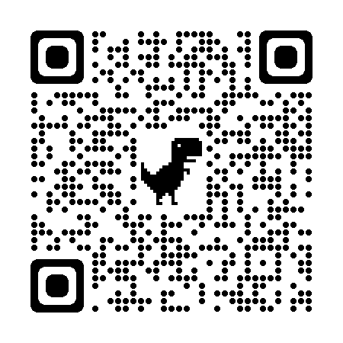
Technical Assistance via UT LEIC
UT Law Enforcement Innovation Center (LEIC) is our contracted technical assistance provider. Contact UT LEIC for assistance with:
  Training ideas and/or needs
  Model policies and procedures for new equipment, training, etc.
  Template resolutions for city/county commission meetings
LEIC Training Calendar
  https://leic.tennessee.edu/events/
Contact:
  Rhiannon Jones, Program Manager
  rhiannon.jones@tennessee.edu
  (865) 946-3201
Notes:
UT LEIC Training Calendar: https://leic.tennessee.edu/events/

Slide 16
Questions?

Slide 17
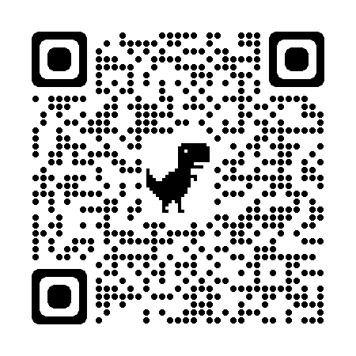
Please Complete Survey
https://stateoftennessee.formstack.com/forms/ocjp_training_satisfaction_survey
Select “VCIF Office Hours”
Use QR Code:
Notes:
Training satisfaction survey: https://stateoftennessee.formstack.com/forms/ocjp_training_satisfaction_survey

Slide 18
Next Office Hours
February 21st, 9:30-11:00 AM Central
  Invitation will be sent by email
  Potential Topics:
    Amendments
    FY24 Monitoring

Slide 19
THANK YOU

