Slide 1
Office of Criminal Justice Programs
Award Notification & Contract Signing

Slide 2
Today's Agenda
Award Notifications - Understanding notification emails and portal alerts
Signatures - Using Conga Sign for contract execution
Accessing Contracts
Contracting Timeline
Q&A Session

Slide 3
Award Notification

Slide 4

Award Notification Email
Receive automated email from OCJP
Sent to: Primary Contact Email
Contains confirmation that you have been awarded funding
Initiates the contracting phase
You will also receive notifications via the bell icon on your TNGrants portal home page

Slide 5
Signatures & Conga Sign

Slide 6
Conga Sign Workflow
Email Notification - Receive Conga Sign email with secure link
Review Contract - Click link to open and review full contract
Sign Document - Click signature fields and type your name
Confirmation - Receive copy of executed contract via email
Important Reminders:
Authorized signatory must match pre-contract documents
Check spam folder for Conga emails
No account creation required

Slide 7
Signing Your Contract
Yellow highlighted fields require your input
Click each field to complete
Type your full legal name
Fields to complete:
Subrecipient Signature
Date
Print Name
Title
All fields must be completed before submission

Slide 8
Physical Signature Process
Receive via email from your program manager
Print and have all required signatories physically sign
Scan and email the signed contract back to your program manger.
OCJP staff will upload and route for internal signatures.
Subrecipients will receive a fully executed copy once complete.
Reminders
Ensure all required signatories have signed
Scan clearly — all signatures must be legible
Return promptly to avoid processing delays
Keep a copy for your records

Slide 9
Accessing Contracts

Slide 10
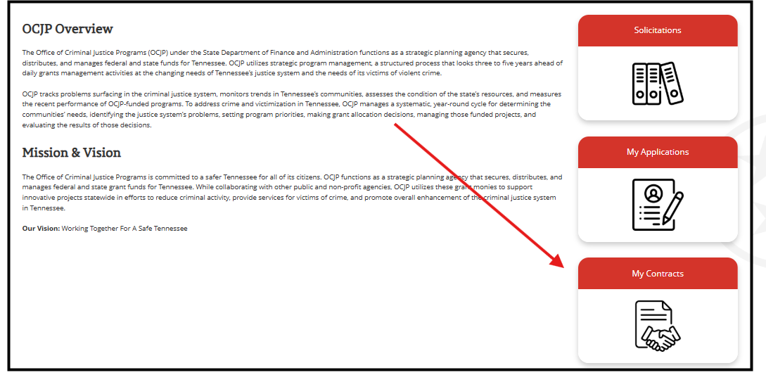
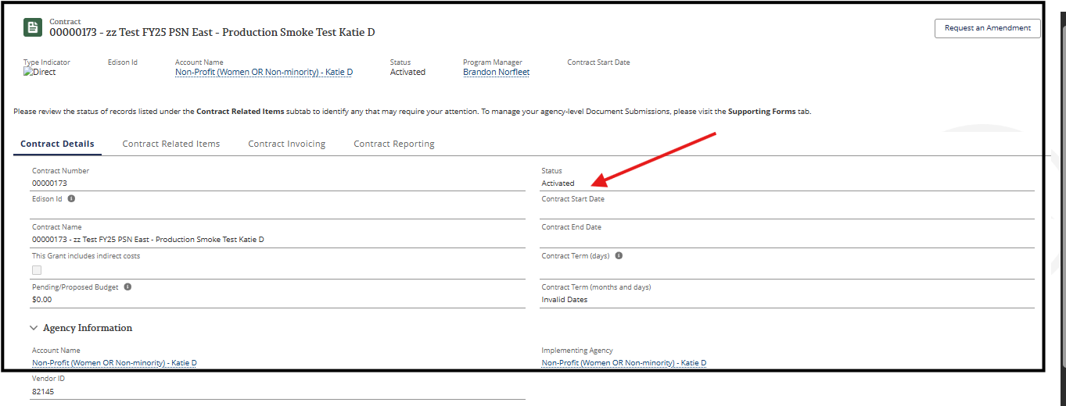
Finding Your Executed Contract
Navigation Path:
Portal Home
Contracts Tab
Click on Contract ID
Review contract details

Slide 11
Contracting Timeline

Slide 12
Contract Execution Timeline Overview
Award Notification - Email & portal alert received
Contract Sent - Conga Sign email arrives
Sign Contract
Fully Executed - Contract complete & active

Slide 13
Q&A

