Slide 1
Office of Criminal Justice Programs
Amendment Requests

Slide 2
Today's Agenda
Where to find your contract
How to request an amendment
Signature and Conga Sign
Q&A Session

Slide 3
Accessing Contracts

Slide 4
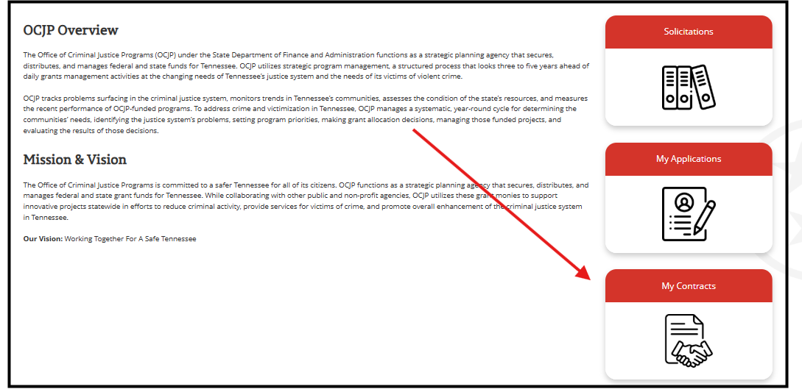
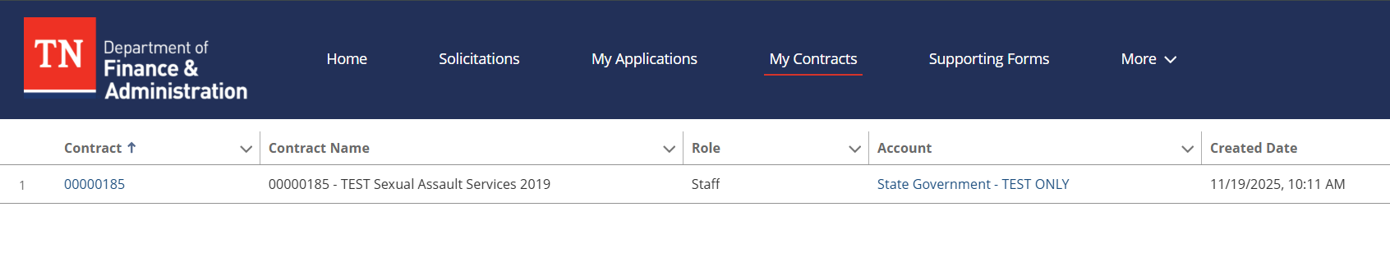
Finding Your Executed Contract
Portal Home Page
  Contracts Tab
  Click on Contract ID

Slide 5
Requesting an Amendment

Slide 6
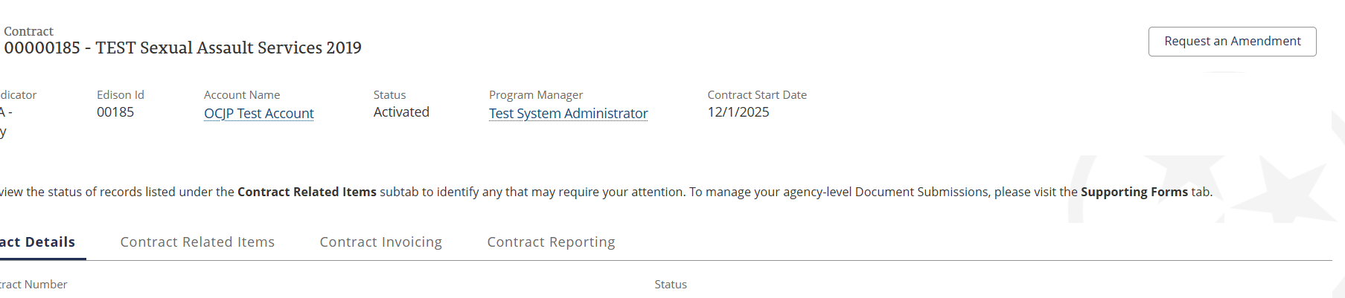
Requesting an Amendment
If a user does not have designated access to the Contract as a Project Participant, you can not see it to make any Amendment requests.
  Project participant designation is managed by OCJP staff. Please reach out to your Program Manager or submit a TA request.
Press the “Request an Amendment” button in the upper right corner
  Pressing the amendment button does not guarantee an amendment will be granted OCJP.

Slide 7
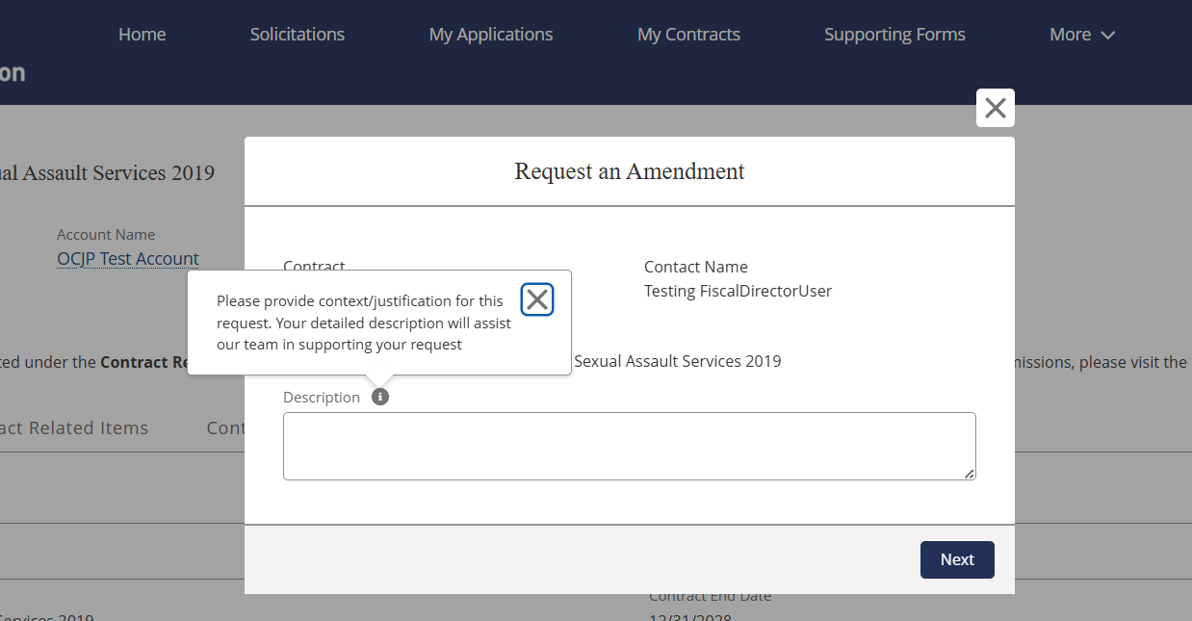
Requesting an Amendment
Amendments should be RARE
  OCJP may decline an amendment request
  Must be allocable, allowable, reasonable to the project
  Not appropriate simply to spend down the grant
Amendment requests should clearly describe the specific changes being proposed and the reason they are needed. This description field serves as the initial step in creating an amendment—similar to the information you would include when first emailing your Program Manager with a change request.

Slide 8
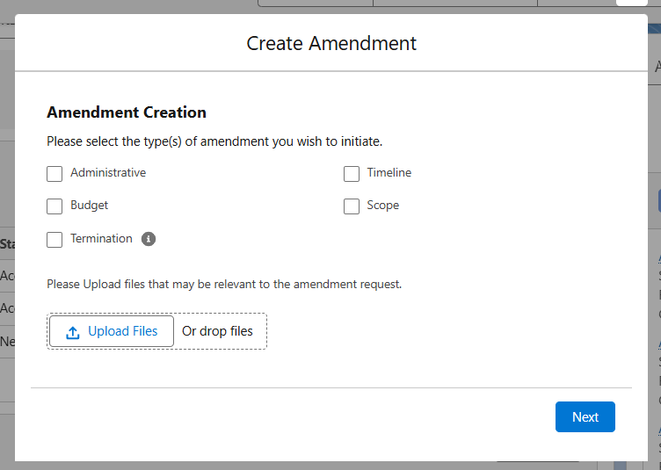
Requesting an Amendment
Types of Amendments:

Slide 9
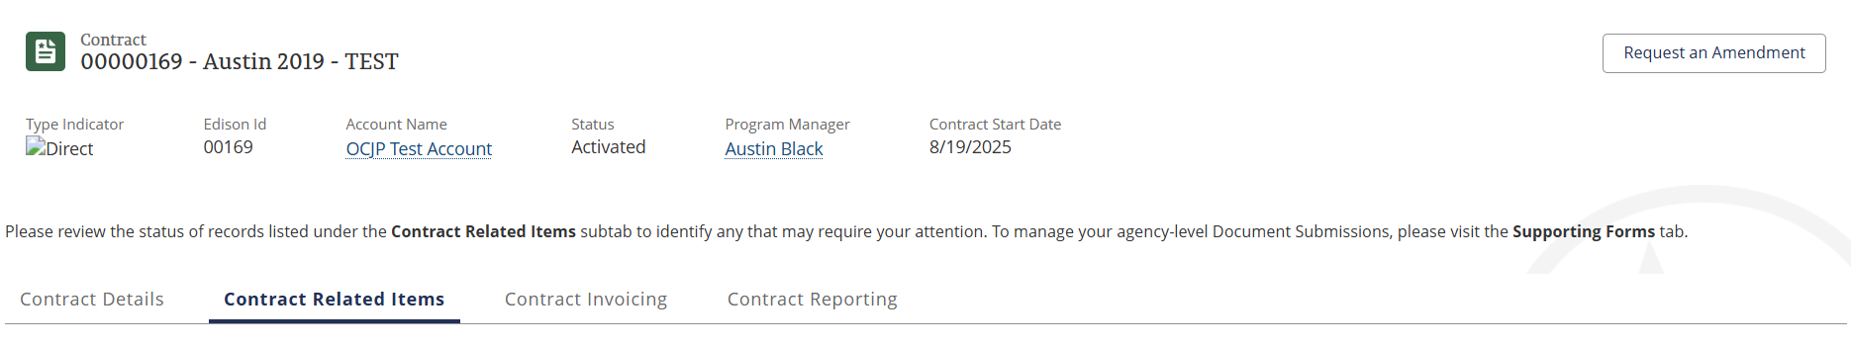
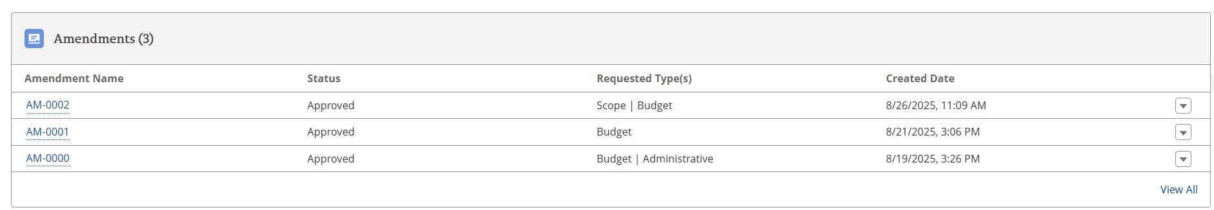
Requesting an Amendment
Start of Amendment Record can be found under Contract Related Items
Status of amendment is listed on the record

Slide 10
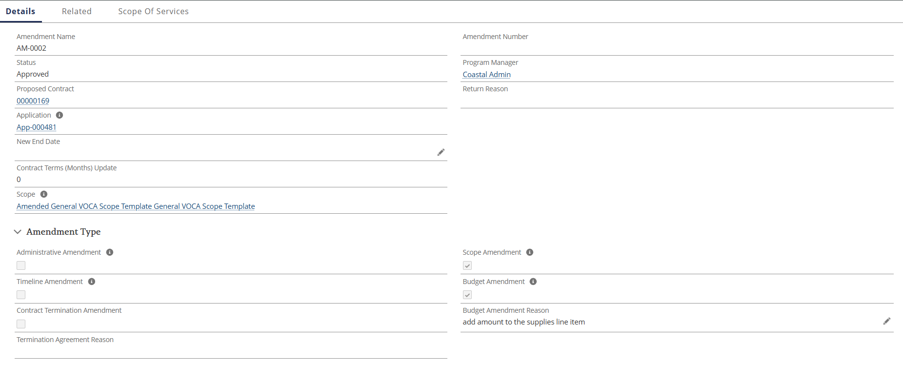
Requesting an Amendment
“Details” provides an overview of what type of amendment change

Slide 11
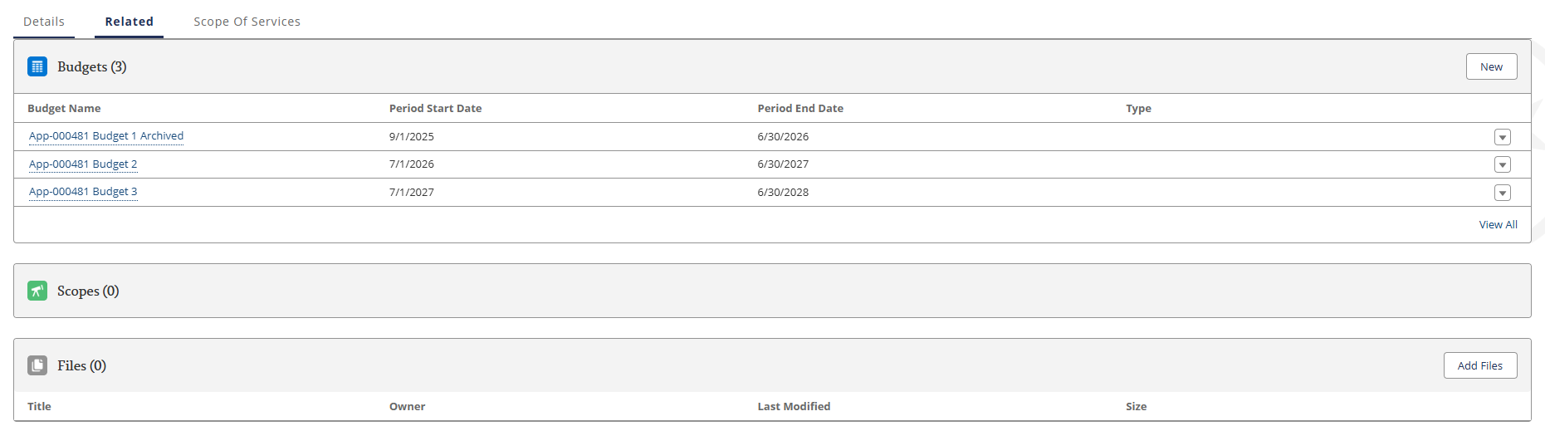
Requesting an Amendment
“Related” allows you to make the edits directly to your initial application submission

Slide 12
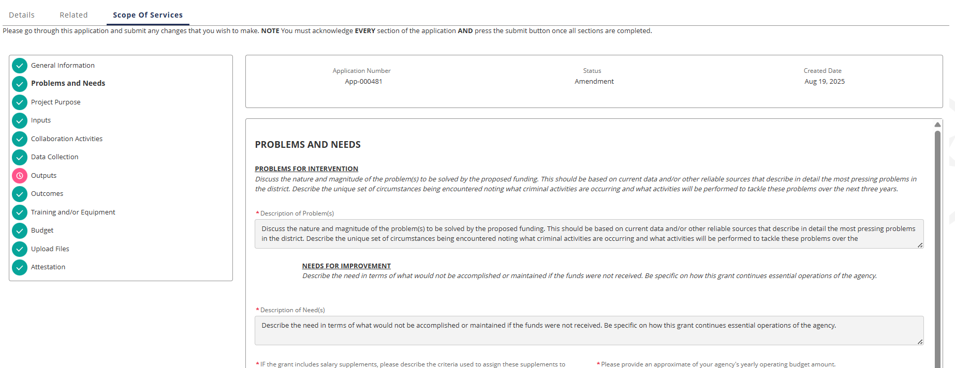
Requesting an Amendment
“Scope of Services” provides an overview of the changes to review before you hit the submit for approval button

Slide 13
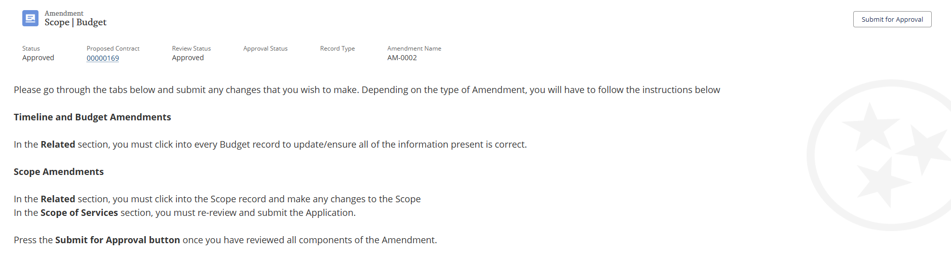
Requesting an Amendment
Once the final edits are made, press the “Submit for Approval” button

Slide 14
Signatures & Conga Sign

Slide 15
Conga Sign Workflow
Email Notification - Receive Conga Sign email with secure link
Review Contract - Click link to open and review full contract
Sign Document - Click signature fields and type your name
Confirmation - Receive copy of executed contract via email
Important Reminders:
Authorized signatory must match pre-contract documents
Check spam folder for Conga emails
No account creation required

Slide 16
Q&A

