Slide 1
Office of Criminal Justice Programs
Applying For Grants in TN Grants

Slide 2
Intro to Application

Slide 3
Before You Begin
Portal URL: https://tngrants.my.site.com/OCJPGrants
Have your account information ready
Know which agency you’re applying for
Identify team members and roles

Slide 4
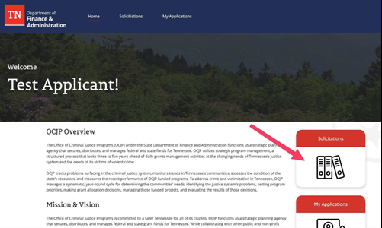
Finding Solicitations
Log into the portal
Select “Solicitations” on homepage
Choose the solicitation you wish to apply for
Click “More Information” to review
Click “Apply Now”

Slide 5
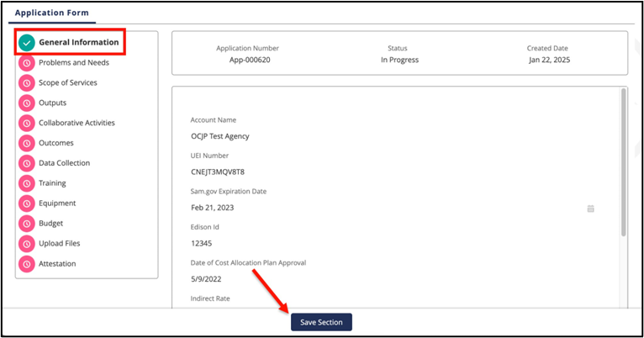
Understanding Application Interface
Pink Icon = Section Incomplete
Green Check = Section Complete
Save Section: Advances to next section (all required fields complete)
Save For Later: Saves progress for incomplete sections

Slide 6
General Information

Slide 7
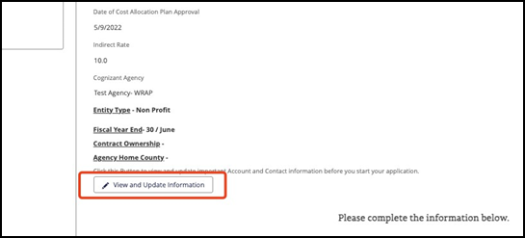
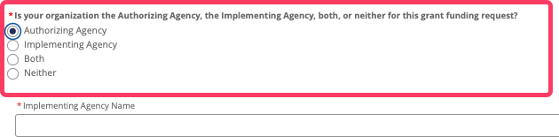
General Information
Review account details (update as needed)
Select Agency Type:
Authorizing
Implementing
Both/Neither

Slide 8
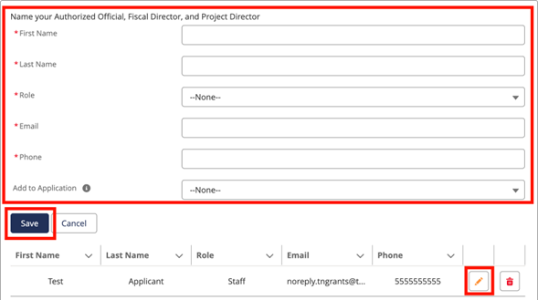
Personnel
Add Personnel (must be unique):
Authorizing Official
Fiscal Director
Project Director
First name
Last Name
Role
Email
Phone
Add To Application

Slide 9
Problems and Needs

Slide 10
Problems and Needs
Complete all narrative Questions
Add county location information
Click “add” for each county served
Click “Save Section” when complete

Slide 11
Scope of Services

Slide 12
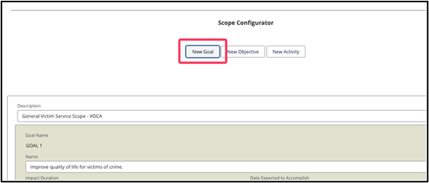
Scope Configurator – Build Project Structure
Create Goals (max 80 characters)
Add Objectives to each Goal
Add Activities to each Objective

Slide 13
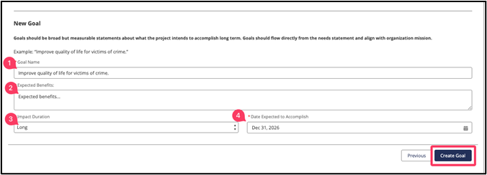
Goals
For each Goal enter:
Goal Name
Expected Benefits
Date Expected to Accomplish
Click “Create Goal”

Slide 14

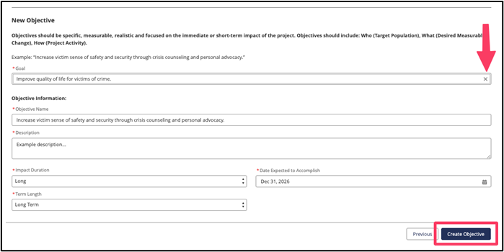
Objectives
Click “Add and Objective”
Objective Name
Description
Click “Create Objective”

Slide 15
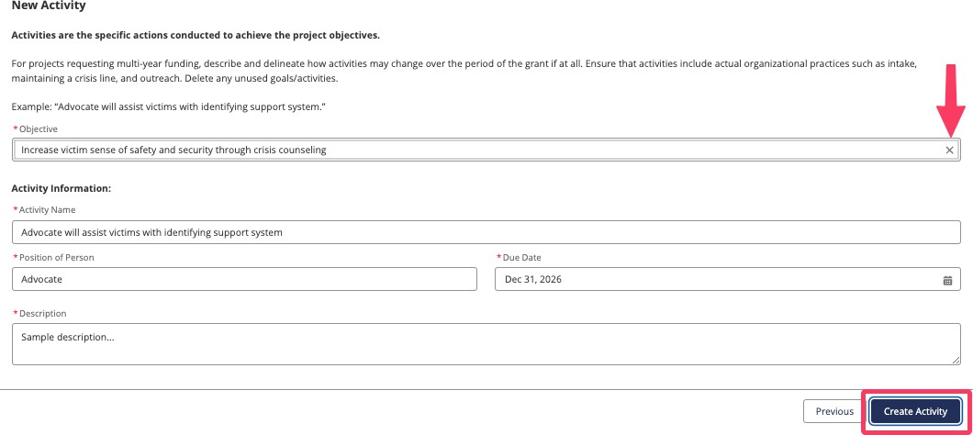
Activities
For each Activity, enter:
Which Objective it belongs to
Activity Name
Position of Person
Due Date
Description
Click “Create Activity”

Slide 16
Outputs and Inputs

Slide 17
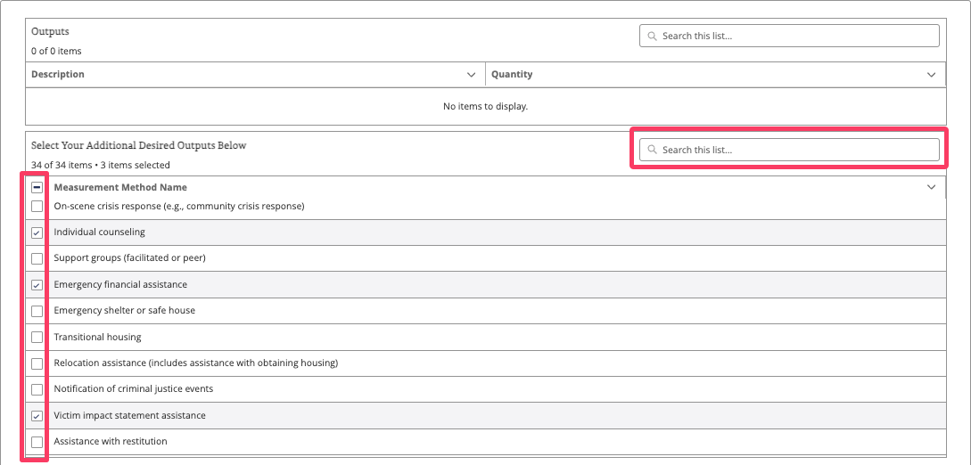
Outputs
In the Select Your Additional Desired Outputs Below table search for and select the checkbox for any outputs that apply to the proposed project

Slide 18
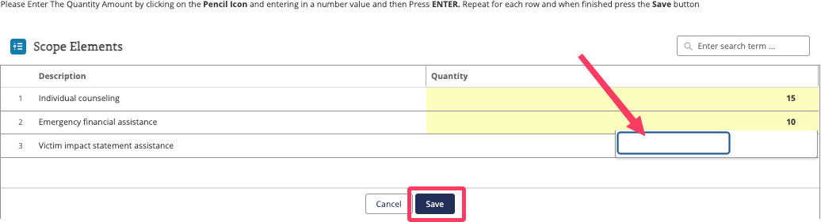
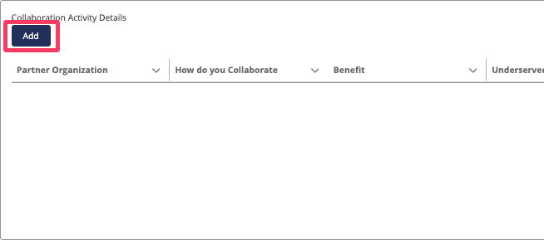
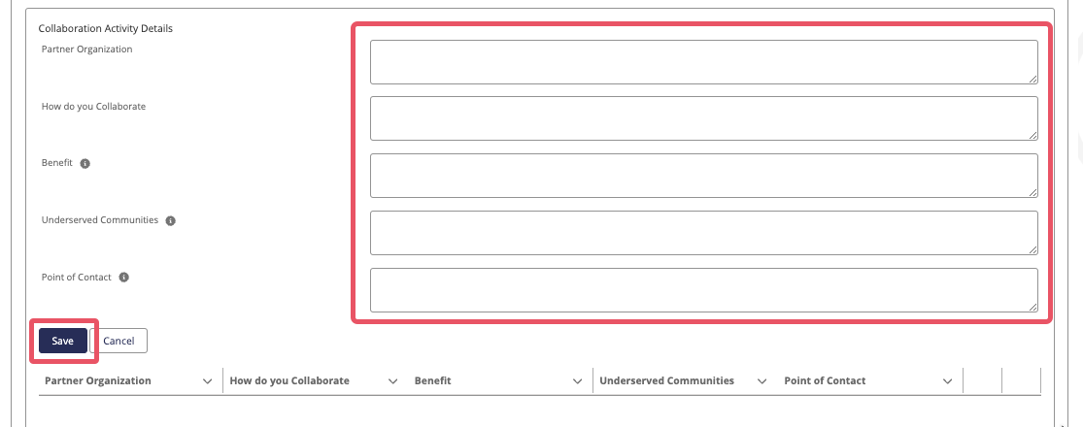
Inputs
Complete all questions about:
Measurable inputs
Project details
Collaborative activities
Click "Save Section" when complete

Slide 19

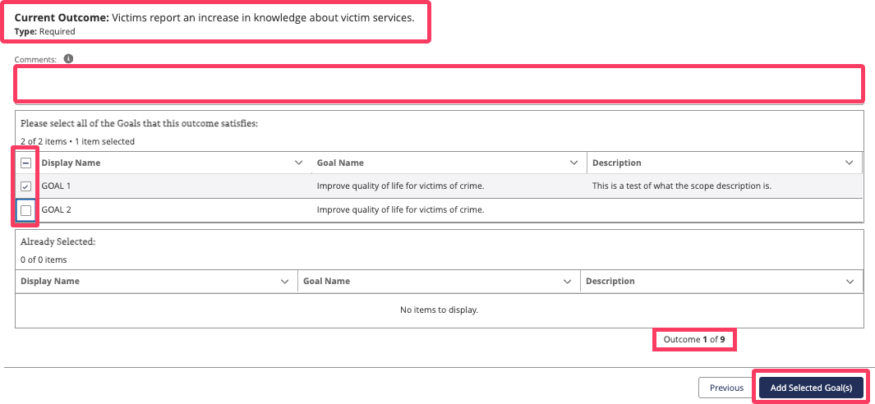
Outcomes
Intended Outcomes Conﬁgurator
Each outcome ties back to a project goal.
To assign, click Assign Goals

Slide 20
Budget

Slide 21
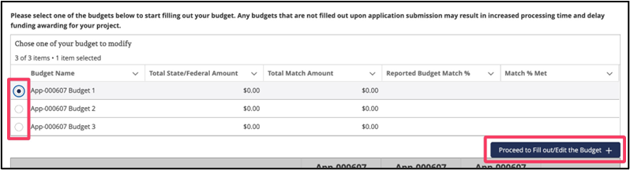
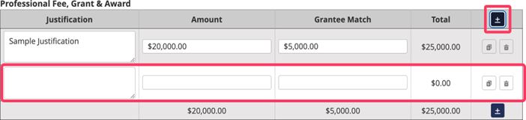
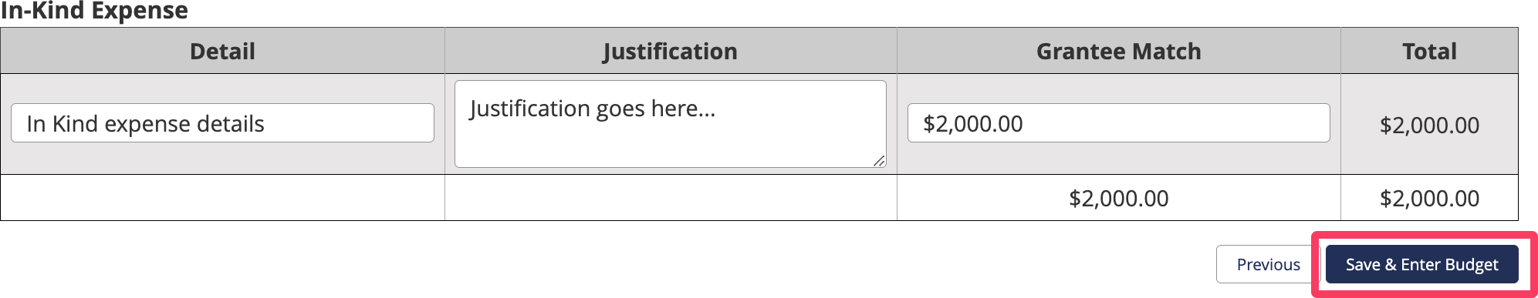
Budget
Budget categories are pre-populated based on solicitation
Enter amounts for each category
Review match requirements
Complete match waiver questions if applicable
Add other funding sources if applicable

Slide 22
Training & Equipment

Slide 23
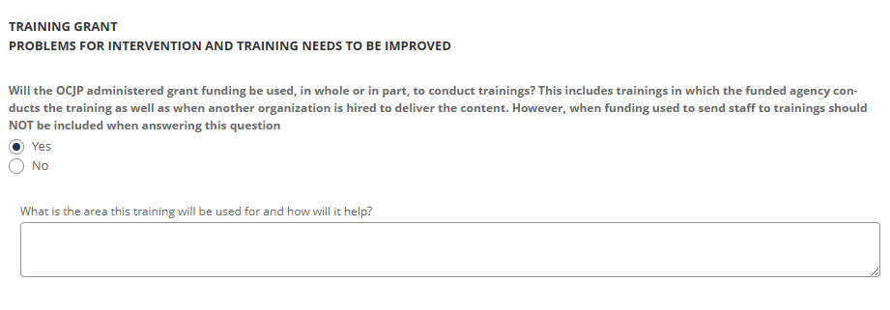
Training
Complete the Training section, clicking Save Section when complete.

Slide 24
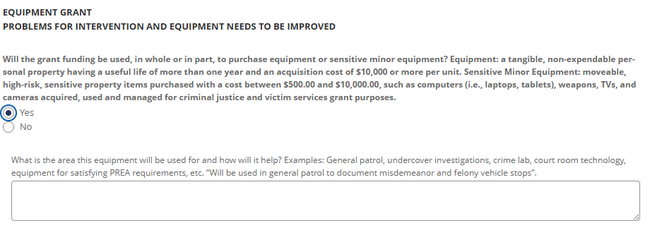
Equipment
Complete the Equipment section, clicking Save Section when complete

Slide 25
Upload Files

Slide 26
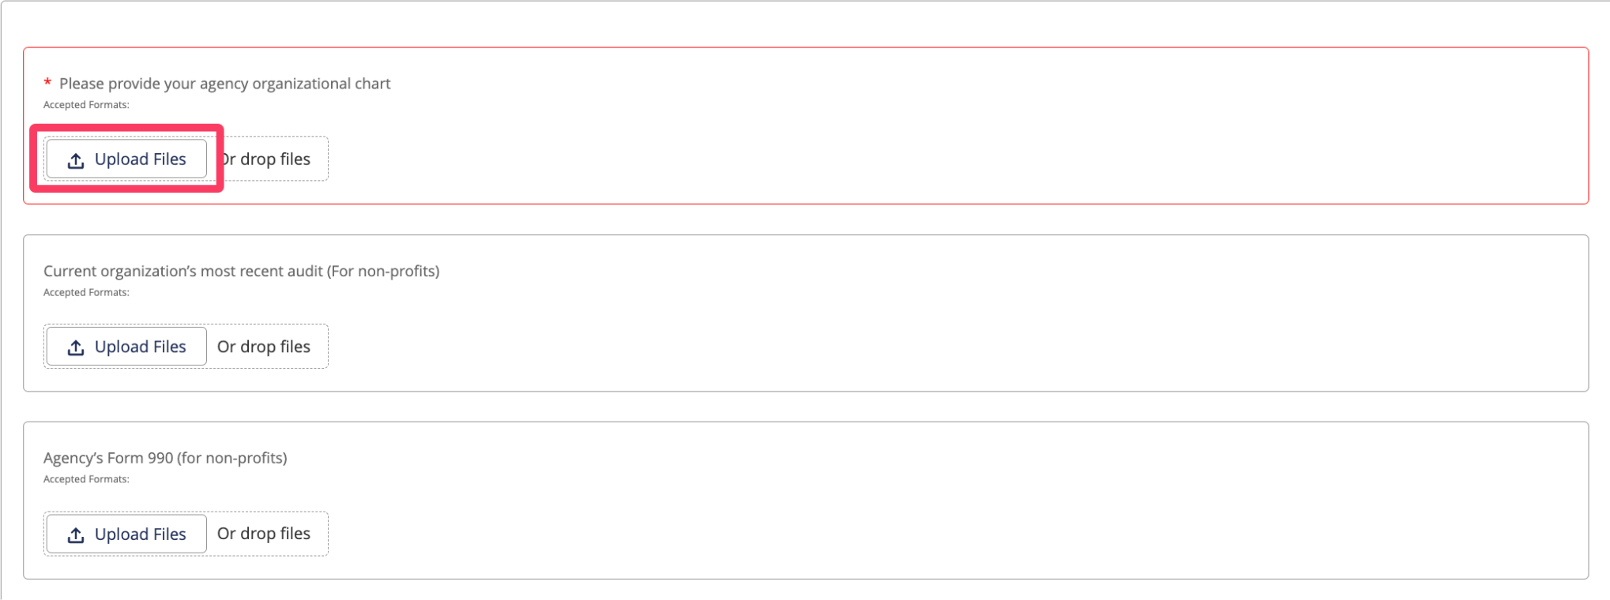
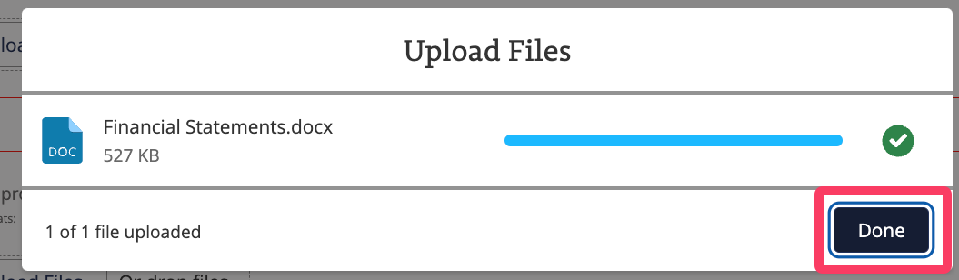
Upload Files
Upload all required documents
Click "Upload Files" for each requirement
Click "Done" after each upload
Verify all attachments are uploaded before saving section

Slide 27
Review and Submit

Slide 28
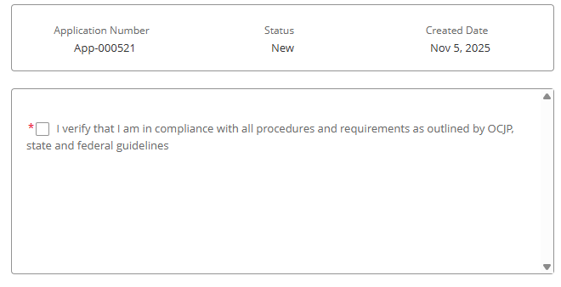
Review and Submit
All sections show green checkmarks
Review all information for accuracy
Confirm all attachments uploaded
Team members have appropriate access
Compete Attestation to submit application

Slide 29
Demo and Q&A

