Slide 1
Office of Criminal Justice Programs
Intro To TN Grants

Slide 2
Intro To TN Grants

Slide 3
Today’s Topics
What is TN Grants?
Portal Registration
Job Aids & Support
Technical Assistance
A live demo of the user portal

Slide 4
What is TN Grants?
Web-based system for managing OCJP grants
Manages full grant lifecycle
Replaces previous grant management processes
Access at: https://tngrants.my.site.com/OCJPGrants

Slide 5
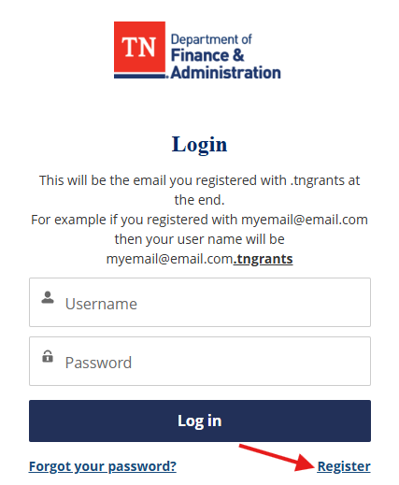
Getting Started
Go to https://tngrants.my.site.com/OCJPGrants
Click login > Register
Be sure to use your organizational email
Check email for verification link

Slide 6
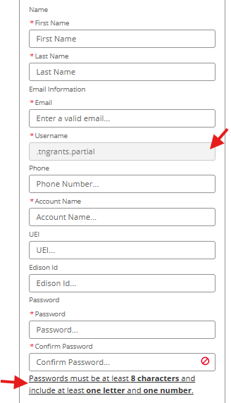
Registration
Use your official organization email
Username (your email + .tngrants)
Verification link expires after 24 hours
One account per person

Slide 7
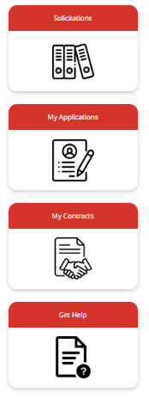
Navigation Basics
Dashboard: Your landing page
Solicitations: Available Grants
Applications: Submit and track
Contracts: View funded contracts
Get Help: TA Requests & Job Aids

Slide 8
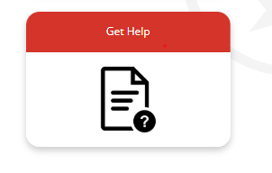
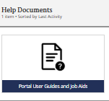
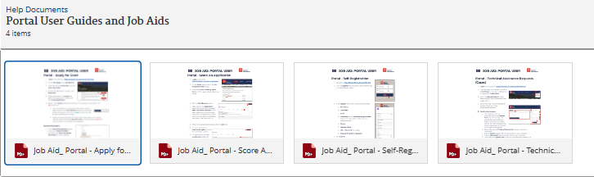
Available Job Aids
Portal Self-Registration
Submitting Applications
Application Scoring
Technical Assistance

Slide 9
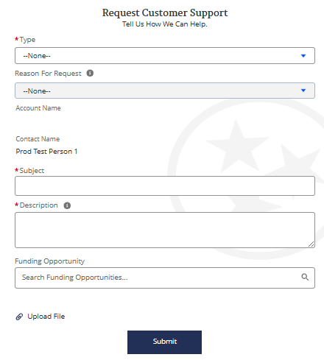
Technical Assistance
Submit Technical Assistance Request in portal
Include error messages
Response within 1-2 business days
This is for system-related issues only

Slide 10
Thank you So much!

