Slide 1

Grants/Projects Year end Closing Procedures & Tips State Fiscal Year 2021

Slide 2
Agenda
Welcome
Grants Operational Closing Procedures Document
Revenue Closing Timeline
Grant Tips
Question and Answers

Slide 3
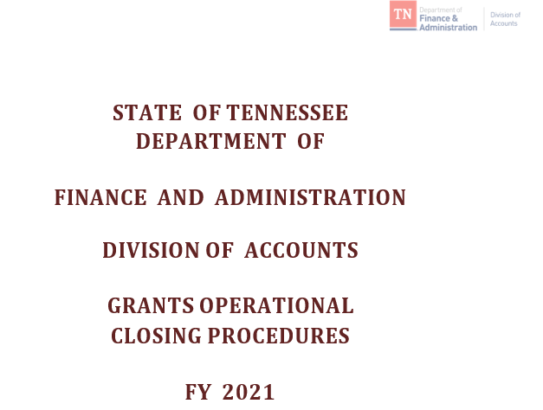
Grants Operational Closing Procedures
Word document
Having step by step
Instructions with
Dates & Examples
for all steps along
With Tips on SEFA
& SIS reporting
(Grants Accounting)
    https://www.tn.gov/finance/grants-information-sharing.html

Slide 4
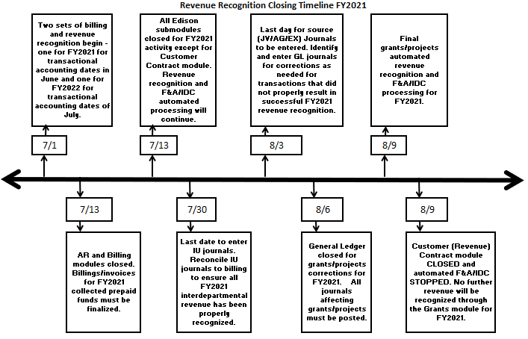
Grants/Projects Revenue Recognition Closing Timeline FY2021

Slide 5
Analyze and take action to close and/or complete Open Grant Items in Accounts Receivable
Run query TN_AR18C_ALL_OPEN_ ITEMS_FD_SC
  Invoice accounting dates greater than 30 days need to be analyzed and resolved.
Run query TN_AR18B_OPEN_OA_ITEMS
  All open OA deposit items should be closed within fourteen (14) days from the accounting date of the OA deposit item.
  Create maintenance worksheet with guidelines in the AR manual; change “Accounting Date to 6/30/21 only can be done until 7/13/21.”

Slide 6
Perform Reconciliations of AR
Accounts 12000001 and 11120001
Reconcile AR Account 12000001
Reconcile Unbilled AR Account 11120001
Directions are on the Grants Sharing Website
    https://www.tn.gov/finance/grants-information-sharing.html

Slide 7
Identify and complete any Customer (Revenue) Contracts/Grants in a Pending Status or any Customer (Revenue) Contract Amendments in a Pending Status
Run TN_GR22_CONTRACTS_PENDING
  Transactions on projects in pending contracts do not bill or recognize revenue.
Run TN_GR40_PENDING_AMENDMENTS
  Transactions awaiting the completion of a Customer (revenue) Contract do no bill or recognize revenue.

Slide 8
Reminders on Customer Contracts
Domino effect of wrong “Rate Set”
  If flow-through from another state agency “68090” or if received from a non-governmental sponsor “68060”
    Could have recognized 68001 Federal Revenue even if you have not billed
  If agency corrects using GL JV’s instead of creating new grant/project – remember domino effect that a billing (BI) journal may be left in the system
  Do NOT change rate set dates once Contract created!
  7XXX expenditures do not bill on STAT rate sets

Slide 9
Identify and resolve
Over-the-Limit (OLT) transactions
Run TN_GR19_OLT_CHECK query
Options to select:
  Contract billing limit could be increased.
  Expenditures need to be moved to different grant.
  Expenditures need to be changed to a STATE activity.
  Expenditures need to be moved to state with no project ID.

Slide 10
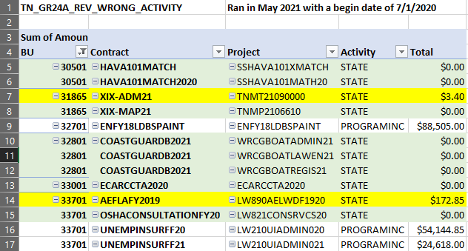
Identify and resolve errors in Revenue Recognition
Step 1: Identify Customer Contracts which have revenue recognized to wrong activity and take corrective action.
Run query TN_GR24A_REV_WRONG_ACTIVITY
Analyze
results
and make
corrections
as needed !
Take care
about entries
crossing
state years.

Slide 11
Identify and resolve errors in Revenue Recognition
Step 1: Identify Customer Contracts which have revenue recognized to wrong activity and take corrective action.
Revenue recognized to wrong activity could be avoided:
  By monitoring TN_GR01_GRANT_PROJECT_LIST after creating new grants to look for mis-matched Rate Sets to Sponsors or Project Activity(s).
  By monitoring TN_GR27_RATE_SET_ERRORS on a weekly basis or after activation of new grants into Edison.
  By monitoring the “TN_GR03” query daily for the “STATE” activity appearing and billing – it should not appear unless it is correcting a previously billed error.
  By monitoring the “TN_GL64_REVENUE” or Trial Balance query looking for 68001000 on Projects with “STATE” activity.

Slide 12
Resolve other errors in Revenue Recognition - Identify and resolve Revenue not recorded to a CN Journal - Step 2
Run query TN_GR_A07_REVENUE_NOT_CREATED
From the query, create a pivot table and analyze…
Unrecognized revenue cannot be resolved if a Customer Contract has had its Contract Processing Status marked Cancelled or Superceded!
Closed Contracts cannot be undone!
Utilization of a prepaid pulls on this query if the second
CN (utilization) journal has not been created – it takes an extra day to create due to the timing of the batch processes.

Slide 13
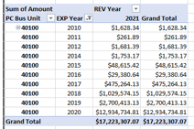
Identify and anticipate year-end effect of revenue recognized in a different year than expenditures - Step 3
Run query TN_GR06X_REV_EXP_IN_DIFF_YEAR
SEFA pulls from
revenue recognized
from the expenditures,
not from the
expenditures
plus the accruals (YAE)
Revenue for adjusting Periods
991, 992, etc. is in Period 12
Revenue
Expenditures

Slide 14
Identify and Resolve Indirect Cost (F&A) Errors
Run TN_GR28_SFA_COM_CNTRL_ERRS query
Run TN_GR29_SFA_INTERACTIVE query
Edison helps to notify you of these errors weekly, but it is up to the agency to resolve the errors.
If not corrected, no indirect cost for any Project ID will process for that agency.

Slide 15
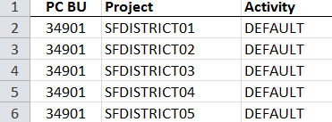
Review and analyze projects not associated with a Customer Contract.
Run TN_GR22A_PROJ_NOT_ON_CONTRACT or TN_PR140_PROJECT_NOT_CONTRACT and analyze…
If reporting project, it
is valid to pull on query.
If costs need to be re-allocated via GL JE, run query TN_PR101_PROJECT_COST_DETAIL to get details.
If Edison does reallocations – the Agency/business unit needs to review to ensure all values were reallocated & clear any errors.

Slide 16
Determine and resolve any Abnormal situations which exist or if “analysis types” have been incorrectly used.
Run query TN_GR23_ANL_TYPE_ABNORMAL
The Project “Activity” along with “Analysis type” should identify funding source.
  7XXXXX accounts do not belong with GLR
  6XXXXX accounts do not normally belong with GLE
    Exception with Refund of PY Federal Expenditure paid back via AP using 68012000 with Project ID and Federal Activity receives an ACT analysis type
  STATE Activity does not normally have GLE
  FEDERAL Activity does not normally have CGE
  Federal Rate Set 68001 should not have a Project ID with an INTERFED, INTERMATCH or NONGOV Activity

Slide 17
Determine and resolve any abnormal situations which exist or if “analysis types” have been incorrectly used
Analysis types to use only in General Ledger Journals
  GLE – General Ledger Expense
  CGE – Cost Shared General Ledger Expense
  SJE – Statistical Journal Entry
  SFA – Indirect Cost Expenditure
  OFA – Contra Indirect Cost Expenditure
  GLR – General Ledger Revenue
  YAE – Year-End Accrued Expenditures
  YAR – Year-End Accrued Revenue

Slide 18
Determine and resolve any abnormal situations which exist or if “analysis types” have been incorrectly used
Analysis types to use only in AG Journals
  GLE – General Ledger Expense
  CGE – Cost Share General Ledger Expense
  GLR – General Ledger Revenue

Slide 19
Determine and resolve any abnormal situations which exist or if “analysis types” have been incorrectly used
Analysis types to use only in IU Journals
  GLE – General Ledger Expense
  CGE – Cost Share General Ledger Expense
  IUR – Interdepartmental Revenue
  GLR – General Ledger Revenue – exception on Refunds or Program Income

Slide 20
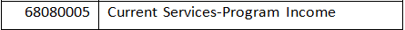
Determine and resolve any abnormal situations which exist or if “analysis types” have been incorrectly used
PROGRAMINC automatically reduces the Federal draw when recorded on a Journal entry or a deposit with Project ID, Federal Activity and analysis type “GLR.”
PROGRAMINC returning as invalid value, but OK if agency is recording program income.

Slide 21
Review Project-related journals which have not posted
Review Project-related Journals which have not posted
This should be done each Friday through July 23rd !
Done daily on these dates from Monday, July 26th to
Tuesday, August 3rd.
Each morning through August 6^{th -} last day for DOA to approve JV/EX journals
As various periods close – watch for journals not approved in the period that is closed
No reallocation JV/AG/EX journals for grants/projects can be entered for state FY 2021 after Tuesday, August 3rd !!!!

Slide 22
Review Project-related journals which have not posted
Run TN_GR20A_JRNLS_NOT_POST_GR and analyze:
  Checking budget status
  Checking processing status
  Remember to include all open period dates
    Approve journals not approved by agency
    Evaluate if any have budget errors and resolve errors
    Budget errors on “ALLOT” must be resolved through F&A Budget
    If interagency IU journals, email or call corresponding agency
    Follow up on journals to determine why they are not posted
    If Division of Accounts General Ledger group has denied – they can be re-worked & re-submitted (short time frame!)

Slide 23
Deadlines for requesting changes on Speedcharts/Task Profiles
6/24 - For new speedcharts related to Projects for FY22 that must be entered for an effective date of July 1st
  Submit 100% speedcharts separately from split speedcharts

Slide 24
Evaluate transactions that have not yet billed
Run TN_GR20_UNBILLED_TRANS_DETAILS query vs TN_GR20_ELIG_UNBILLED_TRANS_DT
Contract Status and Processing Status need to be Active
  Projects must be “O” Open to have transactions to bill
  Activities must be “Active” to have transactions to bill
  OLT does not bill nor recognize revenue
  Just because you delete the temp bill, the transactions
  don’t go away
  Transactions on TN_GR03 with FEDERAL Activity have had revenue recognized & will appear on SEFA
  “DEF” lines have the deferred date as the Bill date on TN_GR20

Slide 25
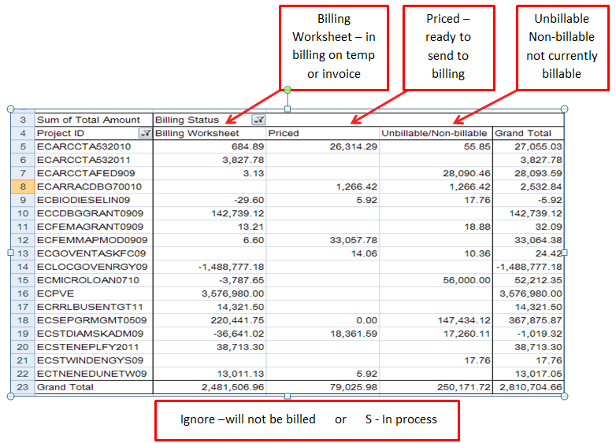
Evaluate transactions that have not yet billed
Then use Query
TN_GR20
to analyze
with Pivot
Table –
Billing
Status in the
Column

Slide 26
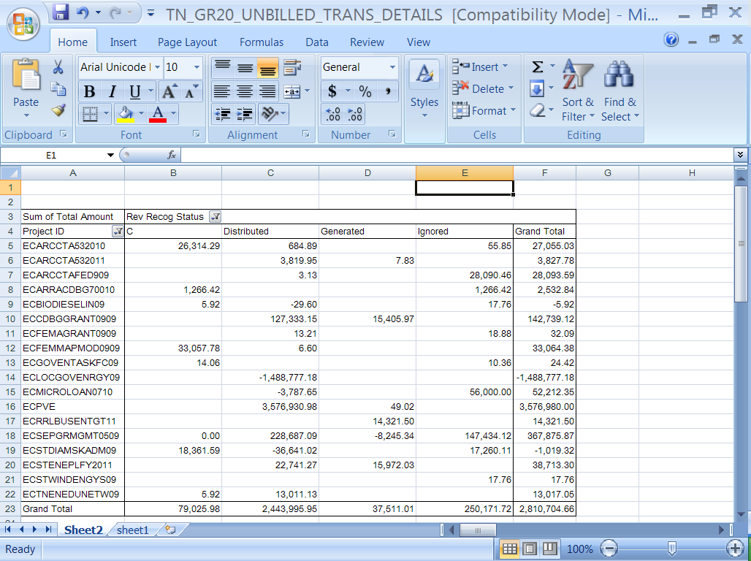
Evaluate transactions that have not yet billed
Then use Query
TN_GR20 to analyze
With Pivot Table-
Revenue
Recognition
Status
Revenue may
be recognized
on future dated
journals;
Revenue is ignored
on interdepartmental
C = Revenue processing has not yet occurred
Distributed = Revenue has been recognized & posted to GL
Generated = Revenue accounting lines have been created but not posted to GL
Ignored = Revenue will not be recognized
S = Revenue is in process None = Revenue has not been recognized

Slide 27
Evaluate transactions that have not yet billed
Run TN_GR_A09_EXP_NOT_PRICED query
Notify:
  Division of Accounts Grant Accounting Manager – Mary Lou Goins
  File an Edison FSCM Projects/Grants Remedy Help Desk Case

Slide 28
Reconcile pass-through
Grants BLD & Interdepartmental Revenue
Run TN_GR04_INTERDEPT_AR query periods & analyze
Does BLD and IUR equal?
  If yes, the billed amounts of the invoices equal the IU revenue & Supplemental Schedule will be correct!
Does BLD and IUR not equal?
  If yes, validate all bills have been approved & processed through Single Action.
  Create IU journals (should have a value $1,000.00 or greater)
  If invoice amount different from IU, does billing need to be adjusted with a GL Journal to move transactions?

Slide 29
Last Day to enter Project Related
Travel Expenditures – 6/30
Last day for all travel expenditures with accounting dates in June related to Grants/Projects to be submitted.
Can I enter travel in July and date it with a June accounting date?....only if agency is reallocating on a journal entry travel that has already been entered and processed in FY21.

Slide 30
New State Year Begins – FY22
Date Reminder on TN_GR03
        July 1st
Two sets of billing and revenue recognition begins for State Fiscal Year 21 and 22
Two temp bills for each Contract/Grant if transactions exist in both state years
JV/EX/AG’s in Adjustment Periods (991-992-993-994) are always dated 6/30/2021!

Slide 31
PREPAID Zero Dollar Billings
Remember to BILL the PREPAIDS
which have June transactional accounting dates
with JUNE Billing dates separately !
Would use two separate run controls in billing !
Can be done until the AR and Billing modules
close on July 13th but recommend doing before the last date !

Slide 32
Prepaids
Creation and Processing of (Immediate Billing) Prepaids associated to Customer Contracts/Grants for deposits received in June or before is July 13th!
  Customer (revenue) Contract and associated Prepaid
    Should be created in June
    Immediate billing (process other billing methods) occurred in June
    Deposit recorded in June
    Invoice Item created from Immediate billing needs to be closed in June
    All has to occur before the AR module closes

Slide 33
Submodules Closed
      Tuesday, July 13th
All Edison submodules closed for FY21
except for……..
  Customer Contract – Revenue recognition
    Remember that revenue recognition for transactions in adjusting periods is recognized in Period 12 not in adjusting periods (991-992-993-994)
  F&A (Indirect Cost) automated processing

Slide 34
IU Journal Dates: July 30 – August 2
7/30 - Last day of entry of IU journals by creating agency
8/3 – Last day of entry by secondary agency
8/4 – Approvals by both creating & secondary agencies
8/6 – Approval by Division of Accounts GL
This is a very short window if waiting until the last minute to enter the IU journals. The agency creating the IU needs to call and notify via email the secondary agency that an IU exists for them to complete!

Slide 35
August 3rd
Last day for entry of
miscellaneous JV/AG/EX journals to correct a
previous FY21 transaction
affecting Projects/Grants!

Slide 36
Perform Deferred/Advanced Revenue analysis
Run TN_GL048_TRIAL_BALANCE_ACCT for Period “0” to get beginning balances
  Use 35% (wildcard) to only get the deferred accounts
Analyze trial balance to get amounts by grant deferred revenue accounts for period “0”
Run TN_GL66_LIABILITY_ENTRIES_PD for each period and combine into a spreadsheet

Slide 37
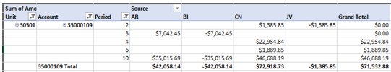
Perform Deferred/Advanced Revenue analysis
Create a pivot table to show the activity by period & source; adding period “0” from Trial Balance gives one the amount carried over from prior State year; interest (if applicable) comes from AL source.

Slide 38
Analyze grant related contra accounts for proper state year-end balancing.
Clear errors on F&A (Indirect Cost) processing.
Run query on Indirect Cost Expenditure & Contra TN_GR_A13_89040000_VS_89035000
Run query on Indirect Cost TN_GR_A13_IDC_NOT_IN_BALANCE
Run query on In-Kind Expenditure & Contra TN_GR_A13_89300000_VS_893010000

Slide 39
Wednesday - August 4th & Friday, August 6th
August 4th -Last day of agency/business unit APPROVALS of miscellaneous JV/AG/EX journals to correct a previous FY21 transaction
affecting Projects/Grants.
August 6th – Last day of Division of Accounts
APPROVALS of miscellaneous JV/EX journals
to correct a previous FY21 transaction affecting
Projects/Grants

Slide 40
Interest on Deferred Revenue accounts should be posted and Conversion (type) prepaids added to Customer Contract(s) and processed.
Refer to Grant Manual for prepaid creation.
Don’t forget about Prepaids created for interest earned on deferred revenue accounts.
Conversion close of interest related prepaids must be done by Edison financials – file Edison Help Desk case.

Slide 41
Tuesday - August 9th
Contracts Module & Automated Indirect Cost Processing Closed
Customer (Revenue) contract module closed for FY 21 (revenue recognition for FY21 will NOT occur after this date – CN Journals)!
Remember Revenue recognition occurs in period 12 for reallocations of expenditures recorded in the adjusting periods.
  Project expenditures coming through Cost Allocation Period 991 along with Indirect Cost will be in the next state year.

Slide 42
August 10th
Billing for State FY2021 Stops
Last day for temporary bills on TN_GR03 with separate 2021 State Year accounting dates to occur!

Slide 43
Evaluate 2021 Journals
Run query TN_GR20A_JRNLS_NOT_POST_GR
Evaluate miscellaneous JV/EX/AG journals which were NOT approved for FY21 transactions affecting projects/grants and delete the journals not approved.
Exception – if material to agency/business unit’s closing

Slide 44
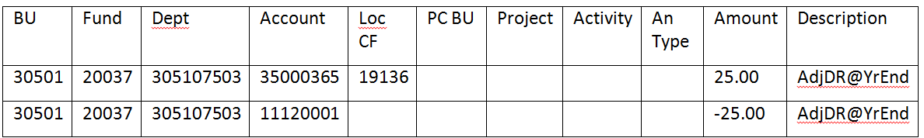
When all “zero dollar” invoices are processed, create a “no project” journal to adjust for Utilization (reduction of Deferred/Advanced of “zero dollar” billings for FY21 with billed dates in FY22)
Run query TN_GR_A06_UTL_IN_NEXT_FY
Create and process Journal to correct the Unbilled AR and the Deferred/Advanced account balances

Slide 45
Project Errors on Speedcharts !
Query TN_GL60PE_SPDCHRTS_PRJ_ERRORS is a query that an agency can use on a regular basis (at least monthly) to identify SpeedCharts/Task Profiles that contain a Project ID that may no longer be valid due to the following situations:
  The Project Budget end date in Commitment Control is in the past
  The Project ID is used in a Task Profile but does not have a budget for salaries and benefits

Slide 46
Grants Operational Closing Procedures
Word document
Having step by step
Instructions with
Dates & Examples
for all steps along
With Tips on SEFA
& SIS reporting
(Grants Accounting)
    https://www.tn.gov/finance/grants-information-sharing.html

Slide 47

Important Note:
Remember the Domino Effect….
As you do various steps, you WILL have to recheck queries…..
Questions & Answers ?????

