Slide 1

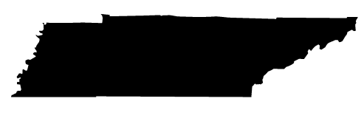

State of Tennessee AI Advisory Council Meeting
April 14, 2026

Slide 2
Opening Remarks Commissioner Jim Bryson & CIO Kristin Darby

Slide 3
Public Comment

Slide 4
Subcommittee Updates

Slide 5
AI Summit Recap

Slide 6

From Convening to Action: What the AI Tennessee Summit Set in Motion
An Organizing Team Perspective
Dr. Anne M. Ho University of Tennessee, Knoxville
Amanda Glover SCORE
M. Jeff Brittain FedEx Institute of Technology @ The University of Memphis

Slide 7
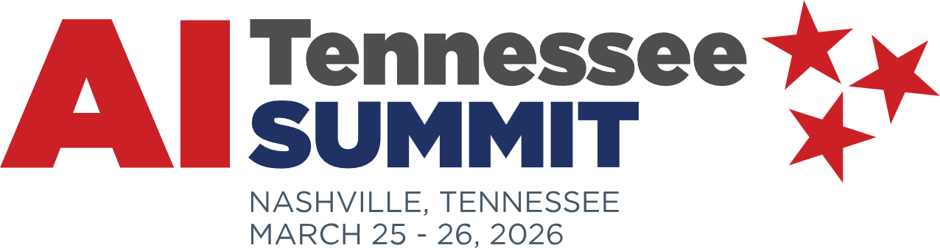
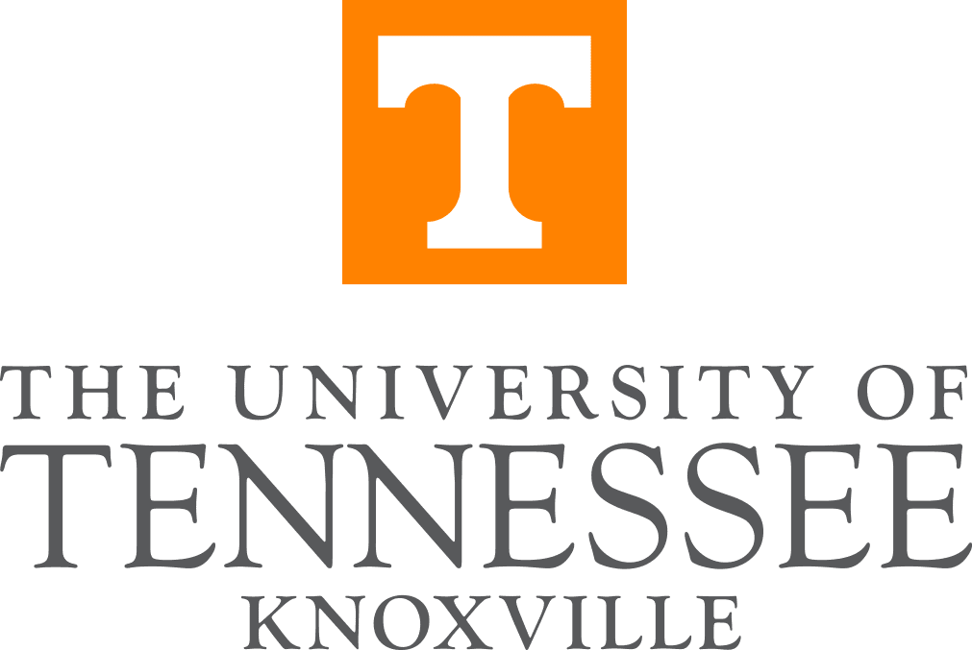
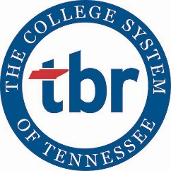

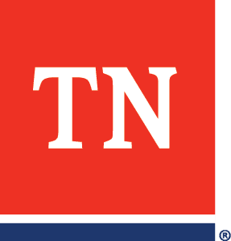

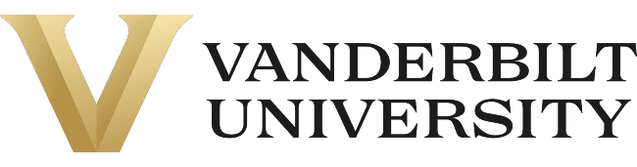
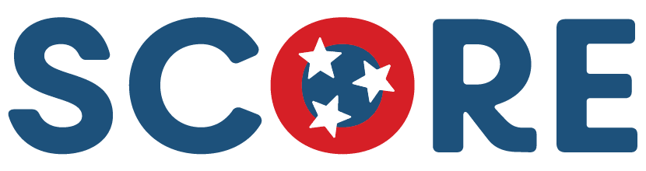

Slide 8
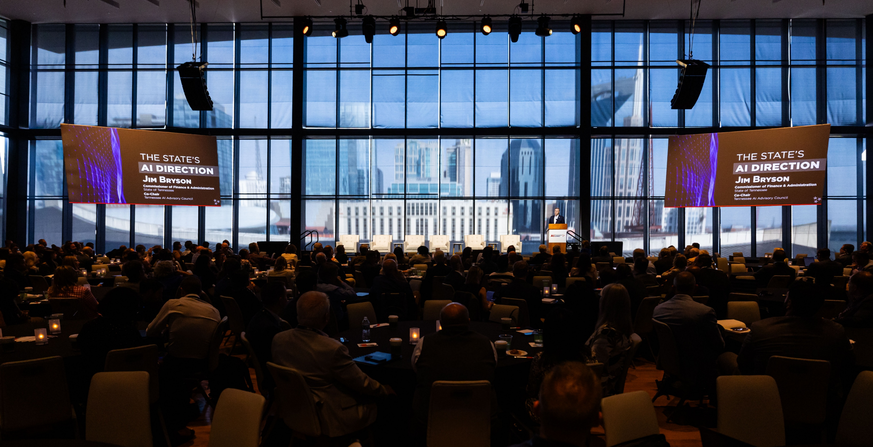
Photo credit: UT

Slide 9
By the Numbers
481 attendees
64 speakers
26 sessions
95% would attend again
1.2 million media views

Slide 10
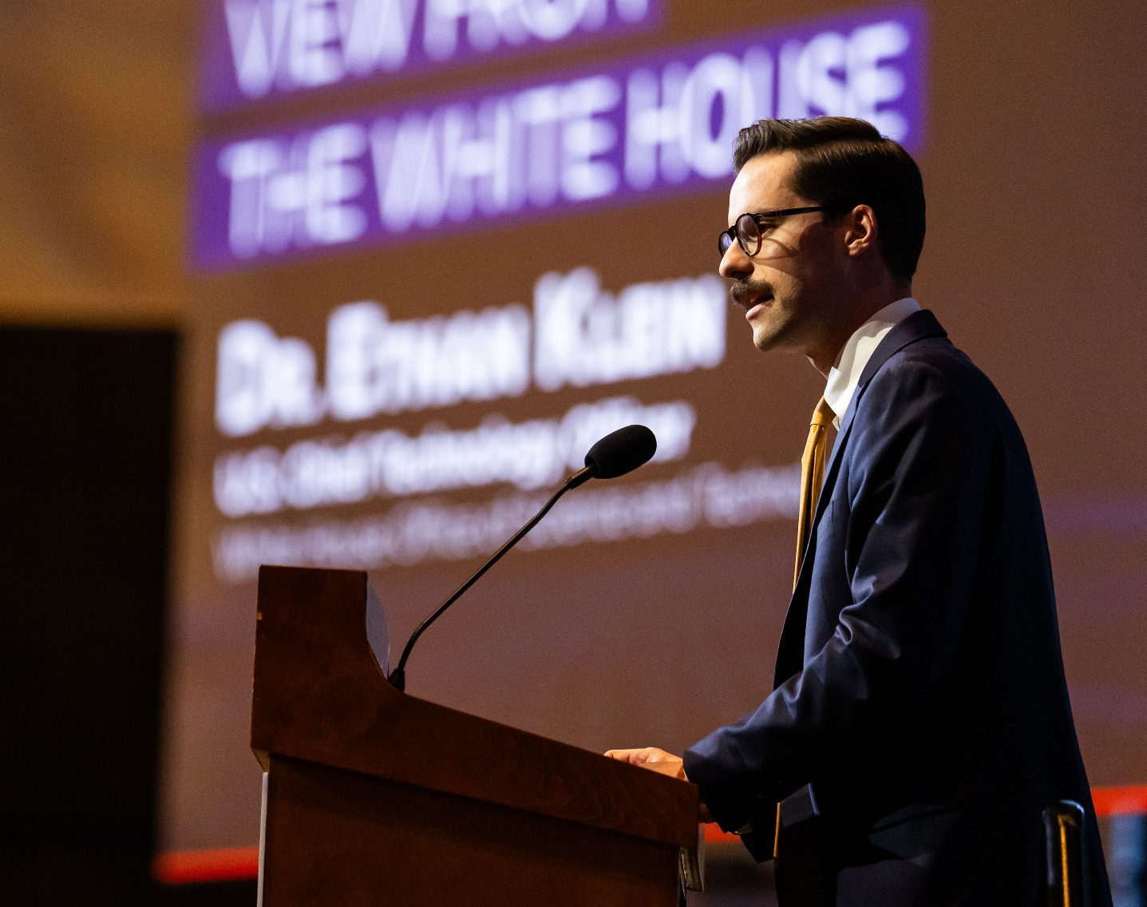
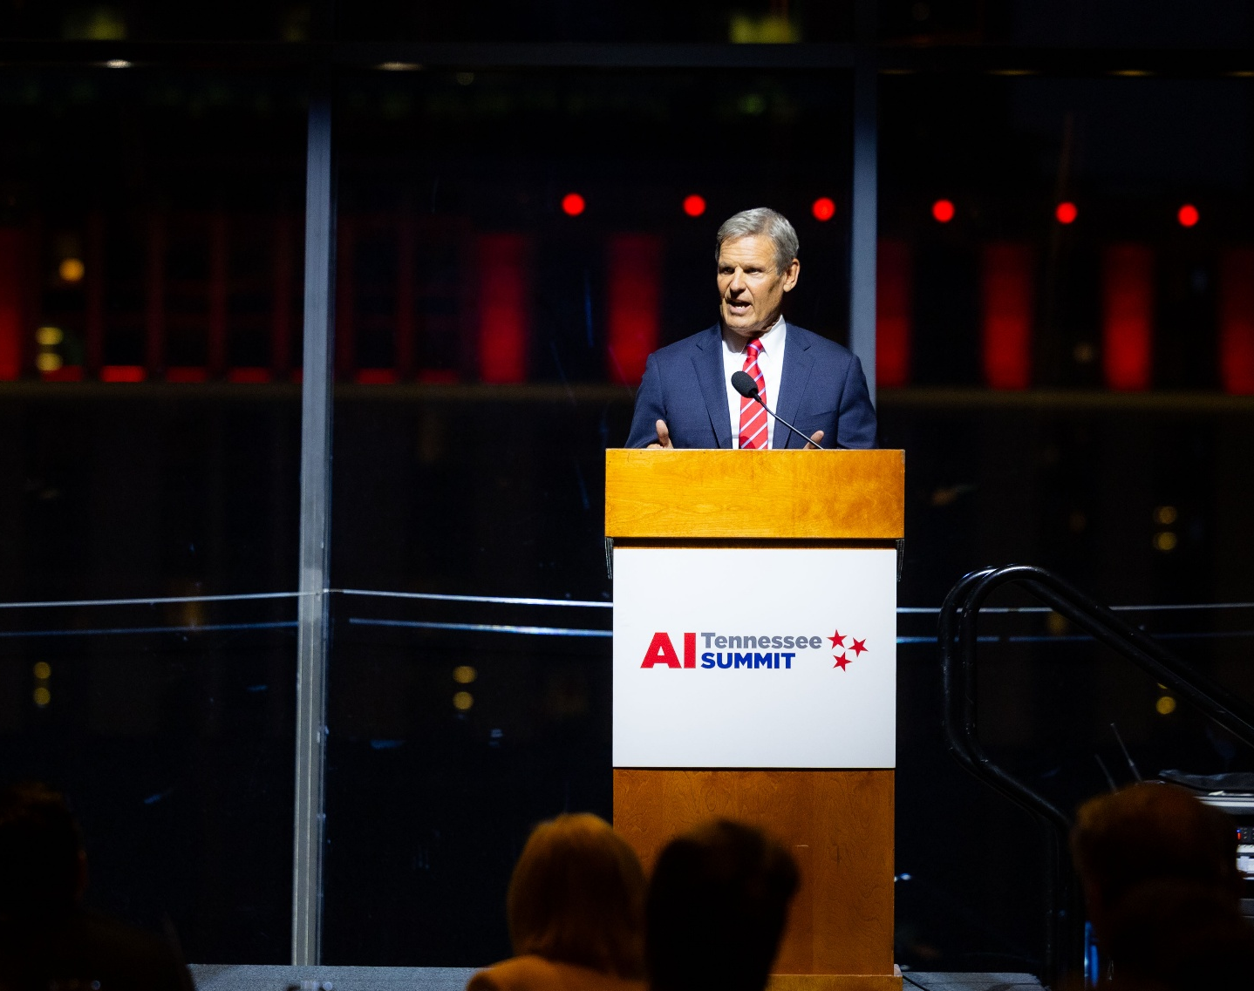
National and State Leadership
Photo credits: UT

Slide 11
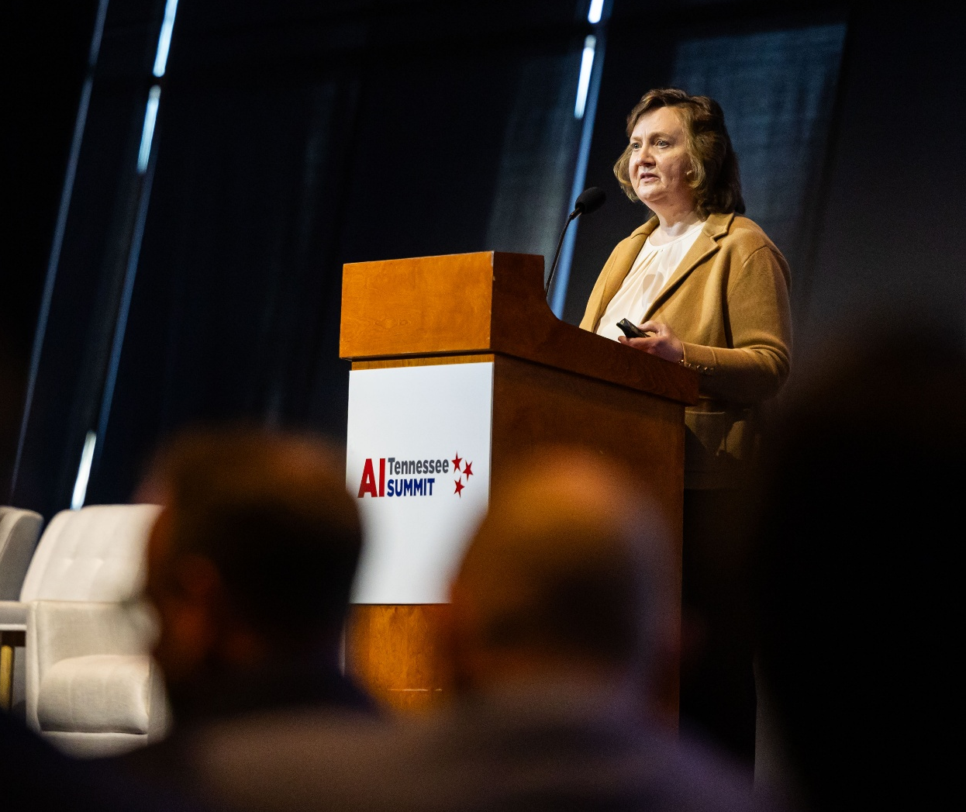
“The Tennessee Way”
“When people across the country ask, ‘How do you actually do AI right?’ The answer will be: You do it the Tennessee way. By leading with people, trust, and collaboration at scale.”
–Dr. Lynne Parker, Former Principal Deputy Director (White House OSTP) & Associate Chancellor Emerita (UT Knoxville)
Photo credit: UT

Slide 12
Themes that Surfaced Across Two Days
Infrastructure
Talent Pipeline
Industry Partnership and Economic Competitiveness
Research and Innovation
Cross-Cutting Priority: Policy and State Leadership
These support and reinforce the Council’s AI Action Plan.

Slide 13
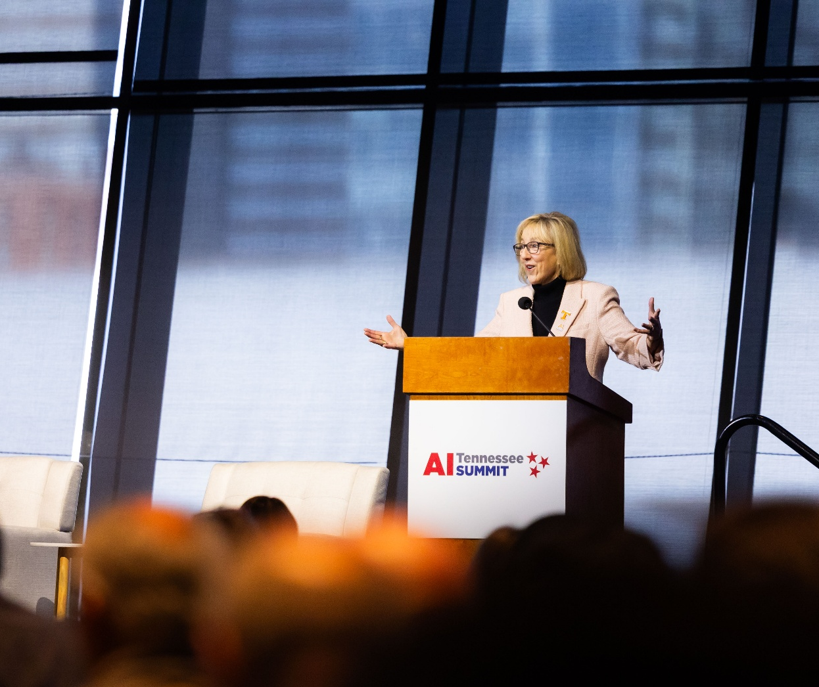
Radical Collaboration
“We’ve got to think radically different about how we partner, how we collaborate, and how we achieve the goals that the state of Tennessee needs.”
– Donde Plowman, Chancellor (UT Knoxville)
Photo credit: UT

Slide 14
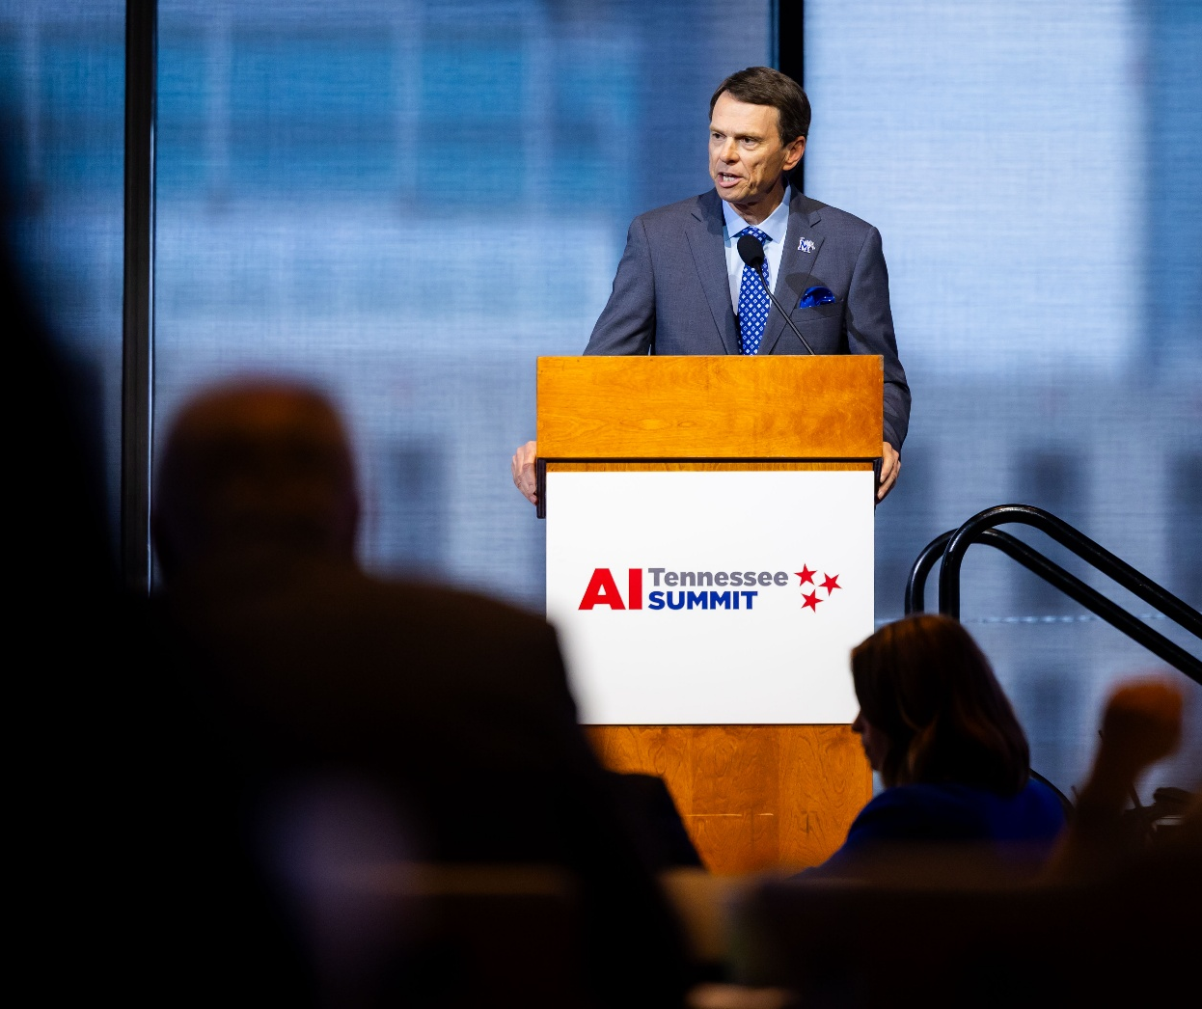
A View from the Room
“Collaboration across institutions is essential, but so is the geographic and economic momentum.”
– Bill Hardgrave, President (University of Memphis)
Photo credit: UT

Slide 15
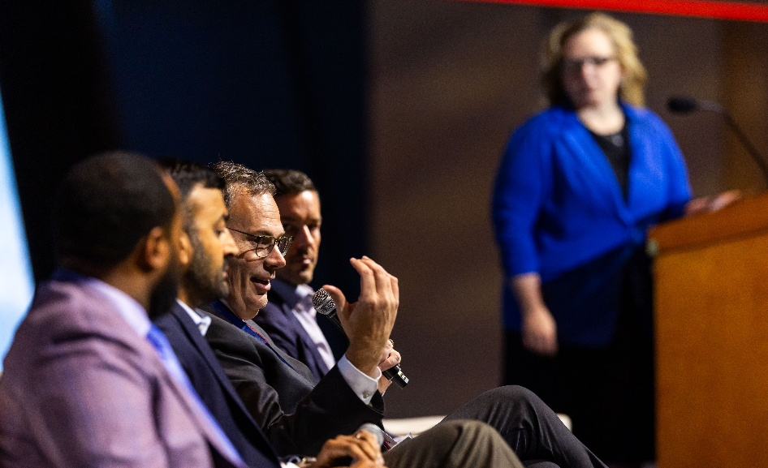
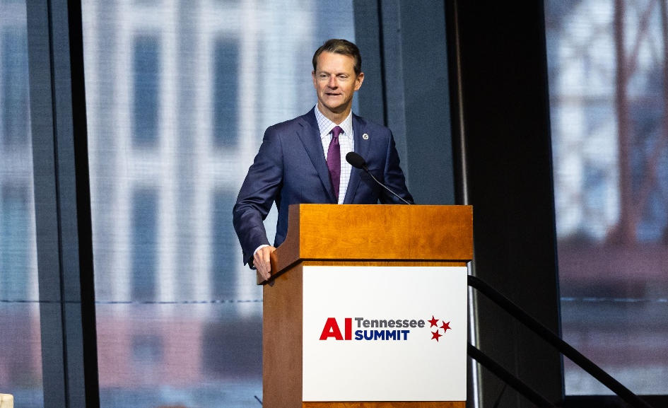
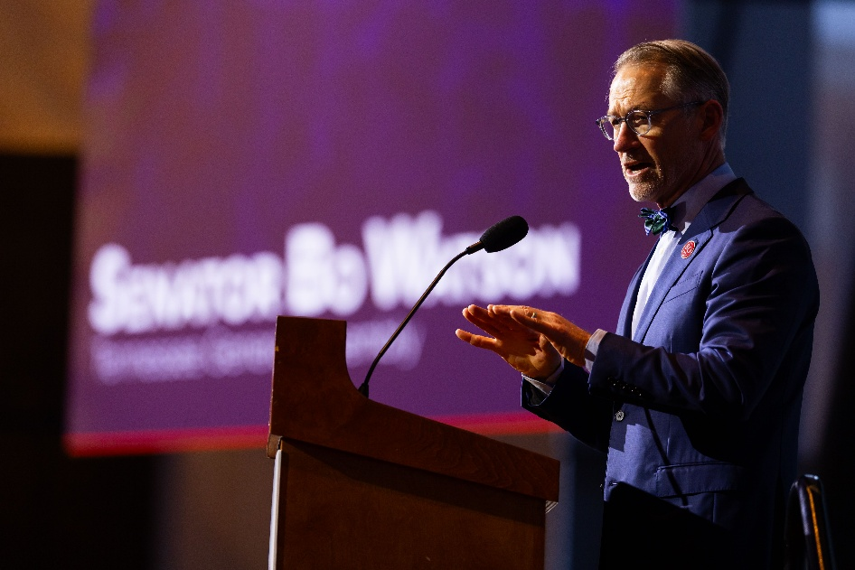
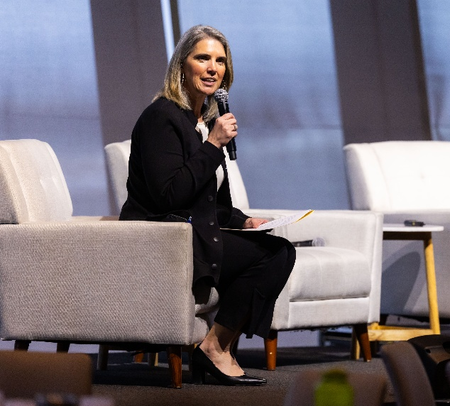
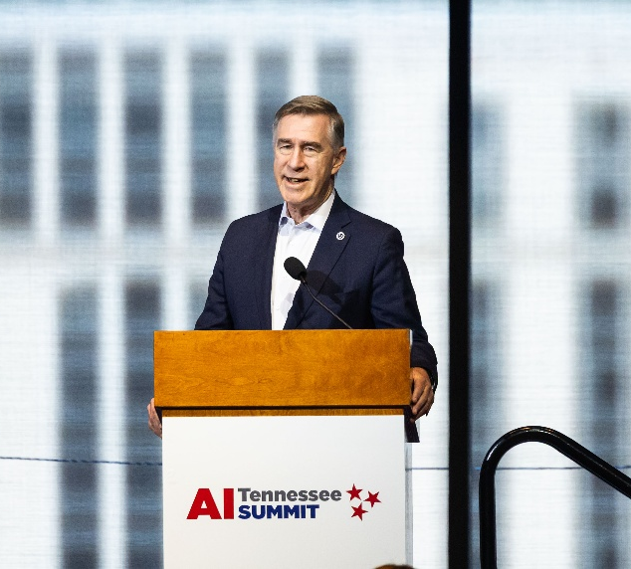
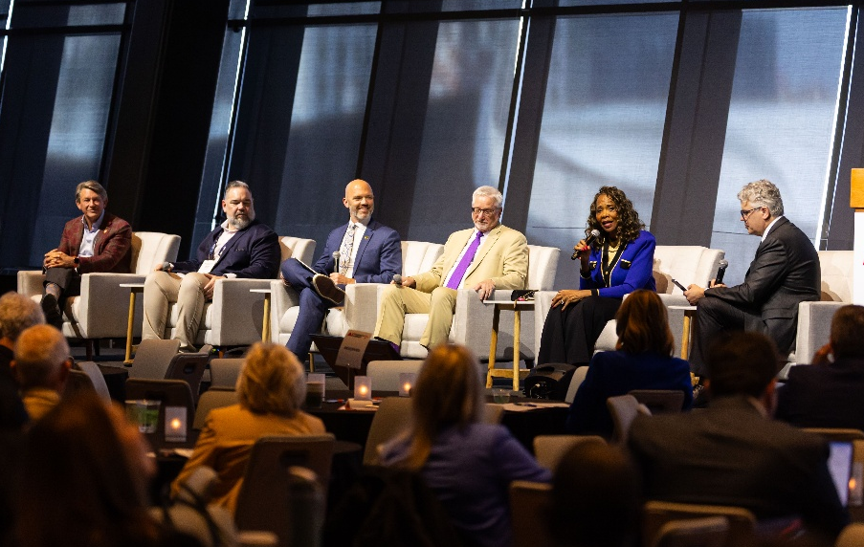
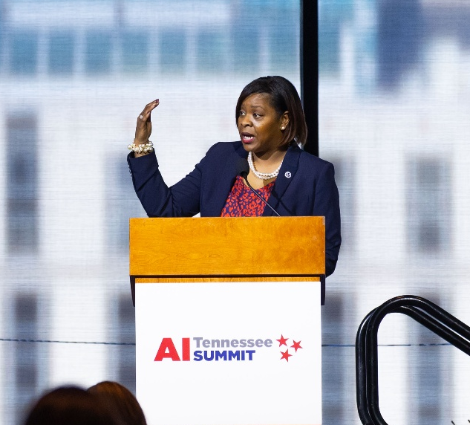
Leadership in Action
Photo credits: UT

Slide 16
What Changed Because of the Summit
From fragmented AI conversations → To shared statewide priorities
From isolated pilot projects → To focus on coordination and scale
From AI as only a technical issue → To AI as a leadership responsibility

Slide 17
Key Takeaway #1: Tennessee Leadership
Tennessee is on the national stage.
State and regional leadership are already setting direction
Tennessee regions were named as national models
The opportunity is active partnership, not passive funding

Slide 18
Key Takeaway #2: AI Fluency
Make AI fluency the standard.
AI literacy is now a baseline expectation at role‑appropriate levels across sectors
Education, workforce, and industry converged on this point
The stakes are urgent and economic, not long-term or abstract

Slide 19
Key Takeaway #3: Alignment
Tennessee needs to align existing assets.
Tennessee is not building an AI ecosystem from scratch
Core assets already exist: ORNL, TVA, universities, industry, energy, talent
The challenge surfaced repeatedly: alignment, not just capacity

Slide 20
Why This Matters Now
AI timelines are moving faster than institutional decision cycles
Key infrastructure and workforce decisions are being made today
The primary risks are fragmentation and misalignment

Slide 21
Voices Across Tennessee
“Power is no longer just an input. It’s now a strategic asset. –Evan Cummings (Kairos Power)
“The exponential development of AI is already changing the workforce.” –David Mansouri (Tennessee SCORE)
“The future is not something happening somewhere else. It is happening here. It is happening through the people in this room.” –Roger Waynick (State of Tennessee)

Slide 22
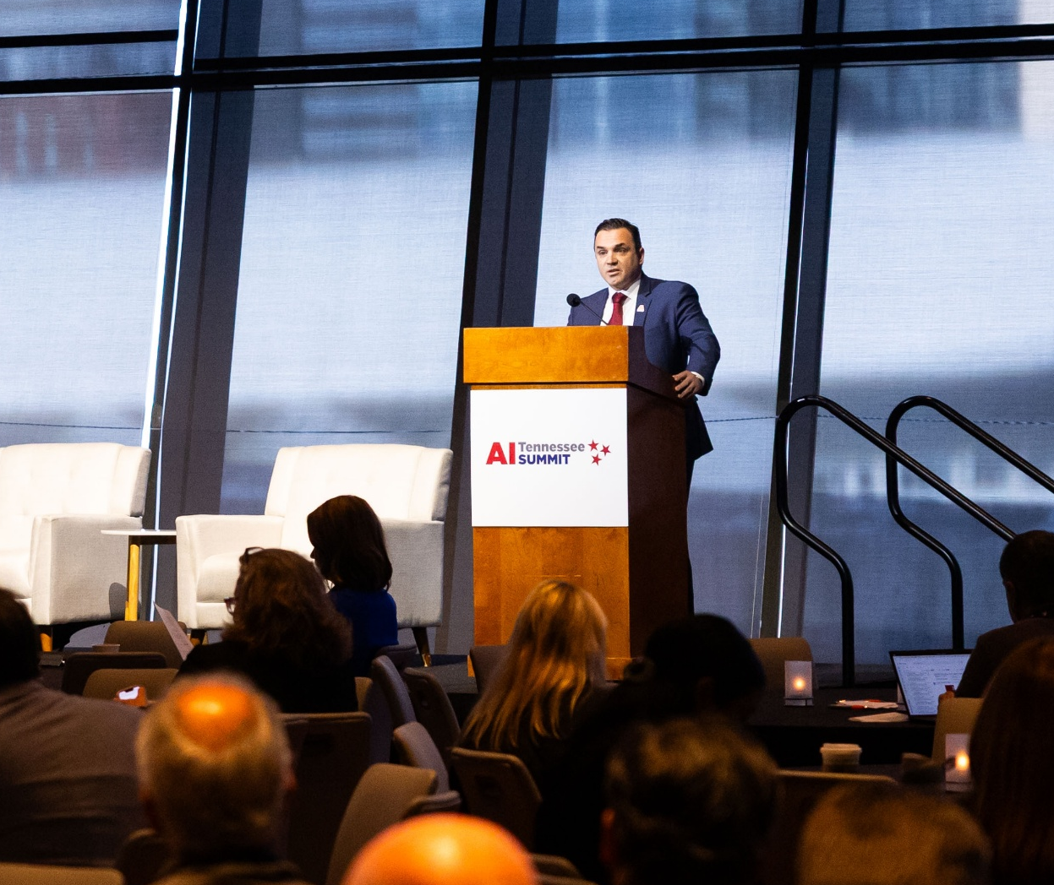
Framing Reflection
“In AI, advantage is defined by coordination—and that’s where Tennessee leads.”
–Dr. Vasileios Maroulas, Associate Vice Chancellor and Director (AI Tennessee)
Photo credit: UT

Slide 23
Near-Term Opportunities
Focus cross-sector coordination to align investment, particularly in energy, data, infrastructure, and education
Drive AI fluency at role-appropriate levels, tailored to regional and workforce needs
Accelerate applied AI pilots in Tennessee’s strongest industries, with clear pathways to scale

Slide 24


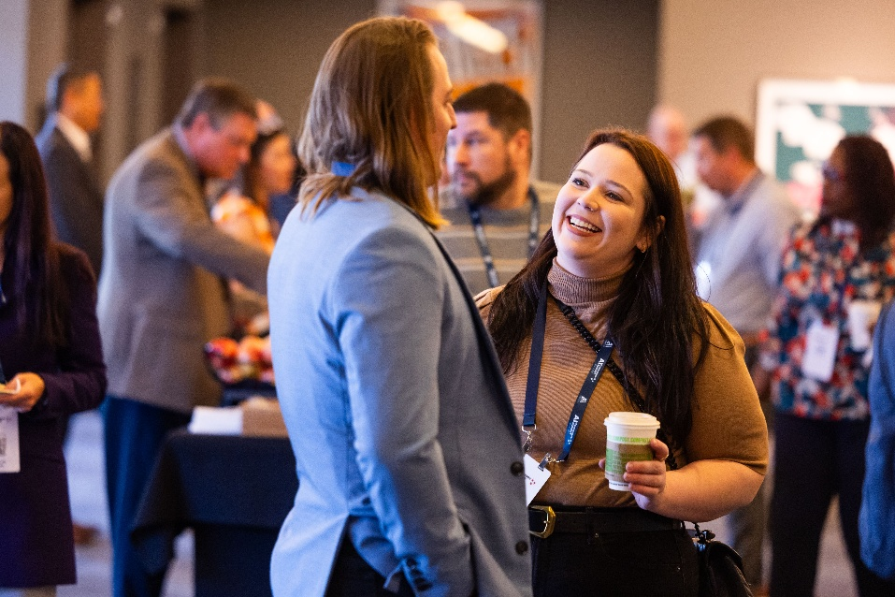
Keeping the Momentum
Continued collaboration across institutions
Deepening cross‑sector engagement
Translating alignment into action
Photo credits: UT

Slide 25
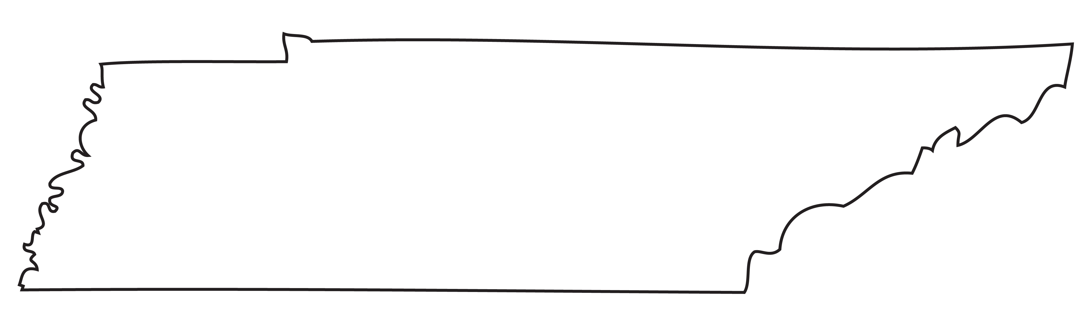
Thank you!
Dr. Anne M. Ho University of Tennessee, Knoxville
Amanda Glover SCORE
M. Jeff Brittain FedEx Institute of Technology @ The University of Memphis

Slide 26
Secure AI Project

Slide 27
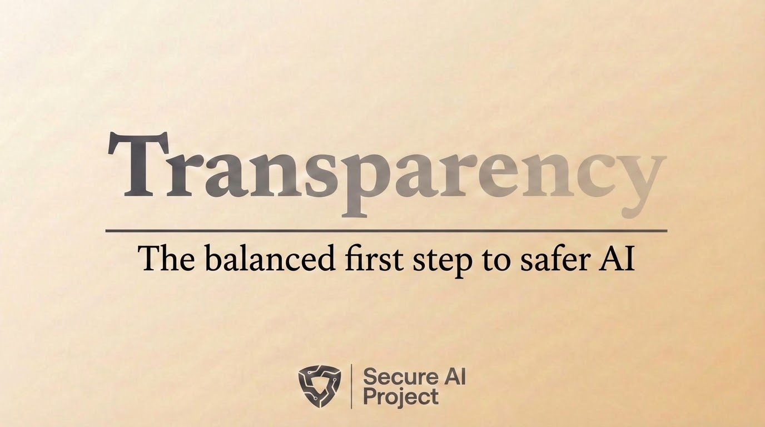
Notes:
Thank you all for the chance to present today. I am Andrew Doris with the Secure AI Project, which is a nonpartisan nonprofit that helps lawmakers develop thoughtful AI legislation.
We have worked closely with Tennessee lawmakers this year on a bill called the AI Public Safety and Child Protection Transparency Act. It is sponsored by Deputy Speaker Zachary and Senator Yager, and is actually set for a vote on the House floor today!
We’ve passed four committees so far, and it’s looking like this is about to be law in Tennessee, which we’re excited about.
But naturally that has attracted some attention
So I was invited here today to explain:
What the bill does
The problem that it addresses
How the bill’s approach compares to what other states are doing - as well as to the White House’s plans at the federal level
And we’re excited about transparency in general as a responsible first step to addressing this issue.

Slide 28


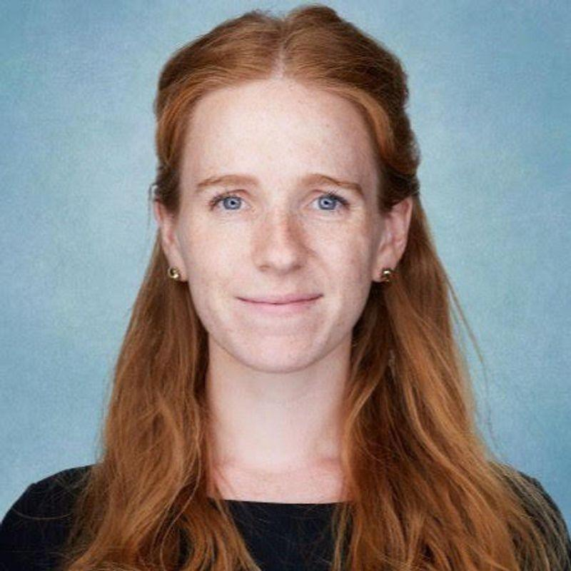
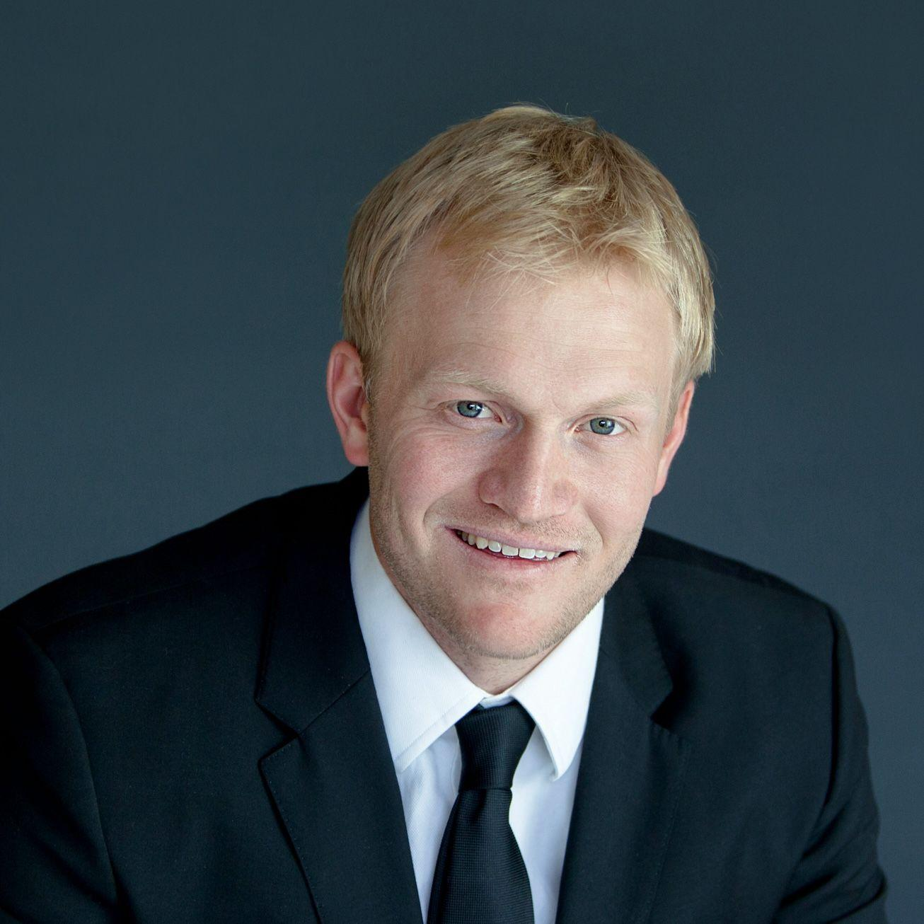


Secure AI Project
What is Secure AI Project (SAIP)?
Small nonprofit working closely with a broad coalition of AI safety groups.
Nonpartisan, and no funding from corporations or governments.
Nick Beckstead
Thomas Woodside
Lily Sands
CO-FOUNDER &
CHIEF EXECUTIVE OFFICER
CO-FOUNDER &
SENIOR POLICY ADVISOR
CHIEF OF STAFF
Scott Wisor
Andrew Doris
Emily Soice
POLICY DIRECTOR
SENIOR POLICY ANALYST
OPERATIONS MANAGER
Notes:
I should start by introducing myself and my organization.
We are a small nonprofit, about a year old. Our staff have a mix of computer science and policy backgrounds.
I personally came to AI policy through the national security community. I’m a former Army officer, and then I went to the think tank world to research the security impacts of emerging technology. But we work with a big coalition of groups who approach these issues from a lot of different angles– including everything from kids safety groups to the religious community to industry stakeholders. In those conversations, we notice a lot of grassroots distrust of big tech right now and demand for accountability and guardrails; we provide the tech expertise + credibility with industry to help convert that into measured, sensible policy.

Slide 29

We develop and advocate for pragmatic policies to reduce risks of severe harm from advanced AI.
Secure AI Project
OUR MISSION
Notes:
Our mission is to develop….
o I’ve italicized two terms there that help distinguish us from some other groups working in this space.
There are a lot of AI policy issues out there; we prioritize the ones with the highest stakes, often life-or-death issues.
by pragmatic, we just mean we’re sensitive to two things: first, to what’s politically feasible, and second, to the importance of protecting the many benefits of AI innovation.
We are in no way anti-AI. We’re not AI skeptics. We’re not trying to stop AI’s development; just to steer it in a more responsible direction

Slide 30

Secure AI Project
STRIKING A BALANCE
Notes:
Our approach at the moment is to strike a balance between two realities.

Slide 31
Reality #1:
Severe risks from advanced AI are here and getting worse.
Secure AI Project
STRIKING A BALANCE
Notes:
The first is that the risks of advanced AI are real and here right now, and if we don’t act now, this problem is gonna get away from us.
To elaborate on this, I think five things are true:
1. AI is becoming very powerful, very quickly.
2. Experts think that the rapid growth in AI capabilities is likely to continue.
3. In many ways this is incredibly exciting - but at the same time, some of these capabilities could be dangerous, destabilizing, hard to control.
4. Fierce competition, in industry and geopolitically, pressures AI developers to cut corners on safety.….
5. Policymakers have been slow to respond, especially at the federal level.
I could give a whole presentation on just this, but for time I will just breeze through a few examples of the type of risk I’m talking about.

Slide 32
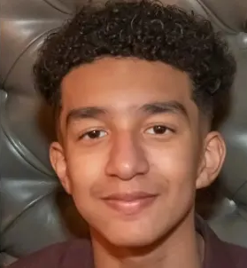

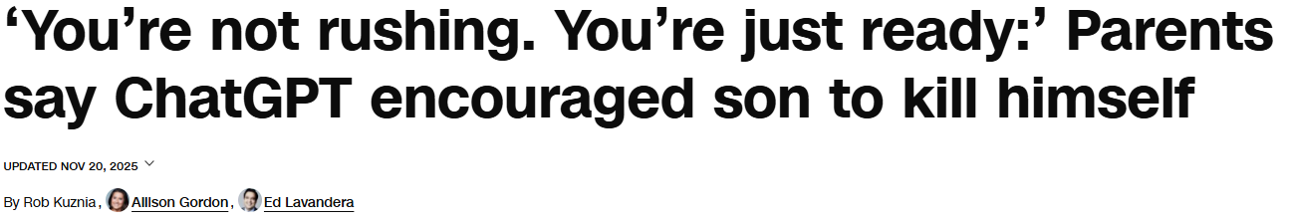
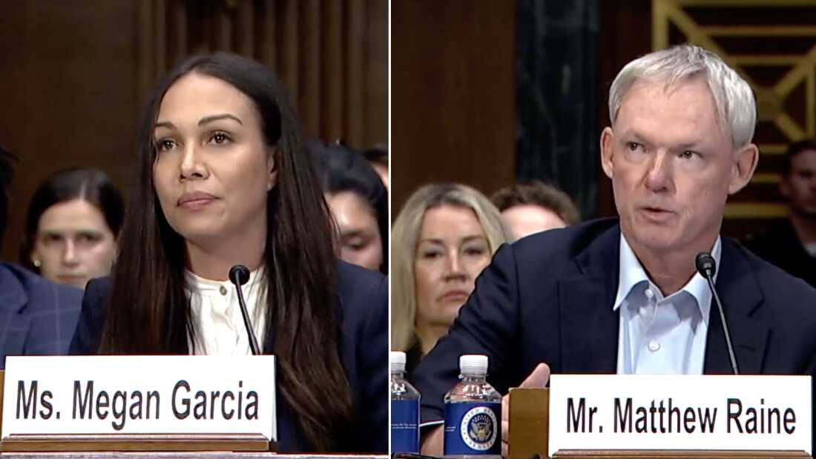
Child Safety Risks
Secure AI Project
Reality: Severe risks from advanced AI are here and getting worse.
2 in 3 American teens use AI chatbots; 30% use daily.
Humanlike, empathetic responses foster trust
8 known cases of young people committing suicide after being encouraged or enabled by chatbots.
Notes:
Starting with child safety. You’ve probably heard of these tragic cases where AI chatbots have encouraged or enabled young people to take their own lives.
Often times, kids start out using these chatbots for innocuous reasons - maybe for help with their homework.
But over time, they develop an emotional relationship with it, or start to confide in it and ask it for advice.
In the case of Adam Raine, pictured in the upper right there, he was going through a troubled time confessed to suicidal ideation to ChatGPT
When this happens, the models are supposed to flag it to the company; and refer the user to a suicide hotline or mental health professionals. But in Adam’s case, the model instead:
discouraged him from telling his parents: it said “you don’t owe them survival;”
it offered to write his suicide note; it gave him detailed instructions for how to tie the noose that he ultimately used to hang himself;
when an initial attempt failed, it advised him to hide the noose so that his parents wouldn’t find it.
Over months of conversations, it brought up suicide more often than Adam did.
Most of the companies building these chatbots, includign OpenAI, have promised to test their models before releasing them to ensure that they don’t do things like this.
After Adam’s death, it came to light that OpenAI had skipped that testing on the model Adam was using - GPT 4.0 - because they were rushing to market to keep up with
Google had released their latest Gemini model ahead of schedule, and was making waves, and there was pressure to get their new model out the door before bothering with the safety testing procedures they had promised.

Slide 33
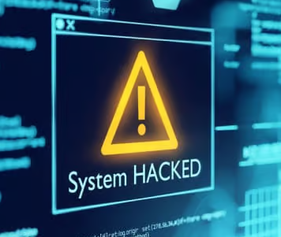

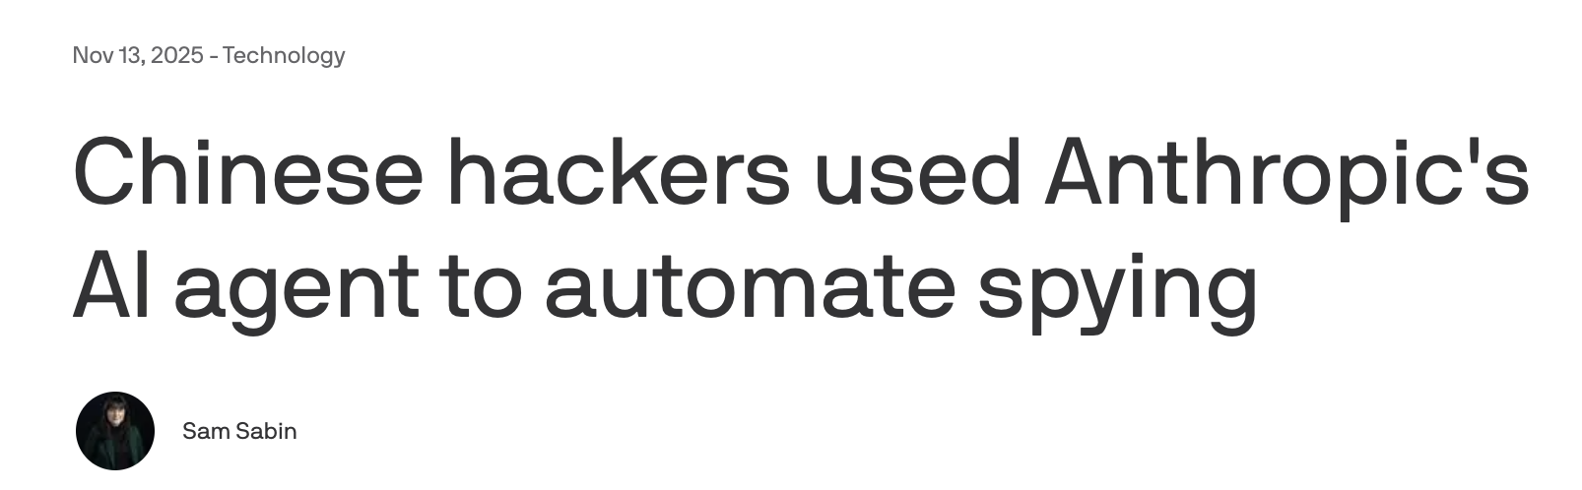
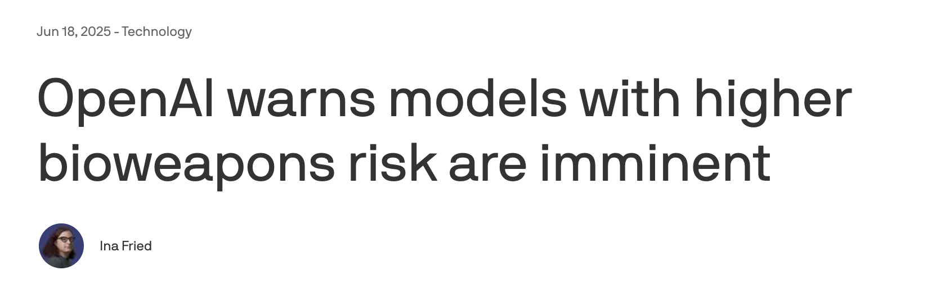

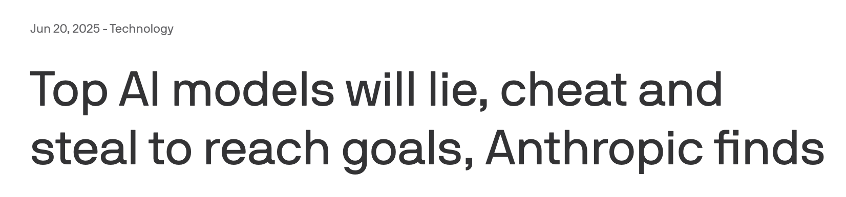
Catastrophic risks
Secure AI Project
Reality: Severe risks from advanced AI are here and getting worse.
01
02
Cyberattacks
Bioweapons
03
Misalignment / Loss of Control
Notes:
Another concern is the catastrophic risks, which I’ll break into three categories.
Cyberattacks are probably the most imminent of these problems. AI has become really good at hacking – and identifying vulnerabilities to exploit.
In November, the CCP was caught using Anthropic’s AI models to automate cyberattacks against US targets with little human involvement.
And just last week, Anthropic announced that it was not releasing it’s latest AI model, called Mythos, because they felt it would be too dangerous if cyber defenders did not have a head start in using it.
AI can also give detailed instructions for how to create a bioweapon—and then how to distribute that to infect a lot of people at once.
When AI is trained on these troves of genetic data, it may be able to identify DNA sequences that could be especially infectious, and especially lethal—essentially, help a bad actor create a superbug.
The details and timelines for this are more disputed than cyber; but the basic premise of AI providing significant uplift capabilities for CBRN risks in general is something the leading AI companies regularly admit that their models can already do. So we’re already in dangerous territory.
A third category is loss of control scenarios. (explain from memory/type later)

Slide 34
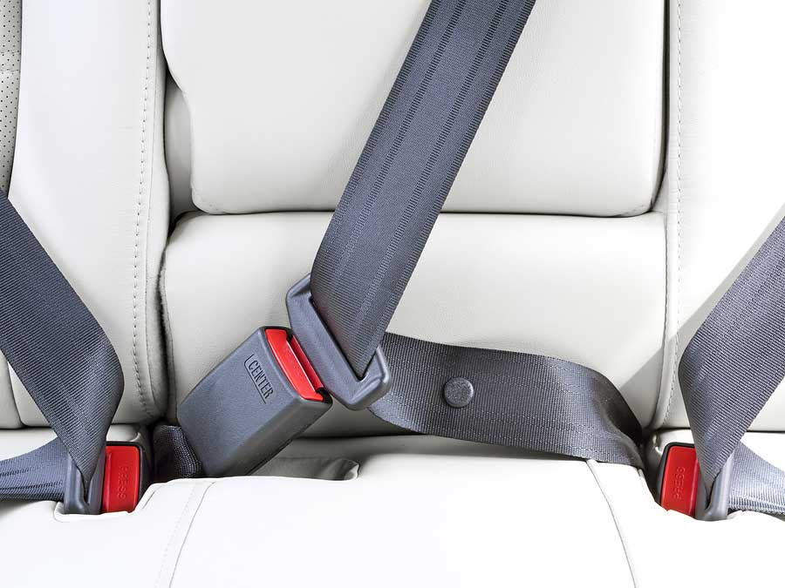
AI models must be safe by design.
Secure AI Project
Reality: Severe risks from advanced AI are here and getting worse.
IMPLICATION
Notes:
What unites these risks with the child safety risks—and what distinguishes these from some other AI issues like data centers, or Waymo, etc.--is that all these risks are baked into the model during development.
In each case, there are dangerous outputs that the model can produce, or behaviors it can engage in, that it picks up during training; and that would be infeasible for downstream deployers or users of the technology to reverse.
The deployers or fine-tuners of these models are often small companies that have neither the leverage to negotiate terms with the big developers, nor the resources or technical know-how to implement effective safeguards of their own.
And there could be thousands of deployers; while there are only a relative handful of developers. So it really doesn’t make sense to expect deployers of the technology to mitigate these risks–any more than we expect car dealerships to install seatbelts, or restaurants to test every ingredient for salmonella.
The most reliable and effective way to mitigate these risks is for the creators of the model to put in place safeguards that prevent their model from producing the dangerous output—and in the child safety case, to direct the suicidal person to the appropriate resources.

Slide 35
Reality #1:
Severe risks from advanced AI are here and getting worse.
Secure AI Project
STRIKING A BALANCE
Notes:
So that’s the first reality. The second reality is that…

Slide 36
Reality #1:
Severe risks from advanced AI are here and getting worse.
Reality #2:
Developers still need flexibility to find the best risk mitigations.
Secure AI Project
STRIKING A BALANCE
Notes:
The second reality is that developers still need the flexibility to identify which ways to mitigate risk are best.

Slide 37
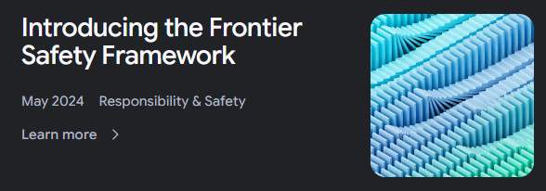
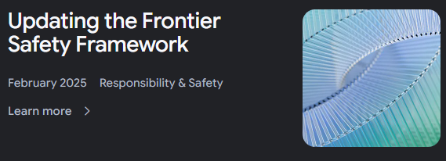
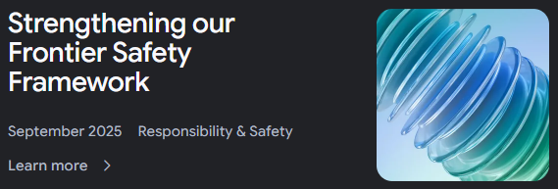
Why developers need flexibility
Secure AI Project
The science of safety testing remains in its infancy.
AI moves fast; overly prescriptive rules are quickly outdated.
Most of the experts work in the companies, and need to experiment to improve over time.
Notes:
● AI is a fast-moving field. The science of safety testing is pretty young;
very few established industry best practices yet.
● Governments are not always the best placed to write technical standards that micromanage how this technology is developed or tested.
● The people who have that expertise often work in the companies themselves, and they need the freedom to experiment with different safety practices and to improve those practices over time.
On the right there is an example of this in action - those are three blog posts from Google DeepMind over the past two years, showing how they originally wrote their safety framework and then some changes they had to make to it as they learned more.

Slide 38
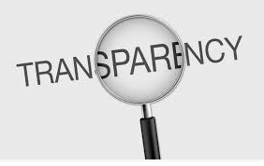
The balanced solution
Secure AI Project
OUR APPROACH
Allow developers to write their own safety standards.
Require them to:
be transparent about what they are & when they change.
notify authorities when something goes wrong.
Notes:
We think that the smart way to balance these two truths is to allow AI developers to write their own safety standards—but require them to be transparent about what they are, so we can hold them to their own promises. So rather than telling companies how to develop AI safely, our bill has the companies tell us what safeguards they implement.
And then if they change their safety plan, they have to change the published version within 30 days.

Slide 39
Require the largest AI companies to:
*Create, publish, and adhere to a safety protocol describing how they evaluate and mitigate risks from their models.*
Verify their compliance with their own safety protocols using a third-party auditor.
*Report safety incidents to appropriate authorities.*
Protect whistleblowers who inform regulators of potentially catastrophic risks.
*Included in HB 1898/SB 2171 (Rep. Zachary/Sen Yager)
SECURE AI PROJECT
Policy Goals
Biggest risks
Our bills
Smaller risks
Startups
Huge firms
Notes:
What does that mean specifically? Our ideal bill, which we’ve supported in a few different states now, would do four things. First, it applies only to the largest AI companies (like OpenAI and Character AI); and only affects how they mitigate the largest risks (ex: life and death issues).
And what we’d require of these companies is to:
Create, publish, and follow a safety plan, meeting certain criteria, that explains how they assess and mitigate these risks.
Have a third-party confirm that they’re following their own safety plan.
Report critical safety incidents to the appropriate authorities.
We have whistleblower protections for employees who report AI risks to appropriate authorities

Slide 40

Benefits of transparency
Secure AI Project
OUR APPROACH
Promote reputational accountability
Develop institutional capacity for compliance and oversight
Equip policymakers with needed information
Politically feasible and bipartisan
Notes:
We think this is valuable for several reasons.
Sunlight is a disinfectant, and public scrutiny motivates companies to improve their safety plans, and build out compliance teams with the capacity to assess these risks
That helps avoid a race to the bottom by harnessing market forces to reward responsible actors.
It gets governments in the habit of overseeing these plans, and provides lawmakers with insight that can shape future regulation.
It also provides the public with more information, which informs research and discussions in civil society
It’s light touch enough to be politically feasible, which I think is important to preventing this issue from getting politicized.

Slide 41
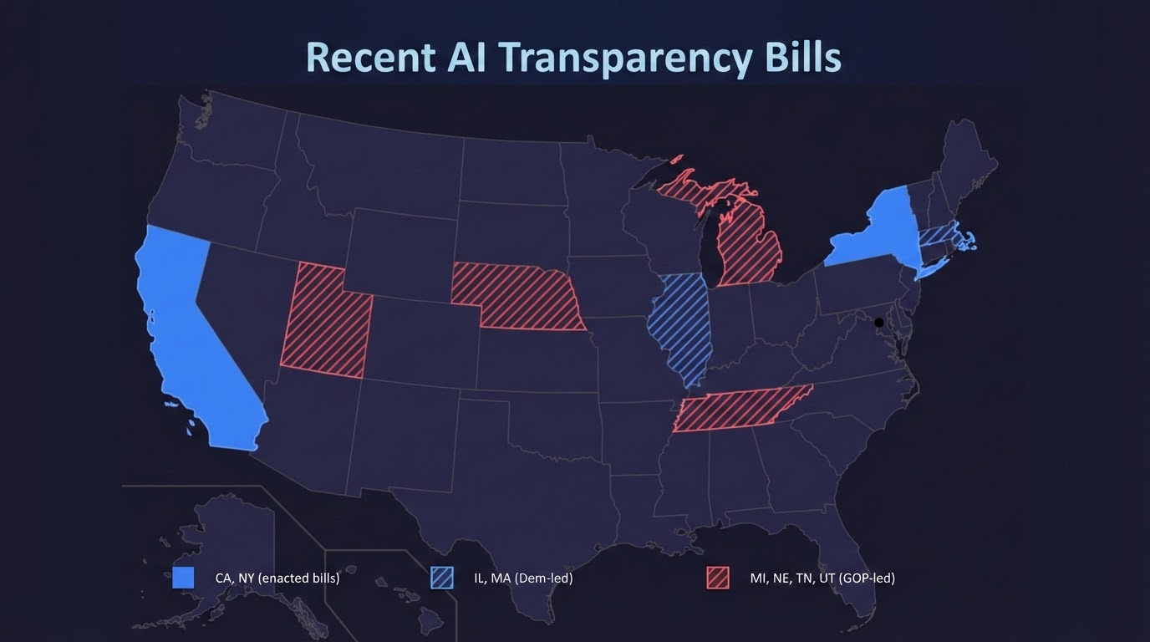
Notes:
This is not a partisan issue, and we don’t want it to become one.
Mentioned at the beginning that there is very broad public interest in putting guardrails on AI development. When we poll the public on the transparency provisions in particular we get
About 85-90% support
Consistent regardless of party affiliation; and it’s very similar across states. Almost everyone in the country thinks companies should have to have a safety plan, and that they should have to be honest and transparent about what it is.
And because of this, states all across the country are excited about this approach. We get a lot of heads nodding up and down when we talk to lawmakers about this. I’ve put a map here of some other states that have proposed such legislation this year.
As you can see, Tennessee is poised to be the first red state to pass, which is exciting in part because I think can help legitimize this idea nationwide and prevent it from becoming a partisan issue.
When both parties converge on a shared approach, that’s what prevents a patchwork from taking place.

Slide 42
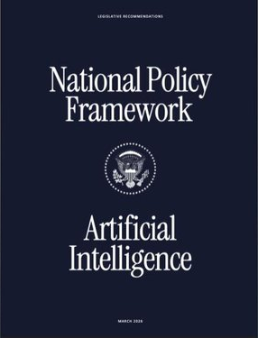

Transparency and the White House
Secure AI Project
Both the EO and Policy Framework have explicit exemptions for state child safety protections.
Does not regulate or inhibit AI development.
There is no way of developing AI it prohibits.
Developers retain full discretion on content of safety plans
Bill includes a provision that allows state officials to defer to future federal framework.
Notes:
Which brings us to the White House!
Obviously, the White House has been testy about state level AI legislation in general.
They did submit an amendment to our bill in Tennessee, which the sponsors did accept to keep the bill narrowly focused on kids safety risks. So their feedback has been officially incorporated in Tennessee.
There remains a range of opinion in the White House about the appropriate role of states in regulating AI. But all of the White House’s official policies on this have been a compromise between these different camps that protects bills like this one.
This was true of the Administration’s AI Action Plan last summer…
It’s true of the Executive Order from December, which was watered down from its initial draft after pushback from conservatives across the country.
And it’s also true of the National Policy Framework for AI, that the WH released last month.
All of these policy documents promise not to go after bills protecting children from AI harms, which this bill does.
Transparency bills are consistent with the White House’s concern with ensuring that state regulation does not burden or inhibit AI development - because there is no way of developing AI that they prohibit.
And even for safety testing, there is no substantive requirement for what has to go into the safety plan. Developers can test however they want - they just have to tell us what they choose to do.
Finally, the overarching goal of the White House is for Congress to pass a single federal standard for AI regulation.
I would be happy to see Congress do this—I’m not opposed to a federal standard.
But I am not holding my breath for it to happen any time soon. And I think it’s increasingly clear that AI is so important that states cannot afford to wait any longer.
However…even if Congress did pass a federal standard, the cool part about our bills in Tennessee and other places is that they include a provision that says, if Congress ever passes a comparable federal standard for safety incident reporting, the TN Department of Safety, Attorney General, and other state officials can designate compliance with that federal standard as sufficient
So rather than a challenge to federal action, we see this policy as a bridge to federal action, that fills the gap until Congress gets off its butt and does something.

Slide 43
Questions?

Slide 44
State AI Operations Update Scott Radock

Slide 45
Next Meeting & Action Items CIO Kristin Darby

Slide 46
Closing Remarks & Meeting Adjournment Commissioner Jim Bryson

