Slide 1


STATE OF TENNESSEE
ARTIFICIAL INTELLIGENCE (AI) ADVISORY COUNCIL MEETING
November 17, 2025

Slide 2


Agenda
Opening Remarks (2:30 p.m.)
Approval of Previous Meeting Minutes
Public Comment
America’s AI Action Plan Overview (2:40 p.m.)
OpenAI Presentation (2:55 p.m.)
Action Plan Subcommittee Report & Discussion (3:55 p.m.)
State AI Operations Update (4:15 p.m.)
Next Meeting & Action Items (4:25 p.m.)
Closing Remarks & Meeting Adjournment (4:30 p.m.)

Slide 3

Opening Remarks Commissioner Jim Bryson CIO Kristin Darby
STATE OF TENNESSEE
ARTIFICIAL INTELLIGENCE (AI)
ADVISORY COUNCIL MEETING
3

Slide 4
Approval of Previous Meeting Minutes
STATE OF TENNESSEE
ARTIFICIAL INTELLIGENCE (AI)
ADVISORY COUNCIL MEETING
4

Slide 5

Public Comment
Any member of the public wishing to address the Council in person should have made this request in writing to Roger Waynick by November 12.
Each speaker has 3 minutes to speak.
STATE OF TENNESSEE
ARTIFICIAL INTELLIGENCE (AI)
ADVISORY COUNCIL MEETING
5

Slide 6
America’s AI Action Plan Overview Dr. Lynne Parker
STATE OF TENNESSEE
ARTIFICIAL INTELLIGENCE (AI)
ADVISORY COUNCIL MEETING
6

Slide 7
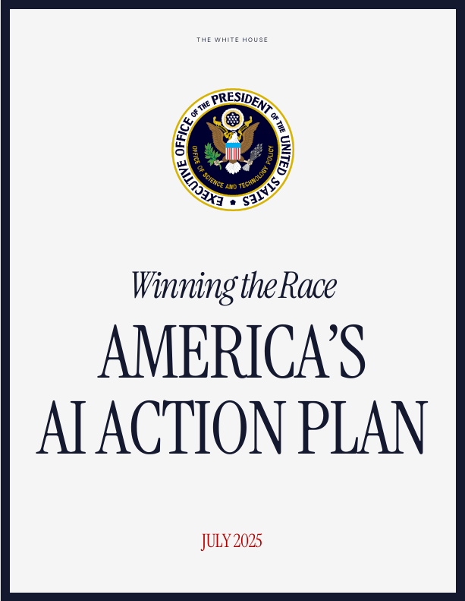
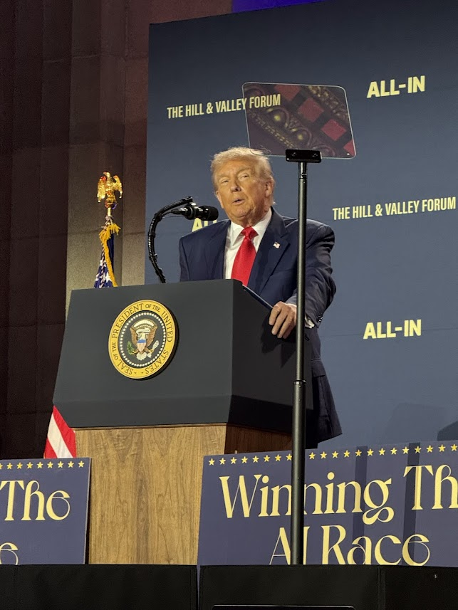

Winning the Race: America’s AI Action Plan An Overview
Presented to Tennessee’s AI Advisory Council (11/17/2025) by:
Lynne Parker, Ph.D.

Slide 8

Key Assumptions
Global leadership in AI matters, due to economic and national security implications
Lessons learned: Huawei
Techno-nationalism is crucial (can’t be neutral on tech source)
Alliances are central, but not guaranteed
Sanctions can be a double-edged sword
A purely punitive approach is insufficient
Public and private sectors must be coordinated
Current commercial AI is working extremely well, so keep it going
It’s dependent on vast computing, and therefore, plentiful energy

Slide 9


Building on Strengths
How to take advantage of current commercial AI landscape?
U.S. Strengths:
High-end AI chips
AI model building
Cloud computing infrastructure
Application software & user interfaces
China’s Strengths:
Quick follower
In AI, open-source models
Turning ideas into products
In AI, building business applications
Strong manufacturing
In AI, “physical” products, like robots, drones, self-driving cars, …

Slide 10
America’s AI Action Plan (released July 2025)
Pillar I: Accelerate AI Innovation
Pillar II: Build American AI Infrastructure
Pillar III: Lead in International AI Diplomacy and Security
Remove red tape & onerous regulation
Ensure AI protects free speech & values
Encourage open-source & open-weight AI
Enable AI adoption
Empower American workers
Support next-gen manuf.
Science: AI-enabled science, scientific datasets, science of AI
AI interpretability, control, etc.
Build AI evaluations ecosystem
Drive AI adoption in gov and DOD
Protect AI innovation
Combat synthetic media in legal system
Streamlined permitting (data centers, semiconductor manufacturing, energy) with security
Develop grid for AI innovation
Restore American semiconductor manufacturing
Build high-security data centers for military/intelligence
Train skilled workforce for AI infrastructure
Bolster critical infrastructure cybersecurity
Promote security-by-design AI tech
Promote mature federal capacity for AI incident response
Export American AI to allies
Counter Chinese influence in international government bodies
Strengthen AI compute export control enforcement
Plug loopholes in existing semiconductor manuf. export controls
Align protection measures globally
Ensure USG is at forefront of evaluating security risks in frontier models
Invest in biosecurity

Slide 11
Ways that Tennessee benefit & contribute (1/3)
Education and workforce development
State-level AI literacy
In K-12 (EO 14277) and trades (EO 14278)
Critical occupations for buildout of AI-related infrastructure
Apprenticeships for electricians, advanced HVAC technicians, data center technicians, etc.
College-level training for critical AI roles
Community college, technical/career colleges, undergrad, grad, postdoc, teachers/educators
Pilots for rapid worker retraining
Leverage authorities under Workforce Innovation and Opportunity Act; and Public Works and Economic Development Act
Leverage DOL’s AI Workforce Research Hub
To provide actionable insights to inform workforce and education policy

Slide 12
Ways that Tennessee benefit & contribute (2/3)
Infrastructure development
AI data centers
Siting on public lands
Energy grid optimization
Reforming energy markets
Interconnections for AI power demands
“All of the above” energy promotion (e.g., nuclear, geothermal)
Semiconductor manufacturing revival
Streamlined regulations to help states attract investments
Streamlined permitting for AI infrastructure
NEPA review, FAST-41 processes
Bolster critical infrastructure cybersecurity
Regulatory coordination
“Light touch” regulation that does not hinder innovation
Hosting of regulatory sandboxes for testing AI applications
Combat synthetic media in legal system

Slide 13
Ways that Tennessee benefit & contribute (3/3)
AI adoption
AI integration into public services
Government piloting for efficiencies like permitting or service delivery
AI procurement toolbox
Build AI evaluations ecosystem
Chief AI Officer, plus talent development within government
Advancing AI innovation
Ensure access to large-scale computing power for startups and academics
Help drive adoption of open-source and open-weight models by small and medium-sized businesses
Support next-generation manufacturing
Includes “physical AI” like drones, self-driving cars, robotics
Build world-class datasets (scientific, public data)
Advance science of AI

Slide 14
Final thoughts…
AI is an economic growth engine—not just a technology
Strategic action now creates longer-term advantage
Public-private collaboration is essential
Innovation and AI trustworthiness must advance together smartly
Tennessee can lead the next wave of U.S. competitiveness
14

Slide 15
OpenAI Presentation Dan Parham, Felipe Millon, Ruthie Barko
STATE OF TENNESSEE
ARTIFICIAL INTELLIGENCE (AI)
ADVISORY COUNCIL MEETING
15

Slide 16
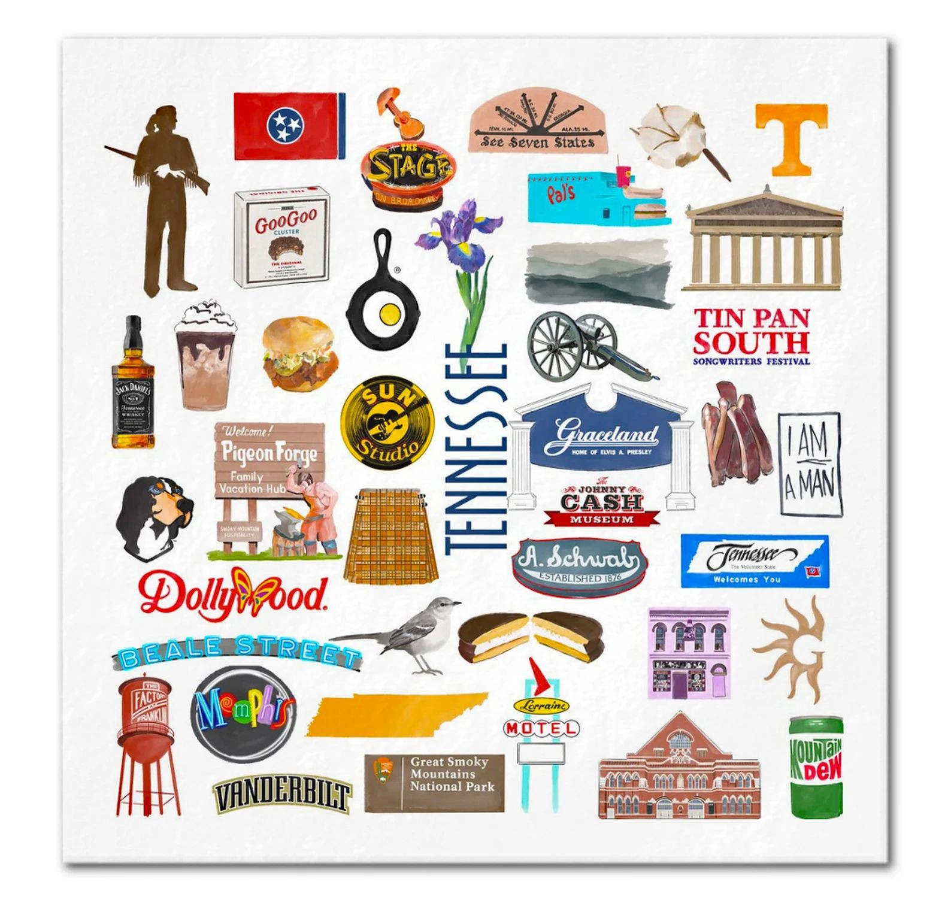
Letʼs talk A.I.
OpenAI Conﬁdential & Proprietary

Slide 17

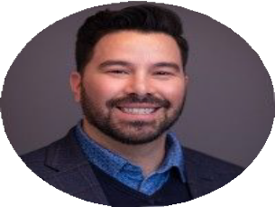

Hello
Dan Parham
Head of State and Local Government
Felipe Millon
Head of Federal and State and Local Government
Ruthie Barko
Global Affairs
State and Local Government Policy
Conﬁdential and proprietary.

Slide 18
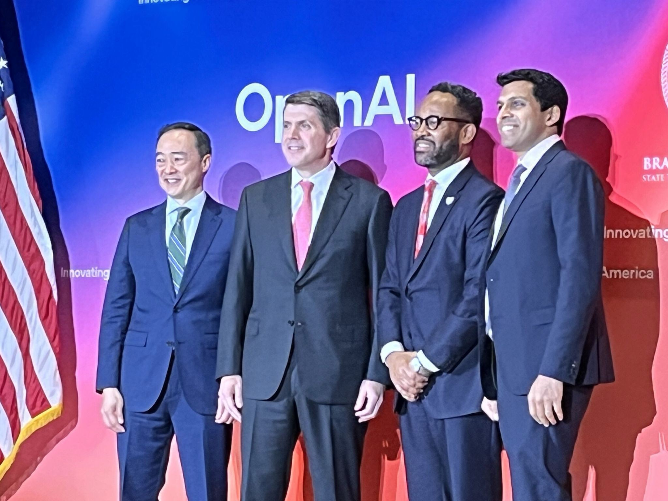
Our team
OpenAI for Government partners with 200+ government agencies at all levels of government – federal, state, regional, county, city, and special districts.
We are a cross-functional team of 70, including enablement, engineering, public affairs, and support primarily based in Washington, D.C.

Slide 19





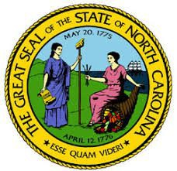


200+ partners at all levels of government
OpenAI for Government
CA
PA
WI
NY
800M weekly active users
CO
NC
92% of the Fortune 500
1M enterprises
MS
FL
4

Slide 20
Today
Insights on how to improve internal operations and service delivery

Slide 21
Why
OpenAIʼs mission is
to ensure that artificial general intelligence benefits all of humanity.
The State of Tennesseeʼs mission is to ensure the safety, prosperity, and quality of life of every Tennessean.

Slide 22



How we work
Research
Develop safe, aligned, scientifically rigorous frontier
AI models
Apply
Design secure, user-centered products that reliably solve problems and scale
Deploy
Deploy ChatGPT Enterprise as a government-grade solution, upskill our partnersʼ workforce

Slide 23


Product innovation
Codex and Codex CLI
Responses API with web search, ﬁle search, computer use, MCP server support, image gen, and Code Interpreter
Agents SDK Reinforcement Fine-Tuning
New Speech-to-Text and Text-to-Speech Models
New Image Generation Model
Realtime API Preference Fine-Tuning
Private Link
Multi-Factor Authentication Projects
Batch API Admin API Audit Logs API
New Embeddings models
Updated GPT-3.5 Turbo, GPT-4 Turbo preview, and Moderation models
Vision Fine-Tuning
Model Distillation & Evals
New Speech-to-Speech Models Structured Outputs
Prompt Caching
New multimodal moderation model Go & Java SDKs
Assistants API Vision
DALL·E 3
Text-to-speech
GPT-3.5 Turbo ﬁne-tuning Updated GPT-3 models
Today
o1
o1-mini
o3-mini o4-mini
o-series models
GPT-4.1
GPT-4.1 mini GPT-4.1 nano GPT-4.5
GPT-4 Turbo
GPT-4o
GPT-4o mini
GPT-5
gpt-oss
GPT series
H2 2023
H1 2024
H2 2024
H1 2025
H2 2025

Slide 24

Safety, privacy, security, compliance, retention
You own and control your data
We do not train on your business data You own your inputs and outputs
You control how long your data is retained
You decide who has access
SAML SSO
Role-Based Access Control
Comprehensive security & compliance
SOC 2 Type II compliance
Data encryption at rest (AES-256) and in transit (TLS 1.2+) Multi-factor authentication
HIPAA Compliance and BAAs Azure Private Link
Learn more at
trust.openai.com
Conﬁdential and proprietary.

Slide 25
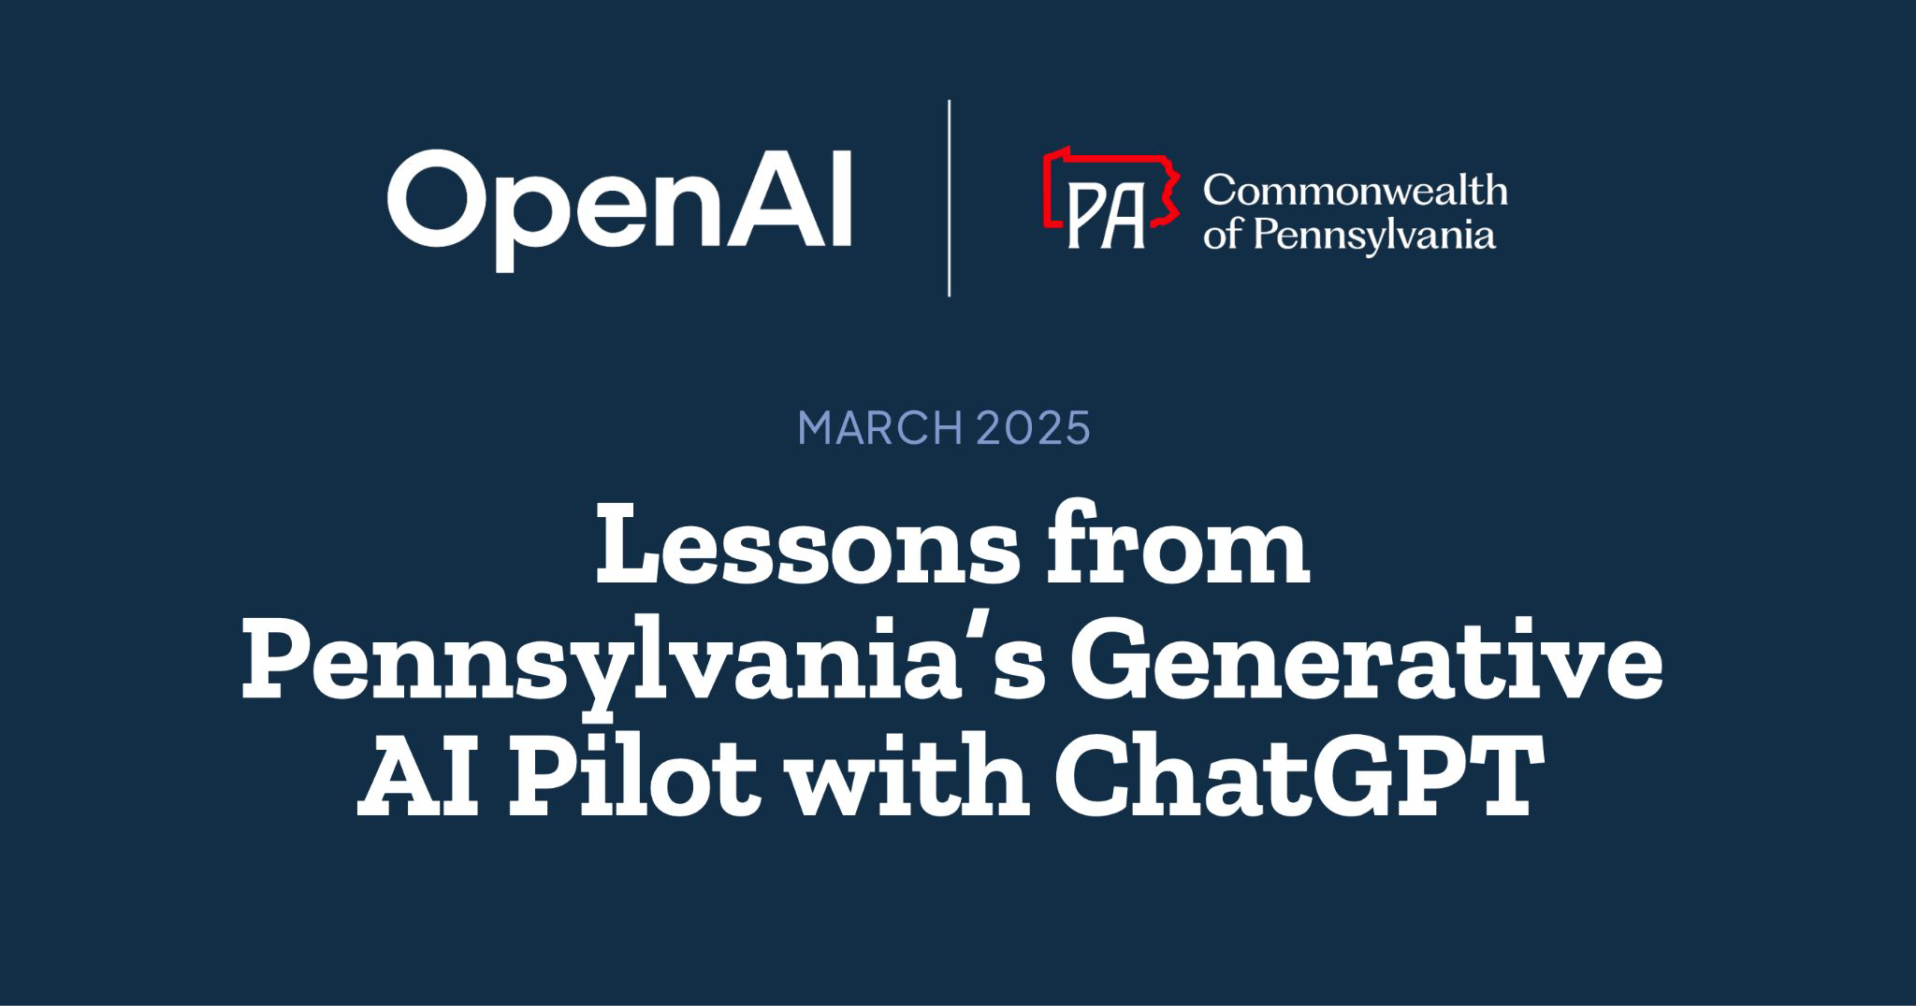
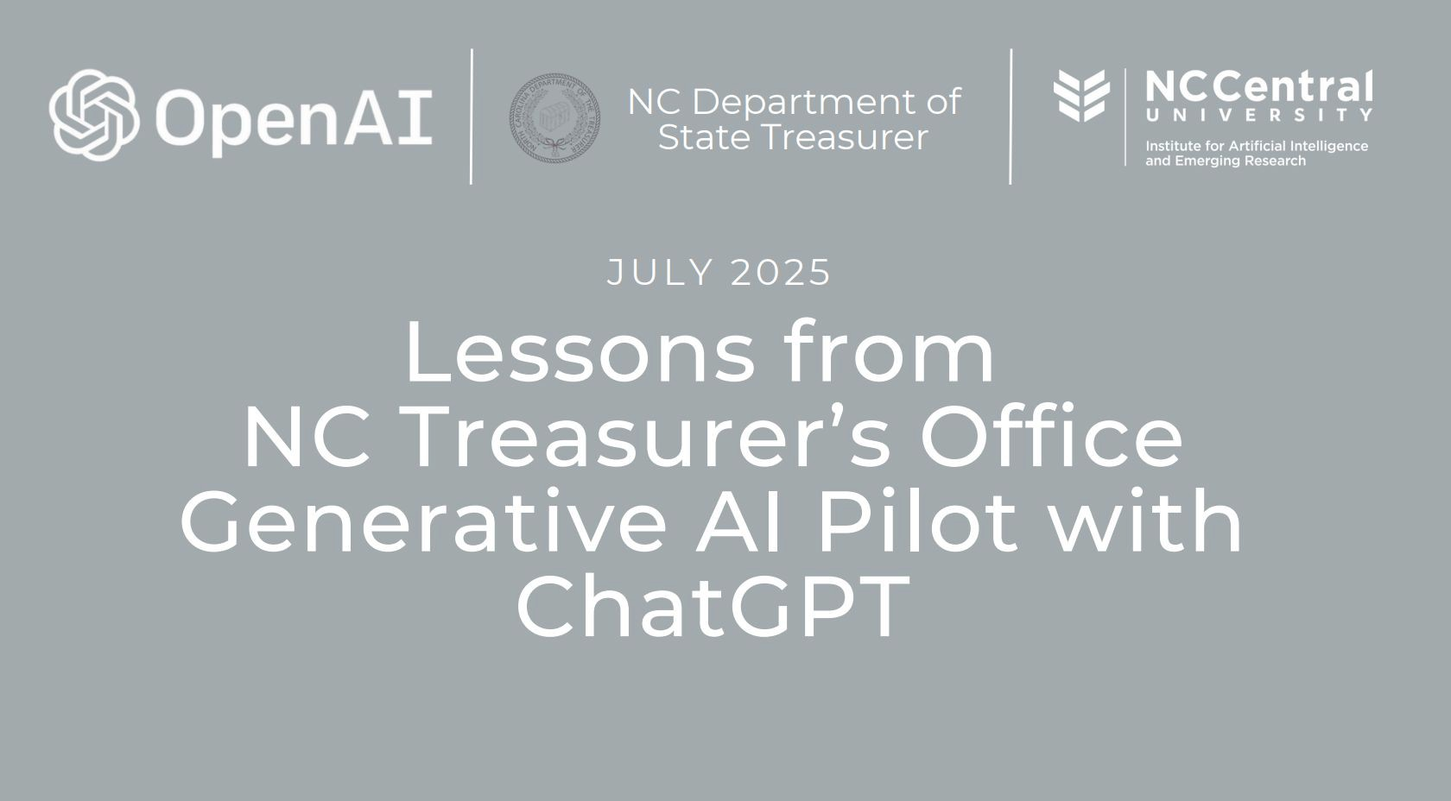

Outcomes
Driving innovation and efficiency
Unearthing value
The North Carolina Department of State Treasurer ran a three-month pilot (March–June 2025) with 36 employees. Key outcomes include: 5 hours per week per employee, millions of dollars saved in unclaimed property
AI as an accelerator, not a replacement
The State of Minnesotaʼs Enterprise Translation Office uses ChatGPT to accelerate and enhance translation services for Spanish, Hmong, and Somali residents.
Their ChatGPT-enabled workflow increases accessibility to government services, cutting translation times from weeks to hours, saving over $100,000 monthly, and expanding multilingual support.
Pennsylvania equipped employees with ChatGPT Enterprise, helping users save an average of 8 hours per week while improving the quality and speed of government services.
Employees used ChatGPT to streamline IT policy reviews, accelerate accessibility initiatives, and simplify HR job classifications, cutting down manual work and increasing impact across 14 agencies.
Staff used ChatGPT for research, drafting, and summarizing, cutting review times from hours to minutes while keeping human oversight for accuracy.
10

Slide 26





Approach
Our proven framework for a secure, impactful, and sustainable deployment.
Compliant Access
Strategic Alignment
Upskilled Employees
Value Check-in
AI
Every Day
Conﬁgure an optimal workspace, reﬁne internal usage policies, and equip your organization with a secure environment.
Identify maximize impact areas, avoid tech-for-tech’s-sake, and position AI to drive
measurable value across your organization.
Invest in education and support resources so employees understand how to eﬀectively engage with ChatGPT, unlocking its full potential across roles.
Measure impact, user engagement and document high value use cases.
Build the muscle for regular AI collaboration, identifying and approaching everyday use cases for deeper day-to-day creativity and eﬃciency.
Conﬁdential and proprietary.
11

Slide 27

Top down + bottoms up
Top-Down Leadership
Executives set the vision
Model AI usage publicly
Align resources and incentives
Establish infrastructure and champions
Transformation happens when both efforts meet in the middle.
Bottom-Up Exploration
Employees test and iterate
Discover new workflows
Share wins and ideas
Grow confidence through hands-on use
Conﬁdential and proprietary. Sensitive use only.
12

Slide 28
The four stages of upskilling
AI Skeptics
AI Champions
Ta-Da!
Uh-oh?
Ah-Hah!!!
Ho-hum
Someone sees a great demo of AI - they see the power but donʼt understand it
They imagine the dangers and risks of a powerful new tool
With training, they see the value to their work & understand its limits
Life goes on as normal, with AI part of the regular routine
Breadth: A User’s Comfort in AI
Conﬁdential and proprietary.
13

Slide 29
Empowering your workforce
Keep the expert in the driverʼs seat. Use AI to amplify—not replace—human judgment. Like putting on a superhero suit or having 1,000 assistants. Over 70% of professionals report feeling more creative with AIʼs help
Stay hands-on and critical. Question its assumptions, verify its reasoning, and refine its outputs to maintain accuracy and scientific rigor
Use AI to grow your expertise. Explore new concepts, stay aware of emerging developments, and let the tool expose you to new ways of thinking and problem-solving
Build a culture of augmentation. When teams value curiosity, validation, and responsible experimentation, AI becomes a catalyst for growth—not a substitute for expertise

Slide 30


Core + advanced features
GPT 5 Chat
Search
GPTs (GPT 5 Chat)
Core
Access to the web
Workhorse model
Task automation
Data analysis
Canvas
Analyze documents & data
Interactive writing and coding
GPT 5 Thinking
GPT 5 Pro
Deep Research
Advanced
Our latest ﬂagship reasoning model
Multi-step reasoning
Research & report generation
ImageGen
Voice
ChatGPT agent
New products
Custom mockups + visuals
Brainstorming
+ Planning
From chat to action
New products, coming soon
Proprietary and confidential

Slide 31

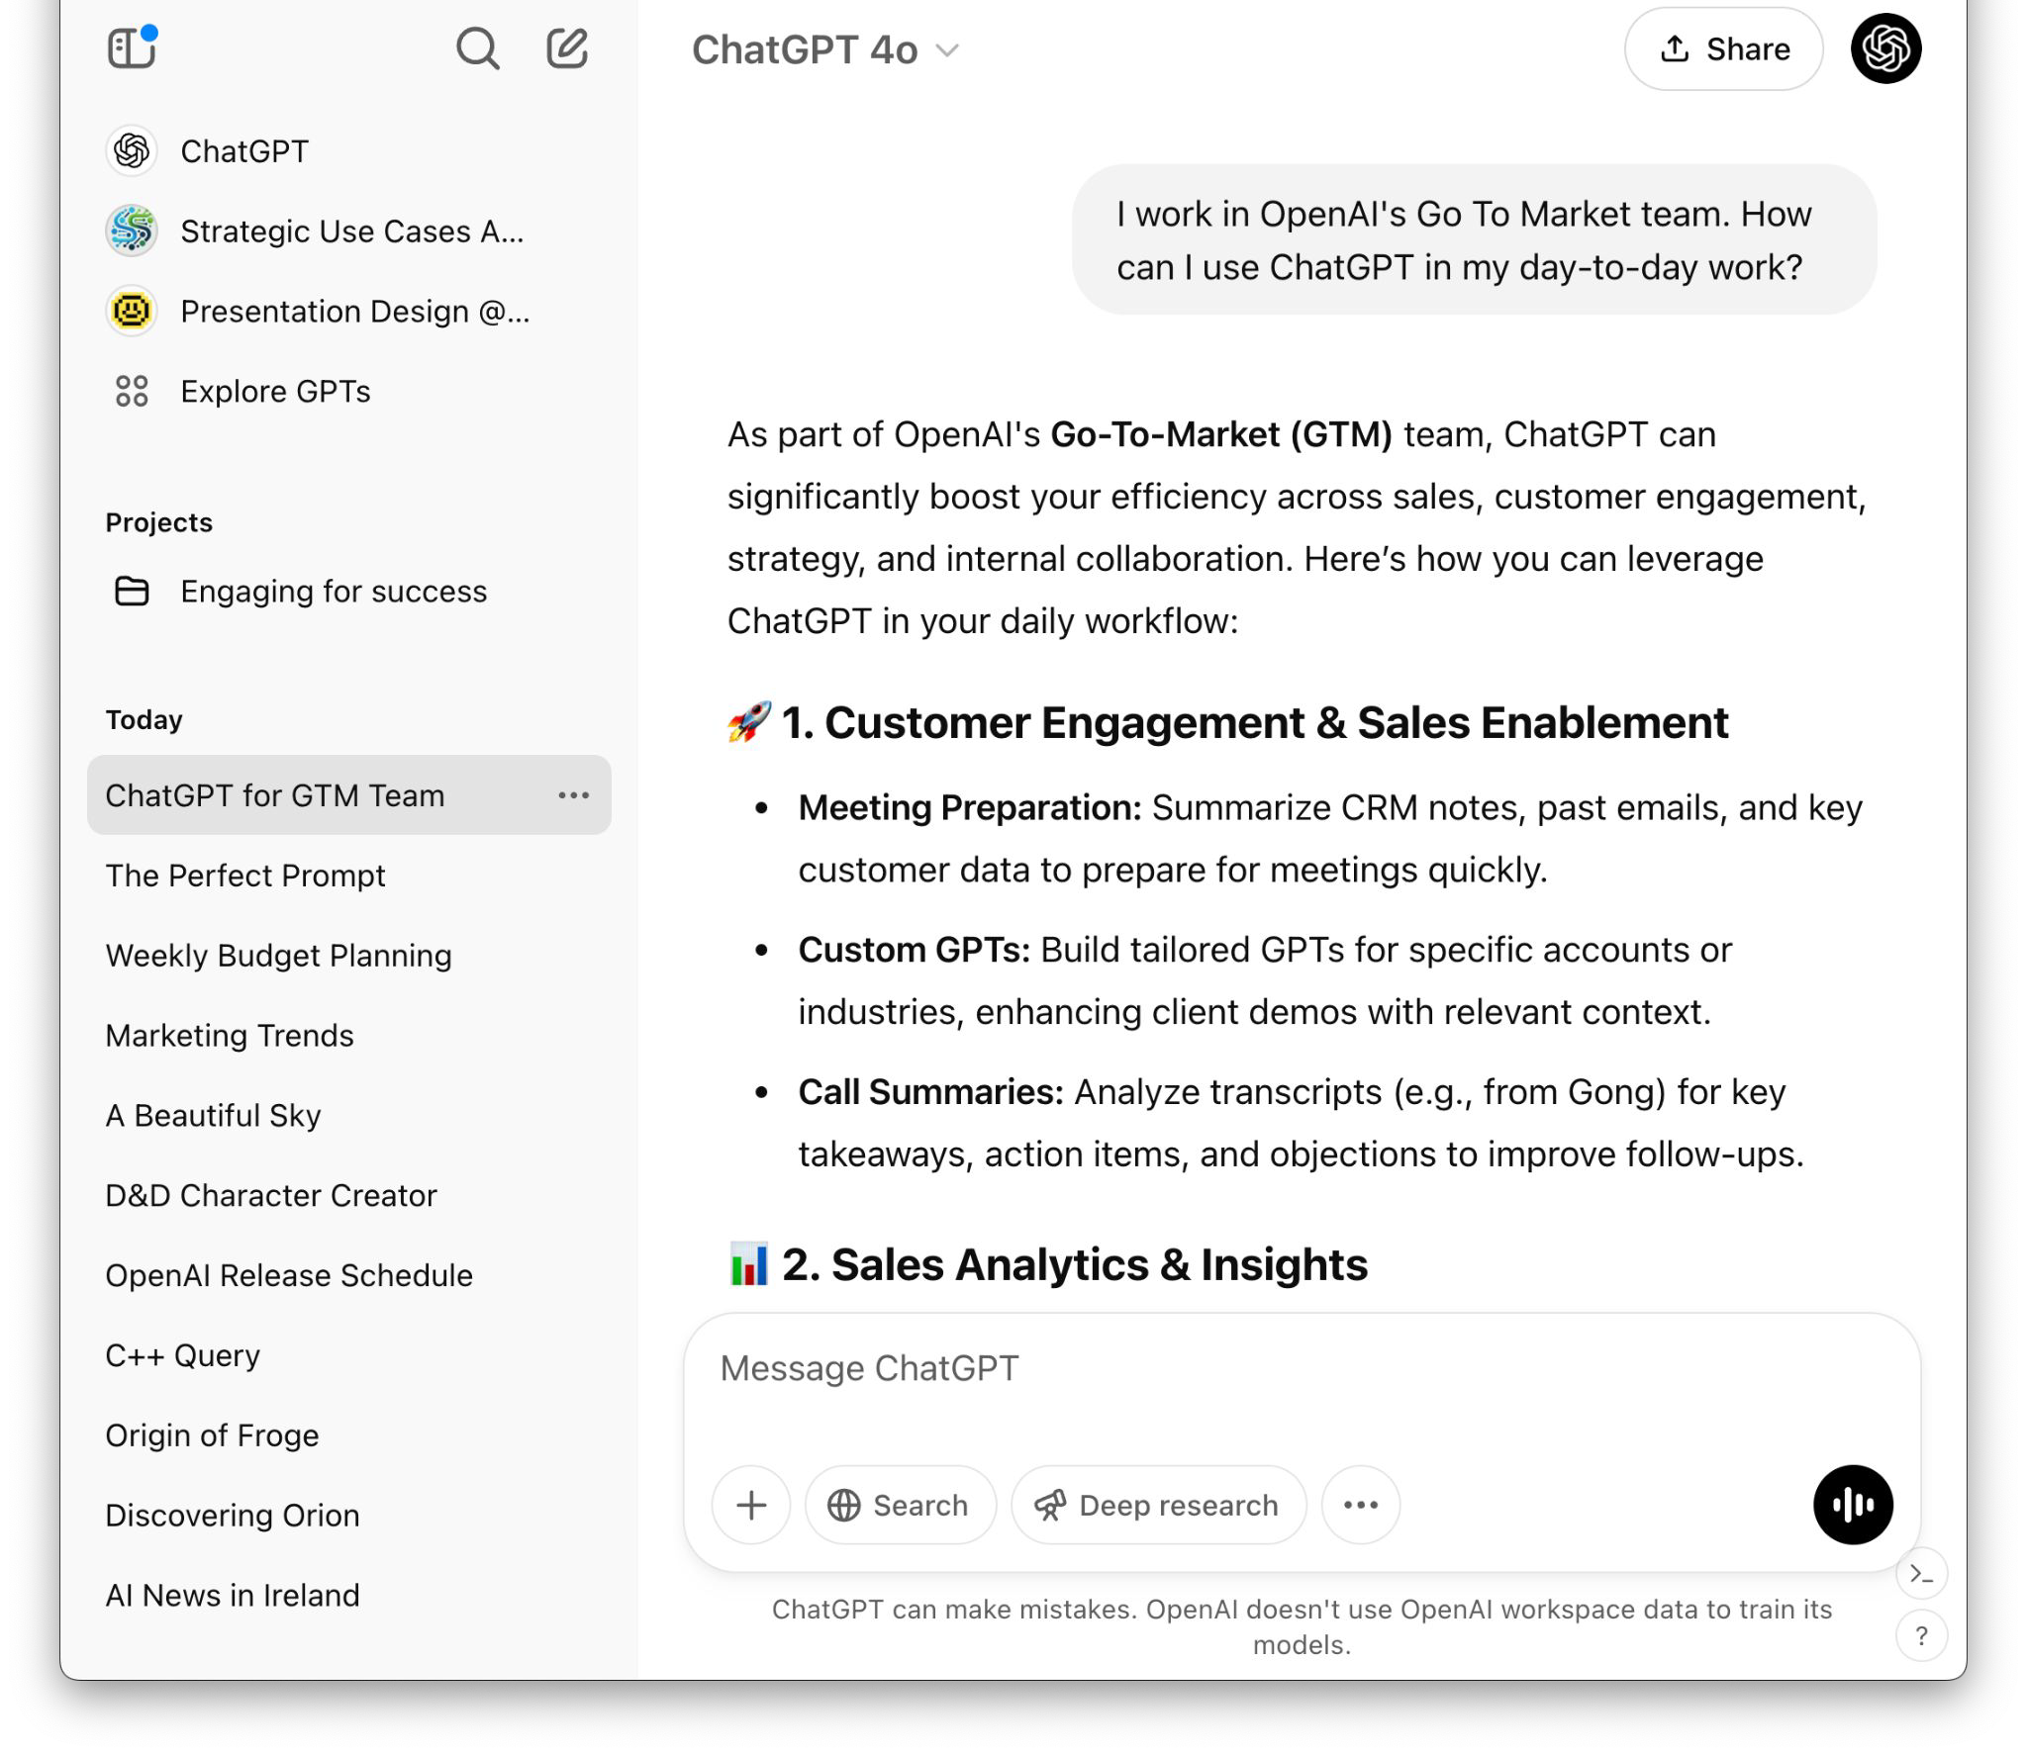
Digital assistant
Chat is a PhD level assistant in any subject that youʼre curious about. It can help you answer questions, broaden your knowledge, and coach you on challenging situations or scenarios
How do I …
Why is it …
Give me ideas for …
Conﬁdential and proprietary.

Slide 32


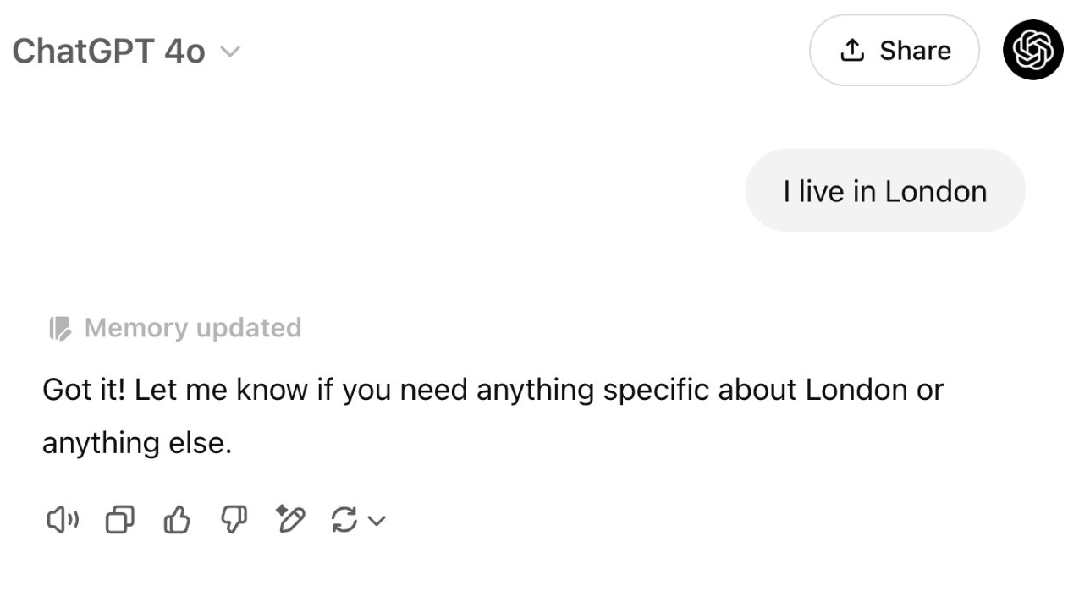

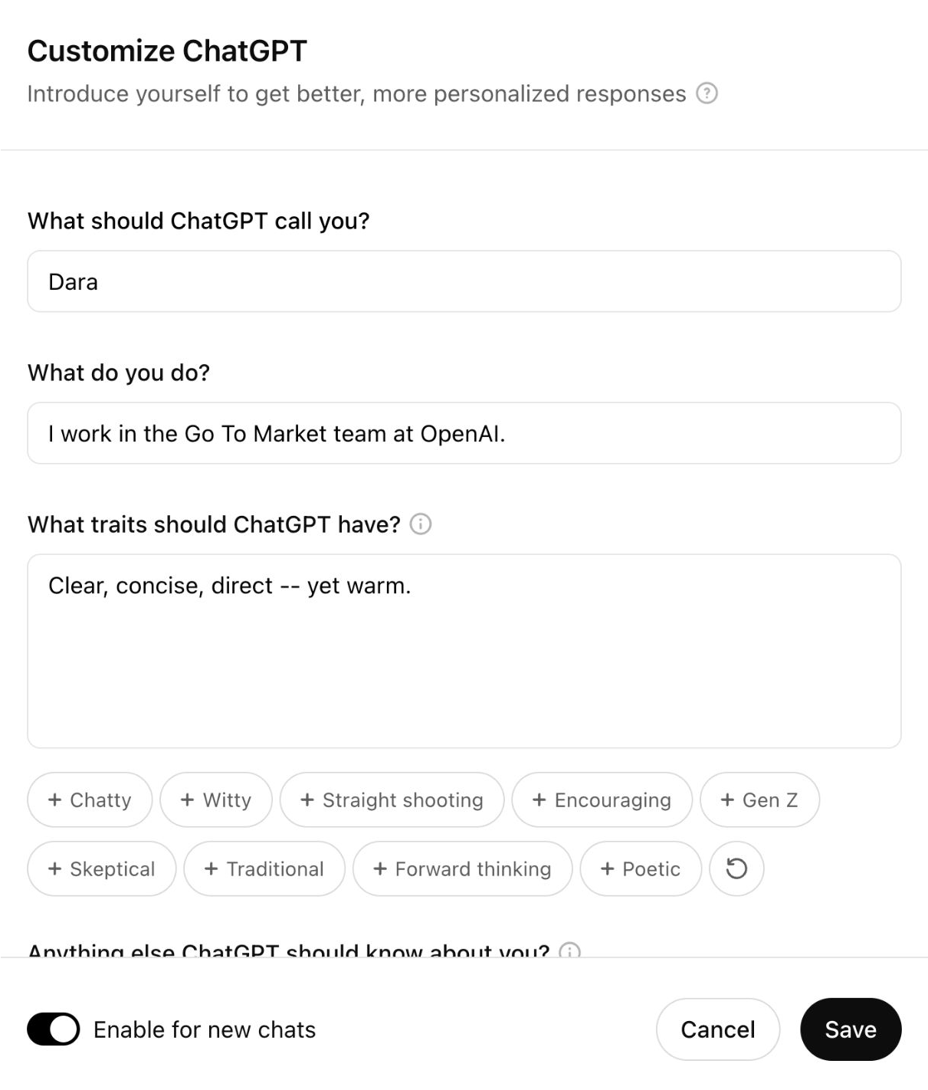
Personalize
Instruct Chat like you would an Executive Assistant
Help Chat understand who you are, your role and responsibilities, your strategy, and your communication style
Remembers you and your preferences
Tell Chat to ignore these at any time
Conﬁdential and proprietary.

Slide 33
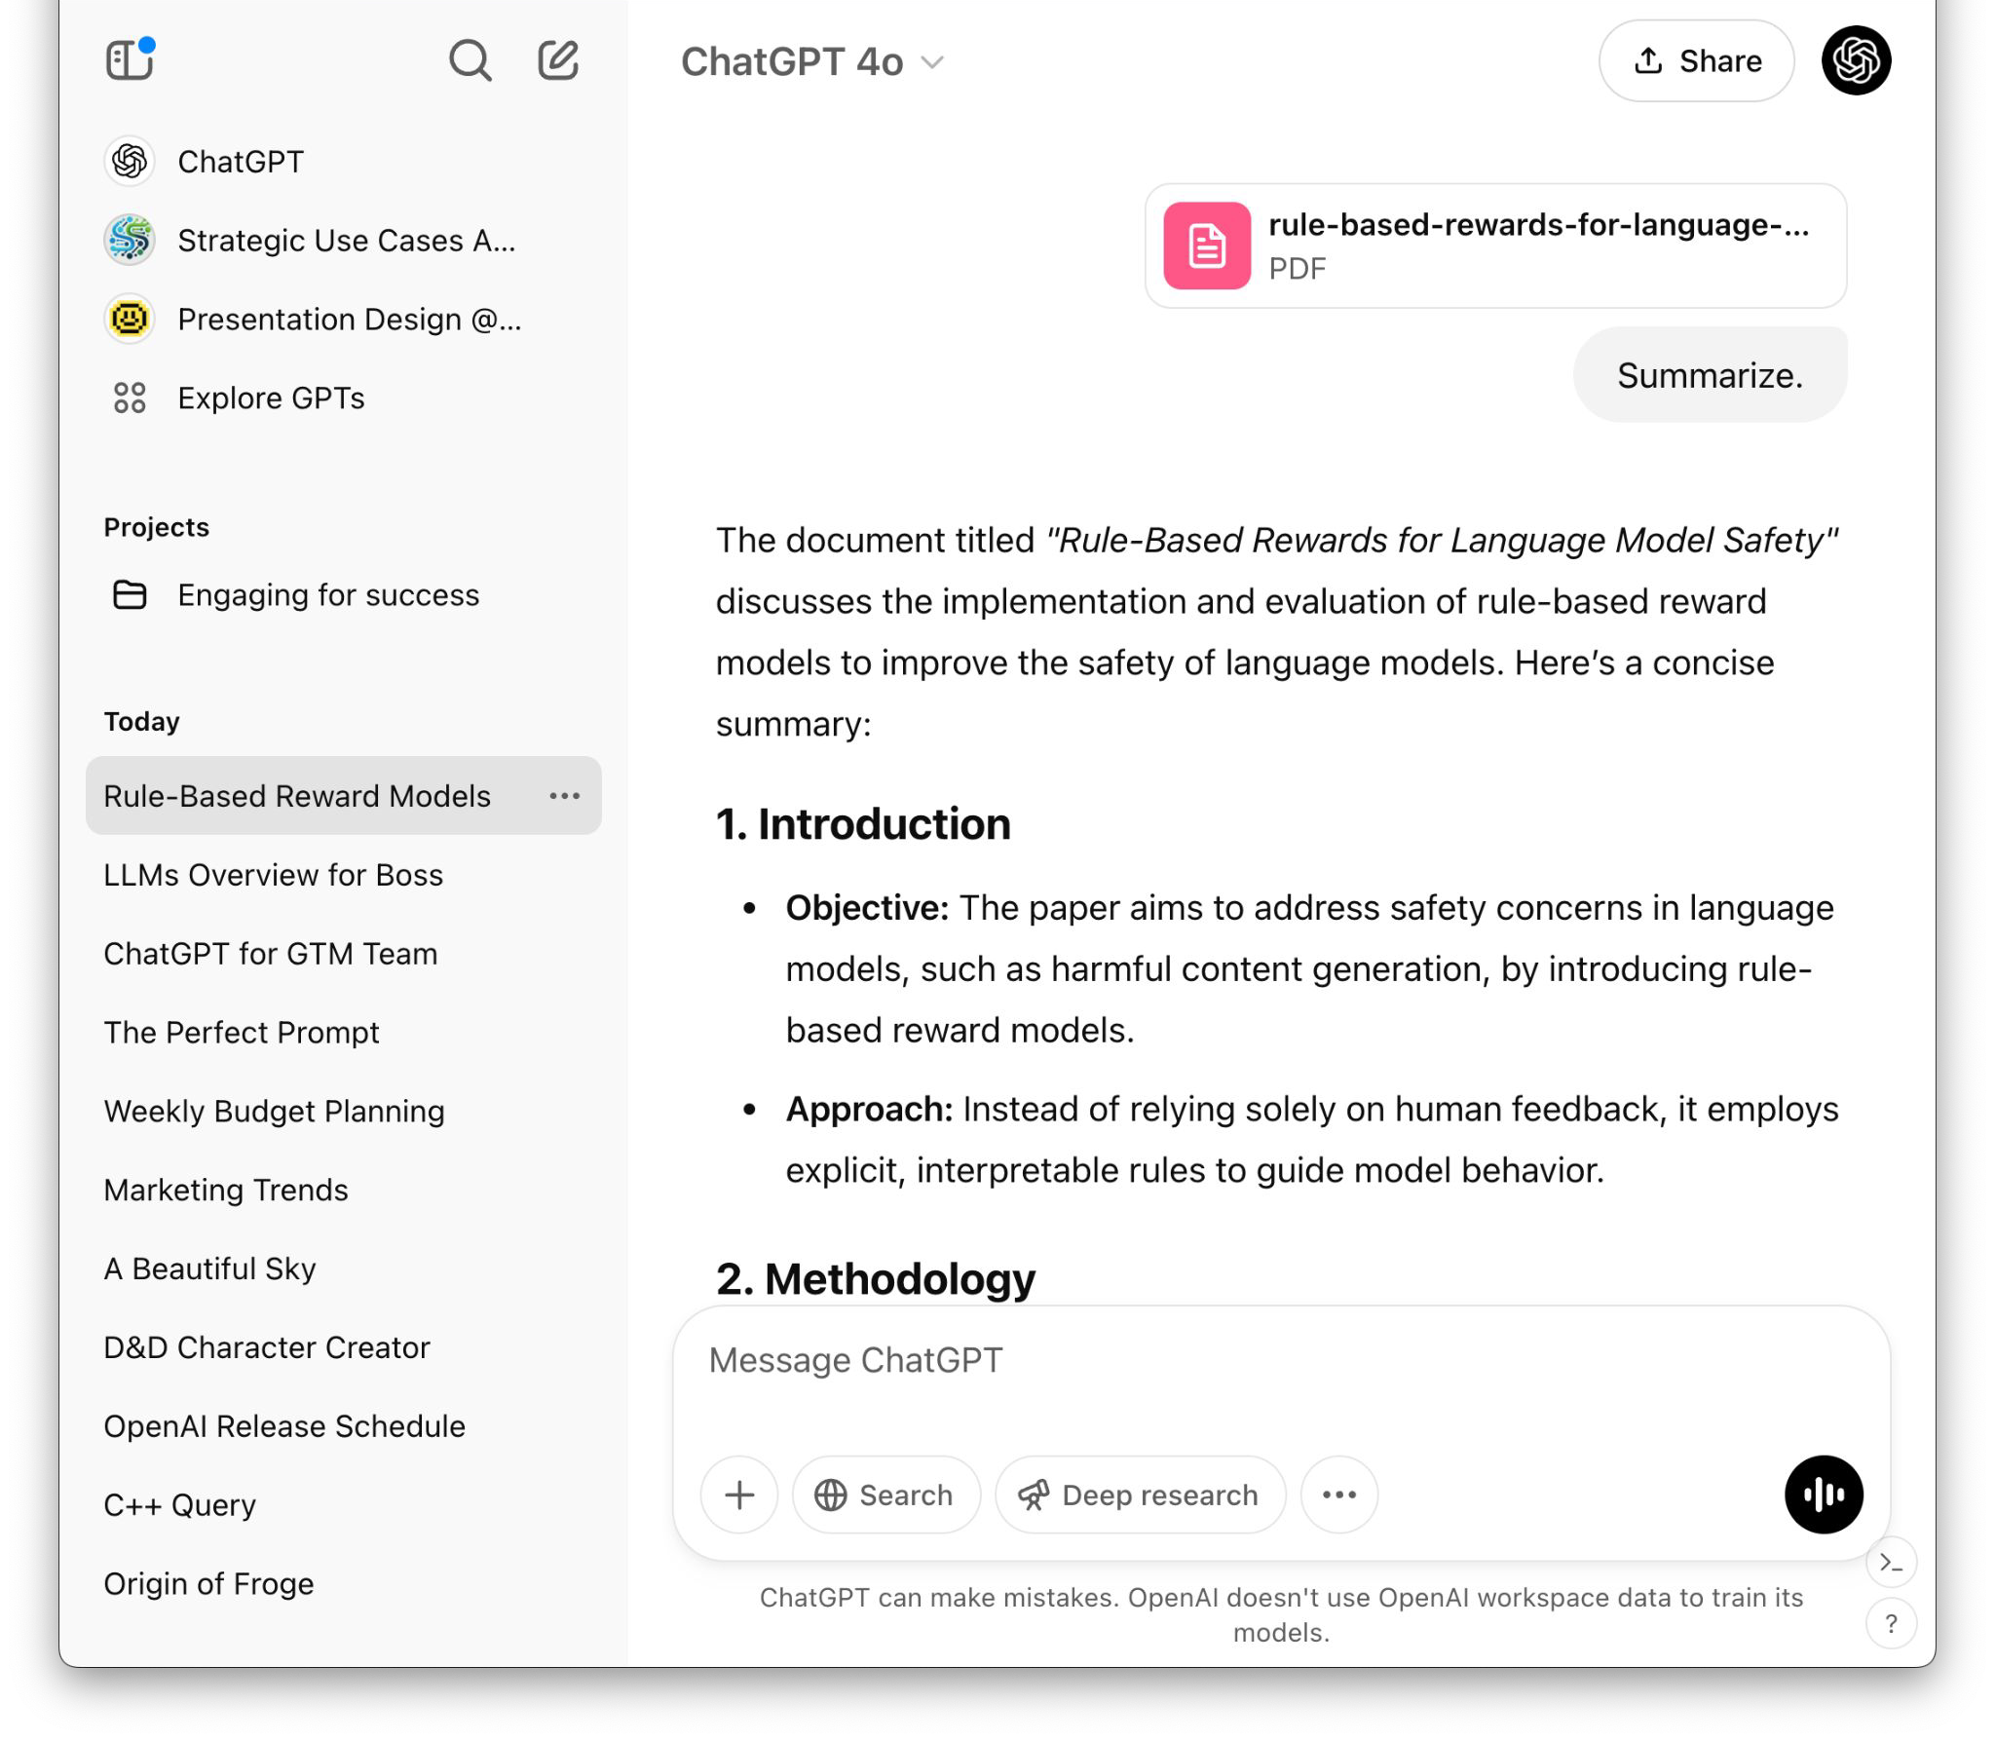
Analysis
One of Chatʼs true superpowers is itʼs ability to read large volumes of highly technical documents
Verify sources
Summarize for any audience
Extract and visualize insights
Built in OCR for scanned images
* up to 10 files per conversation, and up to 512 MB in size.
Conﬁdential and proprietary.

Slide 34
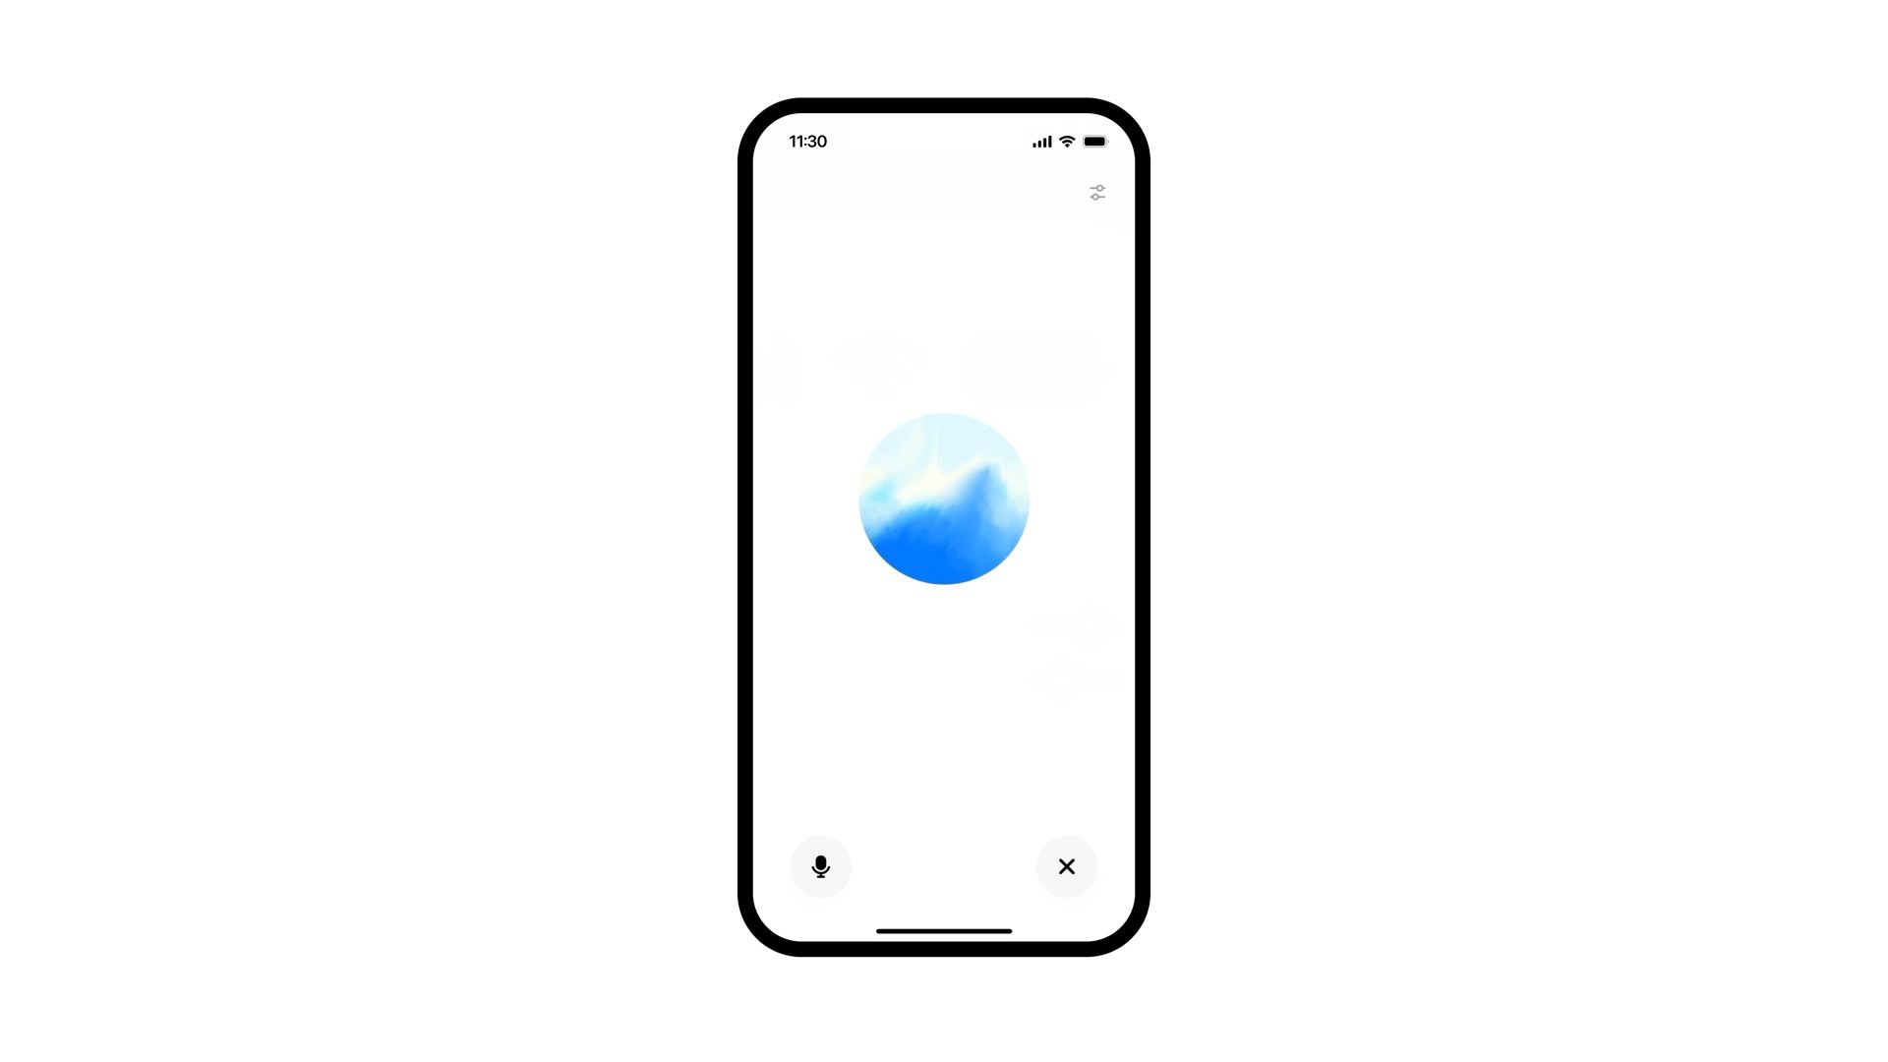
Speak
Natural, real-time, asynchronous, conversations
Help me brainstorm …
Tell me about …
Translate what I say into …
Conﬁdential and proprietary.

Slide 35

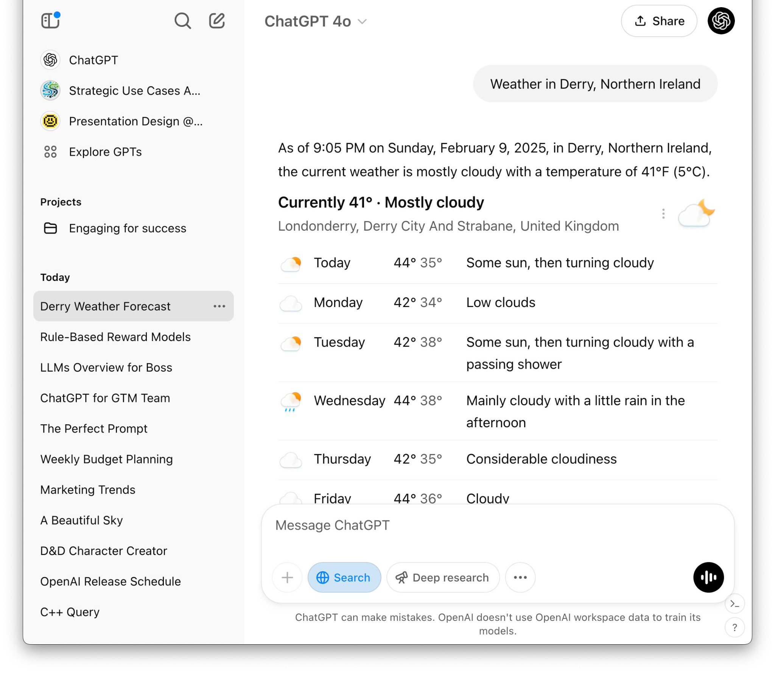
Search the web
What are the latest developments in cargo-screening and port security technology?
What new federal or state regulations are impacting port operations this quarter?
How are other infrastructure focused government authorities using AI?
20
Conﬁdential and proprietary.

Slide 36
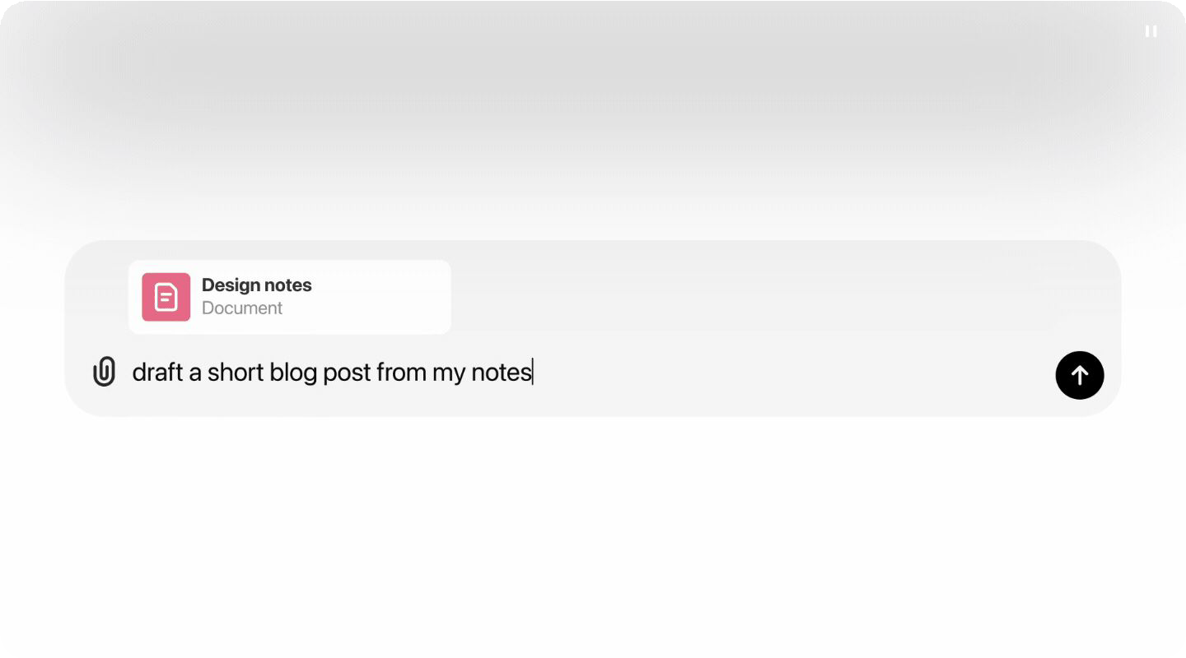
Collaborate
with Canvas
Co-create and edit content with your team and Chat in real-time
Update this paragraph …
Make suggestions for …
Shortcuts & version control
21
Conﬁdential and proprietary.

Slide 37


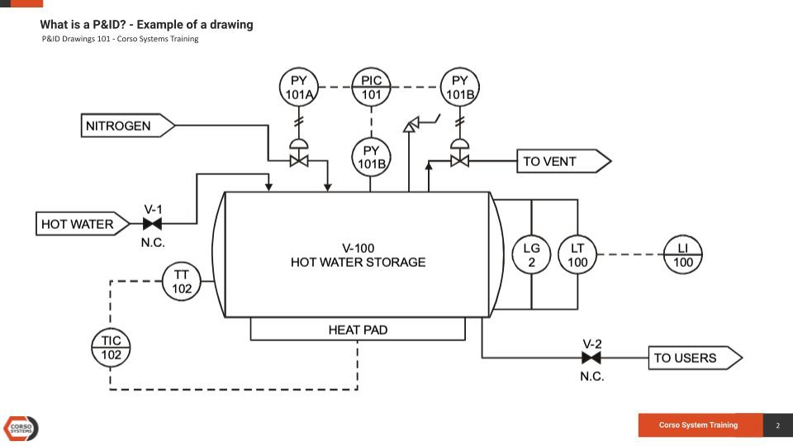
Interpret images
Is the image showing our asset?
Convert this whiteboard image into editable text
Tell me about this engineering diagram …
22
Conﬁdential and proprietary.

Slide 38
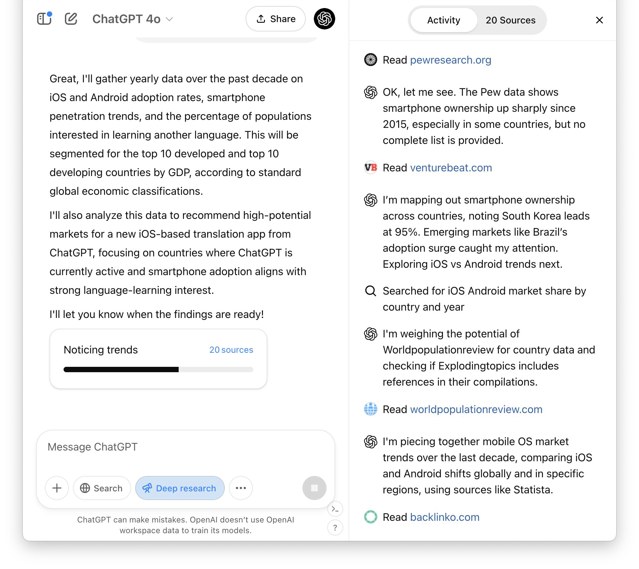
Deep research
Multi-step research on the internet.
Map the technology and vendor landscape for port security and transportation systems …
Evaluate these competing models for cargo screening, fare collection, or tolling…
23
Conﬁdential and proprietary.

Slide 39
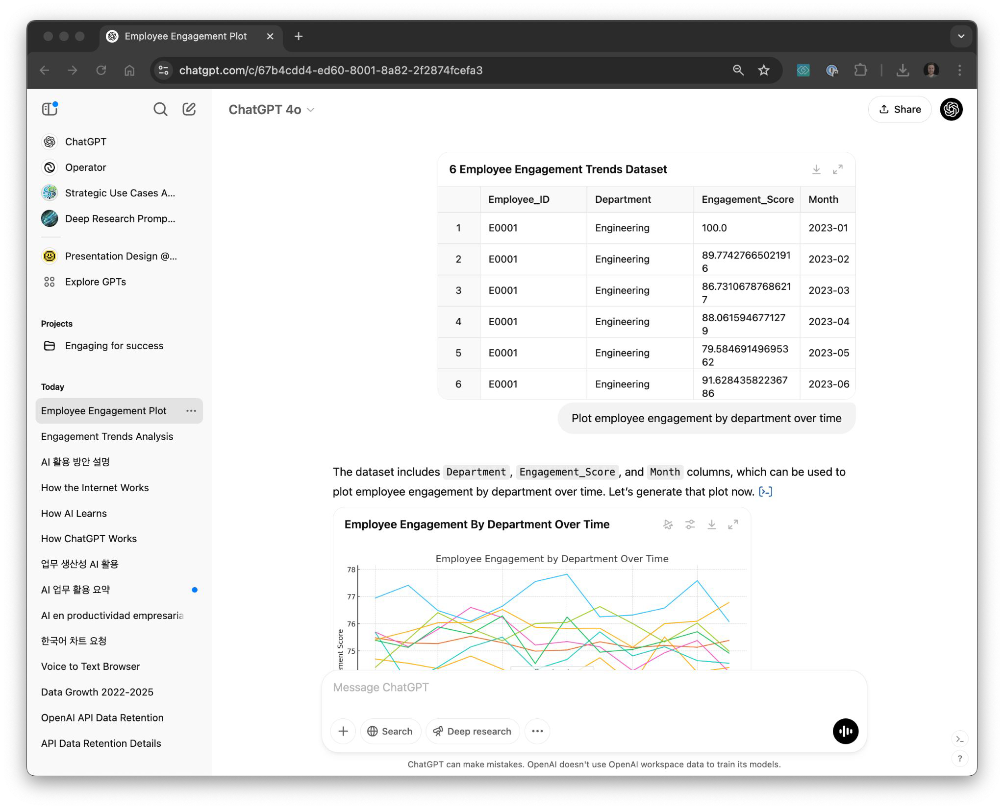
Data science
Write code to process data, compute outputs, draw graphs.
Transform this data …
Analyze this table …
Plot these trends …
24
Conﬁdential and proprietary.

Slide 40

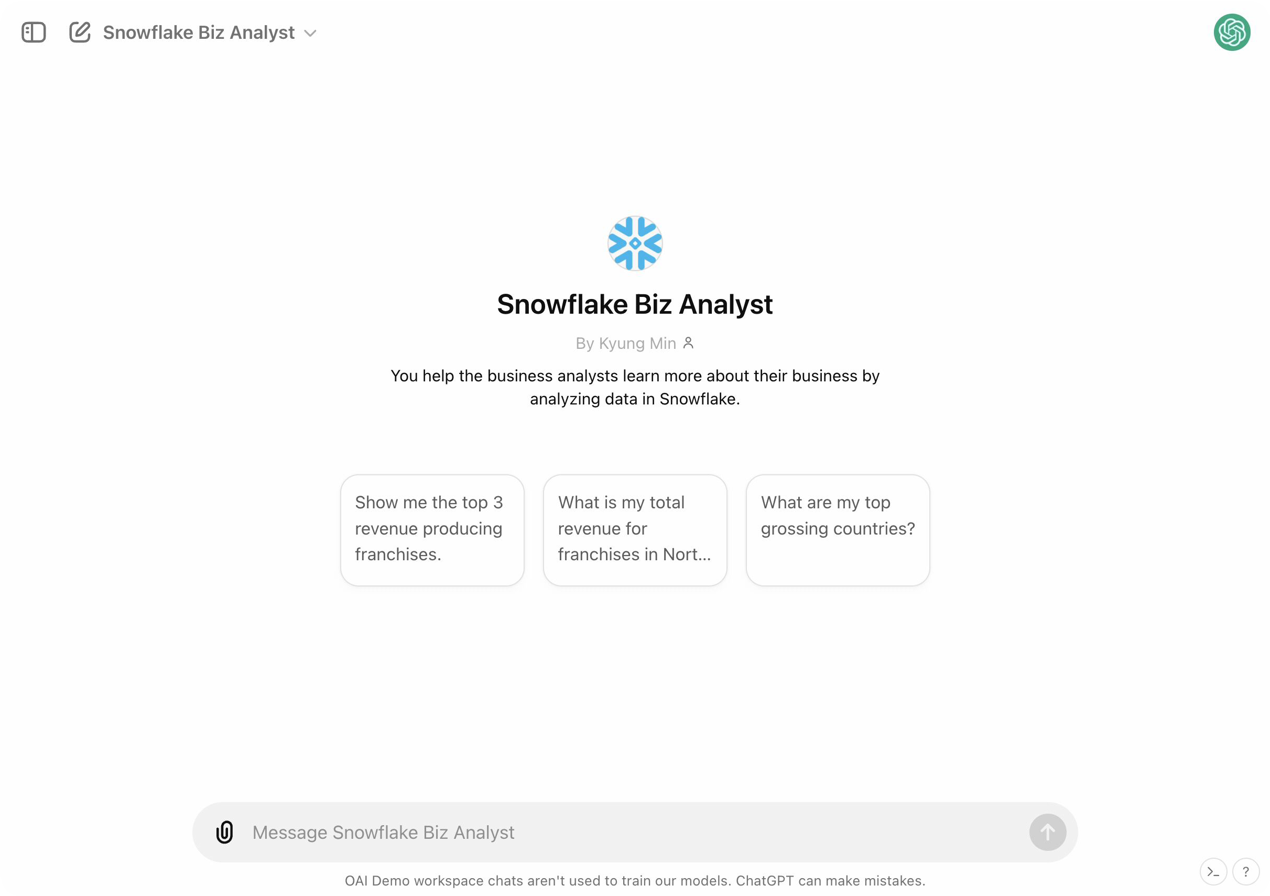
Custom GPTs
Configurable no-code AI applications for repeatable tasks.
Provide standard “instructions” to guide GPT behavior
Upload “knowledge” for the GPT to access when responding
Integrate with external systems via “Actions”
Share and discover re-usable GPTs
25
Conﬁdential and proprietary.

Slide 41

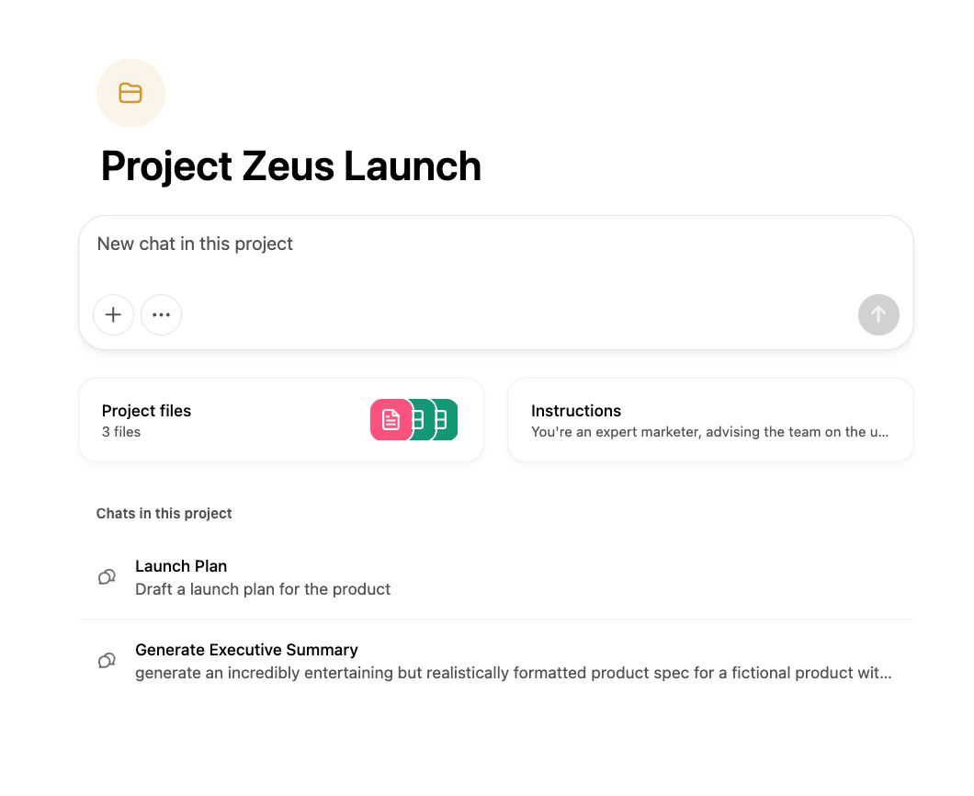
Projects
A helpful way to group and share context across your conversations
Drag ChatGPT conversations into Project folder to group together
Provide standard “instructions” to guide behavior of ChatGPT in Project conversations
Upload “knowledge” for the Project to access when responding
26
Conﬁdential and proprietary.

Slide 42


How Leaders Drive the Journey
Align
Activate
Spotlight wins
Empower AI champions
Encourage experimentation
Govern
Set guardrails for responsible use
Safeguard compliance and privacy
Enable safe, scalable adoption
Set clear expectations
Anchor teams on the journey
Clarify what good looks like
Amplify
Share use cases
Normalize failures
Lead with clear comms

Slide 43
Thank you
OpenAI Conﬁdential & Proprietary

Slide 44
Action Plan Subcommittee Report & Discussion Assistant Director, TBI, Richard Littlehale
STATE OF TENNESSEE
ARTIFICIAL INTELLIGENCE (AI)
ADVISORY COUNCIL MEETING
44

Slide 45
State AI Operations Update Roger Waynick
STATE OF TENNESSEE
ARTIFICIAL INTELLIGENCE (AI)
ADVISORY COUNCIL MEETING
45

Slide 46
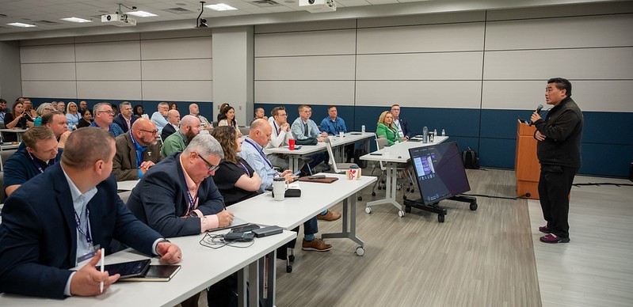
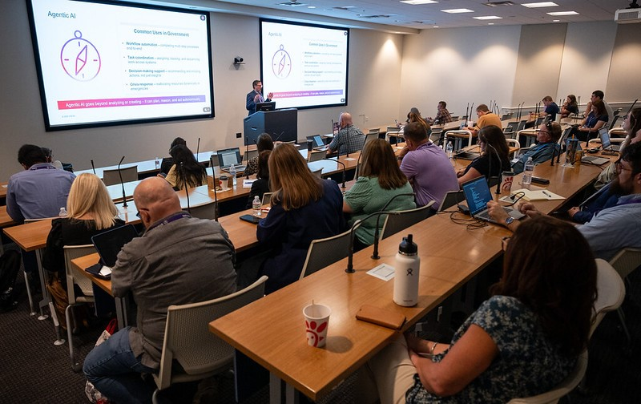
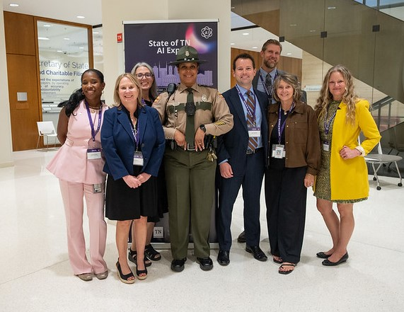
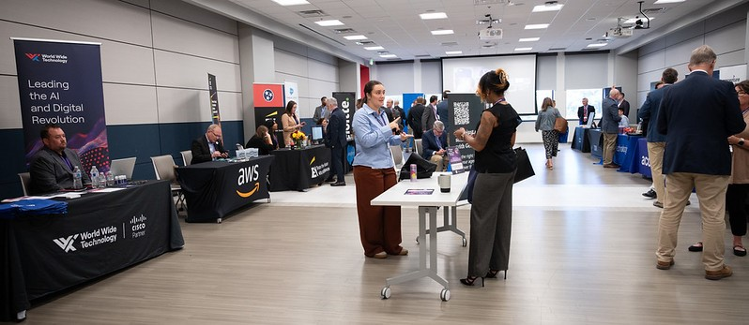

Slide 47
Next Meeting & Action Items CIO Kristin Darby
STATE OF TENNESSEE
ARTIFICIAL INTELLIGENCE (AI)
ADVISORY COUNCIL MEETING
47

Slide 48

Next Meeting & Action Items
Action Plan: Due December 31, 2025
Next Meeting: December 17, 2025
AI Tennessee Summit: January 28 & 29, 2026
STATE OF TENNESSEE
ARTIFICIAL INTELLIGENCE (AI)
ADVISORY COUNCIL MEETING

Slide 49
Closing Remarks & Meeting Adjournment Commissioner Jim Bryson
STATE OF TENNESSEE
ARTIFICIAL INTELLIGENCE (AI)
ADVISORY COUNCIL MEETING
49

Slide 50



Thank You
STATE OF TENNESSEE
ARTIFICIAL INTELLIGENCE (AI)
ADVISORY COUNCIL MEETING
50

