Slide 1


STATE OF TENNESSEE
ARTIFICIAL INTELLIGENCE (AI) ADVISORY COUNCIL MEETING
February 24, 2026

Slide 2


Agenda
Opening Remarks
Approval of Previous Meeting Minutes
Public Comment
Charter Amendments & Updates
AI Tennessee Initiative: Serving Tennesseans: AI Tennessee and the Presidential AI Challenge for K-12
University of Memphis: Tennessee’s AI University
State AI Operations Update
Next Meeting & Action Items
Closing Remarks & Meeting Adjournment

Slide 3

Opening Remarks Commissioner Jim Bryson CIO Kristin Darby
STATE OF TENNESSEE
ARTIFICIAL INTELLIGENCE (AI)
ADVISORY COUNCIL MEETING
3

Slide 4
Approval of Previous Meeting Minutes
STATE OF TENNESSEE
ARTIFICIAL INTELLIGENCE (AI)
ADVISORY COUNCIL MEETING
4

Slide 5

Public Comment
Any member of the public wishing to address the Council in person should have made this request in writing to Roger Waynick by February 18.
Each speaker has 3 minutes to speak.
STATE OF TENNESSEE
ARTIFICIAL INTELLIGENCE (AI)
ADVISORY COUNCIL MEETING
5

Slide 6
Charter Amendments & Updates Commissioner Jim Bryson
STATE OF TENNESSEE
ARTIFICIAL INTELLIGENCE (AI)
ADVISORY COUNCIL MEETING
6

Slide 7
AI Tennessee Initiative: Serving Tennesseans: AI Tennessee and the Presidential AI Challenge for K-12 Dr. Vasileios Maroulas, Dr. Anne M. Ho, Caleb Knight, Tabitha Samuel & Kristen Mecke
STATE OF TENNESSEE
ARTIFICIAL INTELLIGENCE (AI)
ADVISORY COUNCIL MEETING
7

Slide 8


Serving Tennesseans
The Presidential AI Challenge for K-12
Dr. Vasileios Maroulas
Associate Vice Chancellor
Director of AI Tennessee
Dr. Anne M. Ho
Director of AI R&D AI Tennessee

Slide 9

Every Tennessee student should graduate being capable and confident in AI.

Slide 10
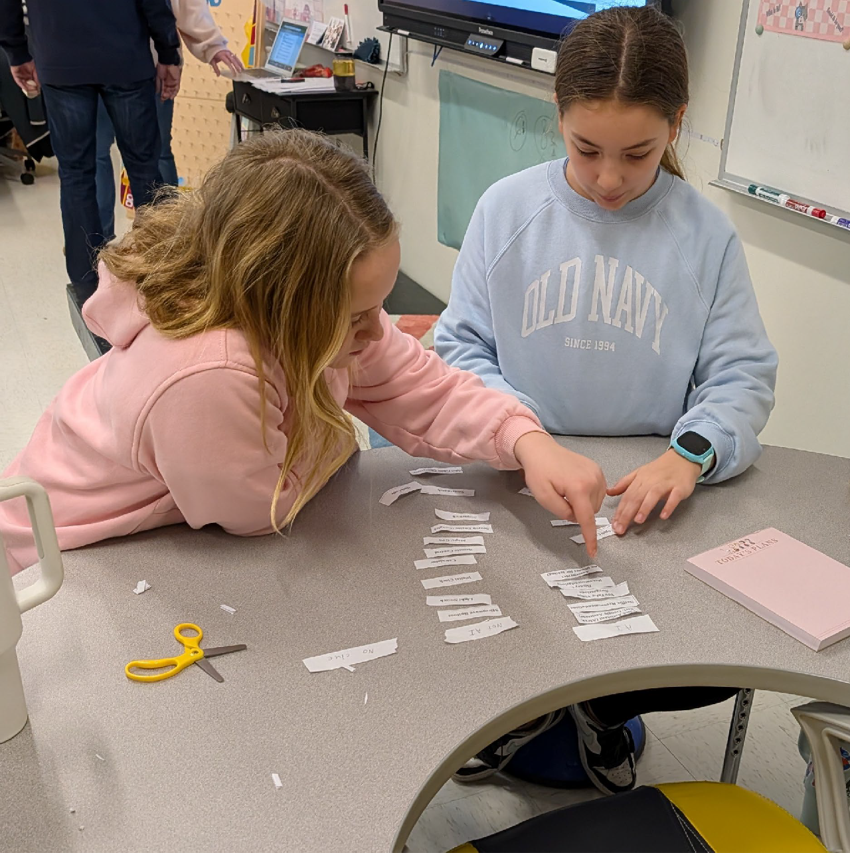
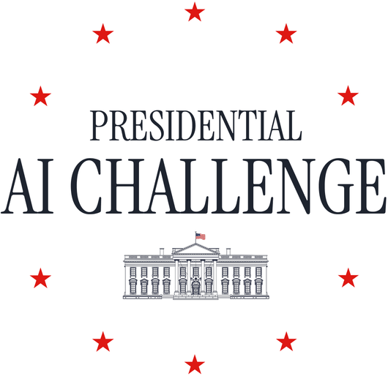

National Competition

Slide 11












Statewide Collaboration

Slide 12
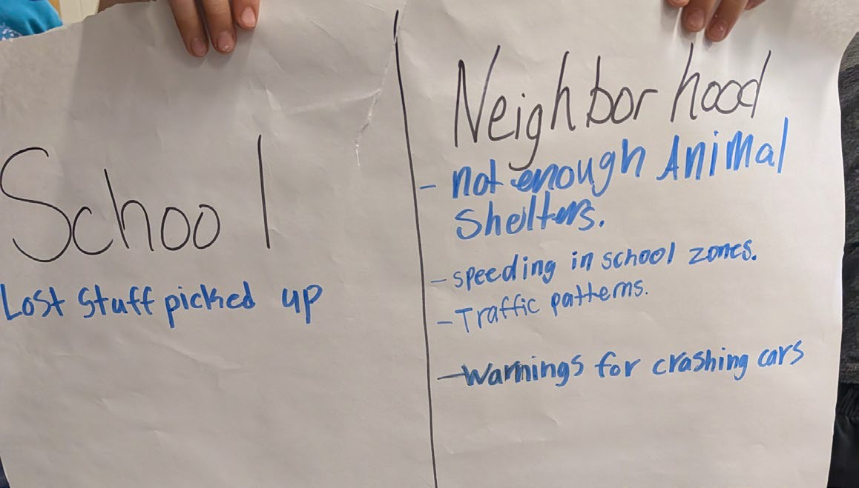
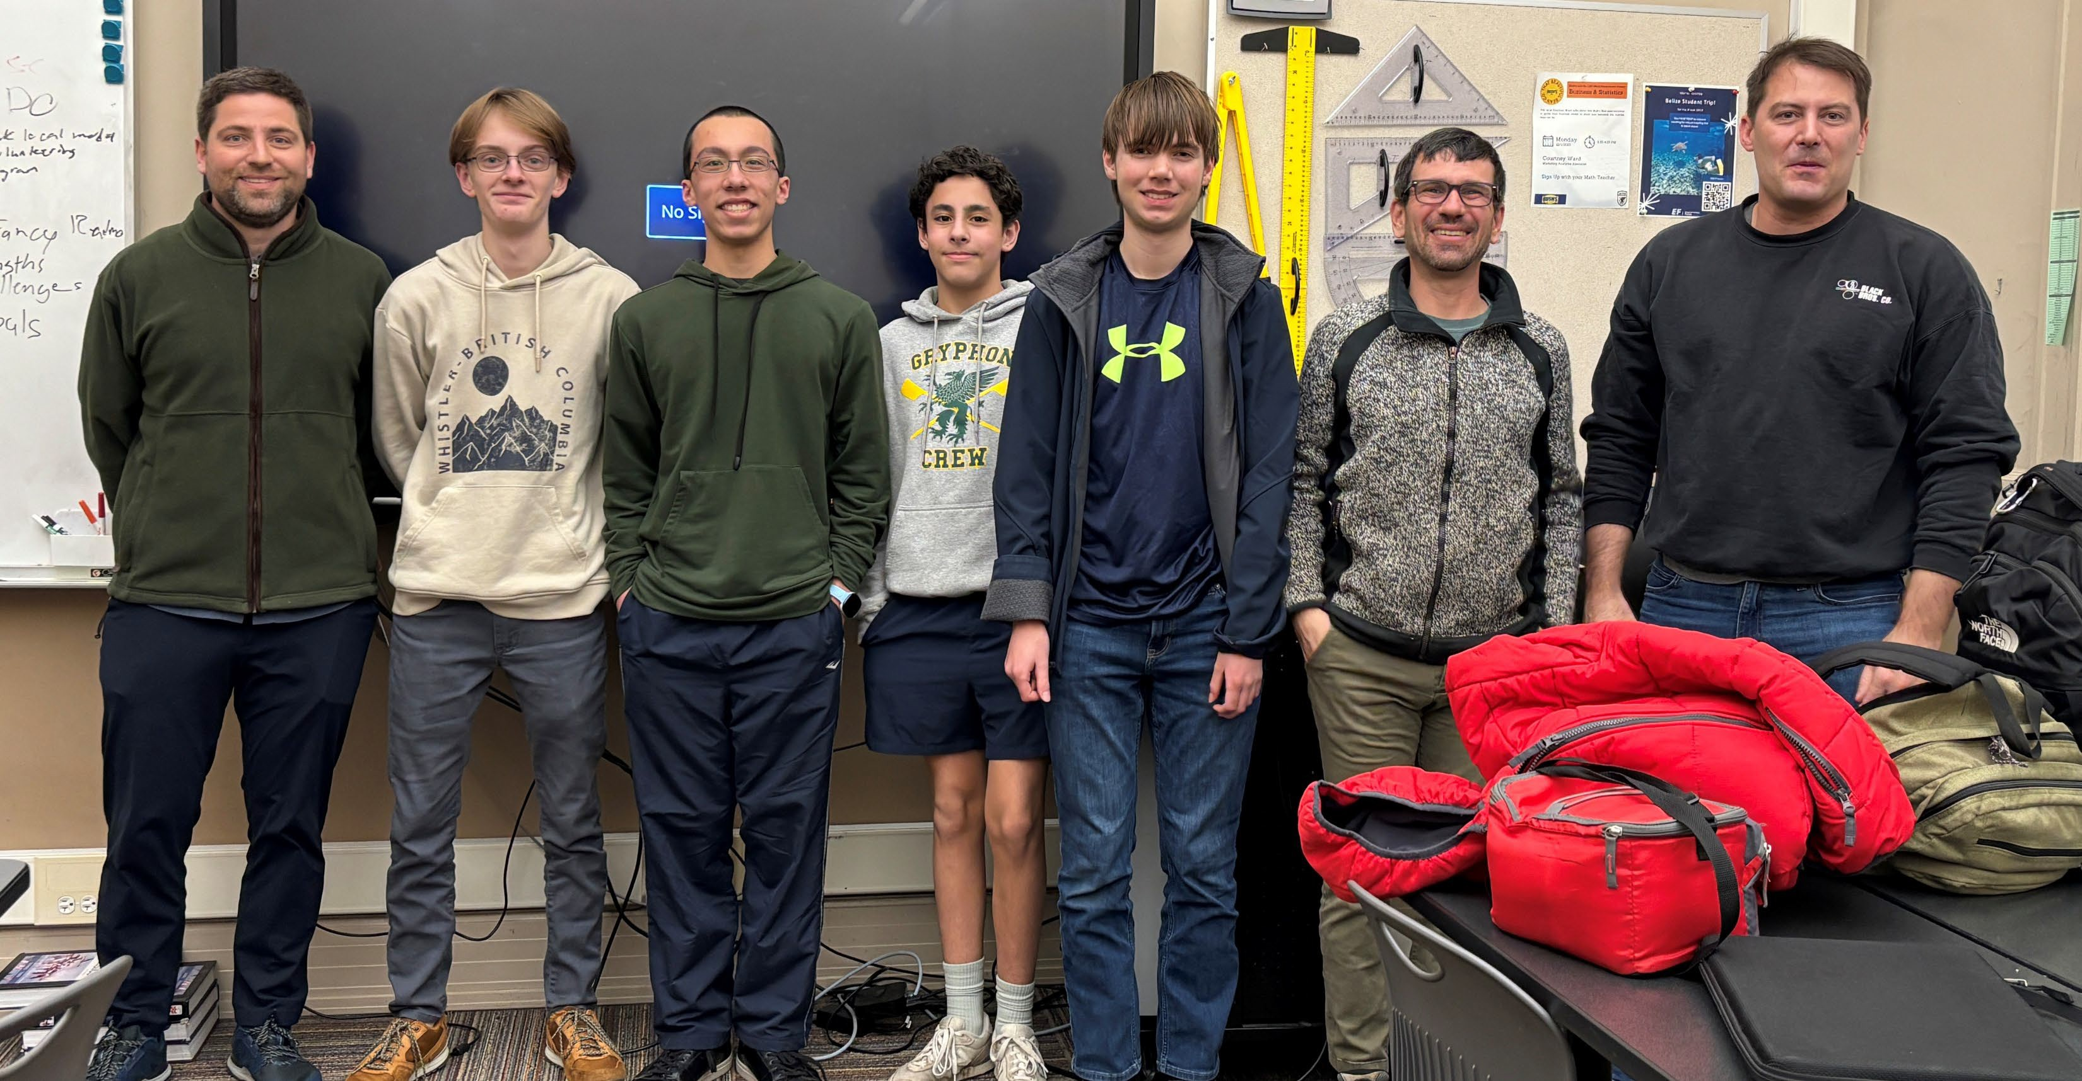
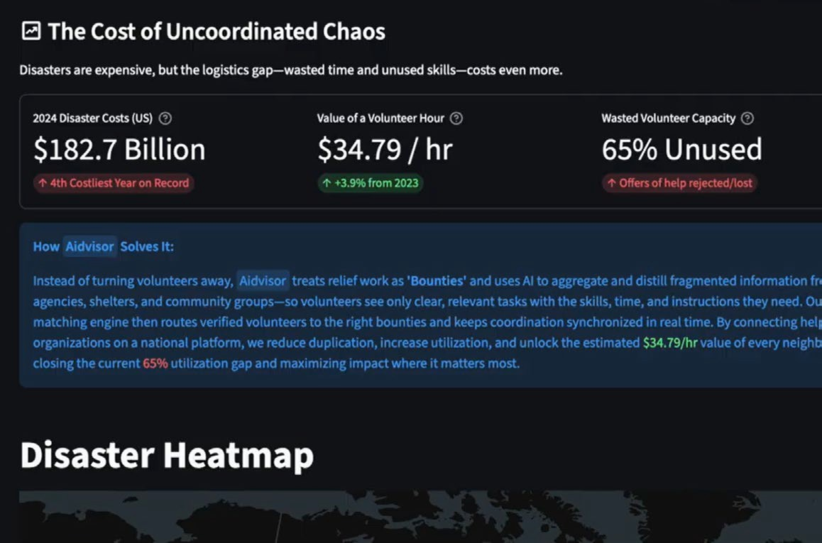
AI Stories from Tennessee Classrooms

Slide 13
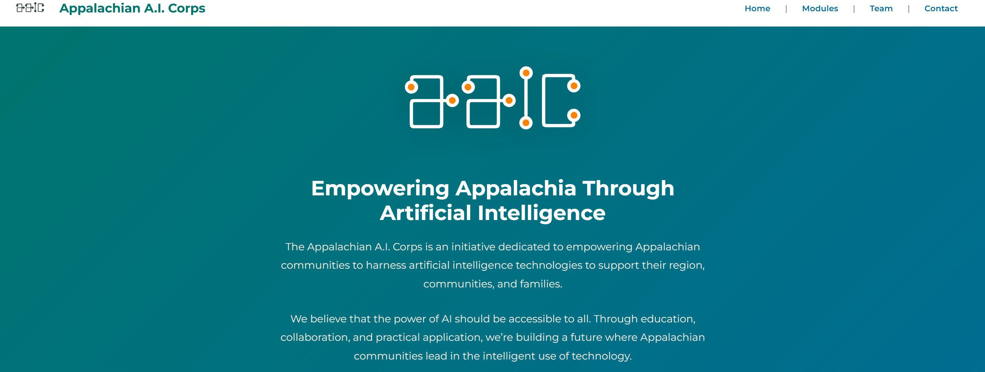
Beyond the Challenge

Slide 14
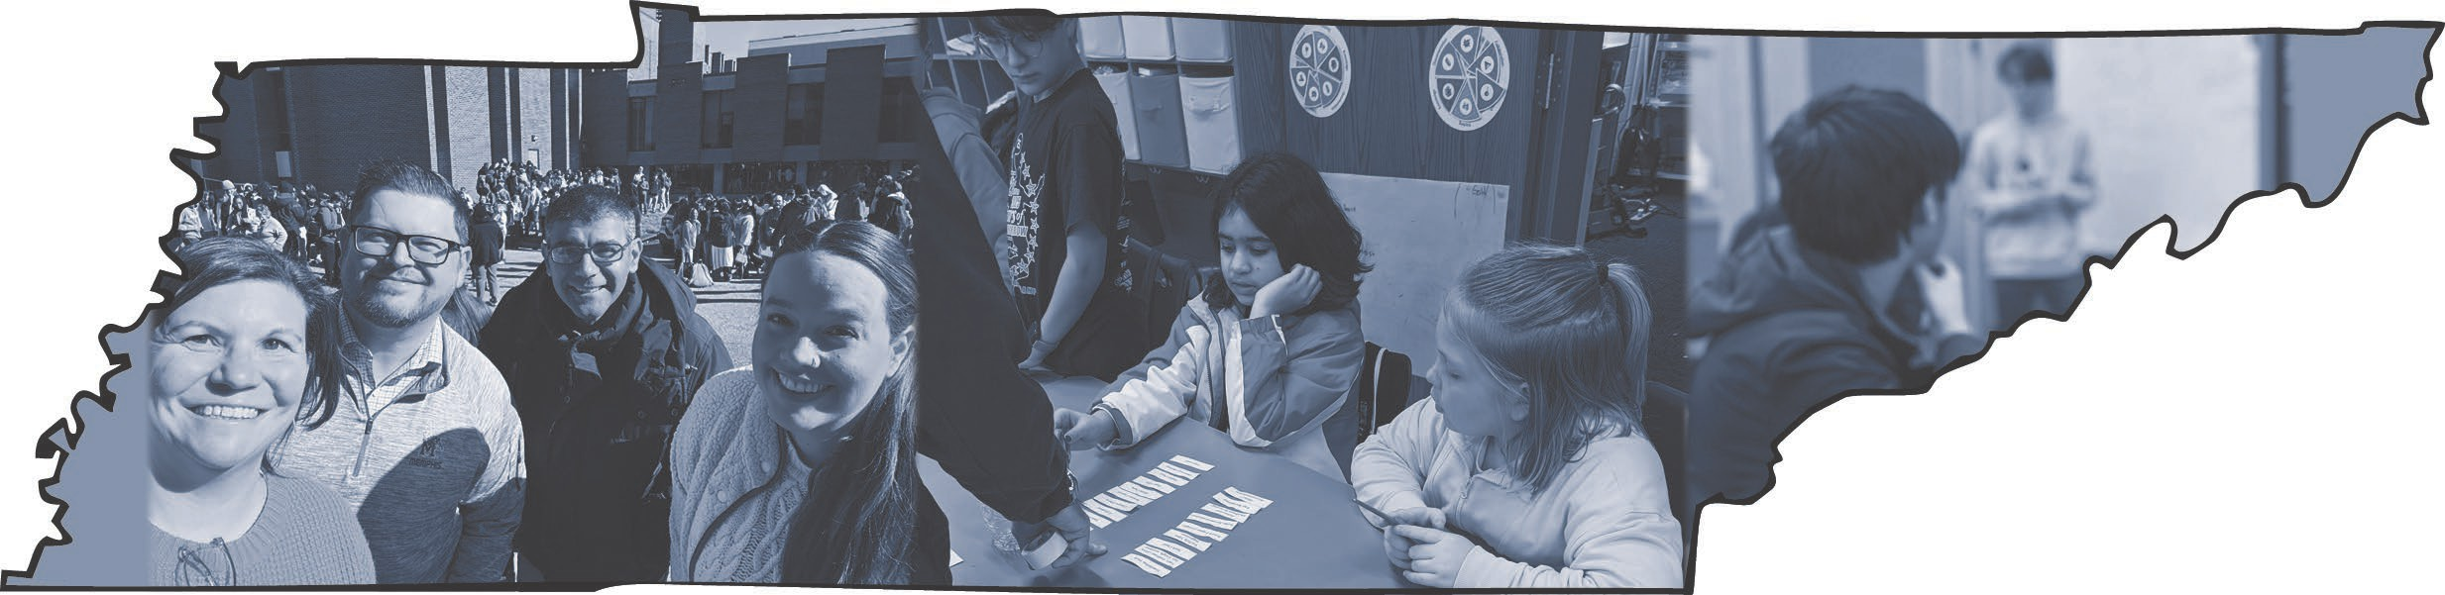
The Tennessee Way Forward

Slide 15








Slide 16
University of Memphis: Tennessee’s AI University Dr. Jasbir Dhaliwal & Jeff Brittain, FedEx Institute of Technology
STATE OF TENNESSEE
ARTIFICIAL INTELLIGENCE (AI)
ADVISORY COUNCIL MEETING
16

Slide 17


TENNESSEE’S AI UNIVERSITY
Advancing the Frontier of AI
in Tennessee for over 30 years.​
Jasbir Dhaliwal PhD.
Distinguished University Professor of Information Systems
Executive Vice-President for Research & Innovation
Notes:
Title Slide Option 1

Slide 18

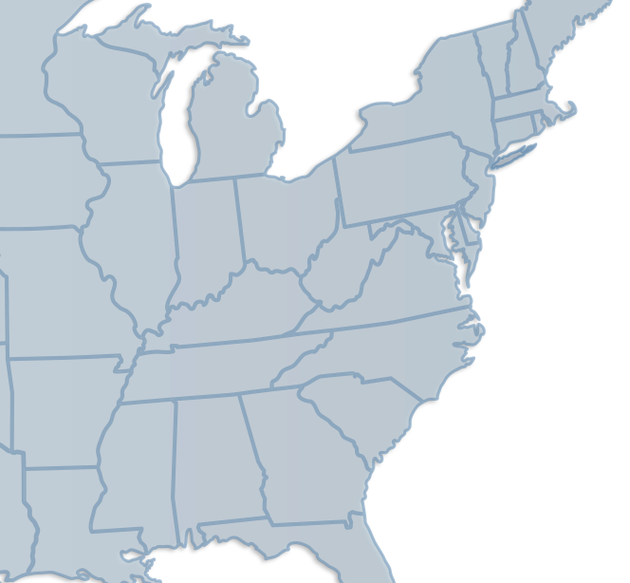




This Moment. This Region.
The Greater West TN region and the broader “Digital Delta” is ​one of the fastest-growing national hubs for AI Data Centers in the U.S.​
Why West TN?
Legacy of supply chain excellence
Commanding proximity to rail, river and road
Nation-leading low-cost energy and low-cost real-estate​
Emerging expertise in battery manufacturing​
Public / Private responsiveness to AI infrastructure needs
The University of Memphis has been a pioneer in AI for decades and remains dedicated to help Tennessee seize this moment.​
Notes:
The State of Tennessee has the opportunity to harness our geographical advantages, natural resources, and deep history of creative and industry breakthrough to once-again lead the nation and the world… The University of Memphis has a strong history of advancements that further position the university and the state to LEAD in AI.

Slide 19



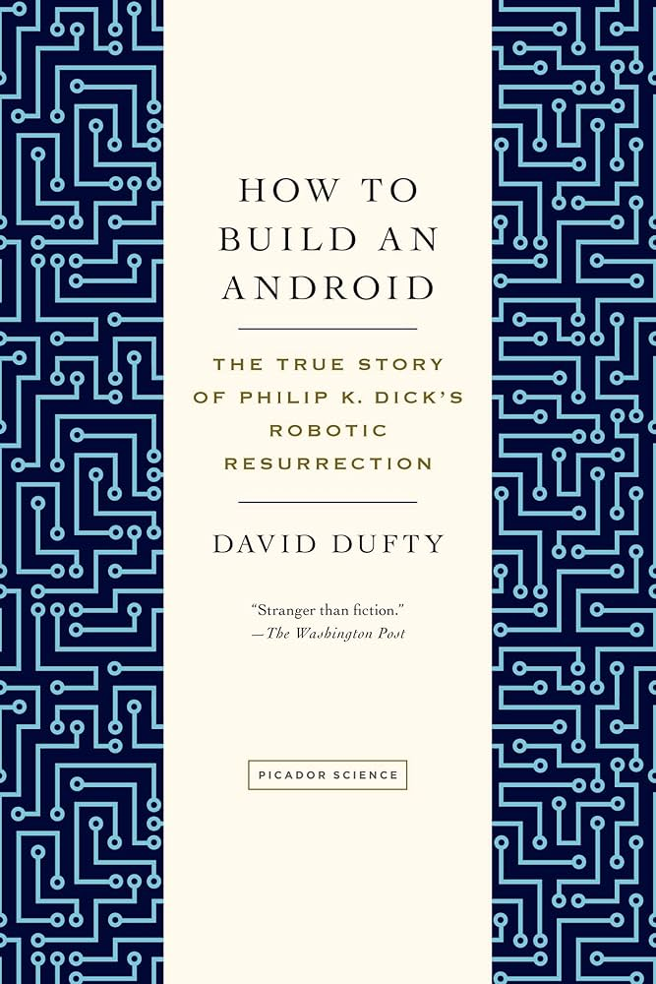



Leading AI. Then and Now.
Research published on Autonomous Agents as Embodied AI
Stan Franklin joins the UofM Math Dept. whose work in Sequential Spaces transforms data analysis
1st NSF-Funded GPU Cluster in Tennessee
1980
2000
2020
1970
1990
2010
Center for Information Assurance leads in Data Security
15+% of faculty directly engaged in AI and ML enabled research
134,000+ Citations of UofM Research in AI and ML
Art Graesser joins Stan and others to form the Institute for Intelligent Systems
Notes:
The University of Memphis faculty have been driving leading-edge research in the area of data science and intelligent systems for more than 30 years. Work pioneered in the 1970’s with Stan Franklin continued with Art Graesser in the 1980’s and continues today. The University of Memphis has been on the frontier of agentic Ai and published papers in the early 2000’s in this area. Our expertise in securing data is crucial to effective Ai systems and is led with Dapankar Dasgupta in the Center for Information Assurance. Most recently, Xiaolei Huang secured the first NSF-funded GPU cluster in Tennessee in 2023. He and his colleagues now run the CERTAIN research center, focused on driving AI Adoption across industries. Across these faculty alone, the University of Memphis has been cited over 134,000 times in research for AI and Machine Learning.

Slide 20

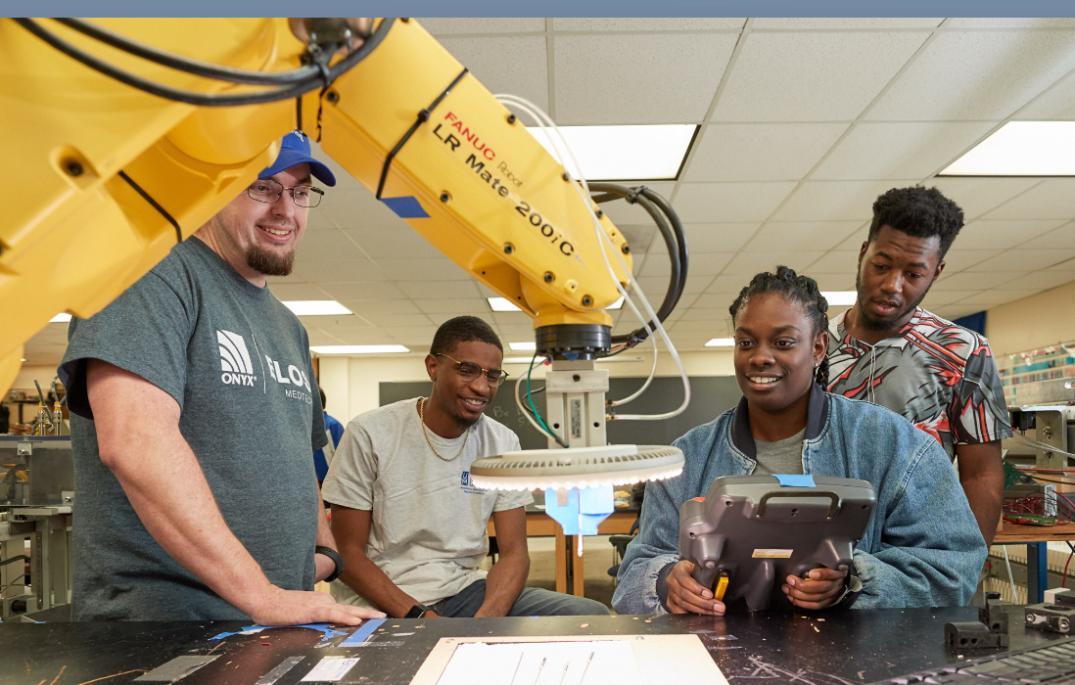



Accelerating Innovation.
AI Literacy, Skills and Techniques
Polytechnic and Applied Technology
AI Task Force:
Building and focusing University Resources
Investing in Translational Research Centers
901 AI Speaker Series and AI+ Cyber Summits
Investing in AI Research and Teaching
Notes:
Schedule/Table of Contents Template

Slide 21
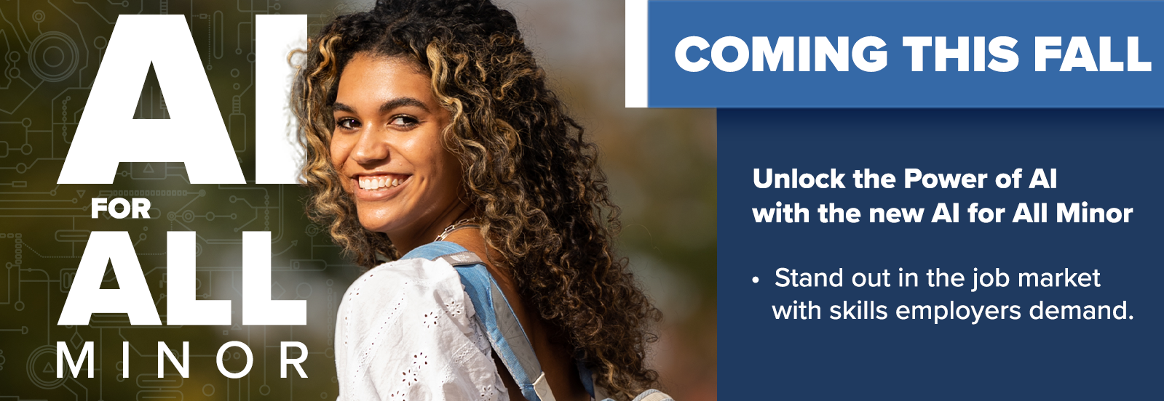
AI for All.
Cross disciplinary approach to ensure all students have a successful outcome and can thrive with AI.
Minor Overview
Artificial Intelligence Literacy
Skills and Techniques for Applied AI
Anthropology and Artificial Intelligence
Geospatial Artificial Intelligence
AI-based Big Data Analytics, Visualization and Decision Making
Designing for Artificial Intelligence in Education
Introduction to Intelligent Systems
AI, Society and Health
AI and Language Learning
AI-Infused Leadership
Launched Fall 2025
Notes:
Schedule/Table of Contents Template

Slide 22
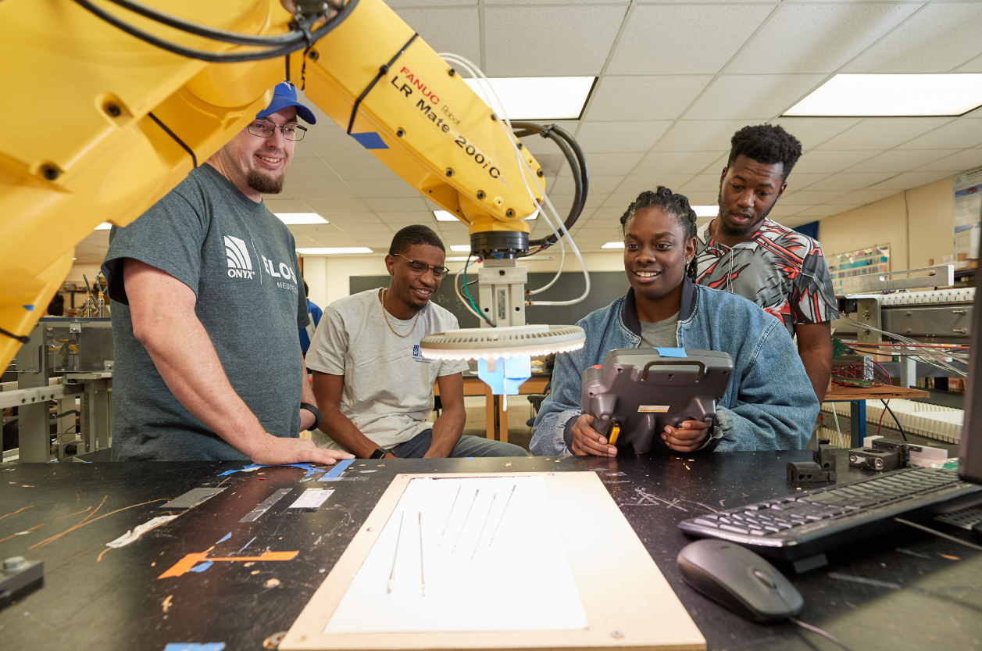
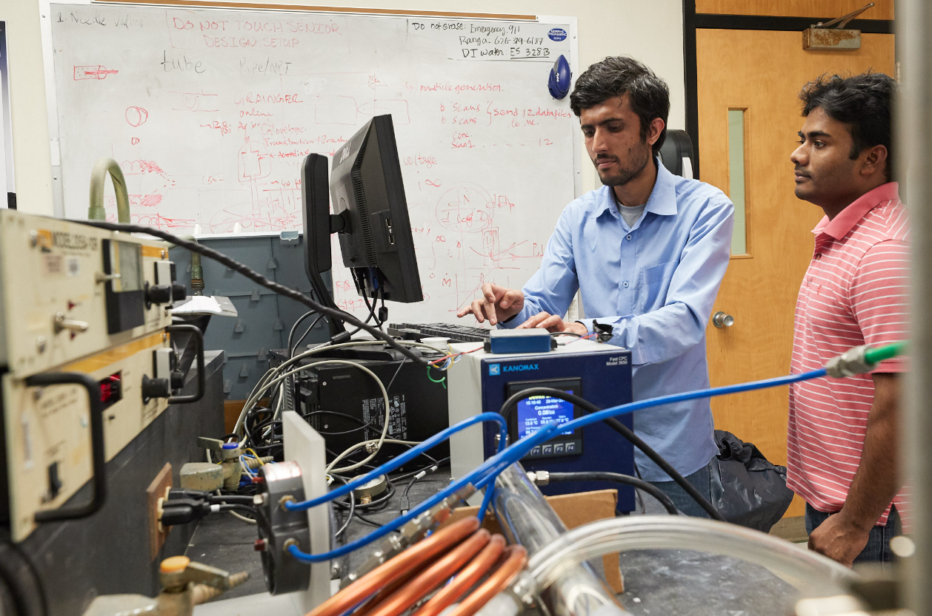
Polytechnic.
University of Memphis is taking a holistic approach to workforce development: Preparing students for the full range of jobs that industries need to build and scale technology-based operations in the U.S.
Real-World Applied Research
The Polytechnic at UofM empowers students and faculty to engage in applied research projects with direct industry impact.
Applied AI
Information Technology
Engineering Technologists
Manufacturing Supervision
Quality Control Specialists
Industrial Technicians
Manufacturing Leadership
Project Managers
Networking and Security
Systems Analysts
Notes:
Schedule/Table of Contents Template

Slide 23
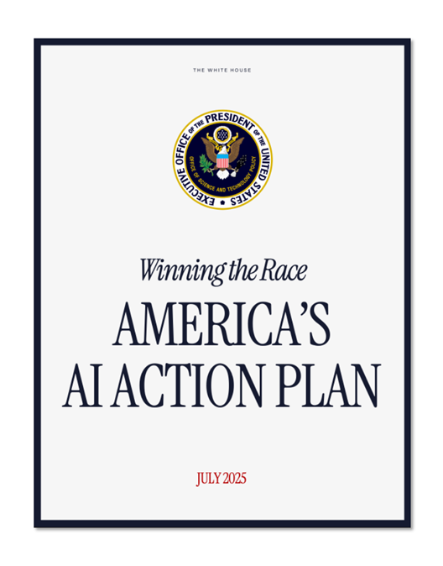
AI Task Force.
University-level focus to accelerate ROI from AI in education. Driven in alignment with national priorities.
National Priorities
AI Governance & Community
AI Tools: explore issues and provide guidance regarding AI tool investments at the University level and guidelines for AI tool investments at the unit level.
AI Community of Practice: Focus of the scholarship of teaching and learning across disciplines in the rapidly emerging AI era. Such a University-level facilitated community of practice must be augmented by similar communities within our academic units.
Accelerate AI Innovation: Remove barriers and rapidly expand U.S. research, development and adoption of advanced AI technologies.
Build American AI Infrastructure: Invest in domestic compute, data, semiconductor and energy systems needed to sustain large-scale AI capabilities.
Lead in International AI Diplomacy & Security: Shape global AI standards, strengthen alliances, and counter adversaries to ensure U.S. leadership and security in the AI domain.
Notes:
Schedule/Table of Contents Template

Slide 24
AI Research Center: CERTAIN
Promote research in AI adoption and adaptation in the areas of healthcare, manufacturing, logistics, higher education, supply chain and software development.
Research Areas & Themes
Human factors and training practices to promote the effective usage of predictive AI in manufacturing
Impact of AI on various stages of the software development life cycle
Effective strategies for integrating Generative AI in developing teaching material, instruction and assessment of undergraduate curricula
Frameworks for adopting and implementing predictive AI in improving agricultural yield
Best practices for AI-enabled scientific discovery and multi-disciplinary collaboration in biomedical science and engineering
Notes:
General Content Slide

Slide 25
AI Research Center: AIHR
The AI for Health Research (AIHR) Lab seeks to develop innovative, ethically grounded applications of artificial intelligence to improve public health outcomes.
Research Areas & Themes
As part of the university’s broader investment in AI and health—including the Center for Responsible Artificial Intelligence in Public Health and the “AI for All” academic programs—the Lab addresses critical challenges across multiple domains.
Lab’s initial focus is on substance use disorder; its work extends to other pressing areas such as maternal and child health, food and nutrition, mental health and broader efforts in preventive health and disease prevention.
The Lab also seeks to incorporate Generative AI tools to enhance public health education and communication, encourage healthy behaviors and support student training and faculty development.
Notes:
General Content Slide

Slide 26
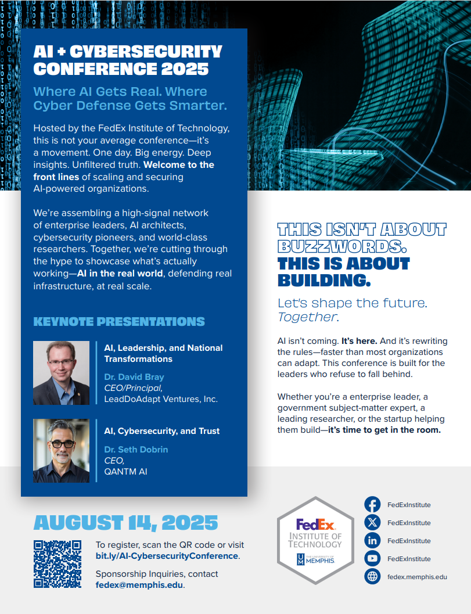
901 AI Speaker Series and AI+Cyber Summits.
National and global experts share their real-world experience and their fresh research to advance the AI capabilities.
Key Highlights
AI, Leadership and National Transformations
Applied AI: From Industry Practice to Business School Partnerships
Building Resilient Systems for a Human-Focused Future
AI and Workforce Development
Intersection of AI and Cybersecurity
Tech Meet-ups and Monthly Speaker Series open to the public Events - FedEx Institute of Technology
Notes:
Schedule/Table of Contents Template

Slide 27
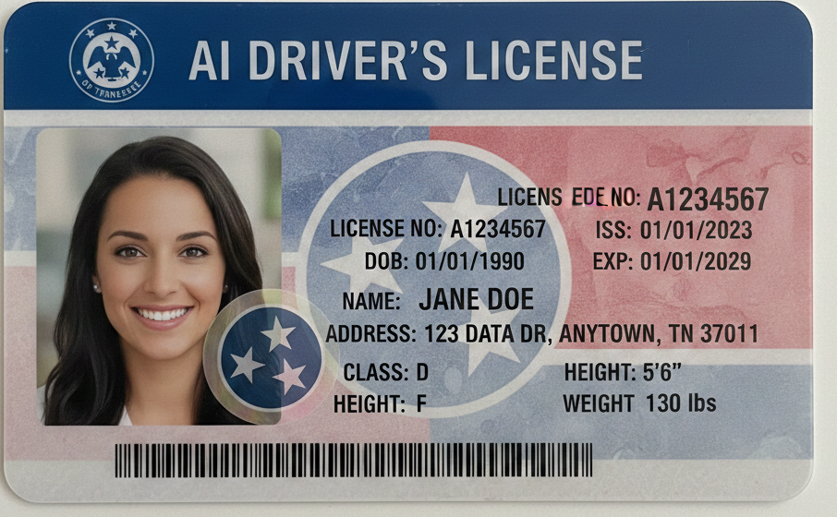

AI Drivers’ License Course
Ensure your teams and partners understand what AI is (and is not). Position your people to thrive with AI by knowing what to do and where to be careful.
More than just AI Literacy – AI Results
Tennessee’s first research-based AI training for businesses, organizations and communities
Executive and Manager tracks help understand what is needed and how to lead. General Employee / Partner tracks enable the organization to scale and deliver AI
Practical and useable
Focus on AI Adoption via proven Change Management Approaches
Contact: fedex@memphis.edu to learn more and register.
Notes:
Schedule/Table of Contents Template

Slide 28




Greater Memphis AI Research Consortium
Building upon the unique strength of the Delta to further Tennessee and the region as a national hub of AI.
Collective Strength to Advance
Rural Health
Precision Medicine
AI Compute + Data Center Management
NexGen Supply Chain
Strengthening National Defense
Notes:
Schedule/Table of Contents Template

Slide 29
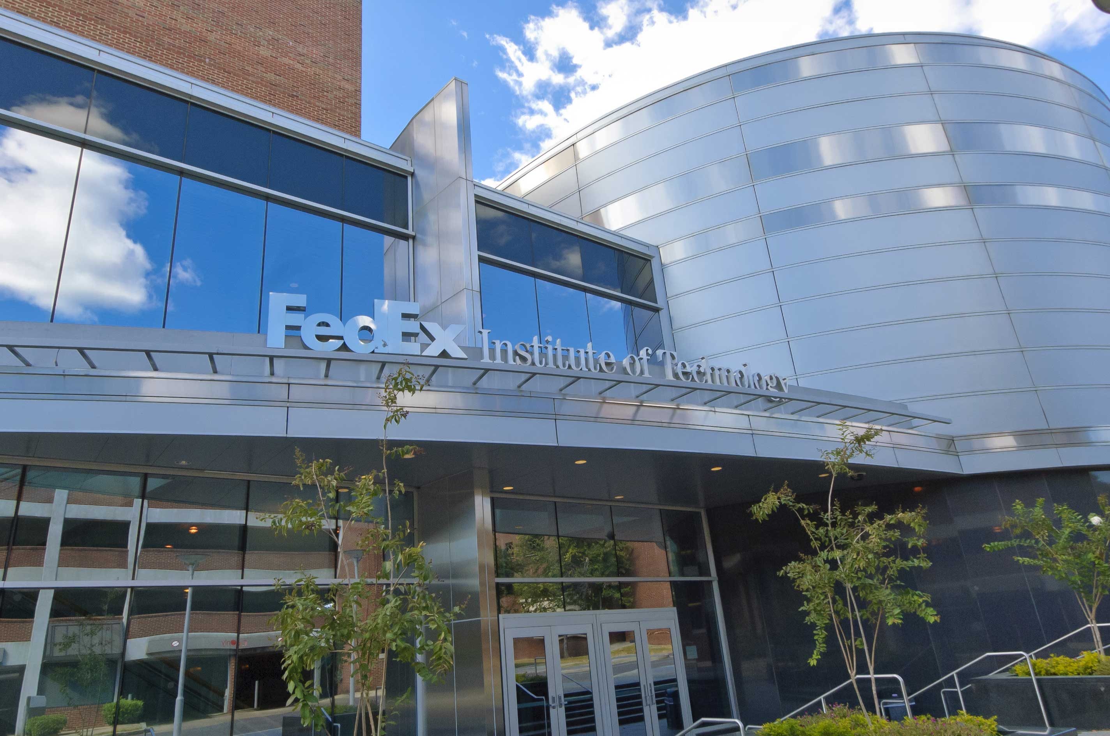
FedEx Institute of Technology
The FedEx Institute of Technology (FIT) is an advanced technology and research organization that serves as the front door to the research infrastructure and innovation capabilities of the University of Memphis.
The Institute accelerates interdisciplinary research through cross-campus technology clusters.
Research clusters focus on areas including:
Artificial Intelligence (AI), Drones, Cybersecurity, GPUs, Autonomous Vehicles, Robotics, Electric Vehicles
Supported by a unique innovation partnership with FedEx, FIT operates as a central hub for:
Research, training, and collaboration
FIT helps keep the region relevant and at the cutting edge of technological advancement.
Notes:
Schedule/Table of Contents Template

Slide 30

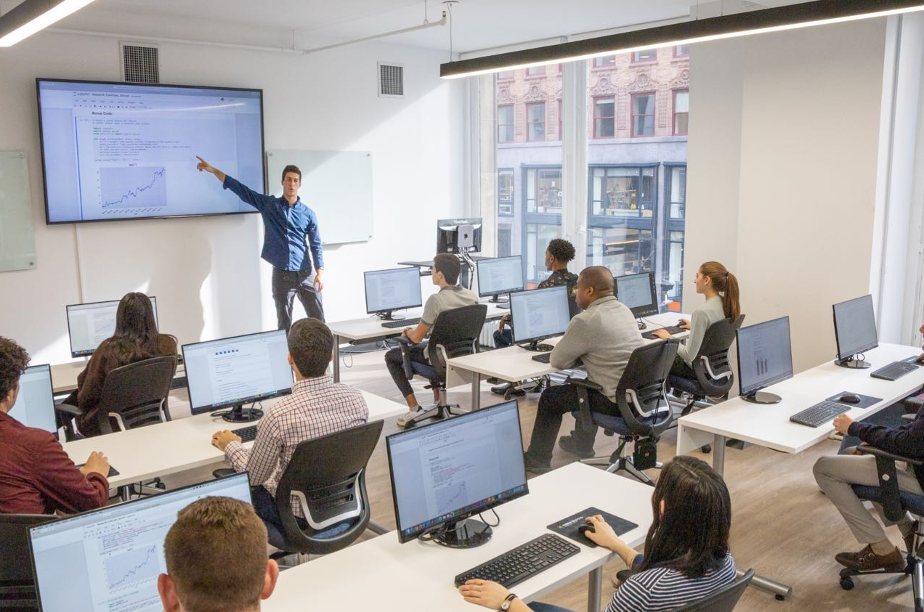
Our Role in Moving the State Forward
Research-Based. Faculty-Led. People-Centered.
Practical solutions tailored to your department or function.
Provide AI Literacy and Readiness Coaching for leaders and staff – Customized for your area.
Ensure a people-centered approach to process improvement that drives AI Adoption and results.
Help you deliver on your priorities by leveraging AI for public service.
Develop AI strategic plans for your departments.
M. Jeff Brittain Managing Director, Emerging Technologies Innovation and Workforce Development
m.brittain@memphis.edu
Notes:
Schedule/Table of Contents Template

Slide 31

Impact Summary
The University of Memphis is Tennessee’s AI University, showcasing more than three decades of leadership in artificial intelligence research, education, and innovation.
The Digital Delta region’s strategic advantages for AI-driven growth, the University’s historic and ongoing contributions to intelligent systems, and its comprehensive, cross‑disciplinary approach to AI literacy, workforce development, and translational research positions the entire state of Tennessee forward.
Major UofM initiatives—including new academic programs, applied research centers, public‑facing AI training, and regional consortium partnerships—position Tennessee to lead nationally in AI adoption, infrastructure, and societal impact.
Notes:
Schedule/Table of Contents Template

Slide 32
TENNESSEE’S AI UNIVERSITY
Dr. Bill Hardgrave
University of Memphis President
901.678.2234
president@memphis.edu
Visit the University of Memphis online to explore how we’re advancing AI, innovation, and opportunity.
Notes:
General Content Slide

Slide 33
State AI Operations Update Roger Waynick
STATE OF TENNESSEE
ARTIFICIAL INTELLIGENCE (AI)
ADVISORY COUNCIL MEETING
33

Slide 34
Next Meeting & Action Items CIO Kristin Darby
STATE OF TENNESSEE
ARTIFICIAL INTELLIGENCE (AI)
ADVISORY COUNCIL MEETING
34

Slide 35

Next Meeting & Action Items
AI Tennessee Summit: March 25 & 26, 2026
Next Meetings: April 14 & July 22, 2026
State of TN AI Expo: October 1, 2026
STATE OF TENNESSEE
ARTIFICIAL INTELLIGENCE (AI)
ADVISORY COUNCIL MEETING

Slide 36
Closing Remarks & Meeting Adjournment Commissioner Jim Bryson
STATE OF TENNESSEE
ARTIFICIAL INTELLIGENCE (AI)
ADVISORY COUNCIL MEETING
36

Slide 37
Thank You
37

