Slide 1
Materials Management
Program Update
Trey White, Recovered Materials Program Manager | 1 May 2019

Slide 2
Overview
Program Highlights
Annual Progress Reporting
Grants
Spring HHW Season

Slide 3
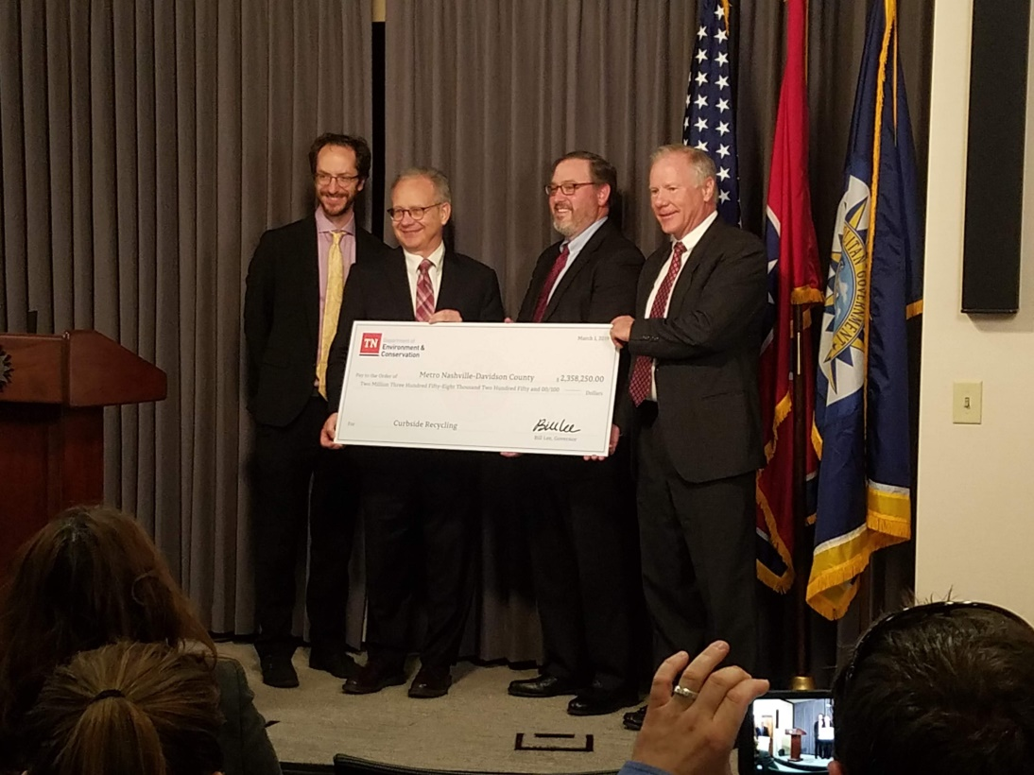
Recovered Materials
Metro Nashville Recycling Grant
$2.3 million, largest TDEC grant ever
Will effectively double recycling capacity

Slide 4
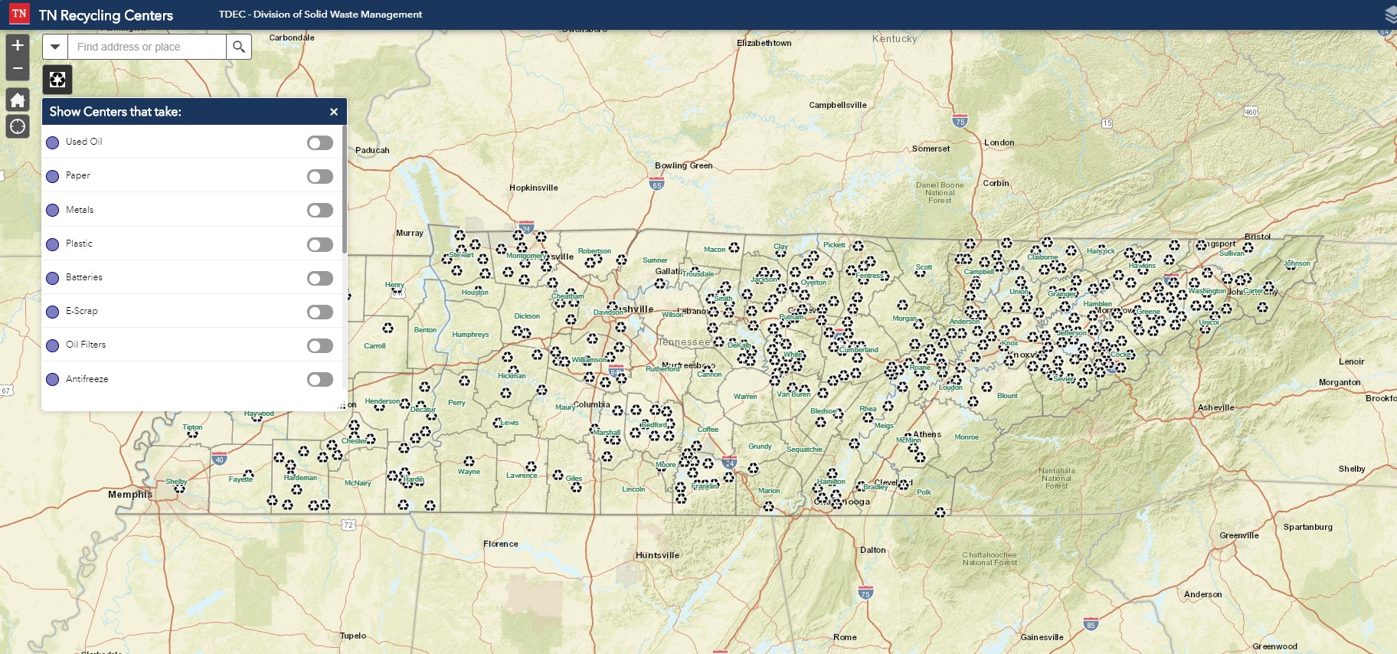
Used Oil
Interactive Online Recycling/Problem Waste Map
https://tdeconline.tn.gov/TNRecyclingCenters/

Slide 5
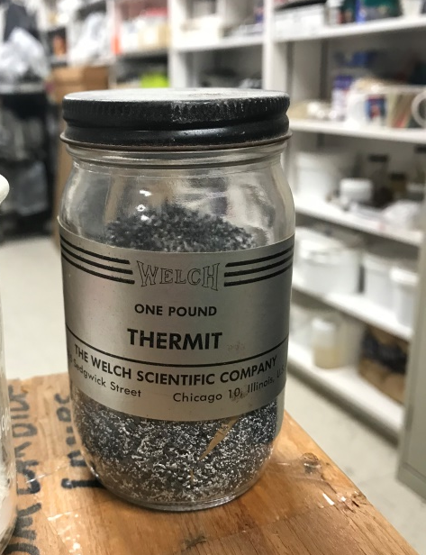
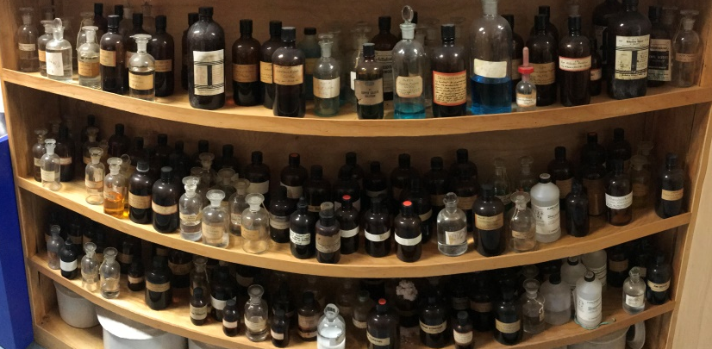
Tennessee Schools Lab Rehab Program
Montgomery
Robertson
Sullivan
Smith
Washington
Wilson
Rutherford
Cannon
Roane
Sevier
Hardin
Wayne
Giles
Program Totals
K-12 Schools Visited: 30
Students Affected: 37,672
Pounds Collected: 9,997 lbs.
November 2018 to Present | No. of Schools | Upcoming | No. of Schools
Cannon | 1 | Giles | 1
Hardin | 1 | Montgomery | 3
Montgomery | 1 | Sullivan | 2
Roane | 6 | Washington | 2
Robertson | 2 | Wilson | 3
Rutherford | 8
Sevier | 1
Smith | 2
Sullivan | 4
Wayne | 2
Wilson | 2
Total: | 30 | Total: | 11

Slide 6
Annual Progress Reporting
Reporting timeframe for counties is closed as of April 30
32% Requested Extension
Quantitative Review
QA/QC
Data Verification
Approval Letters

Slide 7
Annual Progress Reporting
First year of “new format” APR
Objective 1: Increase Accuracy of
Reported Data
Closer to Statutory Requirements
Lessen opportunities for reporting errors
Incorporate feedback from users
Notes:
A large TDOT project in Morgan County led to a large amount of material being put into landfills, which prevented them from accomplishing their APR goals.

Slide 8
Grants
Grant System Revamp
Suspend new grant offerings temporarily
GMS and Rating Improvements
Title VI
Procurement Policy
Eliminate Redundancy
Objective 8: Develop sustainable
funding sources for materials
management
Notes:
Requested Amendments include:
- First Tennessee Development District – Technical Assistance
- Resource Capture Incorporated – Composting
- Isaiah 58 – Recycling Equipment
- Rutherford County – Multiple
- Macon County – Multiple

Slide 9
Grants
2019-2020 New Contracts:
4 Convenience Center Grants
4 Curbside Recycling Grants
11 Education and Outreach Grants
6 Household Hazardous Waste
3 Old Closed Landfill
7 Recycling Equipment Grants
11 Recycling Rebates
1 Special Project Grant UT Glass
4 Special Project Shiloh Planning Region
9 Technical Assistance Grants
16 Used Oil Grants
15 Waste Reduction Grants
Notes:
Requested Amendments include:
- First Tennessee Development District – Technical Assistance
- Resource Capture Incorporated – Composting
- Isaiah 58 – Recycling Equipment
- Rutherford County – Multiple
- Macon County – Multiple

Slide 10
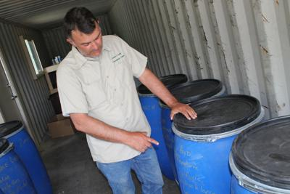
Household Hazardous Waste Spring Season
29 HHW Events Scheduled from March to June
14 Events Completed
2,223 Households
HHW Collection Containers
Blount County Success
2 months in operation
Surpassed Mobile Event HH
Loudon County
Grant Opening
Saturday Collections
Previous 2 Mobile Events/Year
Notes:
Household Hazardous Waste collection analysis can be found at the following URL:
https://www.tn.gov/environment/sw-mm-household-hazardous-waste-program/hhw-mobile-collection-analysis.html

Slide 11
Summary
Program Highlights
Annual Progress Reporting
Grants
Spring HHW Season

Slide 12
Questions?
Notes:
Larry Christley, Program Manager, Materials Management Program - 615-532-0744 – larry.christley@tn.gov
Loretta Harrington, Manager, Grants - 615-532-0086 – loretta.harrington@tn.gov
Nicholas Stengel, Manager, Problem Waste – 615-532-0095 – nicholas.stengel@tn.gov
Trey White, Manager, Recovered Materials – 615-532-0075 – trey.white@tn.gov

