Slide 1
Solid Waste Permitting/Special Waste Update
TENNESSEE UNDERGROUND STORAGE TANKS and
SOLID WASTE DISPOSAL CONTROL
BOARD MEETING
Nick Lytle, Solid Waste Permits Manager| December 4 , 2019

Slide 2
Permitting Update
2019 Permits Issued:
Smith County Class I Lateral Expansion
Yarnell Class III Vertical Expansion (Knox County)
Birchwood Class III New Landfill (Hamilton County)

Slide 3
Permitting Update
2019 Permits Under Consideration:
Carter Valley Class I Lateral Expansion (Hawkins County)
Olin Corp Class II Lateral Expansion (Bradley County)
TVA New Facilities
Cumberland (Stewart County)
Bull Run (Anderson County)
TVA Expansions
Gallatin (Sumner County)

Slide 4
Permitting Update
2019 Permits Under Consideration:
Holston Army Class II Lateral Expansion (Hawkins County)
Fullen Dock Class III Lateral Expansion (Shelby County)
Cocke County Class III Lateral Expansion
Frayser Business Center Class III (Shelby County)
Vertical
Lateral

Slide 5
Permitting Update
2019 Permits Under Consideration:
Lawrenceburg New Class III landfill (Lawrence County)
Shelby Oaks New Class III (Shelby County)

Slide 6
Permit-By-Rule
2019 Permits-By-Rule Facilities
10 Convenience Centers
5 Transfer Stations
1 Composting
1 Land Application Site
Many Amendments and Reissuances

Slide 7
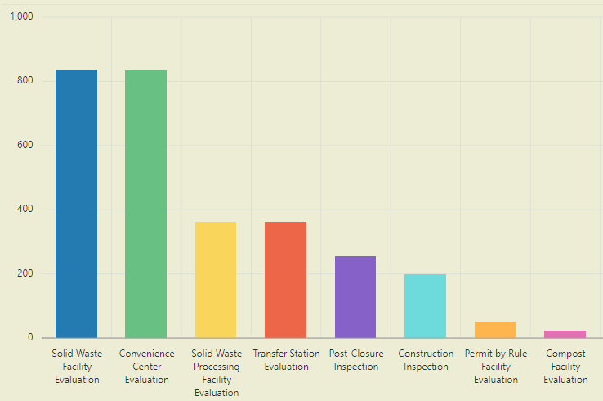
Inspections Performed To Date

Slide 8
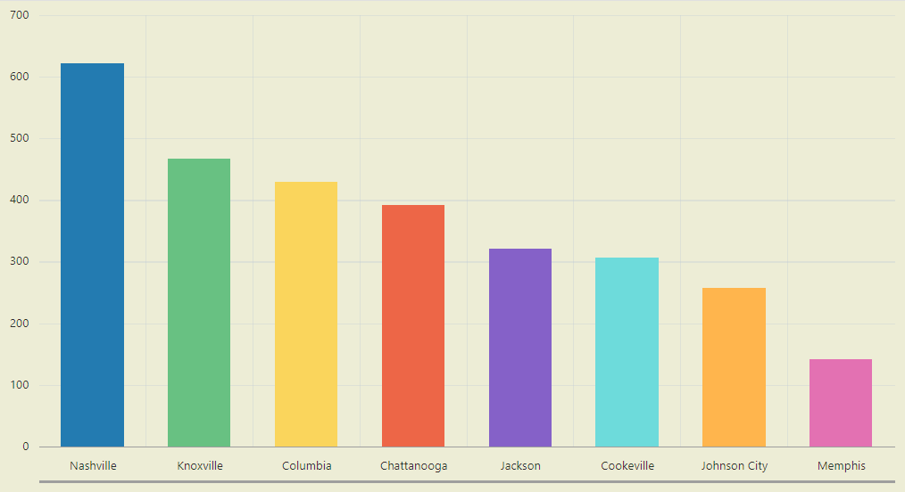
Inspections Performed To Date

Slide 9
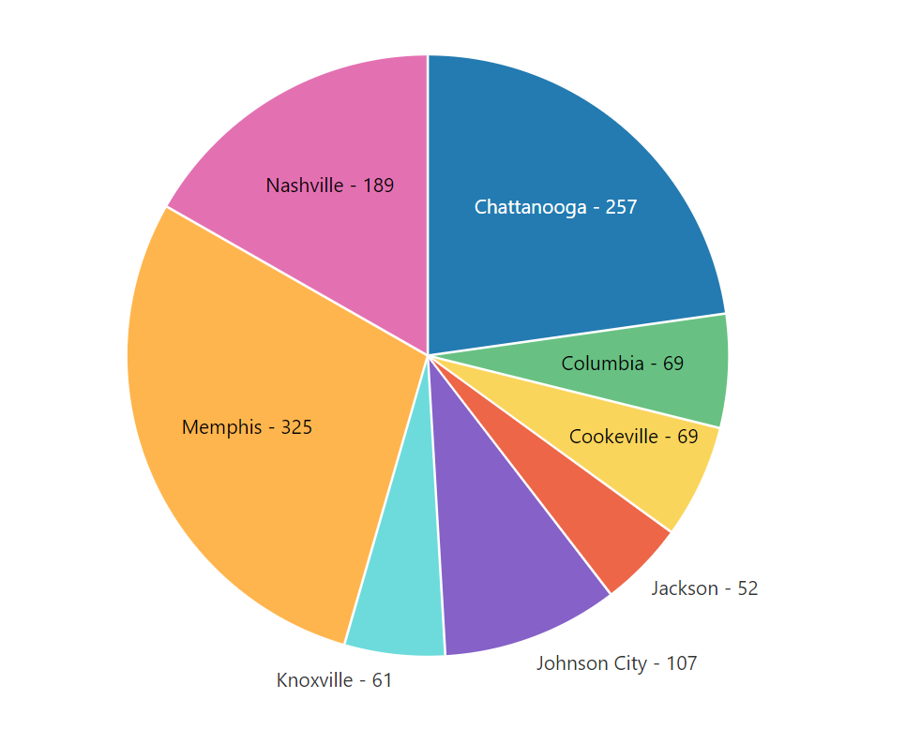
Complaints Investigated

Slide 10
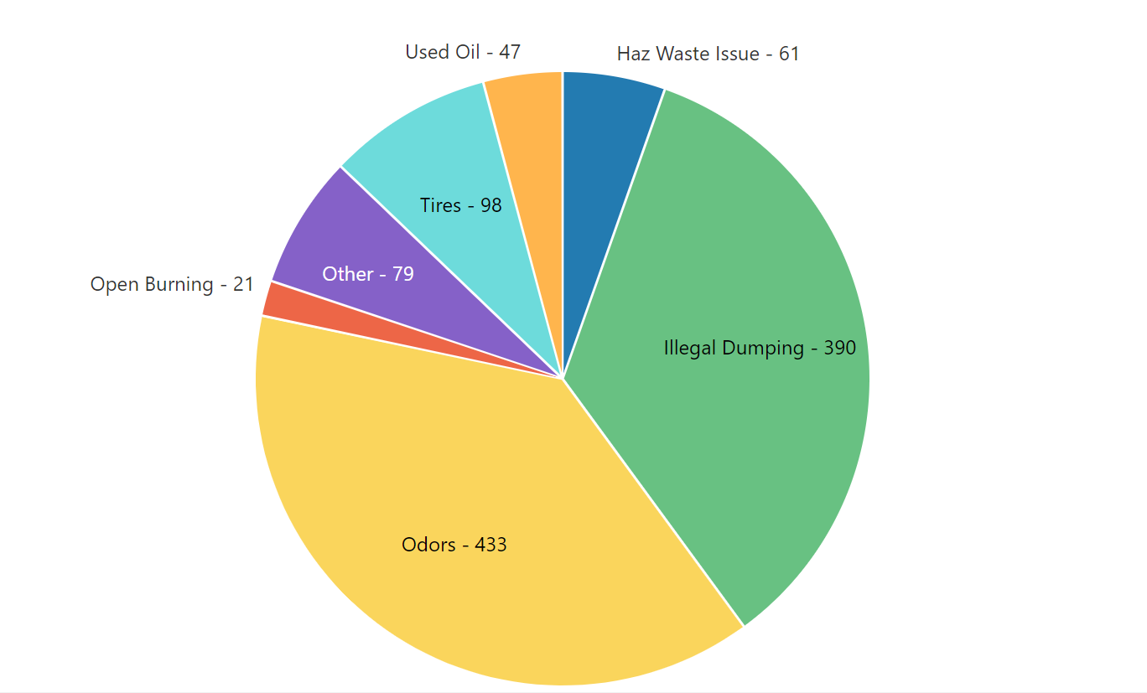
Complaints Investigated

Slide 11
Special Waste Update
Processed 861 Special Waste Evaluations for New and Re-certification
Up from 770 for the same time frame in 2018

Slide 12
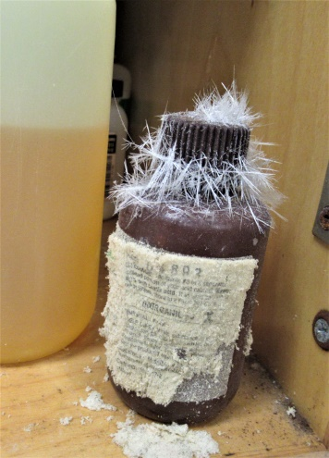
Special Waste Update
Special Waste @ Transfer Stations
Occasionally, a situation arises regarding special wastes being routed through a transfer station before final disposal at an approved landfill.
Rules state that transfer stations cannot receive a special waste without DSWM written approval.
We have recently worked with all EFO’s to ensure a uniform approval process is put into place for these requests.

Slide 13
Special Waste Update
Special Waste @ Transfer Stations
A transfer station facility must request in writing (letter or e-mail) DSWM’s approval to receive a special waste. DSWM written approval is required before receipt of that specific special waste.

Slide 14
Special Waste Update
The DSWM will not approve the receipt of a special waste if:
The current transfer station’s Permit-By-Rule notification states that the facility will not receive a special waste;
The special waste would be dangerous or difficult to manage at the transfer station; or
The special waste requires special procedures and/or equipment to be utilized to adequately confine and segregate the special waste; and the transfer station’s most recent approved Permit-By-Rule notification does not clearly and adequately address the special procedures and/or equipment to be utilized to adequately confine and segregate the specific special waste.

Slide 15
Special Waste Update
If any of these three conditions arise, the transfer station would have to submit a new Permit-By-Rule notification that clearly and adequately describes the special procedures and/or equipment to be utilized to adequately confine and segregate the specific special waste prior to receiving DSWM approval.

Slide 16
Contact
Email: Nickolaus.Lytle@tn.gov
Phone: 615-532-8004
Fax: 615-532-0938
Mail: Division of Solid Waste Management William R. Snodgrass TennesseeTower 312 Rosa L. Parks Avenue, 14th Floor Nashville, TN 37243

