Slide 1
Public Hearing
Water Quality, Oil and Gas Board
WebEx Virtual Meeting
October 20, 2020
10:00am
*There will be an opportunity for public comment,
you may email Drake.Smarch@tn.gov to be placed in line to comment.

Slide 2
Welcome!
Roll call of Board members present.
Opening remarks from the Division of Water Resources Director, Jennifer Dodd

Slide 3
Board Minutes
Presentation of minutes from April 2020
Roll call vote for approval of minutes.
Minutes are available on the Board’s website: https://www.tn.gov/environment/about-tdec/boards-and-commissions/board-tennessee-board-of-water-quality--oil-and-gas.html

Slide 4
Semi-Annual Public Comment Session
Public comment before the Board.
If you would like to participate, please email Drake.Smarch@tn.gov or use the Chat box in WebEx to notify us that you would like to make comments. Please identify the name of the person wanting to comment.

Slide 5
Per- and Polyfluoroalkyl Substances (PFAS)
Update on TDEC PFAS Activities
Division of Water Resources
Notes:
In my regulatory world these compounds that we refer to as emerging contaminants, not that they are new but rather we are only recently becoming aware of the environmental and health implications, occurrence and or persistence.
Emerging contaminats??????

Slide 6
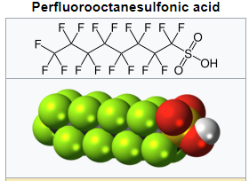
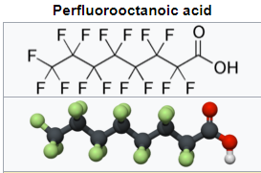
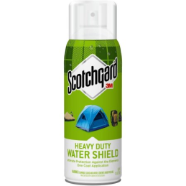
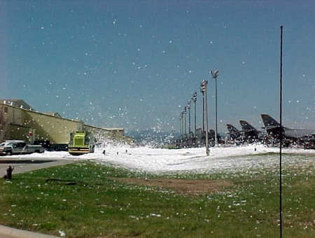




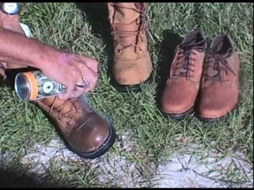

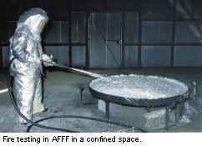
What are PFAS
Per- and Polyfluoroalkyl Substances (PFAS)
Complex family of more than 4,000 manmade fluorinated organic chemicals (Wang et al. 2017) that have been produced since the early -20th century, although not all of these may be currently in use or production.
Notes:
Organofluorine compounds consisting of long chains. Very strong C-F bonds provide the desirable properties, very stable compounds Hydrophobic and Oleophobic Heat resistant . Commercial uses include carpets clothing fabrics paper packaging for food – resistant to grease water or stains used in AFFF

Slide 7
Exposure Pathways and Health Impacts
Food Water Air Dust
Compounds persist in environment and in animal tissues due to extreme stable properties- Bio accumulative
Half-lives in humans
  PFOA: 3.8 years -studies indicate PFOA in 98% of US subjects
  PFOS: 5.4 years
  PFBS: 4 months
Developmental effects to fetuses during pregnancy or to breastfed infants (e.g., low birth weight, accelerated puberty, skeletal variations), cancer (e.g., testicular, kidney), liver effects (e.g., tissue damage), immune effects (e.g., antibody production and immunity), thyroid effects and other effects (e.g., cholesterol changes).
Notes:
PFOS PFOA- carpets clothing fabrics paper packaging for food – resistant to grease water or stains used in AFFF - some studies indicate PFOA detections in human blood occurring in 98% of the us population.

Slide 8
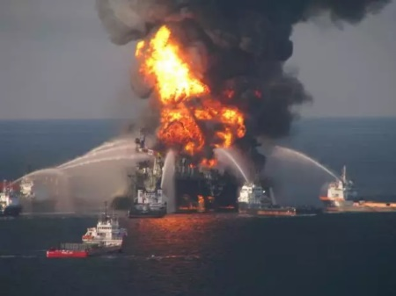


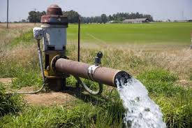
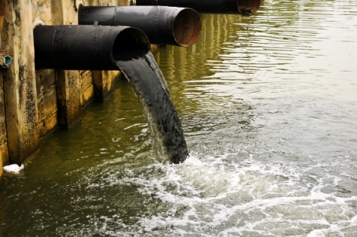
Environmental Contamination Pathways
Air Water Land
Manufacturing – Use - Disposal
Notes:
https://forum.fsairlines.net/viewtopic.php?t=812
So these compounds have made it into our environment through manufacturing processes use and disposal.
As of 2015, the U.S. Air Force had been testing 82 former and active US military installations for fluorosurfactants contained in fire fighting foam.^{[6]} In 2015, PFCs were found in groundwater at Naval Air Station Brunswick, Maine and Grissom Air Reserve Base, Indiana, and in well water at Pease Air Force Base, New Hampshire, where 500 people including children had blood tests as part of a bio-monitoring plan through the state Department of Health and Human Services. The U.S. Department of Defense´s research programs have been trying to define nature and extent of PFAS contamination at U.S. military sites, especially in groundwater.^{[7]}

Slide 9
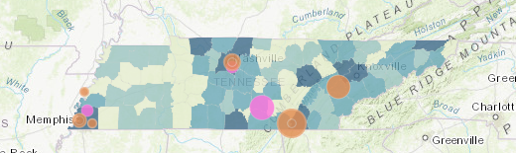
PFAS in TN
UCMR3 (2013-2015)
  500 finished DW samples , 136 PWS
  2 PWS with detections, below EPA HA levels
Fish Tissue Sampling 2008-2009
  Detections of PFAS in fish tissue in the Tennessee
  Cumberland, Wolf, Nolichucky, Duck, French Broad and Mississippi Rivers
DOD Groundwater Sampling
  Nashville Air National Guard (Nashville International Airport) -Nashville
  Arnold Air Force Base -Tullahoma
  Air National Guard – McGhee Tyson Airport - Knoxville
  NSA Mid-South - Millington
  PFAS detections at all locations

Slide 10
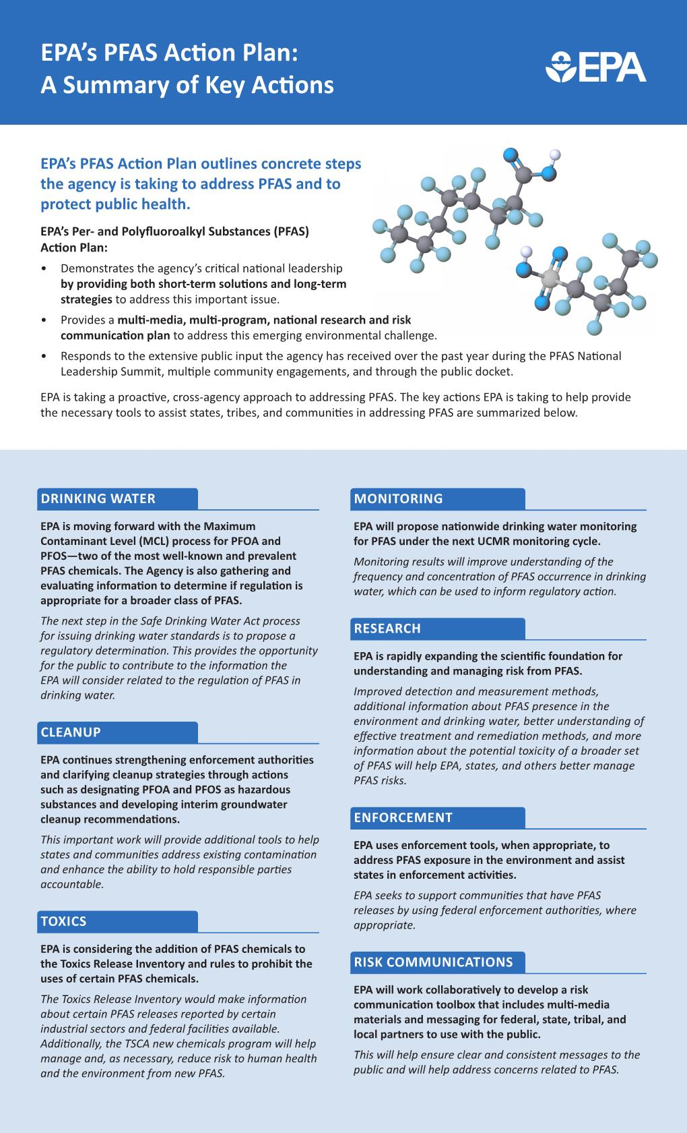
What is EPA doing?
Health Advisory Level for PFOA/PFOS May 2016
EPA PFAS Action Plan released in February 2019
Since Action Plan’s release, EPA has:
  Issued preliminary determinations to regulate PFOA and PFOS in drinking water
  Issued a rule that adds 172 PFAS to the list of chemicals covered by the TRI
  Recommendations for Addressing Groundwater Contaminated with PFOA and PFOS
  Guidance on the Destruction and Disposal of PFAS and Materials Containing PFAS to OMB
  Issued a rule to ensure that new uses of certain PFAS chemicals in surface coatings cannot be manufactured or imported into the U.S. without notification under TSCA
  Proposed inclusion of monitoring for additional PFAS in Unregulated Contaminant Monitoring Rule (UCMR) 5

Slide 11
Sampling in Tennessee
Why do it?
  Human health concerns; EPA Health Advisory Level
  Additional sampling presents more comprehensive picture of if and where PFAS contamination occurs
  Results will help TDEC and regulated community understand how potential federal PFAS regulations may affect Tennessee
Scope
  Statewide
  Conducted by TDEC with analytical support from University of Tennessee
  Anticipated to occur in late 2020 and through 2021
  Public drinking water sources; finished drinking water when needed
  If PFAS found in finished drinking water above EPA’s health advisory level
    Resident notification
    TDEC and drinking water supplier to explore potential treatment technologies and/or mitigation
  Results from sampling to be published on TDEC’s PFAS webpage to allow public access to data

Slide 12
Sampling Lessons Learned in Other States
Have a communication strategy!
Have a plan for responding to if/when PFAS is detected
State responses to PFAS vary, especially from a regulatory perspective
PFAS science and policy are evolving; stay abreast of updates so impacts to Tennessee are understood
TDEC PFAS Risk Communication Resources
  Website
  FAQs
  Sampling Action Plan
  PWS Toolkit
  Decision Tree

Slide 13
Questions & Discussion

Slide 14
Update on Rule Revisions
RULE CHAPTER 0400-40-05 Permits, Effluent Limitations and Standards.
RULE CHAPTER 0400-40-06 State Operating Permits.
RULE CHAPTER 0400-40-10 National Pollutant Discharge Elimination Permits.
These three rules relate to each other so we plan to present them together.
DWR is currently finishing the rules, responses to comments, and outreach.
DWR plans to present these to the Board at the December 15th meeting.

Slide 15
Contested Case Update
DWR has issued 27 new enforcement orders.
  7 Drinking Water
  20 NPDES and/or ARAP
  1 SOP
  2 of these were orders with TDOT for self-reported violations
  5 orders have been appealed
  11 orders have become final
OGC developed a new template for expedited director’s orders for violation of the requirement to obtain CGP coverage to one or more acres for development. Two have been issued.
During this time there have been no new permittee appeals and 2 new third-party permit appeals.
The database indicates a total of 16 pending permit appeals, many of which are related to the rule updates.
There have been no new initial orders issued by ALJs.

Slide 16
Any Old Business?

Slide 17
Thank you for joining us.
Any questions, please direct to
Drake.Smarch@tn.gov

