Slide 1
Objective 1 Update
Trey White, Recovered Materials Section Manager | 5 February 2020

Slide 2
Overview
2025 Plan Objective 1 Overview
Current Reporting Status
Data Analysis
New Goal Considerations

Slide 3
2025 Plan and Objective 1 Overview
TCA 68-211-861
(a) “The goal of the state is to reduce by twenty-five percent (25%) the amount of solid waste disposed of at Class I municipal solid waste disposal facilities and incinerators . . . The goal shall also apply to each municipal solid waste region . . . The base year from which reductions are to be measured is 1995 . . .”

Slide 4
2025 Plan and Objective 1 Overview
Objective 1: Update Goals and Measure Progress
“The purpose of this objective is to establish more robust solid waste management goals, to more accurately measure the disposition of MSW in Tennessee, and to better assess progress toward achieving those goals. As part of this objective TDEC will also develop and conduct training to help local governments understand how to accurately measure and report.”

Slide 5
Current Reporting Status
Regions self-report recycling and diversion through web-based software
TDEC analyzes data for anomalies and makes goal calculations
All landfilled items are considered; residential and ICI are lumped together
  Heavy industry produces large diversion numbers
  Residential diversion has a low impact on diversion numbers

Slide 6
APR Methodology
Rule 0400-11-01-.09 (1995 Base Year Comparison)
  “The goal of the state is to reduce by twenty-five percent (25%) the amount of solid waste disposed of at the municipal solid waste disposal facilities and incinerators, as measured on a per capita basis within Tennessee by weight.”
  “As an alternative to calculating the waste reduction goal on a per capita basis, regions shall have the option of calculating the goal on an economic growth basis using the method prescribed by the Department and approved by the Underground Storage Tanks and Solid Waste Disposal Control Board.”

Slide 7
APR Methodology
Rule 0400-11-01-.09 (Qualitative Equivalence)
“The Department shall use the submission of the municipal solid waste region’s Annual Progress Report for the most current reporting period to determine whether 25% of the solid waste generated in that year was either diverted from Class I facilities or recycled. If it was, the region meets the goal and the Department does not proceed to the next step.”

Slide 8
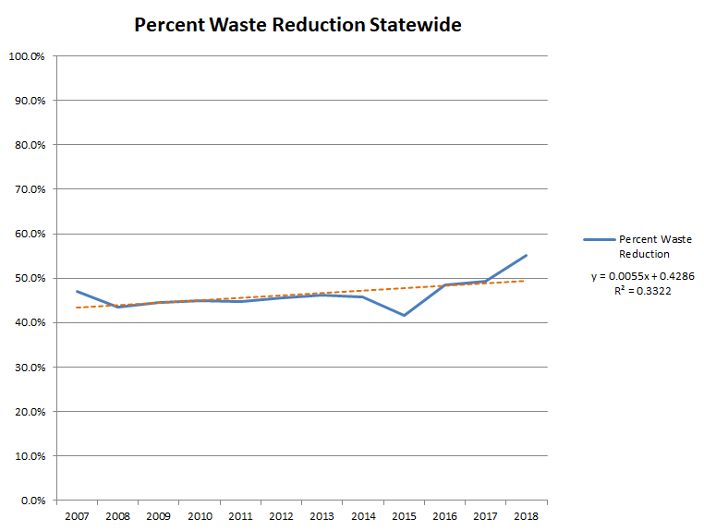

Slide 9
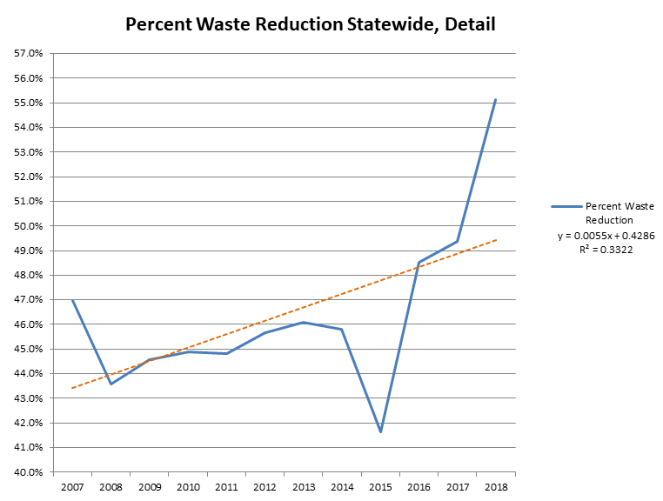

Slide 10
Considerations for New Goals
Five-Year Averages for Lower-diversion Counties
Benton: 33%
Southeast: 31%
Davidson: 43%
Jefferson: 39%
Lake: 36%
Loudon: 36%
Marshall-Maury: 30%
Northeast: 25.8%
Van Buren: 35.8%

Slide 11
Considerations for New Goals
What do we want to measure? What do we want to promote?
Preserve Landfill Airspace
Increase Recycling and Beneficial Use

Slide 12
Summary
2025 Plan Objective 1 Overview
Current Reporting Status
Data Analysis
New Goal Considerations

Slide 13

Questions?
Notes:
Larry Christley, Program Manager, Materials Management Program - 615-532-0744 – larry.christley@tn.gov
Loretta Harrington, Manager, Grants - 615-532-0086 – loretta.harrington@tn.gov
Nicholas Stengel, Manager, Problem Waste – 615-532-0095 – nicholas.stengel@tn.gov
Trey White, Manager, Recovered Materials – 615-532-0075 – trey.white@tn.gov

