Slide 1
Materials Management
Program Update
Trey White, Recovered Materials Program Manager | 5 August 2020

Slide 2
Overview
COVID-19 Update
  2019 APR Mitigation Efforts
  Effect on Recycling and Diversion Numbers
  2019/2020 Reporting Years
County Technical Assistance
  Technical Assistance Grants
  Materials Management’s Role

Slide 3
COVID-19 Effect on Recycling and Diversion
16 counties reported suspensions of recycling services or major changes to recycling operations
  Davidson, Knox, Rutherford, Hamilton
Major hubs operating at diminished capacity
  Lack of inmate labor
Major increase in C&D materials, white goods, and yard waste
  Williamson and Rutherford Counties
Exacerbating effects
  Early Spring severe weather events
  Requested cancellations of HHW events
  Low recycling markets

Slide 4
2019 APR Mitigation Efforts
Original due date by statute: 31 March 2020
  Extended by Director to 31 May 2020
Facilitated digital board meetings
Meeting with Top 5 counties and Development Districts
Continual monitoring of solid waste regions

Slide 5
2019/2020 Reporting Years
TCA 68-211-861 (b): If a region does not meet the twenty-five percent (25%) waste reduction and diversion goal, then the department will objectively assess the activities and expenditures of the region and the local governments in the region to determine whether the region's program is qualitatively equivalent to other regions that meet the goal and whether the failure is due to factors beyond the control of the region.
MM’s determination is that the pandemic and other factors will cause an abnormally high failure rate.

Slide 6
2019/2020 Reporting Years
Reduce/Eliminate 25% goal requirement for 2019 and 2020 reporting years.
Request a blanket statement statewide: Failures to meet the statewide waste reduction and diversion goal for 2019 and 2020 are due to the impacts of COVID-19 and associated exacerbating effects.
Request regions attempt to report as normally as possible to gather data to improve resilience. MM understands this will be hard this year with DDs not having TA grants. MM committed to assisting with reporting.

Slide 7
Technical Assistance Grants
Grants will not be funded this year, includes TA grants
  F&A directive not to spend money from the reserves
  48 grants still active and awaiting completion
Services provided by the nine TA regional contractors:
  Grant Application Assistance/Authorship
  Incidental Solid Waste Assistance
  Solid Waste Planning and Updates
  Professional Development/TDEC Meetings
  APR Authorship (upon request)

Slide 8
Materials Management Role
MM staff will assume technical assistance roles by region
Services provided by MM:
  Incidental Solid Waste Assistance
  County-by-County APR Authorship Assistance (upon request)
  Grant Application Assistance
  Solid Waste Planning and Updates
All-hands, high priority effort

Slide 9
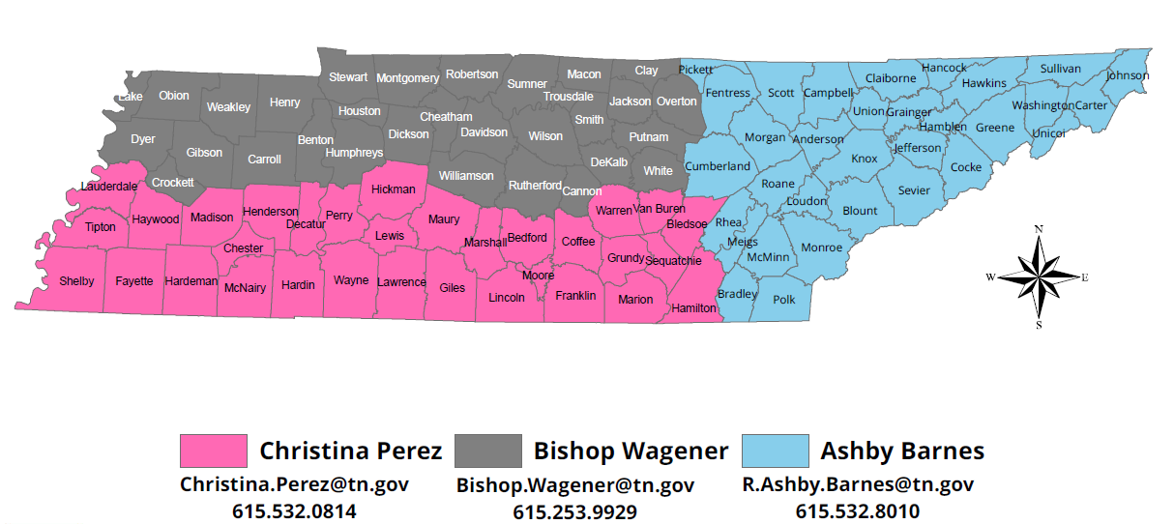
MM Territory Leads

Slide 10

Questions?
Notes:
Larry Christley, Program Manager, Materials Management Program - 615-532-0744 – larry.christley@tn.gov
Loretta Harrington, Manager, Grants - 615-532-0086 – loretta.harrington@tn.gov
Nicholas Stengel, Manager, Problem Waste – 615-532-0095 – nicholas.stengel@tn.gov
Trey White, Manager, Recovered Materials – 615-532-0075 – trey.white@tn.gov

