Slide 1
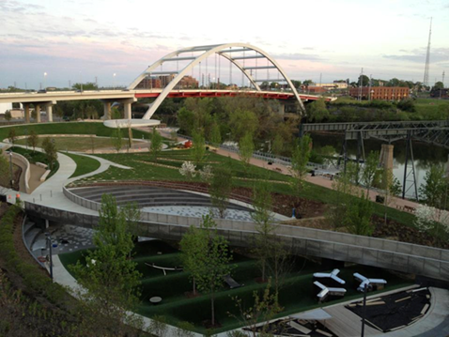
Division of Remediation
HWRAF Report
February 6, 2019

Slide 3
Revenues

Slide 4
VOAP

Slide 5
Enforcement
Ashley Pulley, P. E. , Enforcement Coordinator
  Division’s lead engineer
  Developer of Remediation’s ApEx portal for data - DoRway
  Project Manager for Copper Basin
Revision of entire Enforcement Program

