Slide 1
Special Waste Update
Underground Storage Tanks and Solid Waste Disposal Control Board
February 6, 2019
Jeremy Hooper, Environmental Consultant, DSWM

Slide 2
What’s Been Going On
The Division of Solid Waste Management (DSWM) has been working with stakeholders to make changes to special waste guidance: IMPROVE EFFICIENCY AND CLARITY OF PROCESS
Work with OGC: ensure changes in alignment with Statutes and Rules
12/17/18: Meeting in Columbia EFO
Upcoming meetings across state
  Date TBD

Slide 3
Quick Reminder: Reasons for Special Waste Guidance
Identify wastes requiring evaluations to decrease the potential of hazardous waste being disposed in a solid waste disposal facility [TCA 68-211-102(b)]
Provide guidance to expedite the special waste application process
Provide statewide consistency
IMPROVE EFFICIENCY AND CLARITY OF PROCESS
NOT USED AS REGULATION

Slide 4
Question?
How do we improve overall process to recognize the speed at which business moves
And
Ensure that we are following regulations and protecting human health and the environment

Slide 5
Changes Worth Considering:
Improve overall process: eliminate confusion and reduce required effort of the regulated community
How to handle multiple disposal facilities?
  Special Waste Facility Transfer Form
    Add disposal facility to current permit
    Request secondary disposal facility on new permit
    One fee for two landfills
    More than two landfills, additional fees necessary to cover costs
    Provides record of each landfill used
Same basic fee structure
  New: $300
  Recertification: $150

Slide 6
Reduced Effort
Nothing else required
  Just attach data from first application
Online system
  Auto populate
  Further expedite process

Slide 7
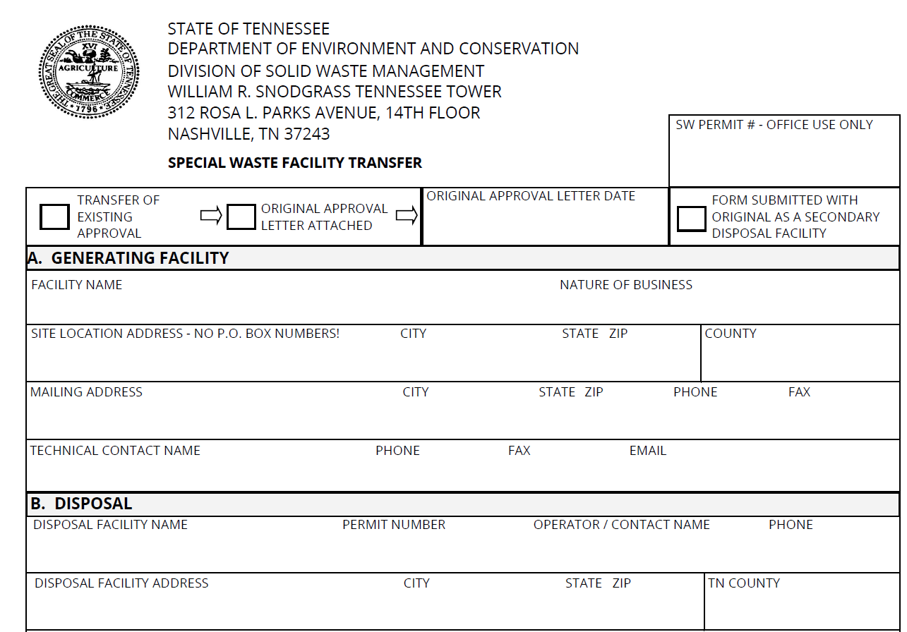
Updated Form: Facility Transfer

Slide 8
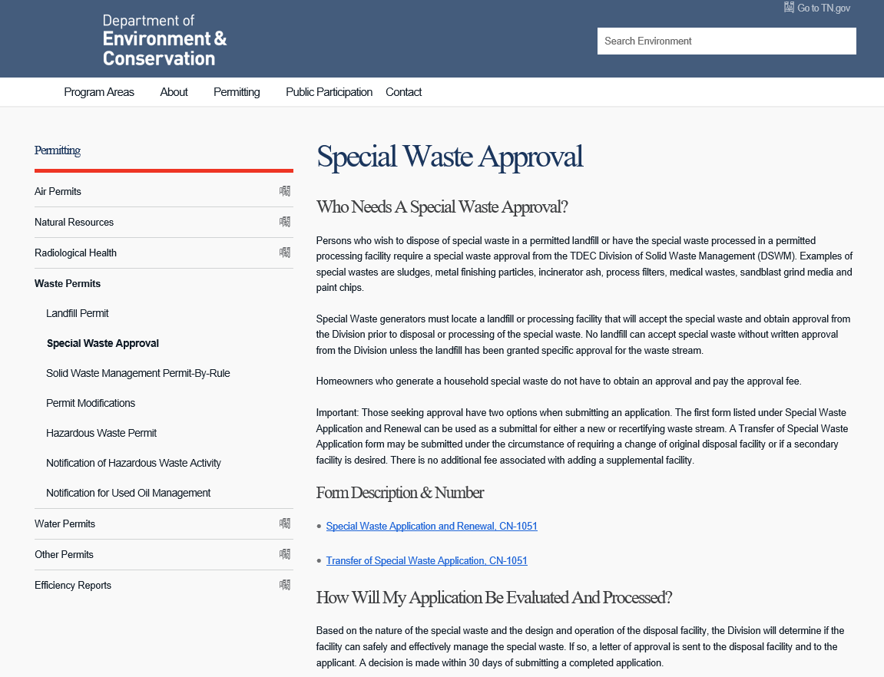
Update Website

Slide 9
Summary
Working with Stakeholders
Upcoming meetings
Updates to applications
Improving process for customers
Questions?
Jeremy.Hooper@tn.gov
615-532-0072

