Slide 1
Division of Remediation
Financial Update
Steve Sanders, Director DoR - December 4, 2019

Slide 2
Sources of DoR Revenue
$1.0M annual appropriation from the General Assembly
  FY19 additional $1.7M supplemental appropriation
$1,964,939 in Hazardous Waste fees
$1,436,548 in Enforcement/Voluntary cost recovery
$1,221,288 in Federal grants, cooperative agreements, etc.
FY19 Total Revenue $7,322,745 (includes obligated $700k)

Slide 3
DoR Expenses
$3,739,470 - Personnel (Salary & Benefits)
$162,525 - Misc. (travel, printing, training, supplies, equipment, etc.)
$110,685 - State Contractor Expenses
$1,030,937 - NPL (State 10% Match offset by appropriation)
$301,055 - Rent
$1,358,468 - Other Services from State Agencies
FY19 Total Expenses $6,703,140
FY19 Revenue minus Expenses $80,395 – (does not include $700,000 obligated supplemental appropriation)

Slide 4
DoR Revenue & Expenses FY15-FY19
FY19 Total Revenue $7,322,745
(includes 1.7M appropriation, $5,622,745 without appropriation)
FY19 Total Expenses $6,703,140

Slide 5
Division of Remediation Finances
What are the areas of need?
Hazardous Waste Remedial Action Fund (HWRAF)
  Division revenues are not keeping pace with expenses
  Federal grants decreasing
Drycleaner Environmental Response Program (DCERP)
  Program is underfunded for obligated workload
Clandestine Methamphetamine Lab Cleanup (CML)
  No funding provided for program

Slide 6
HWRAF Balances FY15-FY19
FY 19 HWRAF balance without obligated $1.7M appropriation

Slide 7
Funding & Unobligated Liabilities

Slide 8
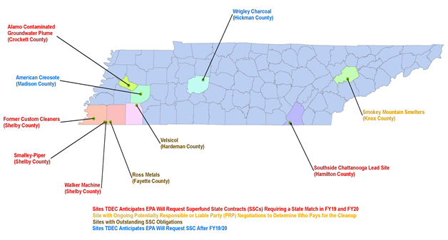
NPL Obligations
There are currently 19 NPL sites in the state. Nine of these sites, identified on the map shown below, are financed using federal dollars.
4 Superfund State Contracts: Ross Metals, Smalley Piper, Velsicol Hardeman County, and Southside Chattanooga Lead - total obligation $6,710,463.
FY18-19 the state paid $1,030,937 from the HWRA Fund to the EPA for the state matches or obligations on EPA Superfund financed.
Estimated obligations in FY19-20: $915,159.

Slide 9
NPL Obligations
NPL sites with contractual obligations
Ross Metals, Rossville, TN - $150,488
Smalley Piper, Collierville, TN - $261,864
Velsicol Hardeman County*, Toone, TN - $3,317,081
($255,159 annual payment to EPA until match paid.)
Velsicol Hardeman County*, Toone, TN - $400,000 (cap maintenance)
    (20,000 annual obligation*20 year period used for estimates)
Southside Chattanooga Lead Site, Chattanooga, TN - $2,581,030
($500,000 payment first two years, then $400,000 annually until match paid.)
As new NPL sites are identified and listed additional SSCs will be required.
The SSC provides a 90/10 match for NPL costs.

Slide 10
HWRAF Obligations
HWRAF
Total GASB 49 related liability of $10,816,894
NPL SSCs - GASB 49 liability of $6,710,463
Non-NPL State Superfund Program - GASB 49 liability of $4,106,431
HWRAF Balance FY18-19: $2,523,504
  (does not include balance from Voluntary Fund)

Slide 11
DCERP Obligations
  FY19 DCERP fund ending balance of $649,102
    This ending balance includes an obligated amount for DCERP cleanups of $548,727 and a required statutory reserve of $100,000.
DCERP sites are not included on GASB49
    TCA §68-217-103(f) states “All claims against the fund shall be expressly and exclusively obligations of the fund only and not of the state,…”
Should the DCERP program/fund cease to exist, obligations for former drycleaners would shift to the HWRAF and those not funded by liable parties would require inclusion into GASB 49 liabilities

Slide 12
Meth Program Obligations
TDEC responsibilities implementing TCA §68-212 Part 5 dealing with property where methamphetamine was manufactured include:
  Developing cleanup standards for properties contaminated by methamphetamine manufacturing
  Maintaining a list of certified hygienists (and such other persons or entities the commissioner certifies as qualified to perform the services of industrial hygienists)
  Maintaining a list of persons authorized to perform clean-up of property
  Compiling a list of all quarantined sites in the state
DoR expenses range between $150k-$200k per year based on the number of CML quarantines.
Program funding was not included in legislation

Slide 13
Funding Requirements
Need to build HWRAF capacity to address obligations
  Annual Expenses
    $5-6 million
  GASB 49 obligations
    $4.3M
  Meth program funding
    $150-200k
  Potential DCERP obligation
    $548,727
  Other obligations under TCA 68-212-201 et. seq.
NPL State Superfund Contract obligations
    $4.7M
* Calculated by the Bureau of Labor Statistics CPI inflation calculator. https://www.bls.gov/data/inflation_calculator.htm

Slide 14
Connection To Stakeholders

Slide 15
Water Quality
DCERP
  Total estimated potential clean-up costs for full site remediation with potential impacts to groundwater supplies is $119.3 million
State Superfund
  60% of sites have groundwater impacts
  79% have groundwater impacts confirmed or impacts currently unknown
  9% of sites have surface water impacts
  32.7% of sites with surface water impacts or impacts currently unknown
NPL
  7 NPL and potential NPL sites have been identified as having potential ground water and/or surface water contamination. The best available estimated financial impact is ~$8.8 million
    Velsicol/Hardeman County Landfill – Toone, TN - $4.0 million
    Murray Ohio Landfill – Lawrenceburg, TN - ~$3.3 million
    Custom Cleaners

Slide 16
Community Health
DCERP
  Unknown number of potential sites
  Potential for vapor intrusion in adjoining businesses or current location of former operations (Ted’s Cleaners)
State Superfund (GASB 49)
  No viable PRPs to address impacts (Arapahoe/Rock Hill Labs, John Little Drum)
CML
  1,169 quarantined properties as of 10/01/2019
  Many additional properties are never placed on the quarantined list by law enforcement
NPL
  Chattanooga Southside Lead, Smalley-Piper, Hardeman County LF

Slide 17
Funding Options

Slide 18
Funding Options
Budget Process
Legislation
Rule Amendment
Additional Grant/Cooperative Agreements

