Slide 1
Materials Management
Program Update
Trey White, Recovered Materials Program Manager | 4 December 2019

Slide 2
Overview
Problem Waste Update
  Fall HHW Season
  Tennessee School Lab Rehabilitation Program
Materials Management Update
  APR Results
  APR Calculation Methodology
  APR Trend Analysis

Slide 3
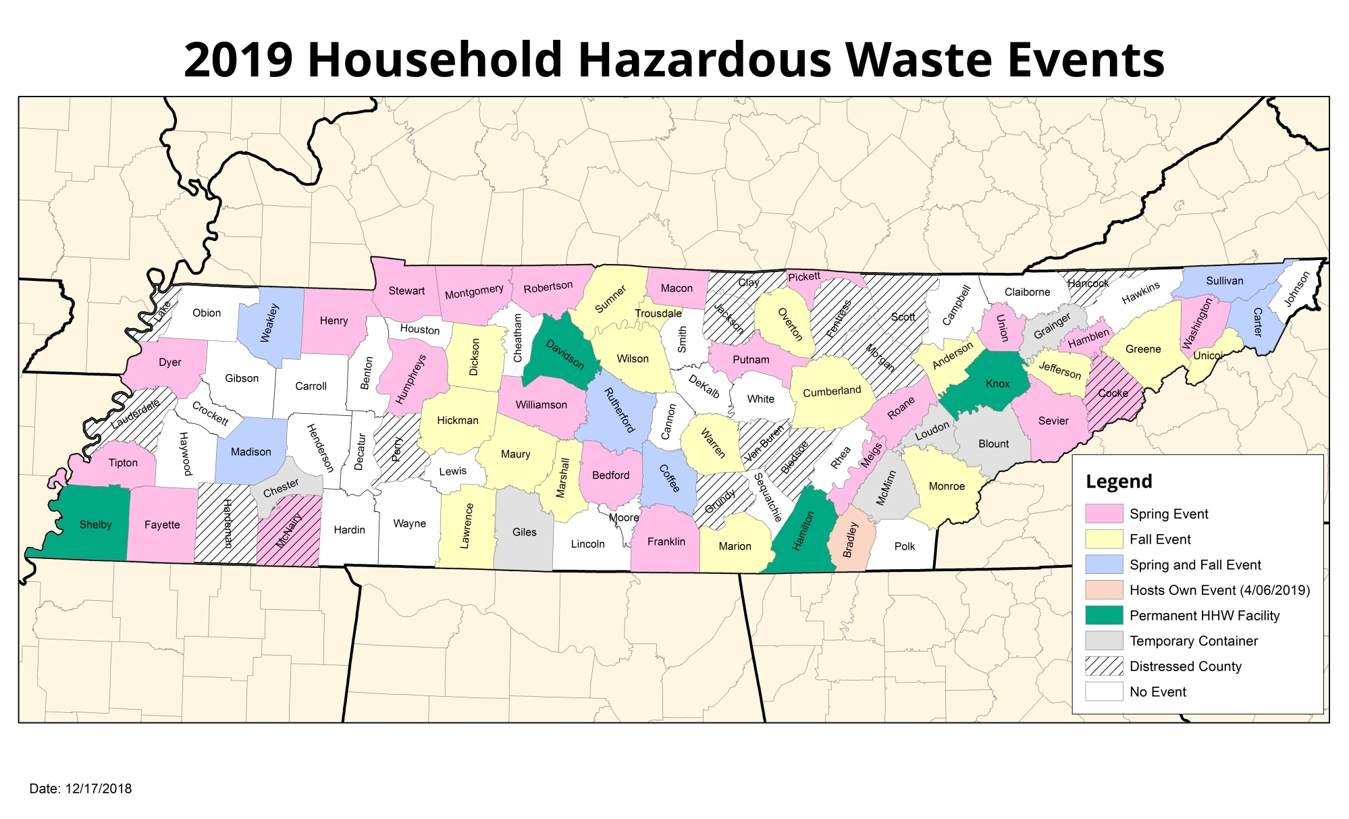
Household Hazardous Waste Fall Season

Slide 4
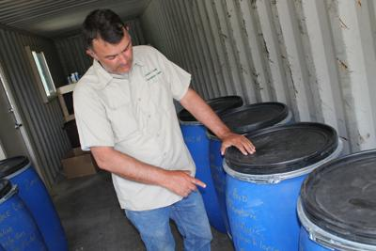
Household Hazardous Waste Fall Season
Mobile HHW Events Held: 24
  Total Participants: 3,498
HHW Milk Runs: 29 (15 Counties)
  Fluorescent Lamps
  Oil-Based Paint
Notes:
Household Hazardous Waste collection analysis can be found at the following URL:
https://www.tn.gov/environment/sw-mm-household-hazardous-waste-program/hhw-mobile-collection-analysis.html

Slide 5
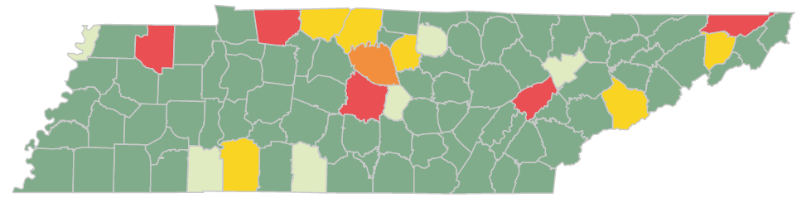
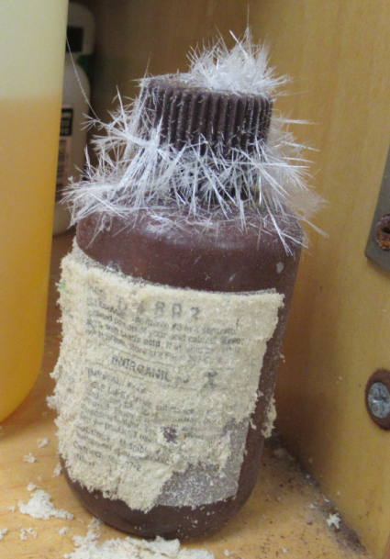
Tennessee Schools Lab Rehab Program
Educational Visits: November 2018-November 2019
Robertson
Sullivan
Lake
Montgomery
Sumner
Jackson
Weakley
Wilson
Smith
Washington
Anderson
Rutherford
Roane
Sevier
Cannon
Hardin
Wayne
Giles
County | No. of Schools | County | No. of Schools
Anderson | 1 | Rutherford | 8
Cannon | 1 | Sevier | 2
Giles | 1 | Smith | 2
Hardin | 1 | Sullivan | 6
Jackson* | 1 | Sumner | 2
Lake* | 1 | Washington | 2
Montgomery | 7 | Wayne* | 2
Roane | 6 | Weakley | 7
Robertson | 2 | Wilson | 3
 |  | Total: | 55
Program Totals
Counties: 18
Educational Visits: 55
Disposals: 40
Weight: 21,221 lbs.
Students Affected: 51,912

Slide 6
Annual Progress Reporting
Regions failing to meet 25% waste reduction goal:
  Lauderdale
  Northeast
  Roane
  Sullivan
MAP OF FAILING REGIONS GOES HERE

Slide 7
APR Methodology
Rule 0400-11-01-.09 (1995 Base Year Comparison)
  “The goal of the state is to reduce by twenty-five percent (25%) the amount of solid waste disposed of at the municipal solid waste disposal facilities and incinerators, as measured on a per capita basis within Tennessee by weight.”
  “As an alternative to calculating the waste reduction goal on a per capita basis, regions shall have the option of calculating the goal on an economic growth basis using the method prescribed by the Department and approved by the Underground Storage Tanks and Solid Waste Disposal Control Board.”

Slide 8
APR Methodology
Rule 0400-11-01-.09 (Qualitative Equivalence)
“The Department shall use the submission of the municipal solid waste region’s Annual Progress Report for the most current reporting period to determine whether 25% of the solid waste generated in that year was either diverted from Class I facilities or recycled. If it was, the region meets the goal and the Department does not proceed to the next step.”

Slide 9
APR Trend Analysis

Slide 10
Summary
Problem Waste Update
  Fall HHW Season
  Tennessee School Lab Rehabilitation Program
Materials Management Update
  APR Results
  APR Calculation Methodology
  APR Trend Analysis

Slide 11

Questions?
Notes:
Larry Christley, Program Manager, Materials Management Program - 615-532-0744 – larry.christley@tn.gov
Loretta Harrington, Manager, Grants - 615-532-0086 – loretta.harrington@tn.gov
Nicholas Stengel, Manager, Problem Waste – 615-532-0095 – nicholas.stengel@tn.gov
Trey White, Manager, Recovered Materials – 615-532-0075 – trey.white@tn.gov

