Slide 1
MyTDEC Forms - Title V Fee & AEAR

Slide 2
Table of Contents
Account Setup – Slides 3-9
Form Submission Process – Slides 10-23
Payment Options – Slides 24-33
Post-Payment Review - Slides 34-36
Second Submission for Facilities with Extension - Slides 38-48
How to Address an APC Correction Request – 49-62
Review the Notes under the slides for instructions and details. If Notes are not open, click the “View” tab. Then, in the “Show” group click “Notes”.
Notes:
Hyperlinks are embedded to take the user to a desired location within the presentation. Ctrl + click to follow link.

Slide 3

Account Setup

Slide 4
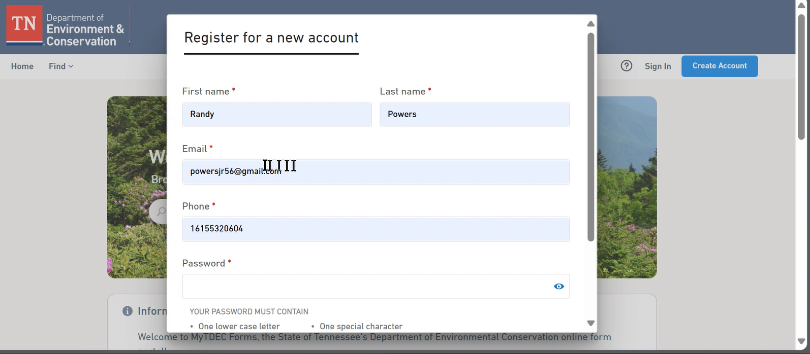
Account Setup
To start the process, go to https://forms.tdec.tn.gov
Use Email Address you check regularly!
Notes:
Go to the website https://forms.tdec.tn.gov to start. Click “Create Account” in the top right of the home page to register. Fill in the information as prompted in the text boxes. Every box must be filled. The user will receive automated emails, so it is imperative the user provides an email address that is checked regularly. Only one person registers and submits per facility.

Slide 5
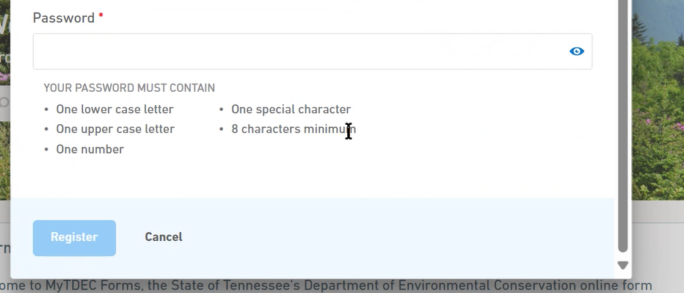
Account Setup
Notes:
Once completed, click on the blue “Register” button. After registration, an email will be sent by the system declaring you have been registered for the account.

Slide 6
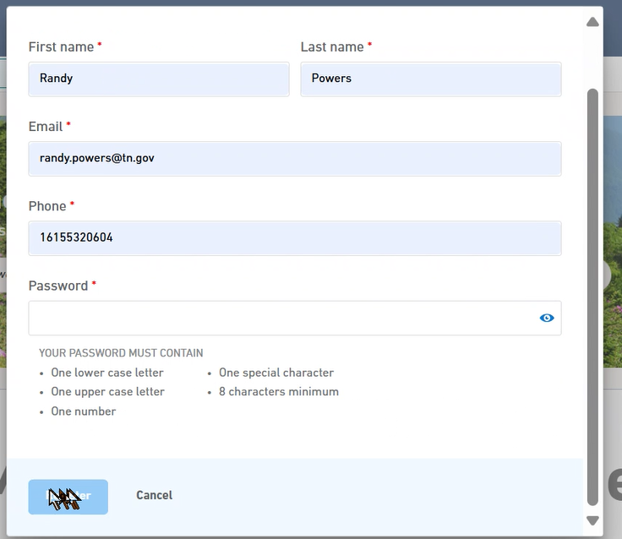
Account Setup
Notes:
Image of full registration box.

Slide 7
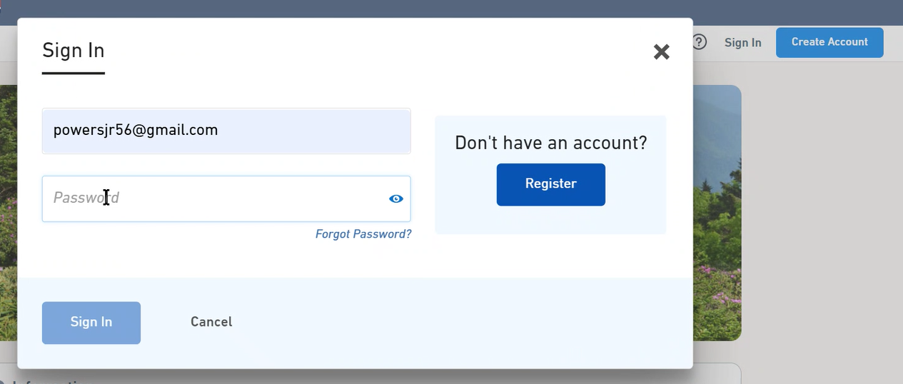
Account Setup
Notes:
Now click “Sign In” in the top right of the home page. Fill out the username and password to sign in.

Slide 8
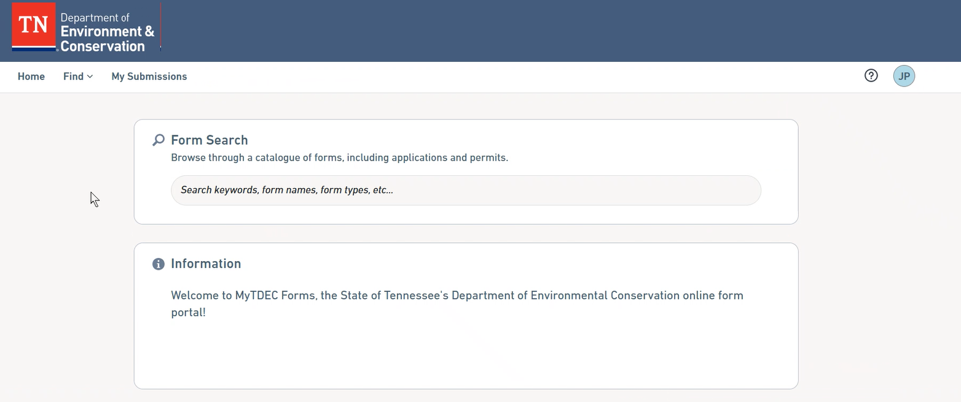
Account Setup
Click on Profile Icon!
Notes:
Once signed in, you will be taken to this page. Click on the circle icon in the top right to get to your profile.

Slide 9
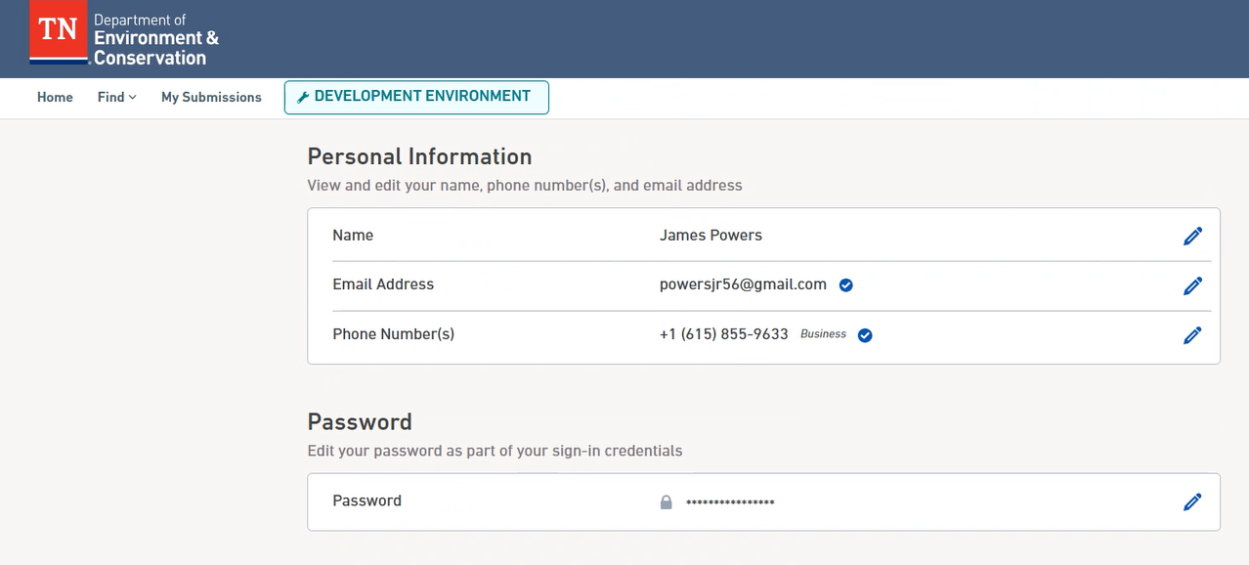
Account Setup
Notes:
Complete the personal information page. This prevents the user from having to reinput personal info at a later stage during the submission process.

Slide 10
Form Submission Process

Slide 11
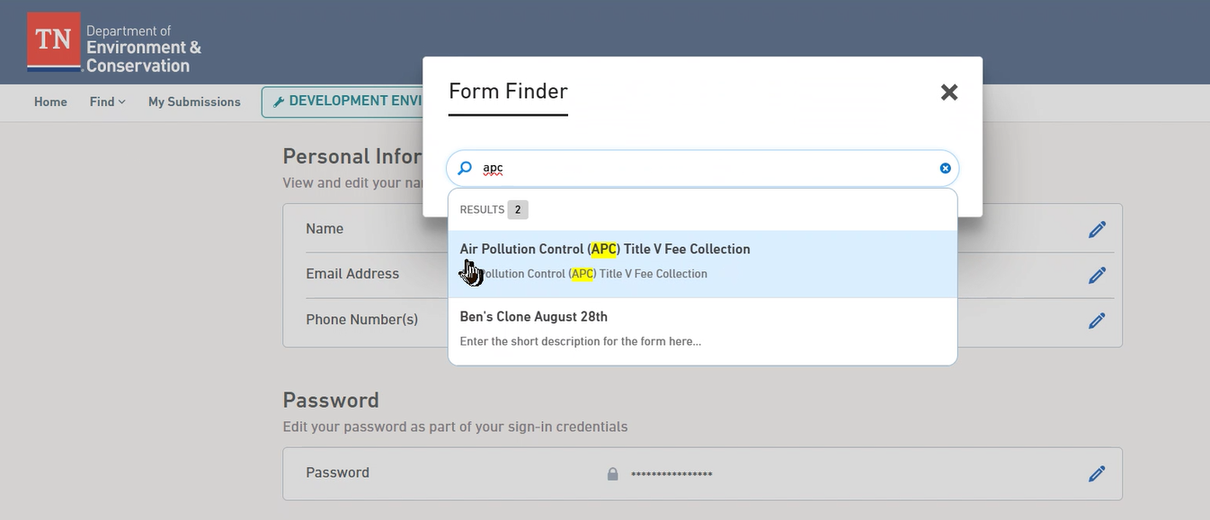
Form Submission Process
If form is not found, then Air Pollution Control (APC) is still preparing fee assessment data.
Notes:
When ready to begin the report, click on the “Find” drop down box in the top left of the screen. Go to the “Form Finder”. Type “Air” or “APC” to find the form for Title V Fee Collection. Click on the form in the dropdown box to continue.

Slide 12
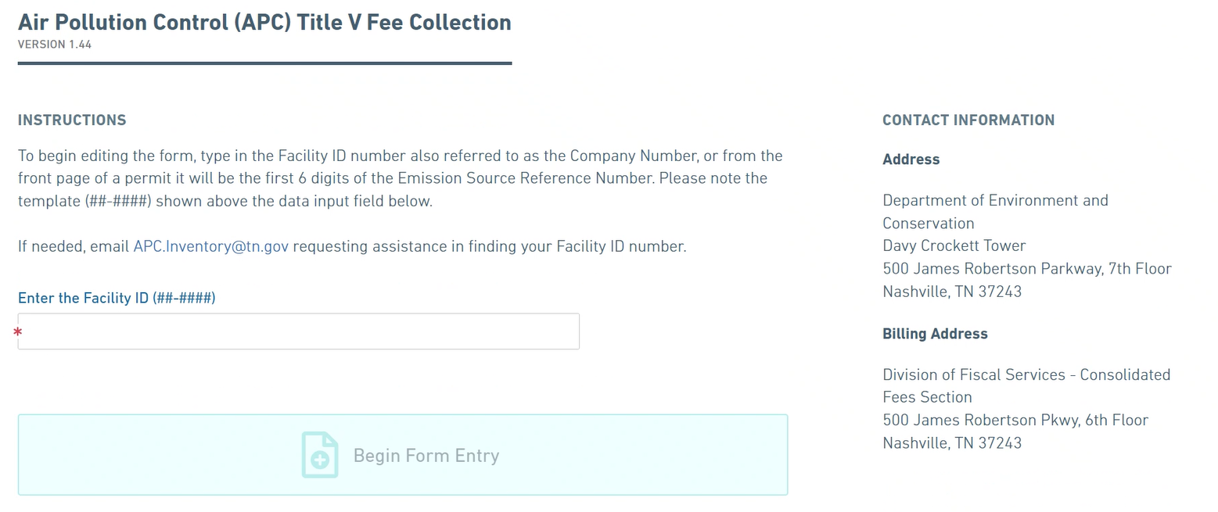
Form Submission Process
Notes:
After selecting the form, the user will be taken to the home page of the form with instructions. Enter the Facility ID (##-###) for your facility, then hit the blue box stating “Begin Form Entry” to start your form.

Slide 13
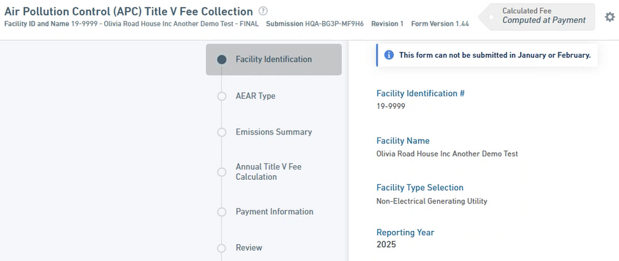
Form Submission Process
Form cannot be submitted until March 1st.
Notes:
After starting the form, the user will be taken to this page. First, the user will see facility information. Please check to ensure the right facility has been populated into the form. After this review, continue down the page. Please note that the form can not be submitted until March 1st.

Slide 14
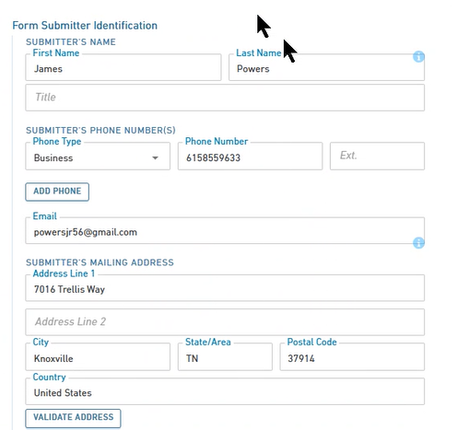
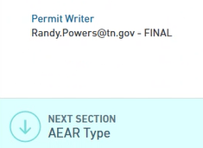
Form Submission Process
Notes:
Filling in the profile page earlier helps with the Form Submitter Identification. The user must fill in the information manually to if it is not auto populated. Below the submitter identification shows who the permit writer is that will review the submission.

Slide 15
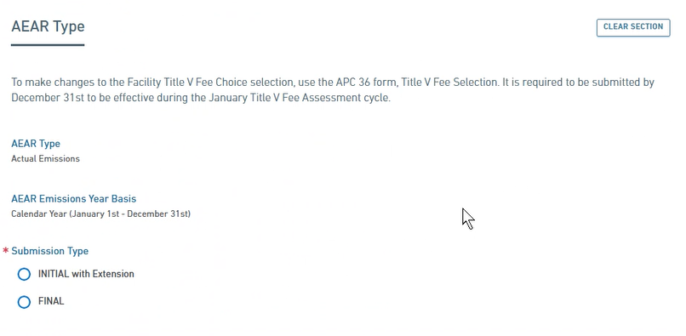
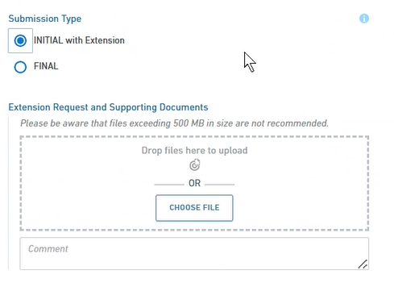

Form Submission Process
Notes:
This is the AEAR Type section of the form. Based on fee selection made by facility, information is pulled from the Air Pollution Control (APC) database to show the facility’s AEAR Type (actual or mixed). The same concept applies to Emissions Year Basis (Calendar or Fiscal.)
Submission Type selection depends on the Emissions Year Basis. INITIAL with Extension, requires 65% fee with submission by April 1st. If selecting FINAL, the full payment is due by April 1st. If submitting an INITIAL, the user must upload a file with comments on why an extension is needed. Example language for fiscal: The facility requests to extend the deadline for the final Major Source Emission Fee Payment from August 1, 2025, to September 28, 2025. We are asking for the extension because accurate emissions calculations are not available for several weeks following the end of the Fiscal Year. This correspondence will be accompanied by at least 65 % of the Estimated Total Annual Title V Fee as required to be paid by April 1, 2025. By September 28, 2025, the facility will submit final payment, to the required mailing address, and the submission of the Actual Emissions Analysis Required (AEAR) through a Final Submission via MyTDEC Forms.
If selecting FINAL, the user must submit documentation showing how they calculated emissions with a Responsible Official signed certification statement. Example language: “I have reviewed this document in its entirety, and to the best of my knowledge, based on information and belief formed after reasonable inquiry, the statements and information contained in this document are true, accurate, and complete.”
Do NOT mail APC any extension requests, RO certification statements, or other supporting documentation. All documentation must be uploaded into the form. There are only two file types allowed, PDF or excel spreadsheets .xls or .xlsx. Once selections and files are uploaded, continue to the next section of the form.

Slide 16
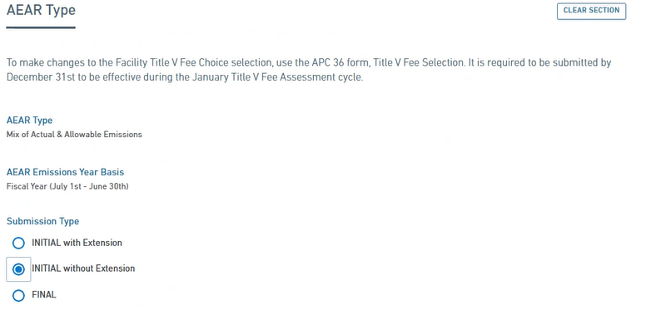
Form Submission Process
Notes:
If the facility’s AEAR Emissions Year Basis is fiscal, they will have the additional option of INITIAL without extension. This will also require a minimum payment of 65% of the Total Annual Fee.

Slide 17
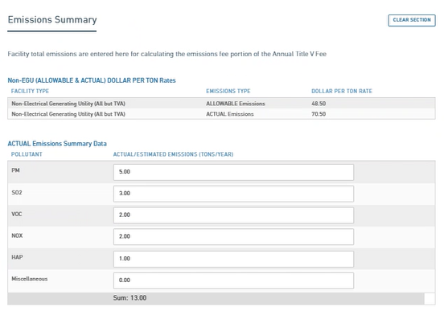
Form Submission Process
Notes:
This is the Emissions Summary section. Here, the user can enter all the actual emissions from the facility. The user must enter information into all boxes, even if 0.00 emissions. The user must report HAPS in the way your permit specifies. This could be reported as HAP or it could be reported within the VOC or PM. This is to avoid double counting of emissions. Once emissions are entered, continue to the next section. If paying on mixed, there will be two tables for reporting emissions. One for ACTUAL and the other for ALLOWABLE.

Slide 18
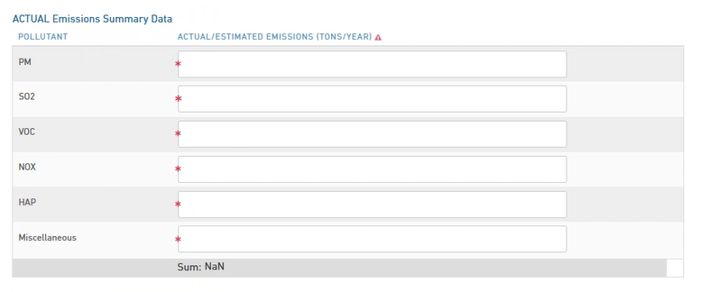
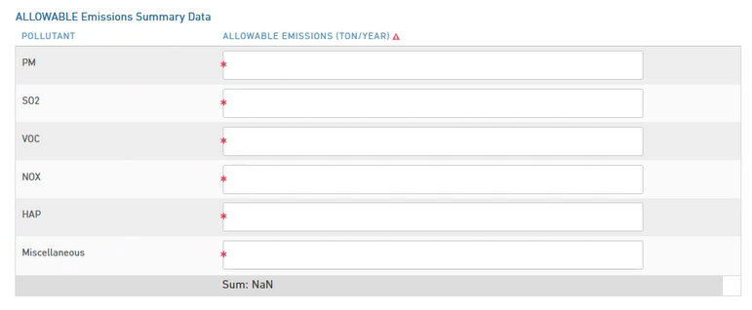
Form Submission Process
Notes:
Example of what a mixed facility’s Emissions Summary page will look like. If a facility’s AEAR Type is mixed, the user must input both Actual and Allowable Emissions.

Slide 19
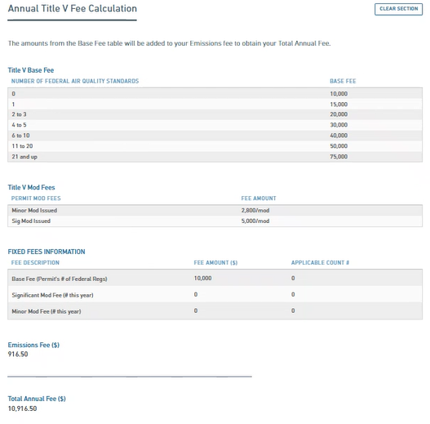
Form Submission Process
Notes:
Zoom in to get a better look if needed. This is the Annual Title V Fee Calculation section. The fees are automatically calculated for facilities based on information pulled from the APC database and the emissions data entered in the previous section.
The first table shows how the Base Fee is calculated.
The second table shows how the Mod Fee is calculated.
The third table shows the facility specific fixed fees information (Permit’s # of Federal Regs., Sig. Mod Fee, & Minor Mod Fee) based on information pulled from the APC database.
The first three tables are auto populated and require no input from the user.
The fourth section shows the emissions fee calculation based on the data entered in the Emissions Summary section.
The fifth part on this page shows the sum of fixed fees and emissions fees for the Total Annual Fee.

Slide 20
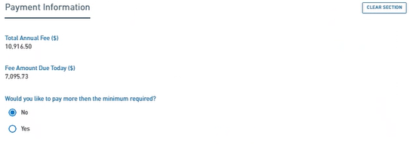
Form Submission Process
Notes:
After reviewing the Annual Title V Fee Calculation section, the user can continue to the Payment Information stage. Here, the facility chooses how they would like to pay their fee. The minimum required for those facilities that request an extension is 65% of the total annual fee. If “No”, the minimum Total Annual Fee will be paid.

Slide 21
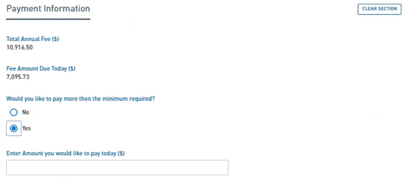
Form Submission Process
Notes:
If “Yes”, the fee amount must equal or exceed the Fee Amount Due Today.

Slide 22
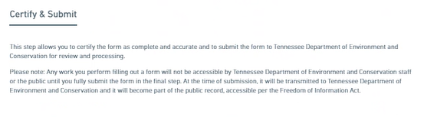
Form Submission Process
Notes:
There is a review stage before reaching this Certify & Submit page. The review stage allows the user to look over their report before certifying that their report is complete. Once review is complete, the user will advance to the Certify & Submit page. After reading the text shown in this slide image, the user can submit the form.

Slide 23
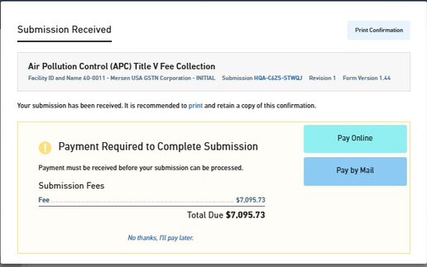
Form Submission Process
Notes:
Once submitted, the user will receive a submission confirmation email. From here, the user may choose to pay either online or through the mail. The user may also opt to pay later.

Slide 24
Payment Options

Slide 25
Payment Options
Online
Mail
Notes:
Pictures are hyperlinks to payment sections. Ctrl+click to follow.

Slide 26
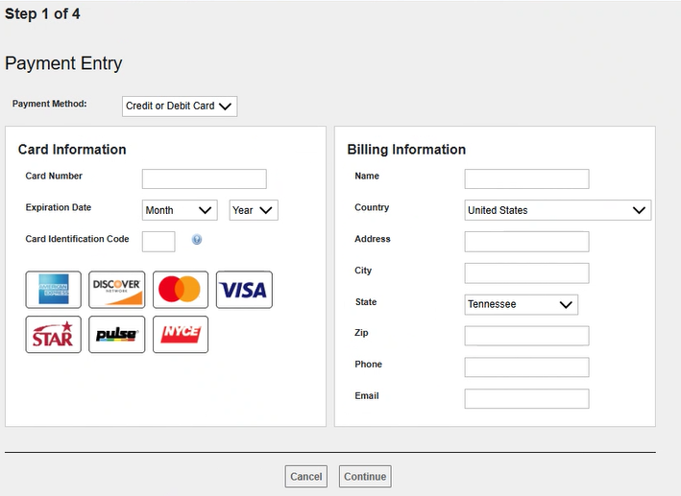
Payment: Online
Drop down to select credit card or E-Check.
Notes:
After selecting the online option, this page will pull up. The user can enter credit card information and billing information then click “continue”. There is no charge to the facility for making online payments. The due date for INITIAL payment is April 1st.

Slide 27
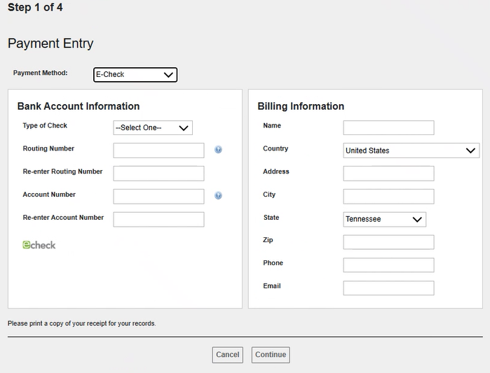
Payment: Online
Drop down to select credit card or E-Check.
Notes:
The user may choose to pay via E-Check instead.

Slide 28
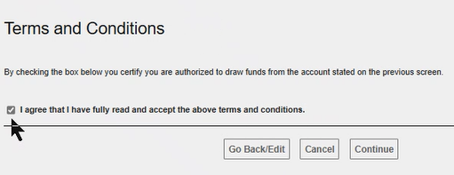
Payment: Online
Notes:
After putting in the payment information, the user must agree to Terms & Conditions. Click the check box to agree and continue.

Slide 29
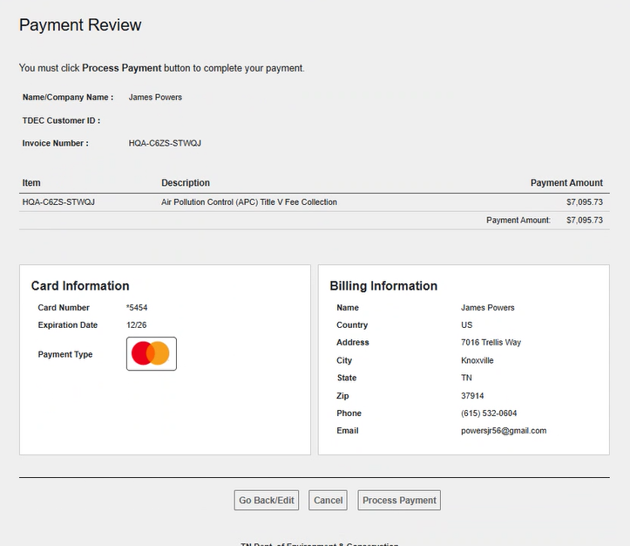
Payment: Online
Notes:
After agreeing to terms and conditions, this page will pop up so that the user can review the payment. If everything is in order, then click “Process Payment”. If not, the user can “Go Back/Edit” to adjust payment information.

Slide 30
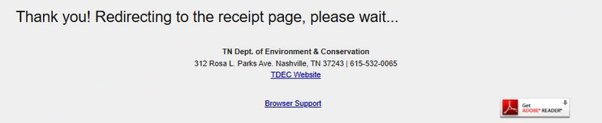
Payment: Online
Notes:
After processing payment, this loading screen will pop up.

Slide 31
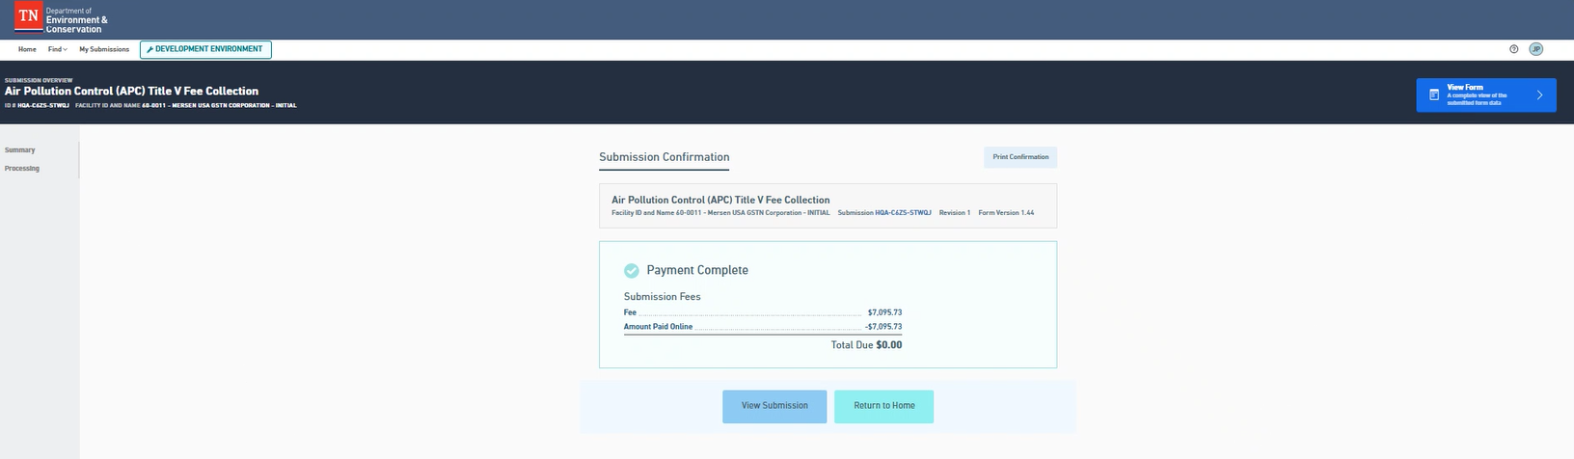
Payment: Online
Notes:
You will be redirected to this page after the payment has been processed. Shown is the user’s submission confirmation. The user will receive a payment confirmation email.

Slide 32
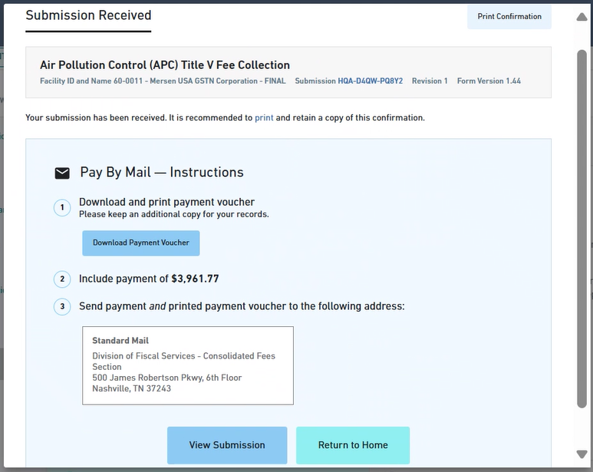
Payment: Mail
Notes:
If selecting “Mail”, you can download your payment voucher. After clicking “download voucher”, a pdf is downloaded to your computer. After downloading voucher, you can view submission or return home.
The payment voucher when mailing in payment is all that is required with the ACH payment or paper check. Remittance copies are no longer needed. Once APC has received the ACH payment or paper check, and the full payment has been met, the submission will be marked as “Paid” in the “My Submissions” Page. See slide 33. The due date for INITIAL payments is April 1st.
Please make checks out to the Division of Air Pollution Control or Tennessee Department of Environment and Conservation. Please mail checks to fiscal services at the new mailing address seen below.
DIVISION OF FISCAL SERVICE – CONSOLIDATED FEES SECTION 500 JAMES ROBERTSON PKWY, 6TH FLOOR NASHVILLE, TN 37243

Slide 33
Payment: Mail
Click on the below document to download a pdf of the ACH payment information.
Double-click to open if in notes view.
Notes:
If selecting “Mail”, you can download your payment voucher. After clicking “download voucher”, a pdf is downloaded to your computer. After downloading voucher, you can view submission or return home.
The payment voucher when mailing in payment is all that is required with the ACH payment or paper check. Remittance copies are no longer needed. Once APC has received the ACH payment or paper check, and the full payment has been met, the submission will be marked as “Paid” in the “My Submissions” Page. See slide 33. The due date for INITIAL payments is April 1st.
Please make checks out to the Division of Air Pollution Control or Tennessee Department of Environment and Conservation. Please mail checks to fiscal services at the new mailing address seen below.
DIVISION OF FISCAL SERVICE – CONSOLIDATED FEES SECTION 500 JAMES ROBERTSON PKWY, 6TH FLOOR NASHVILLE, TN 37243

Slide 34
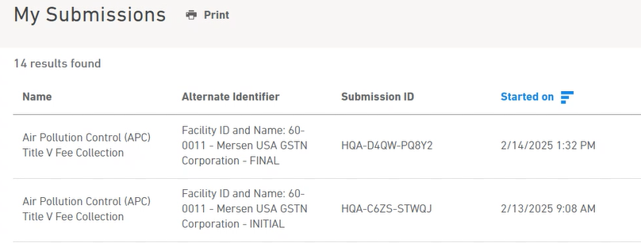
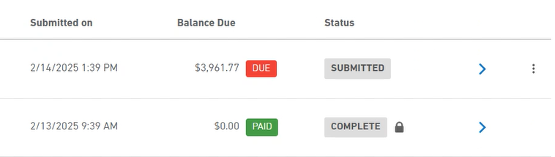
Payment: Mail
Notes:
This is the My Submissions page. The balance will remain as DUE until APC verifies payment received. Once APC verifies payment, the administrator will mark the balance as PAID.

Slide 35
Post-Payment Review

Slide 36
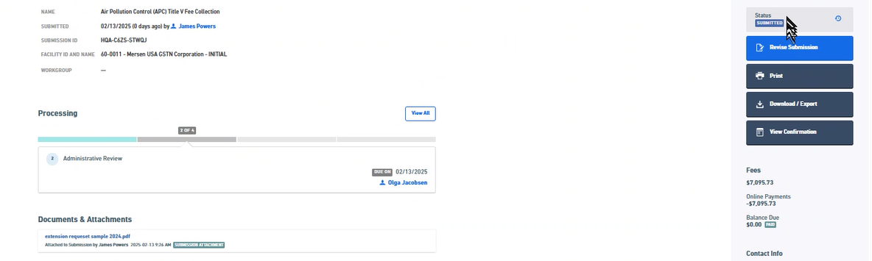
Post-Payment Review
Notes:
The user may choose to view the Post Submission Summary Page by clicking “View Submission” on the last payment screen. This allows the user to check on the status of their form. The user will receive an automated email after the last processing step of when the form and payment are submitted and received.

Slide 37
Post-Payment Review
Click here to reach Summary Page!
Notes:
This is the My Submissions page. The user can review form information here. By clicking on the blue arrow, the user can reach the Summary Page.

Slide 38
Submission for Facilities with Extension Request

Slide 39
Submission for Facilities with Extension Request
Notes:
Same as Initial Submission, search for the Air Pollution Control (APC) Title V Fee Collection form in the Form Finder.

Slide 40
Submission for Facilities with Extension Request
Notes:
Again, type in your Facility ID then click “Begin Form Entry”.

Slide 41
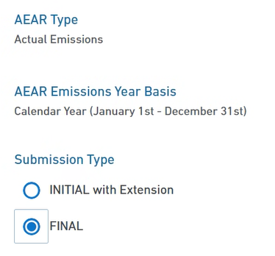
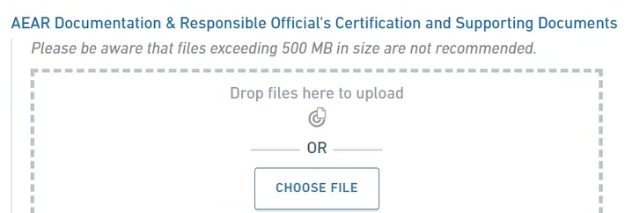
Submission for Facilities with Extension Request
Notes:
Ensure that Submission Type selected is “FINAL”. The form should have “FINAL” automatically selected.

Slide 42
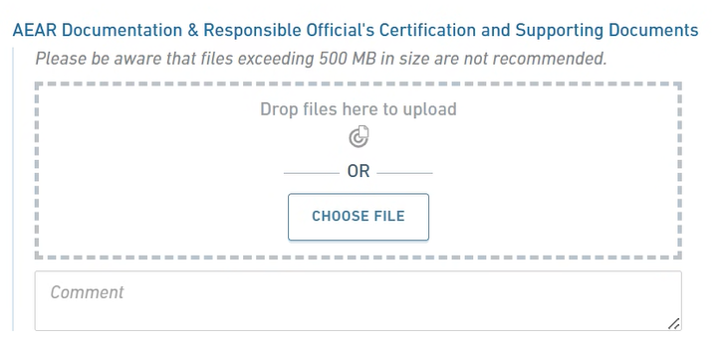
Submission for Facilities with Extension Request
Notes:
For a FINAL submission, the user must submit the following:
AEAR documentation showing how the user calculated emissions
Responsible Official signed certification statement.
Only .pdf, .xls, and .xlsx formats are accepted.
Example language of Responsible Official signed certification statement: “I have reviewed this document in its entirety, and to the best of my knowledge, based on information and belief formed after reasonable inquiry, the statements and information contained in this document are true, accurate, and complete.”

Slide 43
Submission for Facilities with Extension Request
Notes:
Add emissions data for the FINAL submission. Emissions data will likely be different than the INITIAL emissions data. *Please note that this is a Mixed Emissions Summary Data example in the slide*.

Slide 44
Submission for Facilities with Extension Request
$11,057.50
$11,057.50
Notes:
After entering FINAL emission data, go to the Annual Title V Fee Calculation page. Review the updated total fee.

Slide 45
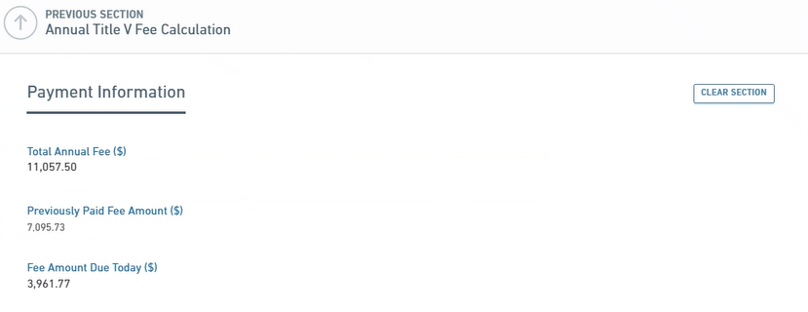
Submission for Facilities with Extension Request
Notes:
Shown here is the payment information section for the FINAL submission. The previously paid amount of 65% of the INITIAL submission total is automatically populated.

Slide 46
Submission for Facilities with Extension Request
Notes:
There is a review stage before reaching this Certify & Submit page. The review stage allows the user to look over their report before certifying that their report is complete. Once review is complete, the user will advance to the Certify & Submit page. After reading the text shown in this slide image, the user can submit the form.

Slide 47
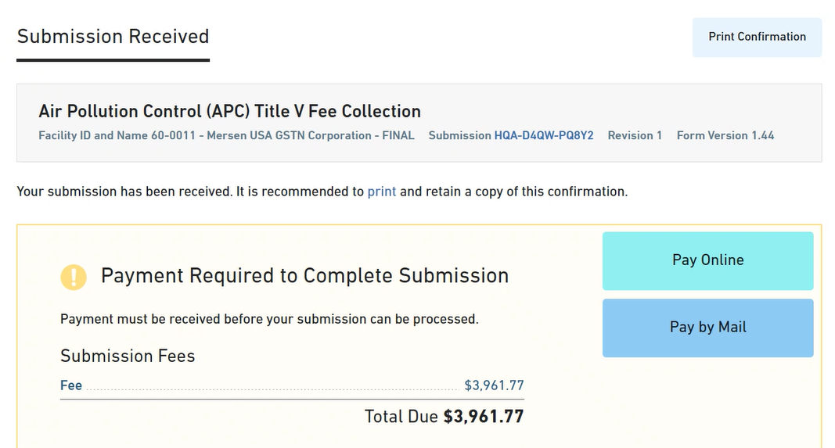
Submission for Facilities with Extension Request
Notes:
This is the submission confirmation page for the FINAL submission. The user will provide the final payment. Please review slides 24-34 for payment options.

Slide 48
Submission for Facilities with Extension Request
Notes:
In this example, the facility paid their INITIAL fee online, which marked the submission as PAID quickly. For the FINAL fee payment, the facility opted to by mail. Once APC verifies payment received, an administrator will mark the balance as PAID.

Slide 49
How to Address an APC Correction Request

Slide 50
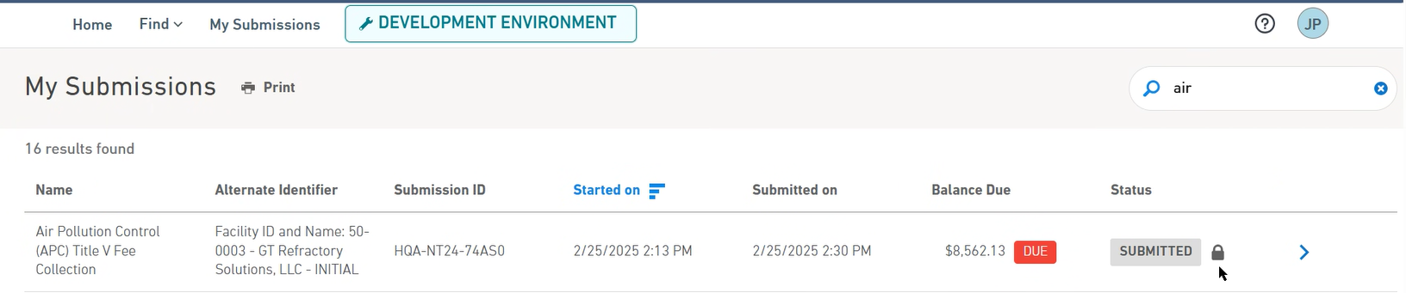
How to Address an APC Correction Request
Click here to go to the Submission Overview page.
Notes:
Here is the My Submissions page. Notice the locked icon next to the Submitted Status. This means that the submission is currently under review. If edits need to be made, the user must contact APC. You can see the locked status of the submission more clearly by going to the Submission Overview page by clicking the blue arrow to the right of the lock icon.

Slide 51
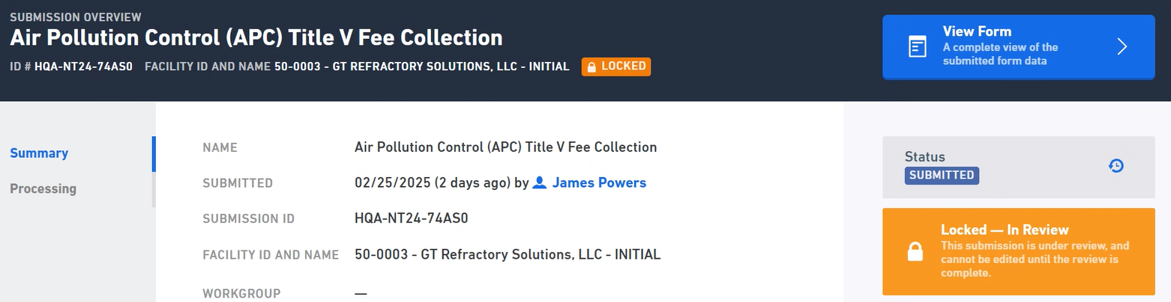
How to Address an APC Correction Request
Notes:
This is the Submission Overview page. The locked status is clearly seen here in the orange boxes.

Slide 52
How to Address an APC Correction Request
From: MyTDEC Forms Dev (no reply) <MyTDECForms@tn.gov> Date: Fri, Feb 28, 2025 at 12:38 PM Subject: Review Complete for Submission HQA-NT24-74AS0 in the MyTDEC Forms System To: <powersjr56@gmail.com> James, Division of Air Pollution Control has completed its review of the contents for the Air Pollution Control (APC) Title V Fee Collection submission HQA-NT24-74AS0 in the Tennessee Department of Environment and Conservation MyTDEC Forms System. Correction Requests were identified and must be addressed in order for the agency to continue processing. Please use the link shown above to open, revise, and resubmit. Open correction requests include:
Section: AEAR Type
Question: Extension Request and Supporting Documents
Extension Request issue
The Responsible Official is required to sign the request. Have it signed and then resubmit the form.
Thank you, Tennessee Department of Environment and Conservation Division of Air Pollution Control
Email example to facility when APC requests a correction.
Notes:
After review, APC may determine that the form needs correction. If this occurs, the submitter(s) will receive an email like the example shown in the slide. At this point, the form will be unlocked, and the user can go into the form to make the necessary revisions.

Slide 53
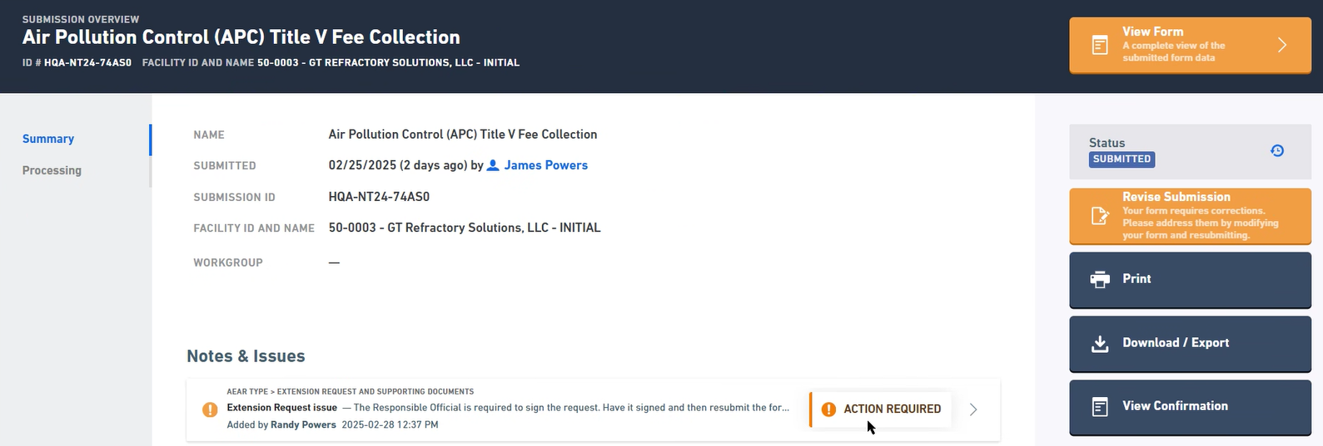
How to Address an APC Correction Request
Click here to start revising the submission.
Notes:
Once the user logs in, they can easily see what part of their form needs revision on the Submission Overview Page under Notes & Issues. If the user sees the Action Required Indicator, it means revisions are needed to be made. To begin corrections, click on Revise Submissions.

Slide 54
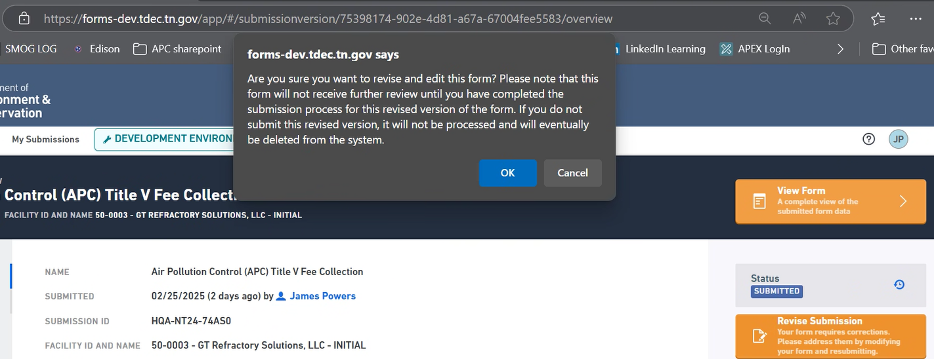
How to Address an APC Correction Request
Notes:
After clicking Revise Submission, this notification box will appear. Please read through the text to ensure you are ready to begin revising the submission.

Slide 55
How to Address an APC Correction Request
From: MyTDEC Forms Dev (no reply) <MyTDECForms@tn.gov> Date: Fri, Feb 28, 2025 at 12:51 PM Subject: Revision Process Activated for Submission HQA-NT24-74AS0 in the MyTDEC Forms System To: <powersjr56@gmail.com>
James, Your Air Pollution Control (APC) Title V Fee Collection submission HQA-NT24-74AS0 in the Tennessee Department of Environment and Conservation MyTDEC Forms System has begun the revision process. To continue processing your submission please complete any revisions and resubmit the form. Failure to resubmit will prevent further processing and the draft revision will eventually be deleted from the system. Thank you, Tennessee Department of Environment and Conservation Division of Air Pollution Control
Email to facility when facility begins revisions.
Notes:
Once the user has begun the revision process, another automated email will be sent showing that the revision process has begun. This slide showcases an example email of what the user will receive.

Slide 56
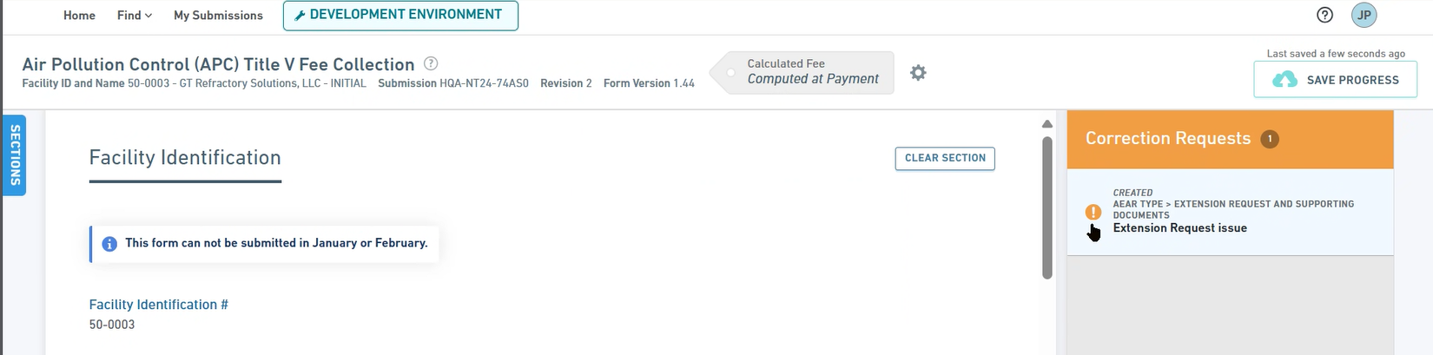
How to Address an APC Correction Request
This submission is now labeled as “Revision 2” as it is the second submission under this submission ID.
Notes:
Once the user has begun their revision, they will be taken to the start of the form. This submission is now labeled as Revision 2 as it is the second submission under this submission ID. There will be a new sidebar labeled Correction Requests to the right of the form. Click on the exclamation point on the Correction Requests tab to be taken directly to the section of the form that needs revision.

Slide 57
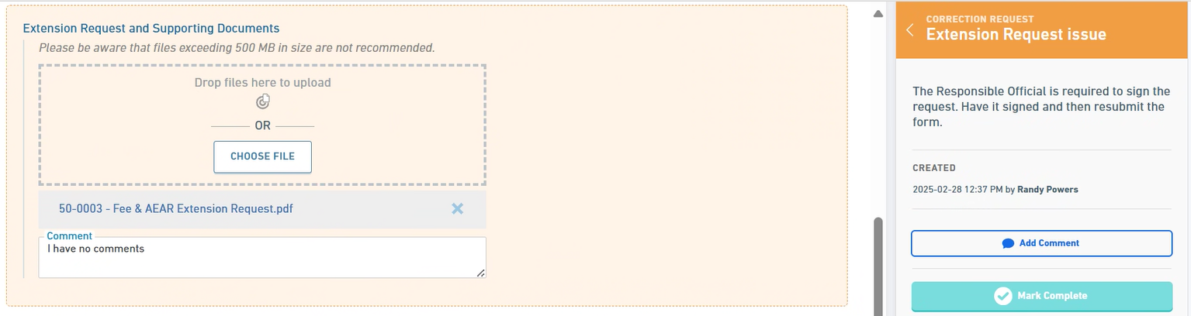
How to Address an APC Correction Request
Notes:
After clicking on the exclamation icon, the location in the form where the correction is needed. In this example, the extension request document did not have the Responsible Official’s signature. This section of the form is now highlighted in orange to indicate that revision is needed. There could be numerous types of correction requests including attachment complications, emissions calculation errors, submitter profile information, etc. Any line item in the form could have a correction request made of it.

Slide 58
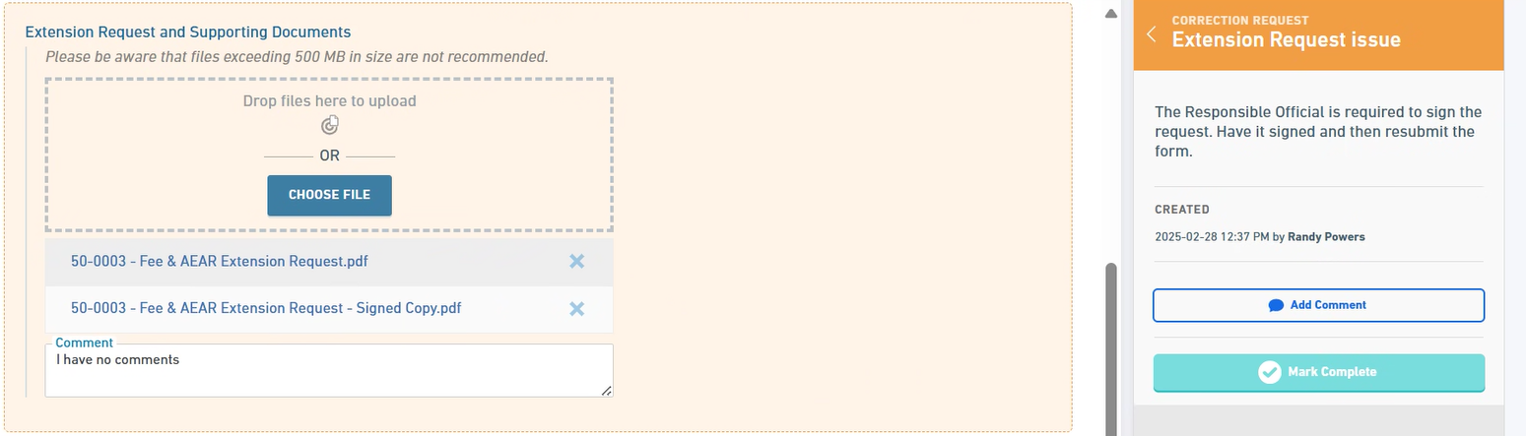
How to Address an APC Correction Request
Updated file with the RO signature.
Click here to mark the Correction Request as complete.
Notes:
To remedy this example Correction Request, an updated extension request with the RO signature has been attached. The user may choose to remove or keep previous attachments in their revision. Once a correction is made, the user can mark the correction as complete and provide comments about the correction.

Slide 59
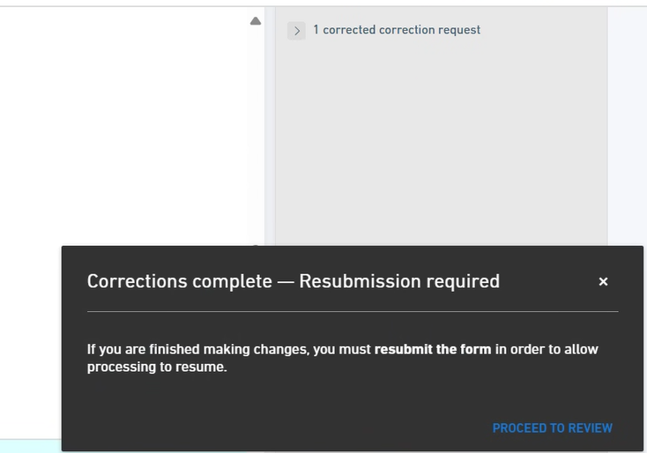
How to Address an APC Correction Request
Notes:
Once all the corrections are marked as complete, the following box will appear. The user may Proceed To Review.

Slide 60
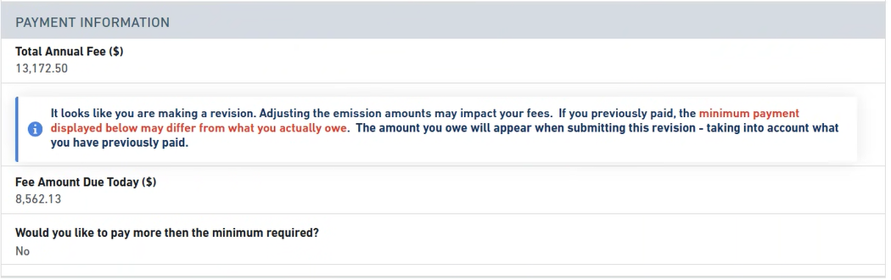
How to Address an APC Correction Request
New notification!
Notes:
This screenshot shows a snippet of the Review page where there will be a new notification box not seen in the first submission. If you have any questions about the fee amount, please contact APC at APC.Inventory@tn.gov.

Slide 61
How to Address an APC Correction Request
Notes:
If corrections do not change fee amount and you have already paid, click No thanks, I’ll pay later.

Slide 62
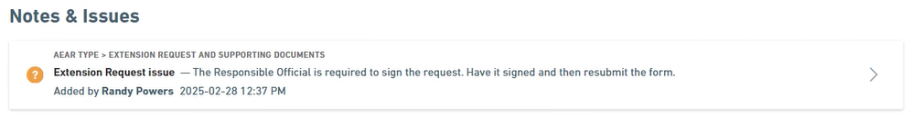
How to Address an APC Correction Request
Notice that the Actions Required Indicator is gone!
Notes:
This is the Notes & Issues portion of the Submission Overview page. Since the corrections have been made, the Actions Required indicator is gone. At this stage, the Revision 2 will be put under review by APC. The user will also receive another automated email stating the submission was received.

Slide 63
If you have any question, please contact us!
APC Emission Inventory
Group Email
APC.Inventory@tn.gov
Olga Jacobsen
Environmental Manager
TDEC Division of Air Pollution Control
olga.jacobsen@tn.gov
615-499-2342
Randy Powers
Environmental Consultant 3
TDEC Division of Air Pollution Control
randy.powers@tn.gov
615-917-0127
Caleb Gruber
Environmental Consultant 1
TDEC Division of Air Pollution Control
caleb.gruber@tn.gov
615-708-3876

