Slide 1
Air Pollution Control Board Meeting
Tennessee Division of Air Pollution Control
Non-Title V Fee Rule Revision
Board Briefing
Mark Reynolds

Slide 2

Overview of fee rule revision
The Division has prepared a rule revision to revise the fees in Chapter 26 of Tennessee Division of Air Pollution Control Rules and Regulations
Primarily, the rule proposes to increase Non-Title V fees
Current expenses exceed revenue for the Non-Title V program
The Division has exhausted all options for decreasing expenses and increasing revenue before exploring a fee increase
During the Fall of 2025, the Division conducted a robust stakeholder engagement process to gather input on best approaches to increase fees
Department of
Environment &
Conservation

Slide 3
Title V source vs. Non-Title V source
Title V Sources vs. Non-Title V Sources
Title V (major) source
  220 facilities (approximately)
Non-Title V source
  Conditional Major
    360 facilities (approximately)
  True Minor
    Approximately 7,000 facilities (including over 3,000 gas stations)
    Only 800 facilities (approx.) pay annual fees
Department of
Environment &
Conservation

Slide 4
Overview of Non-Title V fee rule revision
This rulemaking proposes to revise the following Non-Title V fees:
  Construction permit application fee
  Annual emission fee
  Conditional Major review fee
  Construction permit application revision fee
This rulemaking proposes to add the following fee for Non-Title V and Title V sources
  Construction permit extension amendment fee
The proposed changes ensure sustainable funding for permitting, inspections, compliance, enforcement, and air monitoring
Department of
Environment &
Conservation

Slide 5
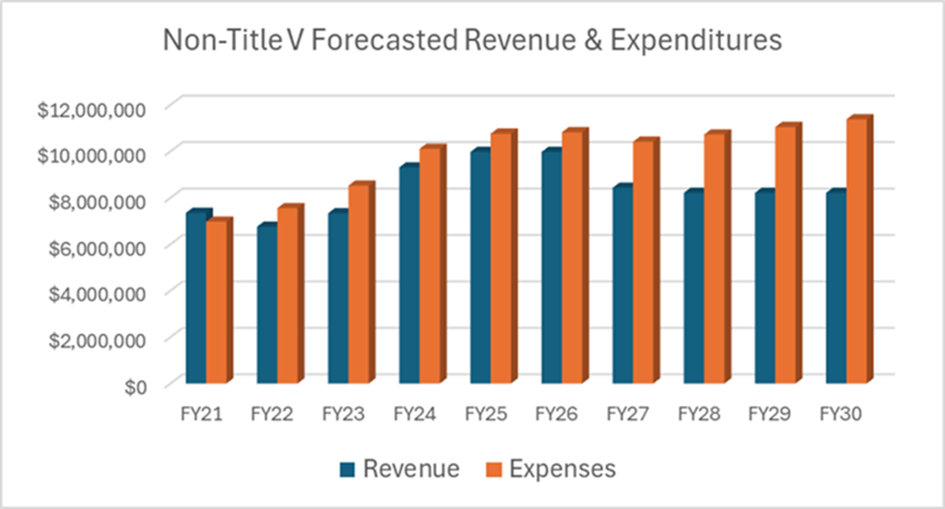
Non-Title V Expenses and Revenue
Department of
Environment &
Conservation

Slide 6
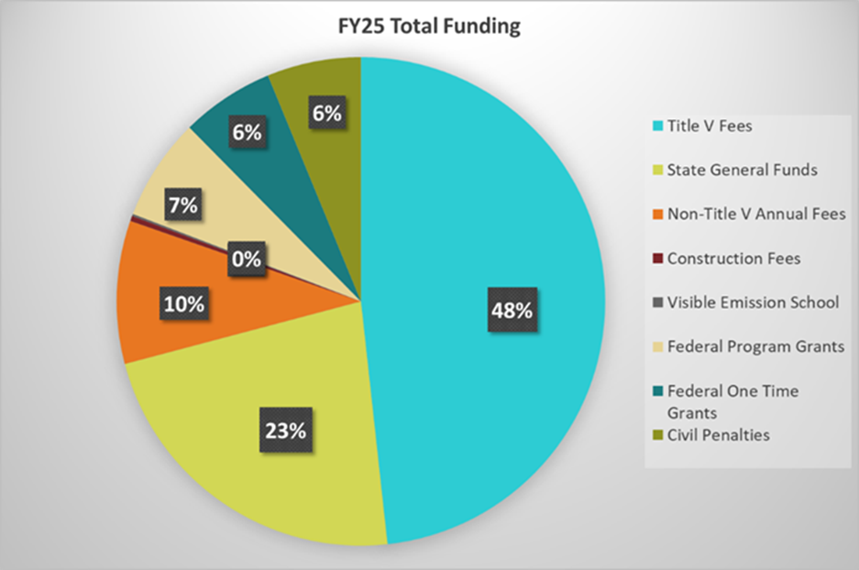
How the Air Division is Funded
Department of
Environment &
Conservation

Slide 7
Efforts to Increase Non-Title V Revenue
State Funds – Significantly Increased Since 2022
Federal Funds – Have received One-Time Funding for various needs (e.g., ambient monitoring equipment purchases)
Fees for Non-Title V facilities – Have not Changed since 2011
  Rising costs
  Increased workload due to statewide economic growth
  Inflationary pressures
Despite the increases in state and federal funding, a fee increase is being proposed to keep up with expenses
Department of
Environment &
Conservation

Slide 8
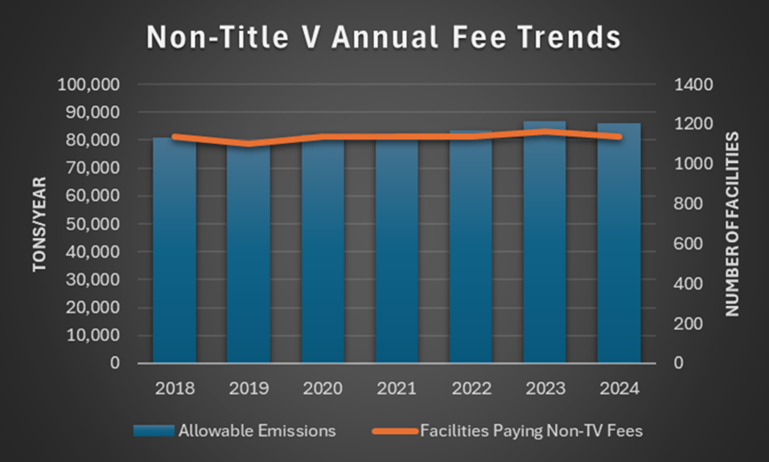
Non-Title V Sources and Emissions Have Been Steady
Department of
Environment &
Conservation

Slide 9
Statutory Authority for Air Quality Fees
The Tennessee Environmental Protection Fund Act (TN Code § 68-203-103) directs TDEC to charge fees for services and functions it performs, including the following fees:
  Permit processing fees
  Permit maintenance fees
  Emission fees
  Other fees
Department of
Environment &
Conservation

Slide 10
Tennessee Environmental Protection Fund Act
Prior to promulgating any fee increase, TDEC must review the basis for the fee increase and determine that the fee increase is warranted. The factors in this determination include:
  Staffing needs
  Ability to attract and retain quality staff
  Feasible cost containment measures
  Levels of federal grants and state appropriations
  Ability of the program to maintain or improve its performance in carrying out its duties
TDEC has reviewed these factors before determining that a fee increase is warranted
Department of
Environment &
Conservation

Slide 11
Stakeholder Engagement (1)
The Division conducted a robust stakeholder engagement process to gather input on best approaches to increase fees
Initial meeting with Tennessee Chamber of Commerce and Industry (TCCI)
  October 10, 2025
  Overview of the need for a fee increase
  Outlined stakeholder engagement plan and asked TCCI for assistance
Department of
Environment &
Conservation

Slide 12
Stakeholder Engagement (2)
TDEC website (tn.gov/environment/air/fees.html)
  General fee information
  Stakeholder engagement plan
  Webinar and public meeting recordings
  Presentations
Department of
Environment &
Conservation

Slide 13
Stakeholder Engagement (3)
Stakeholders were able to submit comments
  Email address (APC.Fee.Rule@tn.gov)
  Comment card (on website)
  Feedback surveys after webinars
Stakeholders were able to join Listserv
  News updates on fees
Department of
Environment &
Conservation

Slide 14
Stakeholder Engagement (4)
Public meetings
  Webinar
    October 21, 2025
    37 attendees
  Hybrid public meeting
    December 9, 2025, in Nashville
    In-person with remote access option
    18 attendees
Department of
Environment &
Conservation

Slide 15
First Stakeholder Meeting Feedback (1)
Stakeholders were asked which type of Non-Title V fees they most supported
Most support was for:
  Increase annual emission fee (dollar per ton)
  Add an annual base fee
  Modeling services
  Permit amendment
Some support for:
  Permit-by-Rule
  Stack Test observation
Not much support for:
  Operating permit application
  Off-permit changes
  Insignificant activity determinations
Department of
Environment &
Conservation

Slide 16
First Stakeholder Meeting Feedback (2)
For the construction permit application fee for Non-Title V sources, stakeholders were split on whether to:
  Maintain the graduated fee structure based on anticipated actual emission rates (53%)
  A flat fee (47%)
Department of
Environment &
Conservation

Slide 17
First Stakeholder Meeting Feedback (3)
The average cost to issue a construction permit for a true minor source is approximately $5,000.
  Should the applicant cover the full cost of issuing a construction permit?
    37% in favor.
  Should the applicant cover a portion of the cost to issue a construction permit with the remaining costs covered by other non-title V funding sources (e.g., annual fees paid by all non-Title V sources, state funds, federal grants).
    63% in favor.
Department of
Environment &
Conservation

Slide 18
First Stakeholder Meeting Feedback (4)
The average cost to issue a construction permit application for a conditional major source is approximately $9,000.
  Should the applicant cover the full cost of issuing a construction permit?
    44% in favor.
  Should the applicant cover a portion of the cost to issue a construction permit with the remaining costs covered by other non-title V funding sources (e.g., annual fees paid by all non-Title V sources, state funds, federal grants).
    56% in favor.
Department of
Environment &
Conservation

Slide 19
Second Stakeholder Meeting Feedback (5)
Stakeholders did support adding a fee for modeling services
  The Division decided not to propose adding a modeling fee
Stakeholders did not support adding an annual base fee for Non-Title V sources
  The Division decided not to propose adding an annual base fee
Department of
Environment &
Conservation

Slide 20
Second Stakeholder Meeting Feedback (6)
The most supported type of amendment fee was for a:
  Construction permit extension
The other types of amendment fees did not receive much support:
  Ownership change
  Name change
Department of
Environment &
Conservation

Slide 21
Second Stakeholder Meeting Feedback
For the Conditional Major annual review fee, stakeholders preferred a:
  Graduated scale (78%) over a
  Flat fee (22%)
Department of
Environment &
Conservation

Slide 22
Proposed Fee Revisions
Based on stakeholder feedback and the Division’s fiscal needs, this rulemaking proposes to:
  Restructure the construction permit application fee for Non-Title V sources
  Increase the annual emission fee for Non-Title V sources
  Increase the Conditional Major review fee
  Increase the fee for revising a construction permit application for Non-Title V sources
  Add a permit amendment fee for construction permit extensions for Non-Title V and Title V sources
  Clarify certain fee rule provisions
Department of
Environment &
Conservation

Slide 23
Non-Title V Construction Permit Application Fee
Existing Fee Table
Proposed Fee
$2,500 flat fee to replace existing fee table
Anticipated Maximum Emission Rate | Permit Fee
Less than 10 Tons/Year | $100
10 to < 100 Tons/Year | $500
100 to < 250 Tons/Year | $1000
250 to < 500 Tons/Year | $2000
500 to < 1000 Tons/Year | $3000
1000 to < 5000 Tons/Year | $4000
5000 and Greater Tons/Year | $5000
Department of
Environment &
Conservation

Slide 24
Construction Permit Application Fee (General Permit)
Existing Fee Table
Division has no plans to develop
a General Permit for Air Curtain Incinerators
Proposed Fee Table
General Permit Category | Permit Fee
Perchloroethylene and Petroleum Solvent Dry Cleaners | $100
Concrete Batch Plants | $100
Portable Rock Crushers | $100
Asphalt Plants | $250
Air Curtain Incinerators | $500
General Permit Category | Permit Fee
Perchloroethylene Dry Cleaners | $100
Petroleum Solvent Dry Cleaners | $100
Concrete Batch Plants (< 10 TPY) | $1,000
Concrete Batch Plants (<79.9 TPY) | $1,000
Nonmetallic Mineral Crushing/Sizing | $1,000
Asphalt Plants | $2,500
Department of
Environment &
Conservation

Slide 25
Annual Emission Fee
Public Chapter 399 (effective May 5, 2025)
  Changed the maximum annual emission fee rate from $18.75 per ton to $38.00 per ton
Proposed increase in annual emission fee rate for Non-Title V facilities with individual permits from $18.75 per ton to $28.00 per ton of allowable emissions
Department of
Environment &
Conservation

Slide 26
Annual Emissions Fee (General Permit)
Existing Fee Table
Proposed Fee Table
General Permit Category | Annual Fee
Perchloroethylene and Petroleum Solvent Dry Cleaners | $0
Concrete Batch Plants (< 10 TPY) | $0
Concrete Batch Plants (≥ 10 TPY) | $400
Portable Rock Crushers at TM | $1,000
Portable Rock Crushers at CM | $1,000
Asphalt Plants | $1,000
General Permit Category | Annual Fee
Perchloroethylene Dry Cleaners | $0
Petroleum Solvent Dry Cleaners | $0
Concrete Batch Plants (< 10 TPY) | $0
Concrete Batch Plants (<79.9 TPY) | $600
Nonmetallic Mineral Crushing/Sizing | $1,500
Asphalt Plants | $1,500
Department of
Environment &
Conservation

Slide 27
Conditional Major Review Fee (Individual Permits)
Existing Fee Table
Proposed Fee Table
Total Allowable (tons per year) | Review Fee
0-50 | $250
50.1 to 100 | $500
100.1 to 250 | $1,000
250.1 and up | $2,000
Total Allowable (tons per year) | Review Fee
0-100 | $2,000
100.1 and up | $4,000
Department of
Environment &
Conservation

Slide 28
Conditional Major Review Fee (General Permits)
Existing Fee Table
Proposed Fee Table
General Permit Category | Review Fee
Portable rock crushers at Conditional Major Facilities | $500
Asphalt Plants | $500
General Permit Category | Review Fee
Asphalt Plants | $2,000
Department of
Environment &
Conservation

Slide 29
Permit Amendment Fee
Proposing a new $500 construction permit extension amendment fee for both Non-Title V and Title V sources
Department of
Environment &
Conservation

Slide 30
Construction Permit Application Revision Fee
Proposing a flat fee of $750 for a construction permit application revision in place of the existing structure, which has a fee up to $500 for Non-Title V sources
Department of
Environment &
Conservation

Slide 31
Administrative and Miscellaneous Changes (1)
Revised the definition of “Permit Amendment”
Added a definition for “Facility”
Clarified that the “Responsible Official” is not personally liable for paying fees
Clarified that a construction permit application is not complete unless all fees have been paid to the Division and required compliance schedules have been submitted
Department of
Environment &
Conservation

Slide 32
Administrative and Miscellaneous Changes (2)
Proposed that air curtain incinerators pay a base fee of $3,000 if they are required to obtain a Title V permit solely due to being subject to 40 C.F.R. 60 subpart CCCC
Clarified the counting of federal air quality standard in relation to determining the Title V base fee
Department of
Environment &
Conservation

Slide 33
Schedule
Event | Date
Stakeholder engagement | October to December 2025
First Board briefing | November 12, 2025
Rule Development | January to May 2026
Second Board briefing | June 10, 2026
Public Notice | Mid-June 2026
Public Hearing | Mid-August 2026
Board Vote | September or October 2026
Governor’s Office, Attorney General, Secretary of State, Government Operations | November 2026 to May 2027
Fee rule becomes state effective | June 2027
Department of
Environment &
Conservation

Slide 34
Questions
Mark A. Reynolds
Environmental Consultant
Tennessee Department of Environment and Conservation
Division of Air Pollution Control
Mark.A.Reynolds@tn.gov
Department of
Environment &
Conservation

