Slide 1
Non-Title V Fee Rule Revisions Stakeholder Meeting
December 9, 2025

Slide 2
Introductions
Moderators: Jan Compton, Office of External Affairs, Deputy Director
Klarissa Kahill, Office of External Affairs, Regional Director
Presenters: Mark Reynolds, Air Pollution Control (APC), Lead Rule Writer
Jimmy Johnston, APC, Deputy Director
Division APC: Michelle Owenby, APC, Division Director
Michelle Oakes, APC, Regulatory Development and Rule Writing Program Manager
Hannah Nodell, APC, Stakeholder Engagement Lead

Slide 3
Sign-In & Agenda
Sign-In
In-person: Sign-In Sheet
Virtual: Email name and affiliation to APC.Fee.Rule@tn.gov
Agenda

Slide 4

Mentimeter & Test Poll
Access the interactive survey
Scan the QR Code
Visit: https://www.menti.com/ales6tskd4ax and use code 6680 1829

Slide 5
Overview of Fee Rule Revision
Tennessee Department of Environment & Conservation (TDEC) Air Pollution Control Division (APC) is exploring a rule revision to update Non-Title V fees
Current expenses exceed revenue for the Non-Title V program
TDEC has exhausted all options for decreasing expenses and increasing revenue before exploring a fee increase
Fee increase is still to be determined
TDEC is seeking stakeholder input
This fee rule revision only affects facilities that receive air quality permits from the Division of Air Pollution Control. It does not affect facilities permitted by a local program in Davidson, Hamilton, Knox, or Shelby Counties.

Slide 6
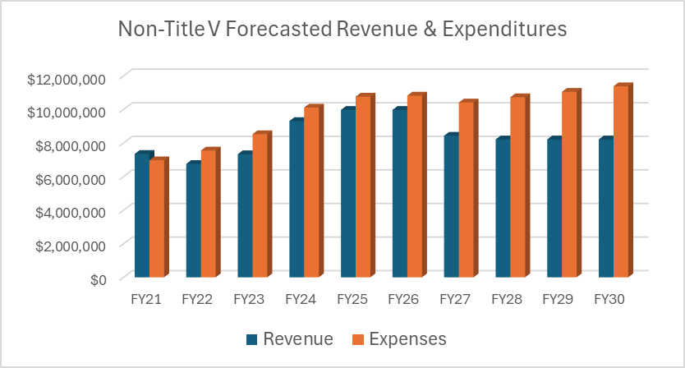
Non-Title V Expenses and Revenue

Slide 7
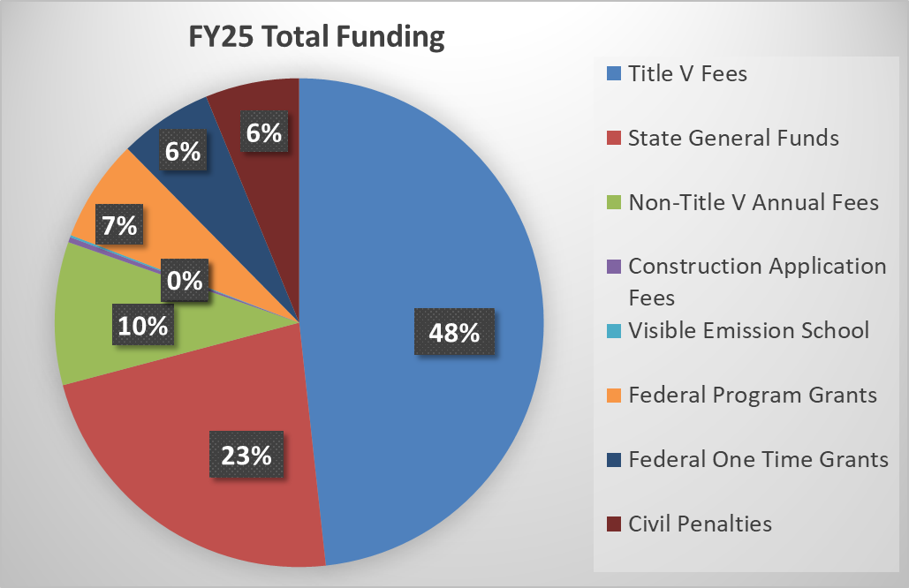
How the Air Division is Funded
TDEC is considering increasing:
Non-Title V Annual Fees
Construction Application Fees

Slide 8
Stakeholder Engagement
October 21, 2025, Webinar
Website (tn.gov/environment/air/fees.html)
Engagement plan, General fee information
Webinar recording, Presentation
Send comment to TDEC
Email address (APC.Fee.Rule@tn.gov)
Comment card (on website)

Slide 9
Timeline
Oct. 2025 –
Dec. 2025
Dec. 31, 2025
Jan. 2026 –
June 2027
July 1, 2027
Stakeholder Engagement
Oct. 21 Virtual Meeting
Dec. 9 Public Meeting
Written Comment Card
And Email
Deadline for Initial Public Comment
There will be additional opportunities for public comment at the Public Hearing and TDEC APC Board Meetings
Formal State Rulemaking Process
Public Hearing
TDEC Air Pollution Control Board
TN General Assembly Government Operations Committee
New Rule and Fees Become State Effective

Slide 10
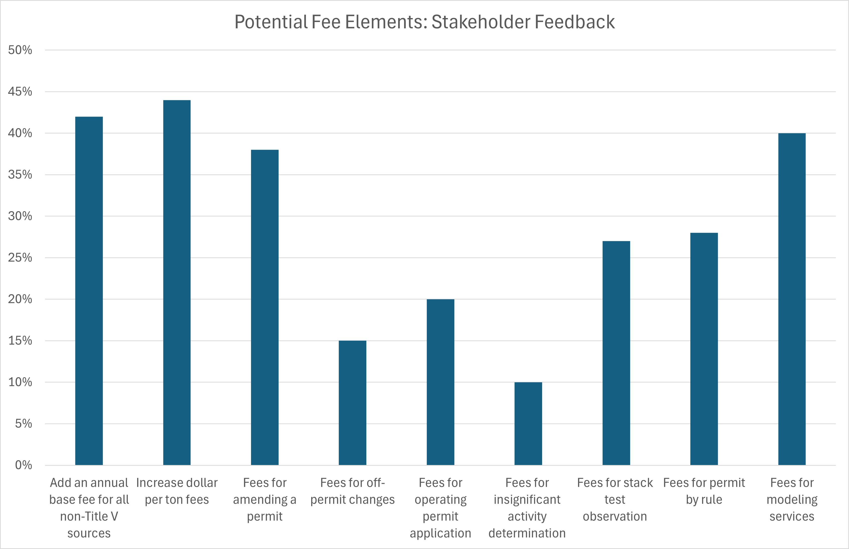
Survey Results

Slide 11
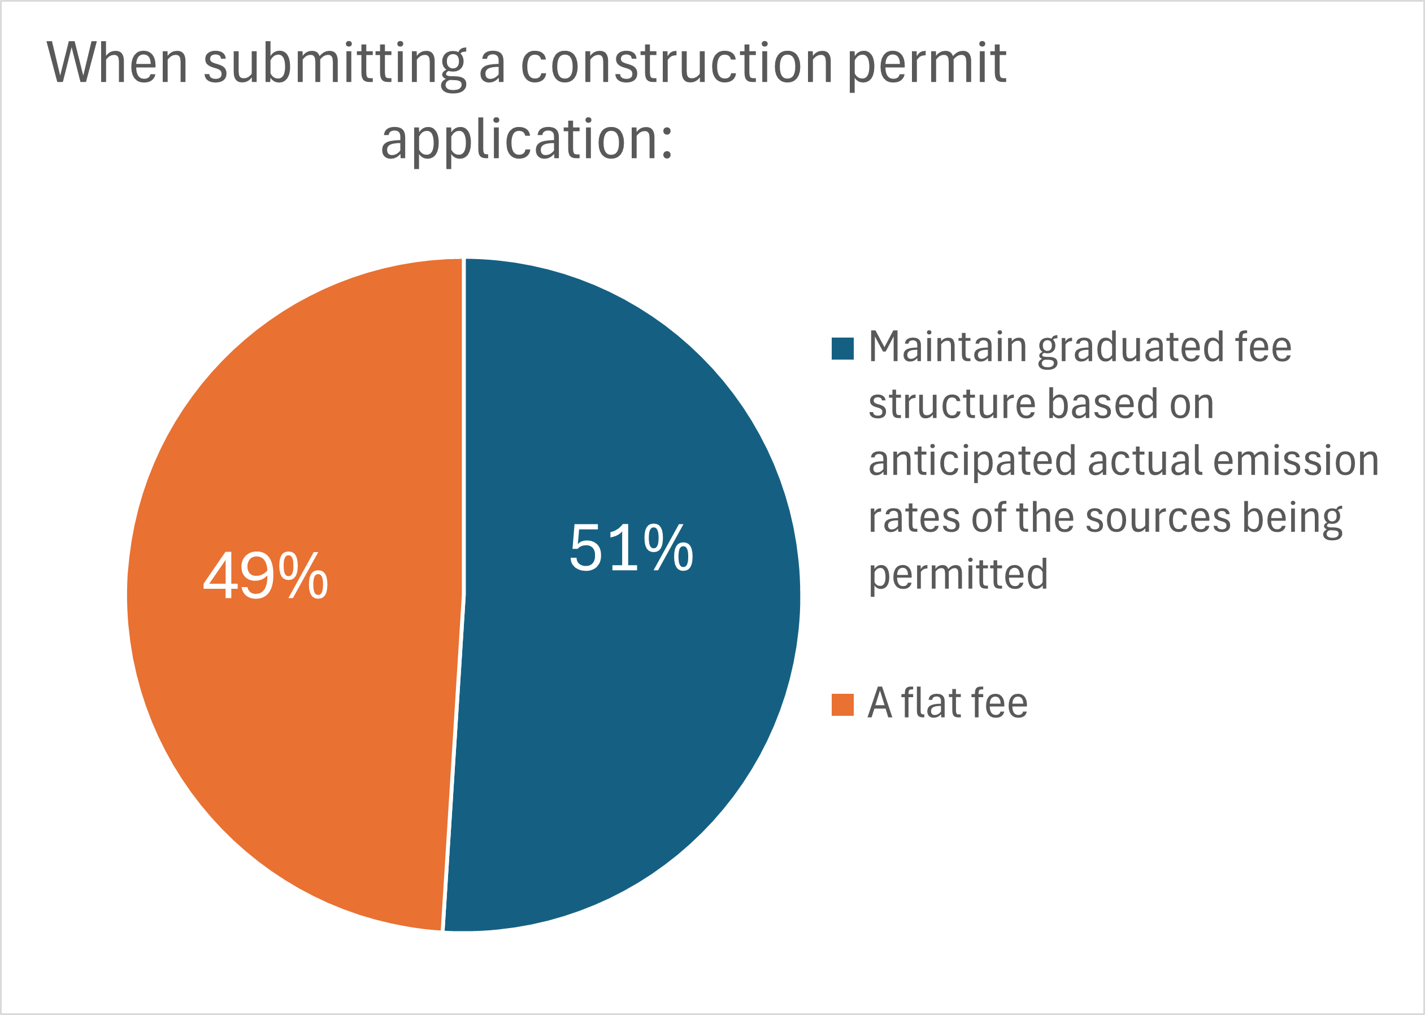
Survey Results

Slide 12
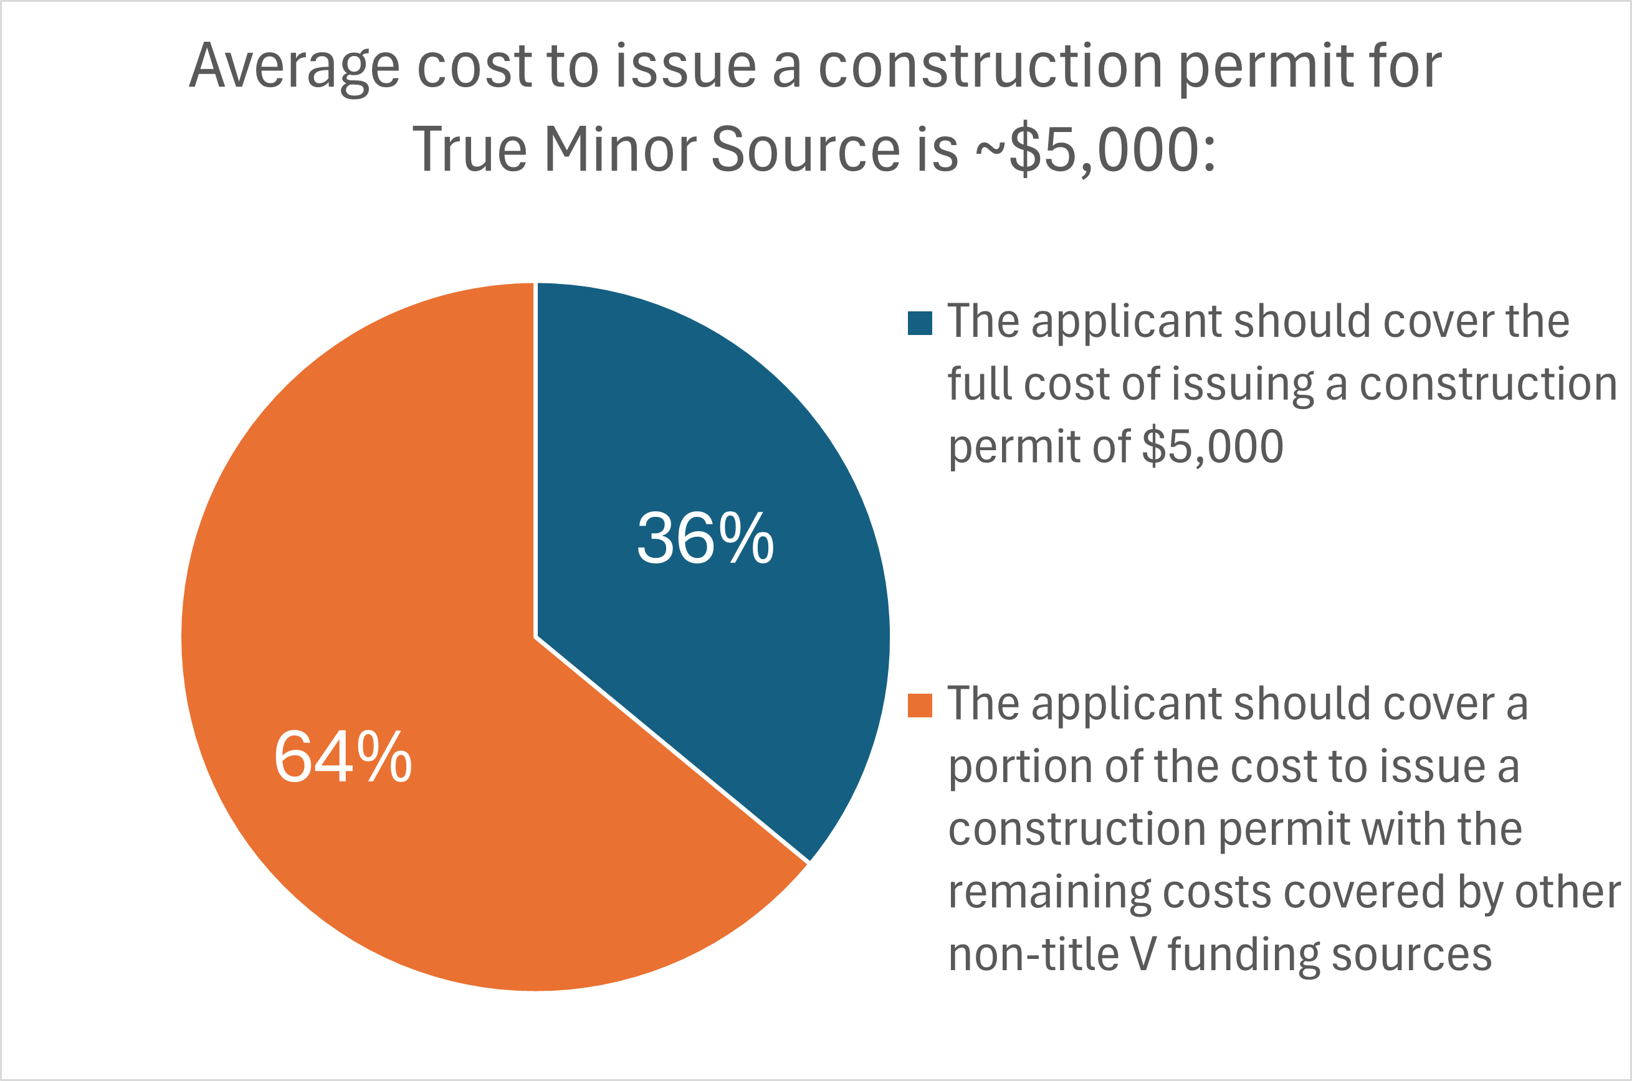
Survey Results: True Minor

Slide 13
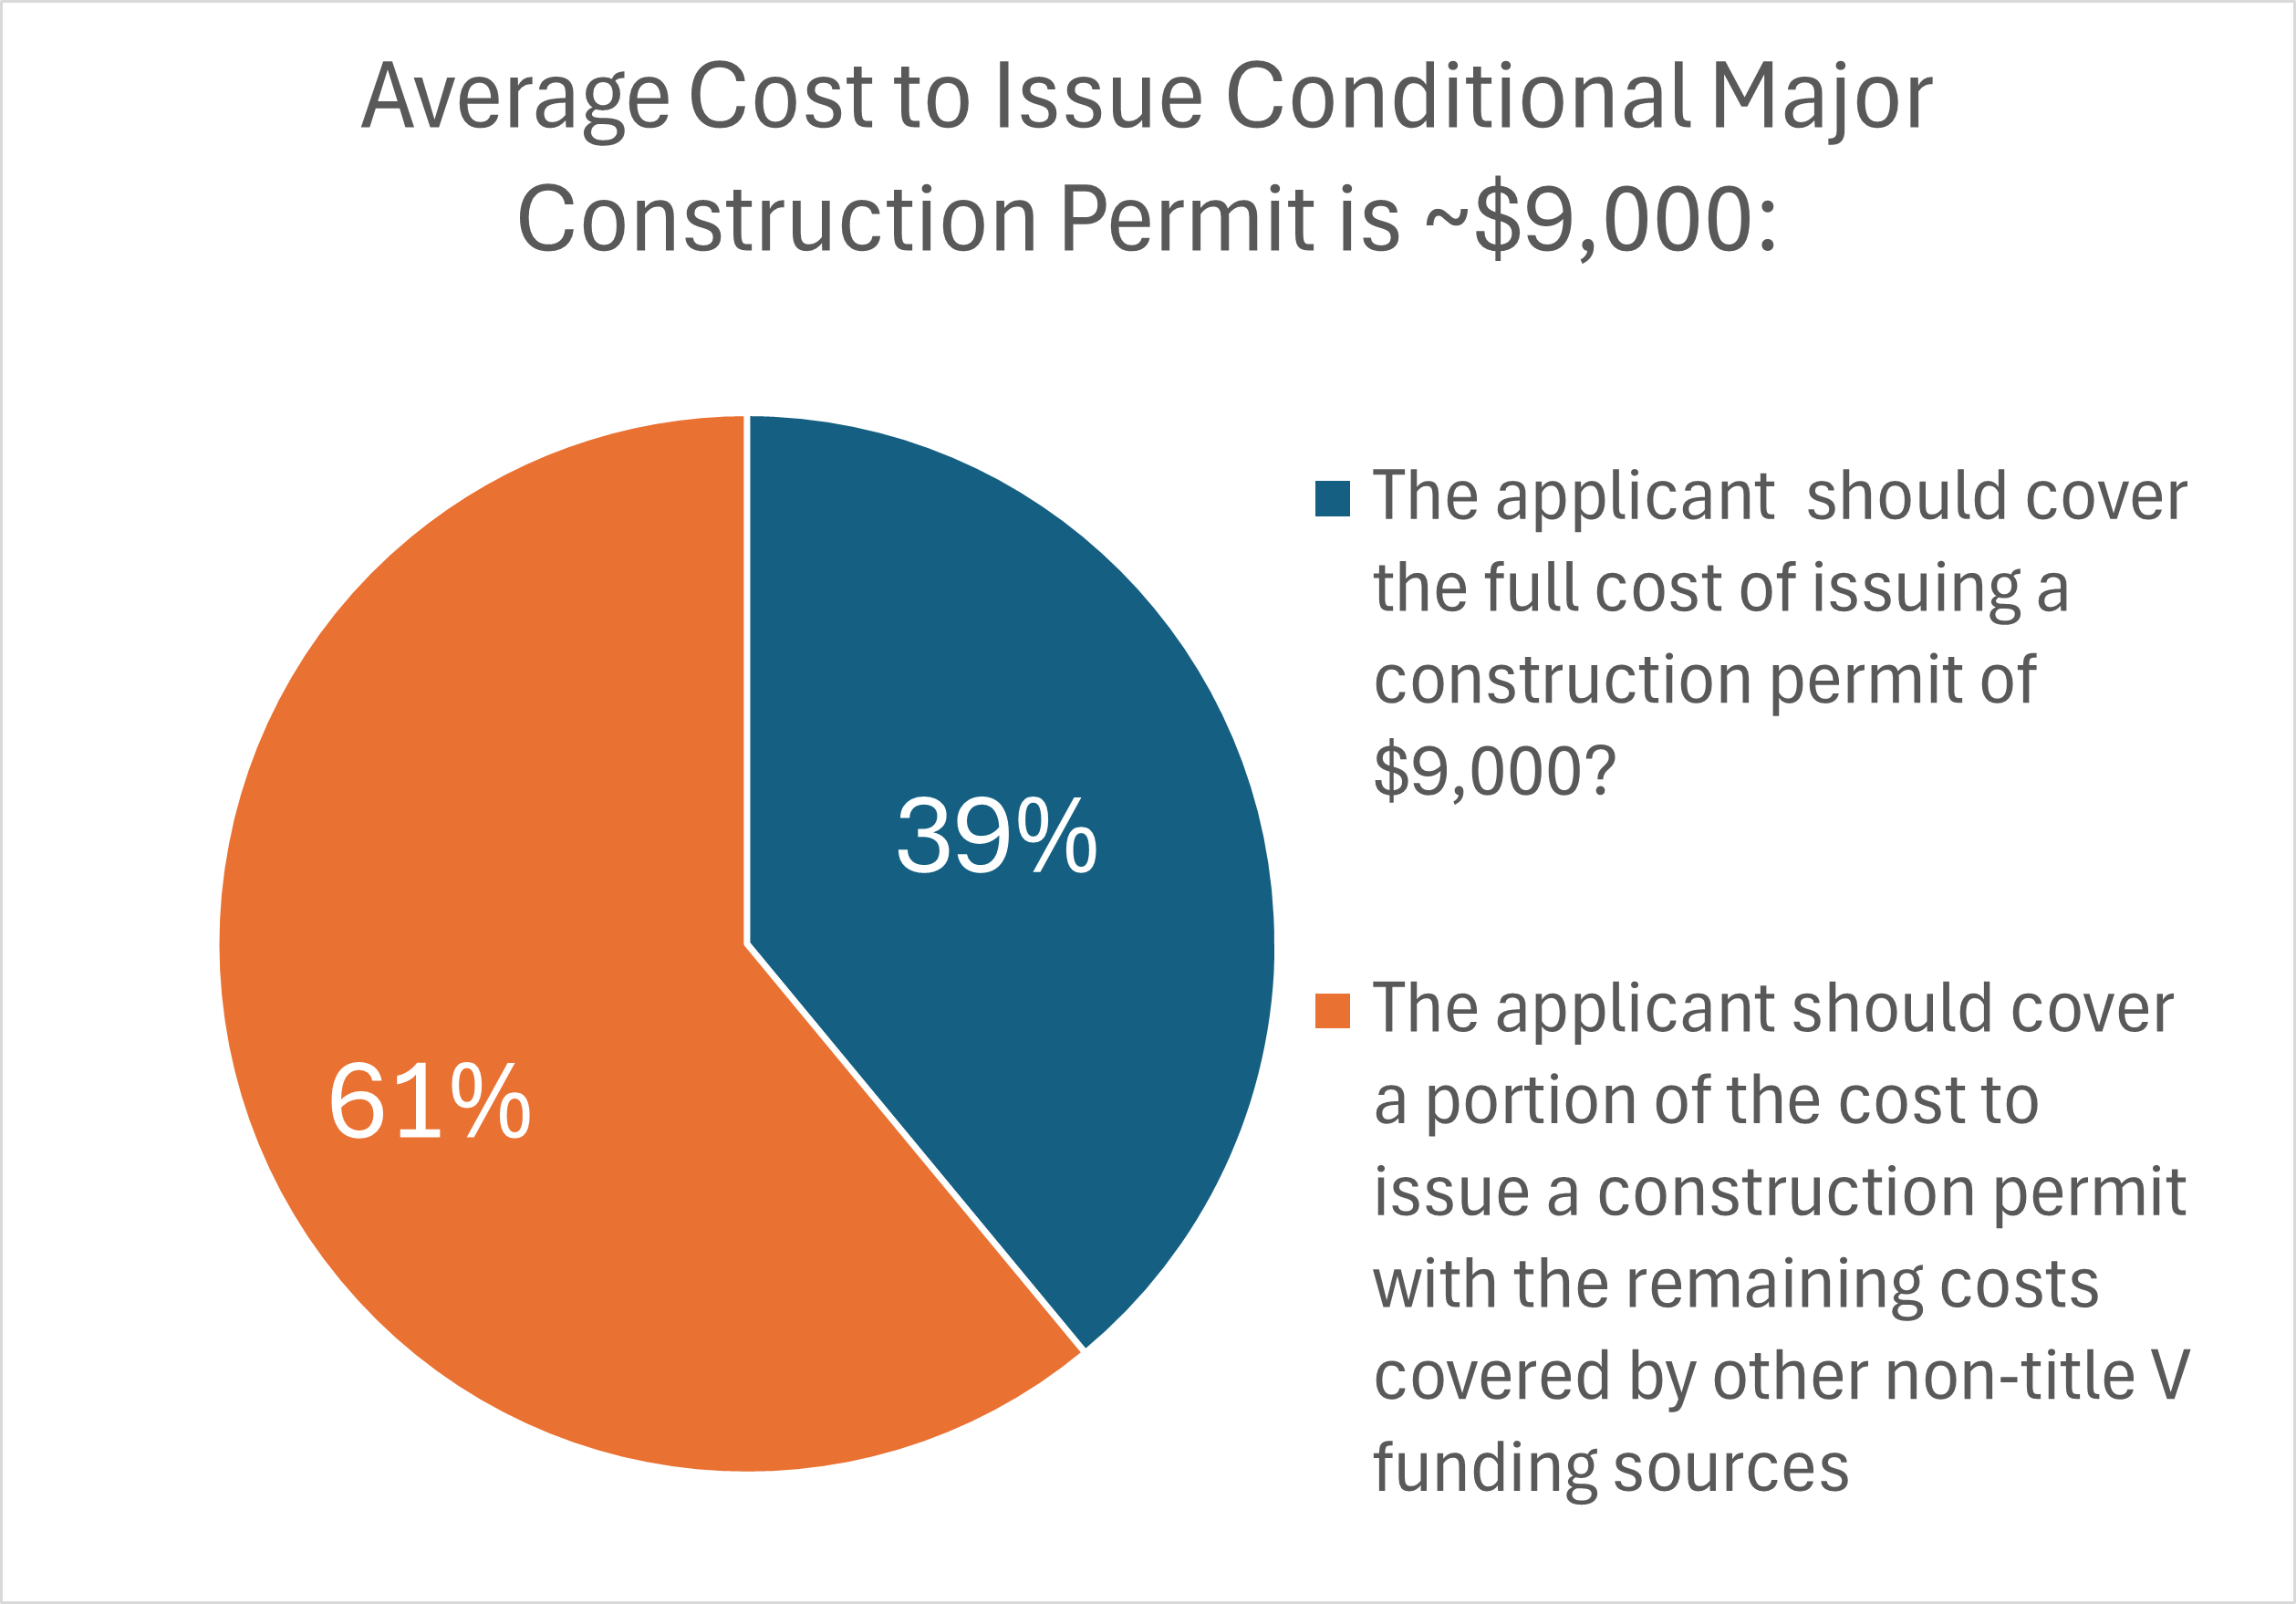
Survey Results: Conditional Major

Slide 14
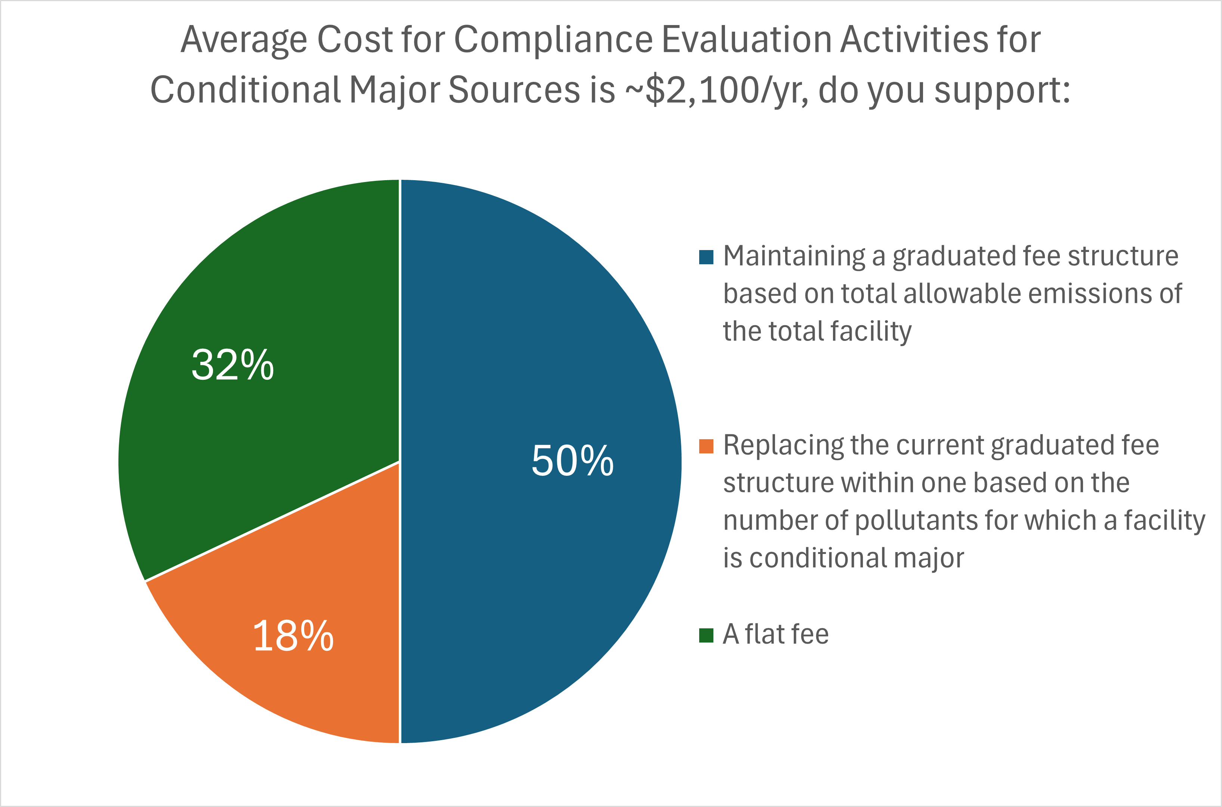
Survey Results: Conditional Major

Slide 15
Potential Elements - Overview
Exploring Fee Elements that will be used to develop proposed rule revision
Not planning to collect a specific total dollar amount
Potential approaches based on:
Results of Surveys
Business goals of the Division
Proposed rule will, at a minimum, consist of changes to three existing fee elements:
Dollar per Ton ($/ton) of permitted allowable emissions paid on an annual basis
Annual Conditional Major Review fee
Construction Permit application fee
Includes combined construction and operating permits
Notes:
Good afternoon, my name is Jimmy Johnston and I am the Deputy Director of Permitting and Regulatory Development.
Upon reviewing the survey results and a discussion of the Division’s business needs, we have developed some potential fee elements
These fee elements will be used to build a proposed non-Title V fee rule revision
Note that we are NOT developing any plans based on collecting a specific dollar amount. This is because, unlike Title V fees which are required to completely fund the Title V fee program, the non-Title V program is supported by a variety of income sources, one of which is fees.
One of the basic business goals we used to develop potential fee options is that the entity that benefits from a service (e.g., construction permit, permit modeling) would cover the cost of that service through a fee
We have determined that at a minimum, changes are needed to three key existing fee elements. They are:
The dollar per ton fee
The annual conditional major review fee, and
Construction permit application fees (which includes combined construction and operating permit applications)

Slide 16
Fee Element – Dollar Per Ton of Permitted Allowable Emissions
Current Rate = $18.75/ton
Statute Allows up to $38.00/ton
Potential Fee Element – Increase to between $28.00/ton to $32.00/ton
Notes:
Read bullets
Where this ends up depends on which of the other elements are incorporated into a non-Title V fee rule the fee rates of those elements. There are some examples of this in the following sides.

Slide 17
Fee Element – Conditional Major Review Fee
Currently Graduated Scale based on Allowable Emissions:
Two Potential Fee Element Options
Option A - $2,000/year
Option B – Graduated Scale based on Allowable Emissions:
Allowable Emissions | Annual Conditional Major Review Fee
0 to 50 tons/year | $250 per year
50.1 to 100 tons/year | $500 per year
100.1 to 250 tons/year | $1,000 per year
250.1 tons/year and up | $2,000 per year
Allowable Emissions | Annual Conditional Major Review Fee
0 to 100 tons/year | $1,000 per year
100.1 tons/year and up | $3,000 per year
Notes:
-Sources which have potential emissions over the Title V major source threshold but have voluntarily taken limits to remain below the major source threshold are called Conditional Major sources.
- Conditional Major sources pay an annual conditional major review fee.
-As discussed in the first webinar, the average annual cost of enforcing a conditional major permit (e.g., inspections, report reviews, responses to complaints) is about $2000 per year.
- Presenting two options that would result in revenue equivalent to this cost
Option A is a flat fee of $2000 per year
Option B is a graduated scale. Facilities with total allowable <= 100 tpy, pay $1000, > 100 tpy, pay $3000
Let’s get some stakeholder feedback

Slide 18
Mentimeter Question 1: Conditional Major Review Fee

Slide 19
Fee Element - Construction Permit Application Fee
Current Fee Schedule based on Anticipated Maximum Annual Emissions Rate (AMER):
Potential Fee Element based on actual workload cost
True Minor Facilities – Flat Fee of $5,000
Conditional Major Facilities – Flat Fee of $7,000
AMER | Application Fee
< 10 tons per year | $100
10 to < 100 tons per year | $500
100 to < 250 tons per year | $1,000
250 to < 500 tons per year | $2,000
500 to < 1,000 tons per year | $3,000
1,000 to < 5,000 tons per year | $4,000
5,000 tons per year and greater | $5,000
Notes:
We currently have a graduated fee structure where the application fee is based on the Anticipated Maximum Annual Emissions associated with the application (AMER)
While there was some support for retaining a graduated fee structure, the Division is not presenting one at this time
Almost no relationship between AMER and cost to issue a construction permit
Construction permits with AMER < 10 tons/yr for true minor sources was slightly less than average (~10-20% lower on average)
However, retaining a graduated fee structure would retain the requirement for all facilities to continue to calculate and report AMER for all construction permit applications
A flat fee removes this and reduces the burden to both the applicant and Division
The application fee we are presenting sets the fee so that it collects most if not all of the average cost of issuing a construction permit. Thus, the cost of t his service would be born by the entities that benefit from it. This is one of the Division’s key business goals.
Presenting flat fee of $5,000 per application for true minor facilities and $7,000 per application for conditional major facilities
If we were to collect less than these amounts, we would need a higher $/ton fee. We issue ~ 150-200 construction applications per year. If we were to drop these by $1000 each, that’s $150-$200k/year, the dollar per ton fee would end up toward the middle or top of the range presented earlier

Slide 20

Discussion on Increases to Three Fee Elements
$/ton of Permitted Allowable Emissions Fee
Conditional Major Review Fee
Construction Permit Application Fee

Slide 21
Other Potential Fee Elements
Seeking input on the following additional fee elements:
Base Fee
Permit Amendment Fee
Permit Modeling Fee
Notes:
Now we would like to discuss other fee elements that received support in at least one-third of survey responses
Includes:
A Base Fee
Amendment Fee
Modeling Fee
All of these would be new types of fees

Slide 22
Other Potential Fee Element – Base Fee
Paid by all non-Title V fee payers with their Annual Fee in addition to $/ton of permitted allowable emissions fee and Conditional Major Review Fee
Four base fee options for consideration and feedback:
None
$100 per facility
$300 per facility
$500 per facility
Notes:
A base fee would be an annual flat fee paid by all non-Title V fee payers.
It is in addition to the $/ton fee and, if applicable, conditional major review fee
Example of a fee that, if adopted, would reduce $/ton fee (e.g., ~1000 non-TV fee payers, $100/hr = ~$100,000, collects about as much as $1/ton)
If a base fee were adopted, the $/ton fee could be toward the lower end, depending on the amount of the base fee
We would now like feedback on the possibility of adding a base fee.
We are going to ask you to vote on one of four options
no base fee,
$100/year base fee
$300/year base fee
$500/year base fee

Slide 23
Mentimeter Question 2: Annual Base Fee

Slide 24
Other Potential Fee Element – Permit Amendment Fee
Limited to common types of permit amendments:
Name Changes
Ownership Changes
Extension of Expiration Date of Construction Permits
Would require development of rules, procedures, regulatory deadline
Notes:
The Division currently does not charge fees for permit amendments for non-Title V permits.
There are a number of reasons that a permit is amended. The most common types are
Name Changes
Ownership Changes
Extension of Expiration Date of Construction Permits
We don’t have a potential fee for this element at this point, but the average cost for all permit amendments is about $1000, a potential amendment fee for these type of elements would probably be there or lower
If we were to adopt an amendment fee, additional regulatory and process changes would be needed, which may take longer than this current rulemaking
Let’s get some feedback on amendment fees
Note that if you believe that we shouldn’t charge a fee for these type of permit amendments, select NO in the survey

Slide 25
Mentimeter Question 3: Permit Amendment Fees

Slide 26
Other Potential Fee Element - Permit Modeling Fee
Dispersion Modeling for Applications with Emissions for the Following Pollutants above Specific Thresholds:
Hydrogen Chloride (HCl)
Hydrogen Fluoride (HF)
Sources subject to a MACT for HF don’t require modeling
Lead
$5,000 would be due with Application Fee
Notes:
Dispersion modeling is required for certain permit applications when emissions of hydrogen chloride (HCl), Hydrogen Flouride (HF), or lead is above a certain threshold.
For sources of HF no testing is required if the source in question is subject to a MACT standard for HF
Only conduct ~ 7/year
$5000 covers the cost of modeling in addition to regular construction application fee
Now like feedback on charging a fee for modeling for construction permits for non-Title V sources

Slide 27
Mentimeter Question 4: Modeling Fee

Slide 28
Fee Elements that did not Receive Significant Support
Off-Permit Change Fee
Operating Permit Application Fees
Insignificant Activity Determination Fees
Fees for Permit-by-Rule Notice of Authorization
Stack Test Observation Fee
Notes:
These fee elements received less than 30% support.
We are not presenting fee options for these

Slide 29
Discussion on Other Fee Elements
Base Fee
Permit Amendment Fee
Permit Modeling Fee

Slide 30
General Permits – Annual Fee
Current Fees:
Potential Fees:
Adjust by Same Percentage as $/ton Fee
If $/ton increased from $18.75/ton to $30/ton = 60% increase
Non-Metallic Mineral Crushing and Sizing increases to $1600/year
General Permit Category | Annual Fee
Dry Cleaners | None
Concrete Batch Plants with Emissions < 10 tons/year | None
Concrete Batch Plants with Emissions >= 10 tons/year | $400
Non-Metallic Mineral Crushing and Sizing | $1,000
Asphalt Plants (fee includes Conditional Major Review Fee) | $1,500
Notes:
So far, we have discussed fees for facilities that hold traditional air quality permits. Some facilities have opted into receiving general permits. The Division has developed some and are working on another. The current fee rule charges annual fees for some of these general permits as shown here.
We are presenting an increase for general permit annual fees proportional to the increase in the $/ton rate for sources with traditional permits.

Slide 31
General Permits – Application Fee
Current Fee (includes construction):
Potential Fee Increases:
Concrete Batch Plants & Non-Metallic Mineral Crushing & Sizing - $1,000
Dry Cleaners – TBD
Asphalt Plants – TBD
Air Curtain Incinerators – Currently no plans to develop
General Permit Category | Application Fee
Dry Cleaners | $100
Concrete Batch Plants | $100
Non-Metallic Mineral Crushing and Sizing | $100
Asphalt Plants | $250
Air Curtain Incinerator | $500
Notes:
Sometimes, a general permit can issued for constructing a new source as well as operating. In those situations, an application fee is required.
The current fees are shown
A potential change is to increase the application fees to cover the cost of processing the general permit application.
The average cost of processing a general permit application (known as a notice of intent) that includes construction of a new source or new emission eources is about $1000 per notice of intent.
Most of these have been for Concrete Batch & Non-Metallic Minerals general permits
Thus, we are presenting a construction fee for general permits for these categories of $1000
Asphalt Plants – General Permit Under Development, don’t have any data to base a fee. We will continue to evaluate the proper construction application fee for asphalt plants that construct under the authority of a General Permit.
Dry Cleaners – Few if Any (dry cleaners moving away from perc & petroleum solvents), thus not data
Currently no plans to work on ACI general permit – very few Title V facilities (three), EPA may be eliminating requirement. We may remove this fee from the fee rule.

Slide 32
Expedited Construction Permit Fee
Notes:
A expedited fee is an additional fee to prioritize a construction permit higher and issue it in a shorter period of time.
A number of stakeholders expressed interest in an expedited fee during the first webinar
While we will continue to explore the possibility of an expedited fee, we don’t intend to proposed one with this rulemaking.
An expedited fee would require additional staff, which would required approval from the Governor and Legislature
An expedited fee would also require the development of rules and processes necessary to implement them.
Other information if asked:
We have looked at expedited programs in other states:
Very popular ~40-50% participation
About 20-40 days quicker than our current deadline (115-days)
Additional staff ~10, but could be significantly higher or lower
Cost ~$1MM/yr, cost per application
Fee necessary to cover cost may require statutory change ($7500 cap)

Slide 33
General Discussion
Notes:
On General Permit Fees or anything else covered during this presentation

Slide 34
Schedule and next steps:
Oct. 2025 –
Dec. 2025
Dec. 31, 2025
Jan. 2026 –
June 2027
July 1, 2027
Stakeholder Engagement
Oct. 21 Virtual Meeting
Dec. 9 Public Meeting
We will accept feedback via the written comment card and Email through Dec. 31, 2025
Deadline for Initial Public Comment
There will be additional opportunities for public comment at the Public Hearing and TDEC APC Board Meetings
Formal State Rulemaking Process
Public Hearing
TDEC Air Pollution Control Board
TN General Assembly Government Operations Committee
New Rule and Fees Become State Effective

Slide 35
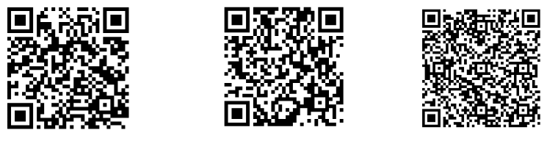
Stakeholder Engagement Resources
Non-Title V Fees Website
Email us here or at APC.Fee.Rule@tn.gov with any comments or questions.
Submit a public comment
Sign up to our Listserv to receive updates
QR codes:
Scan the QR code to visit the website for more information.
Scan the QR code to receive updates through our Listserv.
Scan the QR code to access the public comment card.

Slide 36
Thank you!
Thank you to our stakeholders for your participation and feedback!
If you have further questions regarding stakeholder engagement, please contact Hannah Nodell at:
Hannah.Nodell@tn.gov or at 615-454-8332

