Slide 1


Deputy Commissioner's Office
Operational Data Team
Outcomes Committee
© Tennessee Department of Education

Slide 2

Agenda
Purpose and prior Outcomes Committee
Recap of TISA Outcomes current rules
Review of 2023 - 2025 outcomes allocations and student performance
Next steps

Slide 3

TISA Student-Based Funding Formula
Base + Weights + Direct + Outcomes
Outcomes Funding
Incentivizes student achievement and education excellence
Direct Funding
Offers students learning opportunities beyond everyday classroom instruction
Weights
Provides additional funds for students with unique learning needs or who may need additional supports
Base
Covers the essentials each student needs for a K-12 education

Slide 4

Outcomes Overview
Capture student-based performance indicators
100% state-funded, no local contribution
Awarded once per year based on outcomes from prior year
Students may generate one outcome bonus in elementary school, one in middle school, and one in high school
The TISA Outcomes Committee (3-year terms) makes recommendations on TISA Outcomes targets
^{$80M}
Budgeted for outcomes funding
in SY25-26

Slide 5

Outcomes Targets
Elementary School
Target
Student scores “meets expectations” or “exceeds expectations” on 3rd grade ELA TCAP; OR
Student scored “approaching” or “below” on the 3rd grade ELA TCAP and improves by at least one performance level by the 4th grade ELA TCAP
Source
State TCAP results (or reaching higher performance level on state alternate assessment)
Value
Generates bonus of 10% of the base funding amount
Generates bonus of 20% of the base funding amount if student is identified as Economically Disadvantaged (ED), English Learner (EL), and/or Students with a Disability (SWD)

Slide 6
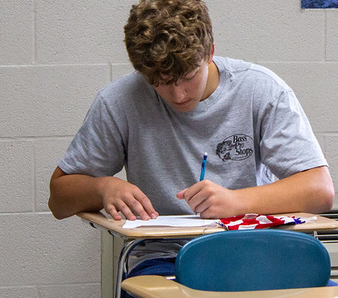
Outcomes Targets
Middle School
Target
Student scores “meets expectations” or “exceeds expectations” on both the ELA and Math sections of the 8th grade TCAP; OR
Student improves by at least one performance level from 7th grade TCAP to the 8th grade TCAP on both the ELA and Math sections
Source
State TCAP results (or reaching higher performance level on state alternate assessment)
  Includes analysis of advanced EOC exams if taken in lieu of 8th grade Math TCAP
Value
Generates bonus of 10% of the base funding amount
Generates bonus of 20% of the base funding amount if student is identified as ED, EL, or SWD

Slide 7

Outcomes Targets
High School, Goal 1
GOAL 1
Early Postsecondary Opportunity (EPSO) Credit
Earning postsecondary credits/clock hours, such as dual enrollment opportunities
Earning passing score on approved exams, such as AP or IB
Earning Tier II or Tier III industry credentials

Slide 8
Outcomes Targets
High School, Goal 1
GOAL 1
Target
Student earns at least 2 EPSO credits AND achieves one of the below:
  Scores an ACT composite score of 21 or higher
  Improve ACT composite score by at least 4 points from first 11th grade attempt
Student earns at least 3 EPSO credits
Student scores 31 or higher on Armed Services Vocational Aptitude Battery (ASVAB) AND earns at least 2 EPSO credits
Source
ACT/EPSO results files and district reporting
Value
Generates bonus of 10% of the base funding amount
Generates bonus of 20% of the base funding amount if student is identified as ED, EL, or SWD

Slide 9
Outcomes Targets
High School, Goal 2
GOAL 2
Available for graduating class of students identified as students with disabilities who did not generate bonus funds on first high school goal
District must meet state goal for the percentage of students receiving instruction 80% of the day in the general education setting as defined in the state’s Annual Performance Report (APR Indicator 5)

Slide 10
Outcomes Targets
High School, Goal 2
GOAL 2
Target
Student achieves at least 2 of the targets below:
  Graduation with a general education diploma
  Proficiency on state’s alternate assessment
  Meets post-school outcome goals such as enrollment in higher education, participation in other postsecondary or training program, or obtaining competitive employment
Source
Graduation data, state alternate assessment files, and district reporting
Value
Generates bonus of 10% of the base funding amount

Slide 11
Outcomes Targets Snapshot
Elementary, Middle, High School Goal 1 + 2
Funding Values:
Students identified as ED, EL, or SWD generate a bonus of 20% of the base funding amount. All other students generate a bonus of 10% of the base funding amount.
Grade Level | Outcomes Funding Criteria
Elementary School | Meets/exceeds on 3rd grade ELA TCAP OR Approaching/below on 3rd grade ELA TCAP AND improves by at least one performance level on 4th grade ELA TCAP
Middle School | Meets/exceeds on both 8th grade ELA and Math TCAP OR Improves by at least one performance level from 7th to 8th grade in both ELA and Math (Includes analysis of high school math EOC if taken in lieu of 8th grade Math TCAP)
High School, Goal 1 | Earns ≥2 EPSO credits AND ACT ≥21 or ACT +4 improvement OR Earns 3 EPSO credits OR ASVAB AFQT ≥31 AND earns ≥2 EPSO credits
High School, Goal 2 | Students with Disabilities only: No Goal 1 outcome AND district meets Indicator 5 (≥80% gen ed setting) AND Meets 2 of 3: 1. Graduation with a general education diploma (Indicator 1) 2. Alternate assessment proficiency (Indicator 3C) 3. Meets post-school outcomes (Indicator 14)
Generates a bonus of 10% of the base funding amount.
Notes:
Early Postsecondary Opportunity (EPSO) Credit: Earning postsecondary credits/clock hours, suchas dual enrollment opportunities; Earning passing score on approved exams, such as AP or IB; Earning Tier II or Tier III industry credentials
Indicator 14: Meets post-school outcome goals such as enrollment in higher education, participation in other postsecondary or training program, or obtaining competitive employment
Middle School: You can meet and grow in different subjects to meet

Slide 12
2025-2026 Outcomes Data
Elementary & Middle School
Elementary School
 | Member of a Subpopulation: (ED, EL, and/or SWD) | Other Students
Met/Exceeded in 3rd-grade ELA TCAP | 18,210 | 29,572
OR
Approached/Below in 3rd-grade ELA TCAP AND demonstrated Significant Growth in 4th-grade ELA
Total Students | 18,210 | 29,572
Base Funding Amount | $7,295.00 | $7,295.00
Multiplier | 20% | 10%
Value | $26,568,390.00 | $21,572,774.00
Total | $48,141,164.00
Middle School
 | Member of a Subpopulation: (ED, EL, and/or SWD) | Other Students
Met/Exceeded on both the 8th-grade ELA and math TCAP | 4,013 | 15,031
OR
Demonstrated Significant Growth in both ELA and math from 7th-grade to 8th-grade TCAP
Total Students | 4,013 | 15,031
Base Funding Amount | $7,295.00 | $7,295.00
Multiplier | 20% | 10%
Value | $5,854,967.00 | $10,965,114.50
Total | $16,820,081.50

Slide 13
2025-2026 Outcomes Data
High School – Goal 1 and 2
High School- Goal 1
 | Member of a Subpopulation: (ED, EL, and/or SWD) | Other Students
Any of the following: - Earned 2+ EPSO credits and either ACT ≥ 21 or ACT growth ≥ 4 points - Earned 3+ EPSO credits - Scored 31+ on ASVAB AFQT and earned 2+ EPSO credits | 8,852 | 20,301
Total Students | 8,852 | 20,301
Base Funding Amount | $7,295.00 | $7,295.00
Multiplier | 20% | 10%
Value | $12,915,068.00 | $14,809,579.50
Total | $27,724,647.50
High School- Goal 2
 | Students
Meets all of the following: - Did not generate a High School Goal 1 outcome bonus - Enrolled in an LEA that meets Indicator 5 (students with disabilities in gen ed ≥80% of the day) - Met at least 2 of the 3 IDEA indicators: 1. Indicator 1: Graduation with a general education diploma; 2. Indicator 3C: Proficiency on the state's alternate assessment; 3. Indicator 14: Post-school outcomes | 1,575
Total Students | 1,575
Base Funding Amount | $7,295.00
Multiplier | 10%
Value | $1,148,962.50
Total | $1,148,962.50

Slide 14
Outcomes Data FY24-26
Fiscal Year | Elementary | Middle | High School Goal 1 | High School Goal 2 | Total
FY24 | $43,631,658.00 | $13,749,498.00 | $29,135,106.00 | $1,268,414.00 | $87,784,676.00
FY25 | $45,274,340.00 | $14,897,120.00 | $21,065,812.50 | $1,090,257.50 | $82,327,530.00
FY26 | $48,142,623.00 | $16,820,081.50 | $27,724,647.50 | $1,148,962.50 | $93,836,314.50

Slide 15
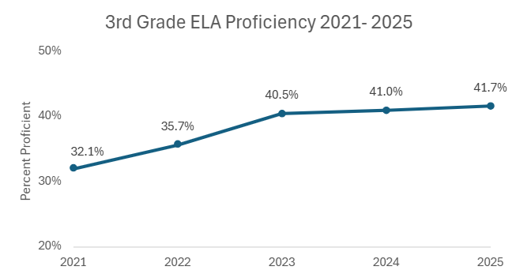
Student Performance Over Time: 3rd Grade ELA

Slide 16
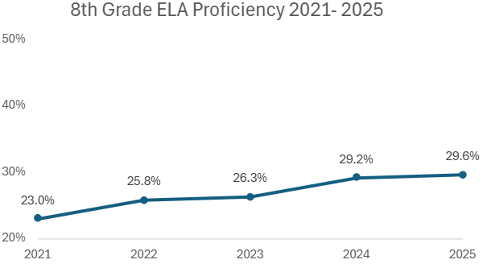
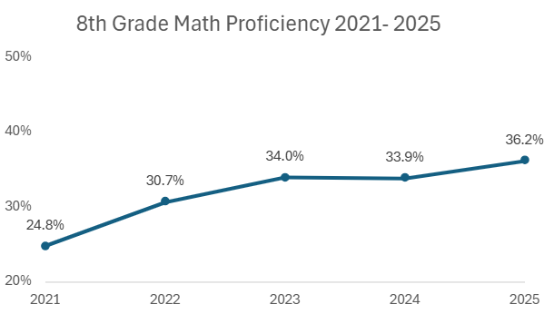
Student Performance Over Time: 8th Grade

Slide 17
Next Steps
Review TISA Outcomes Resources at https://www.tn.gov/education/best-for-all/tnedufunding.html
  TISA Guide
  TISA Professional Development (Outcomes Bonuses)
  Additional Resources (Outcomes Funding Calculator)
We will share a form for you to fill out prior to the next meeting.

Slide 18
Questions?
  For additional questions, contact Caryn.Burkholder@tn.gov.

