Slide 1
The New Look and Feel of Tennessee Career & Technical Education Standards and Textbook Screening Instrument Walkthrough
Publishers’ Pre-Bid Conference
January 12, 2015
Thomas Gibney and Deborah Thompson
Tennessee Department of Education
Notes:
Introductions / say what we do at the division & department

Slide 2
Welcome
Today we’re going to look at some of the key shifts in career and technical education standards revisions.
We will walk through examples and highlight changes to the Human Services, Education & Training, Advanced Manufacturing, and Information Technology career clusters.
Our goal is to provide you with a clear picture of the expectations surrounding the new standards, in order to inform robust textbook development and alignment.
There will be opportunities for group work and Q&A.
Notes:
Here’s our agenda for the next hour. My colleague Deborah Thompson will be doing a deep dive into the look and feel of the standards themselves.

Slide 3
A New Approach to Career & Technical Education
What are the essential ingredients for student success?
Notes:
Briefly, I’ll begin by discussing what we believe about student success. This is important because it informs everything we do at the programmatic level. When we set out to develop standards and sequenced programs of study, we began with these essential beliefs.

Slide 4
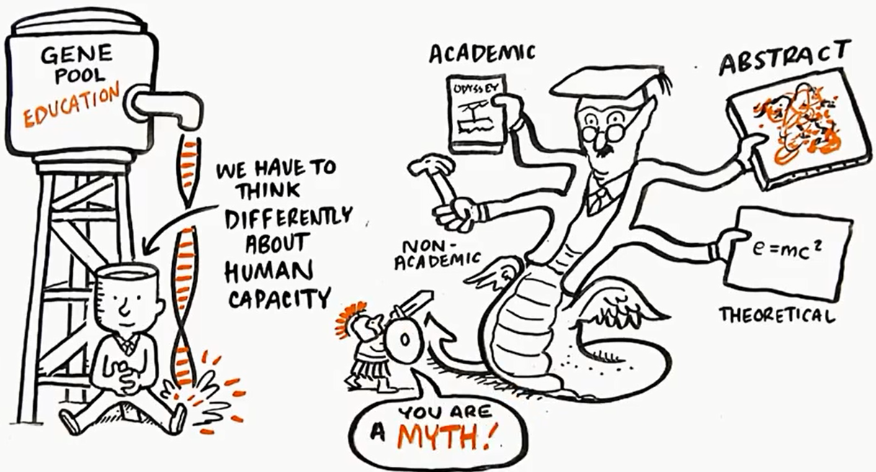
Notes:
**Icebreaker** - Take 1 minute to look at this graphic. Discuss with your table partners what it means to you. 2-3 minutes to discuss as a group.

Slide 5
General Education
Career & Technical Education
DC/DE
Math Courses
STEM
Academic Learning
ELA Courses
Project Based Learning
Career Cluster
Programs of Study
Tennessee
State Standards
Technical Skill Attainment
Social Studies Courses
Science Courses
Writing Prompts
Sequential Courses
Work-
Based
Learning
Citizenship
Industry Certifications
Student Activities
Communication Skills
Problem
Solving
SAE
Standards / Instruction
Assessments
PD / Training
Learning Environment
Technology Fluency
Creativity
Team Work / Collaboration
Work Ethic
Critical
Thinking
21st Century Skills
Robust, Aligned Academic/Career Student Learning Pathway
Notes:
The punchline of that last image? Whether you are a director, a counselor, a teacher, a parent, or a policymaker, most of us can agree that we can no longer afford to view learning in terms of different educational silos; rather, learning must increasingly be viewed as an interconnected process linked by experiences that do not fit neatly in old boxes.

Slide 6
CTE Division: Theory of Action
Realizing Postsecondary & Career Readiness Through CTE
Notes:
The three watchwords that you will hear us use over and over again here are relevant, rigorous, and learner-focused. If we promote a course or a program of study that does not satisfy these three essential components, then we have not done our job to maximize student success.
We also believe that our teachers and directors, if they are asked to use our standards, must be supported and developed instructionally. While this takes many shapes, one part of that puzzle is having access to quality resources and materials. That’s where you come in.

Slide 7
Redefining Student Learning
To meet the needs of Tennessee, our state’s Career & Technical Education must be a Robust, Aligned Academic/Career Learning Pathway
Image Credit: Corporate Voices for Working Families
Realizing Postsecondary & Career Readiness Through CTE
Notes:
When you put it all together, you get this: a braided academic experience that draws on CTE courses, general education courses, and opportunities for career exposure and work-based learning that can feed directly into the future workforce. In other words: a learning pathway.

Slide 8
Student Pathway
Components
Secondary/
Postsecondary
Program
Alignment
Early
Postsecondary
Opportunities
Education/ Career
Transition Supports
Sustainable Student Pathways
Education and Industry Alignment
Rigorous, Relevant Courses and Student Plan
“Data Mining” to Drive Decision Making
Notes:
If we are successful, a sustainable student pathway features many interlocking components—all the essential “ingredients” for student success.

Slide 9
What does a Pathway look like?
RELEVANCE
Work-Based Learning (grades 7-14)
Early Postsecondary Opportunities (Grades 9-12)
Career Awareness (Grades 7-14)
Stackable Credentials (Grades 9+)
High School: Academic Core &
Elective Focus
Career Cluster: Advanced Manufacturing
Program of Study: Mechatronics
Technology College (Industry Certification)
CNC Operator
$35,580
Middle School: Academic Foundation and Career Exploration
Community College (A.A./A.S)
Mechanical Engineering Technician
$50,660
University or College (B.A./B.S)
Mechatronics Engineer
$82,440
SUSTAINABLE
Secondary & Postsecondary Academic Alignment
Industry Engagement
Community Engagement
Robust, Aligned Academic/Career 7th-16th Learning Pathway
Notes:
To illustrate, here’s an example from one of the pathways you’ll be bidding on – the Mechatronics program of study. A student’s preparation for success in careers must be purposeful and progressive, integrating general education, CTE, and 21st Century Skills. Course content and academic experiences must build upon and connect with one another. The pathway a student follows at the high school level is an integral component of the 7-16 pathway, leading into postsecondary programs (certificates and degrees). In many cases, these pathways have “on and off” ramps that allow students to complete one level of postsecondary education, work for several years, then use the “on-ramp” to continue education and training.

Slide 10
Key Shifts in the New CTE Standards
What to pay attention to when developing curricular materials
Notes:
Now that you’ve seen what goes into a robust student learning experience, I’m going to show you how that has translated into the actual architecture of our standards.

Slide 11
Key Shifts
A shift to clear, specific, and measurable expectations for student learning.
Increased focus on rigor in literacy and mathematics within technical contexts.
Sequential progression of knowledge and skills within and across courses.
Notes:
Tennessee’s Career and Technical Education Standards represent a significant shift in the definition of student proficiency within career and technical education environments. Evaluators of materials should understand that the standards replace the proficiency frameworks of years past in three major respects.
I will now break down each of these in more detail.

Slide 12
1. Clear, specific, measurable expectations
The proficiency frameworks of years past relied on lengthy checklists of competencies that were often too procedural for the complex work in CTE courses
The new standards articulate deep knowledge and skill attainment, departing from the competency-based structure of years past
Our standards now describe proficiency at the standards level, often with embedded sample tasks meant to provide teachers with guidance on how to assess student learning
Notes:
No more standard → learning expectations → performance indicators → sample performance task structure; everything you need to know is in the standard statement itself.

Slide 13
Key Shifts: Look and Feel
Retired: Nutrition and Foods
New: Nutrition Across the Life Span
5.0 Demonstrate ability to select, prepare and serve nutritious and aesthetically pleasing foods.
5.1 Examine the effects of various kitchen designs, tools, equipment and technology on food preparation.
5.2 Apply basic food preparation principles when preparing selected foods.
5.3 Identify science principles of food preparation.
5.4 Demonstrate appropriate dining etiquette and table service.
5.5 Plan and evaluate individual and family meals.
6 Analyze a variety of meal plans (including three meals and two snacks daily) that meet nutritional requirements (caloric and RDA) as recommended by the U.S. Food and Drug Administration (FDA). Create a meal plan that addresses the nutritional needs of a specific individual based on their age, gender, activity level and other factors, and justify choices using evidence. Select, prepare, and serve food(s) from the meal plan following recipes precisely, including defining and utilizing specific culinary and measurement terms as needed. (TN Reading 1, 3, 4; TN Writing 7)
Notes:
First, you will see the standards are deeper conceptually and are more cohesive. Many of them do not include specific competencies, rather, are an inclusive expectation for student work that will span multiple days of instruction. This format will reduce the amount of time and effort spent on eTIGER technical skill reporting, as teachers will have far less standards than they are used to and will report on standard proficiency, rather than competency proficiency.
The expectations of the competencies are not lost, rather, more cohesively integrated into an overarching instructional goal. The intent of this comprehensive standard is a deeper conceptual understanding of both the technical and academic content by the student, as concepts will be presented together using real world applications, rather than a check-list of individual tasks, practiced independently of each other.
- Former standards over-emphasized low-level tasks that can be covered quickly by a teacher.
- Former standards gave broad-brush generic statements like “identify science principles of food preparation” without giving enough information or details to the teacher to ensure quality and consistent instruction throughout the state while maintaining a high level of rigor. These were broad-brush generic statements without an outcome.
The over-generalized statements could be rigorous or very low level, depending on the teachers’ interpretation, because of the lack of specificity and expectation setting on what a teacher would use to teach. New standards include higher order thinking, with more specificity for teachers to set expectations for what good teaching to this standard looks like. The new standards offer suggestions for informational text resources such as U.S. Department of Health and Human Services and U.S. FDA.
- New standards include common core aligned language, such as “justify choices using evidence,” “follow steps precisely,” and “define and utilize domain-specific terms” that illustrate to teachers how they can accomplish CCSS standards for literacy in their CTE classroom using their course standards

Slide 14
Your Turn
Take three minutes to read and discuss the following standard at your table. What is clear, measurable, and specific about this standard?
Example: Introduction to Human Studies
Standard 3
Research the development of self-esteem and self-image in individuals. Create a list of factors that promote and hinder the development of positive self-esteem and self-image. Formulate a plan to build/improve self-esteem in a class project or school based project. (TN Reading 2, 5; FACS 12)
Notes:
Elicit responses from the crowd. Resolve any questions that come up before moving on to the next key shift.

Slide 15
2. Rigor in literacy and mathematics
The new CTE standards align to all Tennessee State Standards for English Language Arts and Literacy in Technical Subjects and, where appropriate, select Tennessee State Standards in Mathematics
We are looking for textbooks that can draw out and devote major attention to the importance of literacy in technical contexts; as well as technical applications of mathematics
Strong textbooks will make use of authentic texts appropriate to the industry (i.e., a schematic or a manual in an Advanced Manufacturing class), and provide frequent opportunities for applied writing and math

Slide 16
Here’s an Example
Example: Introduction to Human Studies
Standard 3
Research the development of self-esteem and self-image in individuals. Create a list of factors that promote and hinder the development of positive self-esteem and self-image. Formulate a plan to build/improve self-esteem in a class project or school based project. (TN Reading 2, 5; FACS 12)
TN Reading 2: Determine the central ideas or conclusions of a text; trace the text’s explanation or depiction of a complex process, phenomenon, or concept; provide an accurate summary of the text.
TN Reading 5: Analyze the structure of the relationships among concepts in a text, including relationship among key terms (e.g., force, friction, reaction force, energy).
Notes:
Here’s an example of how literacy skills have been intentionally built into the standards.

Slide 17
Here’s an Example
Measure, weigh, and visually inspect machined parts. Record and compare data to given project specifications using class-defined analysis methods. Interpret and communicate results both written and verbally. If necessary, recommend changes that will reduce the number of product defects during the manufacturing process. (TN Reading 1, 3, 4, 7; TN Writing 1, 4; TN Math N-Q, G-GMD)
TN Math N-Q: Number and Quantity: Reason quantitatively and use units to solve problems.
TN Math G-GMD: Geometric Measurement and Dimension: (1) Explain volume formulas and use them to solve problems. (2) Visualize relationships between two-dimensional and three-dimensional objects.
Notes:
Math example: standard from Principles of Machining I (still in first reading)
What do you notice straight away about this standard?

Slide 18
Your Turn
Take three minutes to read and discuss the following standard at your table. How do you envision this standard covered in an Information Technology Foundations textbook? What literacy supports or examples would you include to aid teacher instruction of this standard?
Drawing on multiple sources (i.e., internet, textbooks, videos, and journals), research the various social, legal, and ethical issues encountered by IT professionals. Using these findings, identify the roles and responsibilities one must consider while developing a prospective project or addressing an IT problem. For example, web developers and programmers must apply copyright laws understand uses of open source software. (TN Reading 1, 4)
Notes:
TG note: Pretty straightforward example from IT Foundations to get everyone thinking, regardless of which textbooks they’ll be bidding on.
After three minutes, let room discuss out loud.

Slide 19
3. Sequential progression of knowledge and skills
The new standards build on each other both within course content and across course levels, arranged within programs of study that culminate in capstone and/or work-based learning experiences for students
Within a course, we want individual standards to serve as stepping stones toward a complete picture of proficiency
Across courses, the collective body of a student’s knowledge and skill should build sequentially to put him/her in a position to be successful after high school
Notes:
This is that pathways piece—rethinking student learning so that knowledge and skills are not acquired in isolation, but as part of a sequenced, logical pathway that leads to multiple entry and exit points across careers.

Slide 20
Student Pathway: Anatomy of Programs of Study
Career Cluster | Program of Study | Level 1 | Level 2 | Level 3 | Level 4
Health Science | Diagnostic Services | Health Science Education | Diagnostic Medicine | Anatomy and Physiology -and/or- Medical Terminology | Cardiovascular Services -and/or- Clinical Internship
Advanced Manufacturing | Mechatronics | Principles of Manufacturing | Digital Electronics | Mechatronics I | Mechatronics II
STEM | Technology | Principles of Engineering and Technology | Digital Electronics | Robotics & Automated Systems | Engineering Practicum -and/or- AP Physics
Agriculture | Agribusiness | Agriscience | Principles of Agribusiness | Organizational Leadership and Communications | Agricultural Business & Finance
 |  | Supervised Agricultural Experience
Robust, Integrated Learning Approach
1. General Education Courses
2. Lab Science Credit
3. Personal Finance Credit
4. Work-Based Learning Opportunities
5. Early Postsecondary Opportunities
(Statewide/Local Dual Credit, Dual Enrollment, AP, etc)
Realizing Postsecondary & Career Readiness Through CTE
Notes:
The division has placed major emphasis on increasing the number of students who complete courses in sequence within a career cluster. The goal: to get more students finishing high school as concentrators (>2) in a CTE elective focus. To that end, we have overhauled our catalogue to streamline courses into logical programs of study. When we talk about pathways, this is what we mean. Pull out Mechatronics as an example.

Slide 21
Level to Level Progression
Principles of Manufacturing (Level 1)
Digital Electronics
(Level 2)
27) Identify and describe the following components of a typical mechatronic system. Select a common machine, such as a robot or a copy machine, to illustrate an example of a mechatronic system. Using supporting evidence from the machine and/or its accompanying schematic, explain why the machine is considered a mechatronic system.
a. Actuators
b. Sensors
c. Digital control devices
d. Input devices
e. Output devices
f. Graphical displays
(TN Reading 1, 2, 4, 7, 9)
19) Consult technical documents (such as data sheets, timing diagrams, operating manuals, and schematics) of digital components (TTL, CMOS, etc.) to develop a troubleshooting methodology for a digital circuit that could be used by a new technician. Create and deliver a presentation demonstrating the troubleshooting procedure for the class. (TN Reading 3, 4, 5, 7; TN Writing 2, 4, 9)
Notes:
In level 1, we’re just explaining what a mechatronic system is and describing examples. In level 2, we build on that to develop an original troubleshooting methodology.
Explain to the group that programs of study will be handed out to accompany their screening instruments.

Slide 22
Another Example
Fundamentals of Education
(Level 1)
Teaching as a Profession I
(Level 2)
10) Compare and contrast physical, emotional, cognitive, and social milestones of development
from toddlerhood through adolescence. Research and summarize, in an informative narrative, specific psychological theories about human development. Illustrate the differences in major
developmental theories and milestones. (TN Reading 1, TN Writing 1; TN Psychology;
FACS 12)
2) Illustrate the stages of human development and the corresponding elements of effective instruction at each stage via graph, chart and/or illustration. Prepare an accompanying
informative narrative to demonstrate knowledge of how students learn and develop at each stage. Provide examples of opportunities that support intellectual, social, and personal development. (TN Writing 2, 8, 9; TN Psychology; TN Sociology; FACS 4, 12)
Notes:
In level 1 course, students are comparing and contrasting the different milestones of development and theories of human development. In level 2, students are challenge to apply previous knowledge & understanding of human development to correlate and select the correct instructional strategies to meet a certain educational need of a group of students.

Slide 23
Pulse Check
Can someone articulate for me what a program of study is under Tennessee’s new standards framework?
Why is it important for students to take courses that follow programs of study?
How will this knowledge impact your approach to the design of textbooks and other curricular supports?

Slide 24
The New Look and Feel
Digging deeper into our standards documents and language
Notes:
Deb: We’re now passing around handouts of a sample course description document, Nutrition Across the Lifespan. In our remaining time before the break, we’ll dive into how this document is structured and how you can use it to help develop your resources.

Slide 25
New Course Description Documents: Overview
The new standards are best thought of as a framework for student learning and a roadmap for teachers to design quality lessons at a pace appropriate for the learning context of each specific classroom.
They outline what students should know and do upon completion of the course in order to achieve proficiency in the subject matter…
…and be sufficiently prepared to pursue all the options available to them when they graduate from their chosen POS: postsecondary, career entry, advanced training, industry certification, and more.
Notes:
Highlight some of the feedback we heard from teachers and why we made the changes we did:
Wanted more information in one place, to assist students and parents with course choice and assist counselors with scheduling
Reduction of eTIGER reporting by focusing on standards not competencies
Higher rigor to push all students to postsecondary and career readiness (our responsibility)
Give specific examples and ideas, which were requested by new and occupationally licensed teachers, while still allowing for flexibility requested by veteran and traditionally prepared teachers.

Slide 26
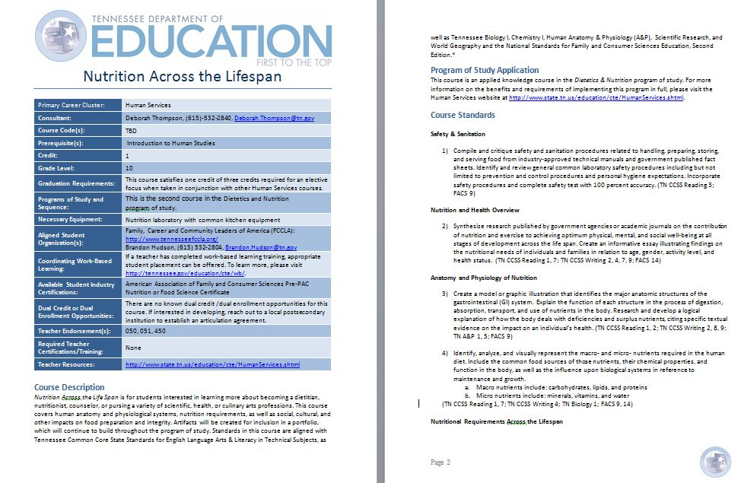
New Course Description Documents: Overview
Notes:
So, what do these courses look like when you get down to it? The first thing you will notice is the look and feel of the course descriptions are very different. Let me walk you through them. Everyone get out a copy of a course description document from your folders and follow along.
(Counterclockwise from top left):
1: Important information can all be retrieved at-a-glance on the cover page: recommended prerequisites and credit, grade level, aligned student organization, work-based learning and dual credit/enrollment opportunities, and more. 2: The “Course Description” paints in detail the picture of proficiency that successful students will attain upon completion of this course, in addition to listing applicable standards alignments. Rather than just tell you about the course in general, we wanted to clearly describe what a student who successfully completes this course will know and be able to do. This is the first guidepost for a CTE teacher to set the expectation for what this course should look like in the classroom.
(Clockwise from top right):
3: The “Program of Study Application” portion describes the proper sequence in which the course resides, and will link the teacher to a website with other important information about that program of study – such as the other courses, equipment, and resource lists to use in the classroom. 4: The course standards begin after that, with content-area headings that group topics, skills, and knowledge into similar bins, to assist with unit planning. While the standards are listed in the order estimated to flow most logically, the sequence presented here is not prescriptive; the standards allow for customized pacing and presentation of the material in each course, according to the discretion of the teacher. The subject area headings will assist in planning, but standards do not have to following one after the other, like a check-list. Many standards will include in-depth understanding that can only be shown through longer-term projects.
Finally, at the end of the course, you will see that we also align our courses to common core state standards for literacy in technical subjects, general education courses (where appropriate), and national standards for each cluster, such as those promoted by the National Council for Agricultural Education. This national organization will provide additional resources, materials, and ideas that you can search through more quickly and implement in your classroom. Have folks flip to the end and put their finger on this section.

Slide 27
Within the document, content headers group like standards together

Slide 28
New Course Description Documents: Look and Feel
Nutrition Across the Lifespan
5) Accurately read, interpret, and communicate understanding of guidance from the U.S. Food and Drug Administration (FDA), and other regulators, such as nutrition labels and daily value recommendations using accurate symbols, key terms, and other domain-specific words and phrases. (TN Reading 4; FACS 9, 14)
7) Analyze a variety of meal plans that meet nutritional requirements (caloric and RDA) as recommended by the U.S. Food and Drug Administration (FDA). Create a meal plan that addresses the nutritional needs of a specific individual based on their age, gender, activity level and other factors, and justify choices using evidence. Select, prepare, and serve food(s) from the meal plan following recipes precisely, including defining and utilizing specific culinary and measurement terms as needed. Practice proper serving and etiquette principles during appropriate situations. (TN Reading 1, 3, 4; TN Writing 7; FACS 9, 14)
Notes:
Next, you will see that rather than offer general theories, we often provide examples, specifics, and details. We anticipate this will assist teachers with designing instructional activities, but we don’t want to limit a teacher’s creativity. Ultimately, we want to set a clear bar for student work by offering examples of what a student should be able to do, but know that it is up to a teacher to reach that expectation in the way that best fits her students needs. Many of the examples will allow for regional interpretation – and we encourage teachers to use examples as models to design the best activities for their particular population.
At the bottom of the standard, you will see we have aligned each standard to the Common Core State Standards for Literacy in Technical subjects as well as Tennessee general education courses. This is two fold: (1) First, we wanted our CTE teachers to be prepared to fully implement common core, without teaching from two separate sets of standards. By teaching the course as written, our teachers will cover all of the expectations they have in reading and writing. (2) Second, academic integration is part of our quality program indicators, and while it has been an expectation of our teachers, we haven’t given our teachers the tools they needed to accomplish this. With these alignments, specific standards are now connected and will provide a roadmap for how educators can collaborate with their colleagues on specific academic concepts and meet their QPIs.
Finally, at the end of the course, you will see that we also align our courses to national standards for each cluster, such as those promoted by the National Council for Agricultural Education. This national organization will provide additional resources, materials, and ideas that you can search through more quickly and implement in your classroom. Have folks flip to the end and put their finger on this section.

Slide 29
Your Turn
Course Description Document Read-Through
Take 3 minutes to skim through the full course description document for a course in your folder. Get out a pen and take notes using the following conventions:
? I have a question about this.
* This will be important for me.
Notes:
After the three minutes, call on volunteers to walk through each (question, important) and answer any questions they bring up.

Slide 30
Ultimately, how do we ensure that our students experience rigorous and robust learning pathways that provide real options upon graduation?
Notes:
Thanks for a great first discussion this morning. Before we break, let’s take a step back to the big picture again. Remember the ultimate goal here is to empower students to make real choices. You, as publishers, are essential partners in reaching this goal. Thank you for helping us provide the options and materials that are in the best interests of students.

Slide 31
Questions before we break?
Notes:
Should be about ~10:15 now. Questions from the audience?
We’ll be back at 10:30 to walk through the screening instrument.

Slide 32
Part II: Screening Instrument Walkthrough
Notes:
Welcome back. We’ll take the next hour to go in depth into one of the screening instruments that will be used to evaluate prospective materials.
We have ample time devoted to discussion here, so please voice questions as they come up.

Slide 33
Before We Begin…
There are several things to know about the screening instruments prior to jumping in.
First, there is more than one. In a similar way that last year’s math instruments were differentiated by middle grades, high grades, and advanced topics, CTE screening instruments for Section A subjects have mostly been developed by program of study. (There are a few exceptions.)
Second, all instruments include three non-negotiable components: (1) focus, (2) rigor, and (3) postsecondary and career readiness.
Third, negotiable components vary by program of study. Because of the great variation in CTE subjects—even within career clusters—screening instruments have also been developed to be sensitive to the curricular needs of each program of study.

Slide 34
There are 12 total instruments for Section A
Advanced Manufacturing (x4) | Machining Technology
 | Electromechanical Technology
 | Mechatronics
 | Welding
Information Technology (x3) | Programming & Software Development
 | Networking Systems
 | Web Design
Human Services (x3) | Childhood Development Services
 | Social Health Services
 | Dietetics & Nutrition
Education & Training (x1) | 1 for all POS
+ 1 for aligned Middle School CTE courses

Slide 35
Example: Mechatronics
Take a few moments to glance at the screening instrument as we’re passing it out.
This instrument is aligned to the Mechatronics program of study (POS) in the Advanced Manufacturing career cluster.
Notes:
Pass out Mechatronics.

Slide 36
Walkthrough
We’re going to walk through each section of the instrument and discuss its negotiable and non-negotiable components, as well as the scoring system associated with each.
Please raise questions as they come up. Feel free to mark up your copy with the conventions we used this morning:
? I have a question about this.
* This will be important for me.
Order of the rubric:
Section I: Non-negotiables
Section II: Negotiables
Section III: Focus area (optional)
Notes:
Pass out Mechatronics.

Slide 37
Section I: Non-negotiables
Take 5 minutes to read this section on your own.
Focus
Rigor
Postsecondary and Career Readiness
**Aligned materials must meet all three non-negotiable components in order to be eligible for consideration!**
Notes:
After five minutes, walk through each component.

Slide 38
Section II: Negotiables
Take 5 minutes to read this section on your own.
Additional Alignment Criteria
Sequence and Progression of Standards
Teacher Supports
Usability
Assessments
Notes:
After five minutes, walk through each component.

Slide 39
Section III: Focus Area
This is an optional section of the instrument designed to capture qualitative observations on an additional area of focus, if presented in the materials.
For example, a Mechatronics textbook (or suite of textbooks, spanning multiple grade levels) could have a distinct focus in robotics. The instrument allows reviewers to recognize such a focus as a distinguishing aspect or additional value offered by this book.
Notes:
Very short; no need for private reading time. We will jump right in and talk as a group.
For those of you who will be bidding on Mechatronics, what are some other possible focus areas you can think of? How about some of the other subjects, like Dietetics & Nutrition?

Slide 40
Table Time
Now that we’ve walked through a sample instrument, take some time to discuss at your tables. Some key questions you may want to consider include the following:
How does the design of the instrument impact how we will approach drafting our materials?
What questions do we have about the individual components? About the scoring system?
What resources will we consult to develop our textbooks? Given the emphasis on literacy in technical contexts (and, where appropriate, on math), how will we support teachers with the activities and texts we include in our materials?
Notes:
At this time we will also pass out a second example for comparison: Dietetics and Nutrition from the Human Services cluster.

Slide 41
Final Q&A
Notes:
We’ll take your questions until 11:45, when we’ll break for lunch.

Slide 42
Thomas Gibney
Program Manager, Student Success
Division of Career and Technical Education
Tennessee Department of Education
Thomas.Gibney@tn.gov
(615) 253-3223
Deborah Thompson
Career Cluster Consultant
Division of Career and Technical Education
Tennessee Department of Education
Deborah.Thompson@tn.gov
(615) 532-2840
www.tn.gov/education/cte
www.TNCore.org

