Slide 1
EPC Contracts Module Training for TN Applicants
Funding Year 2016
Kim Friends, TN State E-rate Coordinator

Slide 2
Access Your Options!

Slide 3
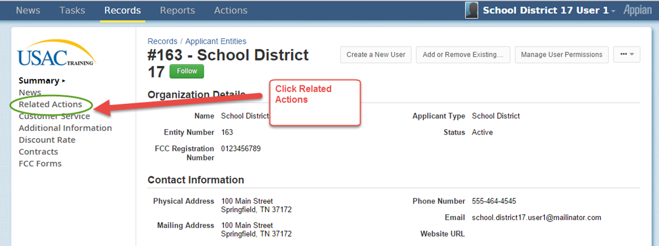
Select from side menu

Slide 4
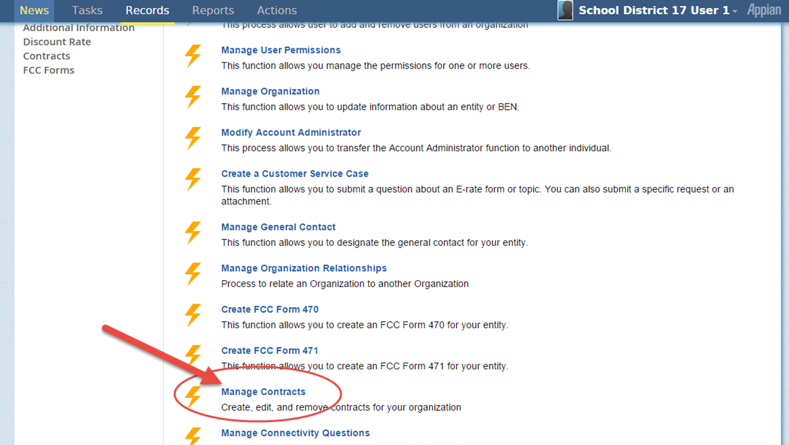
Select “Manage Contracts”

Slide 5
Select “Add a New Contract”

Slide 6
Enter a “Nickname”

Slide 7
Decide whether you wish to upload a copy of your contract

Slide 8
CAUTION!!!!
If you decide to upload the physical contract, note that you can only upload ONE DOCUMENT so if you have multiple documents that comprise your contract, be sure to PDF them all together before you upload
At this time, you CANNOT edit a contract record once it has been submitted

Slide 9
Designate what kind of contract

Slide 10
More contract type designation

Slide 11
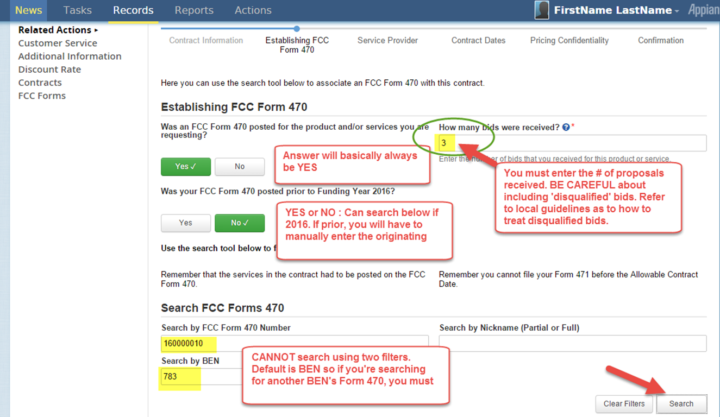
Form 470 and other details

Slide 12
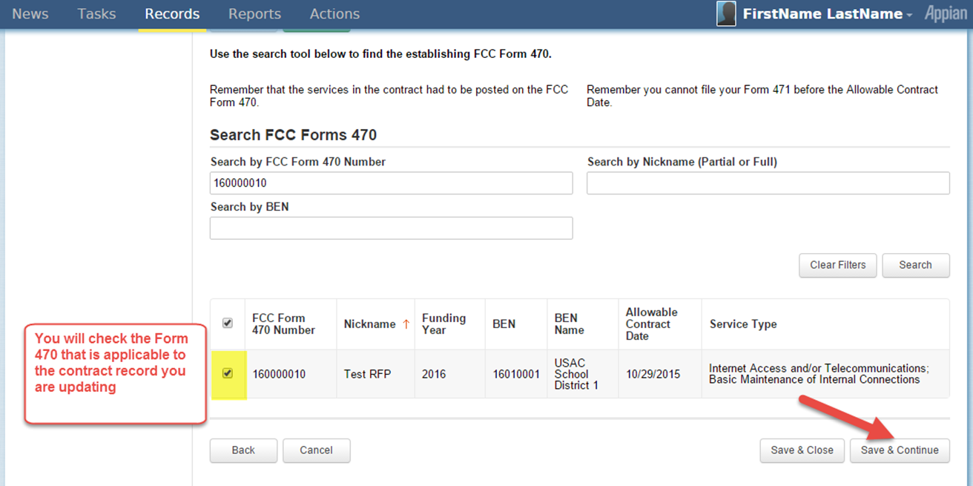
Select correct Form 470

Slide 13
Find your SPIN (498 ID)

Slide 14
Add your Contract Award Date

Slide 15
Contract Extensions?

Slide 16
Pricing Confidentiality

Slide 17
Confirm Details and Complete (1 of 2)

Slide 18
Confirm Details and Complete (2 of 2)

Slide 19
Questions?

