Slide 1
E-rate Category 2 Training for TN Applicants
Funding Year 2016
Kim Friends, TN State E-rate Coordinator

Slide 2
Agenda

Slide 3
Agenda: Category 2
Funding Availability
Discount Calculations - 5-Year Budget Caps
Equipment/Service Eligibility
Competitive Bidding
  Do’s and Don’ts
  EPC/new Form 470
New EPC Contract Wizard Requirement
Timeline for Bidding/Applying
After the FCDL...
  Purchase Orders
  Invoicing
  Inventories
  Maintenance records
  Moving equipment
  Equipment substitutions
Purchasing equipment prior to FCDL

Slide 4
Category 2
Internal Connections
Basic Maintenance of IC
MIBS

Slide 5
Category 2 Overview
Category 2 (previously called Priority 2) funds Wi-Fi and related infrastructure and equipment inside buildings
  And between buildings if schools are located on the same campus
Technology plans are no longer required
Intention is to have all schools obtain Category 2 funding over a period of 5 years (rolling 5 year period)

Slide 6
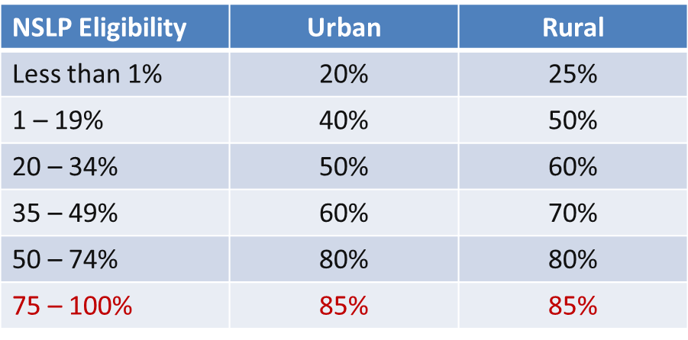
Category 2 Discounts
District-wide simple average calculation for both C1 and C2 requests (no more weighting)
Every school in the district receives the district-wide discount
Maximum C2 E-rate discount is now 85%. All other discount bands remain the same:

Slide 7
Will There Be Funding Available?
Yes
Yes
Yes
FY 2016 cap will be $3.913 billion + additional $1 billion that has been set aside for C2 + inflation adjustment, bringing available funds to over $5 billion
FCC has stated that they will fully fund all eligible C2 requests, regardless of demand

Slide 8
Category 2, 5-Year Budget Caps
Each school is entitled to a pre-discount cap of $150 per student, or a minimum building cap of $9200, over a rolling five years
  Schools with part time students calculate budget based on maximum density at one time during the day
Money is allocated per school (not on a shared-district basis), and applicants cannot move funding from one school to another
Money must be spent during funding year (cannot apply for full budget and spend down over multiple years)
  FY 2016 = April 1, 2016 – September 30, 2017
  There is no provision to allow applicants to spend funds and be reimbursed in a later year
Can use school’s entire budget all in a single year or can apply over multiple years

Slide 9
Category 2 – Enrollment Anomalies
If enrollment increases, you receive benefit of extra students next year
If enrollment decreases, you aren’t required to pay back funds
New schools may estimate the number of students who will be attending the new school and seek funding based on that estimate
  However, if an applicant overestimates the number of students who enroll in that school, it must return to USAC by the end of the next funding year any excess funding based on the actual number of enrolled students
Students who attend multiple schools, such as those that attend vocational schools part-time, may be counted by both schools in order to ensure appropriate LAN/WLAN deployment for both buildings

Slide 10
Category 2 Funding Budgets (Cont’d)
All competitive bidding requirements will continue to apply and applicants can only apply for what they need
Form 471 application is required to be submitted each year

Slide 11
Category 2 Funding Budgets - NIFs
Non-Instructional Facilities (NIFs) don’t have C2 budgets because there is no student population
If equipment is located in the NIF and serves a school(s), that school (or those schools’) budget can be used to fund the equipment.

Slide 12
Category 2 Budgets
Any funding commitments that include a school or library as a recipient of service in that funding year will count against your pre-discount budget for that entity
If not all committed funding is spent, you can file a Form 500 to return the remaining unused commitment to USAC
If entities are sharing the service, USAC will need specific information so that they know how to apply the returned funds to specific entities
C2 Budget Calculator: https://sltools.universalservice.org/portal-external/budgetLookup/

Slide 13
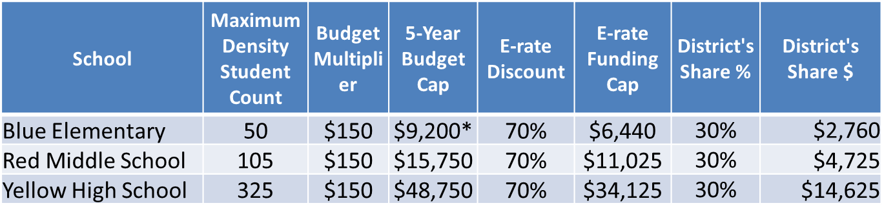
Category 2 Funding Budget Example
The Budget Cap is the pre-discount price. E-rate discounts will then apply on top of the budget cap.
In this example, district would still owe 30% non-discounted share.
* Although 50 x $150 = $7,500, the minimum floor is invoked because school has less than 62 students

Slide 14
What’s Eligible and Not Eligible for
Category 2 Funding?

Slide 15
Category 2 Eligible Items
Access Points
Cabling
Caching Servers *new*
Firewalls
Network Switches
Antennas
Routers
Racks and UPSs
  That support eligible equipment only
Wireless LAN Controllers
Improvements, upgrades and software necessary to support eligible broadband internal connections components
Basic Maintenance Services for eligible equipment
Repair of equipment, cable maintenance, basic tech support, configuration changes
Cloud-based functionality of this equipment

Slide 16
Category 2 Ineligible Items
Gateways
Servers (except caching)
Software
Storage Devices
Telephone Components
Video Components
VOIP Components
End-User Devices

Slide 17
Category 2 Eligible
Managed Internal Broadband Services (MIBS) which cover the operation, management, or monitoring of a LAN or WLAN (wired or wireless)
  Could also include the leasing of equipment
  Paying an outside vendor to own/maintain the equipment
  Paying an outside vendor to maintain school-owned equipment
Eligible for pre-discount $30/year/student
  Uses the same pre-discount budget as Internal Connections

Slide 18
Category 2 Eligibility, etc...
Installation and configuration are eligible
  Do not have to be provided by the same vendor (new)
Also eligible:
  Taxes, surcharges and other similar reasonable charges
  Shipping charges
  Training on how to use eligible equipment
Multi-year licenses are eligible and can be requested in full in first year
Eligible equipment may be purchased and/or installed on or after April 1 prior to the beginning of the funding year
  Must be purchased/installed before September 30 of the following year

Slide 19
Category 2 Procurement Options/Requirements

Slide 20
New EPC Contract Wizard Requirement
All C2 requests must have signed contracts
All contract information must be uploaded into EPC prior to completing the Form 471
  All contract related information (470 #, contract signing dates, extension information (if applicable) vendor’s SPIN, etc.) will be populated outside of 471 in EPC
  Then just refer to that contract in the 471
  Contract can be as simple as a vendor quote that is signed by the school. Be sure to include:
    Contract signing date (must be before 471 filing date)
    Contract term: 4/1/2016 through 9/30/2017
    Purchase is contingent upon E-rate funding and local funding approval

Slide 21
E-rate Bidding Requirements
Applicants should not contact a potential vendor ahead of bidding to seek equipment list (E-rate rule)
  Service providers are allowed to answer general questions about the products and services they sell in response to applicant inquiries, but they may not prepare any part of a RFP or spec sheet that will be used by the applicant for conducting a competitive bid procurement.
  If you don’t know exactly what equipment you need, list general equipment needs (i.e.; wireless controller, WAPs for 35 classrooms, and installation), and then perhaps offer a site walk-through

Slide 22
E-rate Bidding Requirements (cont.)
Equipment list MUST allow for equivalent manufacturer’s products to be bid (E-rate rule)
  “Cisco 48-port PoE Switch or equipment that is equivalent in functionality and quality”
  May include a requirement that equivalent equipment must be fully compatible with District’s existing <manufacturer name> equipment

Slide 23
Category 2 Bidding Options
Form 470
Form 470 (and RFP if necessary)
  Must list “or equivalent” if listing manufacturer’s name or model # on Form 470
TEBC Contract
Before TEBC Form 470/RFP was released in December 2015, each district (and some charters) signed a “Letter Of Agency” permitting the Tennessee Education Broadband Consortium to competitively bid on your behalf

Slide 24
Category 2 Bidding: 470 plus RFP
Post Form 470 and RFP
  Form 470 and RFP process must be done concurrently and bidding window required to be open for at least 28 days before bids are due (E-rate rule)
  Be sure to follow local bidding guidelines to ensure compliance
    May need to advertise in local newspaper, etc.
  Evaluate proposals and select a vendor
  School board will likely have to approve contract prior to signing
    Contract must be signed before submitting Form 471
  If issuing an RFP, it MUST be uploaded at the time the 470 is posted
    All addenda also must be uploaded to the EPC Portal at time of issuance

Slide 25
New Form 470 for FY 2016
Form 470 is new and must be filed in EPC
  Different than previous years
    Much of “profile/contact” information is ported from EPC profile
EPC Full and Partial Rights Users can create the form
  Partial Rights Users can create but must have Full Rights User submit/certify the form
  “Submit” and “Certify” are the same process now – NO MORE PINS
Form 470s being accepted now!
  If 471 window closes April 29, 2016 then the ABSOLUTE last date to post a Form 470 would be April 1, 2016 – DO NOT WAIT!!!!
Form 470 Receipt Notification Letter will no longer be mailed
  Instead, a notice of the 470 posting/certification will appear in your EPC Newsfeed

Slide 26
EPC Form 470 Screens

Slide 27
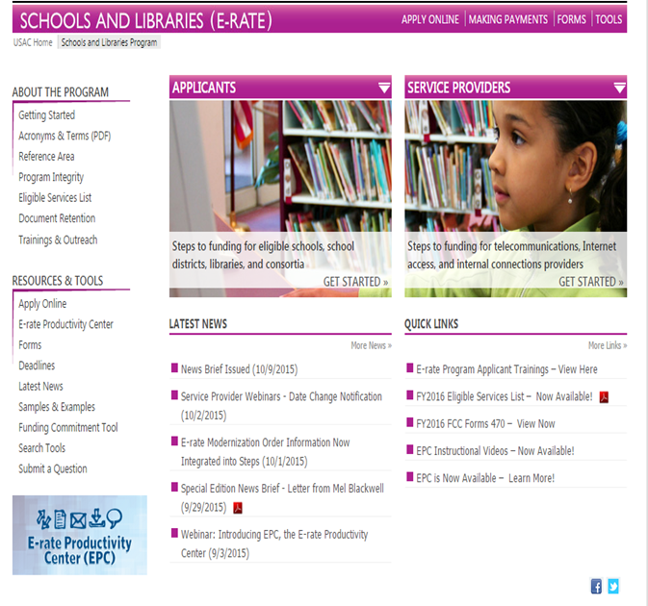
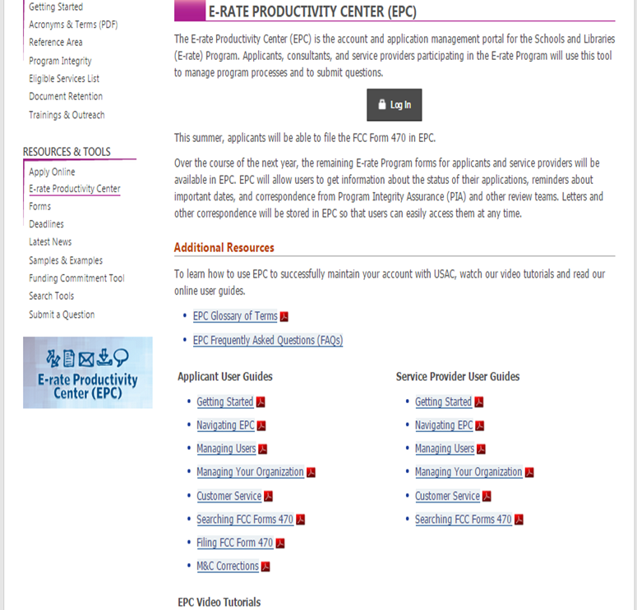
Accessing EPC for 470 Postings

Slide 28

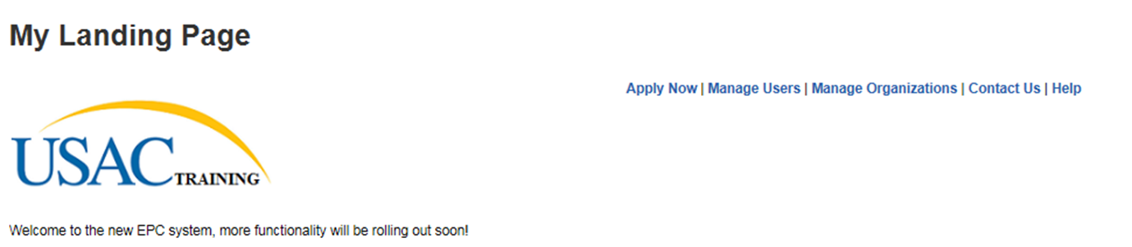
Landing Page

Slide 29
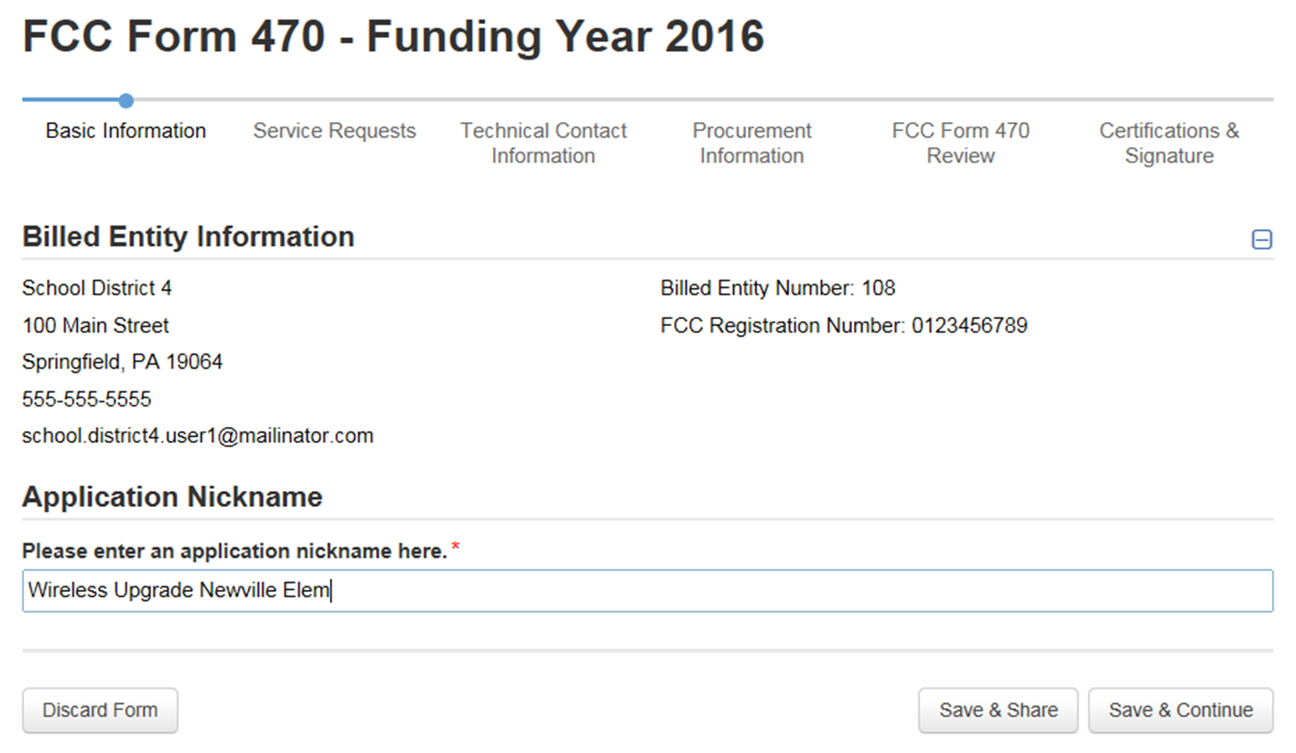
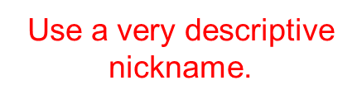



Slide 30
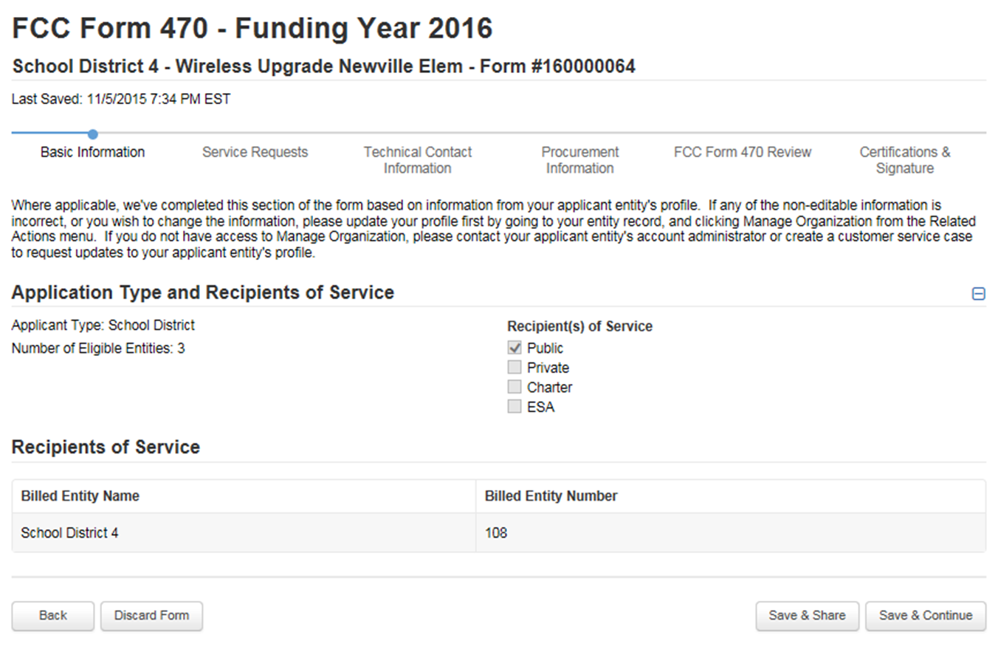


Slide 31
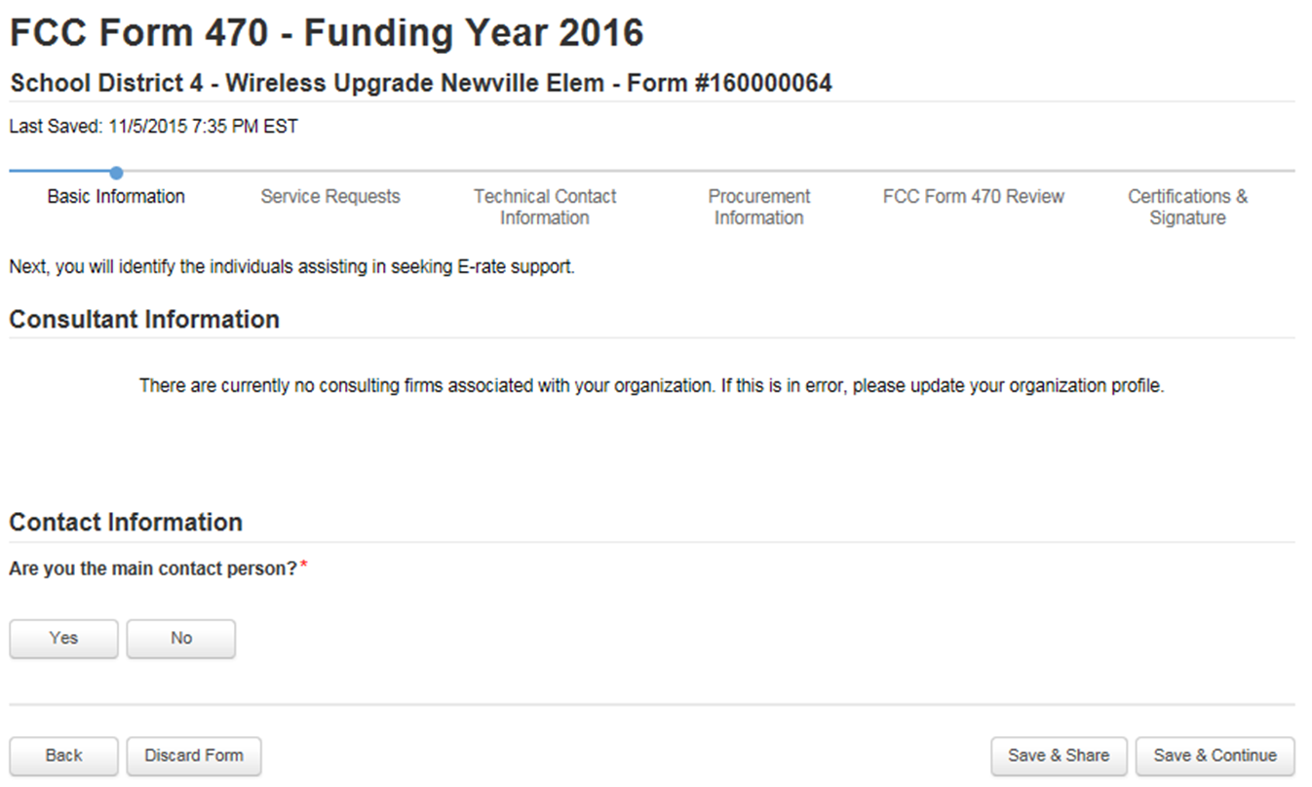

Slide 32
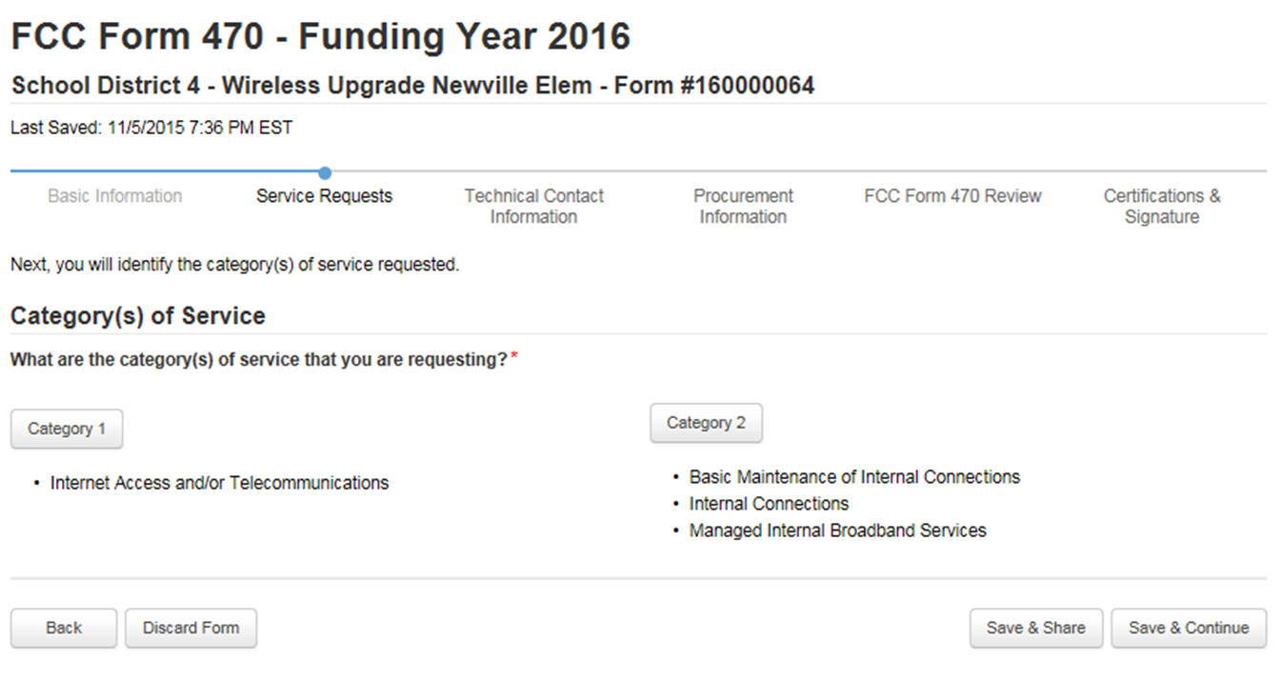


Slide 33
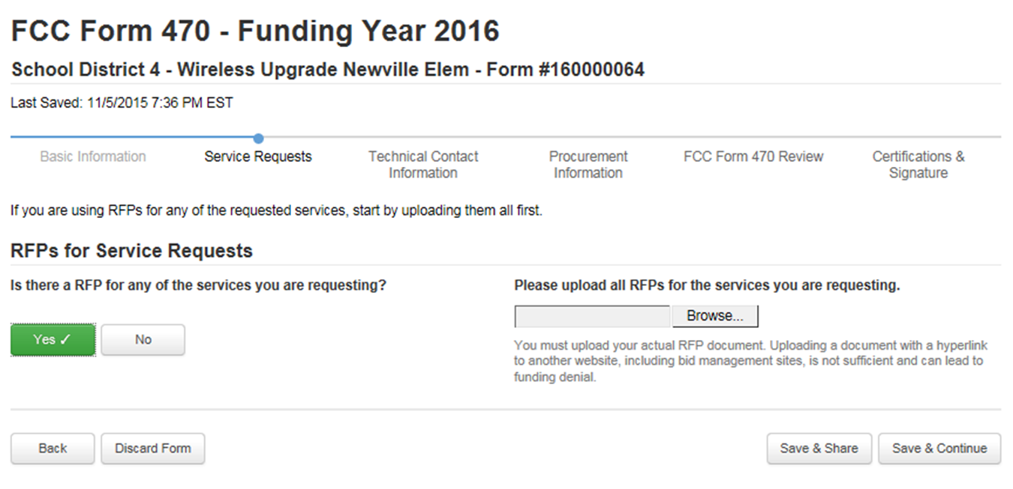

Slide 34
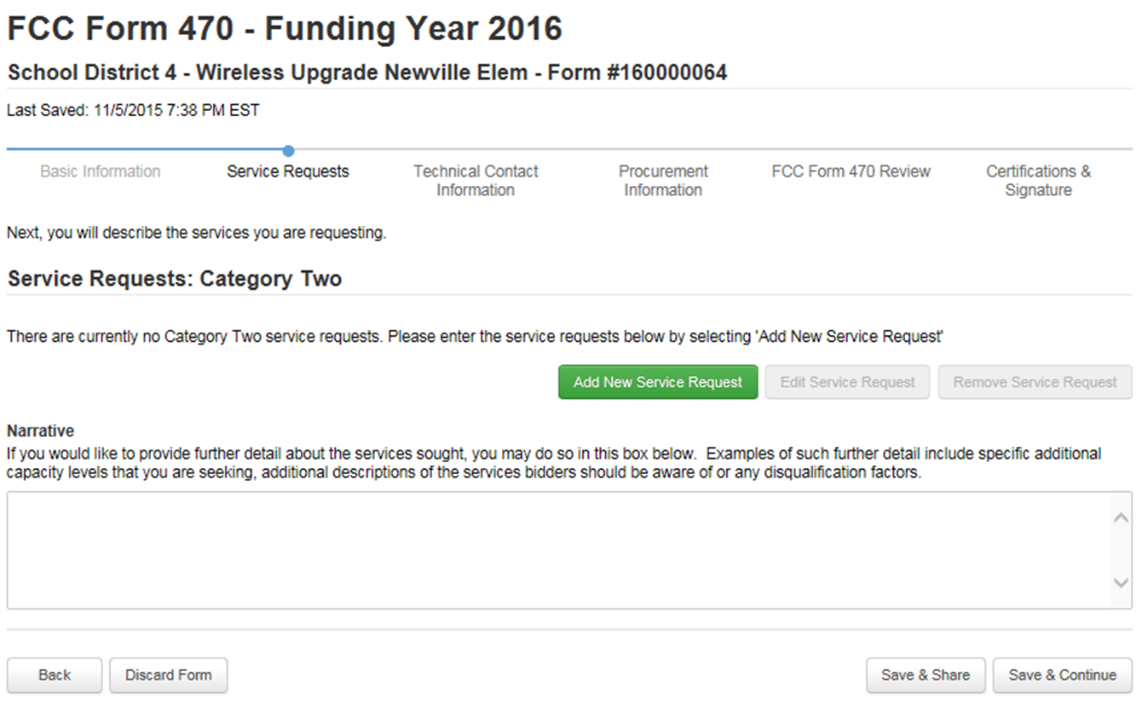

Slide 35
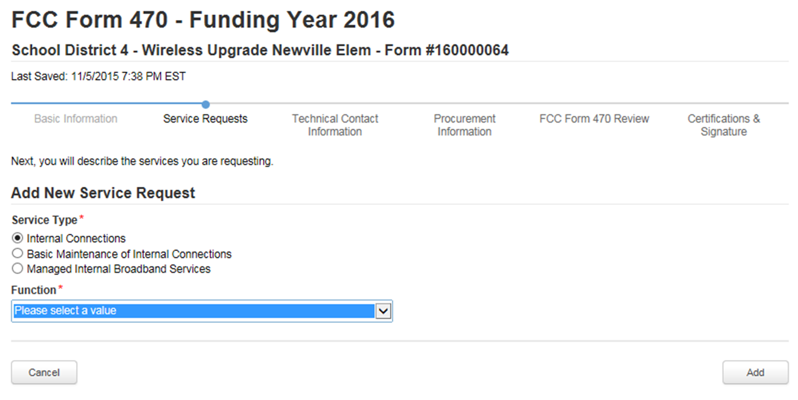
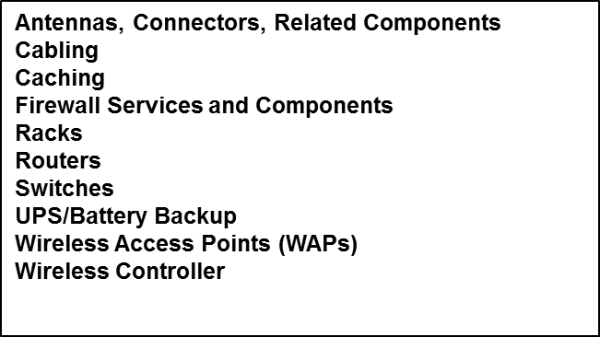

Slide 36
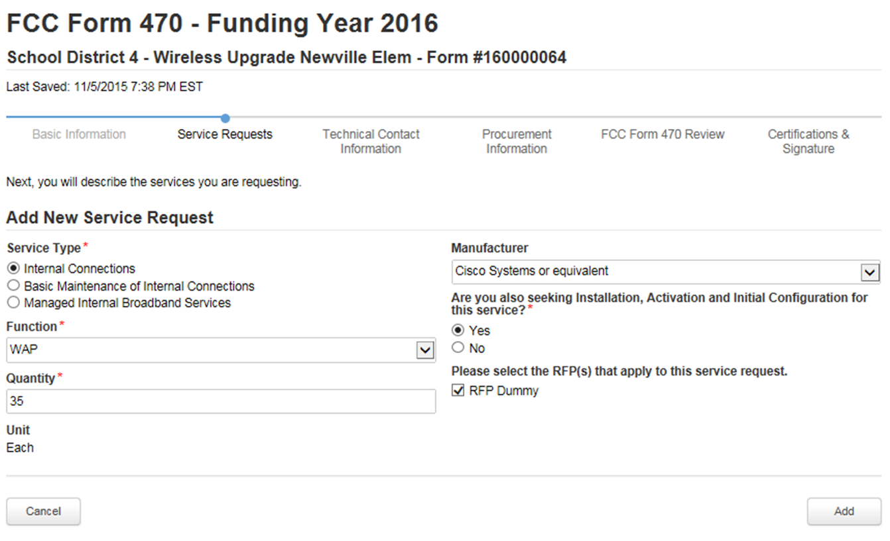

Slide 37
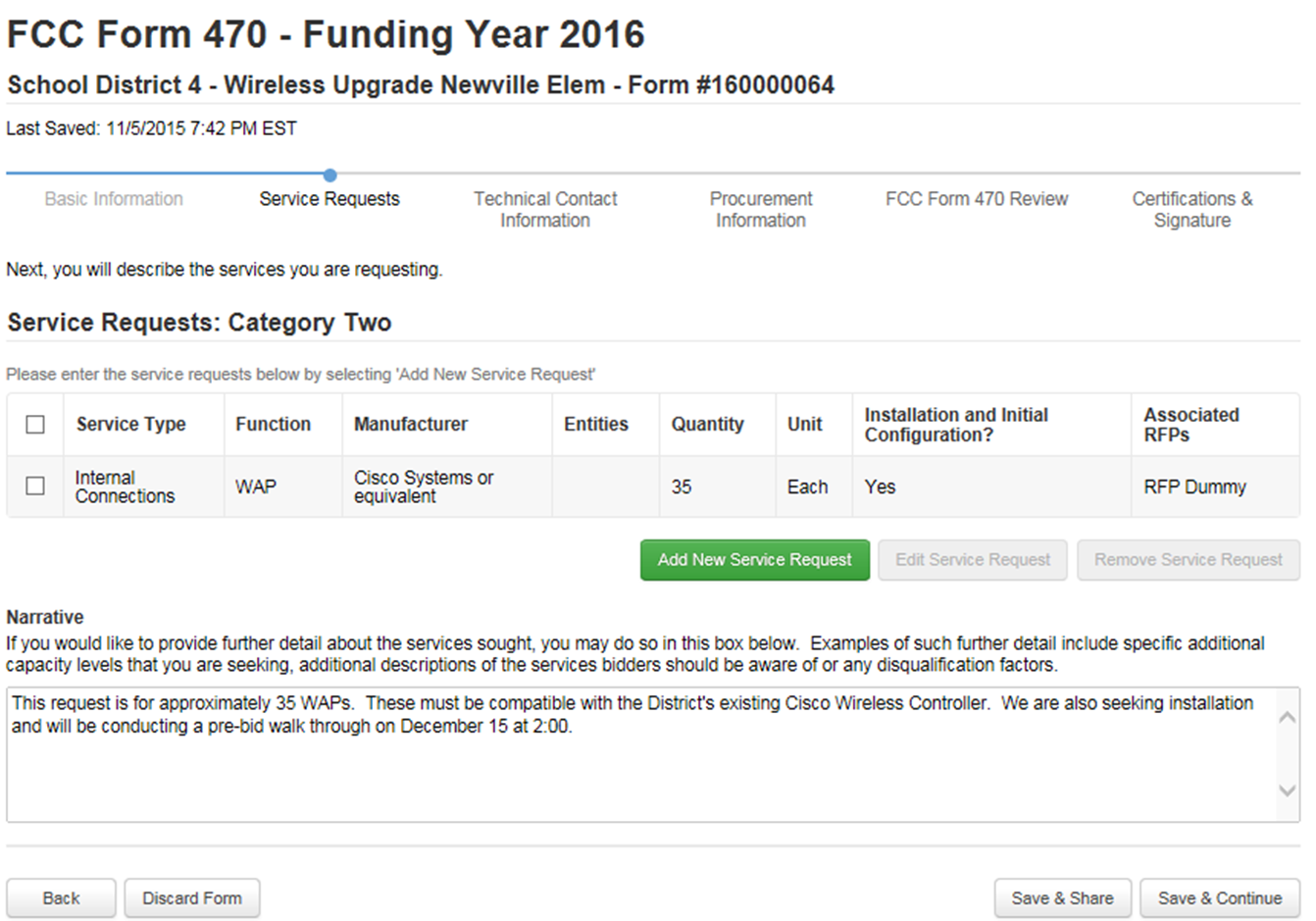
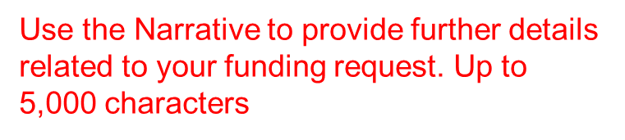


Slide 38
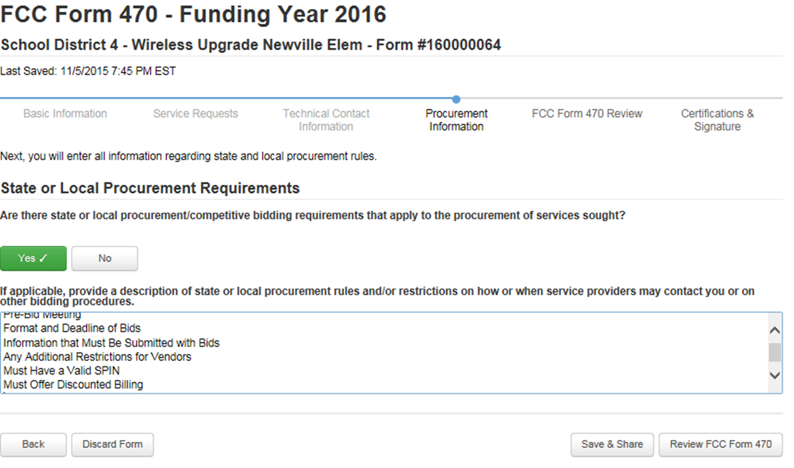
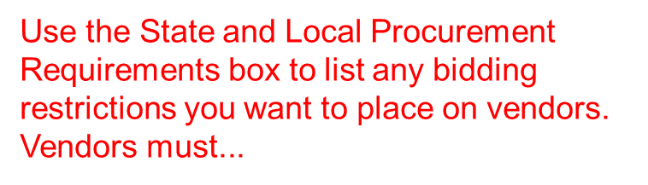


Slide 39
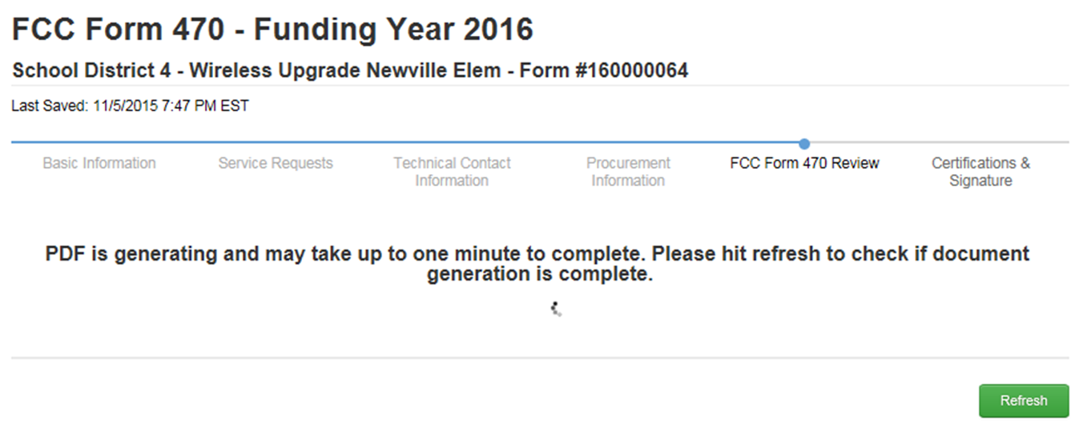


Slide 40
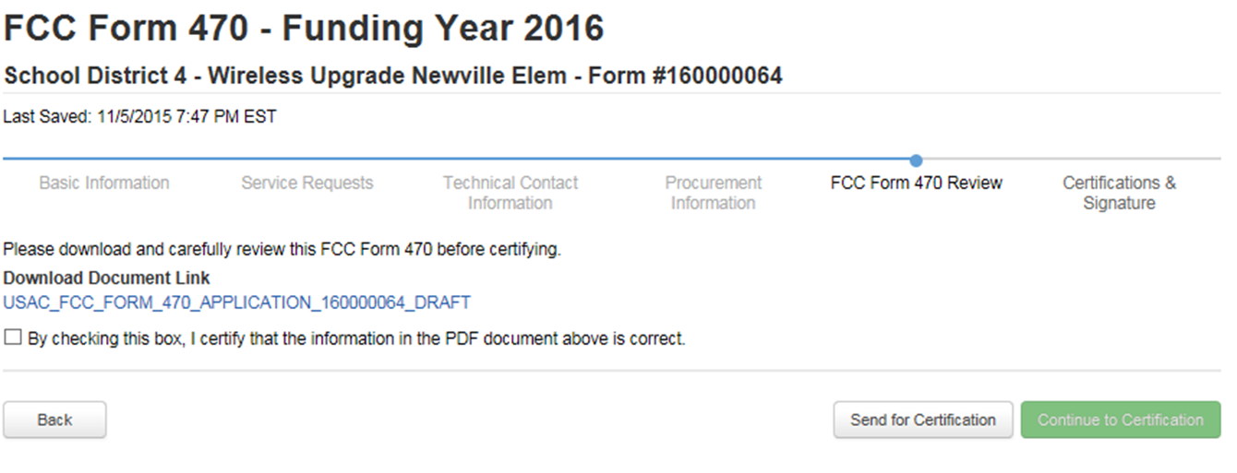



Slide 41
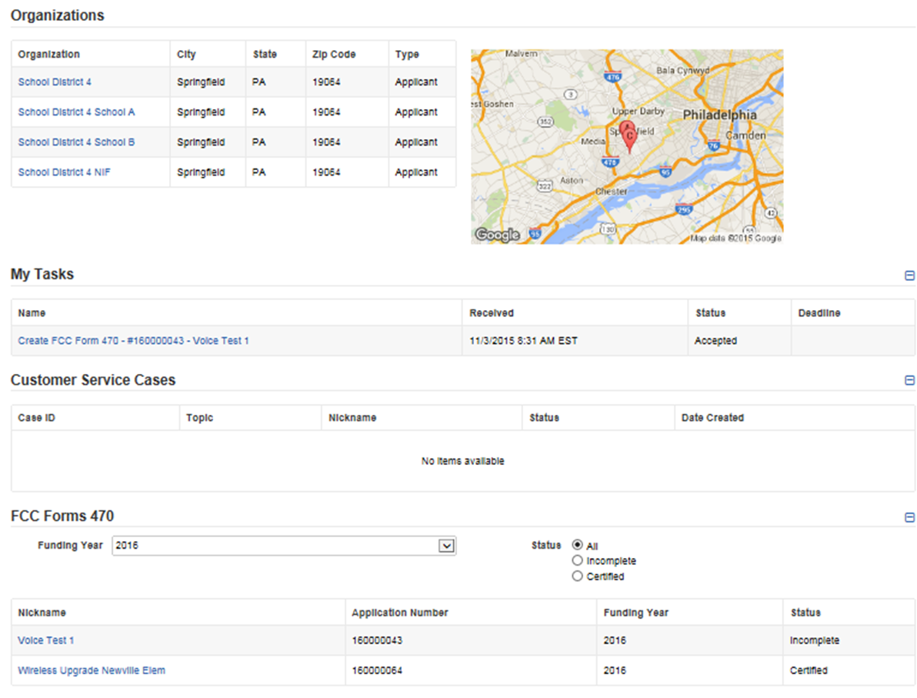


Slide 42
Category 2 Bidding: Option
Conduct TEBC Mini-Bid
  Refer to our mini-bid presentation

Slide 43
Purchasing Prior to FCDL...
May purchase Category 2 equipment as early as April 1 prior to the start of the funding year—even with no FCDL
  Only make early purchases if they are NOT contingent on E-rate funding and you plan to pay for your equipment in full and seek E-rate reimbursement after your Funding Commitment Letter arrives
CANNOT Submit Form 486 until AFTER the FCDL arrives
Submit Form 472 BEAR to USAC once your FCDL arrives, and after you have paid your vendor invoice.

Slide 44
After the FCDL Arrives....
Purchase Orders
  One PO for each FRN (if possible)
Submit the Form 486!
Invoicing (applicant choice of discounted bills)
  After equipment received/discounted portion paid
Create and Maintain Asset Inventory
Maintenance records
  Require detailed invoices (what, when, where)

Slide 45
Equipment Transfer Rules
Equipment MUST stay at the location indicated on the Form 471 for a period of three years after the date of purchase
  After that, the equipment can be transferred to other eligible entities
  Asset Inventory must be updated
If a location closes within three years, equipment from that closed location can be transferred to another eligible entity
  USAC must be notified of such equipment transfers using the Form 500
  Asset Inventory must be updated
After five years from the date of installation, equipment can be disposed of, sold, transferred, traded, etc. with no USAC notification required
  If equipment is sold, no funding is required to be returned to USAC

Slide 46
Equipment Substitution Rules
To change approved equipment, either due to clerical error on your Item 21, or because the vendor is now substituting a newer/different model number, you must submit what USAC refers to as a "Service Substitution Request"
Service Substitution must generally have the same functionality (i.e. data distribution, wireless distribution, cabling, etc)
If the service substitution results in a change in the pre-discount price, the E-rate funding commitment will be adjusted to the lower cost , but not adjusted to a higher cost
File Form 500 to return “commitment” to school’s C2 budget (if substitution results in a lower cost)

Slide 47
Reminder: Keep Everything!
Expanded Document Retention Rules
The document retention requirement has been expanded from five years to ten years from the last date to receive service or service delivery deadline, whichever is later
For multi-year contracts, contract documentation and bids must be kept 10 years from the last date of service under the contract
  Example: A five year contract started July 1, 2016 expires June 30, 2021. All documents related to this contract must be kept through June 30, 2031
Be sure to coordinate this new requirement with your business office AND food services department.

Slide 48
Questions?

