Slide 1
Reading Resources: Reading Assessments to Inform Data-Based Decisions
Any reference herein to any vendor, product, or service by trade name, trademark, manufacturer, or otherwise does not constitute or imply the endorsement, recommendation, or approval by the Tennessee Department of Education.
Updated Spring 2020
Notes:
This document was created to provide information on reading assessments at varying depths of information so that educators can better understand student strengths and needs and align instruction and intervention appropriately.
Some of the assessments included in this document are for purchase, while others are free. Additionally, while the Tennessee Department of Education recommends that each assessment is administered, scored, and interpreted by a certified teacher with knowledge of both reading content and assessment, some assessments have a prescribed assessor qualification level. More information on assessor qualifications can be found on Slide 3.
The purpose of this document is to be one resource that teams can use in the decision-making process; the assessments in this document are provided for reference only and are not in any way an endorsement or recommendation by the Tennessee Department of Education. Again, this is not an approved list and schools are welcome to utilize assessments that are not included in this document.
For more information about using this document, please go to the Table of Contents on slide 6 and click on the audio file.

Slide 2
Document Use
Document Use
This document has been designed to provide information on reading assessments at varying depths of information. Its purpose is to assist the educator in choosing appropriate assessments to identify a student’s reading strengths and needs (i.e., e.g., basic reading, reading fluency, and reading comprehension) and ultimately inform aligned instruction and intervention in the big ideas of reading.
In Tier I, multiple types of formal and informal evidence informs differentiated instruction that proactively responds to the needs of each learner with the ultimate goal of each student meeting or exceeding grade level expectations.
For a student needing Tier II or III intervention in addition to Tier I, the information from the assessment process should provide the foundation for the data-based decisions that the Response to Instruction and Intervention (RTI²) team makes about the student’s intervention intensity and focus.
For a student needing special education intervention in addition to Tier I, the information from the assessment process should inform the present levels of educational performance (PLEPs). The PLEPs should guide the individual education plan (IEP) writing process; they are the foundation for the IEP team’s decisions regarding a student’s goals, supports, accommodations, modifications, and services for the next year. The PLEP also provides information for selecting appropriate interventions and supports and services, including the least restrictive environment (LRE).
Regardless of the tier, a variety of data sources should be used to make decisions about a student’s instruction and intervention. No single test score should determine a student’s experience within any tier of the RTI² framework! Throughout the decision making process, teams should consider qualitative data, as well as specific types of quantitative data, including screening, diagnostic, and progress monitoring (grade level and/or survey level). In many cases, it will be necessary to complete diagnostic testing in addition to screening in order to determine a student’s primary needs. For example, if a student scores “at-risk” on a reading fluency screener, the team should perform additional assessments to determine why the student is not reading fluently. Students who are disfluent most often have a primary deficit in basic reading (decoding or phonological awareness) or comprehension that is impacting their fluency.
Provided for reference only. Mention does not imply endorsement,
recommendation, or approval by the Tennessee Department of Education.

Slide 3
Formatting Note
Formatting Notes
Assessor Qualifications
This document has assessments that could be used by multiple professionals. Some assessments do not have a prescribed assessor qualification level. However, the Tennessee Department of Education (TDOE) recommends that each assessment is administered, scored, and interpreted by a certified teacher with knowledge of both reading content and the assessment.
In accordance with the Standards for Educational and Psychological Testing, some assessments in this document are available only to those professionals who have been trained to administer, score, and interpret psychological tests. Each assessment description includes information on its administration qualifications, described below.
https://www.pearsonassessments.com/professional-assessments/ordering/how-to-order/qualifications/qualifications-policy.html
Age Levels
The notation “4:0-24:11” means 4 years 0 months through 24 years 11 months.
Qualification Level | Description
B | A degree from an accredited four-year college or university in psychology or counseling related field, plus completion of coursework in test interpretation, psychometrics and measurement theory, educational statistics, or a closely related area; or license or certification from an agency/organization that requires appropriate training and experience in the ethical and competent use of psychological tests.
C | All Level B qualifications, plus an advanced professional degree that provides appropriate training in the administration and interpretation of psychological tests; or license or certification from an agency that requires appropriate training and experience in the ethical and competent use of psychological tests.
S | A degree, certificate, or license to practice in a physical or mental health care profession or occupation, plus training and experience in the ethical administration, scoring, and interpretation of clinical behavioral assessment instruments.
Provided for reference only. Mention does not imply endorsement,
recommendation, or approval by the Tennessee Department of Education.

Slide 4
Simple View of Reading
Simple View of Reading
Language Comprehension
Reading Comprehension
Word Recognition
Word Recognition
Language Comprehension
Reading Comprehension
1 x 1 = 1
0 x 1 = 0
1 x 0 = 0
Scarborough, H. S. (2001). Connecting early language and literacy to later reading (dis)abilities: Evidence, theory, and practice. In S. Neuman & D. Dickinson (Eds.), Handbook for research in early literacy (pp. 97–110). New York, NY: Guilford Press.
Provided for reference only. Mention does not imply endorsement,
recommendation, or approval by the Tennessee Department of Education.

Slide 5
Assessing Parts of Reading
Assessing Parts of Reading
Reading requires Identifying the words in print (word recognition), constructing an understanding from them (comprehension), and coordinating those two processes so that reading is automatic and accurate (fluency). All reading assessments are not the same. It is critical to ensure that the assessment you choose is designed to answer the question you are asking.
Reading Assessment Areas
Basic Reading/ Decoding
Fluency
Comprehension
Phonemic Awareness
Word Fluency
Vocabulary
Basic Letter Knowledge
Passage Fluency
Literal or Basic Detail Recall/Retelling
Rhyming and Sound Patterning
Accuracy
Inferential or Knowledge Learned from Text
Phonemic Segmentation
Prosody
Decoding (Phonics)
Pace
Provided for reference only. Mention does not imply endorsement,
recommendation, or approval by the Tennessee Department of Education.

Slide 6
Table of Contents
Table of Contents
Reading Assessments
Acadience
Aimsweb Plus
BAS
CIBS-II
CTP
CTOPP-2
DAB-4
DAB-I
DRA-2
EasyCBM
GORT-5
Heggerty
KTEA-3
PALS
PASI
PASS
PAT-2
PSI
PWRS
QRI-6
RMPM
Really Great Reading
SAT-10
SORT-R3
STAR (Early Literacy)
STAR (Reading)
TORC-4
TOSWRF-2
WIAT-III
WIST
WJ IV Ach
WRAT5
YCAT-2
Appendix
“Say Dyslexia” Law
Dyslexia Evaluation
Provided for reference only. Mention does not imply endorsement,
recommendation, or approval by the Tennessee Department of Education.
Notes:
As you can see in this Table of Contents, this document includes information on several reading assessments, as well as information in the appendix on the “Say Dyslexia” Law and dyslexia evaluation.
Items in the Table of Contents have been hyperlinked so that users can easily navigate the document. Once you click on a link, it will take you directly to the slide for that assessment.
For instance, please click on the first item on the list, Acadience. It will take you directly to the Acadience Reading assessment slide, where you will find the next audio file.

Slide 7
Acadience Reading
Acadience Reading (Formerly DIBELS)
Ages:
NORMS FOR GRADES K-6
Phonemic Awareness: Grades K
Letter Naming Fluency: Grades K-1
Phonics: Grades K-2
Reading Fluency: Grades 1-6
Reading Comprehension: Grades 3-6
Administration & Time:
≈3 minutes per subtest
1:1 Administration
Computer or paper administration
Assessor Qualification Level:
TDOE recommends that each assessment is administered, scored, and interpreted by a certified teacher with knowledge of both reading content and the assessment.
Purpose:
To screen all students (universal screening tool)
To progress monitor broad progress
To identify skill-level needs (some subtests)
English Learner Options:
Spanish IDEL 7a Edicíon Materials:
FNL (Letter Naming)/FSF (Phoneme Segmentation): K-1
FPS (Nonsense Word Fluency): K-2
FLO (Oral Reading)/FRO (Retell Fluency): 1-3
FUP (Word Use Fluency): K-3
Additional Information:.
Previously known as DIBELS 6th edition and DIBELS Next; materials are the same under a new name.
Basic Reading
Phonemic Awareness
Letter Naming Fluency
Phonics
Reading Fluency
Oral Reading Rate
Reading Comprehension
K-2: N/A
3-6: DAZE-cloze passages
Provided for reference only. Mention does not imply endorsement,
recommendation, or approval by the Tennessee Department of Education.
Notes:
This slide provides information on Acadience Reading. You will see that Acadience Reading has norms for grades K-6 and has multiple measures for educators to use based on the student’s grade level. The assessments are designed to be given one-on-one, and each subtest takes approximately three minutes. Depending on the subtest, the assessment could be done on the computer or on paper. There is not a specific assessor qualification level for this assessment, but TDOE recommends that each assessment is administered, scored, and interpreted by a certified teacher with knowledge of both reading content and the assessment.
Acadience Reading is primarily intended to universally screen and to progress monitor, but some subtests could be used to identify skill-level needs. Additionally, there are Spanish options available for use with English Learners as appropriate.
Some assessments have “additional information” that may be helpful for the user to know. In this case, it may be helpful to know that Acadience Reading used to be known as DIBELS 6th edition or DIBELS Next.
Finally, at the bottom of each assessment page are the specific areas of reading addressed in the assessment, categorized by the broad area of reading they fall under. In this case, the assessed areas of basic reading are phonemic awareness, letter naming fluency, and phonics. The assessed area of reading fluency is oral reading rate, and for grades 3-6, reading comprehension is assessed through cloze passages.
We have used Acadience Reading as our example, but the information provided here is similar to the information that can be found about each assessment in this document.
Now, please go ahead to the Appendix and click on the audio file for information about that section.

Slide 8
aimswebPlus
aimswebPlus
Ages:
Early Literacy: Grades K-1
R-CBM (ORF): Grades 1-8
Silent Reading Fluency: Grades 4-8
Vocabulary: Grades 2-8
Comprehension: Grades 2-8
Administration & Time:
≈1-30 minutes per subtest
1:1 or group (varies by subtest)
Assessor Qualification Level:
TDOE recommends that each assessment is administered, scored, and interpreted by a certified teacher with knowledge of both reading content and the assessment.
Purpose:
To screen all students (universal screening tool)
To progress monitor broad progress (some subtests)
To identify skill-level needs (some subtests)
English Learner Options:
Spanish Options:
Letter Naming Fluency: Grades K-1
Letter Sound Fluency: Grades K-1
Syllable Segmenting: Grades K-1 (local norms only)
Syllable Reading Fluency: Grades K-1
R-CBM: Grades 1-8
Additional Information:
Online testing for grades 2-8 (except ORF)
Basic Reading
Early Literacy Assessments
ORF-Accuracy and Error Rate
Reading Fluency
ORF-words per minute
Silent Reading Fluency
Reading Comprehension
Vocabulary
Reading Comprehension
Provided for reference only. Mention does not imply endorsement,
recommendation, or approval by the Tennessee Department of Education.

Slide 9
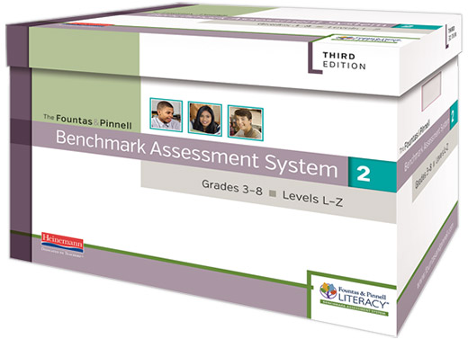
Fountas and Pinnell
Fountas & Pinnell Benchmark Assessment System (BAS, 3rd edition)
Ages:
Grades K-5
Administration & Time:
≈20-40 minutes
1:1 administration
Assessor Qualification Level:
TDOE recommends that each assessment is administered, scored, and interpreted by a certified teacher with knowledge of both reading content and the assessment.
Purpose:
To assess individual reading strengths and needs
To observe, record, and evaluate changes in student reading performance
English Learner Options:
SEL Books: 28 texts from levels A-N in Spanish
(approximately grade levels K-3)
Additional Information:
Aligns with Leveled Literacy Intervention (LLI) progression
Gives overall instructional reading level
Basic Reading
Running record: Accuracy rate, Self-Corrections, and Error analysis
Reading Fluency
Words per minute at instructional level
Reading Comprehension
Comp Conversation Rubric
Provided for reference only. Mention does not imply endorsement,
recommendation, or approval by the Tennessee Department of Education.

Slide 10
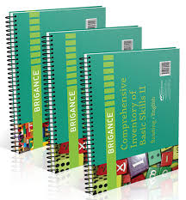
Brigance Comprehensive Inventory of Basic Skills
Brigance Comprehensive Inventory of Basic Skills (CIBS-II)
Ages:
Grades Pre-K-9
Administration & Time:
≈15-30 minutes per subtest
1:1 administration
Assessor Qualification Level:
TDOE recommends that each assessment is administered, scored, and interpreted by a certified teacher with knowledge of both reading content and the assessment.
Purpose:
To assess students' strengths and needs in the classroom
To monitor growth and progress
English Learner Options:
Brigance ABS-R (Assessment of Basic Skills-Revised, Spanish edition) for grades Pre-K-9
Additional Information:
Subtests include Listening Vocabulary and Comprehension, Word Recognition, Oral Reading, Reading Vocabulary and Comprehension, Word Analysis, Functional Word Recognition, Spelling
Basic Reading
Word Recognition
Functional Word Recognition
Word Analysis
Spelling
Reading Fluency
Oral Reading Rate
Reading Comprehension
Vocab/Listening Comp
Vocab/Rdg Comp
Provided for reference only. Mention does not imply endorsement,
recommendation, or approval by the Tennessee Department of Education.

Slide 11
Comprehensive Testing Program
Comprehensive Testing Program
(CTP5/CTP Online by ERB)
Ages:
Grades 1-11
(some subtests begin in grade 3)
Administration & Time:
≈2 ½ - 4 hours
Group administration (paper or online)
Standardized
Assessor Qualification Level:
TDOE recommends that each assessment is administered, scored, and interpreted by a certified teacher with knowledge of both reading content and the assessment.
Purpose:
To assess high-achieving students on content and conceptual knowledge
English Learner Options:
N/A
Additional Information:
Gives percentile ranks based on national norms
Normed on advanced students
Basic Reading
Word Analysis
Reading Fluency
N/A
Reading Comprehension
Auditory Comprehension
Reading Comprehension
Vocabulary
Provided for reference only. Mention does not imply endorsement,
recommendation, or approval by the Tennessee Department of Education.

Slide 12
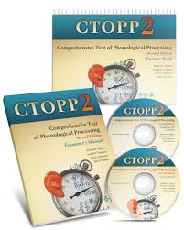
Comprehensive Test of Phonological Processing
Comprehensive Test of Phonological Processing (CTOPP-2)
Ages:
4:0-24:11
Administration & Time:
≈40 minutes
1:1 administration
Standardized
Assessor Qualification Level:
B
Purpose:
To identify phonological processing difficulties and track progress
To identify strengths and weaknesses within phonological processing
English Learner Alternative:
TOPPS (Test of Phonological Processing in Spanish)
for Grades K-Adult
Additional Information:
Subtests include Elision, Blending Words, Sound Matching, Phoneme Isolation, Blending Nonwords, Segmenting Nonwords, Memory for Digits, Nonword Repetition, Rapid Naming (Digit, Letter, Color, Object)
Basic Reading
Phonological Awareness
Phonological Memory
Rapid Naming (Symbolic)
Reading Fluency
Rapid Naming
Reading Comprehension
N/A
Provided for reference only. Mention does not imply endorsement,
recommendation, or approval by the Tennessee Department of Education.

Slide 13
Diagnostic Achievement Battery
Diagnostic Achievement Battery (DAB-4)
Age:
6:0-14:11
Administration & Time:
60-90 minutes
1:1
Standardized
Assessor Qualification Level:
B
Purpose:
To assess academic abilities
To inform remediation planning
English Learner Options:
N/A
Additional Information:
Composite Score: Reading
Basic Reading
Alphabet/Phonics/Word Identification
Spelling
Reading Fluency
N/A
Reading Comprehension
Listening Comp
Synonyms
Reading Comp
Provided for reference only. Mention does not imply endorsement,
recommendation, or approval by the Tennessee Department of Education.

Slide 14
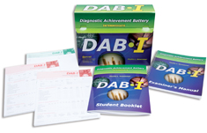
Diagnostic Achievement Battery Intermediate
Diagnostic Achievement Battery Intermediate (DAB-I)
Age:
13:0-17:11
Administration & Time:
60-90 minutes
1:1
Standardized
Assessor Qualification Level:
B
Purpose:
Assess academic abilities
Inform remediation planning
English Learner Options:
N/A
Additional Information:
Composite Score: Reading
Basic Reading
Word Identification
Spelling
Reading Fluency
N/A
Reading Comprehension
Reading Comp
Provided for reference only. Mention does not imply endorsement,
recommendation, or approval by the Tennessee Department of Education.

Slide 15
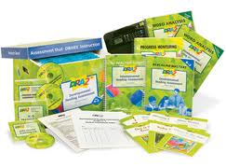
Developmental Reading Assessment
Developmental Reading Assessment (DRA2)
Age:
Grades K-3
Administration & Time:
≈30-40 minutes
1:1 Administration
Assessor Qualification Level:
A
English Learner Options:
EDL2+ (Spanish equivalent of DRA2)
Purpose:
To assess individual reading strengths and needs
Observe, record, and evaluate changes in student reading performance
Additional Information:
Gives overall instructional reading level
Basic Reading
Running record: Accuracy rate, Self-Corrections, and Error analysis
Reading Fluency
Words per minute at instructional level
Reading Comprehension
Retelling Rubric
Provided for reference only. Mention does not imply endorsement,
recommendation, or approval by the Tennessee Department of Education.

Slide 16
Easy CBM
Easy CBM
Ages:
Norms for Grades K-8
Phoneme Segmenting: Grades K-1
Letter Names/Letter Sounds: Grades K-1
Word Reading Fluency: Grades K-2
Passage Reading Fluency: Grades 1-6
Vocabulary: Grades 2-6
Reading Comprehension: Grades 2-6
Administration Time:
2-30 minutes per subtest
1:1 Administration for most subtests
Assessor Qualification Level:
TDOE recommends that each assessment is administered, scored, and interpreted by a certified teacher with knowledge of both reading content and the assessment.
English Learner Options:
Spanish Subtests
Syllable Sounds K-1
Syllable Segmenting K-1
Word Reading Fluency K-2
Sentence Reading Fluency K-2
Purpose:
To screen all students (universal screening tool)
To progress monitor broad progress
To identify skill-level needs (some subtests)
Additional Information:
May be computer or paper administration
Basic Reading
Letter Names
Letter Sounds
Phoneme Segmenting
Word Reading Fluency
Reading Fluency
Passage Reading Fluency
Reading Comprehension
Vocabulary
CCSS
MCRC
Provided for reference only. Mention does not imply endorsement,
recommendation, or approval by the Tennessee Department of Education.

Slide 17
Gray Oral Reading Test
Gray Oral Reading Test (GORT-5)
Age:
Ages 6:0-23:11
Administration & Time:
20-30 minutes
1:1
Standardized
Assessor Qualification Level:
B
Purpose:
To screen reading fluency and comprehension
English Learner Options:
N/A
Additional Information:
N/A
Basic Reading
Accuracy
Reading Fluency
Rate
Reading Comprehension
Passage dependent comp
Provided for reference only. Mention does not imply endorsement,
recommendation, or approval by the Tennessee Department of Education.

Slide 18
Heggerty Phonemic Awareness Assessments
Heggerty Phonemic Awareness Assessments
Age:
Grades PreK-12
Administration:
1:1
Standardized
Assessor Qualification Level:
TDOE recommends that each assessment is administered, scored, and interpreted by a certified teacher with knowledge of both reading content and the assessment.
Purpose:
To assess phonological awareness
Observe, record, and evaluate changes in student phonological awareness
Additional Information:
Free resource: https://www.heggerty.org/download-assessments-and-resources
Basic Reading
Word Discrimination
Rhyme Recognition & Production
Syllable Blending, Segmentation & Deletion
Phoneme Recognition, Blending, Segmentation, Deletion
Reading Fluency
Reading Comprehension
Provided for reference only. Mention does not imply endorsement,
recommendation, or approval by the Tennessee Department of Education.

Slide 19
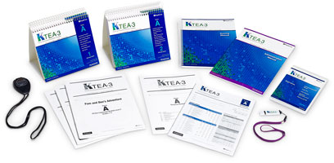
Kaufman Test of Educational Achievement
Kaufman Test of Educational Achievement
(KTEA-3)
Age:
4:0-Adult
Administration & Time:
15-85 minutes
1:1
Standardized
Assessor Qualification Level:
B
Purpose:
To assess key academic skills
2. To determine academic progress
English Learner Options:
N/A
Additional Information:
Composite score: Reading, Sound-Symbol, Decoding, Reading Fluency, Reading Understanding, Comprehension, Orthographic Processing Composite
Basic Reading
Phonological Processing
Letter & Word Recognition
Nonsense Word Decoding
Spelling
Decoding Fluency
Reading Fluency
Silent Reading Fluency
Letter Naming Fluency
Reading Comprehension
Reading Comp
Listening Comp
Reading Vocabulary
Provided for reference only. Mention does not imply endorsement,
recommendation, or approval by the Tennessee Department of Education.

Slide 20
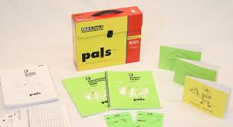
PALS
PALS
Age:
Grades PreK-8
Administration & Time:
1:1 or small group
Paper/pencil
Assessor Qualification Level:
TDOE recommends that each assessment is administered, scored, and interpreted by a certified teacher with knowledge of both reading content and the assessment.
Purpose:
To screen early literacy skills and provide diagnostic information
To monitor progress on specific skills
Additional Information:
Includes guidance for grouping students
Basic Reading
Phonological & Phonemic Awareness
Letter Names & Sounds
Word Concepts, Decoding, Word Recognition
Spelling
Reading Fluency
Passage Fluency
Reading Comprehension
N/A
Provided for reference only. Mention does not imply endorsement,
recommendation, or approval by the Tennessee Department of Education.

Slide 21
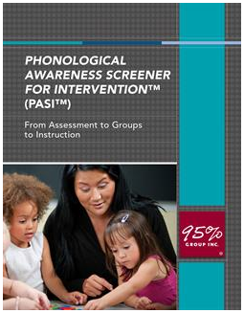
Phonological Awareness Screener for Intervention
Phonological Awareness Screener for Intervention (PASI)
Age:
Grades K-12
Administration & Time:
~5-10 minutes
1:1
Paper/pencil
Assessor Qualification Level:
TDOE recommends that each assessment is administered, scored, and interpreted by a certified teacher with knowledge of both reading content and the assessment.
Purpose:
To assess phonological awareness
To pinpoint deficit skills and guide instruction and grouping
Additional Information:
Aligns with 95% Group reading intervention materials
Includes guidance for grouping students
Basic Reading
Phonological Awareness:
Syllables
Onset-rime
Phonemes
Reading Fluency
N/A
Reading Comprehension
N/A
Provided for reference only. Mention does not imply endorsement,
recommendation, or approval by the Tennessee Department of Education.

Slide 22
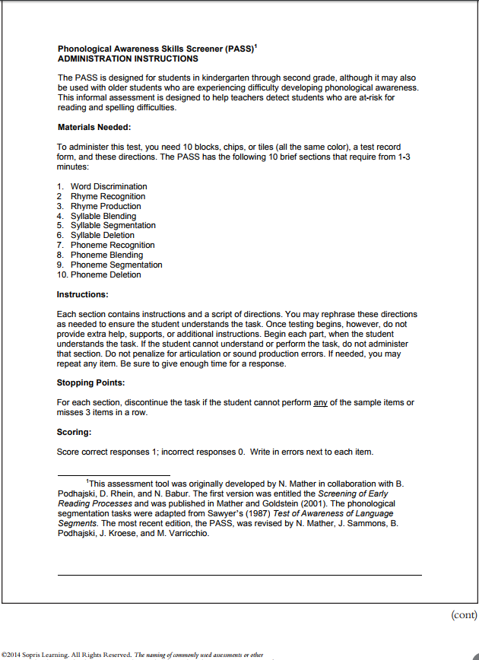
Phonological Awareness Skills Screener
Phonological Awareness Skills Screener (PASS)
Age:
Grades K-12
Administration & Time:
~15-20 minutes
1:1
Assessor Qualification Level:
TDOE recommends that each assessment is administered, scored, and interpreted by a certified teacher with knowledge of both reading content and the assessment.
Purpose:
To assess phonological awareness
Observe, record, and evaluate changes in student phonological awareness
Additional Information:
Free resource created by Sopris Learning, part of TN Reading Course
Go to https://www.tn.gov/education/article/tdoe3-rti-administrators-intervention-resources (password protected)
Basic Reading
Word Discrimination
Rhyme Recognition & Production
Syllable Blending, Segmentation & Deletion
Phoneme Recognition, Blending, Segmentation, and Deletion
Reading Fluency
N/A
Reading Comprehension
N/A
Provided for reference only. Mention does not imply endorsement,
recommendation, or approval by the Tennessee Department of Education.

Slide 23
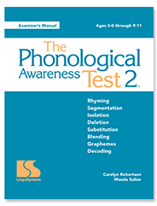
Phonological Awareness Test
Phonological Awareness Test (PAT-2)
Ages:
5:0-9:11
Administration & Time:
≈40 minutes
1:1 administration
Standardized
Assessor Qualification Level:
B
Purpose:
To assess prereading skills
To identify students who lack explicit phonological knowledge
English Learner Alternative:
TPAS (Test of Phonological Awareness in Spanish)
for Ages 4:0-10:11
Additional Information:
Subtests include Rhyming, Segmentation, Isolation, Deletion, Substitution with Manipulatives, Blending, Graphemes, Decoding
Basic Reading
Phonological Awareness
Phoneme-Grapheme Correspondence
Reading Fluency
N/A
Reading Comprehension
N/A
Provided for reference only. Mention does not imply endorsement,
recommendation, or approval by the Tennessee Department of Education.

Slide 24
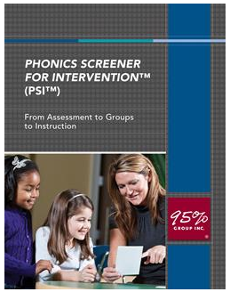
Phonics Screener for Intervention
Phonics Screener for Intervention (PSI)
Age:
Grades K-12
Administration & Time:
~5-10 minutes
1:1
Paper/pencil
Assessor Qualification Level:
TDOE recommends that each assessment is administered, scored, and interpreted by a certified teacher with knowledge of both reading content and the assessment.
Purpose:
To determine where to begin a student’s intervention
To group students with similar needs
To determine when to move students out of one skill into another
Additional Information:
Aligns with 95% Group reading intervention materials
Includes guidance for grouping students
Basic Reading
Letter Names and Sounds
Decoding
Sight Words
Reading Fluency
N/A
Reading Comprehension
N/A
Provided for reference only. Mention does not imply endorsement,
recommendation, or approval by the Tennessee Department of Education.

Slide 25
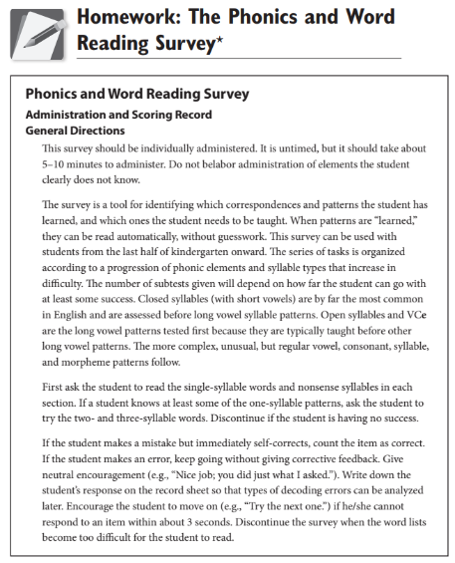
Phonics and Words Reading Survey
Phonics and Word Reading Survey (PWRS)
Age:
Grades K-12
Administration & Time:
~5-10 minutes
1:1
Assessor Qualification Level:
TDOE recommends that each assessment is administered, scored, and interpreted by a certified teacher with knowledge of both reading content and the assessment.
Purpose:
To identify which letter/sounds correspondences and patterns the student has learned, and which ones the student needs to be taught
To observe, record, and evaluate changes in student letter/sound correspondence
Additional Information:
Free resource created by Sopris Learning, part of TN Reading Course
Go to https://www.tn.gov/education/article/tdoe3-rti-administrators-intervention-resources (password protected)
Basic Reading
Letter Naming and Letter-Sounds Correspondences
High-frequency Words
Word identification by syllable type (closed, long, vowel-r, teams, -le)
Encoding letters of the alphabet and 12 sounds
Reading Fluency
N/A
Reading Comprehension
N/A
Provided for reference only. Mention does not imply endorsement,
recommendation, or approval by the Tennessee Department of Education.

Slide 26
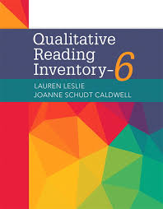
Qualitative Reading Inventory
Qualitative Reading Inventory (QRI-6)
Age:
Grades PreK-12
Administration & Time:
15-20 minutes
1:1
Assessor Qualification Level:
TDOE recommends that each assessment is administered, scored, and interpreted by a certified teacher with knowledge of both reading content and the assessment.
Purpose:
To assess individual reading strengths and needs
To observe, record, and evaluate changes in student reading performance
English Learner Alternative:
Spanish Reading Inventory: Pre-K-8
Additional Information:
Gives overall instructional reading level
Comprehension score differentiates for inferencing
Basic Reading
Running record: Accuracy, Acceptability, Self-corrections, and Error analysis
Reading Fluency
Words per minute at instructional level
Reading Comprehension
Retelling (unscored)
Reading Comprehension (open-ended 50% literal and 50% inferential)
Provided for reference only. Mention does not imply endorsement,
recommendation, or approval by the Tennessee Department of Education.

Slide 27
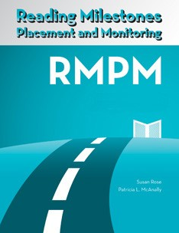
Reading Milestones Placement and Monitoring
Reading Milestones Placement and Monitoring
Age:
Ages 6-18
Administration & Time:
10-30 minutes
Assessor Qualification Level:
A
Purpose:
To place students within the Reading Milestones program
To determine overall approximate instructional reading level, with no verbal output required
English Learner Options:
N/A
Additional Information:
Test A is for K-1 readers and Test B is for grade 2-3 readers
Basic Reading
Word Level Comprehension (word identification implied)
Reading Fluency
N/A
Reading Comprehension
Sentence Level Comp
Passage Level Comp
Provided for reference only. Mention does not imply endorsement,
recommendation, or approval by the Tennessee Department of Education.

Slide 28
Really Great Reading
Really Great Reading
Age:
Grades K-12
Administration & Time:
<10 minutes per assessment
Assessor Qualification Level:
TDOE recommends that each assessment is administered, scored, and interpreted by a certified teacher with knowledge of both reading content and the assessment.
Purpose:
To assess a variety of literacy skills
To quickly diagnose a student’s weakness in basic reading skills
Additional Information:
Most assessments on this site are free, but a few have a cost attached
Basic Reading
Alphabetic Knowledge
Phonological and Phonemic Awareness
Decoding
Sight Words
Reading Fluency
N/A
Reading Comprehension
Functional Vocabulary
Provided for reference only. Mention does not imply endorsement,
recommendation, or approval by the Tennessee Department of Education.

Slide 29
Stanford Achievement Test
Stanford Achievement Test (SAT 10)
Age:
Grades K-12 (paper)
Grades 3-12 (online)
Administration & Time:
Abbreviated Battery: 3 hours
Complete Battery: 5 hours
1:1 (paper); group (online)
Standardized
Assessor Qualification Level:
B
Purpose:
To identify student strengths and needs
To support effective instructional planning
English Learner Options:
N/A
Additional Information:
Composite Score: Total Reading
Cluster Scores: Word Study Skills, Reading Vocabulary, and Reading Comprehension
Basic Reading
Structural Analysis
Phonetic Analysis-Consonants
Phonetic Analysis-Vowels
Reading Fluency
N/A
Reading Comprehension
Reading Comp: eight subtests
Listening: three subtests
Reading Vocabulary: four subtests
Provided for reference only. Mention does not imply endorsement,
recommendation, or approval by the Tennessee Department of Education.

Slide 30
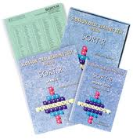
Slosson Oral Reading Test
Slosson Oral Reading Test (SORT-R3)
Age:
Grades PreK-12
Administration & Time:
3-5 minutes
1:1
Standardized
Assessor Qualification Level:
TDOE recommends that each assessment is administered, scored, and interpreted by a certified teacher with knowledge of both reading content and the assessment.
Purpose:
To assess decoding in isolation
To determine overall sight word level
English Learner Options:
N/A
Additional Information:
Gives a sight word level, not a reading level
Basic Reading
Sight words
Decoding of real words by grade level in isolation
Reading Fluency
N/A
Reading Comprehension
N/A
Provided for reference only. Mention does not imply endorsement,
recommendation, or approval by the Tennessee Department of Education.

Slide 31
Star Early Literacy
Star Early Literacy (Renaissance)
Age:
Grades PreK-3
Administration & Time:
≈15-20 minutes
Computer administered
Computer-adaptive
Assessor Qualification Level:
TDOE recommends that each assessment is administered, scored, and interpreted by a certified teacher with knowledge of both reading content and the assessment.
Purpose:
To screen/monitor students for reading achievement levels
To determine placement in Accelerated Reader (AR)
English Learner Options:
N/A
Additional Information:
Provides scaled scores and percentile ranks
Basic Reading
Word Facility and Skills
Reading Fluency
N/A
Reading Comprehension
Sentence-level Comp
Paragraph-level Comp
Provided for reference only. Mention does not imply endorsement,
recommendation, or approval by the Tennessee Department of Education.

Slide 32
Star Reading
Star Reading (Renaissance)
Age:
Grades 1-12
Administration & Time:
≈20 minutes
Computer administered
Computer-adaptive
Assessor Qualification Level:
TDOE recommends that each assessment is administered, scored, and interpreted by a certified teacher with knowledge of both reading content and the assessment.
Purpose:
To screen/monitor students for reading achievement levels
To determine placement in Accelerated Reader (AR)
English Learner Options:
STAR Reading Spanish: Grades 1-12
Additional Information:
*Provides scaled scores and percentile ranks
Basic Reading
N/A
Reading Fluency
N/A
Reading Comprehension
Comp Strategies/Constructing Meaning
Analyzing Literary Text
Understanding Author’s Craft
Analyzing Argument/Evaluating Text
Provided for reference only. Mention does not imply endorsement,
recommendation, or approval by the Tennessee Department of Education.

Slide 33
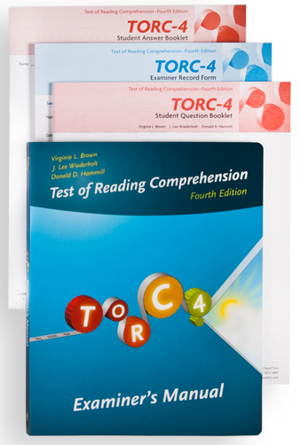
Test of Reading Comprehension
Test of Reading Comprehension (TORC-4)
Age:
7:0-17:11
Administration & Time:
25 minutes
1:1
Standardized
Assessor Qualification Level:
B
Purpose:
To assess silent reading comprehension
To monitor remediation efforts
English Learner Alternative:
The Spanish Reading Comprehension Test: difficulty level ranges from three to nine years of education
Additional Information:
No composite scores
Basic Reading
N/A
Reading Fluency
Contextual Fluency (Silent, isolated words per minute)
Reading Comprehension
Relational Vocabulary
Sentence Completion
Paragraph Construction
Text Comprehension
Provided for reference only. Mention does not imply endorsement,
recommendation, or approval by the Tennessee Department of Education.

Slide 34
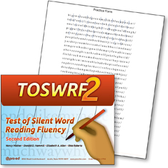
Test of Silent Word Reading Fluency
Test of Silent Word Reading Fluency (TOSWRF-2)
Age:
6:3-24:11
Administration & Time:
3 minutes to administer to individuals or groups
Assessor Qualification Level:
A
Purpose:
To quickly assess the silent word identification ability of school-age students
English Learner Options:
N/A
Additional Information:
An additional screening tool
Primarily a measure of speed of silent word identification
Design: given rows of words without spaces (dimhowfigblue), draw a line showing the boundaries for three minutes (dim/how/fig/blue)
Basic Reading
Isolated word identification
Reading Fluency
*Silent, isolated words per minute
Reading Comprehension
N/A
Provided for reference only. Mention does not imply endorsement,
recommendation, or approval by the Tennessee Department of Education.

Slide 35
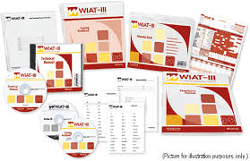
Weschler Individual Achievement Test
Weschler Individual Achievement Test (WIAT-III)
Age:
Grades Pre-K-12 (4:0-Adult)
Administration & Time:
Varies by grade level and number of subtests
1:1
Standardized
Assessor Qualification Level:
B
Purpose:
To identify academic strengths and weaknesses
To inform instructional decisions
English Learner Options:
N/A
Additional Information:
Composite scores: Oral Language, Total Reading, Basic Reading, Reading Fluency & Comprehension
Basic Reading
Early Reading Skills
Word Reading
Pseudoword Decoding
Spelling
Reading Fluency
Oral Reading Fluency
Reading Comprehension
Listening Comp
Reading Comp
Provided for reference only. Mention does not imply endorsement,
recommendation, or approval by the Tennessee Department of Education.

Slide 36
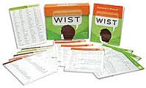
Word Identification and Spelling Test
Word Identification and Spelling Test (WIST)
Age:
7:-18:11
Administration & Time:
≈40 minutes
1:1 (spelling could be group)
Standardized
Assessor Qualification Level:
B
Purpose:
To assess individual needs in decoding & encoding
To analyze and diagnosis by syllable type (color-coded for analysis)
English Learner Options:
N/A
Additional Information:
Elementary version for grades 2-5
Secondary version for grades 6-12
Provide standard scores for Word Identification, Spelling, and Sound-Symbol Knowledge
Basic Reading
Word Identification (regular/irregular/nonwords)
Spelling (regular/irregular)
Letter/Sound Knowledge
Reading Fluency
N/A
Reading Comprehension
N/A
Provided for reference only. Mention does not imply endorsement,
recommendation, or approval by the Tennessee Department of Education.

Slide 37
Woodcock Johnson IV Tests of Achievement and Oral Language
Woodcock-Johnson IV
Tests of Achievement and Oral Language (WJ Ach IV)
Age:
Grades Pre-K-12 (4:0-Adult)
Administration & Time:
Varies by grade level and number of subtests
1:1
Standardized
Assessor Qualification Level:
Medium (Similar to a B)
Click here for more information
Purpose:
To identify and describe patterns of performance across achievement
2. To determine academic strengths and weaknesses
English Learner Options (Spanish):
Clusters: Oral Language, Broad Oral Language, and Listening Comprehension
Subtests: Vocabulario sobre dibujos, Comprensión oral, and Comprensión de indicaciones
Additional Information:
Cluster scores: Phoneme-Grapheme Knowledge, Reading, Broad Reading, Basic Reading, Reading Comprehension, Reading Fluency, Reading Rate, Oral Language, Total Reading, Basic Reading, Reading Fluency & Comprehension, Oral Language
Basic Reading
Letter-Word Identification
Word Attack
Spelling
Segmentation
Sound Awareness & Blending
Reading Fluency
Rapid Picture Naming
Oral Reading
Sentence Reading Fluency
Reading Comprehension
Passage Comp
Oral Comp
Listening Comp
Provided for reference only. Mention does not imply endorsement,
recommendation, or approval by the Tennessee Department of Education.

Slide 38
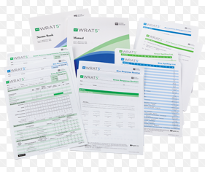
Wide Range Achievement Test
Wide Range Achievement Test (WRAT5)
Age:
Grades Pre-K-12 (5:0-Adult)
Administration & Time:
≈15-45 minutes
1:1
Standardized
Assessor Qualification Level:
B
Purpose:
To assess academic skills
To screen for further evaluation
English Learner Options:
N/A
Additional Information:
Composite Score: Reading
Basic Reading
Word Reading
Spelling
Reading Fluency
Reading Comprehension
Sentence Comprehension
Provided for reference only. Mention does not imply endorsement,
recommendation, or approval by the Tennessee Department of Education.

Slide 39
Young Children’s Achievement Test
Young Children’s Achievement Test (YCAT-2)
Age:
4:0-7:11
Administration & Time:
≈25-45 minutes
1:1
Standardized
Assessor Qualification Level:
B
Purpose:
To assess academic skills
To screen for further evaluation
English Learner Options:
Spanish Version: PHAI (Prueba de Habilidades Académicas Iniciales)
Additional Information:
Composite Score: Reading
Basic Reading
Reading subtest (includes concepts about print, phonological knowledge)
Reading Fluency
N/A
Reading Comprehension
Reading subtest (basic listening comp at some levels)
Provided for reference only. Mention does not imply endorsement,
recommendation, or approval by the Tennessee Department of Education.

Slide 40
Appendix
Notes:
You will see that there are several helpful items in the Appendix, which is also hyperlinked in the Table of Contents. In the Appendix you will find additional information on the screening requirements of the “Say Dyslexia” Law, including the characteristics of dyslexia as defined by the law. Additionally, you will find information on what a typical battery for a full dyslexia evaluation would include.
As stated earlier, this document was created as a tool to assist districts and schools with making informed decisions about how to best use their assessments. This document is one resource that teams can use in the decision-making process.
The assessments in this document are provided for reference only and are not in any way an endorsement or recommendation by the Tennessee Department of Education. Again, this is not an approved list, and schools are welcome to utilize assessments that are not included in this document.

Slide 41
“Say Dyslexia” Law Screening Procedures
“Say Dyslexia” Law Screening Procedures
Per the “Say Dyslexia” Law (Public Chapter No. 1058), districts are required to screen students for characteristics of dyslexia through their RTI² universal screening process.
The screening process must include assessment of the characteristics of dyslexia, defined by the law. Each is defined in the table below.
Step One
Screen all students using a skills-based screener
Step Two
Consider additional sources of information to identify “at-risk” students.
Step Three
Conduct survey-level diagnostic assessments to inform intervention needs.
If a standards-based assessment is used to screen all students instead of a skills-based universal screener, a skills-based screener is necessary to identify more specific skills area(s).
Difficulties | General Definition
Phonological awareness | When a child listens, the ability to recognize and identify sounds and words in spoken language when no print is involved (e.g., recognize and identify individual words within sentences, sounds and syllables within words, blending and changing sounds to create new words, and rhyming)
Phonemic awareness | The awareness of individual sounds within the spoken word and the ability to manipulate those sounds when no print is involved (i.e., a subcomponent of phonological awareness)
Alphabet knowledge | Ability to name letters of the alphabet
Sound/symbol recognition | Ability to identify the sounds that letters or letter combinations make
Decoding skills | Ability to sound out words and read words using phonics (linking letters and sounds)
Encoding skills | Ability to spell words
Rapid naming | Ability to quickly and accurately name familiar things (e.g., letters, objects, shapes, colors, etc.)
Provided for reference only. Mention does not imply endorsement,
recommendation, or approval by the Tennessee Department of Education.

Slide 42
Dyslexia Evaluation
Dyslexia Evaluation
A dyslexia evaluation is not required for a school to provide interventions to address characteristics of dyslexia; however, if a parent chooses to seek an evaluation (outside the school system) for dyslexia and shares the results of the evaluation obtained at private expense with the school district, the school must consider the results of the evaluation in any decision made with respect to the provision of a free appropriate public education (FAPE). Schools are required to screen for characteristics; however, a school team may choose to further assess for the full profile of dyslexia. The International Dyslexia Association (IDA) lists the typical battery*:
*Assessments require varying levels of certification and permission. Refer to your school psychologist for more information.
Background Information
Intellectual Functioning
Achievement Testing
Phonological processing
Automaticity/fluency skills
Word Reading
Reading comprehension
Decoding
Spelling
Written expression
Listening comprehension
Provided for reference only. Mention does not imply endorsement,
recommendation, or approval by the Tennessee Department of Education.

Slide 43
Contact Information
Kate Martin
Senior Director of Special Education
Division of Special Populations
Kate.B.Martin@tn.gov
Joanna Bivins
Director of School Psychology and Behavior Services
Division of Special Populations
Joanna.Bivins@tn.gov
Angela Wegner
Intervention Supports and Best Practices Coordinator
Division of Special Populations
Angela.Wegner@tn.gov
Provided for reference only. Mention does not imply endorsement,
recommendation, or approval by the Tennessee Department of Education.

Slide 44
Any reference herein to any vendor, product or service by trade name, trademark, manufacturer, or otherwise does not constitute or imply the endorsement, recommendation or approval by the Tennessee Department of Education.
This is only a sampling of available products and services. If you would like your product or service to be considered for addition to the list, please contact Kate Martin.

