Slide 1
Introduction to Deescalation
Dr. April Ebbinger, NCSP
Director of Psychological and Behavioral Services
© Tennessee Department of Education

Slide 2
DISCLAIMER – Generative AI Tools
The State of Tennessee does not currently permit the use of Generative AI tools, such as Otter, in meetings hosted on state resources. Meetings with contractors, vendors, and subrecipients are not public meetings and may involve discussion of protected state data. Generative AI tools are not adequately regulated and are designed to train on data that is collected and may misrepresent data or release protected data to the general public. While the State supports your desire to maintain documentation of the meeting and what you learn, please respect our decision to safeguard information and do not attempt to use tools such as these. If you choose to use a tool such as this, the State will block that tool from the meeting.

Slide 3
Agenda
Introductions
School and Classroom Climate
Setting Events
Communication Skills
Initial Identification
Rising Concern
Crisis Situation
Debrief

Slide 4
2. I'm a pro!
3. I need a refresher!
1. I'm a novice!
Introductions
Which statement best represents your confidence level in de-escalating a student?

Slide 5
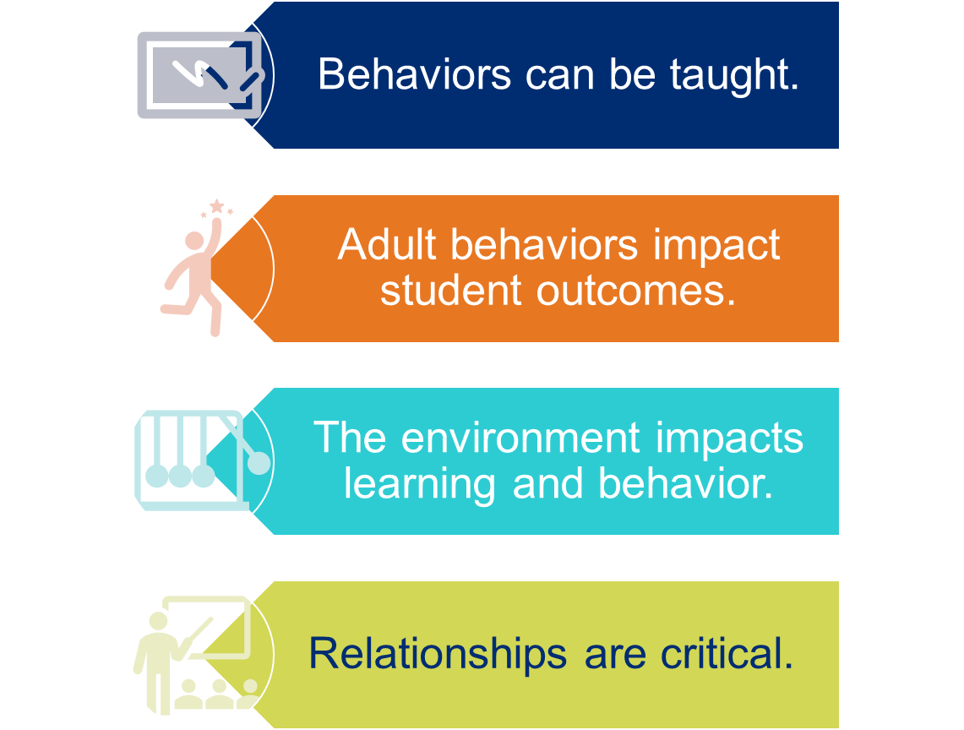
Foundational Beliefs

Slide 6
School and Classroom Climate

Slide 7
Collaborate
In your small groups discuss the following:
How does climate impact students’ behaviors and your ability to de-escalate situations?

Slide 8
What is Climate?
Key Components of Climate
Teaching & Learning
Relationships
Environment
Safety

Slide 9
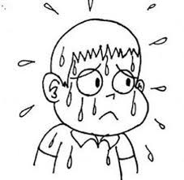
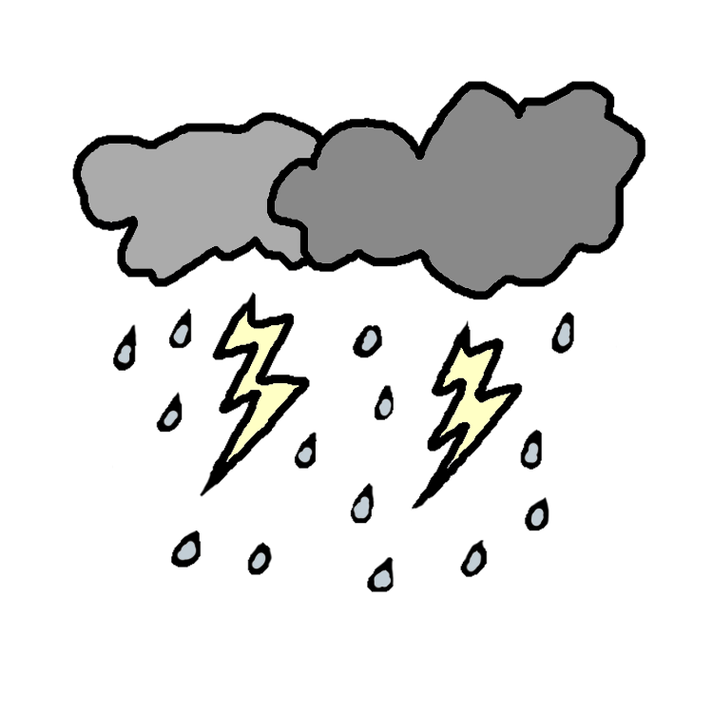
Consider the Climate
The humid climate
The self-motivating climate
The cold climate
The stormy climate
Credit: Alan McLean
Notes:
Describe the different classroom settings.
Humid classroom- In this classroom, students are under challenged and over dependent on the teacher. Empty praise is handed out and students don’t take risks.
Cold Classroom- We all know what this feels like. If you have to go into one of these classrooms, you can’t wait to leave and wish you could bring the students with you.
Stormy classroom- In this classroom, the climate is uncomfortable as some students feel threatened and some feel neglected, and no one knows where they stand. There also may be a consistent struggle for power and respect.
Self-motivating classroom- In this classroom, there is autonomy within structure, genuine praise and encouragement, and students take responsibility for their own behavior and learning.

Slide 10
The kids who need the most love will ask for it in the most unloving ways.
Source: Russel Barkley

Slide 11
Fight or Flight
“De-escalation techniques go against our natural fight - or – flight reflexes. Remaining calm and professionally detached is not natural and therefore is a skill that will need to be practiced.”
-Elizabeth Smith

Slide 12
Factors to Consider

Slide 14
Setting Events
Factors that may influence a person’s behavior.
Lack of sleep or food
Changes in routine
Changes in home routine
Medication changes
Others?

Slide 15
Rational Detachment
“You are the worst teacher I have ever met.”
“You are so dumb!”
This is the fifth incident with this student in your class this week.
Rational detachment is recognizing the need to remain professional by recognizing your own emotions yet remaining logical and objective.

Slide 16
Communication Skills

Slide 17
Forms of Communication
Verbal
Nonverbal
Paraverbal

Slide 18
Verbal Communication
Short, simple, & clear
“Are you okay?”
Positively phrased & respectful
“You seem lost. How may I help you?”

Slide 19
Nonverbal Communication
Personal Space
Body Language
Communication through Touch
Listening with Empathy

Slide 20
Paraverbal
Tone
Volume
Rhythm of Speech

Slide 21
Listening with Empathy
Remain non-judgmental
Give your undivided attention
Listen to facts and feelings
Allow time for silence and reflection
Paraphrase what you understand

Slide 22
The Rollercoaster of Escalation
© Tennessee Department of Education

Slide 23
Rollercoaster
Outburst
What do you notice first before an outburst?

Slide 24
What are the first signs of escalation?
What does it look like?
What does it sound like?
What does it feel like?

Slide 25
Our Choice
How adults respond
to challenging
behavior can either de-escalate
or escalate students.

Slide 26
Our Responsibility
“When little people are overwhelmed by big emotions, it’s our job to share our calm. Not join their chaos.”
-L.R. Knost

Slide 27
Initial Identiciation
Frustration
What behaviors do you exhibit when you are frustrated?

Slide 28
Proactive Techniques
Intervene
Engage non-judgmentally
Show support: “How can I help you?”
Listen
Allow silence
Reflect
Repeat what the person has said
Provide options: “Do you need a break?”
Ask open-ended questions: “Can you tell me more?”
Avoid telling them how you feel
Avoid interrupting or assuming

Slide 29
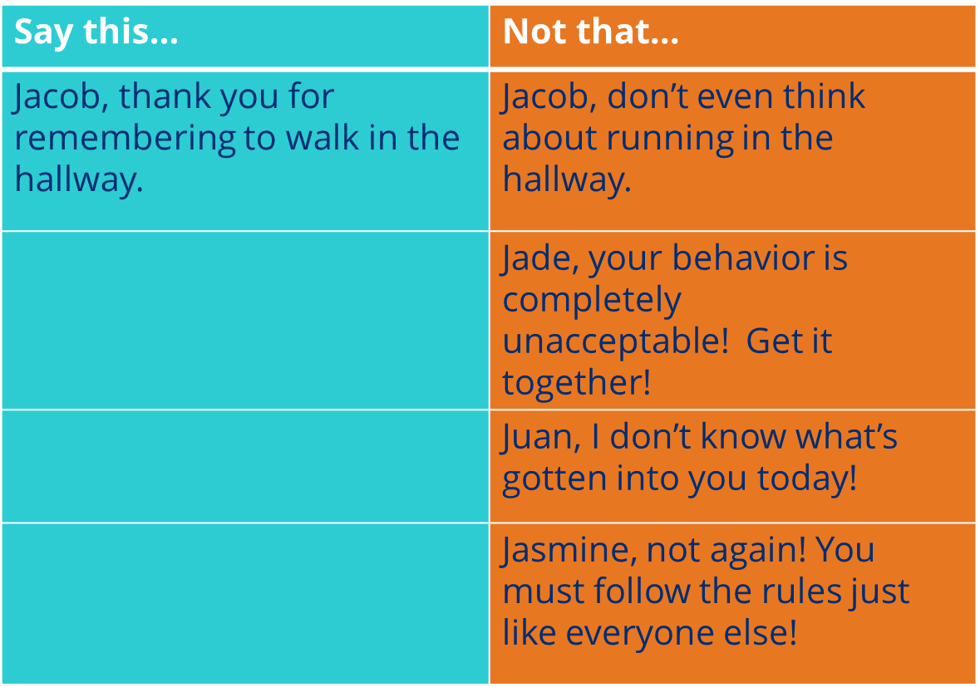
Responding Positively
SAY THIS
NOT THAT

Slide 30
Rising Concern
When the initial proactive approach doesn’t work, what do you do next?

Slide 31
Ignore abusive statements or questions.
Answer questions with rational responses:
Student-“Why do I have to do this stupid work anyway?”
Teacher-“All students must show me they have mastered the subject and this assignment will help show me that.”
What if the student continues to escalate?

Slide 32
What if the student continues to escalate?
Suggest alternatives: “When you lower your voice, then I can hear your concerns and help you find a solution,” or “Would you like to take a break and get a drink of water?”
Provide consequence: “If you continue to throw things, then I will have to call an administrator.”
Offer choices: “Would like you to continue our meeting calmly or would you prefer to stop now and continue tomorrow?”

Slide 33
Things to avoid
Forcing a student to talk
Using sarcasm
Telling a student how you feel
Giving advice
Blaming the student for the situation
Power struggles
Arguing with the student

Slide 34
Crisis Situation
Outburst

Slide 35
Intervene Safely
Remove items that could be dangerous
Remove other people in a clear classroom
Tag in another staff member
Keep space between you and student
Call for help

Slide 36
Deescalation Practice

Slide 37
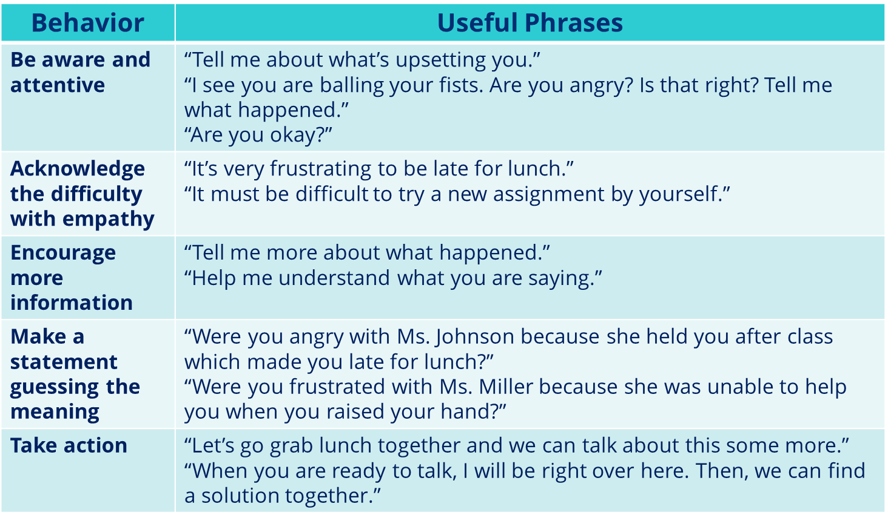
Example Script

Slide 38
Example Script Together
Teacher: “I see you rubbing your hands together. Is everything okay?”
Teacher: “Are you feeling frustrated?”
Teacher: “What are you frustrated about?”
Teacher: “So, you’re frustrated about missing practice and now you can’t start at the game. Is that right?”
Teacher: “I would be frustrated too if missing practice was out of my control, and I couldn’t start in the game.”
Teacher: “Would you like to talk to your coach to discuss why you missed practice? I can’t promise you he will change his decision, but at least you will feel heard.”

Slide 39
Using the sentence starters provided, work with a partner to role play. Be ready to share the experience with the group.

Slide 40
What happens after the incident?

Slide 41
Guiding Question: In your small groups discuss the following: Why is it important to debrief with the student and the staff involved?

Slide 42
Debriefing
Improve practices
Improve self-awareness of faculty, staff, and student
Implement preventative approaches with the student
Obtain consent for functional behavioral assessment if situation warrants
What can we do/implement to proactively prevent the likelihood that we must engage in restraint and/isolation in the future?

Slide 43
Closing

Slide 44
When you change the way, you look at things, the things you look at change.
Today was the absolute worst day ever
And don’t try to convince me that
There’s something good in every day
Because, when you take a closer look,
This world is a pretty evil place.
Even if
Some goodness does shine through once in a while
Satisfaction and happiness don’t last.
And it’s not true that
It’s all in the mind and heart
Because
True happiness can be obtained
Only if one’s surroundings are good
It’s not true that good exists
I’m sure you can agree that
The reality
Create
My attitude
It’s all beyond my control
And you’ll never in a million years hear me say that
Today was a good day

Slide 45
Thank You!
Dr. April Ebbinger, NCSP
Director of Psychological and Behavior Services
April.Ebbinger@tn.gov
Permission is granted to use and copy these materials for non-commercial educational purposes with attribution credit to the “Tennessee Department of Education”. If you wish to use the materials for reasons other than non-commercial educational purposes, please contact the office of general counsel at (615) 741-2921 or TDOE.GeneralCounsel@tn.gov.

