Slide 1

De-escalation &
Self-Regulation
Sarah Arnold
Director of Student and Family Services
© Tennessee Department of Education

Slide 2
Notes:
Talking points:
• Academics: ALL TENNESSEE STUDENTS WILL HAVE ACCESS TO A HIGH-QUALITY EDUCATION, NO MATTER WHERE THEY LIVE. This might look different across the state, but we must ensure that every child has access to an excellent education and access to the similar opportunities as their peers.
• Student Readiness: TENNESSEE PUBLIC SCHOOLS WILL BE EQUIPPED TO SERVE THE ACADEMIC AND NON-ACADEMIC NEEDS OF ALL STUDENTS IN THEIR CAREER PATHWAYS. This has been the #1 piece of feedback that we heard for the strategic plan and we know that the needs of our children have shifted over the last 10 years – we must devote capacity to meeting those needs to ensure students are successful in their chosen career pathway.
• Educators: TENNESSEE WILL SET A NEW PATH FOR THE EDUCATION PROFESSION AND BE THE TOP STATE TO BECOME AND REMAIN AN EDUCATOR. The single most important factor in a child’s education in our K12 public schools is the teacher, so we must support the profession to ensure our teachers feel supported, and valued.
Talking points:
• Academics: ALL TENNESSEE STUDENTS WILL HAVE ACCESS TO A HIGH-QUALITY EDUCATION, NO MATTER WHERE THEY LIVE. This might look different across the state, but we must ensure that every child has access to an excellent education and access to the similar opportunities as their peers.
• Student Readiness: TENNESSEE PUBLIC SCHOOLS WILL BE EQUIPPED TO SERVE THE ACADEMIC AND NON-ACADEMIC NEEDS OF ALL STUDENTS IN THEIR CAREER PATHWAYS. This has been the #1 piece of feedback that we heard for the strategic plan and we know that the needs of our children have shifted over the last 10 years – we must devote capacity to meeting those needs to ensure students are successful in their chosen career pathway.
• Educators: TENNESSEE WILL SET A NEW PATH FOR THE EDUCATION PROFESSION AND BE THE TOP STATE TO BECOME AND REMAIN AN EDUCATOR. The single most important factor in a child’s education in our K12 public schools is the teacher, so we must support the profession to ensure our teachers feel supported, and valued.

Slide 3
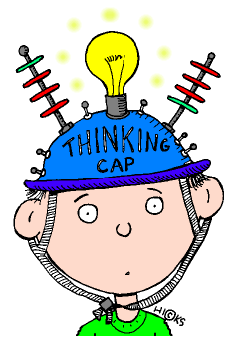
Objectives
Build and enhance knowledge of de-escalation strategies
Examine and integrate practices that promote self-regulation strategies
Identify ways to implement trauma-informed education strategies to support social personal competence
Notes:
By the end of this training, participants will be able to (read slide)

Slide 4
Reflection & Brainstorm
How do you de-escalate a dysregulated student?
What is your proactive approach to manage student behavior and emotions in your classroom?
What does self-regulation look like in the classroom?
What does self-regulation look like on the playground/lunch/transitions?

Slide 5
De-escalation

Slide 6
De-escalation
De-escalation is a targeted intervention for use with a student who is at risk for aggression by using calm language along with other communication techniques to diffuse, redirect, or de-escalate a conflict situation.
When adults use effective de-escalation techniques as a student's behavior is becoming more intense, they have a unique opportunity to prevent intense behavioral responses or other student behavior that often leads to disciplinary removal, stigmatization, marginalization, or harm to the student or others.

Slide 7
Verbal De-escalation Skills
Be present - be an active listener, attentive without disruption
Show empathy - recognize and acknowledge feelings and express compassion
Validate feelings - it is important to confirm feelings
Ask open-ended questions - encourage expression of the situation and alternatives moving forward

Slide 8
De-escalation Strategies
Be mindful of:
Body Language
  Non-threatening posture
  Get on the child’s level if possible (kneel, squat, etc)
  Relax
Voice
  Tone
  Volume
  Inflection
  Rate/Speed
Words Choice
  Unconditional Positive Regard
  Non-threatening words
  Not too many words
Notes:
Note: Unconditional positive regard involves showing complete support and acceptance of a person no matter what that person says or does. This does not mean we overlook a harmful behavior it is instead the act of viewing the student separate from their actions. It conveys to the student you have value and I am here to support you as we process through the situation.

Slide 9
De-escalation Strategies
Do your best to keep the environment life calm, supportive, and respectful.
Do not use aggression or violence yourself
If a student is acting aggressively, reinforce alternative behaviors (i.e., have a drawing pad handy or play a game that requires the students’ calm attention, such as “eye spy”)
Be sure to praise good behavior immediately and often
Help students articulate their feelings because talking through their emotions helps children of all ages
Notes:
A dysregulated adult cannot de-escalate a dysregulated child

Slide 10
De-escalation Strategies
Work with students to develop strategies to calm them when they feel scared, angry, or frustrated
Explain consequences for misbehavior ahead of time so students understand them before they are enforced
Once you have set up consequences, enforce them because if behavior is not addressed regularly, it may continue or even get worse
Notice the antecedent when and where the student is most aggressive or violent, and try to avoid those places
Provide a physical space (calming corner, reset space, regulation station)
Notes:
Note: It is important to be consistent and timely when enforcing consequences.

Slide 11
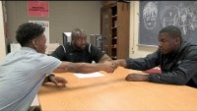
De-escalation Stations
Notes:
Rather than encouraging students to push through and move on, there is an opportunity to enhance their self-management skills. Allowing time to reflect, process and problem-solve empowers students with skills they can utilize across settings.

Slide 12
Strategies for Self-Regulation

Slide 13
Brainstorm
Brainstorm ideas for teaching students self-regulation strategies

Slide 14
Self-Regulation
Self- regulation is the ability to understand and manage one’s own behavior and reactions
Self-regulation skills allow students to learn more effectively because they can self-monitor themselves, their progress and goals
Self- regulation skills create a more proactive rather than reactive approach

Slide 15
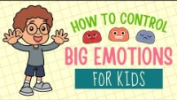
Managing your Emotions
Notes:
This video offers developmentally appropriate information and tools to help students to better understand, identify and cope with the emotions they are feeling.
Feeling triggers occur due to a wide range of circumstances and stimuli. They range from triggering happy or excited emotions to sad or angry emotions. Triggers have the ability to elicit an internal or external response impacting how a student thinks and acts through a situation. It is important that students can identify circumstances or experiences that trigger emotions across a spectrum.
Some students will have difficulty naming their feelings, a feelings chart, wheel or thermometer are great ways to help students attach names to their emotions. For students who struggle with naming their emotions, it is helpful to help them think through 3 key areas:
What am I thinking?
What do I feel in my body?
How do I act when I feel this way?
These not only help to identify the feeling, but identify the actions associated, which helps to pinpoint an appropriate range of coping strategies.

Slide 16
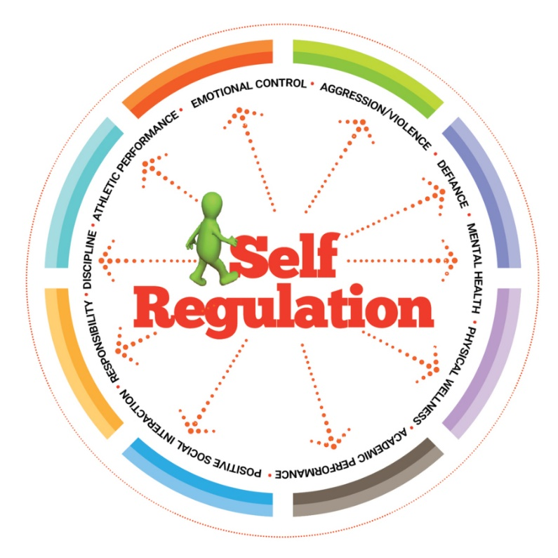
Promoting Self-Regulation
Feelings Identification
Relaxation
Distraction
Movement
Thinking
Notes:
We are going to look at these realms of improving self regulation using more specific strategies that can be summed up into
Calming Strategies
Sensory Strategies
Feelings Identification-when students are able to recognize their emotions: they are better able to self-manage, seek out support when needed and empathize with others.
Relaxation skills- mindfulness activities, deep breathing, counting, visualization, music etc
Distraction skills- these are not to escape the emotion, but allow time to regulate. These include activities to help distract the mind such as coloring, puzzles etc.
Movement- movement creates regulation and allows the body to have a physical release
Thinking skills- positive affirmations, identifying thoughts and reshaping them positively, problem solving/chunking tasks/goal setting etc.

Slide 17
Calming Strategies for Self-Regulation
Tactics, activities, worksheets, or exercises aimed to help reduce their anxiety, anger, over excitement and/or tension
Examples:
Deep Breathing
Controlled Breathing
Meditation
Positive Thoughts
Mantras
Notes:
Learning to Take a Deep Breath
Box Breathing
Six Sides of Breathing (a breathing technique that uses a hexagon to structure breaths)
Lazy 8 Breathing (a breathing technique that uses a lazy eight to structure breaths)
Count to Ten
Calming Sequence (a meditative routine to follow that repeats steps consisting of muscle contraction and deep pressure input).
Breathing Techniques used in Yoga
Use of creative outlets (arts, music, writing)

Slide 18
Sensory Strategies for Self-Regulation
Any equipment or technique that increases or decreases sensory input to help a student to focus and learn
Sensory Input Types:
Auditory (soft sounds, noise canceling headphones)
Visual (remove visual distractions)
Oral (chewing gum, straw)
Vestibular (stretching, side to side movement)
Proprioceptive (self joint compression activity, heavy work, squeeze your textbook)
Tactile (fidget, squeezy)
Taste (hard candy, gum)
Smell (neutral smell, eliminate strong order, avoid strong perfumes)
Notes:
Often these supports are associated with students with disabilities; however, Sensory Supports may help some students to self-regulate by helping them to focus when they feel themselves starting to escalate.
Movement (as Medicine)
Chewing Gum or on a straw
Squeezy in the hand or a rubber band
Controlled smells in classroom
Digging for objects in a rice bin
Sitting with a weighted blanket, vest, or lap pad
Wearing noise-cancelling headphones
Wall push ups
Pushing, pulling, or carrying something heavy
Swinging, Jumping
Deep pressure squishes with bean bag or oversized pillow
Bouncing on a therapy ball
Burrowing in pillows/cushions/blankets

Slide 19
Executive Functioning &
Self-Regulation Skills
Mental processes that enable us to plan, focus attention, remember instructions, and juggle multiple tasks successfully
Examples:
Chunking
To Do List/Checklists
Visual Schedules and Supports
Countdown Timer or Verbal Prompting for Transitions
Peer Buddy System for Accountability
PBIS of Reward System
Conferencing/Check Ins
Center for the Developing Child
Notes:
Just as an air traffic control system at a busy airport safely manages the arrivals and departures of many aircraft on multiple runways, the brain needs this skill set to filter distractions, prioritize tasks, set and achieve goals, and control impulses.
Growth-promoting environments provide children with “scaffolding” that helps them practice necessary skills before they must perform them alone. Adults can facilitate the development of a child’s executive function skills by establishing routines, modeling social behavior, and creating and maintaining supportive, reliable relationships. It is also important for children to exercise their developing skills through activities that foster creative play and social connection, teach them how to cope with stress, involve vigorous exercise, and over time, provide opportunities for directing their own actions with decreasing adult supervision.
breaking a larger task into smaller chunks; externalizing information using to-do lists, notepads, or phone reminders; buddying up with a peer to foster accountability; blocking access to distractions (putting one’s phone in a drawer or blocking tempting websites); and using rewards to motivate periods of consistent effort.
Executive Function | Psychology Today

Slide 20
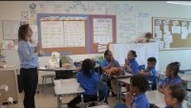
Teaching Self-Regulation
Notes:
In education we often model skills to help a student be academically successful in learning something new. The approach of modeling is also essential in helping students to be able to recognize and process through their emotions.

Slide 21
In the classroom…
Examples of self-regulation in the classroom include:
  Following class/school expectations
  Listening
  Completing tasks in a timely manner
  Timeliness
  Respecting others
  Patience
  Flexibility
  Managing behavior
  Staying in one’s seat/area

Slide 22
Connecting De-escalation and Self-Regulation Skills
De-escalation and Self-Regulation Skills compliment one another and can be used together to build a student's skill set in managing emotions and behavior
Often the use of verbal de-escalation opens the door for teaching self-regulation skills that are missing
When self-regulation skills are developed, the need for verbal de-escalation is reduced
Notes:
While these two strategies are distinct they compliment one another and can be used together to build a students skill set in managing emotions and behavior.

Slide 23
Building Social Personal Competence

Slide 24
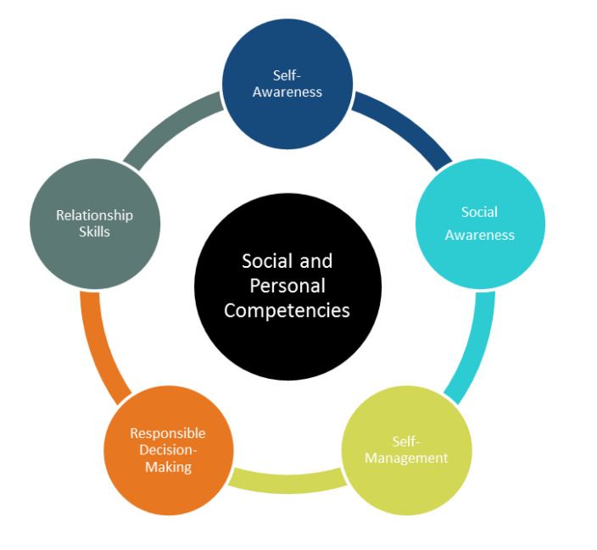
Social Personal Competence
Notes:
The goal of education is not only to help students develop content knowledge and skills, but to prepare them for success after graduation. One way to increase postsecondary and career success is by helping student to develop social and personal competence. Over the next few slides we will review the definition of each social and personal competency skill.

Slide 25
Self-Awareness
Self-awareness is the ability to accurately recognize one’s emotions, thoughts, and values and their influence on behavior. This includes accurately assessing one’s strengths and limitations and possessing a grounded sense of confidence, optimism, and a “growth mindset.”

Slide 26
Self-Management
Self-management is the ability to regulate one’s emotions, thoughts, and behaviors effectively in different situations. This includes managing stress, controlling impulses, motivating oneself, and setting and working toward achieving personal and academic goals.

Slide 27
Social Awareness
Social awareness is the ability to understand the perspective of others from diverse backgrounds and cultures, to understand social and ethical norms for behavior, and to recognize and practice civic responsibility in family, school, and community.

Slide 28
Relationship Skills
Relationships skills are the ability to establish and maintain healthy and rewarding relationships with diverse individuals and groups. This includes communicating clearly, listening actively, cooperating, resisting unwanted or inappropriate social pressure, negotiating conflict constructively, and seeking and offering help when needed.

Slide 29
Responsible Decision-Making
Responsible decision-making is the ability to make constructive and respectful choices about personal behavior and social interactions based on consideration of ethical standards, safety concerns, social norms, the realistic evaluation of consequences of various actions, and the well-being of self and others.

Slide 30
Contact
Sarah Arnold
Sarah.Arnold@tn.gov

Slide 31
Additional Resources
Creating a Trauma Informed School
Promoting Self-Determination Among Students With Disabilities: A Guide for Tennessee Educators
https://bestforall.tnedu.gov/resource/creating-trauma-informed-school/wc-professional-development
https://vkc.vumc.org/assets/files/resources/psiSelfdetermination.pdf
Advancing Crisis Intervention Team Programs in Tennessee
Tennessee Tiered Supports: RTI2-B School Team
https://www.tn.gov/content/dam/tn/mentalhealth/documents/Advancing_CIT_Programs_in_Tennessee_ALL.pdf
https://tennesseetsc.org/your-role/rti2-b-school-team/
FAQ: Restraint and Isolation for Students
RTI2-B Framework
https://www.tn.gov/content/dam/tn/education/special-education/ri_faq.pdf
https://tennesseetsc.org/your-role/rti2-b-school-team/
K-12 Social and Personal Competencies Resource Guide
The Urban Institute
SPC Resource Guide (tn.gov)
Urban Child Institute

