Slide 1
TENNESSEE SUCCEEDS.

Slide 2
CALL TO ACTION
In the spring of 2007, the U.S. Chamber of Commerce released an education report card for all states.
Tennessee received an “F” in the category of Truth in Advertising when comparing proficiency on Tennessee assessments to National Assessment of Education Progress (NAEP).
Tennessee also received an “F” in the category of Postsecondary and Workforce Readiness.

Slide 3
RESPONSE:
RAISE
STANDARDS
INCREASE
ACCOUNTABILITY
ALIGN
ASSESSMENTS
2008: TN adopts higher standards through the Tennessee Diploma Project
2010: State Board unanimously adopts the Common Core State Standards in ELA and math
2013-15: TN completes overhaul of Career and Technical Education (CTE) courses.
2014: Review process for new math and ELA standards begins.
2011–12: Tennessee earns approval for first ESEA waiver and led nation in implementing statewide teacher evaluation model
2012–15: Evaluation model modified each year based on feedback from the field
2015: USED approves Tennessee’s application for four-year waiver renewal
2011–12: Tennessee students begin completing CRA in math, applying multiple skills to solve a problem
2014–15: All students in grades 3-11 took writing assessment and social studies field test online
2015–16: First year of TNReady!

Slide 4
SUCCESSES TO DATE
Fastest improving state in the nation on 4th and 8th grade NAEP
Fastest growing graduation rate of any state
4
Consistent gains on TCAP every year since new assessments in 2010
ACT statewide average has increased to 19.4

Slide 5
2014-15 TCAP RESULTS:

Slide 6
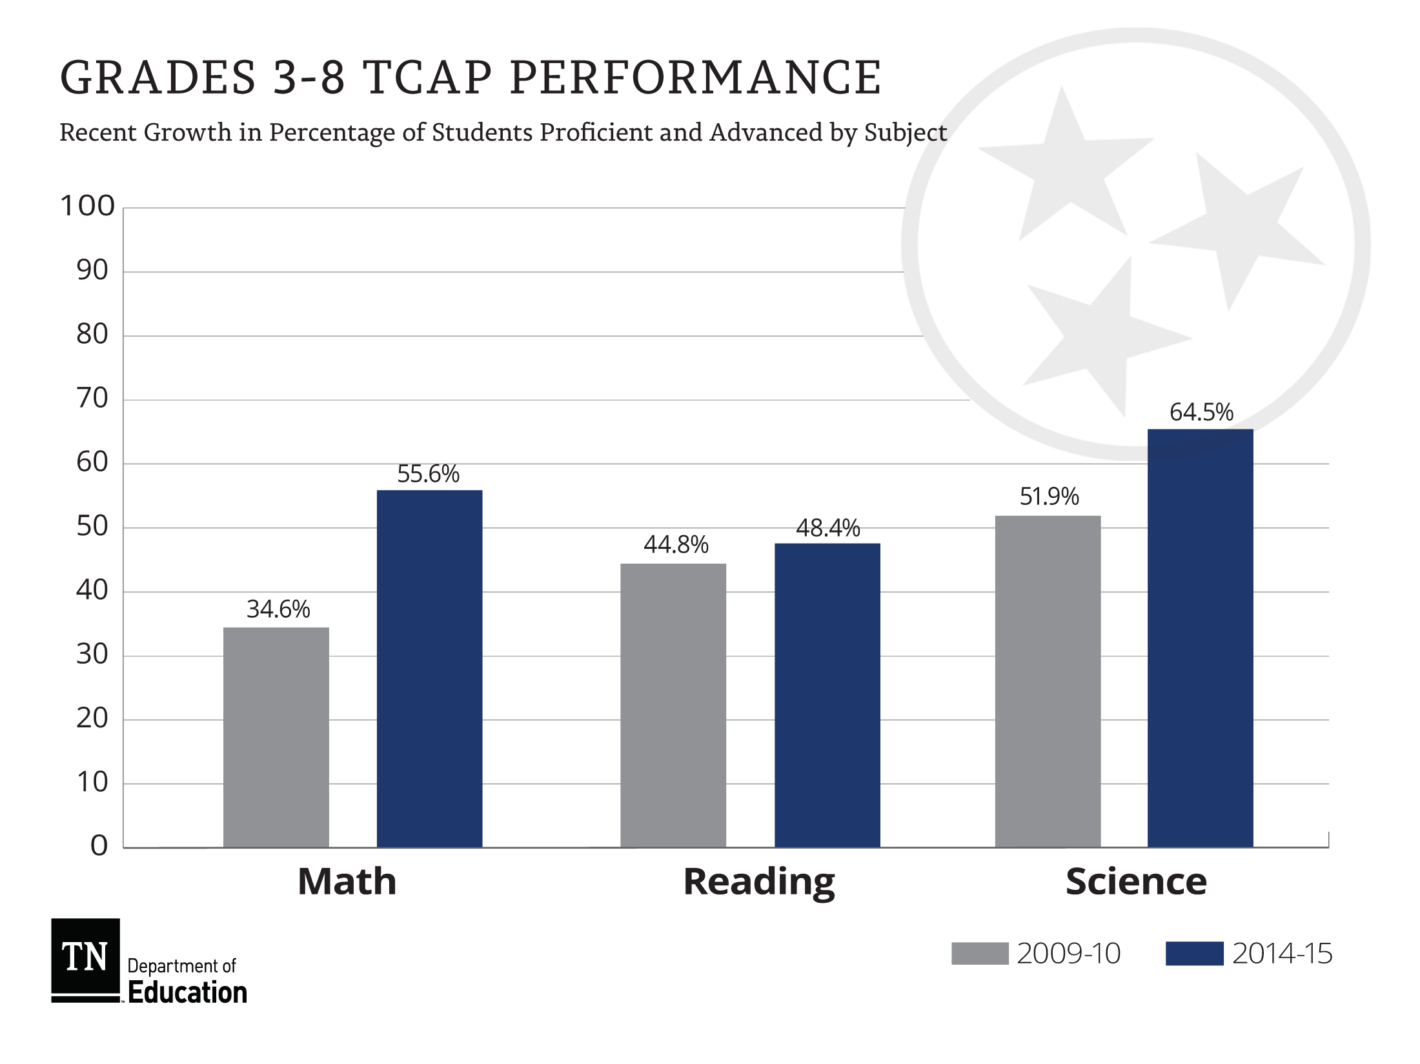

Slide 7
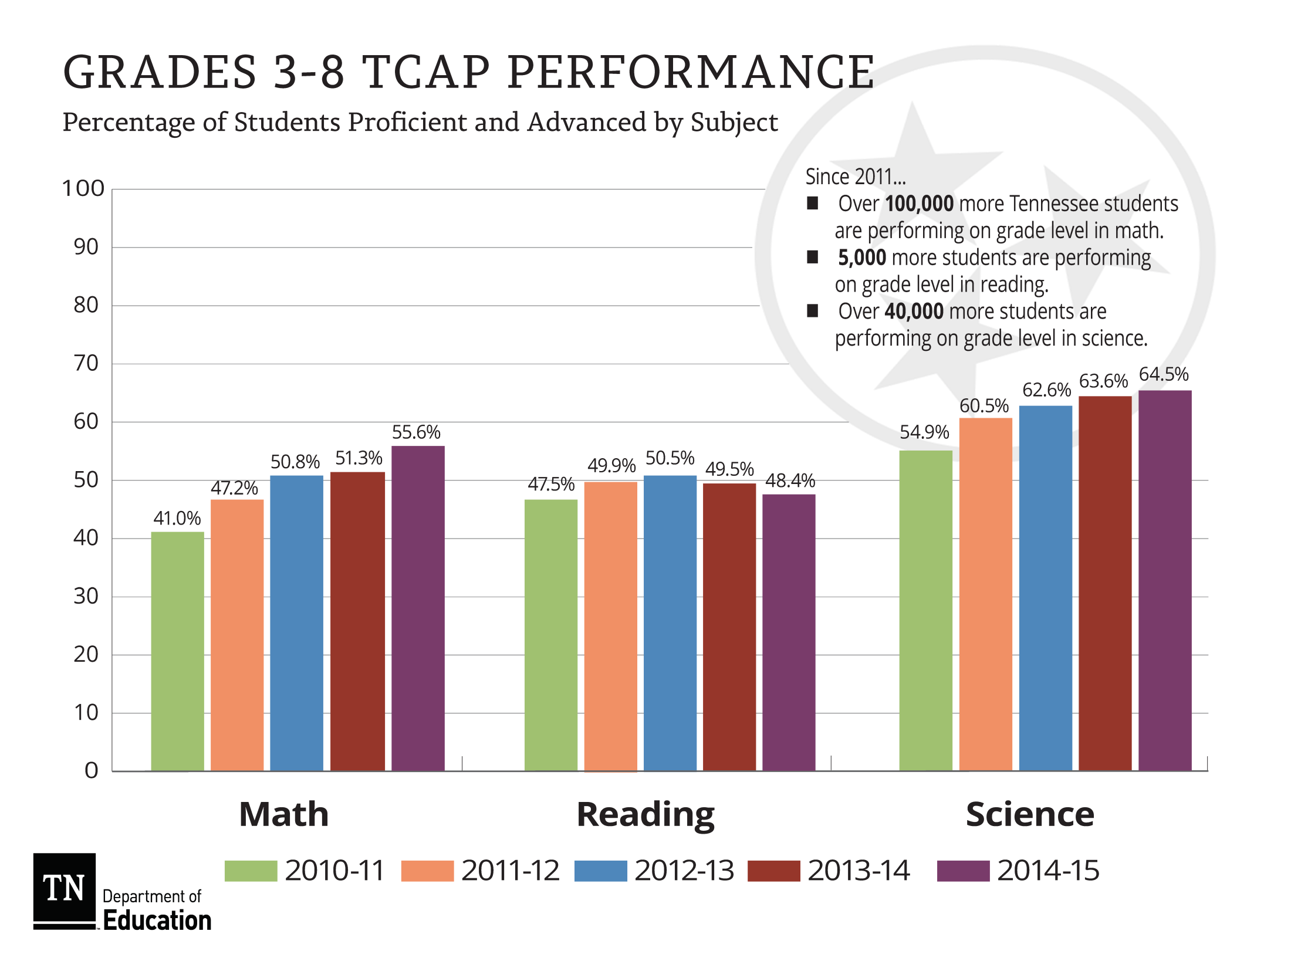

Slide 8
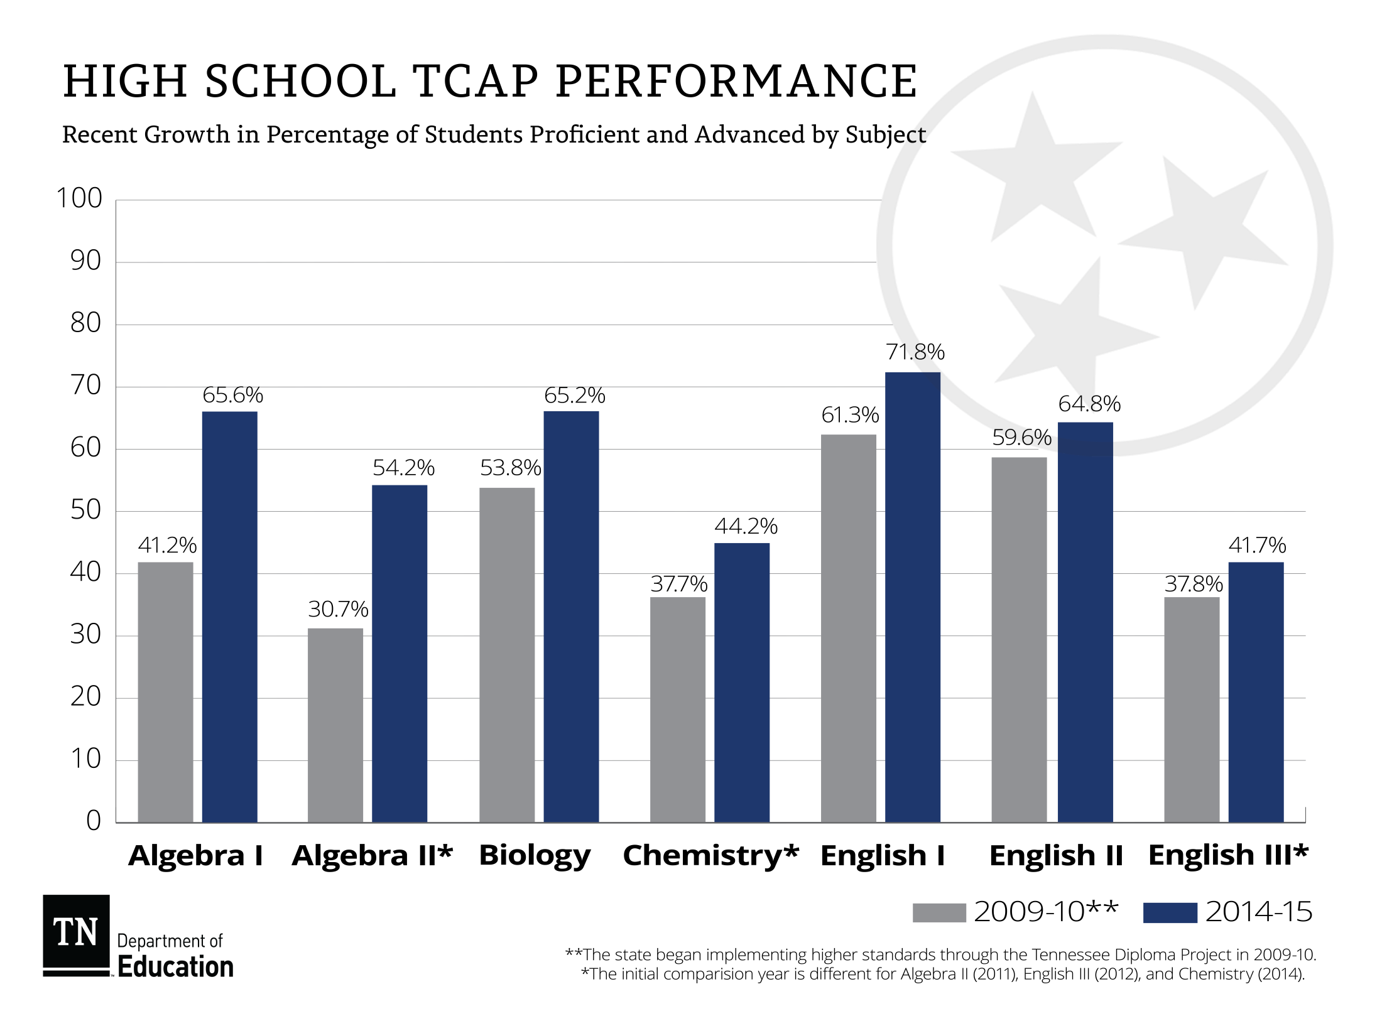

Slide 9
BUT, WE STILL HAVE ROOM TO IMPROVE
Less than half of all 3rd thru 8th grade students are proficient or above in reading.
Tennessee still ranks in the bottom half of all states on the Nation’s Report Card or NAEP.
In fall 2014, 43% of high school graduates did not enroll in postsecondary.
Almost 60% of first-time freshmen in TN community colleges took at least one remedial or developmental course.
Tennessee’s six-year graduation rate is 28% for community colleges and 58% for universities.

Slide 10
SUCCESS AFTER GRADUATION
71,403 Students
2008 Cohort of High School Freshmen
Students who graduated from high school and entered the workforce and earn an average salary of $9,161 annually, far below the poverty line.
13%
After one year
9,089 students
25%
Not
enrolled
Did not graduate from high school
75%
31%
39,748
students
Still enrolled
Graduated from high school only
Enrolled in postsecondary
Only 6 percent of students who were enrolled after one year completed a degree or certificate within two years.

Slide 11
OUR VISION
Districts and schools in Tennessee will exemplify excellence and equity such that all students are equipped with the knowledge and skills to successfully embark upon their chosen path in life.

Slide 12
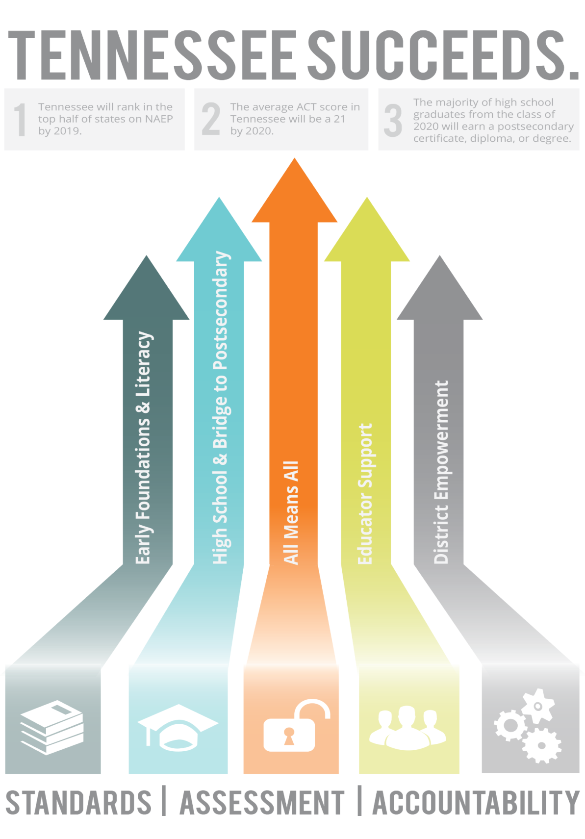

Slide 13
OUR GOALS
1
Tennessee will continue rapid improvement and rank in the top half of states on the Report Card.
MEASUREMENT
Tennessee will rank in top half of states on 4th and 8th grade
NAEP in 2019.
Notes:
To ensure our students are ready for postsecondary success, we must meet the following goals.

Slide 14
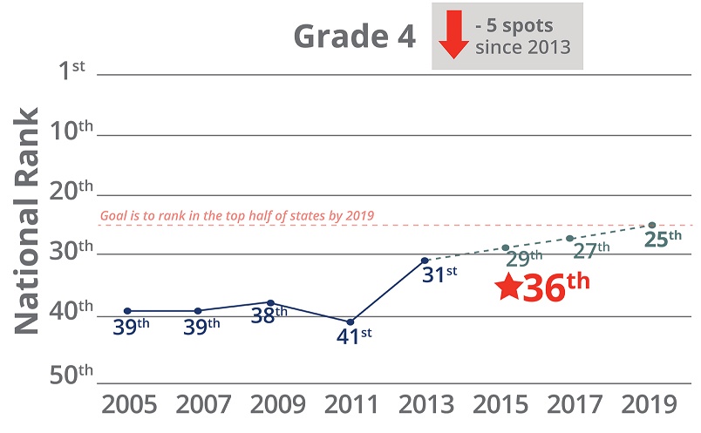
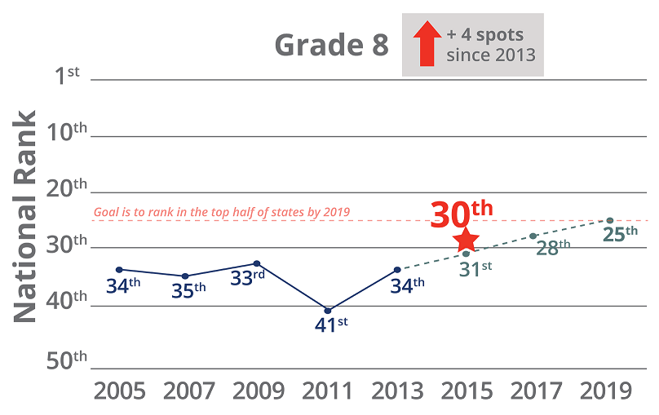
GOAL 1 READING

Slide 15
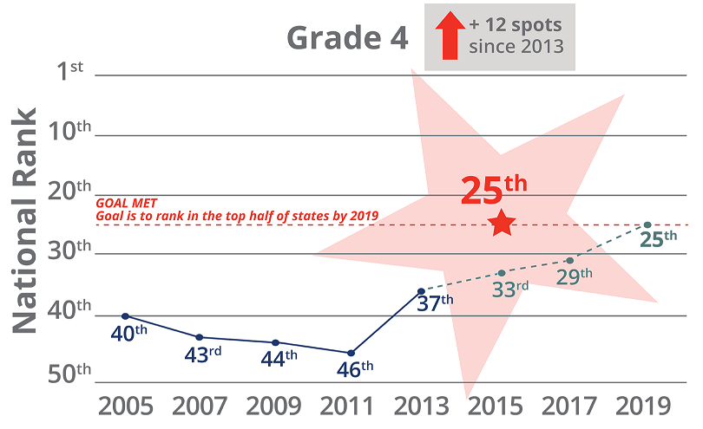
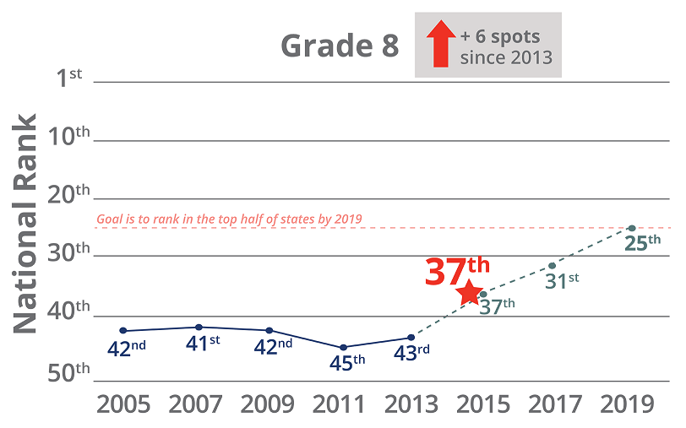
GOAL 1 MATH

Slide 16
OUR GOALS
1
2
Tennessee will continue rapid improvement and rank in the top half of states on the Report Card.
The average ACT score in Tennessee will be a 21, allowing more students to earn HOPE scholarships.
MEASUREMENT
Tennessee will rank in top half of states on 4th and 8th grade
NAEP in 2019.
MEASUREMENT
Tennessee will have an
average public ACT composite
score of 21 by 2020.
Notes:
To ensure our students are ready for postsecondary success, we must meet the following goals.

Slide 17
GOAL 2

Slide 18
OUR GOALS
1
2
3
Tennessee will continue rapid improvement and rank in the top half of states on the Report Card.
The average ACT score in Tennessee will be a 21, allowing more students to earn HOPE scholarships.
The majority of Tennessee high
school graduates will earn a certificate, diploma, or degree.
MEASUREMENT
Tennessee will rank in top half of states on 4th and 8th grade
NAEP in 2019.
MEASUREMENT
Tennessee will have an
average public ACT composite
score of 21 by 2020.
MEASUREMENT
The class of 2020 will be on track to achieve 55% postsecondary completion in six years.
Notes:
To ensure our students are ready for postsecondary success, we must meet the following goals.

Slide 19
GOAL 3
Postsecondary Enrollment Next Steps After High School Graduation Based on Graduates from Class of 2014
Postsecondary Attainment Next Steps After High School Graduation Based on Graduates from Class of 2008
42%
35%
21%
2%

Slide 20
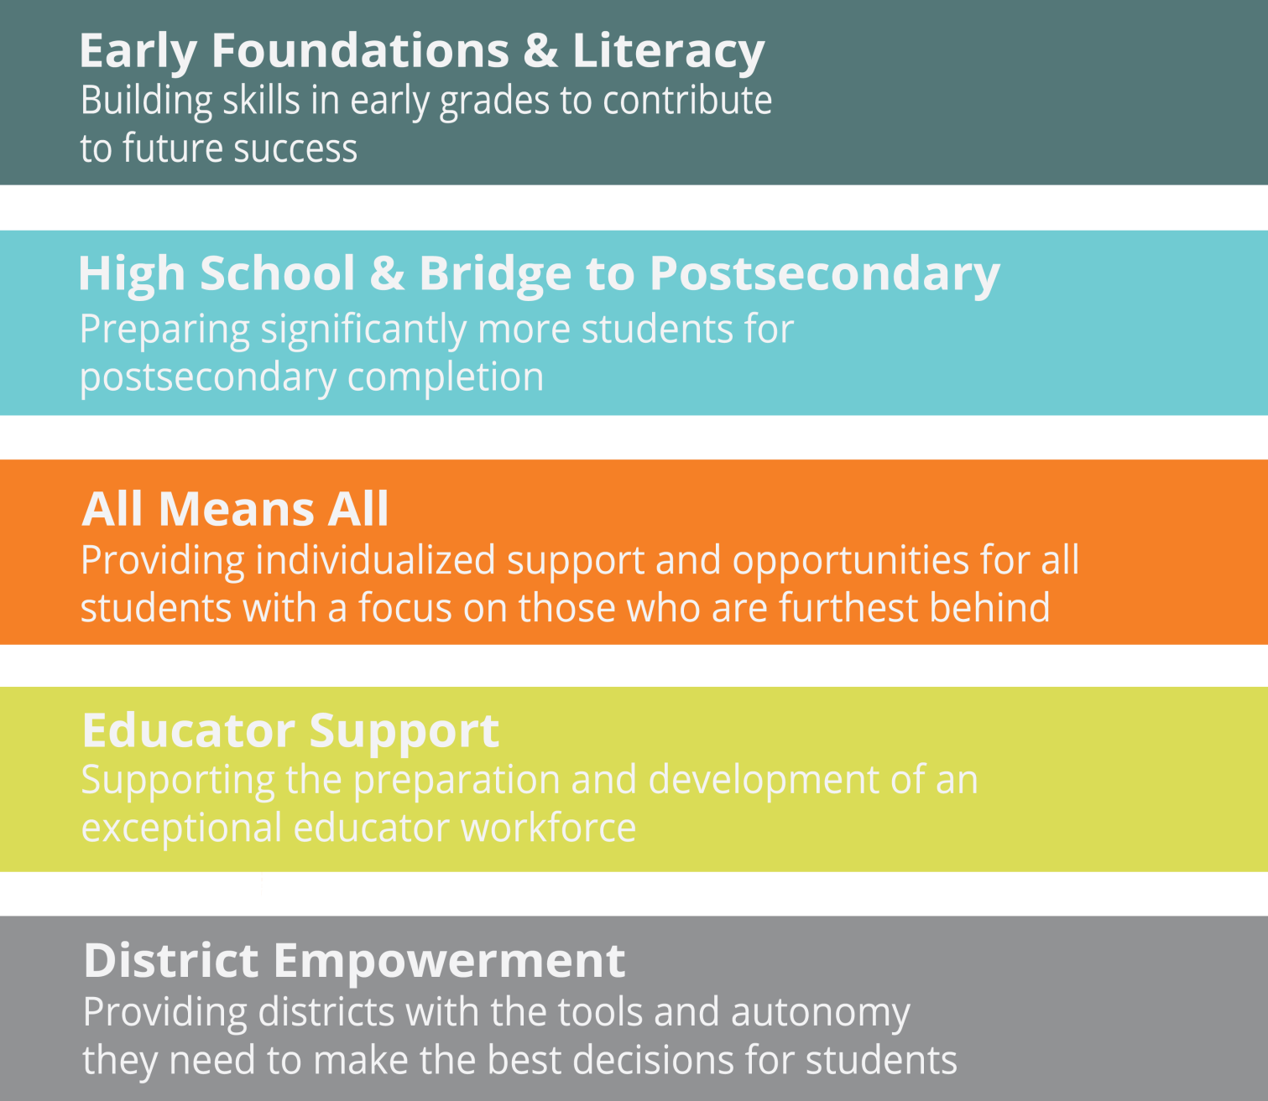
OUR PRIORITIES

Slide 21
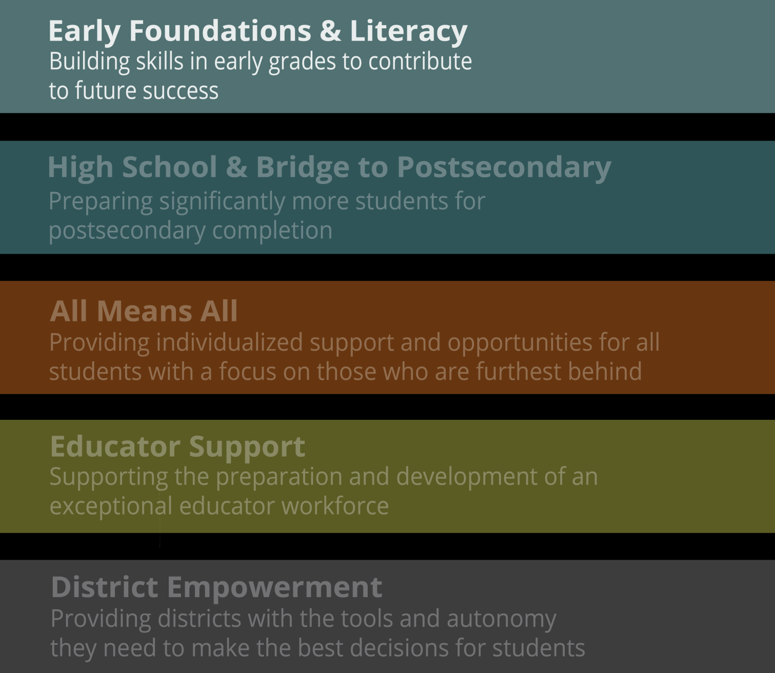
OUR PRIORITIES

Slide 22
EARLY FOUNDATIONS & LITERACY
WHY THIS MATTERS
Over the past several years, we have seen steady gains in math performance in grades 3-5; however, English language arts performance has remained stagnant or declined.
Statewide assessments to measure student learning do not begin until grade 3.
Of almost 6,000 Tennessee students rated below basic in third grade English language arts, less than 3 percent reach proficiency by fifth grade.
For many students, early intervention is a key element of later outcomes.
National data show that children who are not reading proficiently by third grade are four times less likely than their peers to graduate high school by age 19.

Slide 23
EARLY FOUNDATIONS & LITERACY
WHY THIS MATTERS

Slide 24
EARLY FOUNDATIONS & LITERACY
We have set a goal to see the 43 percent of students who are reading on grade level in third grade move to 75 percent by 2025. To reach this goal, we must begin developing a love of reading long before a child begins third grade.
Launch the Read to be Ready: Building Thinkers in Tennessee campaign beginning a statewide focus on the critical value of reading—not only the value of learning to read but also the importance of reading to learn.
Implement a kindergarten entry screener focused on four domains: social foundations, language & literacy, mathematics, and physical well-being and motor development.
Deepen literacy instruction in educator preparation programs with a focus on both skills- and knowledge-based competencies.
Develop an academic literacy coach network across the state to share effective strategies and provide on-the-job teacher training.

Slide 25
OUR PRIORITIES

Slide 26
OUR PRIORITIES

Slide 27
HIGH SCHOOL & BRIDGE TO POSTSECONDARY
WHY THIS MATTERS
If we allow current trends to continue, only 24 percent of high school graduates will earn a postsecondary certificate or degree within six years of their high school graduation.
Among students from the graduating class of 2015, only half of the 12 percent that took Advanced Placement tests for early postsecondary credit earned a passing score.
Less than half of students who completed a Tennessee Promise application, which would qualify them for free attendance at any Tennessee community college or TCAT, fulfilled all requirements to qualify for the scholarship.

Slide 28
HIGH SCHOOL & BRIDGE TO POSTSECONDARY
WHY THIS MATTERS
Average Student Performance on ACT
By Subject Subtest Over Time
Average ACT Scores

Slide 29
HIGH SCHOOL & BRIDGE TO POSTSECONDARY
As a state, we recognize that high school graduation cannot be the end goal and that students need experiences in high school that directly translate into postsecondary and career opportunities.
Improve access to quality early postsecondary opportunities and industry certifications.
Establish the Career Forward task force that will develop a comprehensive definition for postsecondary and workforce readiness.
Enhance and expand access to postsecondary and career data for students, parents, and district and school personnel.
Provide training opportunities to school counselors so they are equipped with aligned postsecondary and career access knowledge and skills.

Slide 30
OUR PRIORITIES

Slide 31
OUR PRIORITIES

Slide 32
ALL MEANS ALL
WHY THIS MATTERS
We cannot improve outcomes overall without improving outcomes for our historically underserved subgroups: economically disadvantaged, Black-Hispanic-Native American, English learners, or students with disabilities.
While average student performance has risen in past years, we continue to see substantial achievement gaps between students in historically underserved subgroups and their comparison groups.
In grades 3-8, nearly 35,000 of the 450,000 students – 8 percent – tested below basic in both math and English language arts. All but 2,000 of these students fall into one of our four historically underserved subgroups.

Slide 33
ALL MEANS ALL
WHY THIS MATTERS
Achievement Gaps Grades 3-8 Reading Language Arts
Percent of students who are proficient or advanced
67%
57%
57%
53%
36%
33%
19%
19%
Black-Hispanic- Native American (BHN)
Not Students with Disabilities
Economically Disadvantaged
Not English Learners
Students with Disabilities
Not Economically Disadvantaged
Non-BHN
English Learners

Slide 34
ALL MEANS ALL
Tennessee is committed to the success of all students. Our work in this area involves providing individualized support and opportunities for all students, with a specific focus on those who are furthest behind.
Improve research and sharing of best practices in RTI² implementation in specific grade levels.
Address student non-academic needs with an increased focus on chronic absenteeism, student behavior, and mental health support.
Improve instruction and intervention for students with disabilities by training special educators on instructionally appropriate IEPs.
Confront systemic gaps in different student groups’ access to highly effective teachers.

Slide 35
OUR PRIORITIES

Slide 36
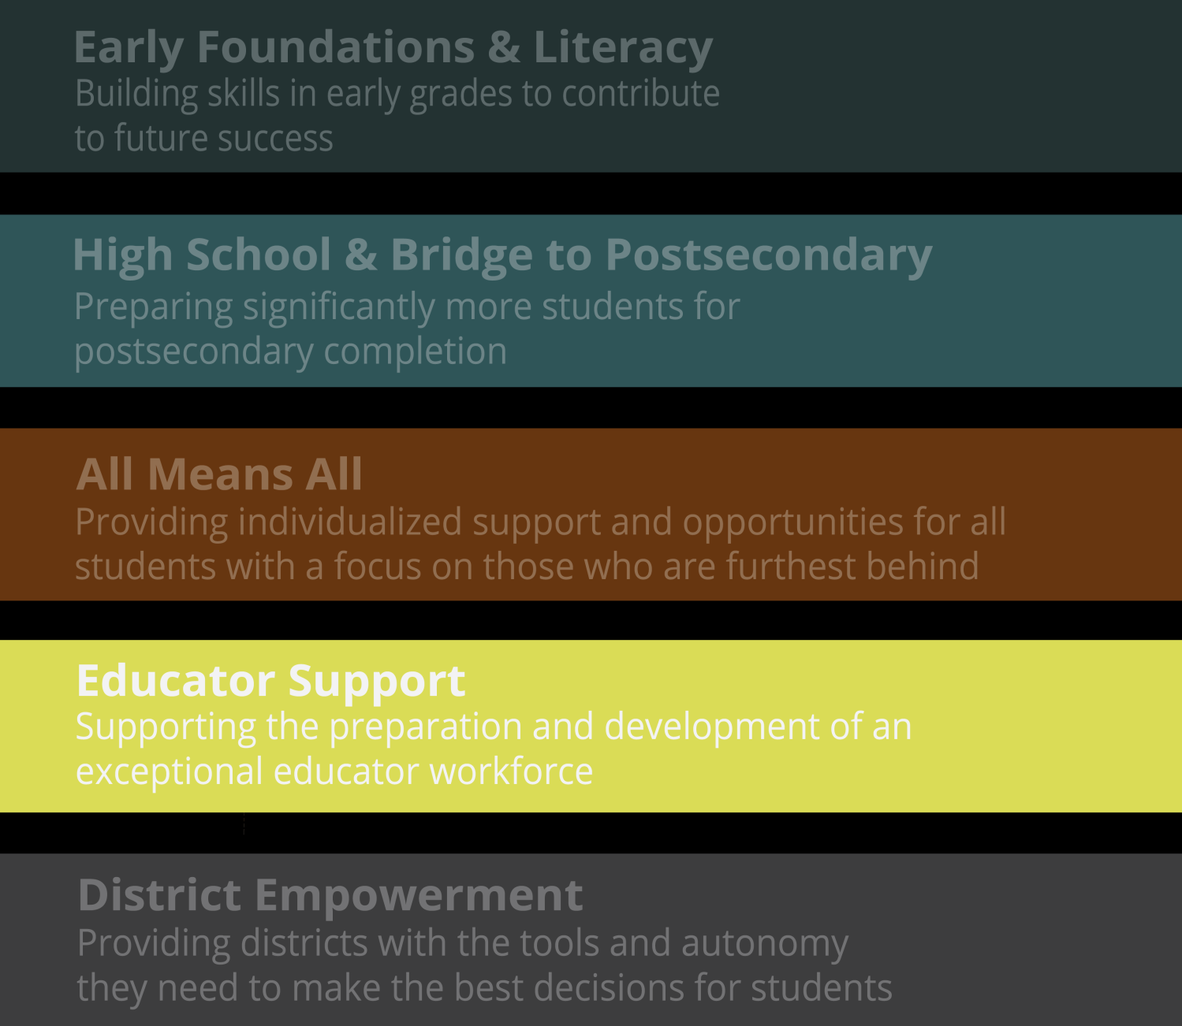
OUR PRIORITIES

Slide 37
EDUCATOR SUPPORT
WHY THIS MATTERS
Since 2010, 15,000 educators have entered Tennessee public schools through 40 state-approved preparation programs. Improving teaching across the state will require improving teacher preparation.
Nearly one-third of Tennessee teachers have less than five years of teaching experience, and 7 percent are in their first year on the job.
The percentage of teachers who say the process of teacher evaluation improves their teaching has risen steadily to 68 percent of educators since the introduction of a new statewide evaluation system in 2012.

Slide 38
EDUCATOR SUPPORT
WHY THIS MATTERS
How would you rate the amount of each of the following resources in your school?
Percent of teachers who rate resources as “adequate”
Time for collaboration with other teachers
Resources or staff expertise available during collaboration (e.g., instructional coaches)
Administrative support for collaboration

Slide 39
EDUCATOR SUPPORT
School leaders and teachers are the backbone of the work we are doing to improve learning across our state. Preparing and developing educators for success in today’s classrooms requires personalized, innovative training both before and once they arrive in a school.
Improve quality of relationships between districts and their teacher and leader providers.
Increase the rigor of the accreditation process for educator preparation programs with a focus on outputs.
Support and replicate innovative leadership preparation programs.
Provide districts a suite of tools to support accurate and high-quality teacher evaluation and feedback loops.
Develop a rigorous professional learning rubric for schools and districts.

Slide 40
OUR PRIORITIES

Slide 41
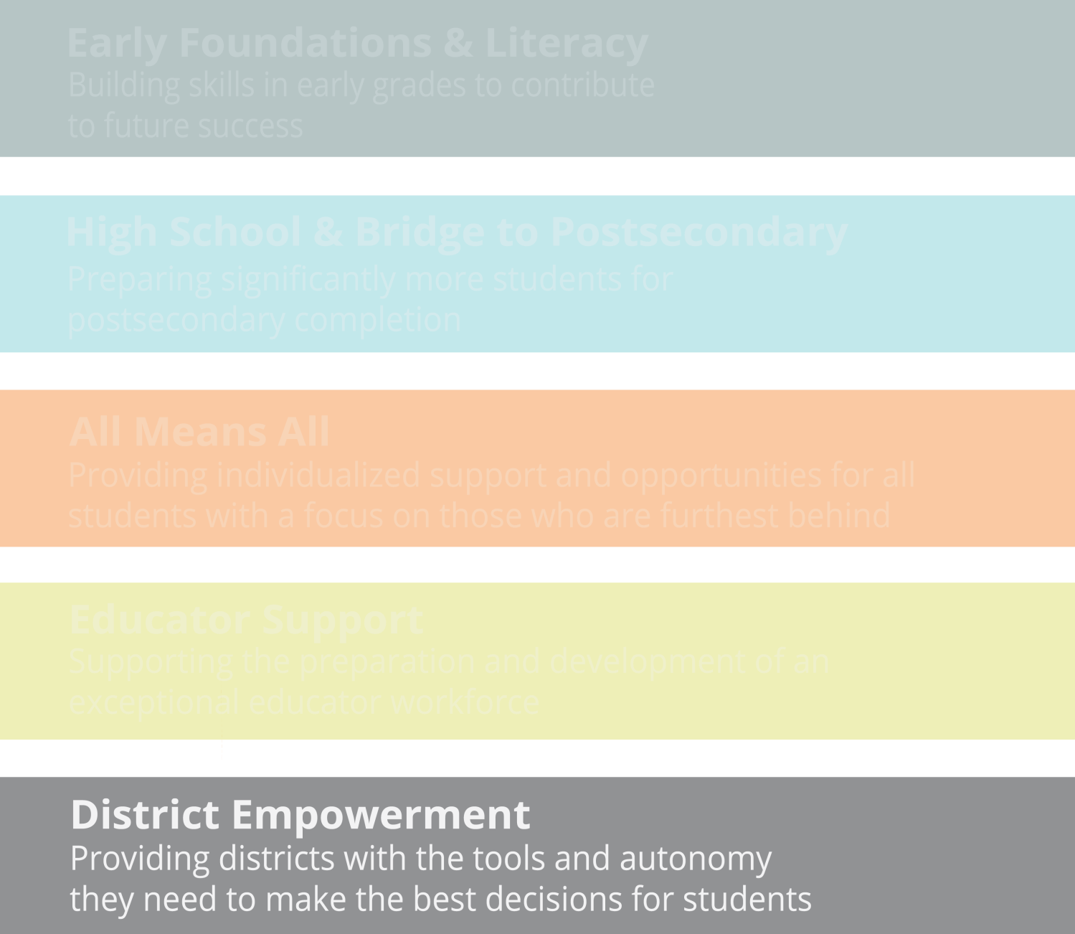
OUR PRIORITIES

Slide 42
DISTRICT EMPOWERMENT
WHY THIS MATTERS
Serving the state means serving a diverse group of 142 districts. We cannot achieve our collective goals without building flexibility and district ownership into all that we do. There is no one-size-fits-all model.
The department actively measures ongoing progress to ensure a department orientation toward empowerment rather than compliance.
Currently, 25 districts are using an alternative, district-selected model for teacher evaluation, and 114 districts are making use of state-provided evaluation support tools.
Over a hundred districts have integrated with the state data system to allow real-time educator dashboards and fully-automated state reporting.

Slide 43
DISTRICT EMPOWERMENT
WHY THIS MATTERS
Tennessee School Districts
By Student Enrollment Numbers

Slide 44
DISTRICT EMPOWERMENT
Ideas worth replicating and spreading have started in our schools and classrooms—not at the state. We are committed to providing districts with the autonomy they need to best serve their students.
Increase delivery of actionable data to our districts and schools
Expand access to and understanding of personalized learning to support the needs of students and all educators:
Algebra I pilot
Competency-based high school diploma
Micro-credentialing for professional development
Predictive analytics
Launch the first networked improvement communities (NIC) to promote district innovation and idea-sharing

Slide 45
HOW WILL TENNESSEE SUCCEED?
Notes:
To meet the needs of the future, we must move together toward a unifying vision of student progress. We will succeed if students are equipped with foundational knowledge and skills. We will succeed if the needs of all students are valued equally. We will succeed if students are set on a path toward postsecondary completion. We will succeed if educators receive adequate support. We will succeed if schools and districts are empowered to make the right decisions for students. This is our story in Tennessee and this will continue to be how Tennessee Succeeds.

Slide 46
TENNESSEE WILL SUCCEED WHEN YOU SUCCEED.
Your leadership is key.
Your teacher leadership is key.
Your community is key.

Slide 47
TENNESSEE WILL SUCCEED WHEN YOUR STUDENTS SUCCEED.
Students must be met where they are.
Students must be engaged to achieve.
Students must be Promise Ready.

Slide 48
HOW WILL YOU LEAD THIS VISION?
How will you align?
How will you communicate?
How will you inspire?

Slide 49
QUESTIONS?

