Slide 1
Tennessee Succeeds Update TACTE Conference
Commissioner Candice McQueen | February 22, 2018

Slide 2
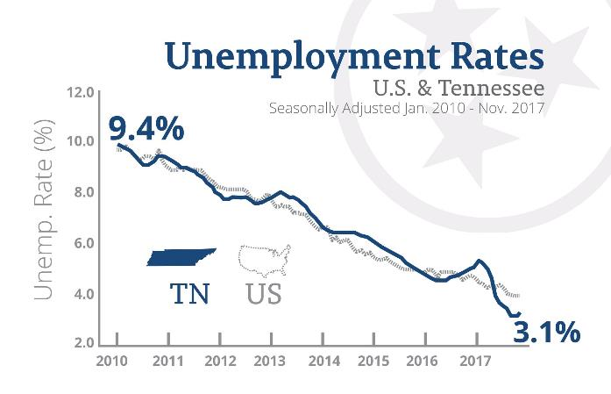
Our State is Showing Historic Success
We have incredible economic strength
Record low unemployment rate
#1 in small business job growth

Slide 3
Our State is Showing Historic Success
And we believe education is the reason why
Record high graduation rate
Record high ACT composite
Nationally recognized strength in career and technical education and aligned pathways to workforce
First in the nation to remove financial barriers with Tennessee Promise
Community college freshmen requiring remediation is down by 14.4 percentage points since 2011
More students going onto college – and being successful when they get there

Slide 4
Tennessee’s Progress Literally Stands Out

Slide 5
We are Simply Outpacing Other States

Slide 6
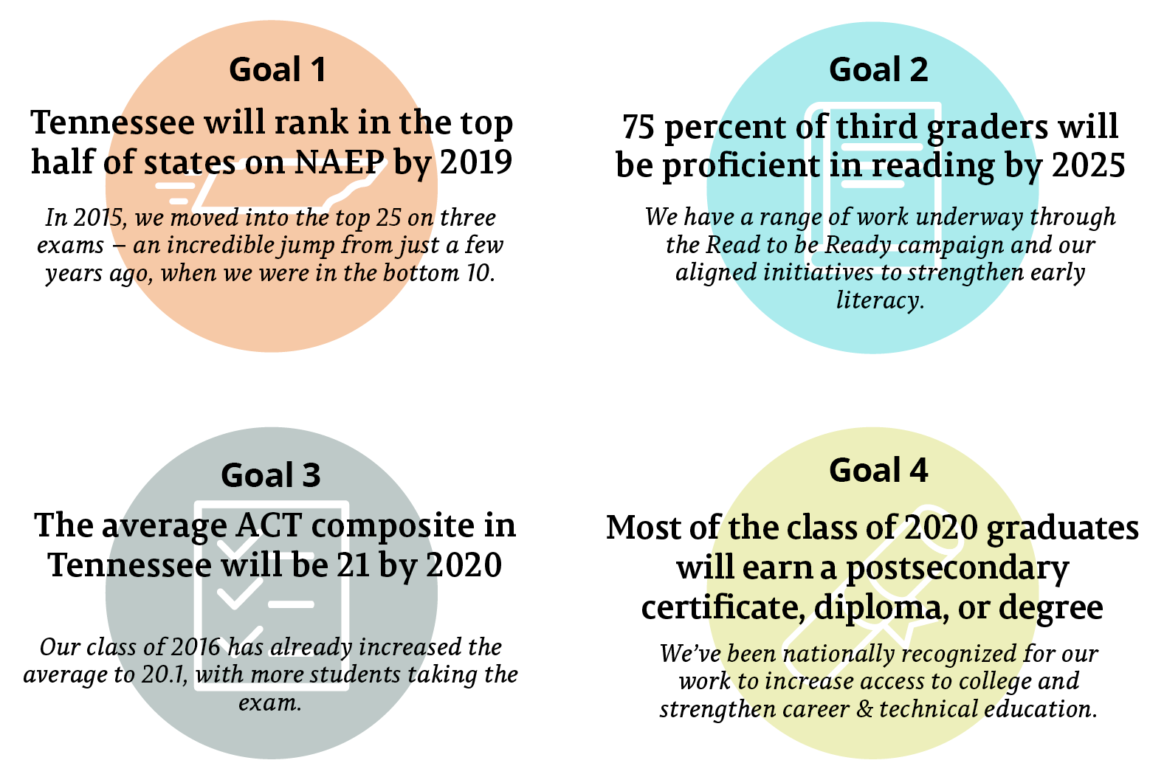
We’ve Made Progress Toward Our Goals

Slide 7
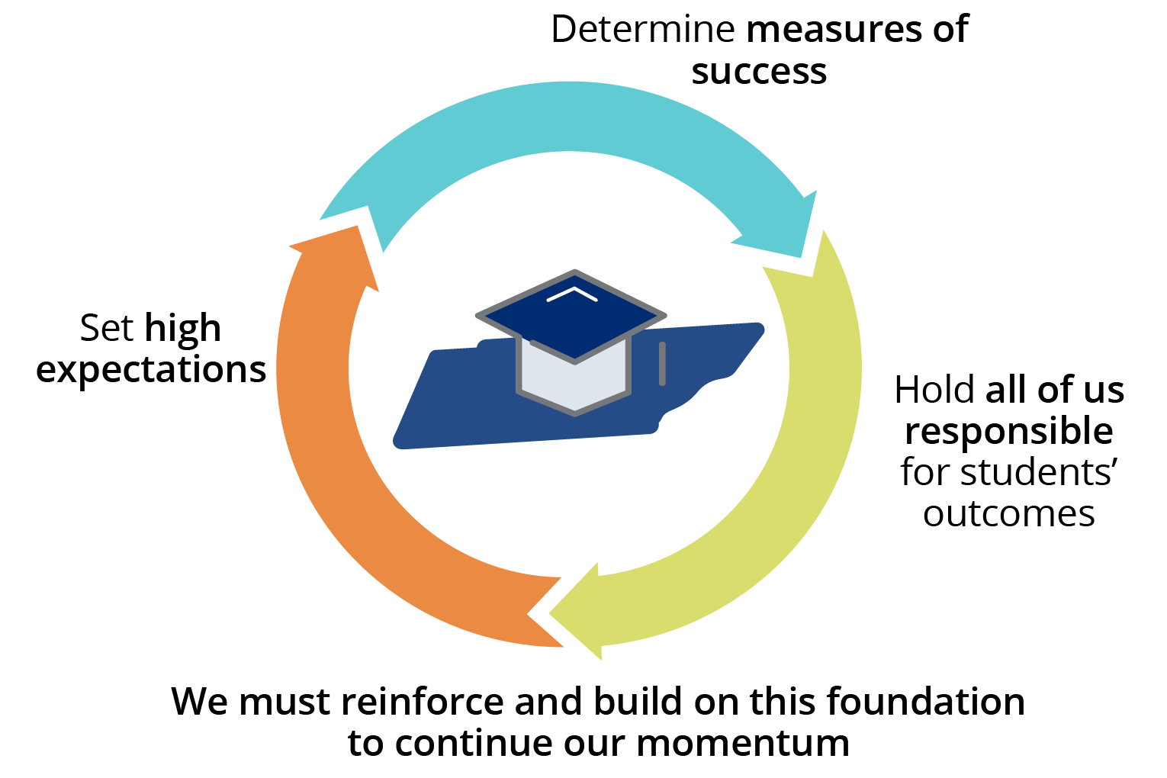
Our Policy Foundation Makes This Possible

Slide 8
2018 Focus: We Believe Every Child Deserves
1
To be reading on grade level by the end of third grade
2
To have an effective teacher – supported by an effective principal – every year
3
To be set up for success on a path to a career
Notes:
As of last summer, we have 200+ reading coaches who support 2,500+ teachers and 44,000 students
Last summer, 8,000 students participated in RTBR summer camps and showed statistically significant gains in critical reading skills and increased motivation to read.
From 2014 report:
This figure illustrates that while 92 percent of teachers continued to teach in Tennessee schools, about 10 percent of teachers taught at a different Tennessee school in the 2012-13 school year. Early career teachers, especially highly effective early career teachers, were more likely to move to a new school.
Highly effective teachers—those who earned a score of Level 4 or Level 5—tended to be retained at a higher rate than teachers who earned a score of Level 1, 2, or 3.
Overall retention rate of Level 5 teachers was 95.2 percent
XX% more students are on the path to a career

Slide 9
Early reading: Then & Now
2015
No comprehensive focus or approach to teaching literacy
Limited statewide data in early grades
Old, outdated/poorly aligned teacher preparation standards in literacy
No statewide summer options for kids who were behind in reading
2018
Comprehensive, statewide definition and approach (TLiT) to literacy aligned to standards and assessment
Kindergarten Entry Inventory (KEI), PreK/K student growth portfolio, 2nd grade standards-based assessment
New literacy standards for teacher prep
Thousands of students are being served and are improving in summer camps across the state

Slide 10
To be Reading on Grade Level by the End of Third Grade
In addition to what is already underway, the department is focusing in 2018 on:
Providing quality instructional resources; ensure educators understand and have rich, diverse, high-quality text and materials
Supporting stronger instruction and professional development for educators to improve how we teach reading
Refining and expanding summer reading camps

Slide 11
Effective Teachers/Principals: Then & Now
2015
Limited assessment data for instructional improvement
Teacher prep held accountable in seven year program review cycles
No Governor’s Academy for School Leadership (GASL)
No transformational leadership network
2018
Detailed assessment reports
Annual teacher prep report card and yearly outcome measures for annual program reviews/accountability
Two cohorts of GASL graduates
Nine transformational leadership programs
Notes:
We hire 270 new principals every year
1,833 public schools in TN
70 new hires come from ranks of existing principals
TTLA pipeline grants: 160 candidates in 9 TTLA pipeline programs
20 districts
7 CORE regions
Elements of TTLA programs:
Rigorous residency model w/qualified mentors
Bridge support for program completers
Induction program for newly placed leaders
We do site visits in March and May
GASL:
- 2 cohorts/46 candidates
26 new candidates just started
43% (or 20) have been placed as principals
New School leader investment:
New school leadership fellowships
Retention and recruitment incentives for priority school leaders
Scholarships and network development for rural leaders

Slide 12
Improving EPPs: Then & Now
2015
Partnerships between EPPs and LEAs often transactional with a focus on clinical placements
Literacy preparation standards were dated
Review processes were input driven and lacked clear expectations
2018
Shift in partnerships that are highly collaborative, strategic, and consistent across the state
New literacy standards
Improved program review process to include performance reports, rubrics aligned to standards, and an increase in useful data

Slide 13
To Have an Effective Teacher – Supported by an Effective Principal – Every Year
In addition to what is already underway, the department is focusing in 2018 on:
Equipping educator preparation providers to use data about their graduates to improve their programs
Strengthening leader preparation to increase expectations and outcomes for school leaders
Recruiting and retaining effective principals in Priority schools and supporting principals in rural schools

Slide 14
Career Readiness: Then & Now
2015
Less that 26,000 students concentrate in CTE
Only 26% of students concentrate in a CTE program leading directly to a high-demand occupation in their region
Beginning of alignment of CTE programs to high growth industries
62 advanced manufacturing programs
No district/school level incentive for earning EPSOs/industry credentials
2018
Almost 37,000 students concentrate in CTE; a 40% increase
76% of students concentrate in a CTE programs directly aligned to regional labor market needs
CTE programs aligned to TN’s highest growth industries are increasing # of students enrolled at record rates
180 advanced manufacturing programs; a 300% increase
Accountability for college/career readiness using EPSOs/industry credentials

Slide 15
To Be Set Up for Success on a Path to a Career
In addition to what is already underway, the department is focusing in 2018 on:
Providing increased access to high-quality early postsecondary courses and industry-aligned certifications
Providing and supporting districts and schools in using post-high school data to inform improvements
Implementing new recommendations from CTE transition advisory council

Slide 16
Standards Update
New English and math standards are being implemented this year (2017-18)
New science standards are being implemented next year (2018-19)
New social studies standards are being implemented in 2019-20
New K-8 computer science standards will be brought to SBE for first reading at April 2018 meeting
Foundational concepts and operations
Analytical and innovative thinking
Information storage and access
Communication and collaboration
Digital citizenship
Coding and computer programming

Slide 17
Assessment Update
In the fall, 266 high schools across 97 districts successfully completed TNReady fall block end-of-course testing completely online
Nearly 120,000 TNReady EOC tests, which included more than 300,000 subparts, were taken on the online Nextera platform
With our new improvements in data flow and optimization, students’ raw scores were returned the first week of January, as promised
Additionally, over the course of the fall, more than 160,000 practice sessions were completed on Nextera

Slide 18
Fall TNReady Scores Delivered On Time
All raw score data was delivered on Jan. 5
All district and school reports were delivered Feb. 12
These dates were the delivery dates we communicated in early fall, and every date has been met for fall EOC testing
Districts received paper copies of family reports earlier this week

Slide 19
Assessment Update
Classroom Assessment Builder (CAB) now available to educators
CAB includes assessment items for every grade level and released items from 2016-17 TNReady test
Spring assessment window: April 16-May 4; all high schools will test online with most of grades 3-8 on paper this year
For 2017-18: Raw scores will be back to high schools by May 22 and to grades 3-8 by June 15
Paper processing (delivery and scanning) takes longer
For 2018-19: Generally, raw score delivery will move to end of May when grades 5-12 move to online testing (grades 3-4 will always have paper option)

Slide 20
Assessment Task Force
The Assessment Task Force reconvened in December; next meeting is February 26th
Materials and a recording can be accessed on the department’s website
Goals of the reconvened task force:
Make recommendations for further improvements, including a review of 11th grade testing
Review the first full year (2016-17) of grades 3–8 and EOC TNReady exams, including timeline and results
Review the first year of the optional grade 2 TNReady exam
Review of district formative assessments and alignment to standards and TNReady expectations

Slide 21
Accountability Update
The state’s revised accountability model under the Every Student Succeeds Act (ESSA) is being implemented this year
Schools will be rated using the A-F grading criteria for the first time using this school year’s data; schools will see a preview of new accountability dashboard using last year’s data this spring
The department will release a new Priority school list (lowest 5% of schools) and Focus school list (lowest performing schools with various student groups) after the completion of this school year (in fall 2018)

Slide 22
What We are Doing is Working – and Other States Are Following Our Lead
—Chalkbeat
—U.S. News and World Report
—Chattanooga Times Free Press
—Georgetown University researchers
—Tennessean

Slide 23
Our Success is Why We Can’t Stop
—Doug Mesecar, adjunct scholar at the Lexington Institute, former senior official at the U.S. Department of Education and in Congress

Slide 24
Questions?

